Slide 1




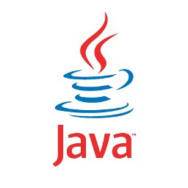

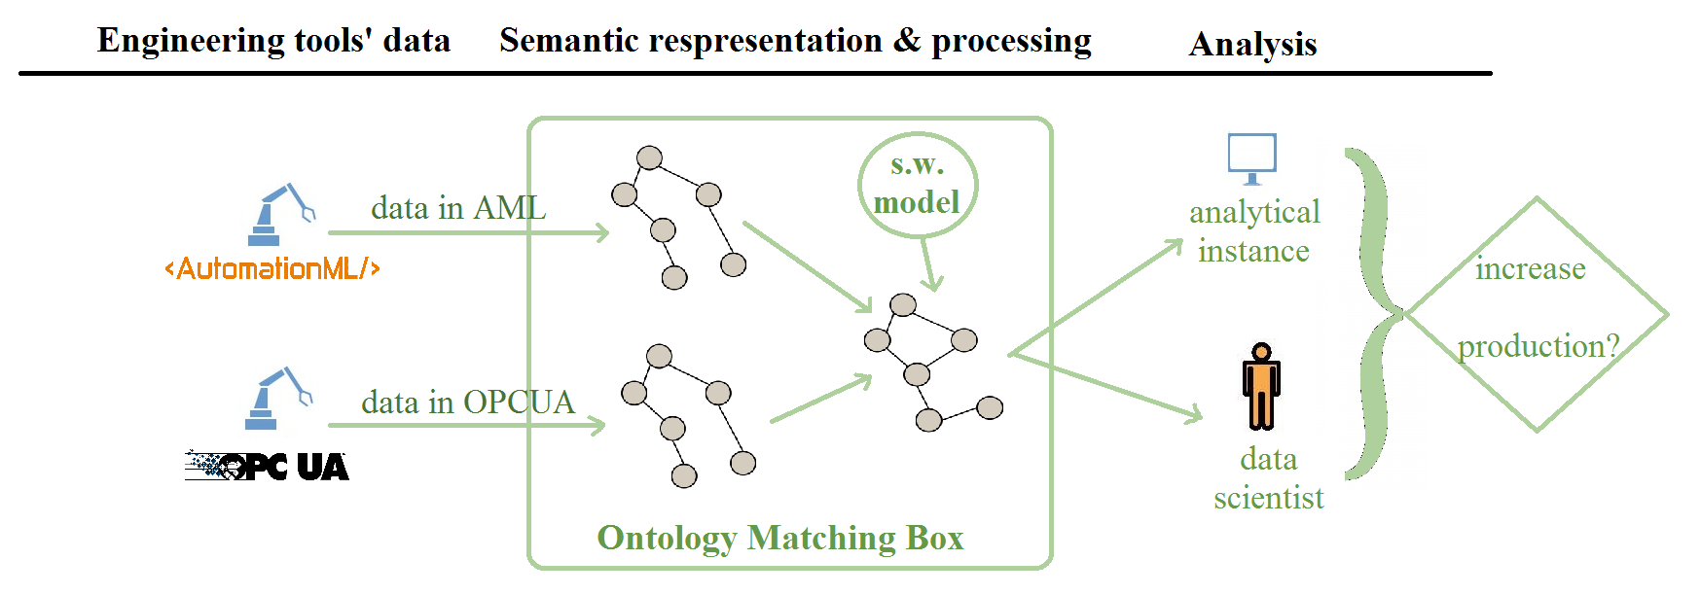
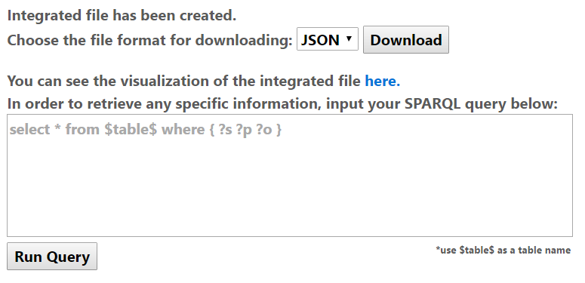
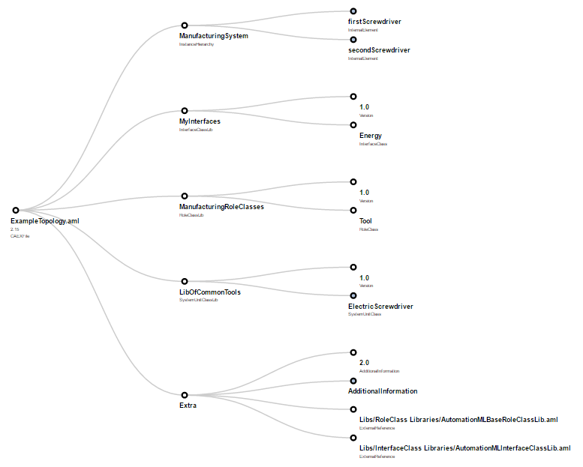
Integration of Industry 4.0 Standards
Integration of Industry 4.0 Standards is a process of receiving input data in AML and/or OPC UA format, converting it into RDF triples and outputting a matched integrated file.
Useful links
Git-hub: https://github.com/IntegrationI40StandardsSemLab/Integration-I4.0
Documentation: https://github.com/IntegrationI40StandardsSemLab/Integration-I4.0/tree/master/Docs
Demo-version: https://youtu.be/-XkQ0r8_UKo
Components
The frontend module:
User interface with browsing;
Visualization of the data;
Testing the correctness of the result.
The backend module:
Input validation;
Integration with existing model;
Matching and transformation into RDF.
Motivation
Problems: manual object notation transcription, existence of different industrial standards
Project
Add-ons
Objective: to provide a flexible tool for modern industry integration standards mapping and visualization.
Major challenge: matching quality.
SPARQL queries execution using output data;
Prediction of document matching rate.
Results
Workstation:
EIS03: eis-user
TeamViewer remote access:
Login: 507779268
Pass: E1sUseri40
Mentor: Irlán Grangel
Students: Alina Arunova, Maxim Maltsev, Philipp Matyash, Sattar Rahimbeyli

