Slide 1

Bomb MUSiC
Team: Bomb
Team Members: Tao Xu | Wenzhuo Li | Qiuyi Zhang

Slide 2
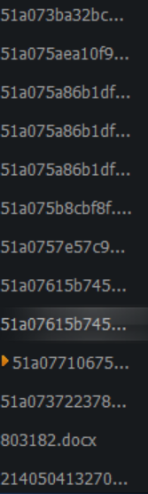
Problem Statement
Traditional Music Player
A list of songs with no collection
No music society
No ways to find new songs
No admin
Just music player without social functionalities
Have to download the songs one by one without directly interacting with record company

Slide 3
Approach
Bomb Music
Gather songs use song lists
Add songs from song lists
Song admin, singer admin
Find your bosom friends who love the same song lists
Directly get songs

Slide 4
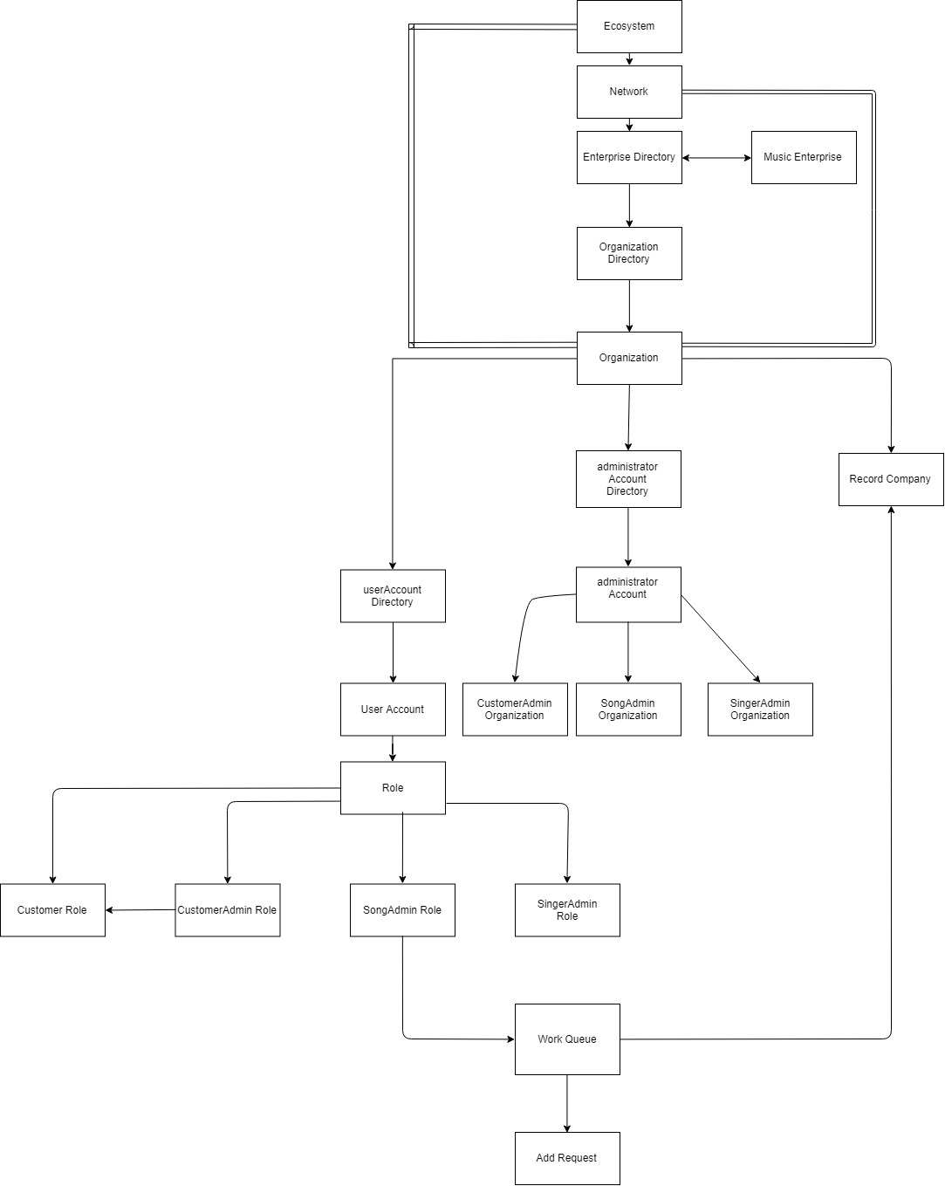
Object Model

Slide 5
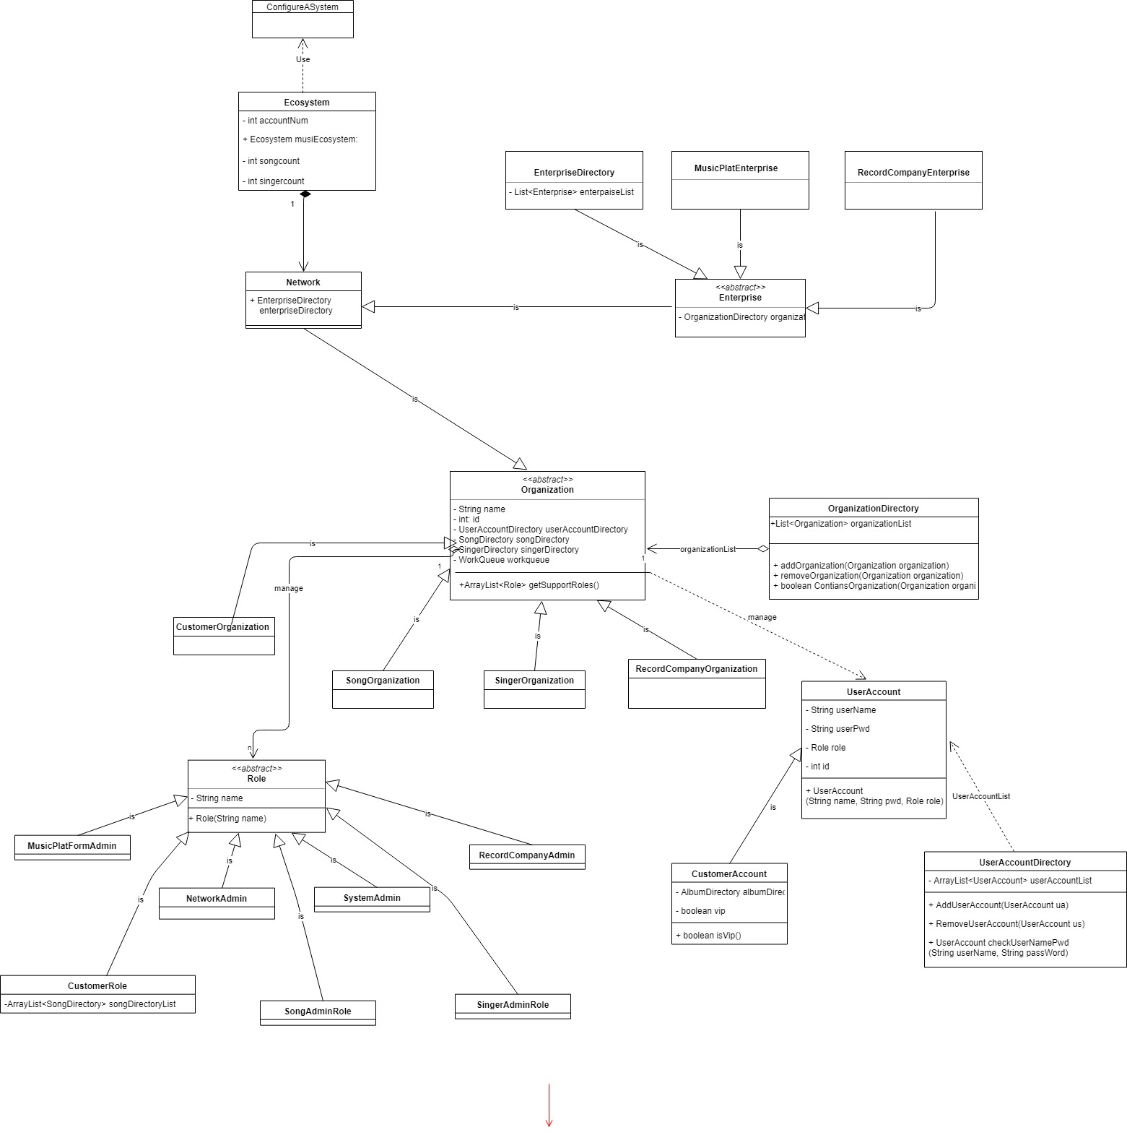
Object Model
Overall

Slide 6
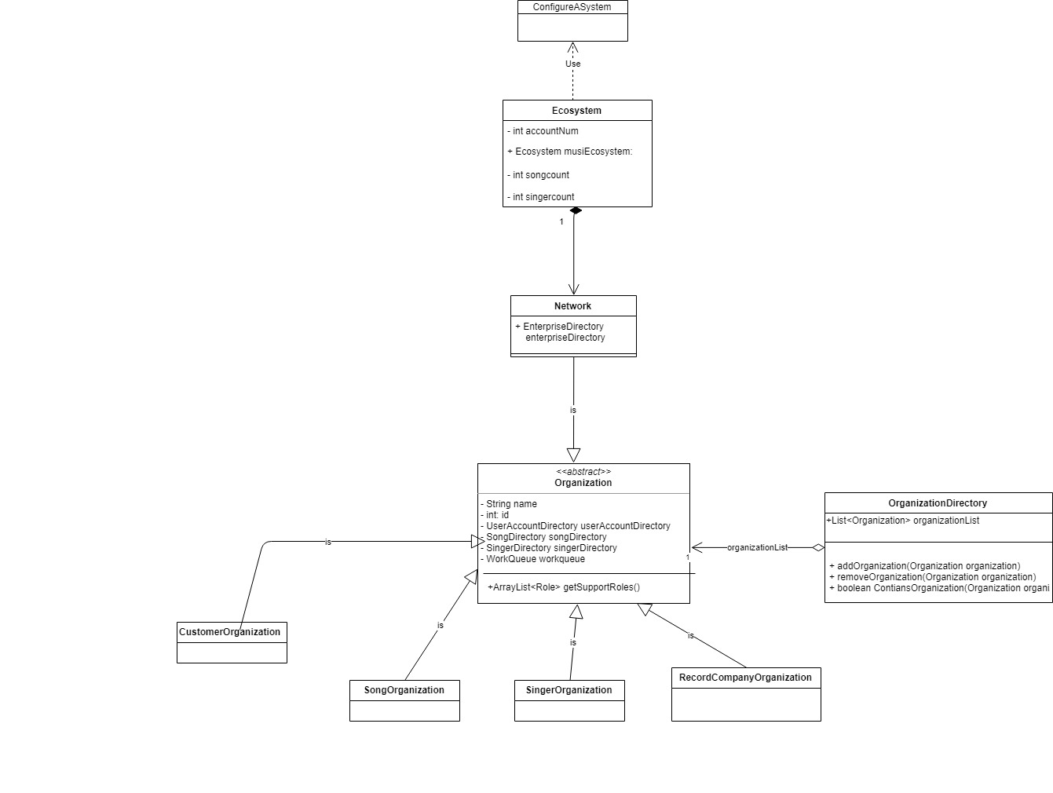
Object Model
Network

Slide 7
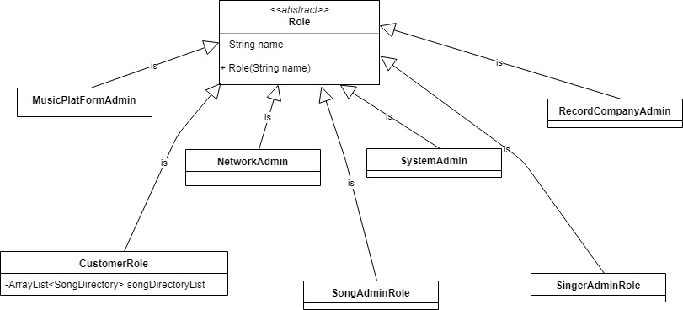
Object Model
Role

Slide 8
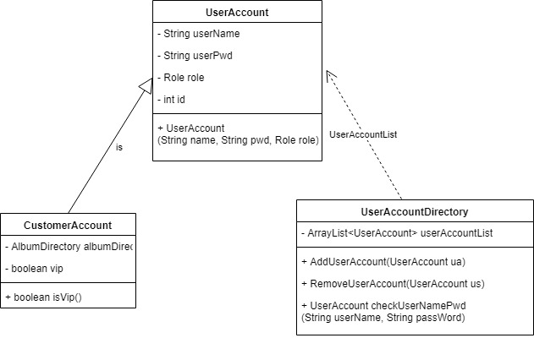
Object Model
User Account

Slide 9
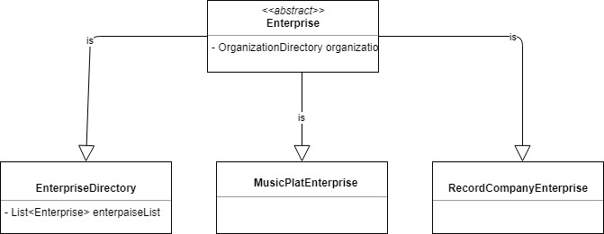
Object Model
Enterprise

Slide 10
Use Case
Overall
Music Platform Manage user
Log in & Log out
Create music platform admins/record companies
Delete music platform admins/record companies
Import excel as original data
Use DB4O as data storage
Create singer managers/customers/song managers by choosing combo Box
View admin details including username, password, role, ID and VIP state
Update admin details including username and password
Delete roles

Slide 11

Use Case
Record Company
Manage work request
Agree song admin request
Reject song admin request
Search all song admin request by state
Manage Record company
Add & Delete record company
Add & Delete singer to certain record company including details of Name, ID(Autogenerate), Description
View & Update singer details
Add & Delete albums of certain singer
Add & Delete new songs including Name, ID(autogenerate), Time(require certain format), Singer Name, Album
Update song details(Except Song ID, Singer Name)

Slide 12
Use Case
Singer Admin
Song Admin
Send ‘add songs’ request to record company
Delete songs on the platform
View song details
Update song details especially VIP limit
View work request sent from record company
Search request by state
Reject request
Search singer by name
Update singer details
Delete singer from the platform

Slide 13
Use Case
Customer
Create new ‘own song list’ and set access limits for them
Add certain song to one of ‘own song list’
View all songs on the platform
Delete song list
Change limit of song list
View certain song list and delete song from it
View all song lists of platform & Add it to ‘my own song list’

Slide 14
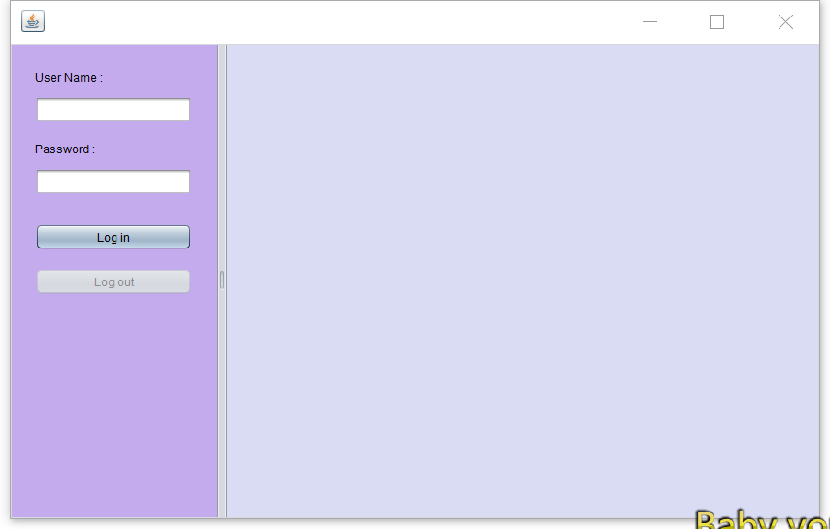
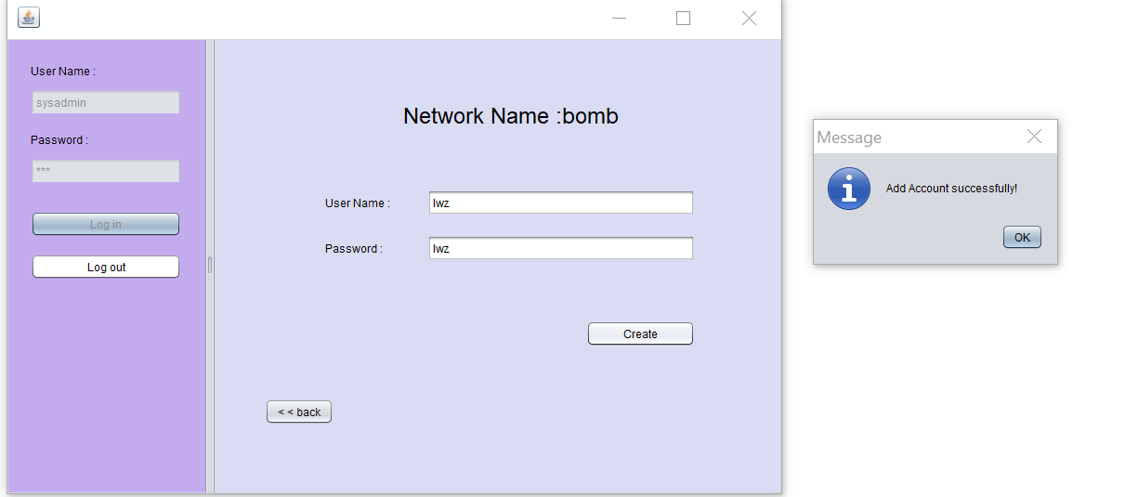
Screen Shot

Slide 15
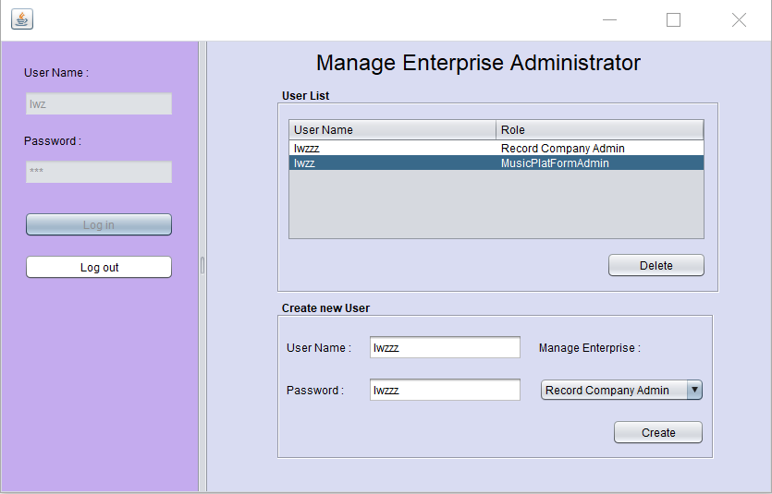
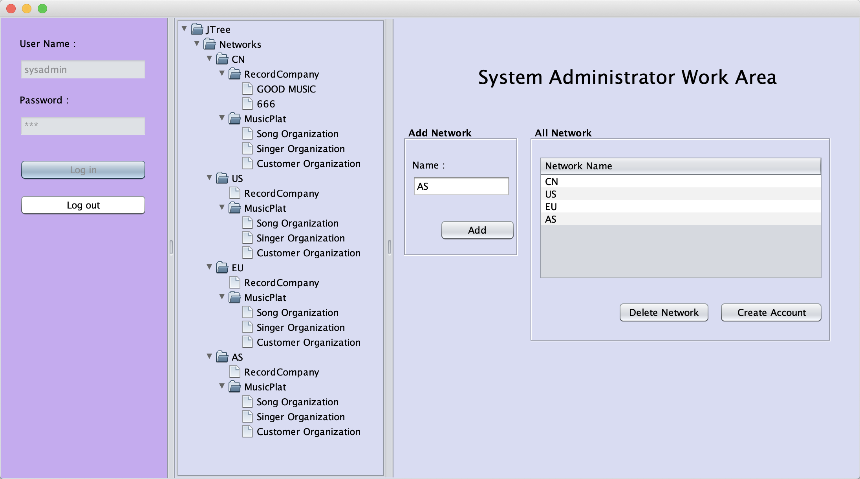
Screen Shot

Slide 16
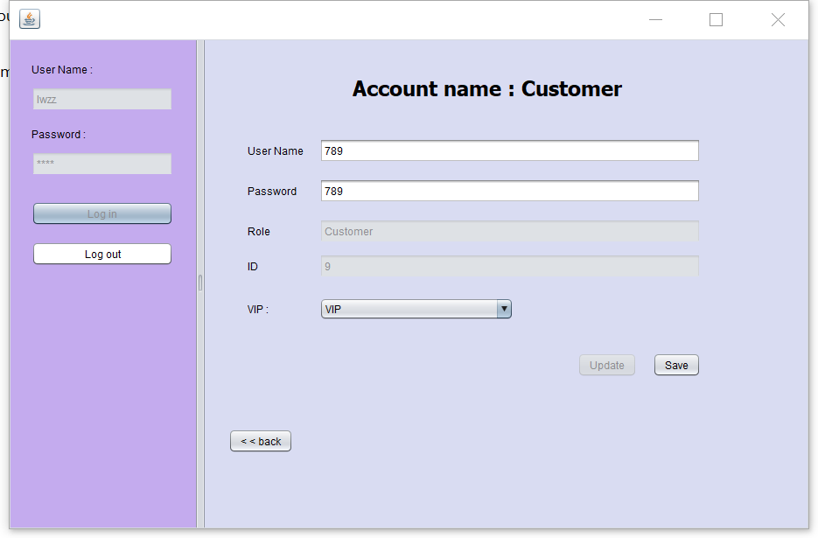
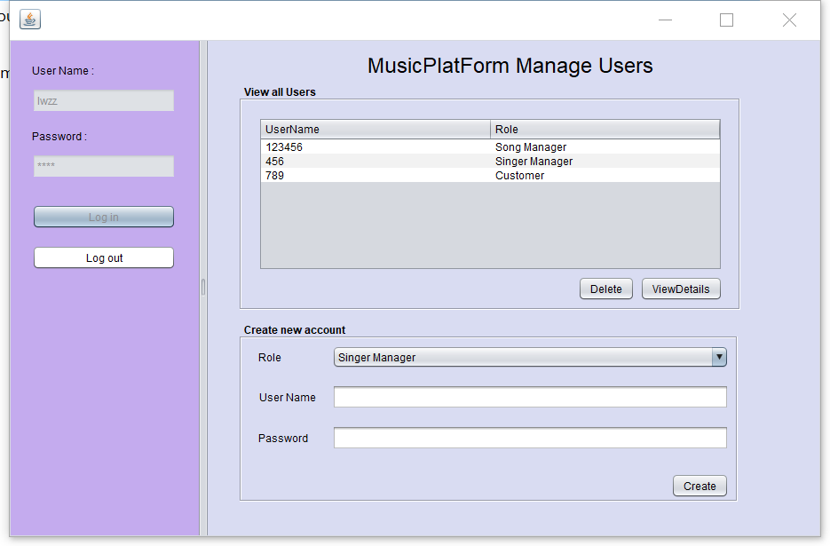
Screen Shot

Slide 17
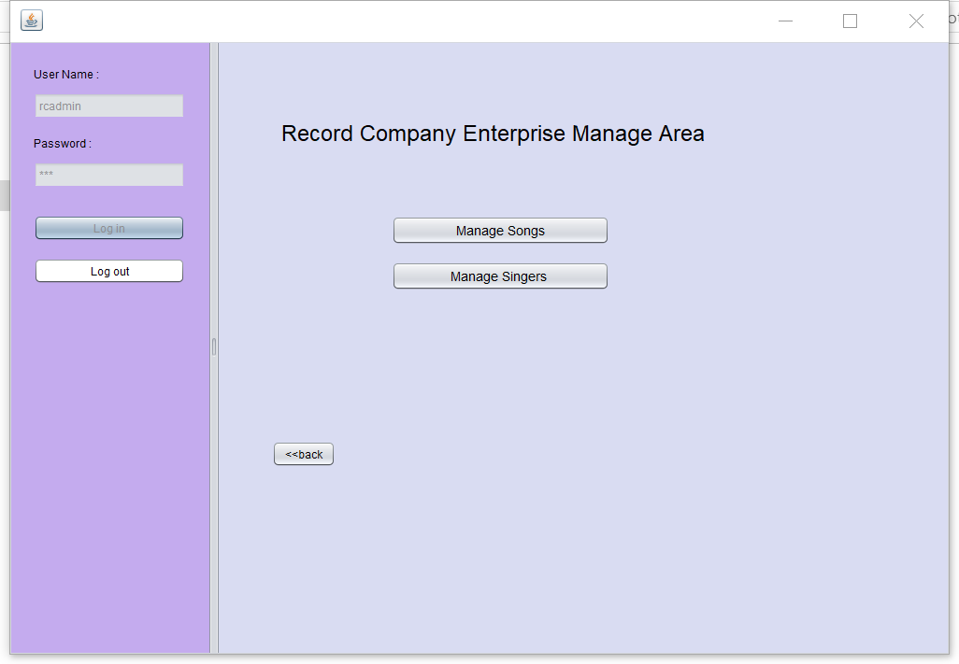
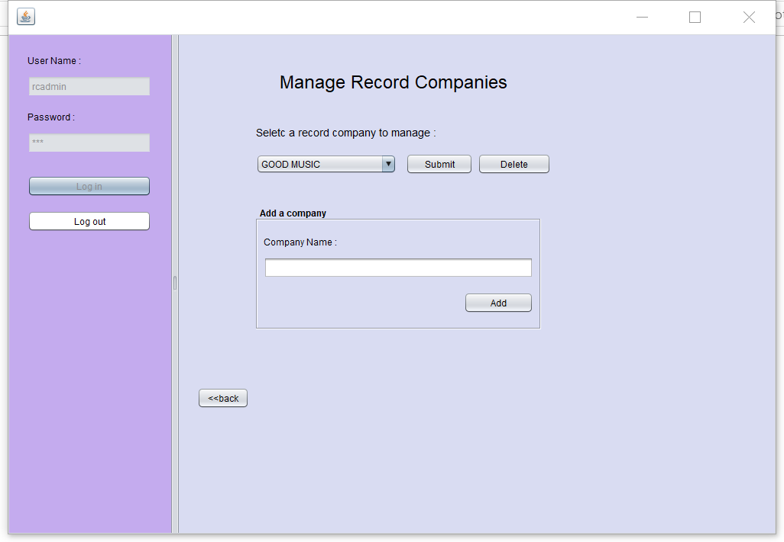
Screen Shot

Slide 18
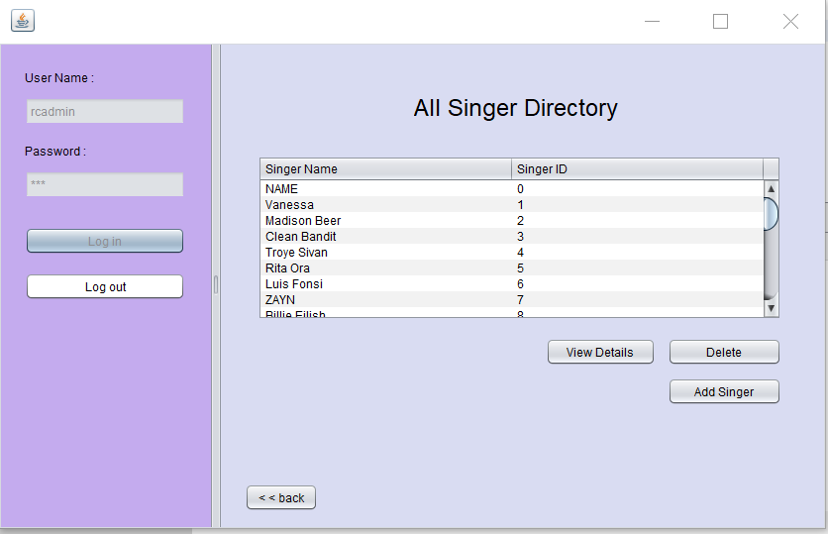
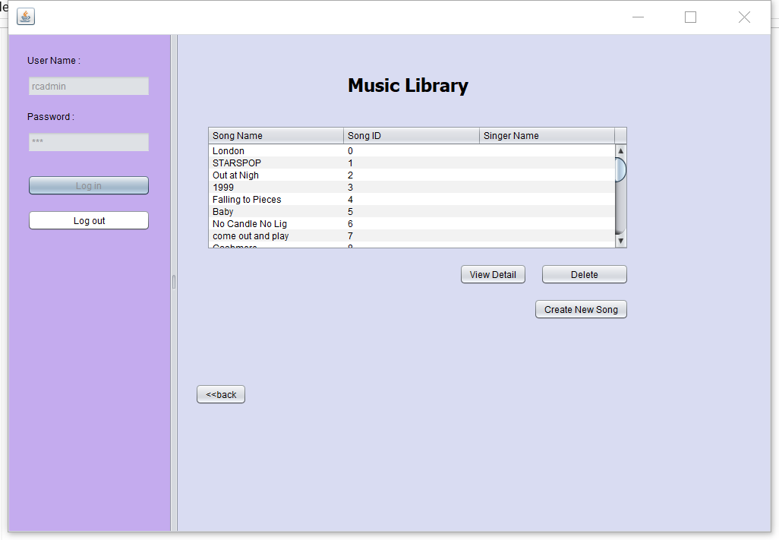
Screen Shot

Slide 19
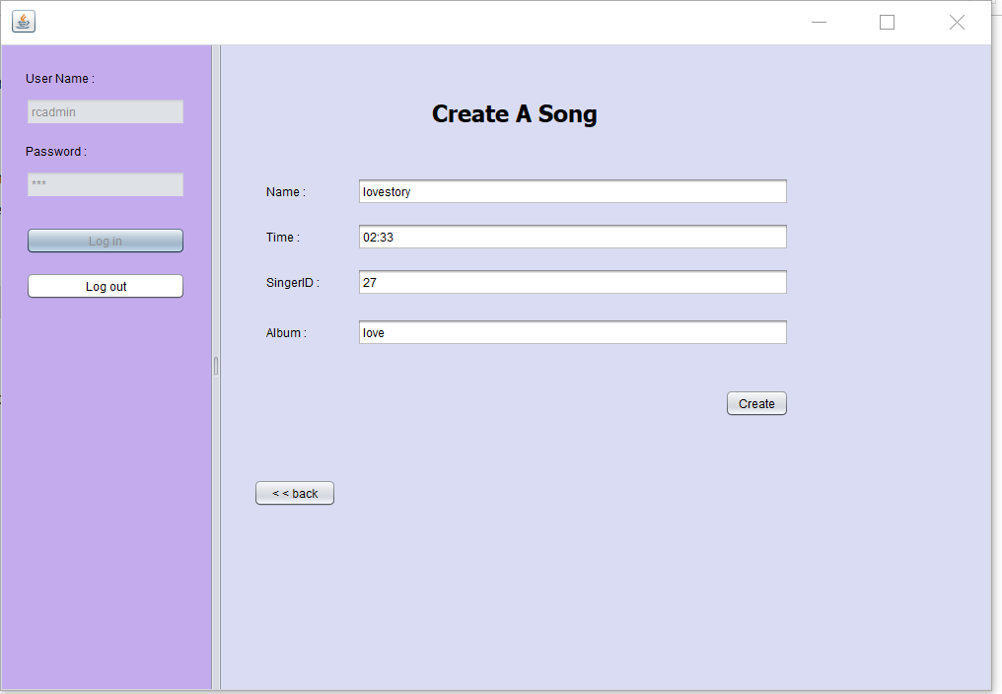
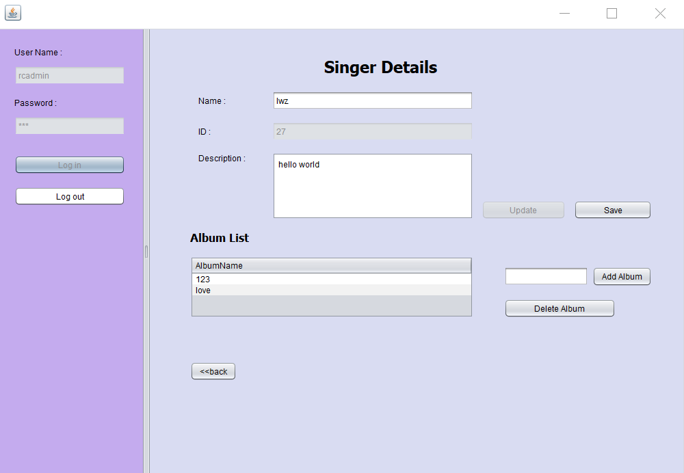
Screen Shot

Slide 20
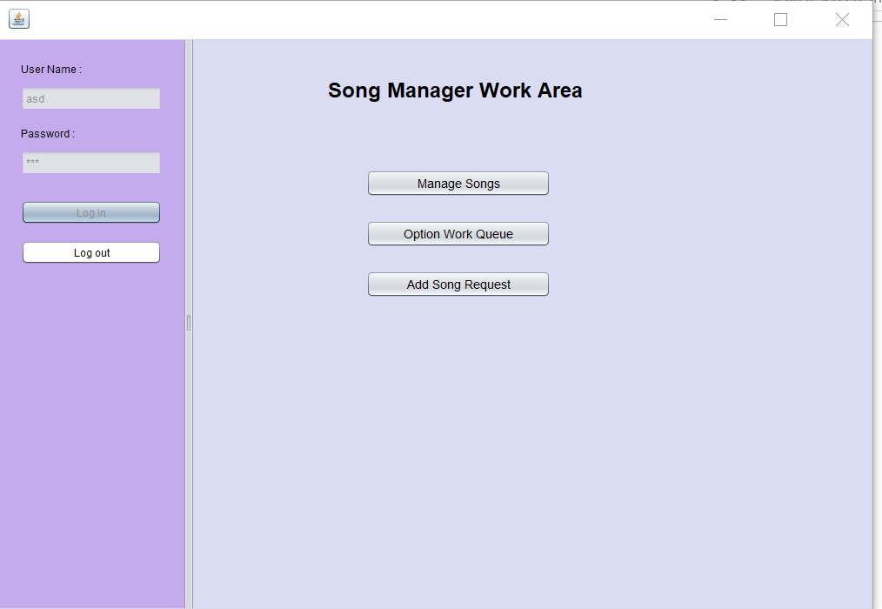
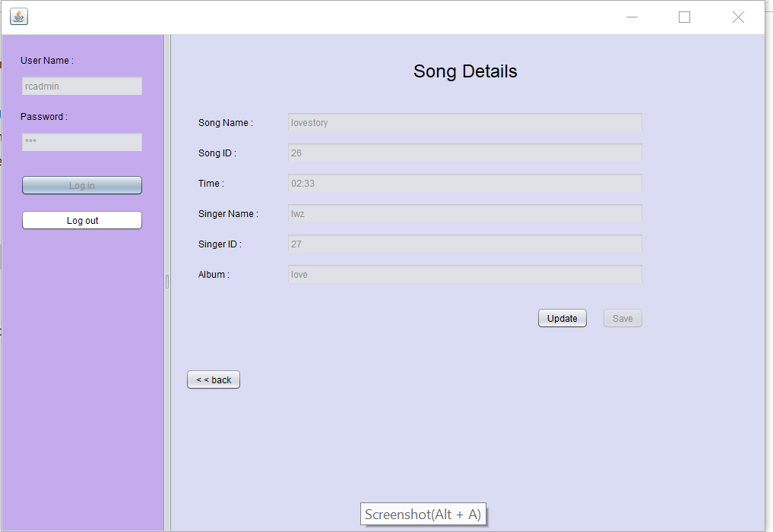
Screen Shot

Slide 21
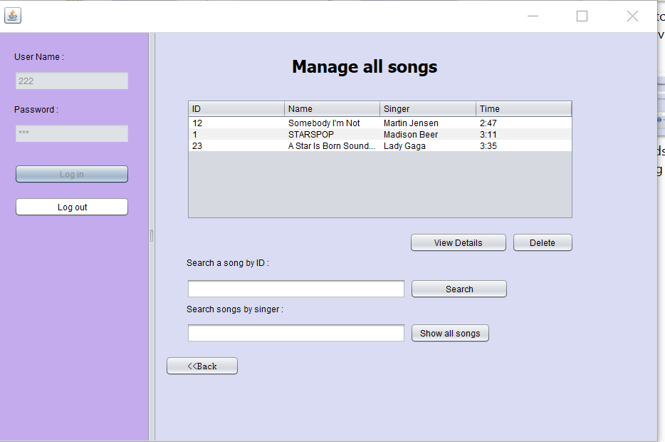
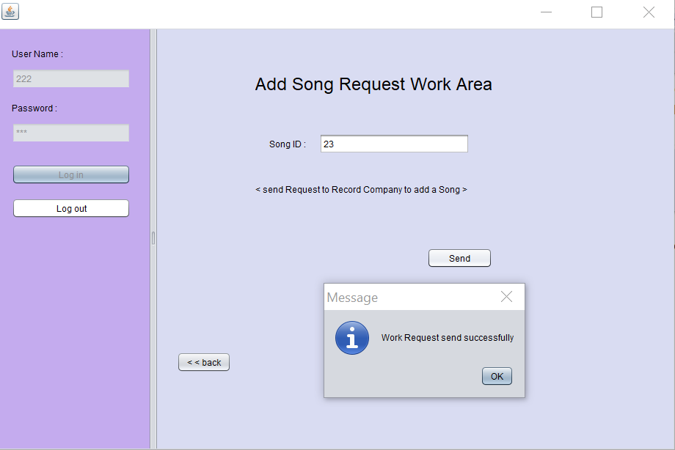
Screen Shot

Slide 22
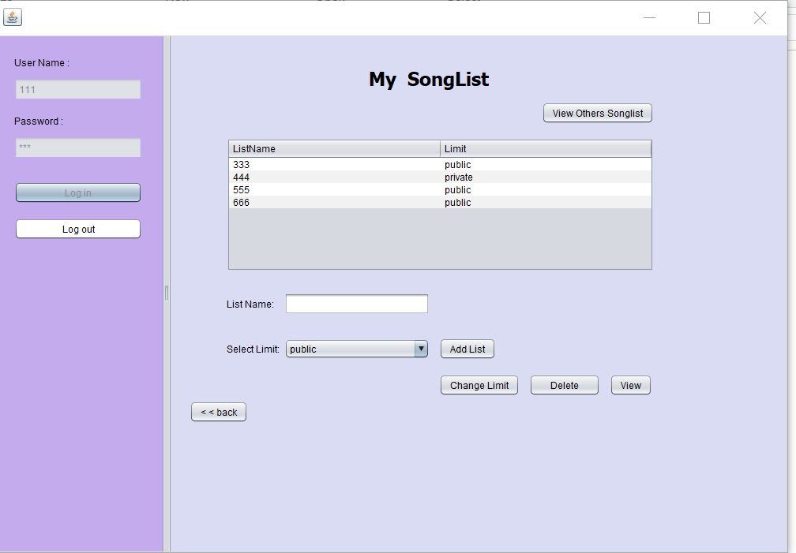
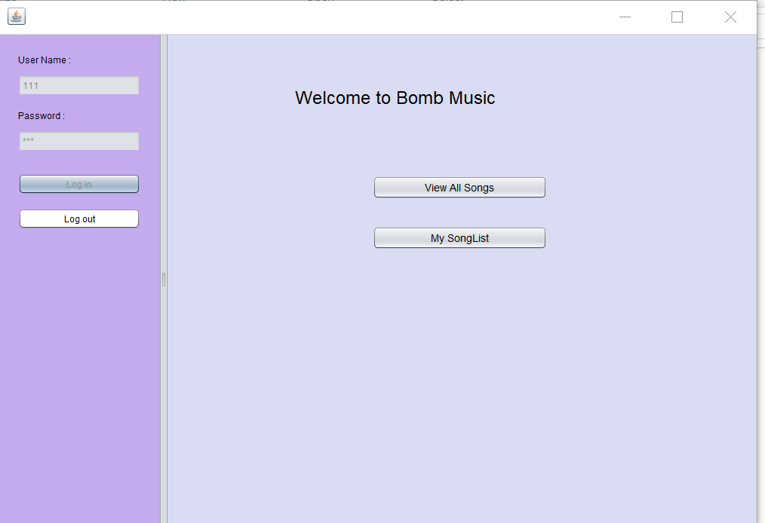
Screen Shot

Slide 23
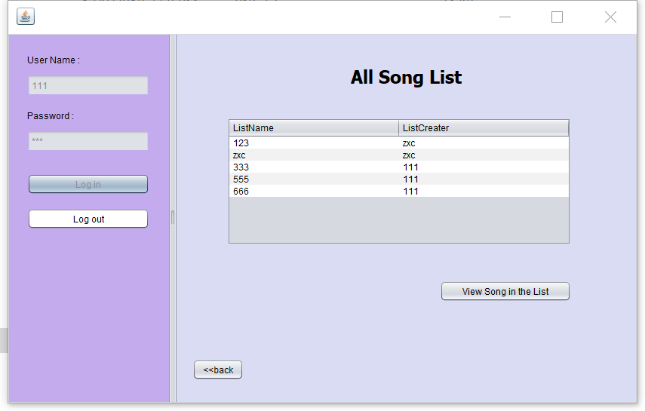
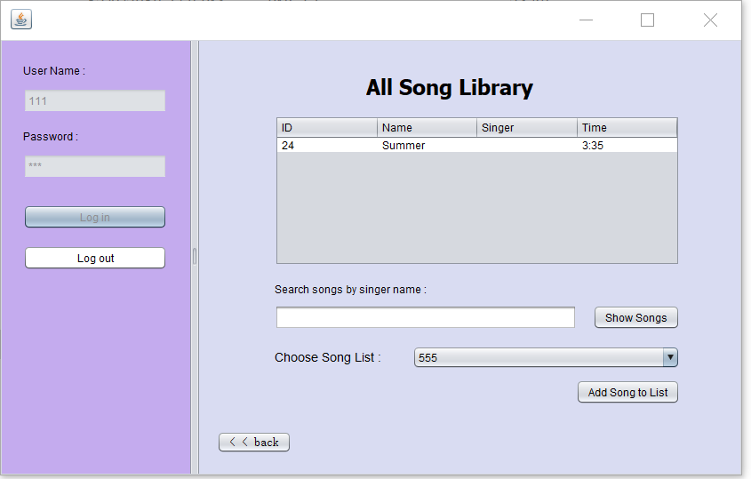
Screen Shot

