Slide 1

Protocols
Industrial IoT
Software and Services Group
IoT Developer Relations, Intel

Slide 2
Legal Notices and Disclaimers
Intel technologies’ features and benefits depend on system configuration and may require enabled hardware, software or service activation. Performance varies depending on system configuration. No computer system can be absolutely secure. Check with your system manufacturer or retailer or learn more at www.intel.com.
This document contains information on products, services and/or processes in development. All information provided here is subject to change without notice. Contact your Intel representative to obtain the latest forecast, schedule, specifications and roadmaps.
Any forecasts of goods and services needed for Intel’s operations are provided for discussion purposes only. Intel will have no liability to make any purchase in connection with forecasts published in this document.
ARDUINO 101 and the ARDUINO infinity logo are trademarks or registered trademarks of Arduino, LLC.
Intel, the Intel logo, Intel Inside, the Intel Inside logo, OpenVINO, Intel Atom, Celeron, Intel Core, and Intel Movidius Myriad 2 are trademarks of Intel Corporation or its subsidiaries in the U.S. and/or other countries.
*Other names and brands may be claimed as the property of others.
Copyright 2018 Intel Corporation.
2

Slide 3

IIoT Connectivity Challenge
The goal of the industrial internet is to enable seamless information sharing across domains and industries.
Past capital investments in equipment have created a myriad of domain specific connectivity technologies, tightly vertically integrated and optimized to solve domain specific needs.
IIoT systems usually integrate with brownfield technologies to preserve the capital investments, and greenfield technologies to spur innovation.
Notes:
IIoT Connectivity Challenge
The goal of the industrial internet is to enable seamless information sharing across domains and industries.
Past capital investments in equipment have create a myriad of domain specific connectivity technologies, tightly vertically integrated and optimized to solve domain specific needs.
IIoT systems usually integrate with brownfield technologies to preserve the capital investments, and greenfield technologies to spur innovation.

Slide 4

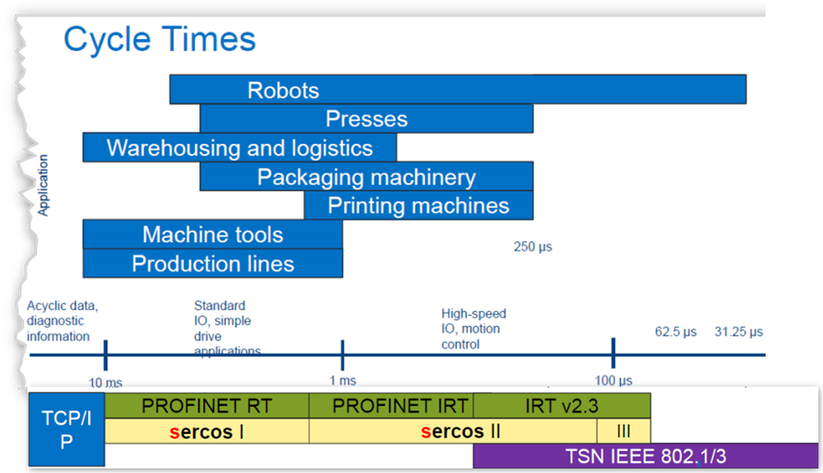
NETWORKING for Automation and Robotics
For machine-to-machine and process communication (the distributed controller level), the role of OPC UA (IEC 62541) is rapidly increasing in significance alongside the traditional Ethernet-based M2M fieldbus systems (PROFINET, EtherNet/IP, CC-Link IE).
Although these technologies share common requirements, their implementations differ substantially. Hence, comparing them depends heavily on the intended application (process control, motion, I/O, centralized vs. decentralized control, etc.).
Notes:
INDUSTRIAL according to the automation pyramid (see Fig. communication today is mainly organized ac-
1)On top at the computer level, standard IT protocols (Internet Protocol Suite) are used.
2)For machine-to-machine and process communication (the distributed controller level), the role of OPC UA (IEC 62541) is rapidly increasing in significance alongside the traditional Ethernet-based M2M fieldbus systems (PROFINET, EtherNet/IP, CC-Link IE).
3)Inside the machine (device and sensor levels), protocols with hard real-time capabilities (also known as real-time Ethernet) dominate the field. According to market share, the most significant ones are EtherCAT, PROFINET IRT, POWERLINK and Sercos III.
Although these technologies share common requirements, their implementations differ substantially. Hence, comparing them is a complicated matter and depends heavily on the intended application (process control, motion, I/O, centralized vs. decentralized control, etc.). An endeavor to compare the performance of various real-time Ethernet protocols in a number of categories has been undertaken by the Ethernet POWERLINK Standardization Group (EPSG)

Slide 5
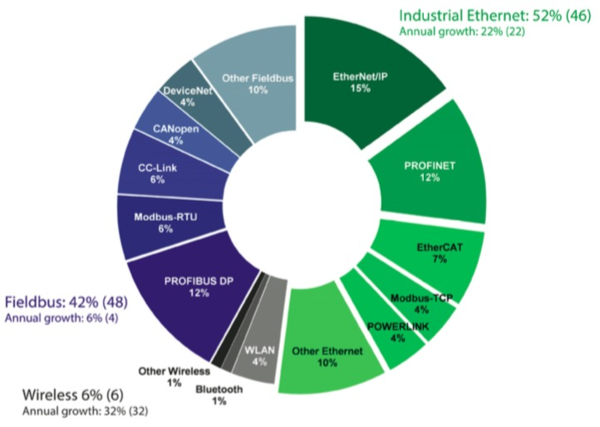
Industrial Ethernet market share
Growth powered by IIoT (e.g OT/IT)
Wireless redefining network picture
Regional network variations :
EMEA - PROFINET and EtherNet/IP are dominant
US - Movement towards EtherNet/IP
Asia - no network stands out as truly market-leading: PROFINET, EtherNet/IP, PROFIBUS, EtherCAT, Modbus and CC-Link
Fieldbuses expected to decline
PROFIBUS and Modbus still significant
Source: Industrial Ethernet Book Issue 105 / 2 : Industrial Ethernet book April,2018
http://www.iebmedia.com/index.php?id=12993&parentid=74&themeid=255&hpid=2&showdetail=true&bb=1&appsw=1
Notes:
Source http://www.iebmedia.com/index.php?id=12993&parentid=74&themeid=255&hpid=2&showdetail=true&bb=1&appsw=1
Annual market analysis
HMS Industrial Networks, again this year, has presented their annual analysis of the industrial network market which focuses on new installed nodes within factory automation globally.
As an independent supplier of products and services for industrial communication and the Internet of Things, HMS has insight into the industrial network market. Here are some of the trends they see within industrial communication in 2018, also looking back on the network market share evolution during the last 5 years.
Growth powered by IIoT
Industrial Ethernet has been growing faster than traditional fieldbuses for a number of years, and has now overtaken fieldbuses. With a growth rate of 22%, Industrial Ethernet now makes up for 52% of the global market compared to 46% last year. EtherNet/IP has emerged as the largest network with 15% of the market. Ethernet runners-up globally are PROFINET, EtherCAT, Modbus-TCP and Ethernet POWERLINK.
"We have seen the transition to industrial Ethernet for a long time, but it isn′t until now that it has actually overtaken fieldbuses when it comes to number of new installed nodes," said Anders Hansson, Chief Marketing Officer at HMS. "The transition to industrial Ethernet is driven by the need for high performance, integration between factory installations and IT/IoT-systems, as well as the Industrial Internet of Things in general."
Fieldbuses expected to decline
Boosted by a strong industry and cyber-security concerns in the industry, fieldbuses are still growing slightly. However, despite an increased growth rate at 6% (4% last year), the number of fieldbus installations are expected to decline steadily over the next few years. The dominant fieldbus is still PROFIBUS with 12% of the total world market, followed by Modbus-RTU and CC-Link, both at 6%.
Wireless redefining network picture
Wireless technologies are also growing by 32% and accounts for 6% of the total market. Within Wireless, WLAN is the most popular technology, followed by Bluetooth.
"Wireless is increasingly being used by machine builders and system integrators to realize innovative automation architectures. Users can reduce cabling and create new solutions for connectivity and control, including Bring Your Own Device solutions via tablets or smartphones," said Hansson.
Regional network variations
In Europe and the Middle East, PROFINET and EtherNet/IP are leading and PROFIBUS is still widely used. Other popular networks are EtherCAT, Modbus-TCP and Ethernet POWERLINK. The US market is dominated by the CIP networks, with a clear movement towards EtherNet/IP.
In Asia, no network stands out as truly market-leading, but PROFINET, EtherNet/IP, PROFIBUS, EtherCAT, Modbus and CC-Link are widely used, with the Ethernet version CC-Link IE Field also gaining traction.
Looking back five years
A special feature in this year′s study is a look back on five years of steady industrial network growth. HMS concludes that during 2017, industrial Ethernet finally passed fieldbuses in terms of market share.
"The growth of industrial networks has been steady over the last five years, and it is interesting to see that industrial Ethernet now has passed fieldbus, currently accounting for 52% of the market with EtherNet/IP as the leading network," said Hansson.
"Nevertheless, our study confirms that the network market remains fragmented; users continue to ask for connectivity to a wide variety of networks, depending on application. Looking ahead, it is clear that industrial devices will become increasingly connected, boosted by the Industrial Internet of Things and Industry 4.0. From our point of view, we are well-suited to grow with these trends," Hansson added.
Anders Hansson, Chief Marketing Officer, HMS Industrial Networks.

Slide 6
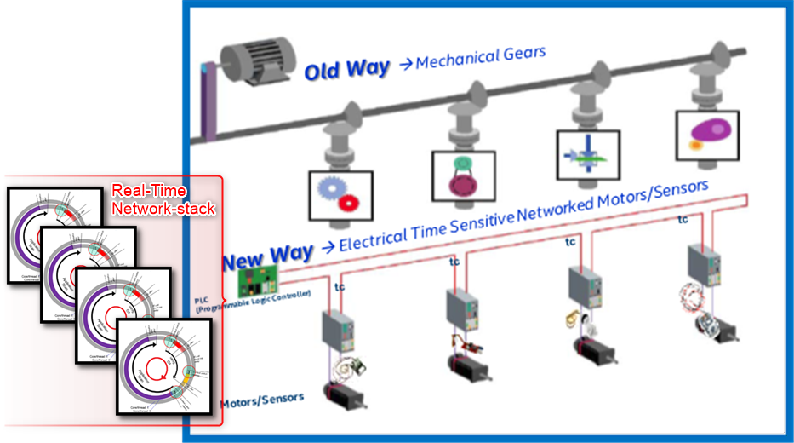

NETWORKING for Automation and Robotics
Time-Synchronized (IEEE 1588v2 or 802.1AS) real-time control.
Down the wire updates
Reduced OPEX
Flexible function
Reconfigurable production

Slide 7
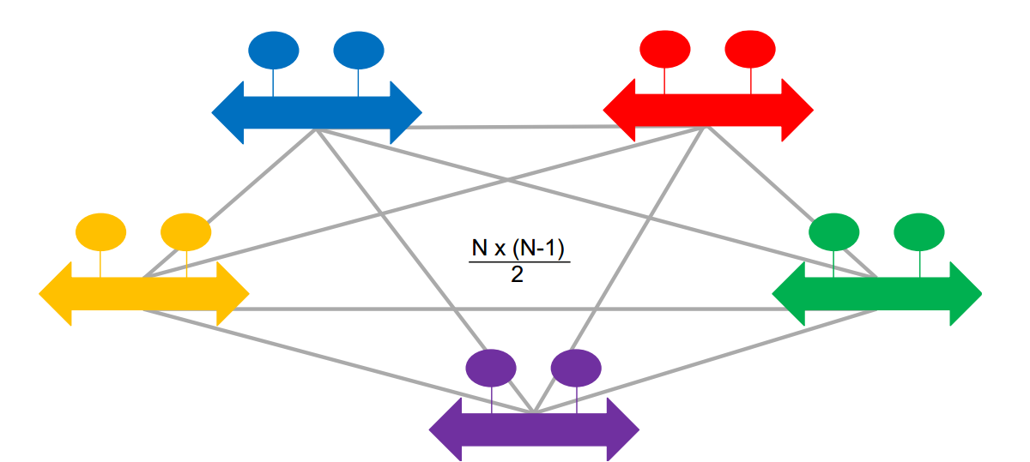

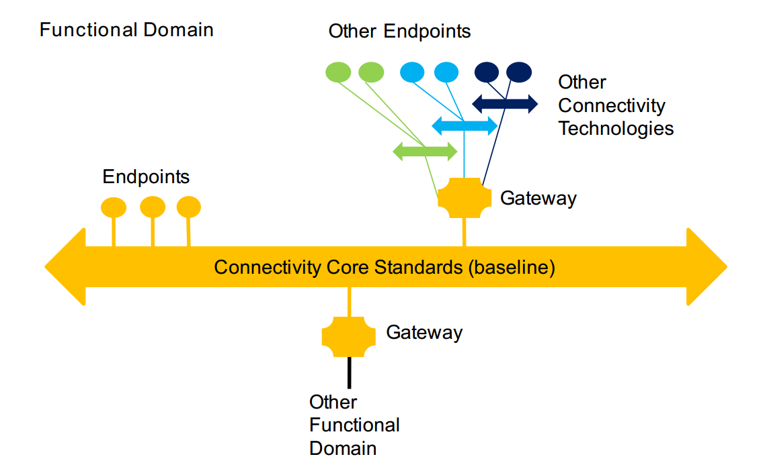
Protocol Scalability Model Needs Domain Translation Gateways
Complete connectivity rapidly becomes unmanageable.
To keep the connectivity architecture manageable, a connectivity technology standard is chosen as the baseline within a functional domain, and referred to as the “connectivity core standard”
To facilitate information exchange, one has to build bridges to each of the other connectivity technologies.
Notes:
IIoT Connectivity Reference Architecture
The Industrial Internet of Things requires us to think about scale and interoperability. Both the number of installed communicating devices and the number of communication types.
In this talk we will introduce an IIoT Connectivity Reference Architecture that achieves near linear scalability, O(N), with respect to the number of connectivity technologies. This is important from the our four main viewpoints. From the business viewpoint implementing scalable systems will decrease capital expenditure. From a Usages and Functional view points it increases the maximum size potential devices that can be connected. We will mainly focus on the implementation viewpoint by first introducing the idea of a mutli-bus, multi-protocol network system. Then we will discuss some of the commonly used protocols that used in IIoT deployments.
First, let’s consider a fully connected graph of IoT sensor devices. Fully connected in this case doesn’t just mean that there is a network connection between two endpoints, but that there is data and protocol compatibility.
To keep the connectivity architecture manageable, a connectivity technology standard is chosen as the baseline within a functional domain, and referred to as the “connectivity core standard” (see Figure 3-2). Gateways are used to bridge other connectivity technologies within the domain and to the connectivity core standards used in other functional domains. Connectivity between functional domains, often implemented in a tiered manner, can be intermittent. Connectivity gateways can help mitigate this intermittent connectivity. Applications are simpler and easier to maintain if logic is not needed to react to failed data exchanges.
Some endpoints can connect directly to a core standard. Other endpoints and subsystems connect through gateways. A core standard then connects them all together, allowing multiple connectivity technologies to be integrated without having to bridge between all possible pairs, so avoiding the dreaded N-squared bridging problem (see Figure 3-1). Each domain-specific connectivity technology needs only a gateway to just one connectivity core standard.
Connectivity gateways enable incorporation of new connectivity technologies. They provide a stable foundation anchored in the “best-of-breed” technologies available today, yet can pivot in the future to a new baseline core standard that better satisfies the requirements.
It accomplishes this by defining a small set of connectivity core standards. Standardized core gateways bridge the connectivity core standards. Domain-specific connectivity technologies need a gateway to just one of the connectivity core standards, to participate in an information exchange with the rest of the IIoT ecosystem.
The first diagram shows the challenge of building applications that require information exchange across different connectivity technologies. To facilitate information exchange, one has to build bridges to each of the other connectivity technologies. Given N connectivity technologies, this requires building N*(N-1)/ 2 = O(N²) bridges. That quickly becomes impractical for large N (> 3 or 4). The result is information silos, making it impossible to realize the vision of the Industrial Internet to create new value stream from heretofore locked up information flows.
Using a gateway to a core connectivity standard, a domain-specific endpoint can communicate with endpoints on other domain-specific technologies also connected via gateways to the core connectivity standard (see Figure 3-2). Core connectivity endpoints can directly communicate with each other, and via gateways with domain-specific connectivity endpoints. Different functional domains may have different choices of core connectivity standards, due to different priorities on technical requirements, tradeoffs and ecosystems. To enable communication between different connectivity core standards, standardized gateways are needed. A standardized gateway between core connectivity standards is referred to as a core gateway. It allows domain-specific endpoints connected to one core standard to communicate with domain-specific endpoints integrated over another core standard, as shown in Figure 3-3.
Also, it allows endpoints on the two core connectivity standards to interoperate.

Slide 8
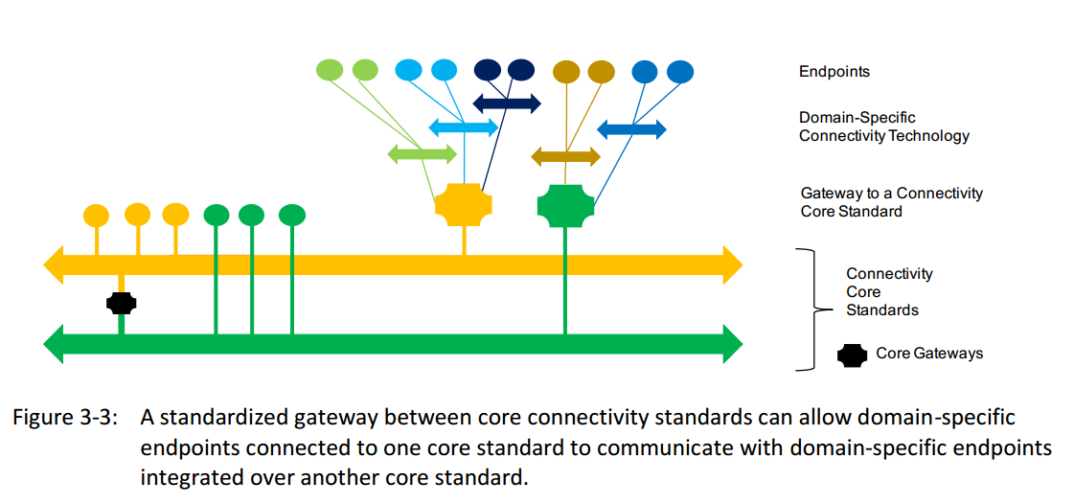
Bridging Core Connectivity Standards
Notes:
Let K be the number of core standards. Then the number of core gateways that will be standardized is K * (K - 1) / 2, as shown in Figure 3-4. If N is the total number of connectivity technologies (see Figure 3-1), then only additional (N-K) gateways are needed with the introduction of core standards. The total number of gateways required becomes
K*(K-1)/2 + (N-K) vs. the original N*(N-1)/2 shown in Figure 3-1. Assuming K << N, the number of gateways goes from O(N²) to O(N), which is much more tractable.
Each additional core standard creates increasing complexity and interoperability challenges with the square of the number of core standards. A few (small K) core connectivity standards should suffice to cover the needs of IIoT systems across the functional domains and industries to attain the goal of horizontal interoperability.

Slide 9
Tools: Protocol Assessment template
Core Standard Criterion | Protocol Checklist
Provide syntactic interoperability | √
Open standard with strong independent, international governance | X
Horizontal in its applicability across industries
Stable and deployed across multiple vertical industries
Have standards-defined Core Gateways to all other core connectivity standards
Meets connectivity functional requirements
Meet non-functional requirements of performance, scalability, reliability, resilience
Meet security and safety requirements
Not require any single component from any single vendor
Have readily-available SDKs both commercial and open source
The assessment template is intended to be a tool for understanding any connectivity technology in the context of the IIoT needs.
The worksheet is helpful for:
understanding how a connectivity technology supports specific IIoT functional needs,
evaluating a connectivity technology’s trades-offs for typical IIoT considerations and
determining a connectivity technology’s suitability for a particular use case (once the specific requirements are understood).

Slide 10
Connectivity Framework Core Functions
Data Resource Model – represents structured data objects that can change state over time
ID and Addressing – provides the means to identify and address each data object
Data Type System – provides a way to describe the constrains place on data, includes a method of evolving and versioning the data syntax
Publish/Subscribe – supports the well-know pubsub pattern for decoupled data exchange
Request/Reply - supports the well-know request/reply pattern for data exchange
Discovery – must be able to find pubsub services, request/reply services, endpoints and datatypes.
Exception Handling – mechanisms for handling disconnections, changes in configuration or quality, endpoint failures, etc…
Data Quality of Service – QoS method implemented, best-effort vs. reliable delivery
Data Security – confidentiality, integrity, authenticity and non-repudiation of the data
Data Governance – is there a standards body that directs this protocol’s evolution

Slide 11
IIoT CONNECTIVITY STACK MODEL
Industry
Energy Sector
Health Care
Transportation
Manufacturing
……
Transport
DDS
Web Services
OPC-UA
Network
RTSP
CoAP
MQTT
HTTP
OPC-UAB
TCP
UDP
TCP
Link
IP Protocol
TSN / Ethernet
Wireless PAN
Wireless LAN
Wireless 2G/3G/LTE
Wireless Wide Area
Physical
Notes:
The lowest layer is the physical layer, which refers to the exchange of physical signals (electric, optical, or other) on the physical media (wired or wireless) connecting the participants. Above it is the link layer, which refers to the exchange of frames using signaling protocols on the shared physical link between adjacent participants. Above it is the network layer, which refers to the exchange of packets (bounded length), possibly routing them over multiple links to communicate between non-adjacent (remote) participants. Above it is the transport layer, which refers to the exchange of messages (variable length) between participant applications. Above it is the framework layer, which refers to the exchange of structured data (state, events, streams) with configurable quality-of-service between participant applications. Above it, but outside the scope of connectivity, is the distributed data interoperability and management layer crosscutting function that relies on the data sharing mechanism provided by the connectivity framework layer.
Performance
Latency and jitter. Latency is the time it takes for data to go from source to destination (“time of flight”). Jitter is the variation in latency. The data usually has a limited useful lifetime, so low latency is essential. Low jitter is also needed to ensure the application has integrity and system
maintains predictable performance. The connectivity function addresses latency and jitter in the data exchanged between endpoints, possibly in exchange for throughput. Throughput. Throughput is the load on the network as defined by the volume of data flow per unit of time. Bandwidth is the network capacity of a connectivity technology. In some designs, a large volume of data may be exchanged in a short time on an ongoing basis among endpoints; high throughput would be needed. In practice, the operational settings that optimize for high throughput are not the same as those that optimize for low latency. Therefore, the connectivity function should support achieving the right balance as per the requirements of the data flow. In industrial internet applications, particularly at the edge, low latency and jitter are generally more important to performance than throughput and bandwidth. Automation and control of real-world processes require short reaction times or tight coordination to maintain effective control. Industrial devices in the control domain do not produce large amounts of data in short periods and therefore do not require high bandwidth connectivity. Rather, the data needs to be communicated quickly and consistently (with low latency and jitter).
Resilience
Because many IIoT systems will operate continually in a real-world environment, the connectivity function should be available (in the logical view), even when there is a temporary physical disconnection. When a broken connection is restored, data exchange should be automatically restored so that the latest updates are available to the consumers along with any relevant missed updates. The connectivity function should support graceful failure or disconnection of endpoints, by, for example, confining the loss of data exchange only to disconnected endpoints.
Longevity - Connectivity components, especially those in the network layer and below, are built into the hardware and hence are not easily replaceable. Where possible and feasible, the connectivity software components should support incremental evolution including upgrades, addition and removal of components. The connectivity function should also be able to support incremental evolution of the data exchange solutions during the lifecycle of a system.
Integration and Interoperability
IIoT systems comprise components that are often systems in their own right. The connectivity function should support the integration and the interoperability of system components, isolation and encapsulation of data exchanges internal to a system component, and hierarchical organization of data exchanges. In dynamic systems, the connectivity function should also support discovery of system components and the discovery of relevant data exchanges for system composition.
Operation IIoT systems generally operate non-stop in a real-world environment. To support a system’s operational needs, it should be possible to monitor, manage and dynamically replace connectivity elements. Monitoring includes health, performance and service-level characteristics of the connectivity function; management includes configuring and administering the capabilities; dynamic replacement requires replacement of hardware and or software while a system is operating
SAFETY
A high degree of assurance is required in life- and mission-critical systems1 to avoid unintended consequences during system operation. The connectivity function should be able to support safety evaluations and provide evidence required to make informed safety assessments.
CONNECTIVITY FRAMEWORK LAYER The connectivity framework layer provides a logical data exchange service to the endpoints participating in an information exchange. It can observe and “understand” the data exchanges, and use that knowledge to optimize data delivery. It is a logical functional layer on top of the connectivity transport layer (see Figure 2-1) and should be agnostic to the technologies used to implement connectivity transports. The key role of the connectivity framework layer is to provide syntactic interoperability among the endpoints. Data that is exchanged is structured in a common, unambiguous data format, independent of endpoint implementation, and decoupled from the hardware and programming platform. Depending on the application logic behind endpoint, one or more data exchange patterns may be required. There are two predominant data exchange pattern styles: publishsubscribe (see section 4.1.6) and request-reply (see section 4.1.7). A key benefit of the connectivity framework is to abstract and hide the implementation of the various functions so that the applications that use the connectivity framework won’t need to know the implementation, just use its capabilities. It reduces the cost of development and increases productivity and quality.

Slide 12
Data Distribution Service (DDS)
Data Writer
Data Reader
The Data Distribution Service for real-time systems (DDS) is an Object Management Group (OMG) machine-to-machine(sometimes called middleware) standard that aims to enable scalable, real-time, dependable, high-performance and interoperable data exchanges using a publish–subscribe pattern. DDS addresses the needs of applications like financial trading, air-traffic control, smart grid management, and other big data applications. The standard is used in applications such as smartphone operating systems,^{[1]} transportation systems and vehicles,^{[2]} software-defined radio, and by healthcare providers. DDS was promoted for use in the Internet of things.^{[3]}
Data Writer
Topic B
Topic A
Data Writer
Topic D
Data Writer
Topic C
Data Reader
Data Reader
Notes:
The Data Distribution Service (DDS™) is a middleware protocol and API standard for data-centric connectivity from the Object Management Group® (OMG®). It integrates the components of a system together, providing low-latency data connectivity, extreme reliability, and a scalable architecture that business and mission-critical Internet of Things (IoT) applications need.
In a distributed system, middleware is the software layer that lies between the operating system and applications. It enables the various components of a system to more easily communicate and share data. It simplifies the development of distributed systems by letting software developers focus on the specific purpose of their applications rather than the mechanics of passing information between applications and systems.
DDS provides a “middleware” software layer that abstracts an application from the details of the operating system, network transport, and low-level data formats. An application links to a DDS middleware library to participate in an data exchange. The same concepts and APIs are provided in different programming languages allowing applications to exchange data across of operating systems, languages and processor architectures. Low level details like data wire format, discovery, connections, reliability, timing and QoS management are managed by the middleware layer. It integrates the components of a system together, providing low-latency data connectivity, extreme reliability and a scalable architecture that business and mission-critical Internet of Things (IoT) applications need.
The DDS Middleware is a software layer that abstracts the Application from the details of the operating system, network transport, and low-level data formats. The same concepts and APIs are provided in different programming languages allowing applications to exchange information across of operating systems, languages, and processor architectures. Low-level details like data wire format, discovery, connections, reliability, protocols, Qos management, etc. are managed by the middleware.
There are many communications middleware standards and products. DDS is uniquely data centric, which is ideal for the Internet of Things. Most middleware works by sending information between applications and systems. Data centricity ensures that all messages include the contextual information an application needs to understand the data it receives.
The essence of data centricity is that DDS knows what data it stores and controls how to share that data. Programmers using traditional message-centric middleware must write code that sends messages. Programmers using data-centric middleware write code that specifies how and when to share data and then directly share data values. Rather than managing all this complexity in the application (your) code, DDS directly implements controlled, managed, secure data sharing for you.

Slide 13
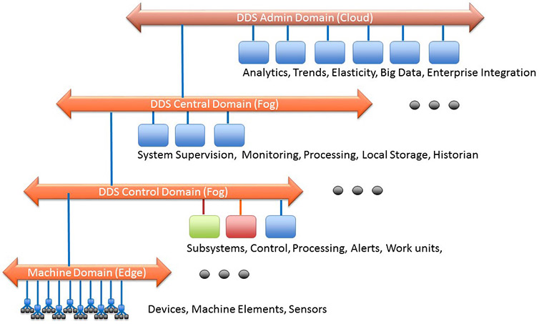
Properties of DDS
Quality of Service
Dynamic Discovery
Scalable Architecture
Notes:
Quality of Service
The data can also be shared with flexible Quality of Service (QoS) specifications including reliability, system health (liveliness), and even security. In a real system, not every other end-point needs every item in your local store. DDS is smart about sending just what it needs. If messages don’t always reach their intended destinations, the middleware implements reliability where needed. When systems change, the middleware dynamically figures out where to send which data, and intelligently informs participants of the changes. If the total data size is huge, DDS intelligently filters and sends only the data each end-point really needs. When updates need to be fast, DDS sends multicast messages to update many remote applications at once. As data formats evolve, DDS keeps track of the versions used by various parts of the system and automatically translates. For security-critical applications, DDS controls access, enforces data flow paths, and encrypts data on-the-fly.
The true power of DDS emerges when you specify all of these things simultaneously, at extremely high speeds, and in a very dynamic, demanding, and unpredictable environment.
Dynamic Discover
DDS provides Dynamic Discovery of publishers and subscribers. Dynamic Discovery makes your DDS applications extensible. This means the application does not have to know or configure the endpoints for communications because they are automatically discovered by DDS. This can be completed at runtime and not necessarily at design or compile time, enabling real “plug-and-play” for DDS applications.
This dynamic discovery goes even further than discovering endpoints. DDS will discover if the endpoint is publishing data, subscribing to data, or both. It will discover the type of data being published or subscribed to. It will also discover the publisher’s offered communication characteristics and the subscriber’s requested communications characteristics. All of these attributes are taken into consideration during the dynamic discovery and matching of DDS participants.
DDS participants can be on the same machine or across a network: the application uses the same DDS API for communications. Because there is no need to know or configure IP addresses, or take into account the differences in machine architectures, adding an additional communication participant on any operating system or hardware platform becomes an easy, almost trivial, task.
Scalable Architecture
The OMG DDS architecture is designed to be scalable from small devices to the cloud and for very large systems.DDS enables the Internet of Things by scaling across thousands or millions of participants, delivering data at ultra-high speed, managing many thousands of data objects, and providing extreme availability and security. DDS simplifies distributed systems development by absorbing much of the complexity in a single, standard communications layer.
For further information on the DDS standard then please visit the specifications page.

Slide 14
DDS: Functional Summary
Core Standard Criterion | Protocol Checklist
Provide syntactic interoperability | √
Open standard with strong independent, international governance | √
Horizontal in its applicability across industries | √
Stable and deployed across multiple vertical industries | Military, Software Integration
Have standards-defined Core Gateways to all other core connectivity standards | Web Services, OPC-UA
Meets connectivity functional requirements | √
Meet non-functional requirements of performance, scalability, reliability, resilience | √
Meet security and safety requirements | √
Not require any single component from any single vendor | √
Have readily-available SDKs both commercial and open source | √
DDS has been applied in multiple verticals to realize higher domain-specific interoperablity
open architecture specifications. These include: • SGIP OpenFMB v1.0 (uses CIM extensions over DDS) - NAESB Standard • MDPnP OpenICE Integrated Clinical Environment for Medical Device Interoperability • ROS: Robot Operating System (Open Source) • EUROCAE ED-133 flight data exchange between air traffic control centers • Generic Vehicle Architecture (GVA) • Future Airborne Capability Environment (FACE) • Open Mission Systems (OMS) • Open Architecture Radar Interface Standard (OARIS) • Unmanned Aircraft Systems Control Segment (UCS) • Joint Architecture for Unmanned Systems (JAUS) over DDS • Layered Simulation Architecture • Navy Open Architecture

Slide 15
MQTT - message queue telemetry transport
Network decoupling: publisher and subscriber do not need to know each other IP address
Time decoupling: Publisher and subscriber do not need to run at the same time.
Synchronization decoupling: pub/sub is non-blocking.
Pub/Sub provides a greater scalability than the traditional client-server approach because its operations can be highly parallelized and event-driven.
Publisher (Source)
MQTT Broker
Subscriber (Sink)
sub(topic)
pub(topic, data)
pub(topic, data)
15

Slide 16
What is OPC-UA?
OPC UA is a protocol for industrial communication and has been standardized in the IEC 62541 series. At its core, OPC UA defines:
OPC Unified Architecture (OPC-UA) is a platform independent service-oriented architecture that integrates all the functionality of the individual OPC Calssica specifications into one extensible framework.
an asynchronous protocol (built upon TCP, HTTP or SOAP) that defines the exchange of messages via sessions, (on top of) secure communication channels, (on top of) raw connections,
a type system for protocol messages with a binary and XML-based encoding scheme,
a meta-model for information modeling, that combines object-orientation with semantic triple-relations, and
a set of 37 standard services to interact with server-side information models. The signature of each service is defined as a request and response message in the protocol type system.
The standard itself can be purchased from IEC or downloaded for free on the website of the OPC Foundation at https://opcfoundation.org/.
Notes:
OPC UA is a sophisticated, scalable and flexible mechanism for establishing secure connections between clients and servers. Features of this unique technology include:
Scalability –OPC UA is scalable and platform independent. It can be supported on high-end servers and on low-end sensors. OPC UA uses discoverable profiles to include tiny embedded platforms as servers in an OPC UA system.
A Flexible Address Space – The OPC UA address space is organized around the concept of an object. Objects are entities that consist of variables and methods and provide a standard way for servers to transfer information to clients.
Common Transports and Encodings – OPC UA uses standard transports and encodings to ensure that connectivity can be easily achieved in both the embedded and enterprise environments.
Security – OPC UA implements a sophisticated security model that ensures the authentication of clients and servers, the authentication of users and the integrity of their communication.
Internet Capability –OPC UA is fully capable of moving data over the Internet.
A Robust Set of Services –OPC UA provides a full suite of services for eventing, alarming, reading, writing, discovery and more.
Certified Interoperability –OPC UA certifies profiles such that connectivity between a client and server using a defined profile can be guaranteed.
A Sophisticated Information Model – OPC UA profiles more than just an object model. OPC UA is designed to connect objects in such a way that true information can be shared between clients and servers.
Sophisticated Alarming and Event Management –OPC UA provides a highly configurable mechanism for providing alarms and event notifications to interested clients. The alarming and event mechanisms go well beyond the standard change-in-value type alarming found in most protocols.
Integration with Standard Industry-Specific Data Models – The OPC Foundation is working with a number of industry trade groups to define specific information models for their industries and to support those information models within OPC UA.

Slide 17
OPC-Ua
Drive Device
OPC Factory Client
OPC-UA tries to solve large scale industrial networking and automation process with platform independent, service oriented and object base data communication architecture.
OPC-UA provides integrated models and services to ease management of numerous devices and client connections.
Device/Sensor represented as node object with object-oriented approach custom methods, data fields can be added, OPC Server service are used to access nodes through the provided address spaces.
Client are end points where control and automation handled with connecting to server.
PLC Device
OPC-UA Server
OPC-UA Server
Robot
OPC Remote Control Client
Solar Panel Farm

Slide 18
Secure client/server communications
XML Web Services
SOAP/HTTPS with UA Binary
Native Binary
UA XML
UA Binary
Authentication
Authorization
Encryption
Data integrity
WebServices Secure Conversation
UA Secure Conversation
SOAP
OPC TCP
TCP/IP
HTTPS
Protocol Stack diagram: GFDL-self/cc-by-sa3.0 https://de.wikipedia.org/wiki/Datei:Uaprotocols.png
Notes:
Message format: UA XML, UA Binary
Transport: OPC TCP, SOAP/HTTP(S)
Channel Security: None, Signed, Signed and Encrypted
Authenthication, Authorization, Encryption and Data integrity are performed by signatures.
SOAP w/ binary is a firewall-friendly variant with efficient coding.

Slide 19
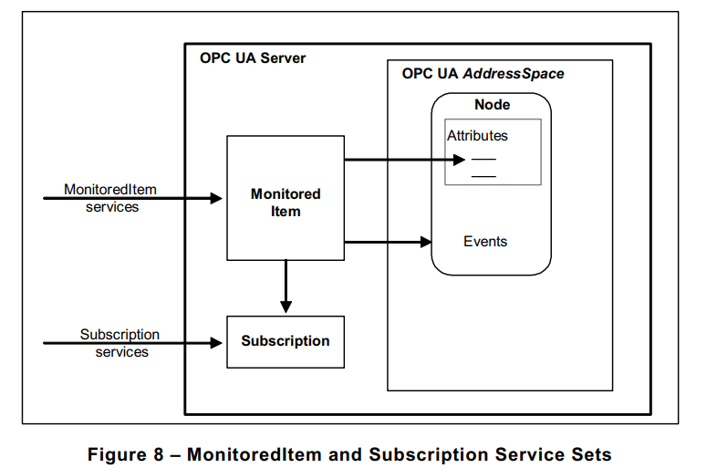
Service discovery Models
The Subscription Service Set defines Services that allow Clients to create, modify and delete subscriptions.
Subscriptions send notifications generated by MonitoredItems to the Client.
Subscription Services also provide for Client recovery from missed Messages and communication failures.
OPC UA Address Space
Monitored
Item
Node
Events
Monitored Item services
Attributes
Subscription services
Subscription

Slide 20
Service discovery Models
The Subscription Service Set defines Services that allow Clients to create, modify and delete subscriptions.
Subscriptions send notifications generated by MonitoredItems to the Client.
Subscription Services also provide for Client recovery from missed Messages and communication failures.

Slide 21
Resilient communications
Redundancy
OPC UA client and server high-availability
Client: Active/Active
Server: Passive/Active
Bidirectional “heartbeat”
OPC UA clients and servers detect connection failures
Buffering
OPC UA clients detect missing data and may request again
Notes:
Client redundancy: the server simply sees two clients. But the clients are talking to each other.
Server redundancy: client sends commands to both servers, but only the active one processes it.

Slide 22
Sophisticated interactions
I need to drill this plate
Are you able to drill materials?
Yes, which one?
Steel
Fine, which diameter?
1 inch (2.54 cm)
Fine, please provide coordinates and depth
X: 10, Y: 5, Z: 1
Fine, I am available now
I am sending you the plate
Ok, waiting for it

Slide 23
The OPC-UA Unified Architecture Specification
Part 1: OPC UA Specification: Part 1 – Concepts
Part 2: OPC UA Specification: Part 2 – Security Model
Part 3: OPC UA Specification: Part 3 – Address Space Model
Part 4: OPC UA Specification: Part 4 – Services
Part 5: OPC UA Specification: Part 5 – Information Model Release
Part 6: OPC UA Specification: Part 6 – Mappings
Part 7: OPC UA Specification: Part 7 – Profiles
Part 8: OPC UA Specification: Part 8 – Data Access
Part 9: OPC UA Specification: Part 9 – Alarms and conditions
Part 10: OPC UA Specification: Part 10 – Programs
Part 11: OPC UA Specification: Part 11 – Historical Access
Part 12: OPC UA Specification: Part 12 – Discovery and Global Services
Part 13: OPC UA Specification: Part 13 – Aggregates
Part 14: OPC UA Specification: Part 14 – Pub/Sub

Slide 24
Open62541 Features
Communication Stack
model – Support for all OPC UA node types (including method nodes) – Support for adding and reOPC UA binary protocol
Chunking (splitting of large messages)
Exchangeable network layer (plugin) for using custom networking APIs (e.g. on embedded targets)
Information model
Support for all OPC UA node types (including method nodes)
Support for adding and removing nodes and references also at runtime.
Support for inheritance and instantiation of object- and variable-types (custom constructor/destructor, instantiation of child nodes)
Subscriptions
Support for subscriptions/monitor items for data change notifications
Very low resource consumption for each monitored value (event-based server architecture)
Code-Generation
Support for generating data types from standard XML definitions
Support for generating server-side information models (nodesets) from standard XML definitions

Slide 25
Resources

Slide 27
MQTT - message queue telemetry transport
Network decoupling: publisher and subscriber do not need to know each other IP address
Time decoupling: Publisher and subscriber do not need to run at the same time.
Synchronization decoupling: pub/sub is non-blocking.
Pub/Sub provides a greater scalability than the traditional client-server approach because its operations can be highly parallelized and event-driven.
Publisher (Source)
MQTT Broker
Subscriber (Sink)
sub(topic)
pub(topic, data)
pub(topic, data)
27

Slide 28
Example RESTFUL HTTP API
Addressable Resources
Constraint Interface
Resources may be consumed in multiple formats (JSON, XML, etc..)
All stateful information is held on the client side.
HTTP Verb | URI Path | Purpose
GET | /lcd/text/ | Returns the current text on the LCD screen
POST | /lcd/text/ json: {value:”Hello World”} | Sets the text on the LCD
DELETE | /lcd/text/ | Clear Texts
GET | /lcd/backlight/ | Returns the current state of the LCD backlight
POST | /lcd/backlight/ json:{r:255, b:0, g:0} | Sets the backlight to rgb(255,0,0) or RED
DELETE | /lcd/backlight/ | Turns the backlight off

