Slide 1

Automation
Industrial IoT
Software and Services Group
IoT Developer Relations, Intel

Slide 2
LEGAL NOTICE
Intel technologies’ features and benefits depend on system configuration and may require enabled hardware, software or service activation. Performance varies depending on system configuration. No computer system can be absolutely secure. Check with your system manufacturer or retailer or learn more at www.intel.com.
Performance estimates were obtained prior to implementation of recent software patches and firmware updates intended to address exploits referred to as "Spectre" and "Meltdown." Implementation of these updates may make these results inapplicable to your device or system.
Cost reduction scenarios described are intended as examples of how a given Intel-based product, in the specified circumstances and configurations, may affect future costs and provide cost savings. Circumstances will vary. Intel does not guarantee any costs or cost reduction.
This document contains information on products, services and/or processes in development. All information provided here is subject to change without notice. Contact your Intel representative to obtain the latest forecast, schedule, specifications and roadmaps.
Any forecasts of goods and services needed for Intel’s operations are provided for discussion purposes only. Intel will have no liability to make any purchase in connection with forecasts published in this document.
ARDUINO 101 and the ARDUINO infinity logo are trademarks or registered trademarks of Arduino, LLC.
Altera, Arria, the Arria logo, Intel, the Intel logo, Intel Atom, Intel Core, Intel Nervana, Intel Xeon Phi, Movidius, Saffron and Xeon are trademarks of Intel Corporation or its subsidiaries in the U.S. and/or other countries.
*Other names and brands may be claimed as the property of others.
Copyright 2018 Intel Corporation.

Slide 3
https://www.intel.com/content/www/us/en/big-data/pecan-street-smart-grid-technology-video.html

Slide 4
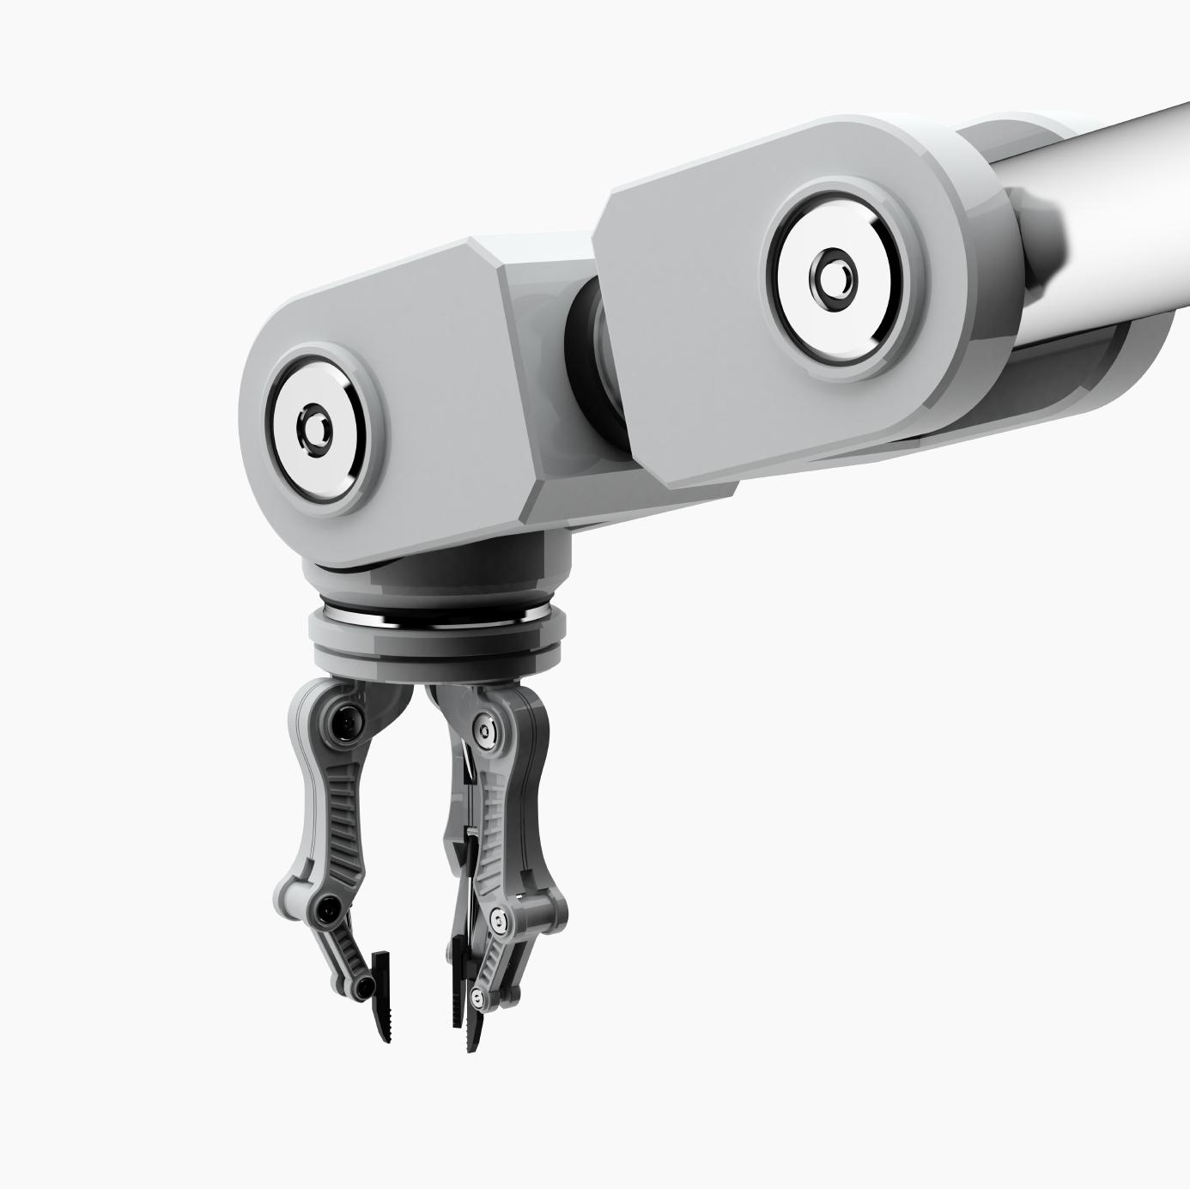
The Next 10 Years and Automation
Big Data and the Internet of Things will drive automation, expert systems and artificial intelligence into common use.
The earliest system systems in artificial intelligence were rule based systems similar to many system in IoT
As IoT system increase in complexity and create huge amounts of data intelligent systems will be needed to understand and create actionable, intelligent processes.

Slide 5

















Intel® IoT Platform – What is Close Loop Management?
Closed loop management is the ability of an IoT Edge Network to monitor sensors and automatically trigger actions based on predefined rules.
Things
Third-Party Cloud
Security
Management
Data Processing
API Libraries, APIs, SDK
Network
Cloud
Security
Management
Data Processing
API Libraries, APIs, SDK
Network Infrastructure
Batch & Stream Analytics
Storage
Servers
No Internet Connectivity
Internet Connectivity
Security
Management
Data Management
API Libraries, APIs, SDK
Notes:
Shown here is the Intel® IoT Platform, with an overlay of a family of Intel products that seamlessly and security connect and manage devices, deliver trusted data to the cloud, and deliver value through analytics.
Intel offers a broad product portfolio for IoT and, looking forward, we are continuing to invest in the further integration and interoperability of our products looking. The product portfolio consists of the following product categories:
Intel® processors and Intel® IOT gateways
Connectivity
End to end security
Device Manageability
Data management and analytics
API management
Developer kits, tools and SDKs

Slide 6
What and Why?
Efficiency, safety and productivity - Moving from a reactive to proactive maintenance operation has great effects.
Real time understanding of the status of the critical factors for a factory or corporate installation will aid to accurately predict when an important or high-value piece of equipment may break-down, and then fixing the issue ahead of time, enables you to remain competitive and profitable.
Liability and Risk Reduction - companies that are able to identify potential risks can minimize their liabilities.
Return on Investment is fast becoming a core component of next generation predictive maintenance and optimization applications.
Accelerated learning and understanding - The renaissance of cognitive sensing allows businesses to be intelligent with their time and resources.

Slide 7

Approaches to Automation Systems
ANN - Artificial neural network
DCS - Distributed Control System
HMI - Human Machine Interface
SCADA - Supervisory Control and Data Acquisition
PLC - Programmable Logic Controller

Slide 8
Approaches to Automation Systems
System | Control | Constraint | Interface
Rules based systems | Predicate System | Predefined behavior; does not handle unexpected | Sensors for events Administrators for behavior
ANN - Artificial neural network | Fuzzy Activation Logic | Behavior always defined not always expected | Trained reactive interface
DCS - Distributed Control System | Hierarchical | Conflicts in behavior may occur | Multi-layered
HMI - Human Machine Interface | Person | Interface must expose behavioral options through UI | Human Controls all actions
PLC - Programmable Logic Controller | Automatic | Predefined in the field but able to be repurposed | Software/Hardware Defined
Supervisory control an data acquisition (SCADA) is a control system architecture concept that uses computers, networked data communications and graphical user interfaces for high-level process supervisory management, but uses other peripheral devices such as programmable logic controllers and discrete PID controllers to interface to the process plant or machinery.
Notes:
Supervisory control and data acquisition (SCADA) is a control system architecture concept that uses computers, networked data communications and graphical user interfaces for high-level process supervisory management, but uses other peripheral devices such as programmable logic controllers and discrete PID controllers to interface to the process plant or machinery. The operator interface which enables monitoring and the issuing of process commands, such as controller set point changes, are interfaced through the SCADA supervisory processor. However, the real-time control logic or calculations are performed by the networked peripheral devices.

Slide 9
Artificial Neural Networks
X1
W1_{J}
O1
X2
W2_{J}
O2
...
W3_{J}
O3
Xn
W4_{J}
O4
Input Layer
Hidden Layers
Output Layer

Slide 10
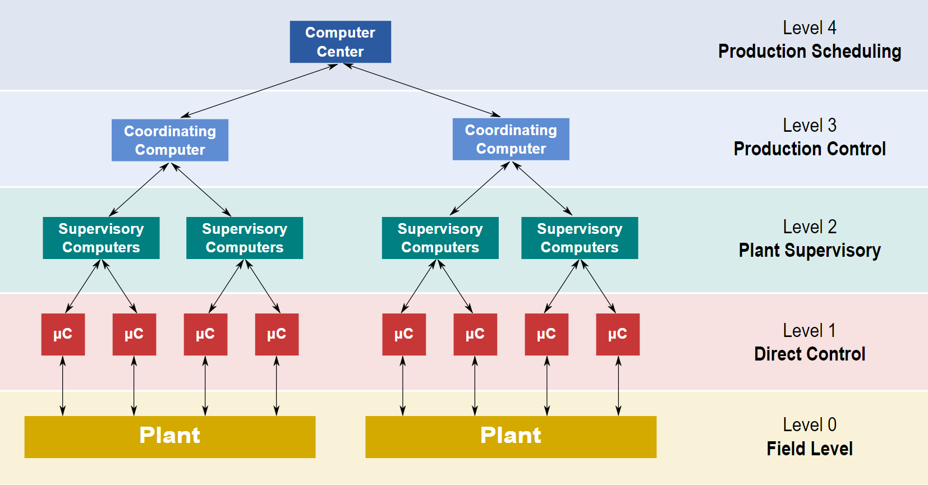
Distributed Control System
C:\Users\dwholmlu\Documents\GitHub\Industrial-IoT-Workshop\presentations
CC BY-SA 3.0
Notes:
Level 0 contains the field devices such as flow and temperature sensors, and final control elements, such as control valves
Level 1 contains the industrialised Input/Output (I/O) modules, and their associated distributed electronic processors.
Level 2 contains the supervisory computers, which collate information from processor nodes on the system, and provide the operator control screens.
Level 3 is the production control level, which does not directly control the process, but is concerned with monitoring production and monitoring targets
Level 4 is the production scheduling level.
Levels 1 and 2 are the functional levels of a traditional DCS, in which all equipment are part of an integrated system from a single manufacturer.
Levels 3 and 4 are not strictly process control in the traditional sense, but where production control and scheduling takes place.

Slide 11
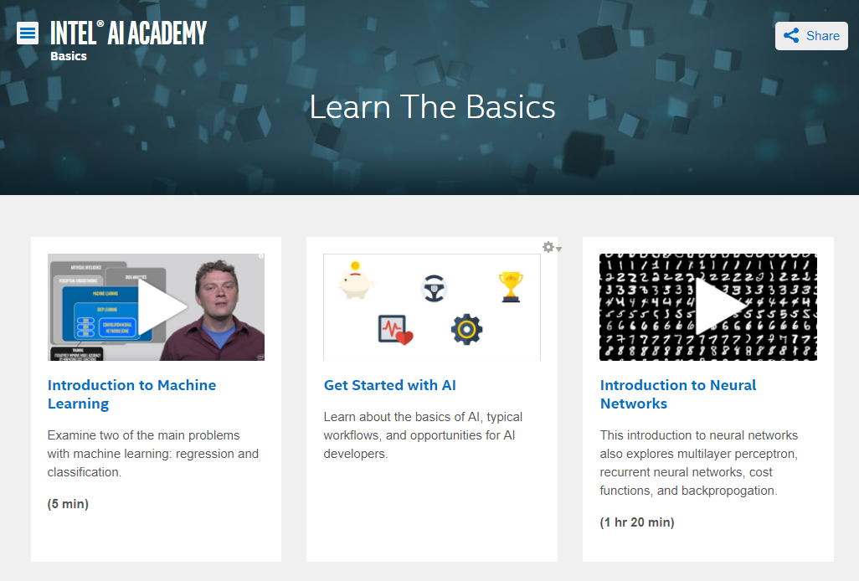
Intel Offers Software and Documentation for Machine Learning
https://software.intel.com/en-us/ai-academy/basics

Slide 12
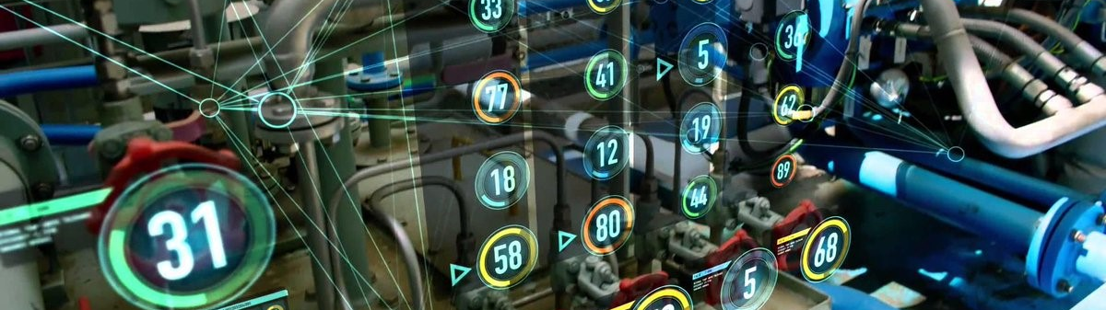
Creating a Rule Based System
Lamdba Functions, Serverless Architecture

Slide 13
Deployment of Automation Engine
Closed loop management is the ability of an IoT Edge Network to monitor sensors and automatically trigger actions based on predefined rules.
Intel IoT
Gateway
Things
Cloud
Security
Management
Data Processing
API Libraries, APIs, SDK
Security
Management
Data Processing
API Libraries, APIs, SDK
NodeJS Automation Engine
AngularJS Interface for Automation Engine
Network Infrastructure
No Internet Connectivity
Sensors publish values over MQTT-TLS service
Internet Connectivity
Actuators await commands via RESTful HTTPS
Copyright © 2016 Intel Corporation. All rights reserved.
Notes:
Shown here is the Intel® IoT Platform, with an overlay of a family of Intel products that seamlessly and security connect and manage devices, deliver trusted data to the cloud, and deliver value through analytics.
Intel offers a broad product portfolio for IoT and, looking forward, we are continuing to invest in the further integration and interoperability of our products looking. The product portfolio consists of the following product categories:
Intel® processors and Intel® IOT gateways
Connectivity
End to end security
Device Manageability
Data management and analytics
API management
Developer kits, tools and SDKs

Slide 14
Requirements of Automation Engine
Accessibility to a store which contains the business rules and policy actions for the IoT edge network. This is probably a database, but could be simple like a file or complex like a blockchain.
Subscribes to all sensor data traffic on the edge network
As sensor data arrives, all automation rules associated with that sensor have their predicate functions evaluated.
If the predicate function evaluates to True then the action function is run.

Slide 15
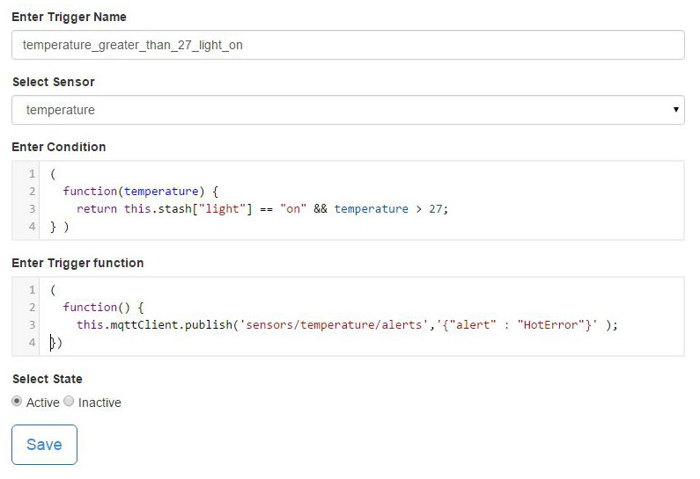
What is a Trigger?
A trigger is a predicate (condition) function and an action function that implements the rule based business logic on the edge network.
The predicate function returns a true or false, a “Go” or “No Go”
In our implementation, the stash always holds the last sensor reading from each sensor.

Slide 16
Device Triggers Actions
There are many possible events that an action function could trigger.
Write Data to the LCD screen
Restart the device
Execute an application
Run a script
Request data item from the device
Send an SMS messages to an administrator.
Send time synchronization
Send an alert to the cloud

Slide 17
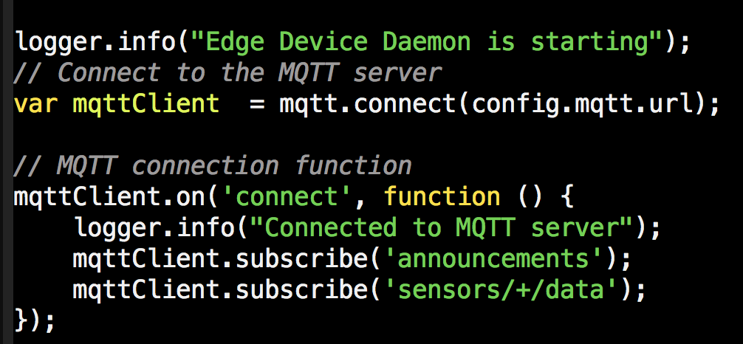
Creating a Connection to the MQTT Broker
A connection URI looks like mqtt://192.168.1.1/
NodeJS has a NPM package for MQTT.
var mqtt = require(‘mqtt’) will import the package
MQTT has an event driven loop that allows you to customize your response to different events.
On the Connect Event, we log that we connected and subscribe to the “announcement” topic
the “+” matches any string. We are subscribing to all sensors that publish data be subscribing to “sensors/+/data”

Slide 18
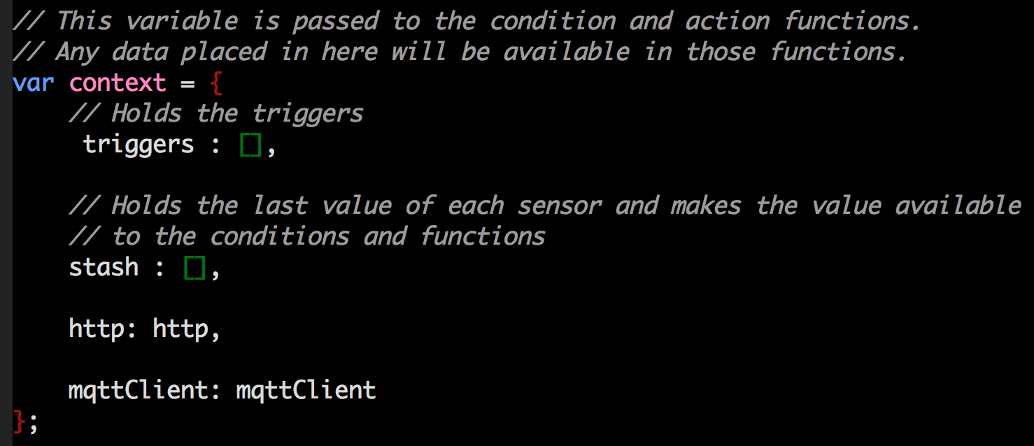
The Context Object
This object holds variables and libraries that will be made accessible to the condition and trigger functions.
If you want to use HTTP or MQTT in a trigger define them in the context object.

Slide 19
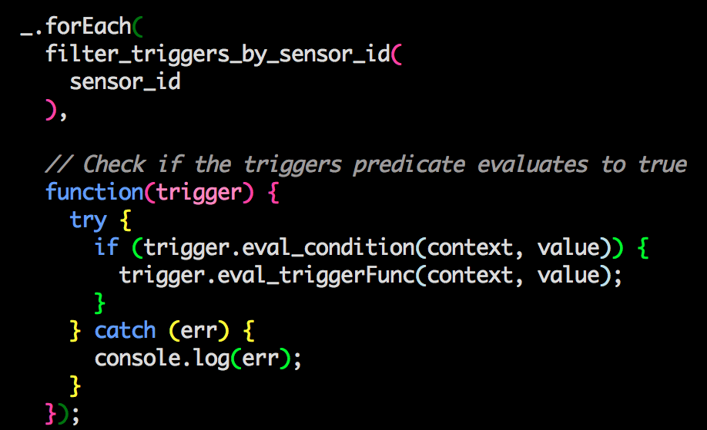
Rules Engines
For each incoming piece of data
filter the list of rules by the sensor that send the incoming data
and evaluate the condition function with the context
if it returns true then execute the trigger function

Slide 20
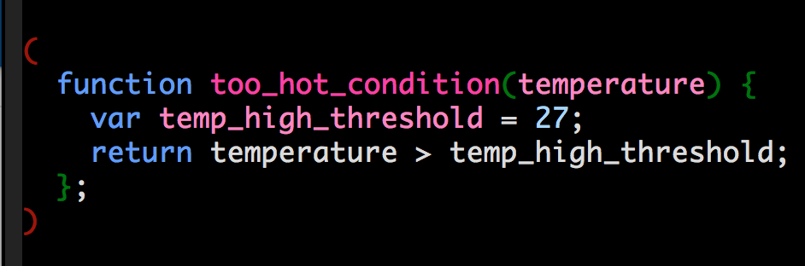
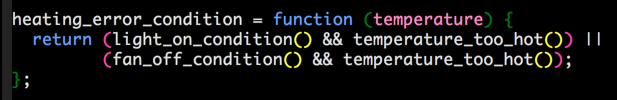
Condition Functions
Conditions Functions, also called predicate functions, always return TRUE or FALSE.

Slide 21
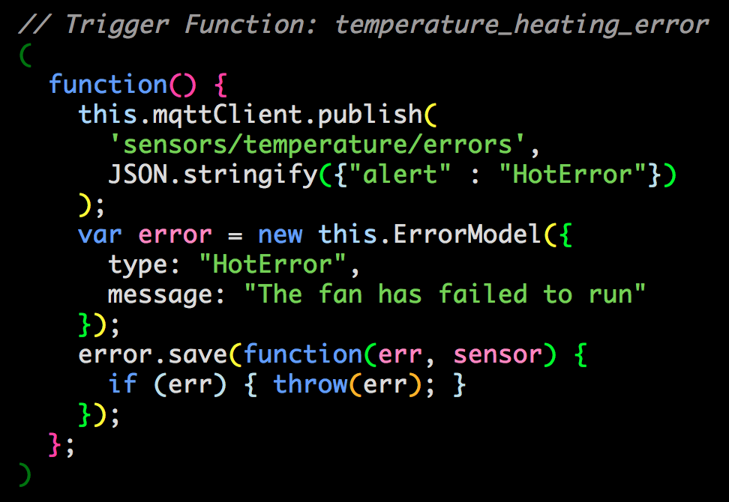
Example MQTT Trigger Function
Example Trigger Function
Publish an JSON error report to the MQTT topic sensors/temperature/errors
mqttClient and ErrorModel are part of the Context Object and now are accessible under the this object
Create a new MongoDB document called error.
Save error to the database
Be sure to put the parentheses around the entire function

