Slide 1

Sensors and Actuators
Industrial IoT
Software and Services Group
IoT Developer Relations, Intel

Slide 2
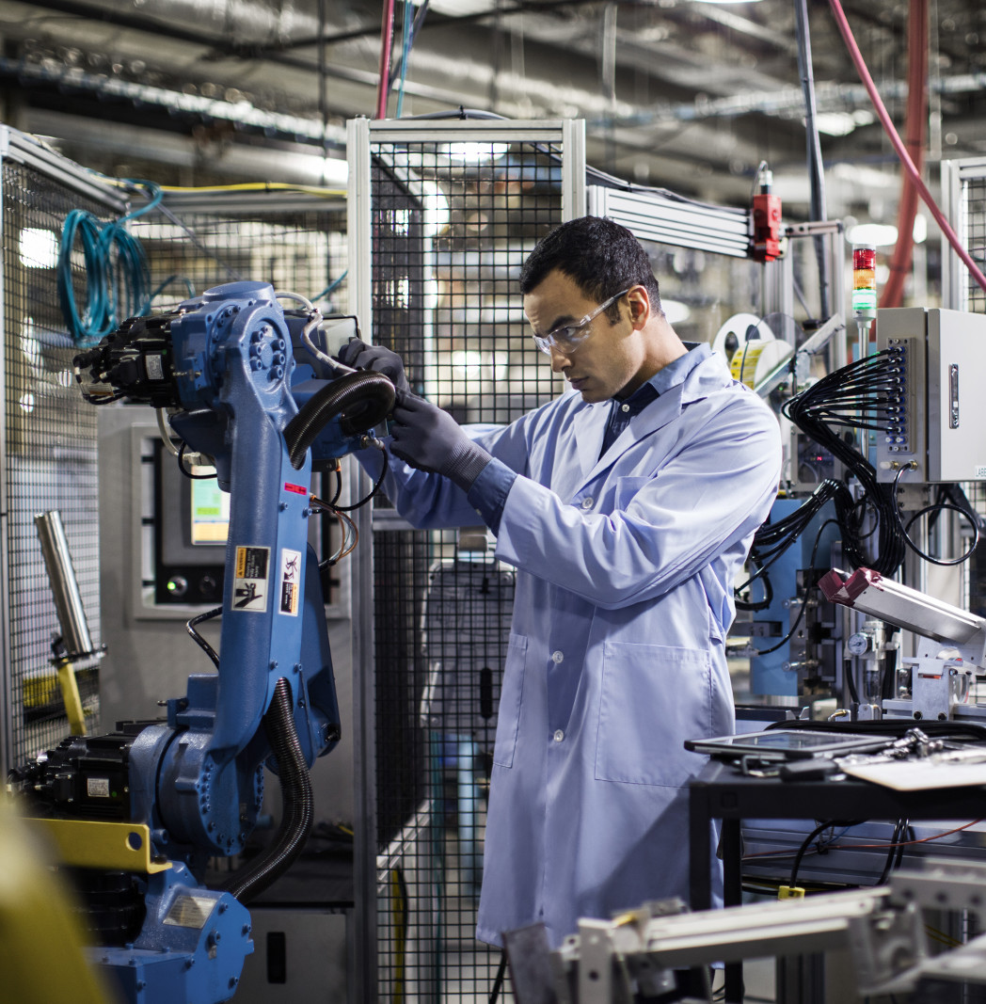
Cyber-Physical
Cyber-Physical Systems (CPS) are integrations of computation, networking, and physical processes.
Physical processes affect the computation model of the process and vice-versa.
The economic impact of cyber-physical systems is vastly greater than what has been realized. Major investments are being made worldwide to develop the technology.

Slide 3
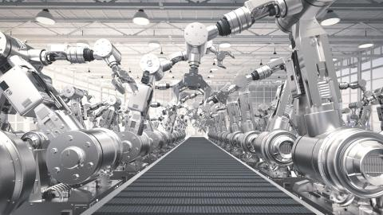
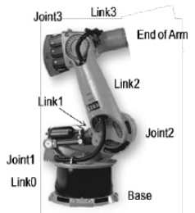
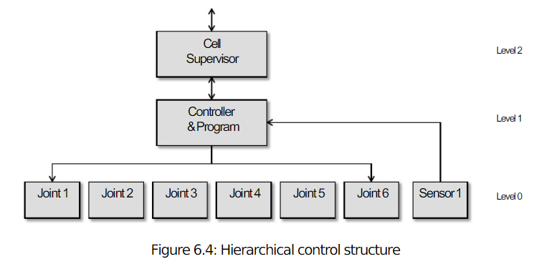
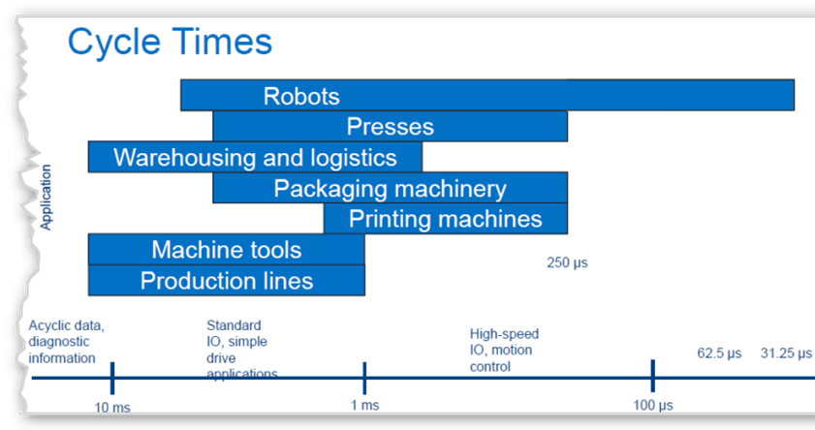

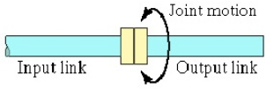
Sensing for Automation and Robotics
Microprocessor-based controllers are regularly used to perform robot joint movements control.
Typically the controller is organized in a hierarchical fashion:
Joint can loop-control data individually
Supervisory controller coordinating the combined actuations of the joints according to the loop-control of the robot program for given cycle-time.
Internal & External Sensors are used to monitor and control the various joints of the robot; they form a feedback control-loop with the robot controller.
Groover, M. P. (2008),
Automation, Production Systems, and Computer-Integrated Manufacturing, 3rd ed., Chapter 8
Notes:
The SCARA body-and-arm configuration typically does not use a separate wrist assembly; its usual operative environment is for insertion-type assembly operations where wrists joints are unnecessary. The other four body-and-arm configurations more-or-less follow the wrist-joint configuration given above, deploying various combinations of rotary joints type R and T
An example is outlined below: TLR : TR
Body-and-arm manipulator:
T = Twisting joint for joint 1;
L = Linear joint for joint 2;
R = Rotational joint for joint 3.
Wrist:
T = Twisting joint for joint 4;
R = Rotational joint for joint 5
The combination of drive system, sensors, and feedback control system determines the dynamic response characteristics of the manipulator. Speed in robotic terms refers to the absolute velocity of the manipulator at its end-of-arm.
Speed of response influence’s the robot’s cycle time, which in turn affects the production rate that can be achieved.
EXAMPLE: A robot performs a loading and unloading operation for a machine tool.
The work cycle consists of the following sequence of activities:
Robot reaches and picks part from incoming conveyor and loads into fixture on-machine tool. (Time=5.5 sec)
Machining cycle (automatic). (Time=33.0 sec)
Robot reaches in, retrieves part from machine tool, and deposits it onto outgoing conveyor. (Time=4.8 sec)
Move back to pickup position. (Time=1.7 sec)
The activities are performed sequentially as listed.
Every 30 work-parts, the cutting tools in the machine must be changed. This irregular cycle takes 3.0minutes to accomplish. The uptime efficiency of the robot is 97%; and the uptime efficiency of the machine tool is 98%, not including interruptions for tool changes. These two efficiencies are assumed not to overlap (i.e., if the robot breaks down, the cell will cease to operate, so the machine tool will not have the opportunity to break down; and vice versa).
Downtime results from electrical and mechanical malfunctions of the robot, machine tool, and fixture. Determine the hourly production rate, taking into account the lost time due to tool changes and the uptime efficiency.
Solution
Tc = 5.5 + 33.0 + 4.8 + 1.7 = 45 sec/cycle Tool change time
Ttc = 180 sec/30 pc = 6 sec/pc
Robot uptime E = 0.97, lost time = 0.03.
Machine tool uptime E = 0.98, lost time= 0.02.
These two inefficiencies are assumed not to overlap in the following solution.
Tc+ Ttc/30 = 45 + 6 = 51 sec = 0.85 min/pc
Rc= 60/0.85 = 70.59 pc/hr
Accounting for uptime efficiencies,
Rp= 70.59(1.0 0.03 0.02) = 67.06 pc/hr

Slide 4
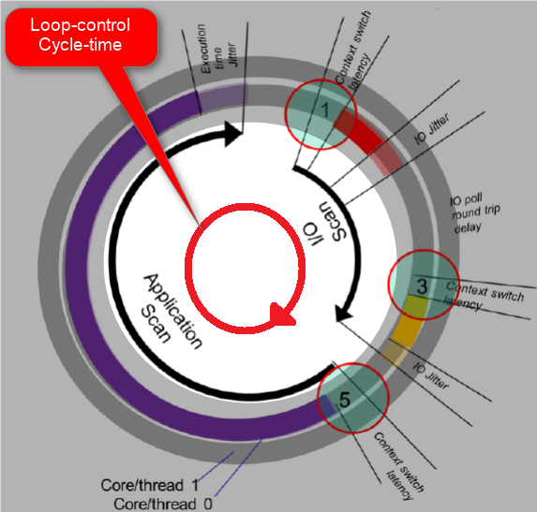
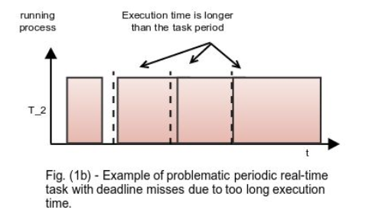
Sensing for Automation and Robotics
The combination of Drive system, Sensors, and Programmable Loop Controller (PLC) determines the dynamic response characteristics of the Industrial manipulator.
A Real-Time Guaranteed Deadline is defined by application problem domain, usually two components to a deadline :
The period is the interval at which events occur also called cycle-time.
The Maximum Latency is the largest time delay acceptable in servicing the event before causing a failure.
250us
Notes:
For our Robot example, the absolute velocity of the manipulator at its end-of-arm influence’s the cycle time, which in turn affects the production rate that can be achieved. Three factors may be examined :
Control resolution — ex: the capability of the robot’s positioning system to divide the range of the joint into closely spaced points, called addressable points, to which the joint can be moved by the controller.
Repeatability — ex: the measure of the robot’s ability to position its end-of-wrist at a previously taught point in the work volume.
Accuracy — ex: the robot’s ability to position its end-of-wrist at a desired location in the work volume.

Slide 5
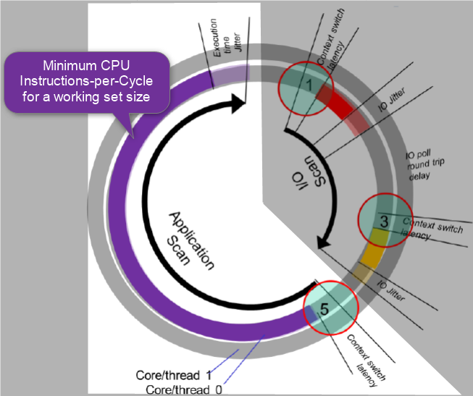
Sensing for Automation and Robotics
In Programmable Loop Controllers (PLC) program CPU execution three factors shall be examined :
WCET (Worst-Case Execution Time) — For reliable real-time systems understanding the worst case timing behavior of software is very important and critical to guaranty functional safety behavior.
Execution Jitter — Being early sometimes as bad as being late. The goal is to be On-Time.
Context Switch — The scheduling of RT-task introduce execution latency (interrupt latency + handler duration + scheduler latency + scheduler duration) that might become significant.

Slide 6
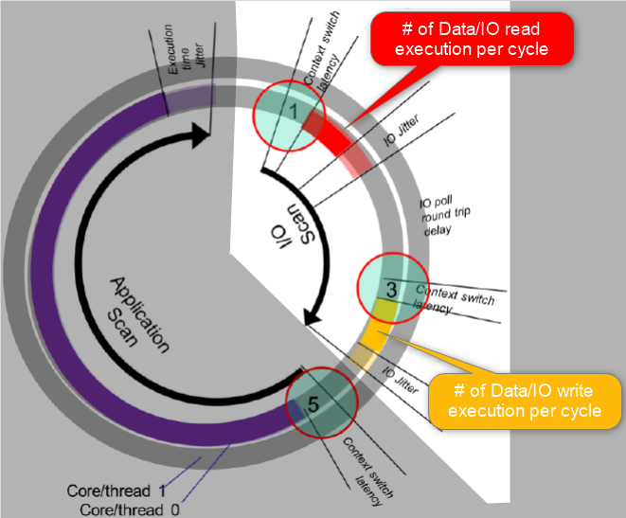
Sensing for Automation and Robotics
Three factors may be examined in Drive system and Sensors data acquisition program :
IO Latency (Guaranteed) — For reliable real-time systems understanding the worst case IO timing behavior of hardware is very important.
IO Jitter — Time-difference between Sensor (or Actuator) the minimal response time and the maximal response time.
Working set-size — Defined # of B/KB/MB per Read/Written every cycle.

Slide 7
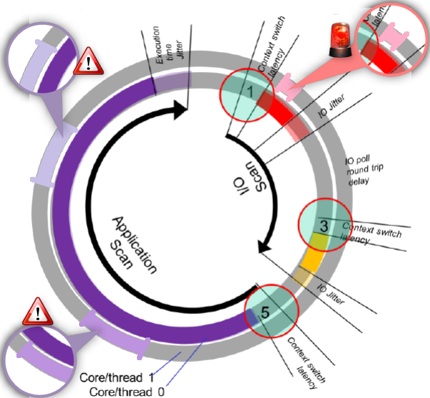
Sensing for Automation and Robotics
A Programmable Loop Controllers (PLC) program in Multicore CPU execution context require scalability :
Concurrent CPU Traffic (.e.g Noisy-Neighbors) CPU penalty is general concern that usually requires resource memory & cache isolation (cache misses or cache eviction,…) and Task-to-CPU affinity (load balancing avoidance) .
Concurrent IO Traffic Bus arbitration penalty is general concern that require resource isolation or affini

Slide 8
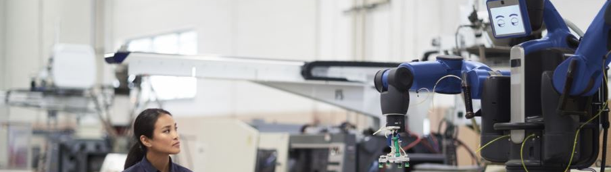
PROTOTYPING WITH Sensors and Actuators
https://software.intel.com/en-us/industrial-sensors-with-upm-support

Slide 9
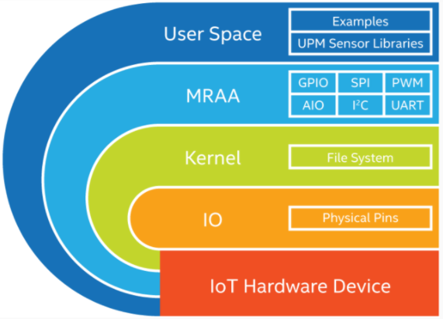
MRAA - An I/O Library for the Internet of Things
Provides I/O abstraction across both Intel and non-Intel (community added) MCU boards, UNIX boards and IoT Gateways.
X86
Minnowboard
NUC
UP2 Board
Intel® NUC
UP* and UP Squared*
Arduino* and Genuino* 101
ARM
Raspberry Pi
Banana Pi
Beaglebone Black
phyBOARD-Wega
96Boards
https://github.com/intel-iot-devkit/mraa

Slide 10
Introducing Intel IoT Device Libraries: MRAA and UPM
libmraa aka “MRAA”: https://github.com/intel-iot-devkit/mraa
Open Source IO Libs (UART, SPI, GPIO, I2C, AIO)
Provides higher level abstraction making hardware IO easier to use from userspace
Enables portability between devices
Supports Intel® Galileo and Intel® Edison boards, MinnowBoard MAX, etc.
UPM: https://github.com/intel-iot-devkit/upm
High level library repository of sensor drivers
Sensors/Actuators using libmraa
Making it easy to control
Expanding support to Industrial grade sensors
UPM and MRAA make it easy to build IoT projects!

Slide 11


























Making Sensors and Actuators Accessible
Support for Multiple Operating Systems
Support for Multiple Languages
Maker Sensors
Industrial Sensors

Slide 12
MRAA & UPM – Architecture
UPM Module
UPM Module
UPM Module
UPM Module
UPM C++ Interfaces
iTemp
iGyro
iCompass
iAccel
iMotor
iDisplay
iLoRaWAN
iLTEClient
Others …
iSensor
iActuator
iRadio
iio
UPM C generic interfaces
Mraa C/C++ APIs
Libmodbus
Bacnet
Others …
GPIO
i2c
SPI
UART
PWM
Linux Kernel

Slide 13
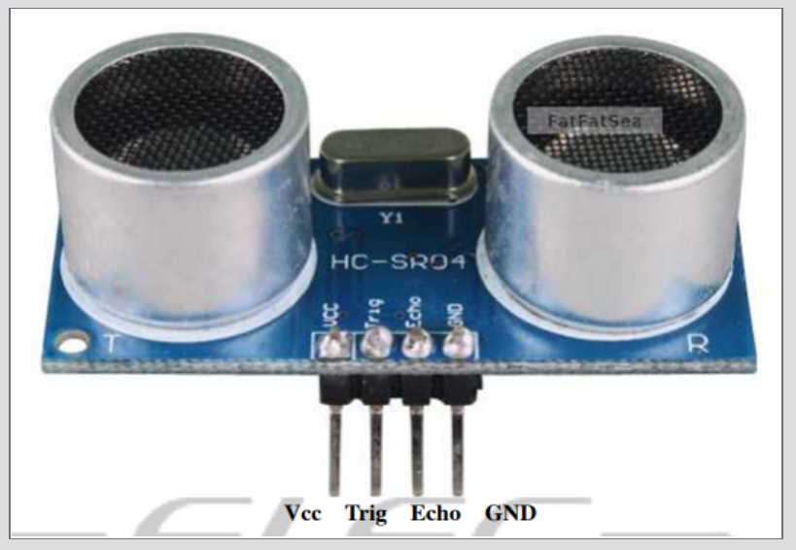
MRAA and UPM Benefit
Let’s see what kind of advantage MRAA, UPM brings sensor software development with Ultrasound Sensor example
GOTO: https://github.com/SSG-DRD-IOT/ultrasound_sensor (https://goo.gl/cbQmcH)

Slide 15
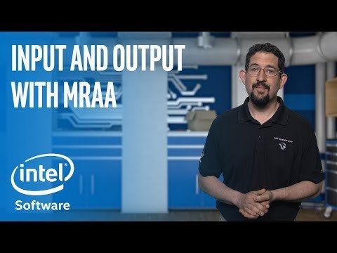
MRAA, UPM Introdction video

