Slide 1

Security
Industrial IoT
Software and Services Group
IoT Developer Relations, Intel

Slide 2
Security Is Critical
Connecting “things” to the Internet that have never been connected is valuable, but also introduces risk. - Source: McAfee Labs Q1 ‘14
46% | Increase in new malicious signed binaries
 | “The ability to attack will outpace the ability to defend.” —Rand Group
“
236 | New threats every minute, or almost four every seconds
 | "It takes 20 years to build a reputation and five minutes to ruin it. If you think about that, you'll do things differently.“ —Warren Buffet on Target Corp
“
49% | Growth in new threats attacking the master boot record and an all-time high for a single quarter

Slide 3





Protecting the execution, storage, and transfer of data
1
Security built into the hardware: Hardware integrity must be enforced to ensure the device has not been altered.
From the Field
A lack of security in implanted medical devices opens the door for malicious activity that could put patient health at risk.
Industrial devices, if tampered with, can leak sensitive operational data.
Hackers may breach retail devices to gain insight into sales patterns, change prices, or hide inventory.
2
Secures OS and applications: The gateway itself must have a secure operating system to ensure that data is safely stored.
3
Secures data from chip to cloud: Data must be transmitted securely from sensor to data center, even when one or more gateways must process it on the way.
4
Enabling ecosystem security: Standardized Intel solutions allow augmented security with third-party solutions.
Security and privacy are the top two inhibitors of the success of IoT deployments.
Recent survey of more than 450 IT and business leaders¹
Notes:
Talk about the IOT security factor.
Businesses looking to turn the IoT promise into bottom-line benefits face challenges. They must connect things to the cloud, integrate with existing infrastructure, and manage and analyze the data things generate—and it all needs to be secure.
Security is crucial as customers need to be able to trust the data they use to make critical decisions. The only way to do that is to secure the data through all parts of the data’s path from device to cloud.
Protect the device
Protect the application
Protect the data at rest and in flight
We call it end-to-end protection, and it’s Intel’s strategic security differentiator.
Intel IoT Gateway security solution suite not only protects the hardware, but also secures the applications and operation systems, and then extends security to the always-moving data streaming from the edge to the cloud.
Let’s take a closer look at some of the specific security solutions in each category: hardware, OS and apps, and data.
1. Strategy Analytics IoT 2015 Deployment and Usage Trends Survey: http://news.sys-con.com/node/3361862

Slide 4
Looking Ahead in 2018 – USGov IoT/Cyber Security
Protecting your own IT & OT Networks is critical for brand and security excellence
Cyberthreats by nation states, including Russia, China, Iran & N Korea lead threat assessment
DARPA has released several broad agency announcements (BAA/RFQ), seeking innovative IoT/Cyber solutions. 74 DARPA budget activities, totaling $856M¹ related to IOT and Cyber in 2018.
USGov funding IoT/Cybersecurity over $5B¹ in 2018 budgets.
Fastest BAA’s ever:
Urgent call for securing SCADA system at international waste water giant on US side of Mexico border is due Sep 29 (only $1M).
Anti-phishing BAA HR001117S0050 was posted 9/11, abstract due 9/19 and bid 11/9. Bid must include best practices in bots & whitelisting, AI for zero day and for honey pots to collect attacker info .
1. Per Bloomberg Gov Analyst, at IoT/CyberSecurity Summit Sep 27.

Slide 5

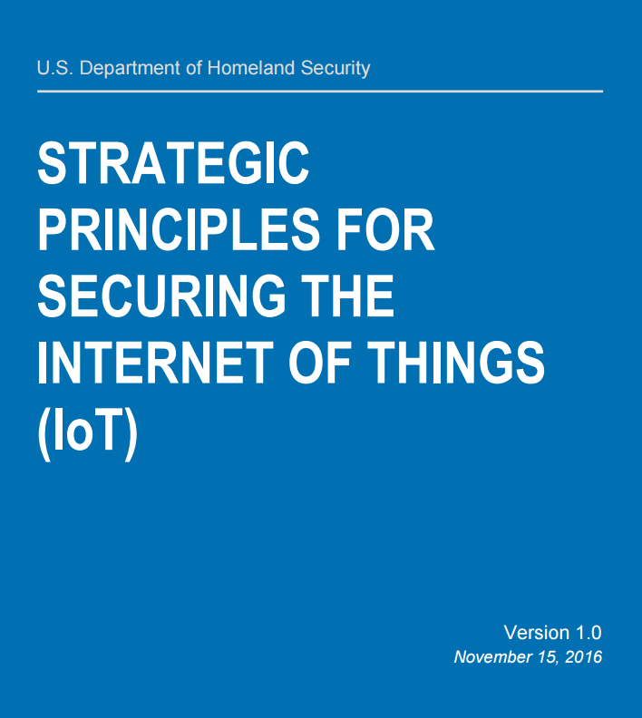
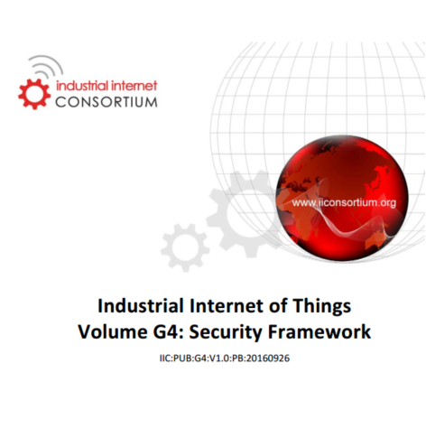







IoT Security Is Essential to Scale IoT Deployments
HW Security is an IOT Priority
New Specs
Customer Requirement
Barrier to IoT Adoption*
Most Important Items for IOT Platform*
RFP
Hackers exploiting poor device security
Isolation & added protections of HW security has recognized role
Pattern to secure & role of HW is defined
HW security moving from shadows to key RFP request
Security solutions Designed-in to HW are keys to accelerating adoption and scale
*Gartner 2016 IoT Backbone Survey
*Trusted Computing Group: What Embedded and IoT Developers Think About IoT Security
Notes:
IOT security can be a major barrier or accelerator to scale IoT deployments. Today Gartner highlights that security is the #1 barrier to IoT adoption and the industry is recognizing the unique role HW security can play. The role of HW security and how to implement is not a mystery, the government and consortia like the IIC have defined the best practice patterns for how HW security should be applied. Intel security architects where heavily involved with this the crafting of the IIC Security Frameworks.
From a customer perspective, we are seeing their security teams engaging on RFPs to add security requirements and use cases as a priority. In many cases, customers go through a POC to prove out a use case but security gets added when they gear up to deploy at scale into production. This is where the reality of security needs and challenges arise to move to SCALE.
IIC Security Frameworks
https://www.iiconsortium.org/pdf/IIC_PUB_G4_V1.00_PB.pdf

Slide 6
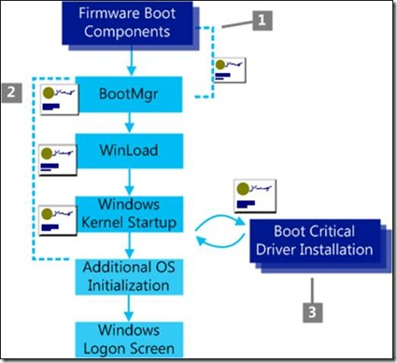
Protected Boot types
Windows Secure Verified Boot Process
Root of Trust
A set of hardware, firmware, and/or software that is inherently trusted to perform a vital security function (NIST Definition)
through Secure Boot/UEFI Secure Boot
BIOS security standard that prevents use of unauthorized option ROMs, and ensures the next stage of the boot is “authorized
Secure Boot
Boot process where each stage of the boot is cryptographically verified by the previous stage; a failure in the any verification causes the boot to fail.
Measured Boot
Boot process where each stage of the boot is measured, usually by a cryptographic hash, and the measurements are stored for later comparison to known good values.”.
http://blogs.msdn.com/b/olivnie/archive/2013/01/09/windows-8-trusted-boot-secure-boot-measured-boot.aspx
Notes:
There are two primary types of protect boot: Verified Boot and Measured Boot. Protected boot checks that platform is booted with code that is trustworthy.
Protected boot depends on a Root of Trust. A RoT is something on the platform that is inherently trusted – normally this includes both some code or a secret. A RoT is considered strong when its code and secret is difficult or impossible to change. Thus a hardware root of trust is better than a software or firmware root of trust, but both types can be used. Examples of a RoT include a hardware ROM and a cryptographic key in hardware fuses. Another example is boot code in a locked flash block along with a cryptographic key in one-time-programmable (OTP) flash memory.
RoT can be used for more than just protected boot, and we will discuss that in some future slides, but on this slide we will concentrate on boot.
So how is the RoT used provide protected boot? Since we inherently trust the RoT, we ensure the RoT code is the first thing that is executed, and we use it check a cryptographic signature on our other boot components – like the boot loader and operating system kernel.
Now I said that there are two types of protected boot.
Verified boot is a type of protected boot that cryptographically verifies each part of the boot process before it is run, and prevents anything from running that is not properly signed by the key. The RoT is run first, and it checks “Part A”. Then “Part A” is allowed to run, and it checks “Part B” before it passes control over to “Part B”. This continues through as many different parts of the boot as needed. The picture here on the slide shows protected boot. The Firmware is our ROT and it contains a public key. The Firmware checks the boot manager was singed by this key, and if it was, it passes control to the Boot Manager. The boot Manager contains another key – which is now considered trusted because it was checked by the firmware RoT. The boot Manager checks the Windows Loader with it’s key, and if it passes the signature check, it passes control. This continues for each component. If at any time, a signature check fails, then the boot is halted. This prevents any code that was not properly signed by a valid cryptographic key from running on the platform.
Measured boot is similar, but instead of checking code and stopping the boot process, all measured boot does it measure a cryptographic hash of the code that is going to be run. These measurements are stored in a protected storage location called the Platform Configuration Registers or PCRs. The benefit of measured boot over verified boot is that unless the software on the platform is completely corrupted so that it cannot run, the platform will boot. The measurements allow you to later query the PCRs to determine if the software that was executed was indeed trustworthy, but it does not prevent untrustworthy or maliciously modified code from runnging on the platform.
UEFI Secure boot is a type of verified boot that is standardized for BIOS, and is used in Intel’s secure platforms.

Slide 7
Intel® Platform Trust Technology: Protected Storage
Intel® PTT is a hardware TPM 2.0 implementation for credential storage and key management across Atom, Core and Xeon. Benefits:
A secure trust element to meet requirements for TPM 2.0 and Measured Boot for systems on which TPM 2.0 is required.
Integrated solution
Compliance with: TCG specifications, TPM Profile commands, EK cert provisioning, ECC, SHA2, Windows 10 requirements
Protects: anti-replay, dictionary attack
Key protection technology for distributed HW Security Module (HSM)
Reduction in BOM cost and board savings as compared to a discrete TPM, or use with a Discrete TPM (for geo or vendor-specific)
This is have existing installations can perform TE
Notes:
https://www.intel.in/content/www/in/en/data-center-efficiency/enterprise-security-platform-trust-technology-white-paper.html
https://rd.springer.com/content/pdf/10.1007%2F978-1-4302-6572-6_7.pdf 2014 so dated, but chapter 7 on PTT

Slide 8
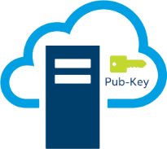
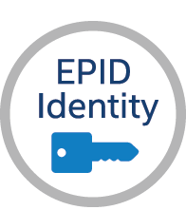

Hardware Identity management
Prevents Attack Mapping- Protects device data vs PKI that reveals data to hack device
Baseline Minimum
HW Root of Trust
Intel® Enhanced Privacy ID (Intel ® EPID)
TCG/ISO standard with privacy preserving group authentication scheme
Used to authenticate & open secure, authenticated channel for remote attestation
Proven- 2.5 Billion keys fused into Intel processors since 2008. Intel® Xeon®, Intel® Core™, & Intel® Atom™
Open source SDK
Used by Intel solutions- SGX, DRM, IPT, Intel® Secure Device Onboard
EPID vs. PKI
Intel® EPID
Traditional PKI
Secure App
Container “TEE”
Attest SW
HW Identity
1-to-many key match, unique signature every time, anonymous
1-to-1 key match, standard signature every time
Pvt-Key 1
Pvt-Key 2
…
Pvt-Key X
Pvt-Key
Enables Customers to deliver many use cases where privacy & attestation are key requirements

Slide 9




Designed in Security Foundation SW Identification – for Device “Health” Attestation
Trusted Platform Module (TPM) - on chip firmware to safely store credentials or (PCR) platform configuration registry values. Intel® Platform Trust Technology (Intel® PTT)
Baseline Minimum
HW Root of Trust
Protected Boot – platform dependent capabilities to ensure firmware & OS are running trustworthy configuration
Secure App
Container “TEE”
Attest SW
Stored Image
Actual Image
HW Identity
Remote Attestation - ”best.” send both boot and app measurements to 3rd party that verifies device stack running is equal to predefined Trusted Configuration
White Listing - ”best.” allowable agents/applications for that specific device- Intel helps manage ecosystem solutions
vs
=
SW Stack
Enables Core Security capabilities available during lifetime
Utilization of “Health” Services through Device Management Platforms

Slide 10


Designed in Security Foundation 5. Trusted Execution Technology (TXT) & Security Engines
Baseline Minimum
HW Root of Trust
Crypto – random # generator to create secure keys or apply message encryption - Intel® Secure Key, Intel® Advanced Encryption Standard New Instructions (Intel® AES NI)
Trusted Execution Environment (TEE) – physical/logical separated processing. Only Intel signed apps run. Stored data sealed in protected memory- Intel® Software Guard Extensions ( SGX), engines- Intel® Dynamic Application Loader applets
Usages - secures keys for device comms, attestation, & authentication. Enables ISVs to provision & run app containers protected by hardware. Enforce code IP protection “DRM”
2
Main CPU
OS & Untrusted Apps
Secure App
Container “TEE”
Attest SW
HW Identity
Hardware SP800-90 B & C ENRNG
1
Trusted Execution Environment
Protects – data, code, EPID or other keys
SNOOP
Intel delivers simple means to run multiple apps in our TEEs
Lowers BOM costs & increases performance by using on chip vs discrete security co-processors
Notes:
Talk about the TXT before EPID and SDO

Slide 11
HW Features for Data Protection
Hardware Entropy Source
AES Hardware Acceleration with AES-NI
Data Protection with Cryptographic Acceleration
AES-NI allows significant performance at a lower price point, no custom hardware.
Hardware DRNG
Better Encryption Keys and Simulations with On-Board Digital Random Number Generator
Solves the problems of limited entropy in virtual platforms
Nondeterministic Random Numbers
Hardware AES-CBC-MAC
High Quality Seeds for Pseudo-Random Generation
Hardware SP800A AED CTR Based DRNG
Hardware SP800-90 B & C ENRNG
Cryptographically Secure Random Numbers
Cryptographically Secure Random S
Functions meet NIST SP800-90A, B & C: improving encryption of full disk, data at rest, in transit or transaction and app-level granularity
https://software.intel.com/en-us/articles/intel-digital-random-number-generator-drng-software-implementation-guide
https://csrc.nist.gov/publications/detail/sp/800-90a/archive/2012-01-23

Slide 12
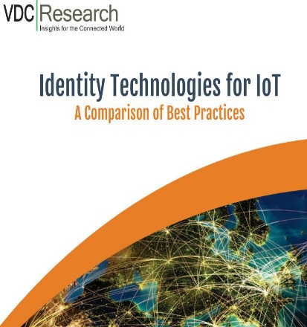
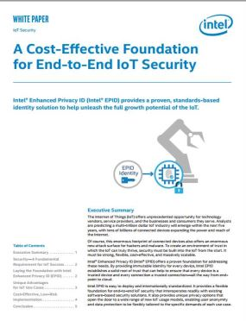
EPID Comparison & whitepapers
 | Key Strength | Provisioning | Key Distribution | Trust Model | Privacy | Scalability | Static vs. Dynamic | HWROT
X509 RSA | 80-112 RSA | SW | TLS | HW + SW |  | 1/Device | S | N
X509 ECDH | 128-192 | HW/FW | TLS (ATTEST depends on HW) | HW |  | 1/Device | S | Y
E-SIM Card | Variable 80-192 | FW | TLS/IKE | HW + SW |  | 1/SIM | S | Y
DICE | 128-192 | FW | ATTEST | HW + SW |  | 1/Device | S | Y
EPID 2.0 | 128 ECC | HW | ATTEST | HW |  | 1/Group= millions | Dyn | Y
Best practice for privacy oriented use cases like IoT device onboarding
Post EPID authentication can swap for traditional PKI key
Complementary to use in conjunction with other traditional PKI keys
Post EPID authentication can swap for known identity
* www.intel.com/content/dam/www/public/us/en/documents/white-papers/iot-identity-comparison-white-paper-vdc-research.pdf
www.intel.com/content/dam/www/public/us/en/documents/white-papers/intel-epid-white-paper.pdf
* EPID Whitepaper

Slide 13
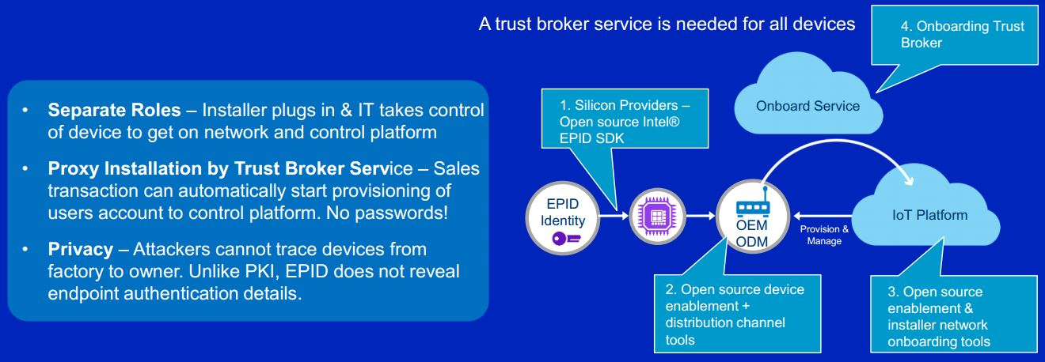
Intel® Secure Device Onboard – Zero Touch Service
Solves major pain point in securely deploying IoT “things”
Manual deployment, staging, & OEM pre-loads are not optimal and causing deployment delays
Hardware root of trust EPID based service for “0” touch device onboarding
Tremendous ROI for customers & ecosystem
Scale’s POCs to production. Increases number of devices in use
Notes:
Source: www.rsaconference.com/writable/presentations/file_upload/spo2-r10_zero-touch-device-onboarding-to-iot-control-platforms.pdf

Slide 14

Intel® SDO - Zero Touch Concept & Components
Onboarding Service
“Rendezvous, not authentication Service”
IoT Platform
Service Provider
Supplier
Silicon Providers - EPID SDK
Initial Device Identification
(EPID Attestation)
ONBOARD
TB Service Identification
Platform Registration Service
Ownership Proxy
Device
TEE
2
1
TrustBrokerage API
ATTEST
3
EPID SDK
TB
Client
New Owner
Take Ownership
CSP/ISV Toolkit - integrate MP API into their IoT Platform
Mgr Agent
4
Platform Manager Service
OEM Development Toolkit - board and gateways - integrate TB client software into their boot code
Device securely on-boarded → under Normal Platform Control
Notes:
Source: www.rsaconference.com/writable/presentations/file_upload/spo2-r10_zero-touch-device-onboarding-to-iot-control-platforms.pdf
Here we present a view of the major integration points and tools for the ecosystem. We see where each SDK or tool is integrated into the existing ecosystem systems. Finally the steps mirror how the Intel supplied software & HW identity components interact during the onboarding sequence.

Slide 15
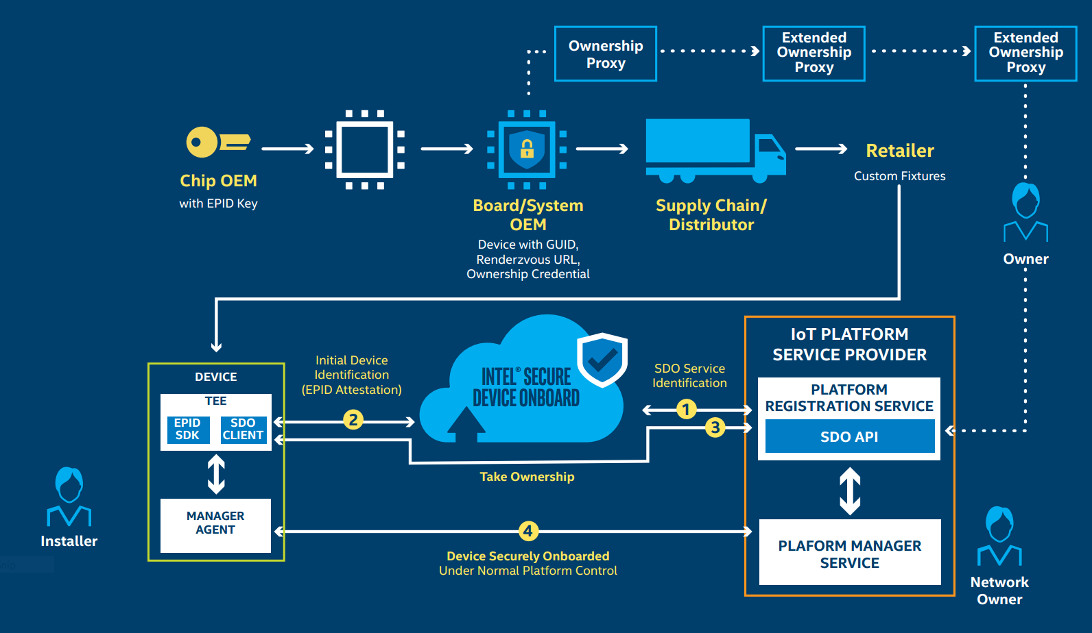
Intel® SDO - Use Case Flow

Slide 16




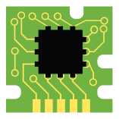







Intel® SDO - Zero Touch Use Case Flow
(fab)
(a)
(b)
(c)
(d—Ownership Transfer)
Owner C
Owner B
Owner B
IoT Platform Device Management Service
EPID
Identity
Owner A
g=123
Owner A
g=123
Owner A
g=123
Datacenter
GUID, ZT URL
Ownership Credential
I manage Guid 123. I’m available at this IP: 11.11.11.11
Here is my Ownership Proxy, I am Owner for GUID 123
Intel Onboard Service
Silicon
Provider
TEE
OEM/ODM
Board/Device
Here is my EPID signature, Device GUID=123
Distributor/ Reseller
Online Retailer
Try 11.11.11.11.
123
Hi, I am 123. Where is my management service?
GUID 123
Office Install
Power On, Phone Home, Securely Onboarded
<1 min/device, anonymous rendezvous, 2-way trust channel, enterprise scaling
Notes:
Source: www.rsaconference.com/writable/presentations/file_upload/spo2-r10_zero-touch-device-onboarding-to-iot-control-platforms.pdf
Fab) EPID Identity is stored in the trusted execution environment of the processor
Board-level mfg stores GUID + public key in device. PubKey is the base of a chain of signatures that establishes device ownership. Device is powered off and placed in box.
Distribution chain members extend signature chain with their own keys
Each extends the chain
Eventual Owner rendezvous with device at Intel ZT Broker Service (Device discovers Owner’s IP address). Device and Owner prove themselves to each other. Owner can then configure device to speak to Owner’s NOC, download software, keys, etc.

Slide 17
Lab

