Slide 1
Intel IoT Developer Products and Program Accelerating IoT Solution Design and Deployment
Core and Visual Computing Group, Intel®

Slide 2
Legal Notices and Disclaimers
Intel technologies’ features and benefits depend on system configuration and may require enabled hardware, software or service activation. Performance varies depending on system configuration. No computer system can be absolutely secure. Check with your system manufacturer or retailer or learn more at www.intel.com.
This document contains information on products, services and/or processes in development. All information provided here is subject to change without notice. Contact your Intel representative to obtain the latest forecast, schedule, specifications and roadmaps.
Any forecasts of goods and services needed for Intel’s operations are provided for discussion purposes only. Intel will have no liability to make any purchase in connection with forecasts published in this document.
ARDUINO 101 and the ARDUINO infinity logo are trademarks or registered trademarks of Arduino, LLC.
Intel, the Intel logo, Intel Inside, the Intel Inside logo, OpenVINO, Intel Atom, Celeron, Intel Core, and Intel Movidius Myriad 2 are trademarks of Intel Corporation or its subsidiaries in the U.S. and/or other countries.
*Other names and brands may be claimed as the property of others.
Copyright 2018 Intel Corporation.
2

Slide 3
Enabling New Developer Opportunities
ACCESS TO KNOWLEDGE
ACCELERATED PROTOTYPING
DEFINE
What Intel Brings
OPTIMIZE
Common and seamless Developer experience
Start to finish technologies for robust solutions
Simplified path to develop and deploy products, systems, solutions
Reusability, extensibility, portability, future proof
The Developer’s Journey
Technology
EVALUATE
STREAMLINED
DEVELOPMENT
Developer Experience
Future Trends
DEVELOP
POWERFUL FOUNDATION OF IOT INGREDIENTS
MANAGE
DEPLOY
FAST DEPLOYMENTS
Real world start to finish relevant technologies for robust solutions
Simplified path to develop and deploy products, systems, solutions
Reusability, extensibility, portability
Notes:
Key Message: Intel creates new opportunities in the IoT developer journey, by leveraging deep understanding of IoT, in-house design/development expertise, silicon and software products, and strong ecosystem relationships to accelerate IoT architecting, development, and deployment.
Time is of the essence for IoT developers. Learning, evaluating, selecting, prototyping, and integrating takes time that the developer cannot afford in order to stay competitive.
Intel is working to accelerate and simplify the IoT developer experience in order to speed time to proofs of concept and help bring solutions to market faster that are designed to meet customer needs over long-term deployments.
From definition through evaluation of ingredients, technologies, and architectures, Intel offers tools, technologies, and proven developer kits with amazing out-of-box experiences to get you prototyping quickly.
Intel’s enablement in the developer journey is driven by our developer program that requires tools to be useful and proven, provide multiple points of entry along the developer journey, and designed to deliver more than just functionality. For our kits and tools, we provide documentation, a web portal, API references, robust code samples and tutorials, and paths to integration.

Slide 4

Delivering a Unified, Seamless IoT Developer Experience
DEEP INVESTMENT
in understanding, addressing IoT developer challenges
ACCELERATING
the development process
AMAZING
out-of-box experiences
simplified
for ease of use, consistency, and compatibility
Notes:
Key Message: Intel’s investment in the IoT developer experience to simplify and accelerate the journey.
The IoT solution architect and developer integrate across multiple technologies, devices and drivers, software, silicon, and form factors to create robust, scalable solutions at the edge. They face many challenges due to the volume, variety, and velocity of data being generated, security and protection requirements, costs to move data, and other issues as they are under pressure to deliver innovative solutions to stay competitive.
Intel has invested deeply over the years to help solve IoT developer challenges in order to accelerate the development and deployment processes. This has resulted in creating purpose-built silicon, IDEs, software tools—such as software development kits, libraries, optimized AI frameworks, and sample code—along with reference designs, support, and other resources to accelerate development of scalable solution designs on the rich and diverse portfolio of Intel silicon. Working through its strong ecosystem relationships, Intel has brought many of these resources into fully supported developer kits with proven out-of-box experiences to help make the journey from architecting to prototype smooth and seamless.
Working with a diverse and capable ecosystem to supply the kits allows fast migration from development to deployment of solutions that support applications for today and the future.
The kits offer amazing out-of-box experiences that were tested with developers across various service providers. Often, developers were up and running, creating solutions from sample code in 30 minutes or less. The developer kits are readily available from various ecosystem partners to get you started immediately creating innovative IoT solutions.
Intel’s investment in supporting and enabling IoT developers creates a unified and seamless experience as they work across a vast design domain.

Slide 5
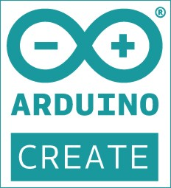
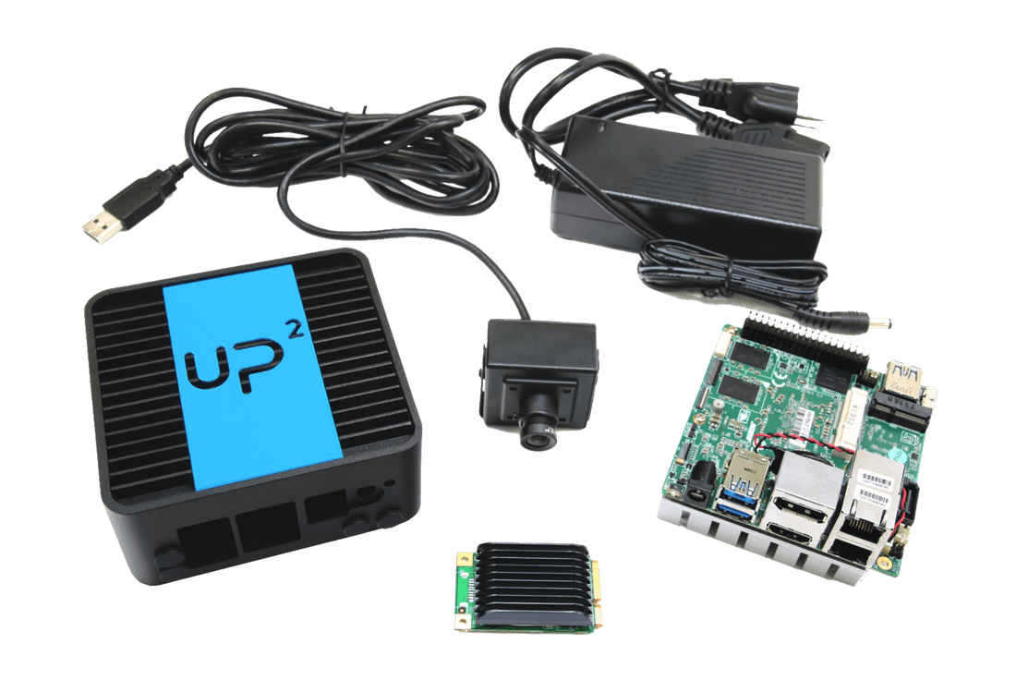
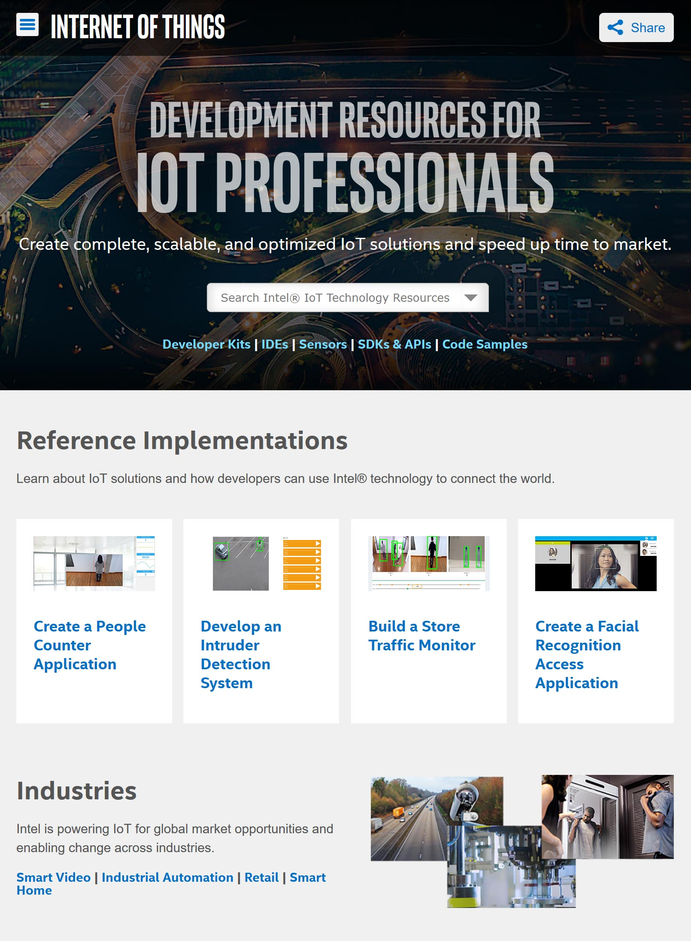
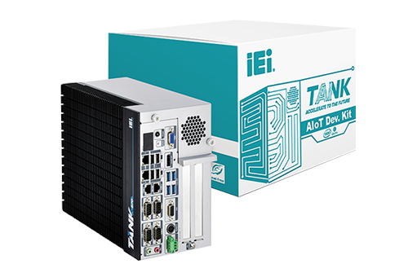
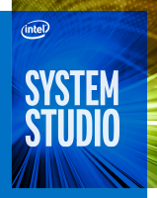
Comprehensive portfolio of developer resources
ToolS
KITS
SDKS
INTEL DEVELOPER ZONE
OpenVINO™ Toolkit
Intel® Media SDK and
Intel® Media Server Studio
Intel® SDK for OpenCL™ Applications
Intel® Active Management
Technology (AMT)
mRAA/UPM
Notes:
Key Message: Describe the comprehensive range of offerings to help accelreate IoT development and deployment.
Flexibility of kits and software.
Portfolio of kits available from Intel.
Message to ODM – you too can be a kit providers.
Message to OEM – you have choices to accelerate your developer journey.
Intel has created a rich environment to accelerate design and deployment of scalable IoT solutions with choices of Integrated Development Environments for both prototyping and production deployment, developer kits with all the needed resources to quickly start creating and innovating on Intel silicon, software development kits for optimizing code and speeding the coding process, and a focused portal where you can interact with experts and peers to get answers you need.
By bringing together these critical resources and tools, you can focus on innovative solutions and your designs instead of building, troubleshooting, and validating a workable environment that lets you effectively compete in a growing market.

Slide 6
Fast Prototyping and Rich Optimization with Choice of Tools
Rapid Prototyping
Cloud-Based developer environment
Easy Out of Box Experience
Supports Intel based platforms running Linux
For Production and Performance Optimization
Easy Migration From Arduino Create*
Integrates Analyzers and Debug Tools
Leverages Sample Codes in the Kit
Notes:
Key Message: Choice of IDEs to match the prototyping and development needs.
One IDE does not fit all developers and environments. So, the Intel developer kits offer you choices.
You can quickly prototype in the cloud with Arduino Create* and then optimize your solution with Intel® System Studio. Or start with Intel System Studio and immediately take advantage of the powerful coding resources in Intel’s IDE. And, if you prototype with Arduino Create, there is an easy and fast migration process to bring your code into Intel System Studio without time consuming recoding and cleanup.
Arduino Create allows fast and easy prototyping in the cloud using Intel silicon. There’s probably no faster environment to begin your solution prototyping. The platform and the developer kit provide all the resources to get you prototyping and testing your ideas immediately instead of building your environment. Once you’ve proven your design, you can easily take your code into Intel System Studio.
Intel System Studio is an all-in-one, cross-platform, comprehensive tool suite for IoT device application development. It helps system engineers and developers shorten the development cycle so products can be brought to market faster, boost performance and power efficiency, and strengthen reliability for intelligent systems and IoT device applications running on Intel® processor-based platforms.

Slide 7
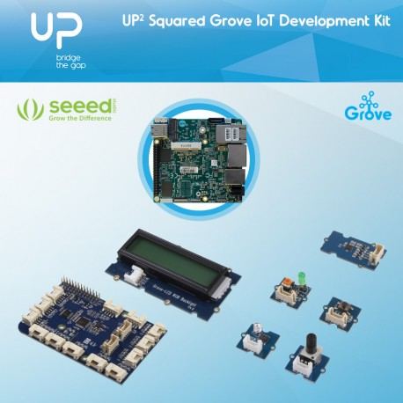


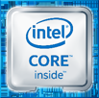
Developer Kits Accelerate Design of Innovative Solutions
UP2 grove IoT development Kit
UP2 AI Vision development Kit
iEi TANK aIot Development Kit
Versatile, broad prototype application
Traditional computer vision – Non-inference based training/learning
Basic essential components
Light computer vision/deep learning applications (1-2 cameras)
Conceptualization and early CV prototype development
Optional accelerator options
Demanding computer vision/deep learning applications (multi-camera environments)
Commercial production ready development
Built-in scaled support for complex/parallel video streams
Reduced time to prototype, expedite path to productization, and designed for scalability and extensibility
All kits include the start-up essentials for a bootable development environment
Notes:
Key Message: Developer Kits provide the environment, tools, and ingredients to get you started quickly.
Developer kits are the results of our strong ecosystem enablement goals to help accelerate the development process from concept to architecture to prototype to design and deployment. Developer kits include hardware, software, drivers, SDKs, and other tools to help developers hit the ground running. Kits are designed for an easy out-of-box experience. We are continuing to develop more kits to meet the needs across multiple application domains using Intel® silicon.
Computer Vision Kits: AI Computer Vision Developer Kits provide bootable prototyping environments with everything you need to get to work quickly, whether your solution requires light or heavy computing and AI inferencing at the edge. Kits are available from our ecosystem partners, who will help you bring your solution to production.
All kits include a pre-installed custom Ubuntu* Desktop OS, integrated Arduino Create* and Intel® System Studio IDEs, sample codes and reference designs, integrated I/O, sensor, and other libraries. All you need is your innovative ideas, a keyboard, mouse, and monitor.
You can choose from different kits from various suppliers with a range of Intel silicon to meet your edge computing needs and production plans. The kit processors offer robust graphics and media performance to accommodate different levels of computer vision applications. Optimized image processing and video analytics create opportunities for vertical IoT applications. Accelerator options are available or included with the kits.
For applications that require lighter computing, such as one or two cameras, Aaeon* offers the UP-squared AI Vision Developer Kit with the Intel Atom® x7-3950 processor, Intel® HD Graphics Gen 9, and an included Intel® Movidius™ Myriad™ 2 Vision Processing Unit plug-in accelerator. For consolidated computer vision applications of multiple cameras and inferencing, iEi offers the TANK AIoT Developer kit with a choice of 6th Gen Intel® Core™ i5 or i7 processor and Intel® HD Graphics 530 GPU in a 2-slot or 4-slot ruggedized, industrial-grade chassis. An Intel Movidius Myriad 2 VPU accelerator stick is available as an option.
Kit manufacturers offer a quick path to production hardware to meet the performance and scalability needs of your design, so you can go into production ready for future functionality without having to replace the hardware. Production solutions are optimized for a wide array of industrial applications. You also have ready access to over 400 sensor drivers with MRAA* and UPM* library compatibility. Intel and our ecosystem partners provide industry-level and back-end product support.
Testimonial – Intel Atom® Processor-based Dev Kit:
"This is one of the smoothest setup processes from an Intel solution I have done. The instructions are very detailed and exact on what to do”
- P9, implementer
Testimonials – Intel® CoreTM Processor-based Dev Kit:
“I want to leverage the foundational kits for our customer engagements, I like the direction you are going with these”
-Craig Owen SMG
“A definite improvement over previous Intel products, which I heard were difficult to get up and running” -P4, Architect (Stealth)
“Once I can see what the device can do [*the CV Sample], I get really motivated to get to do and surpass the level” - P9, R&D Engineer (Broadcom)
“It was a lot simpler than my prior experiences with hardware, which is why I decided to go for software (professionally), very satisfied” -P7, Software Engineer (SoundHound)
User Results at EW Workshop:
95% of participants were willing to recommend UP² to others—based on the “getting started” process, the HW/SW design, and the commitment to open source & the Arduino community.
--Embedded World, 2018

Slide 8
SDKs—Common Tools for Heterogenous Silicon Development
Intel® MEDIA SDK and Intel® Media
Server studio
Intel® SDK for OpenCL™ Applications
Intel® Active management
technology (AMT)
OpenVINO™ Toolkit
mRAA/ UPM
Accelerate Computer Vision, Integrate Deep Learning Inference
Deliver Fast, High-Density Video and Image Processing
Customize Solutions, Optimize Compute with Intel® Graphics
Remotely access a device to discover, activate, monitor, protect, and manage it independent of its power state
Easy, standardized connection and
interface to over 400 to devices and sensors
Notes:
Key Message: Intel provides many different SDKs to help accelerate development along specific application domains using optimized libraries for Intel silicon.
Intel’s Software Development Kits help accelerate development for IoT applications. These kits include optimized libraries for different kinds of workloads and applications, such as computer vision, deep learning, inferencing, and AI.
OpenVINO™—With the Open Visual Inference & Neural Network Optimization (OpenVINO™) toolkit, you can develop applications and solutions that emulate human vision. Based on convolutional neural networks (CNN), the toolkit extends workloads across Intel® hardware and maximizes performance on the silicon. The toolkit enables CNN-based inferencing at the edge and supports heterogeneous execution across Intel’s computer vision accelerators—CPU, GPU, Intel® Movidius™ Neural Compute Stick, and FPGA—using a common API. With the OpenVINO toolkit, you can accelerate time to market via a library of functions and preoptimized kernels, which includes optimized calls for OpenCV and OpenVX*.
Intel® Media SDK—With the Intel® Media SDK, you can develop professional-grade media and video applications for digital surveillance, retail, industrial, smart home, video conferencing, and more using the libraries, tools, and samples it includes. Its single API enables hardware acceleration for fast video transcoding, image processing, and media workflows, while helping you tap into Intel® Quick Sync Video capabilities. Accelerate rich media performance; speed up video playback, encoding, processing, and media formatting conversion. Cut product time to market; prototype, optimize, and productize your media pipelines with a comprehensive, convenient API. Speed transition to new codecs. Use efficient codecs with hardware acceleration to increase speed, compression, and quality across AVC, HEVC, and MPEG-2. And debug and customize quickly; find and solve application bugs, port applications to new operating systems, and add new features using source code for open source Linux*.
Intel® Media Server Studio—The Intel® Media Server Studio is a comprehensive software development tool suite for transcoding, live and over-the-top (OTT) broadcasting and streaming, cloud gaming, virtual desktop infrastructure (VDI), and video conferencing. Created with simplicity in mind, Intel Media Server Studio provides state-of-the-art components and features for tailoring visual quality versus performance. These components include Intel® Media SDK, Intel® SDK for OpenCL™ applications, runtimes, graphics drivers, and advanced analysis tools. These capabilities allow developers to achieve real-time 4K at 60 fps HEVC decode and encode, and up to 18 AVC full HD at 30 fps transcoding sessions on select versions of Intel® Xeon® and 6th generation Intel® Core™ processors.¹
Intel® SDK for OpenCL™ Applications—Intel is a strong supporter of OpenCL™ software technology. The Intel SDK for OpenCL Applications is a comprehensive development environment for developing and optimizing OpenCL applications on Intel® platforms, and part of an increasingly rich portfolio of Intel tools for heterogeneous programming. The SDK supports offloading compute-intensive parallel workloads to Intel® Graphics Technology using an advanced OpenCL kernel compiler, runtime debugger, and code performance analyzer.
Intel® Active Management Technology—Intel® Active Management Technology (Intel® AMT) is a capability embedded in Intel® architecture-based platforms that enhances the ability of IT organizations to manage enterprise computing facilities. Intel AMT operates independently of the platform processor and operating system. Remote platform management applications can access Intel AMT securely, even when the platform is turned off, as long as the platform is connected to line power and to a network. Independent software vendors (ISVs) can build applications that take advantage of the features of Intel AMT using the application programming interface (API).
mRAA/UPM—The UPM repository provides software drivers for a wide variety of commonly used sensors (and actuators). These software drivers interact with the underlying hardware platform (or microcontroller), as well as with the attached sensors, through calls to MRAA APIs. You can access the interfaces for each sensor by including the sensor’s corresponding header file and instantiating the associated sensor class. In the typical use case, a constructor initializes the sensor based on parameters that identify the sensor, the I/O protocol used, and the pin location of the sensor.
1 Specific hardware technical specifications apply. See performance benchmarks and the Details page for more information.

Slide 9
Intel Developer zone for iot: Central resource for E2E solution support
Training, How-Tos, Documentation, Forums, Support
Development Kits, SDKs, Libraries, Sensor Drivers, APIs, Tools
Code Samples and Tutorials, End-to-End Reference Implementations
Guides for Productization and Commercialization
software.intel.com/iot
Notes:
Key Message: Intel® Developer Zone (IDZ) is the hub for all IoT developer resources, including evolving knowledge, tools and SDKs, code samples, reference implementations, and tutorials, and productization and commercialization support.
The Intel Developer Zone is your one-stop shop for all things IoT.
When you need information, the IDZ is where to start. Information and experiences in IoT continually evolve, making the “Zone” a fresh and dynamic space for consuming content and interacting with others.
The IDZ is where you download tools and libraries, where you find out how to get develop kits from the ecosystem. We are continually developing new kits for new applications and use cases and adding optimized libraries, along with sample codes and more.
When it comes to moving your product on to the final stages, you can find resources to make the journey easier.
The IDZ is the richest resource from Intel for developers who are building innovative solutions.

Slide 10

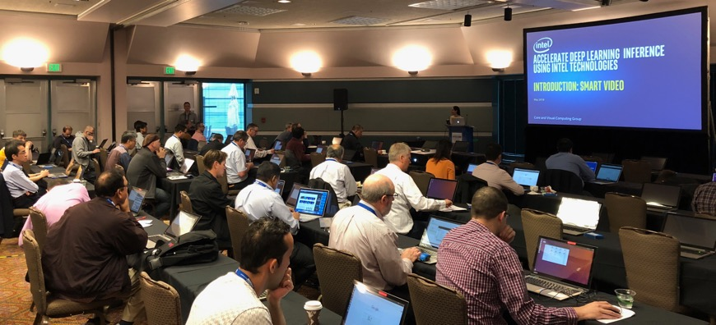
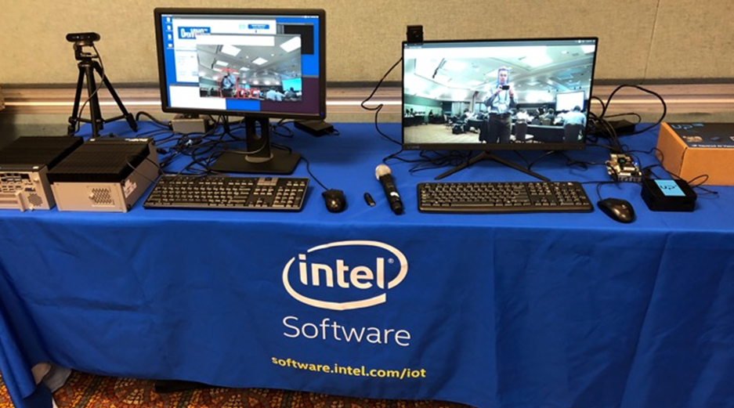

Engaging Through All Phases of Development
Events
Virtual/Tradeshows
(Global IoT DevFest)
Prototype
Productize and Scale
Define
Workshops
Hands-On Training
Promotion
Showcase Reference Implementations
IoT Innovators sharing Expertise
Engagements
ISV Engagement
App Enablement
Architecture Conversion
Notes:
Key Message: Beyond helping you accelerate development to deployment, Intel is engaged in understanding the IoT developers’ needs and challenges—from architecture to productization.

Slide 11
Intel Final Slide

