Slide 1

Sensors and Actuators
Industrial IoT
Software and Services Group
IoT Developer Relations, Intel

Slide 2
Legal Notices and Disclaimers
Intel technologies’ features and benefits depend on system configuration and may require enabled hardware, software or service activation. Performance varies depending on system configuration. No computer system can be absolutely secure. Check with your system manufacturer or retailer or learn more at www.intel.com.
This document contains information on products, services and/or processes in development. All information provided here is subject to change without notice. Contact your Intel representative to obtain the latest forecast, schedule, specifications and roadmaps.
Any forecasts of goods and services needed for Intel’s operations are provided for discussion purposes only. Intel will have no liability to make any purchase in connection with forecasts published in this document.
ARDUINO 101 and the ARDUINO infinity logo are trademarks or registered trademarks of Arduino, LLC.
Intel, the Intel logo, Intel Inside, the Intel Inside logo, OpenVINO, Intel Atom, Celeron, Intel Core, and Intel Movidius Myriad 2 are trademarks of Intel Corporation or its subsidiaries in the U.S. and/or other countries.
*Other names and brands may be claimed as the property of others.
Copyright 2018 Intel Corporation.
2

Slide 3
Quotes from the New England Journal of Medicine
Notes:
In the good old days, clinicians thought in groups; “rounding,” whether on the wards or in the radiology reading room, was a chance for colleagues to work together on problems too difficult for any single mind to solve.
Today, thinking looks very different: we do it alone, bathed in the blue light of computer screens. Our knee-jerk reaction is to blame the computer, but the roots of this shift run far deeper. Medical thinking has become vastly more complex, mirroring changes in our patients, our health care system, and medical science. The complexity of medicine now exceeds the capacity of the human mind.
Computers, far from being the problem, are the solution. But using them to manage the complexity of 21st-century medicine will require fundamental changes in the way we think about thinking and in the structure of medical education and research.
It’s ironic that just when clinicians feel that there’s no time in their daily routines for thinking, the need for deep thinking is more urgent than ever. Medical knowledge is expanding rapidly, with a widening array of therapies and diagnostics fueled by advances in immunology, genetics, and systems biology. Patients are older, with more coexisting illnesses and more medications. They see more specialists and undergo more diagnostic testing, which leads to exponential accumulation of electronic health record (EHR) data. Every patient is now a “big data” challenge, with vast amounts of information on past trajectories and current states.
All this information strains our collective ability to think. Medical decision making has become maddeningly complex. Patients and clinicians want simple answers, but we know little about whom to refer for BRCA testing or whom to treat with PCSK9 inhibitors. Common processes that were once straightforward — ruling out pulmonary embolism or managing new atrial fibrillation — now require numerous decisions.
So, it’s not surprising that we get many of these decisions wrong. Most tests come back negative, yet misdiagnosis remains common.1 Patients seeking emergency care are often admitted to the hospital unnecessarily, yet many also die suddenly soon after being sent home.2 Overall, we provide far less benefit to our patients than we hope. These failures contribute to deep dissatisfaction and burnout among doctors and threaten the health care system’s financial sustainability.
If a root cause of our challenges is complexity, the solutions are unlikely to be simple. Asking doctors to work harder or get smarter won’t help. Calls to reduce “unnecessary” care fall flat: we all know how difficult it’s become to identify what care is necessary. Changing incentives is an appealing lever for policymakers, but that alone will not make decisions any easier: we can reward physicians for delivering less care, but the end result may simply be less care, not better care.
The first step toward a solution is acknowledging the profound mismatch between the human mind’s abilities and medicine’s complexity. Long ago, we realized that our inborn sensorium was inadequate for scrutinizing the body’s inner workings — hence, we developed microscopes, stethoscopes, electrocardiograms, and radiographs. Will our inborn cognition alone solve the mysteries of health and disease in a new century? The state of our health care system offers little reason for optimism.
But there is hope. The same computers that today torment us with never-ending checkboxes and forms will tomorrow be able to process and synthesize medical data in ways we could never do ourselves. Already, there are indications that data science can help us with critical problems.
Consider the challenge of reading electrocardiograms. Doctors look for a handful of features to diagnose ischemia or rhythm disturbances — but can we ever truly “read” the waveforms in a 10-second tracing, let alone the multiple-day recording of a Holter monitor? Algorithms, by contrast, can systematically analyze every heartbeat. There are early signs that such analyses can identify subtle microscopic variations linked to sudden cardiac death.3 If validated, such algorithms could help us identify and treat the tens of thousands of Americans who might otherwise drop dead unexpectedly in any given year. And they could guide basic research on the mechanisms of newly discovered predictors.
Algorithms have also been deployed for an analysis of massive amounts of EHR data whose results suggest that type 2 diabetes has three subtypes, each with its own biologic signature and disease trajectory.4 Knowing which type of patients we’re dealing with can help us deliver treatments to those who benefit most and may help us understand why some patients have complications and others don’t.
There is little doubt that algorithms will transform the thinking underlying medicine. The only question is whether this transformation will be driven by forces from within or outside the field. If medicine wishes to stay in control of its own future, physicians will not only have to embrace algorithms, they will also have to excel at developing and evaluating them, bringing machine-learning methods into the medical domain.
Machine learning has already spurred innovation in fields ranging from astrophysics to ecology. In these disciplines, the expert advice of computer scientists is sought when cutting-edge algorithms are needed for thorny problems, but experts in the field — astrophysicists or ecologists — set the research agenda and lead the day-to-day business of applying machine learning to relevant data.
In medicine, by contrast, clinical records are considered treasure troves of data for researchers from nonclinical disciplines. Physicians are not needed to enroll patients — so they’re consulted only occasionally, perhaps to suggest an interesting outcome to predict. They are far from the intellectual center of the work and rarely engage meaningfully in thinking about how algorithms are developed or what would happen if they were applied clinically.
But ignoring clinical thinking is dangerous. Imagine a highly accurate algorithm that uses EHR data to predict which emergency department patients are at high risk for stroke. It would learn to diagnose stroke by churning through large sets of routinely collected data. Critically, all these data are the product of human decisions: a patient’s decision to seek care, a doctor’s decision to order a test, a diagnostician’s decision to call the condition a stroke. Thus, rather than predicting the biologic phenomenon of cerebral ischemia, the algorithm would predict the chain of human decisions leading to the coding of stroke.
Algorithms that learn from human decisions will also learn human mistakes, such as overtesting and overdiagnosis, failing to notice people who lack access to care, undertesting those who cannot pay, and mirroring race or gender biases. Ignoring these facts will result in automating and even magnifying problems in our current health system.5 Noticing and undoing these problems requires a deep familiarity with clinical decisions and the data they produce — a reality that highlights the importance of viewing algorithms as thinking partners, rather than replacements, for doctors.
Ultimately, machine learning in medicine will be a team sport, like medicine itself. But the team will need some new players: clinicians trained in statistics and computer science, who can contribute meaningfully to algorithm development and evaluation. Today’s medical education system is ill prepared to meet these needs. Undergraduate premedical requirements are absurdly outdated. Medical education does little to train doctors in the data science, statistics, or behavioral science required to develop, evaluate, and apply algorithms in clinical practice.
The integration of data science and medicine is not as far away as it may seem: cell biology and genetics, once also foreign to medicine, are now at the core of medical research, and medical education has made all doctors into informed consumers of these fields. Similar efforts in data science are urgently needed. If we lay the groundwork today, 21st-century clinicians can have the tools they need to process data, make decisions, and master the complexity of 21st-century patients.

Slide 4
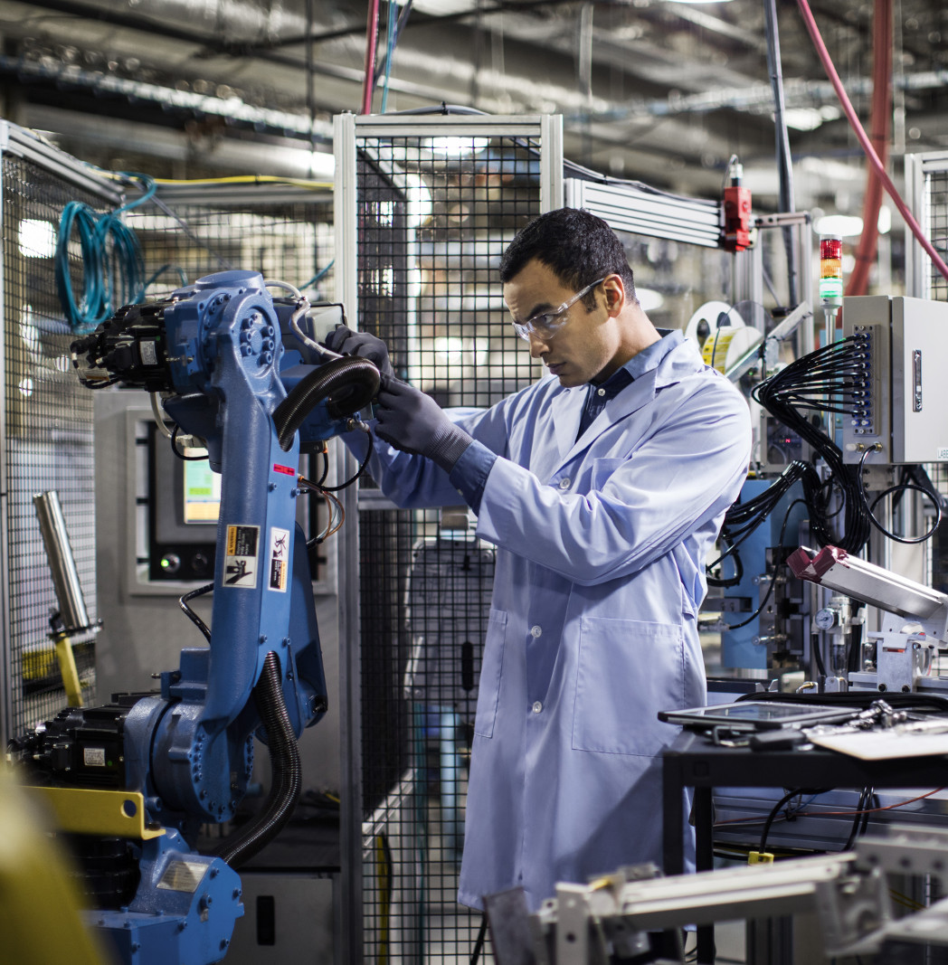
Cyber-Physical
Cyber-Physical Systems (CPS) are integrations of computation, networking, and physical processes.
Physical processes affect the computation model of the process and vice-versa.
The economic impact of cyber-physical systems is vastly greater than what has been realized. Major investments are being made worldwide to develop the technology.

Slide 5
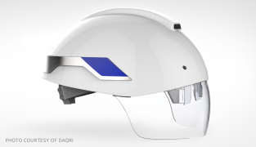
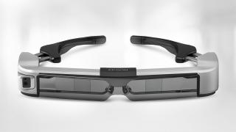

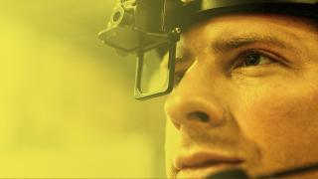
Sensors for products that enhance worker safety
DAQRI Brings Augmented Reality to Industry
The DAQRI Smart Helmet* powered by Intel allows wearers to overlay maps, schematics, and thermal images to effectively see through walls, pipes, and other solid objects.
Epson Offers Augmented-Reality-Ready Smart Glasses
MOVERIO* smart glasses are powered by an Intel Atom® processor.The BT-350 is designed for multi-user, augmented reality applications, such as remote support, arts & culture, enterprise drone, and subtitling & translation.
Fujitsu Improves Worker Management
Fujitsu’s UBIQUITOUSWARE* is an industrial worker management platform enabling data acquisition from a wide variety of sensors. An Intel® architecture-based IoT gateway gathers, filters, and applies local analytics.
KNAPP Aims at Zero Defects
The KNAPP IVII Headset* is an Intel-powered wireless, smart worker wearable solution with a unique see-through display that gives workers access to both real and virtual information.

Slide 6
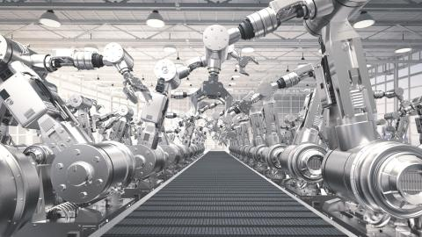
Sensing for Automation and Robotics
Intel® architecture-based connected worker solutions bring essential capabilities, including:
Continuous environmental monitoring and alerts, both locally on the gateway, and in the remote command center
Immediate, one-to-one “over the shoulder” coaching by remote experts
Timely access to contextually relevant, critical information while on the job
Contextual augmented-reality-based training on site.

Slide 7
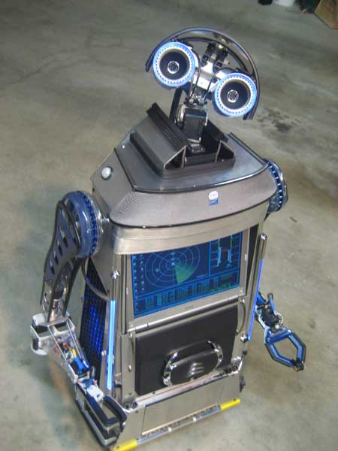
Sensing for Automation and Robotics
Intel® architecture-based connected worker solutions bring essential capabilities, including:
Continuous environmental monitoring and alerts, both locally on the gateway, and in the remote command center
Immediate, one-to-one “over the shoulder” coaching by remote experts
Timely access to contextually relevant, critical information while on the job
Contextual augmented-reality-based training on site.

Slide 8
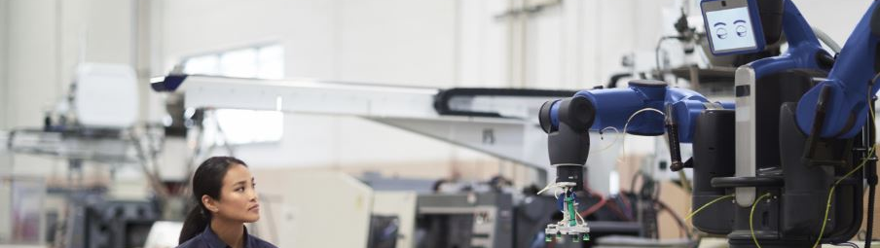
Industrial Sensors

Slide 9
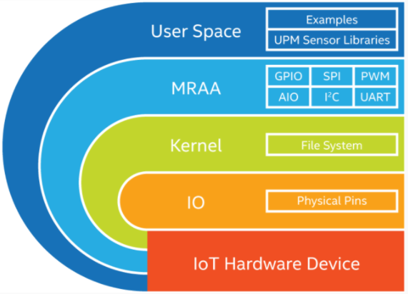
MRAA - An I/O Library for the Internet of Things
Provides I/O abstraction across both Intel and non-Intel (community added) MCU boards, UNIX boards and IoT Gateways.
X86
Minnowboard
NUC
UP2 Board
Intel® NUC
UP* and UP Squared*
Arduino* and Genuino* 101
ARM
Raspberry Pi
Banana Pi
Beaglebone Black
phyBOARD-Wega
96Boards
https://github.com/intel-iot-devkit/mraa

Slide 10
Introducing Intel IoT Device Libraries: MRAA and UPM
libmraa aka “MRAA”: https://github.com/intel-iot-devkit/mraa
Open Source IO Libs (UART, SPI, GPIO, I2C, AIO)
Provides higher level abstraction making hardware IO easier to use from userspace
Enables portability between devices
Supports Intel® Galileo and Intel® Edison boards, MinnowBoard MAX, etc.
UPM: https://github.com/intel-iot-devkit/upm
High level library repository of sensor drivers
Sensors/Actuators using libmraa
Making it easy to control
Expanding support to Industrial grade sensors
UPM and MRAA make it easy to build IoT projects!

Slide 11











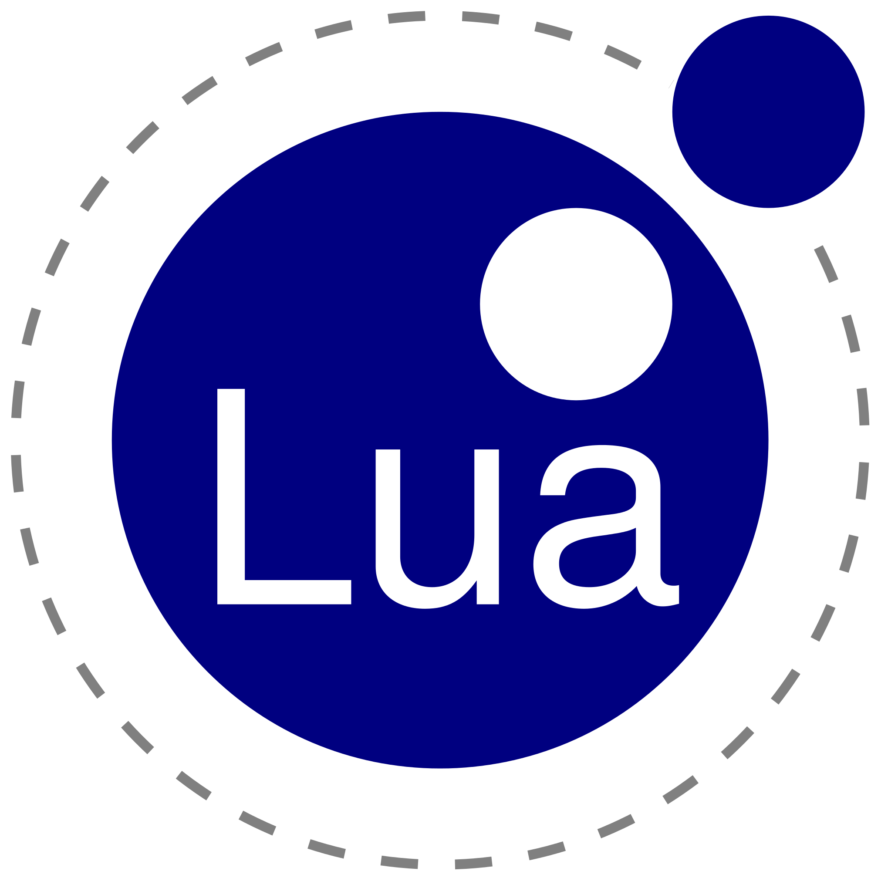




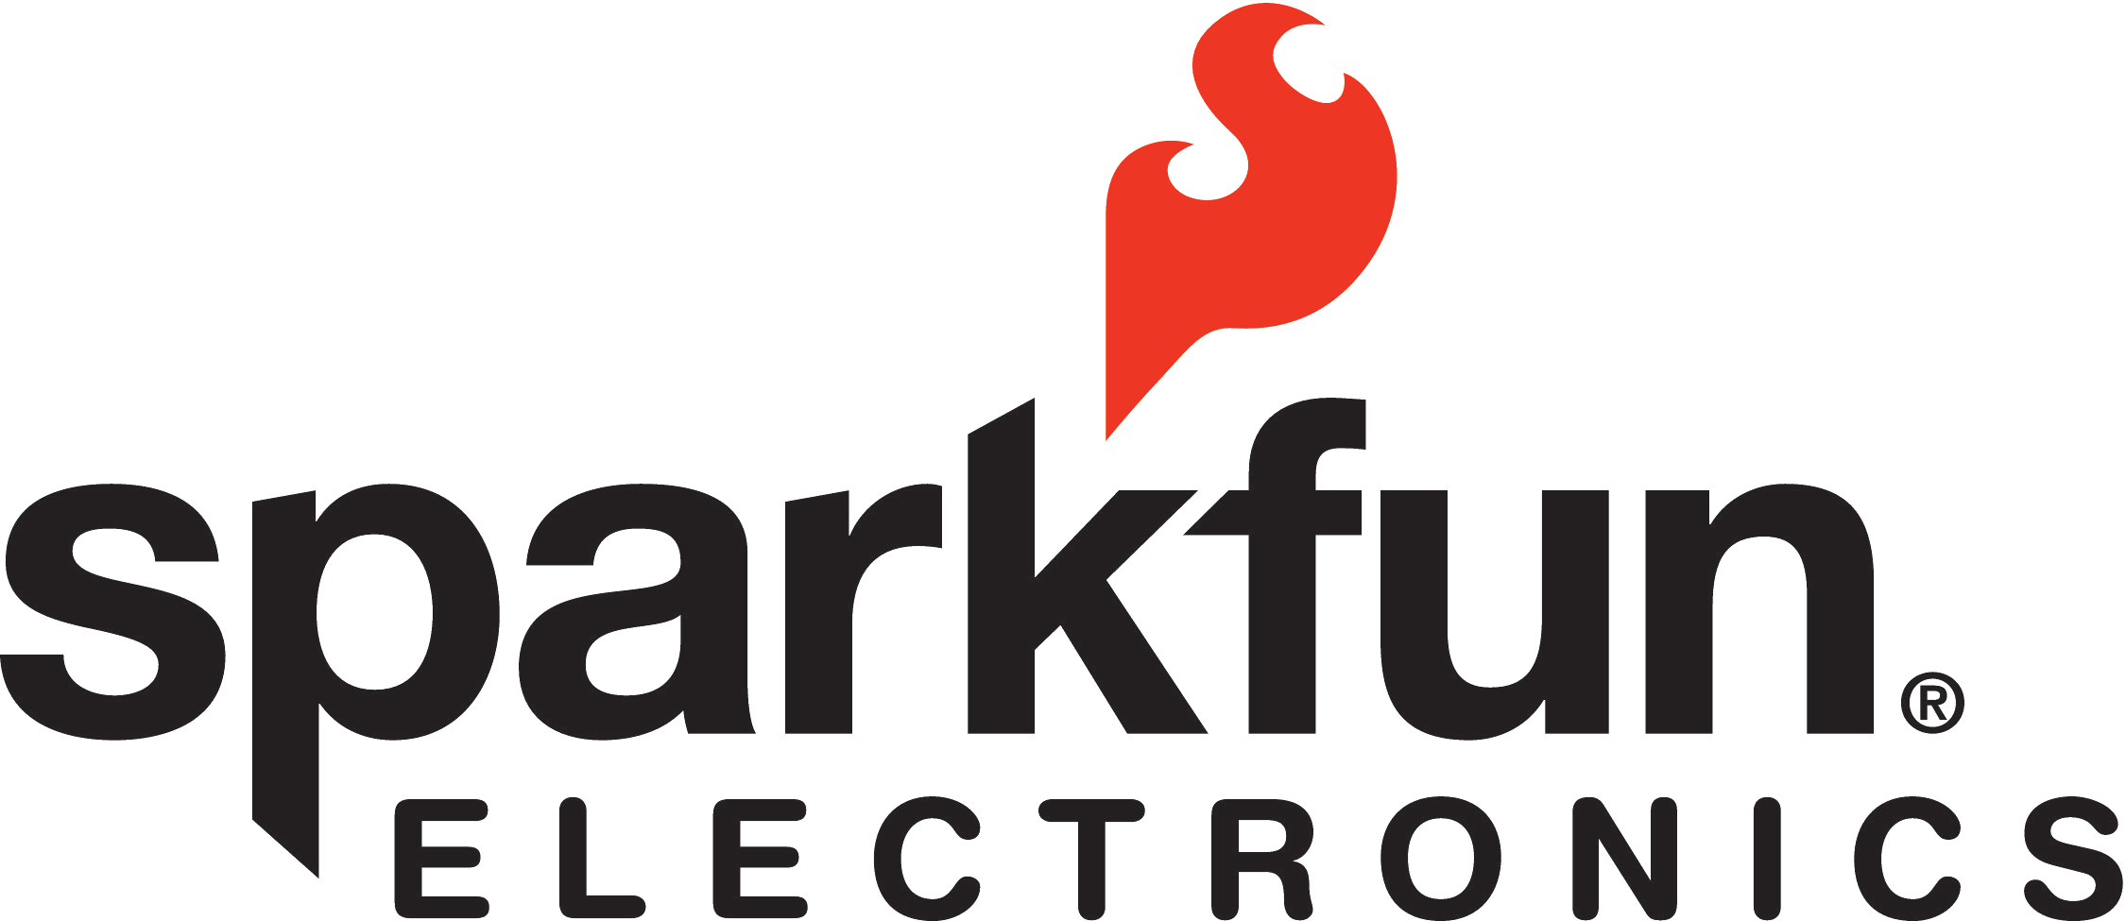
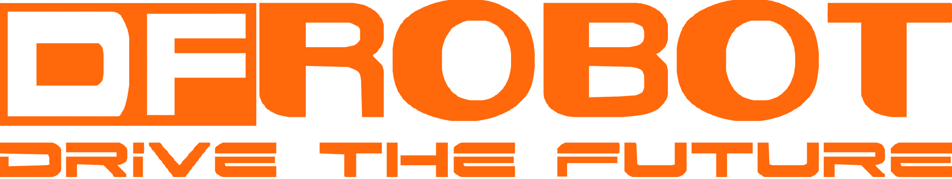








Making Sensors and Actuators Accessible
Support for Multiple Operating Systems
Support for Multiple Languages
Maker Sensors
Industrial Sensors

Slide 12
MRAA & UPM – Architecture
UPM Module
UPM Module
UPM Module
UPM Module
UPM C++ Interfaces
iTemp
iGyro
iCompass
iAccel
iMotor
iDisplay
iLoRaWAN
iLTEClient
Others …
iSensor
iActuator
iRadio
iio
UPM C generic interfaces
Mraa C/C++ APIs
Libmodbus
Bacnet
Others …
GPIO
i2c
SPI
UART
PWM
Linux Kernel

Slide 13
Node.js Code for Temperature Sensor
// Load Grove module
var groveSensor = require('jsupm_grove');
// Create the temperature sensor object using AIO pin 0
var temp = new groveSensor.GroveTemp(0);
console.log(temp.name());
// Read the temperature ten times, printing both the Celsius and
// equivalent Fahrenheit temperature, waiting one second between readings
var i = 0; var waiting = setInterval(function() {
var celsius = temp.value();
var fahrenheit = celsius * 9.0/5.0 + 32.0;
console.log(celsius + " degrees Celsius, " );
console.log(Math.round(fahrenheit) + " degrees Fahrenheit, " );
i++;
if (i == 10) clearInterval(waiting);
}, 1000);

Slide 14
Node.js Code for Relay
// Load Grove module
var groveSensor = require('jsupm_grove');
// Create the relay switch object using GPIO pin 0
var relay = new groveSensor.GroveRelay(0);
// Close and then open the relay switch 3 times,
// waiting one second each time. The LED on the relay switch
// will light up when the switch is on (closed).
// The switch will also make a noise between transitions.
var i = 0;
var waiting = setInterval(function() {
if ( i % 2 == 0 ) {
relay.on();
if ( relay.isOn() ) console.log(relay.name() + " is on");
}
else {
relay.off();
if ( relay.isOff() ) console.log(relay.name() + " is off");
}
i++;
if ( i == 6) clearInterval(waiting);
}, 1000);

Slide 15
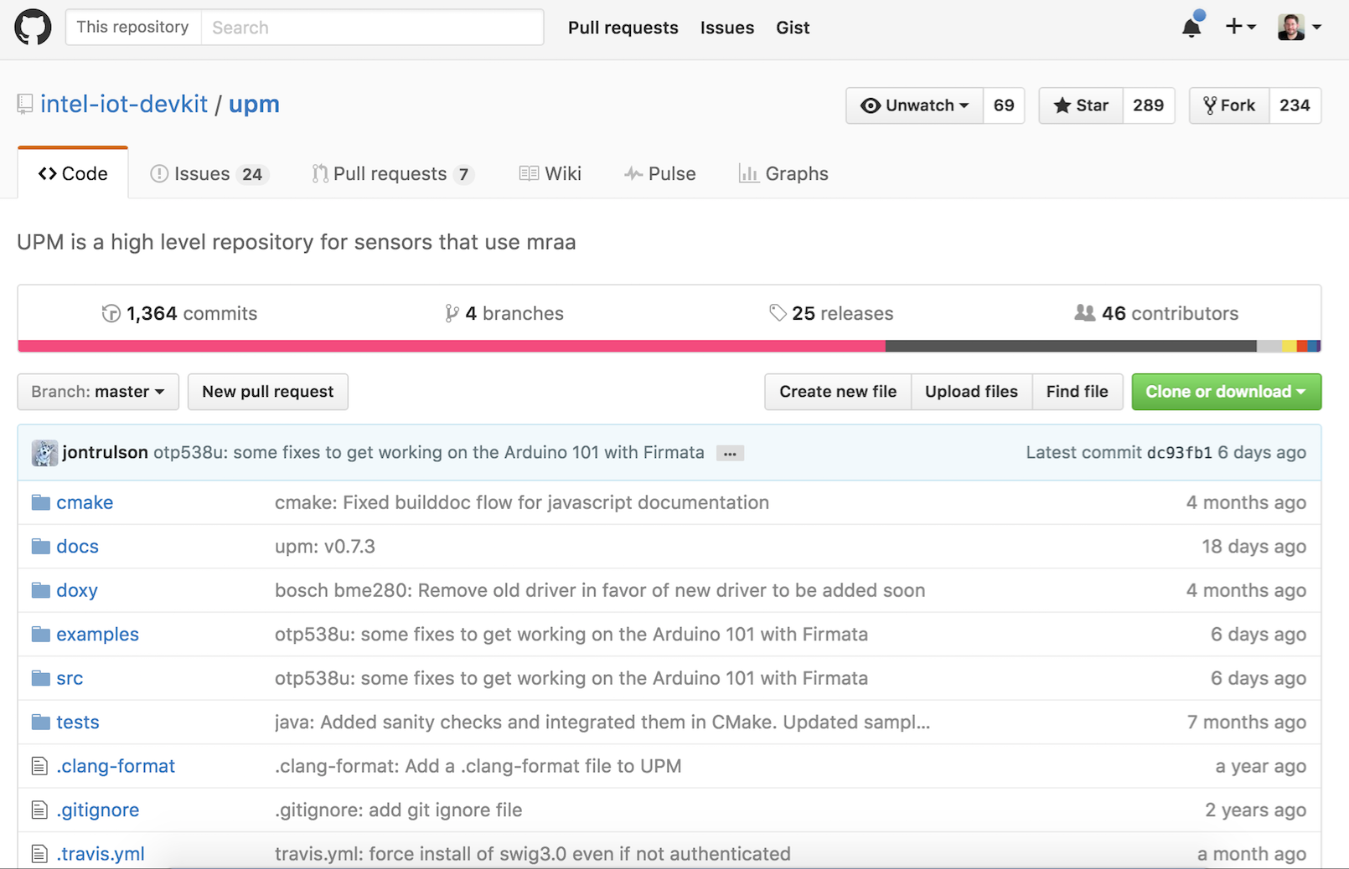

Slide 16
Notes:
Path to Industry 4.0 slide …

