Slide 1

Formal Architecture Overview
Industrial IoT
Software and Services Group
IoT Developer Relations, Intel

Slide 2

Introduction Video

Slide 3
Introduction Video
PLAY Video : https://vimeo.com/185239991

Slide 4
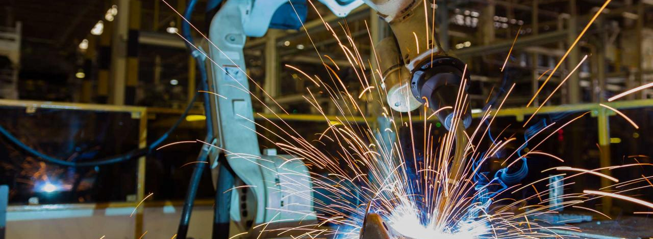
Formalizing the Industrial Internet of Things

Slide 5
Addressing Environment Complexity
“
The IIoT landscape is replete with proprietary connectivity technologies and specialized connectivity standards optimized for a narrow set of domain-specific use cases in vertically integrated systems. These domain-specific connectivity technologies, though optimal in their respective domains, can be a hindrance to the sharing of data, designs, architectures, and communications essential to creating new value streams and unlocking the potential of a global IIoT marketplace. The overarching goal of IIoT connectivity is to unlock data in these isolated systems (“silos”) and enable data sharing and interoperability between previously closed components and subsystems (brownfield) and new applications (greenfield), within and across industries.
”
The Industrial Internet of Things Consortium Volume G5

Slide 6
INDUSTRIAL INTERNET REFERENCE ARCHITECTURE
Industrial Internet Reference Framework
Apply to
IIoT Systems
System Architecture
Frame
Representations
Stakeholders
Identify
Views
Extend, enrich & develop
Evaluate
Concerns
Models
Viewpoints
Address
Concerns
Feedback & Improvement
The Industrial Internet of Things Volume G1 – Reference Architecture
Notes:
A common approach for designing a complex system is to decompose it into constituent subsystems. Suppose we want to address the concerns of what the functional subsystems are, across what interfaces they interact and how they interact to realize the desired system behaviors. A functional decomposition of the system can make each of the subsystems easier to conceive, understand, design, implement, reuse and maintain. A component diagram may be used to describe structure of the subsystems and their interfaces, sequence diagrams the way in which the subsystems interact, and state diagrams the way in which the system or one of its subsystems behaves in response to external events. These diagrams and their associated documentation collectively describe and address the concerns of the functional decomposition. The component, sequence and state diagrams are said to be the model kinds for addressing the concerns of functional structure of the system. The resultant concrete models by applying these model types to system decomposition are the part of the architecture models.

Slide 7
Multiple Stakeholders
Architecture Representation
Business Model
Architecture Frame
Stakeholders
Business Viewpoint
Usage Model
Usage Viewpoint
Functional Viewpoint
Functional Model
Implementation Viewpoint
Implementation Model
Implementing Industry 4.0 processes requires the vision and coordination of the entire business unit.
Notes:
Dr. John Lund, communications researcher and author, held a seminar on communication where he gave some amazing advice on how to better communicate with others. His input was simple and easy to follow, yet powerful. The best quote of the entire event was this: “Don`t communicate to be understood; rather, communicate so as not to be misunderstood.” What a great way to put things in perspective regarding our efforts on how to improve our communication. So in that spirit, we will decompose the requirements of Industry 4.0 into the different perspectives that stakeholders will have.
ARCHITECTURE FRAMEWORK An architecture framework contains information identifying the fundamental architecture constructs and specifies concerns, stakeholders, viewpoints, model kinds, correspondence rules and conditions of applicability. System architects can use an architecture framework to discover, describe and organize topics of interest (concerns) about the system at hand; they can further use architecture representation to clarify, analyze and resolve these concerns.
At the core of the ISO/IEC/IEEE Architecture Description standard are viewpoints. A viewpoint comprises conventions framing the description and analysis of specific system concerns. A viewpoint frames one or more concerns. The term concern refers to any topic of interest pertaining to the system. A stakeholder is an individual, team, organization or classes thereof, having an interest in a concern and by extension an interest in the viewpoint and system1. To aid the tasks of describing, analyzing and resolving concerns, one or more modeling constructs can be defined as the model kinds2 for each viewpoint. The constructs of viewpoints and their corresponding stakeholders, concerns and model kinds can be considered as the architecture frame.
BUSINESS VIEWPOINT The business viewpoint attends to the concerns of the identification of stakeholders and their business vision, values and objectives in establishing an IIoT system in its business and regulatory context. It further identifies how the IIoT system achieves the stated objectives through its mapping to fundamental system capabilities. These concerns are business-oriented and are of particular interest to business decision-makers, product managers and system engineers.
USAGE VIEWPOINT The usage viewpoint addresses the concerns of expected system usage. It is typically represented as sequences of activities involving human or logical (e.g. system or system components) users that deliver its intended functionality in ultimately achieving its fundamental system capabilities. The stakeholders of these concerns typically consist of system engineers, product managers and the other stakeholders including the individuals who are involved in the specification of the IIoT system under consideration and who represent the users in its ultimate usage.
FUNCTIONAL VIEWPOINT The functional viewpoint focuses on the functional components in an IIoT system, their structure and interrelation, the interfaces and interactions between them, and the relation and interactions of the system with external elements in the environment, to support the usages and activities of the overall system. These concerns are of particular interest to system and component architects, developers and integrators.
IMPLEMENTATION VIEWPOINT The implementation viewpoint deals with the technologies needed to implement functional components (functional viewpoint), their communication schemes and their lifecycle procedures. These elements are coordinated by activities (usage viewpoint) and supportive of the system capabilities (business viewpoint). These concerns are of particular interest to system and component architects, developers and integrators, and system operators.
The business, usage, functional and implementation viewpoints facilitate a systematic way to identify IIoT system concerns and their stakeholders, to bring similar or related concerns together so they can be analyzed and addressed effectively. The deliberation of the concerns is often performed within each of the viewpoints to which they belong. However, this is not to suggest that system concerns are always to be resolved within each of the viewpoints, in isolation to those in other viewpoints.
The order in which the business, usage, functional and implementation viewpoints are arranged, from top to bottom, as depicted in Figure 3-5, reflects a general interaction pattern between the viewpoints. Broadly speaking, decisions from a higher-level viewpoint guide and impose requirements on the viewpoints below it. For example, the decisions resulting from the business viewpoint has direct influence to the deliberations in the usage viewpoint and so forth. On the other hand, the deliberation of the concerns in a lower viewpoint, including implementing requirements from the viewpoints above it, validate and in some cases cause revisions to the analysis and possibly the decisions in the viewpoint above it. For example, the deliberation in the usage viewpoint may validate if some of the fundamental system capability proposed in the business viewpoint can be realized.
Cross Cutting Concerns
Moreover, there are classes of system concerns, such as those related to safety and security, which may require consistent consideration across the viewpoints. These are sometimes referred to as crosscutting concerns. These classes of concerns are often related to system properties resulting not just from its components but also the interactions among these components—the emergent properties of the system. Emergent system-wide properties are called system characteristics in the context of this reference architecture. More formally, system characteristics are system properties and behaviors of an IIoT system resulting from those of its constituent
subsystems and the nature of their interactions with each other, the context and the environment in which they operate. These properties usually have contractual value, e.g. supporting Service Level Agreement (SLA), for the system stakeholders.
System concerns related to safety and security are of crucial importance to IIoT systems. To ensure the system is capable of demonstrating the expected system characteristics, it is essential to have a clear understanding of the business drivers for strong safety and security requirements and their potential effect on the business objectives in case they are not met. It also requires detailed consideration of how these requirements affects the usages of the system. Finally, the requirements and usage considerations must be reflected in the design of the functional components and the choice of technologies and actual implementation of the system.

Slide 8
Business and Usage Viewpoints
Business Decision Maker and Key Stakeholders
System Engineers, Product Managers
Present
Identify
Develop
Develop
Identify
Vision
Values
Key Objectives
Capabilities
Business Viewpoint
Usage Viewpoint
System Requirements
Derive
Notes:
Business Viewpoint
Business-oriented concerns such as business value, expected return on investment, cost of maintenance and product liability must be evaluated when considering an IIoT system as a solution to business problems. To identify, evaluate and address these business concerns, we introduce a number of concepts and define the relationships between them.
STAKEHOLDERS Stakeholders have a major stake in the business and strong influence in its direction. They include those who drive the conception and development of IIoT systems in an organization. They are often recognized as important strategic thinkers and visionaries within a company or an industry. It is important to identify these major stakeholders and engage them early in the process of evaluating these business-oriented concerns.
VISION Vision describes a future state of an organization or an industry.1 It provides the business direction toward which an organization executes. Senior business stakeholders usually develop and present an organization’s vision.
VALUES Values reflect how the vision may be perceived by the stakeholders who will be involved in funding the implementation of the new system as well as by the users of the resulting system. These values are typically identified by senior business and technical leaders in an organization. They provide the rationale as to why the vision has merit.
KEY OBJECTIVES Key objectives are quantifiable high-level technical and ultimately business outcomes expected of the resultant system in the context of delivering the values. Key objectives should be measurable and time-bound. Senior business and technical leaders develop the key objectives.
FUNDAMENTAL CAPABILITIES Fundamental capabilities refer to high-level specifications of the essential ability of the system to complete specific major business tasks.2 Key objectives are the basis for identifying the fundamental capabilities. Capabilities should be specified independently of how they are to be implemented (neutral to both the architecture and technology choices) so that system designers and implementers are not unduly constrained at this stage. The process for following this approach is for the stakeholders to first identify the vision of the organization and then how it could improve its operations through the adoption of an IIoT system. From the vision, the stakeholders establish the values and experiences of the IIoT system under consideration and develop a set of key objectives that will drive the implementation of the vision. From the objectives, the stakeholders derive the fundamental capabilities that are required for the system. To verify that the resultant system indeed provides the desired capabilities meeting the objectives, they should be characterized by detailed quantifiable attributes such as the degree of safety, security and resilience, benchmarks to measure the success of the system, and the criteria by which the claimed system characteristics can be supported by appropriate evidence.
USAGE VIEWPOINT The usage viewpoint is concerned with how an IIoT system realizes the key capabilities identified in the business viewpoint. The usage viewpoint describes the activities that coordinate various units of work over various system components. These activities—describing how the system is used—serve as an input for system requirements including those on key system characteristics and guide the design, implementation, deployment, operations and evolution of the IIoT system.

Slide 9
Functional Viewpoint
THE CONTROL DOMAIN
the collection of functions that are performed by industrial control systems.
Functional Domains
Business
THE OPERATIONS DOMAIN
the collection of functions responsible for the provisioning, management, monitoring and optimization.
Operations
Information
Application
THE INFORMATION DOMAIN
the collection of functions for gathering data and transforming, persisting, modeling or analyzing that data to acquire high-level intelligence about the overall system.
THE APPLICATION DOMAIN
the collection of functions implementing application logic that realizes business functionalities.
Control
Physical System
THE BUSINESS DOMAIN
enable end-to-end operations of the industrial internet of things systems
Notes:
THE CONTROL DOMAIN The control domain represents the collection of functions that are performed by industrial control systems. The core of these functions comprises fine-grained closed-loops, reading data from sensors (“sense” in the figure), applying rules and logic, and exercising control over the physical system through actuators (“actuation”).1 Both accuracy and resolution in timing is usually critical. Components or systems implementing these functions (functional components) are usually deployed in proximity to the physical systems they control, and may therefore be geographically distributed. They may not be easily accessible physically by maintenance personnel, and physical security of these systems may require special consideration.
Implementation of the Control Domain also include the protocols the sensors use to communication as well as PLC and Fieldbuses that coordinate the Control level actions.
The control domain comprises a set of common functions, as depicted in Figure 6-2.2 Their implementation may be at various levels of complexity and sophistication depending on the systems, and, in a given system, some components may not exist at all. We describe each in turn.
Sensing is the function that reads sensor data from sensors. Its implementation spans hardware, firmware, device drivers and software elements. Note that active sensing recursively, requires control and actuation, and may therefore have a more complex linkage to the rest of the control system, for example, an attention element to tell the sensor what is needed.
Actuation is the function that writes data and control signals to an actuator to enact the actuation. Its implementation spans hardware, firmware, device drivers and software elements.
Entity abstraction, through a virtual entity representation, provides an abstraction of scores of sensors and actuators, peer controllers and systems in the next higher tiers, and expresses relationships between them. This serves as the context in which sensor data can be understood, actuation is enacted and the interaction with other entities is carried out. Generally, this includes the semantics of the terms used within the representations or messages passed between system elements.
Modeling deals with understanding the states, conditions and behaviors of the systems under control and those of peer systems by interpreting and correlating data gathered from sensors and peer systems. The complexity and sophistication of modeling of the system under control varies greatly. It may range from straightforward models (such as a simple interpretation of a time series of the temperature of a boiler), to moderately complex (a prebuilt physical model of an aircraft engine), to very complex and elastic (models built with artificial intelligence possessing learning and cognitive capabilities). These modeling capabilities, sometime referred to as edge analytics, are generally required to be evaluated locally in control systems for real-time applications. Edge analytics are also needed in use cases where it is not economical or practical to send a large amount of raw sensor data to remote systems to be analyzed even without a realtime requirement.
A data abstraction sub-function of modeling may be needed for cleansing, filtering, de-duplicating, transforming, normalizing, ignoring, augmenting, mapping and possibly persisting data before the data are ready for analysis by the models or destroyed.
Industrial Control Systems (ICSs) have been widely deployed to enable industrial automation across industrial sectors.1 As we bring these automated control systems online with broader systems in the Industrial Internet effort, control remains a central and essential concept of industrial systems. Control, in this context, is the process of automatically exercising effects on physical systems and the environment, based on sensory inputs to achieve human and business objectives. Many control systems today apply low-latency, fine-grained controls to physical systems in close proximity, without a connection to other systems.
Increasing local collaborative autonomy: New sensing and detection technologies provide more and more accurate data. Greater embedded computational power enables more advanced analytics of these data and better models of the state of a physical system and the environment in which it operates. The result of this combination transforms control systems from merely automatic to autonomous, allowing them to react appropriately even when the system’s designers did not anticipate the current system state. Ubiquitous connectivity between peer systems enables a level of fusion and collaboration that was previously impractical.
Increasing system optimization through global orchestration: Collecting sensor data from across the control systems and applying analytics, including models developed through machine learning, to these data, we can gain insight to a business’s operations. With these insights, we can improve decision-making and optimize the system operations globally through automatic and autonomous orchestration.
These two themes have far-reaching impact on the systems that we will build, though each system will have a different focus and will balance the two themes differently. A functional domain is a (mostly) distinct functionality in the overall IIoT system. A decomposition of a typical IIoT system into functional domains highlights the important building blocks that have wide applicability in many industrial verticals. It is a starting point for conceptualizing a concrete functional architecture. Specific system requirements will strongly influence how the functional domains are decomposed, what additional functions may be added or left out and what functions may be combined and further decomposed. We decompose a typical IIoT system into five functional domains: • Control domain • Operations domain • Information domain • Application domain • Business domain

Slide 10
Control Domain
Functional Viewpoint
The collection of functions that are performed by Control Domain
Sensing
Actuating
Entity Abstraction
Modeling
Functional Domains
Business
Predictive
Models
Operations
Information
Application
Implementation Viewpoint
Physical Sensors and Actuators
Communications and Protocols
Control
Physical System
Notes:
THE CONTROL DOMAIN The control domain represents the collection of functions that are performed by industrial control systems. The core of these functions comprises fine-grained closed-loops, reading data from sensors (“sense” in the figure), applying rules and logic, and exercising control over the physical system through actuators (“actuation”).1 Both accuracy and resolution in timing is usually critical. Components or systems implementing these functions (functional components) are usually deployed in proximity to the physical systems they control, and may therefore be geographically distributed. They may not be easily accessible physically by maintenance personnel, and physical security of these systems may require special consideration.
Implementation of the Control Domain also include the protocols the sensors use to communication as well as PLC and Fieldbuses that coordinate the Control level actions.
The control domain comprises a set of common functions, as depicted in Figure 6-2.2 Their implementation may be at various levels of complexity and sophistication depending on the systems, and, in a given system, some components may not exist at all. We describe each in turn.
Sensing is the function that reads sensor data from sensors. Its implementation spans hardware, firmware, device drivers and software elements. Note that active sensing recursively, requires control and actuation, and may therefore have a more complex linkage to the rest of the control system, for example, an attention element to tell the sensor what is needed.
Actuation is the function that writes data and control signals to an actuator to enact the actuation. Its implementation spans hardware, firmware, device drivers and software elements.
Entity abstraction, through a virtual entity representation, provides an abstraction of scores of sensors and actuators, peer controllers and systems in the next higher tiers, and expresses relationships between them. This serves as the context in which sensor data can be understood, actuation is enacted and the interaction with other entities is carried out. Generally, this includes the semantics of the terms used within the representations or messages passed between system elements.
Modeling deals with understanding the states, conditions and behaviors of the systems under control and those of peer systems by interpreting and correlating data gathered from sensors and peer systems. The complexity and sophistication of modeling of the system under control varies greatly. It may range from straightforward models (such as a simple interpretation of a time series of the temperature of a boiler), to moderately complex (a prebuilt physical model of an aircraft engine), to very complex and elastic (models built with artificial intelligence possessing learning and cognitive capabilities). These modeling capabilities, sometime referred to as edge analytics, are generally required to be evaluated locally in control systems for real-time applications. Edge analytics are also needed in use cases where it is not economical or practical to send a large amount of raw sensor data to remote systems to be analyzed even without a realtime requirement.
A data abstraction sub-function of modeling may be needed for cleansing, filtering, de-duplicating, transforming, normalizing, ignoring, augmenting, mapping and possibly persisting data before the data are ready for analysis by the models or destroyed.
Industrial Control Systems (ICSs) have been widely deployed to enable industrial automation across industrial sectors.1 As we bring these automated control systems online with broader systems in the Industrial Internet effort, control remains a central and essential concept of industrial systems. Control, in this context, is the process of automatically exercising effects on physical systems and the environment, based on sensory inputs to achieve human and business objectives. Many control systems today apply low-latency, fine-grained controls to physical systems in close proximity, without a connection to other systems.
Increasing local collaborative autonomy: New sensing and detection technologies provide more and more accurate data. Greater embedded computational power enables more advanced analytics of these data and better models of the state of a physical system and the environment in which it operates. The result of this combination transforms control systems from merely automatic to autonomous, allowing them to react appropriately even when the system’s designers did not anticipate the current system state. Ubiquitous connectivity between peer systems enables a level of fusion and collaboration that was previously impractical.
Increasing system optimization through global orchestration: Collecting sensor data from across the control systems and applying analytics, including models developed through machine learning, to these data, we can gain insight to a business’s operations. With these insights, we can improve decision-making and optimize the system operations globally through automatic and autonomous orchestration.
These two themes have far-reaching impact on the systems that we will build, though each system will have a different focus and will balance the two themes differently. A functional domain is a (mostly) distinct functionality in the overall IIoT system. A decomposition of a typical IIoT system into functional domains highlights the important building blocks that have wide applicability in many industrial verticals. It is a starting point for conceptualizing a concrete functional architecture. Specific system requirements will strongly influence how the functional domains are decomposed, what additional functions may be added or left out and what functions may be combined and further decomposed. We decompose a typical IIoT system into five functional domains: • Control domain • Operations domain • Information domain • Application domain • Business domain

Slide 11
Operations Domain
Functional Viewpoint
The operations domain represents the collection of functions responsible for the provisioning, management, monitoring and optimization of the systems in the control domain
Functional Domains
Business
Operations
Information
Application
Implementation Viewpoint
Virtualization and Consolidation
Security and IIoT
Control
Physical System
Notes:
THE OPERATIONS DOMAIN The operations domain represents the collection of functions responsible for the provisioning, management, monitoring and optimization of the systems in the control domain. Existing industrial control systems mostly focus on optimizing the assets in a single physical plant. The control systems of the Industrial Internet must move up a level, and optimize operations across asset types, fleets and customers. This opens up opportunities for added business and customer value as set out by higher-level, business-oriented domains.
Provisioning and Deployment consists of a set of functions required to configure, onboard, register, and track assets, and to deploy and retire assets from operations. These functions must be able to provision and bring assets online remotely, securely and at scale. They must be able to communicate with them at the asset level as well as the fleet level, given the harsh, dynamic and remote environments common in industrial contexts.
Management consists of a set of functions that enable assets management centers to issue a suite of management commands to the control systems, and from the control systems to the assets in which the control systems are installed, and in the reverse direction enable the control systems and the assets to respond to these commands. For this, many of the legacy “dumb” assets need to be retrofitted to have compute, storage and connectivity capabilities.
Monitoring and Diagnostics consists of functions that enable the detection and prediction of occurrences of problems. It is responsible for real-time monitoring of asset key performance indicators, collecting and processing asset health data with intelligence so that it can diagnose the real cause of a problem, and then alerting on abnormal conditions and deviations. This set of functions should assist operations and maintenance personnel to reduce the response time between detecting and addressing a problem.
Prognostics consists of the set of functions that serves as a predictive analytics engine of the IIoT systems. It relies on historical data of asset operation and performance, engineering and physics properties of assets, and modeling information. The main goal is to identify potential issues before they occur and provide recommendations on their mitigation.

Slide 12
Information Domain
Functional Viewpoint
The collection of functions for gathering data and transforming, persisting, modeling or analyzing that data to acquire high-level intelligence about the overall system.
Functional Domains
Business
Predictive
Models
Operations
Information
Application
Implementation Viewpoint
Automated Control Systems
Smart Video Systems
Control
Physical System
Notes:
THE INFORMATION DOMAIN The information domain represents the collection of functions for gathering data from various domains, most significantly from the control domain, and transforming, persisting, and modeling or analyzing those data to acquire high-level intelligence about the overall system.1 The data collection and analysis functions in this domain are complementary to those implemented in the control domain. In the control domain, these functions participate directly in the immediate control of the physical systems whereas in the information domain they are for aiding decisionmaking, optimization of system-wide operations and improving the system models over the long term. Components implementing these functions may or may not be co-located with their counterparts in the control domain. They may be deployed in building closets, in factory control rooms, in corporate datacenters, or in the cloud as a service. ExampleOptimizing the electricity generation level of a plant or a generator based on the condition of the facility, fuel cost and electricity price. Changing the route of a fleet of freight trucks based on weather, traffic and the condition of the goods in the trucks. Changing the output of an automated production plant based on condition of the facility, energy and material cost, demand patterns and logistic. Changing the temperature set-point of a boiler based on energy cost, weather condition and usage pattern. Data consists of functions for: • ingesting sensor and operation state data from all domains, • quality-of-data processing (data cleansing, filtering, de-duplication, etc.), • syntactical transformation (e.g., format and value normalization), • semantic transformation (semantic assignment, context injection and other data augmentation processing based on metadata (e.g. provisioning data from the Operations Domain) and other collaborating data set, • data persistence and storage (e.g. for batch analysis) and • data distribution (e.g. for streaming analytic processing). These functions can be used in online streaming mode in which the data are processed as they are received to enable quasi-real-time analytics in support of orchestration of the activities of the assets in the control domain. They may be used in offline batch mode (e.g. seismic sensor data collected and accumulated in an offshore oil platform that does not have high-bandwidth connectivity to the onshore datacenter). Data governance functions may be included for data security, data access control and data rights management, as well as conventional data management functions related to data resilience (replication in storage, snapshotting and restore, backup & recovery, and so on). Analytics encapsulates a set of functions for data modeling, analytics and other advanced data processing, such as rule engines. The analytic functions may be done in online/streaming or offline/batch modes. In the streaming mode, events and alerts may be generated and fed into functions in the application domains. In the batch mode, the outcome of analysis may be provided to the business domain for planning or persisted as information for other applications. The data volume at the system level in most IIoT systems will eventually exceed a threshold at which the traditional analytic toolsets and approaches may no longer scale in meeting the requirement in performance. “Big Data” storage and analytic platforms may be considered for implementing these functions.

Slide 13
Intelligently use existing production data
Existing deployments are integrated with sensors
Data sheds light on existing processes
Real-time monitoring allows optimization
Machine Learning
Predictive
Models
Data Mining
High level
Modeling
Data mining reveals new patterns
Machine Learning builds predictive models of business processes
Data Visualization
Reporting
Dashboards
Data Integration
Unified
Data Access
Data Collection
Sensor
Framework

Slide 14
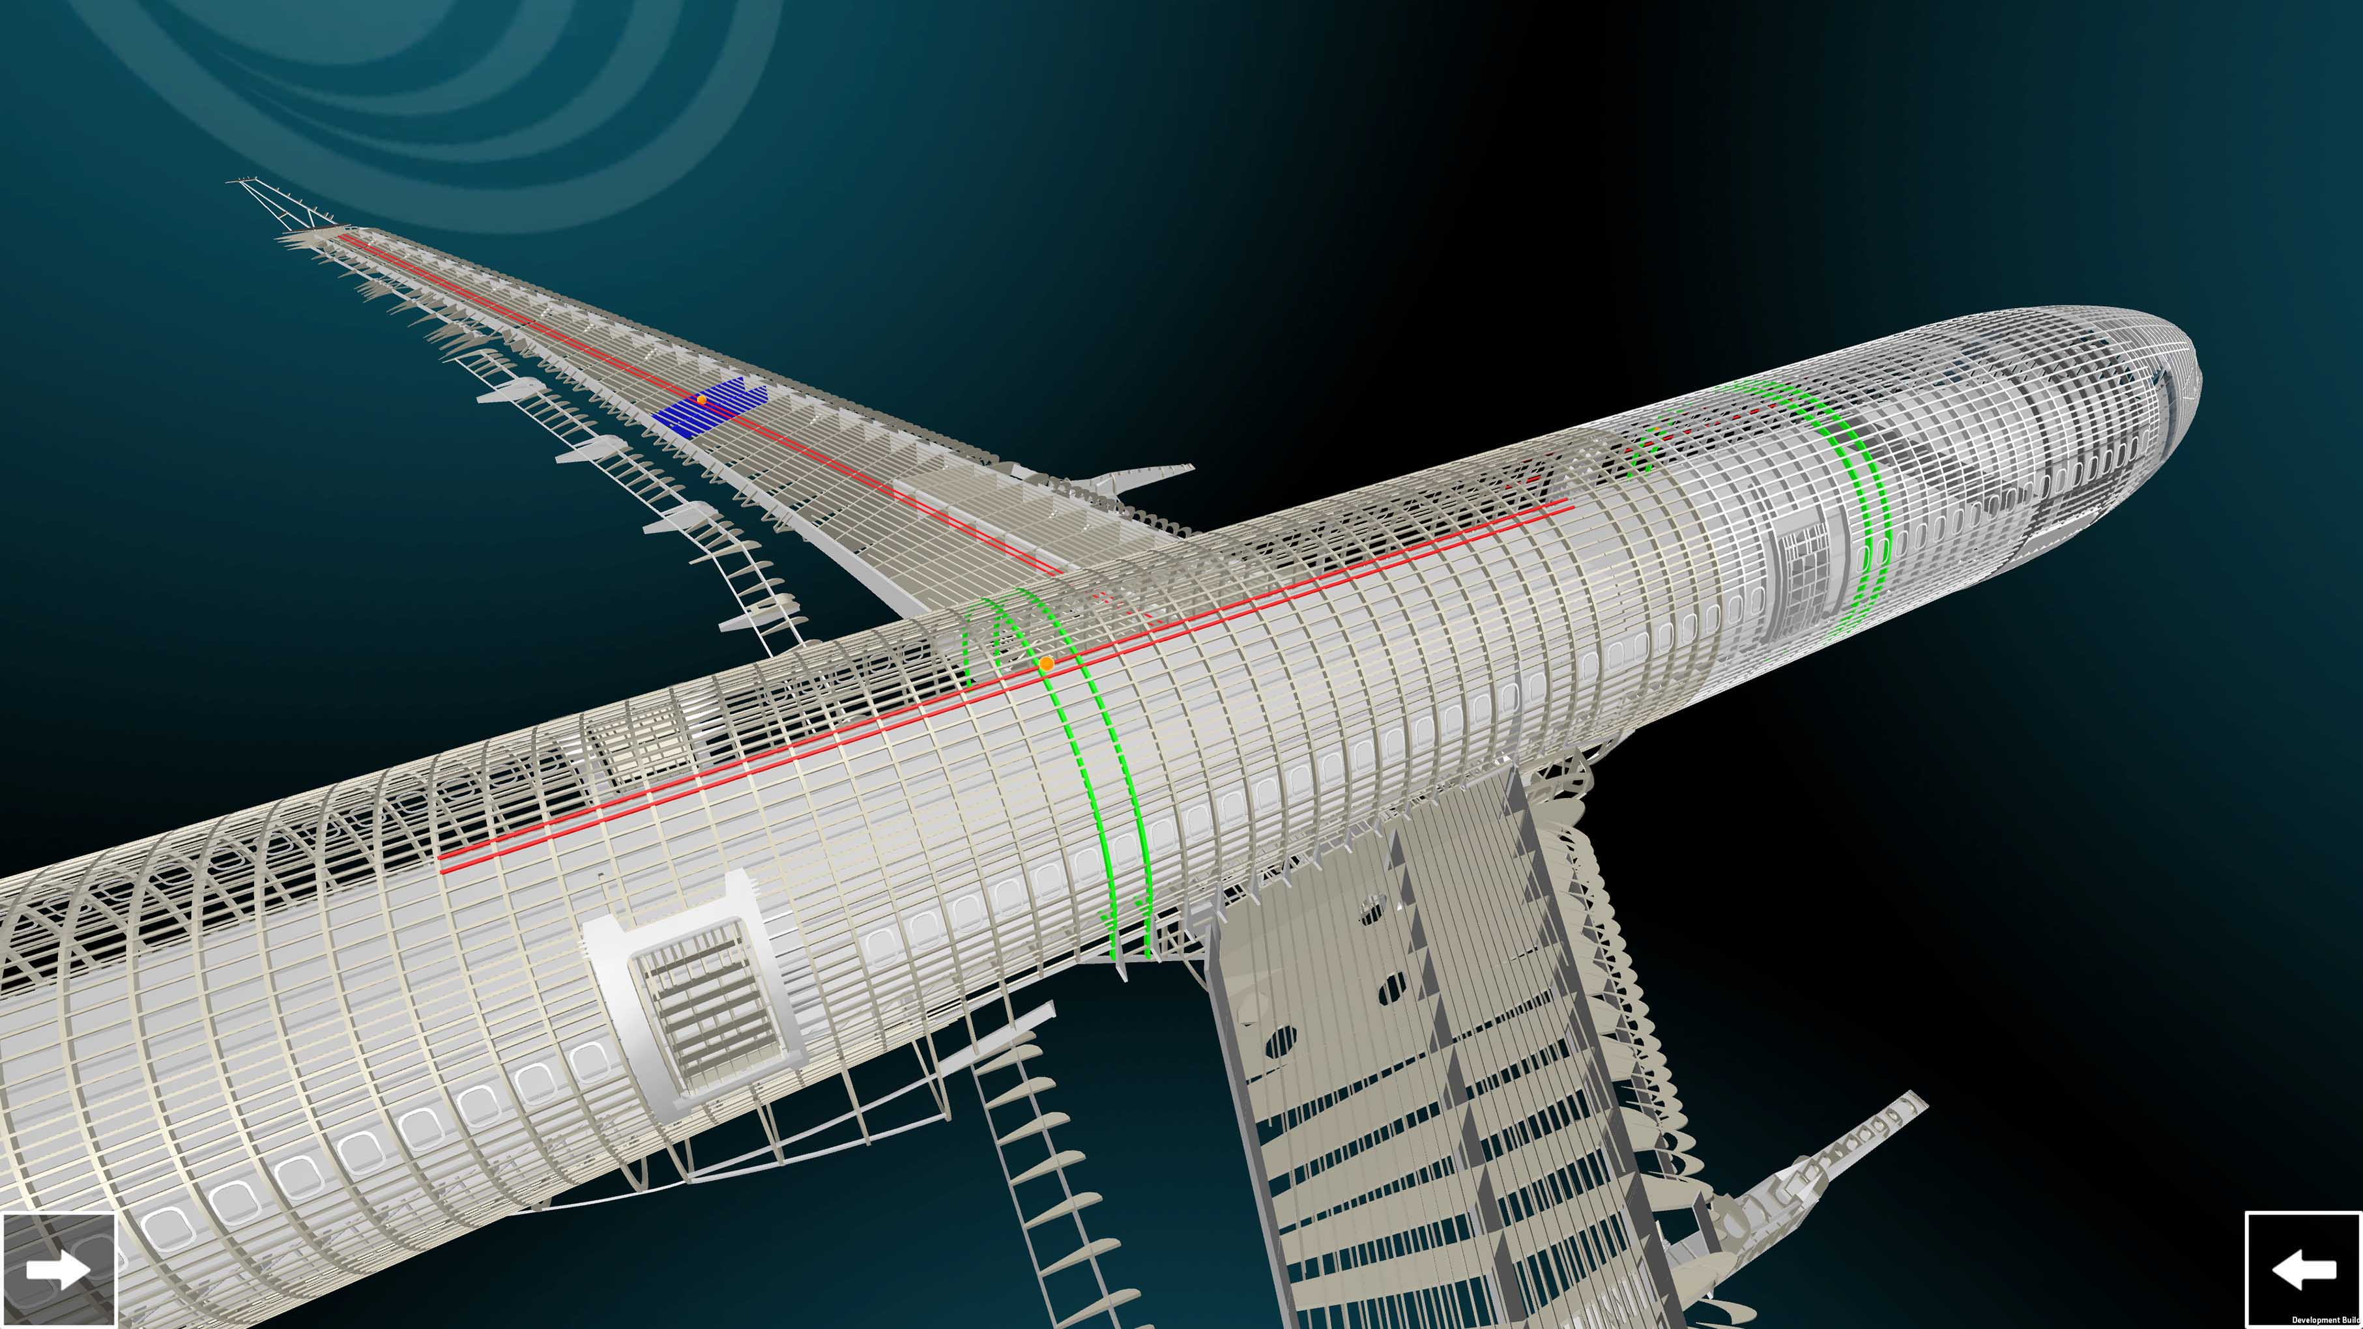
Digital Twin
A Digital Twin is the ability to take a virtual representation of the physical elements and the dynamics of how an IoT device operates and use that feedback to make predictions that improve the lifecycle and lifetime of a product.
Notes:
Digital Twin is the ability to take a virtual representation of the elements and the dynamics of how an Internet of Things device operates and works. It’s more that a blueprint. It’s more that a diagram. It’s an understanding of all of the dynamics of a device throughout it’s lifecycle. It affects the design, build and operating phases of a devices lifecycle. It allows the designer, builder or operator to ask questions of the device and to have the answers simulated.
The digital twin is where physical elements and virtual elements (the software) and being about to coordinate those together in to a single virtual design that will bring about the highest possible product.
The digital twin facilitates the operating of the project itself. Products are place in different environment conditions. Solar Panels may be placed in a desert. Hydro-electric turbines are placed in the water. Projects have different tolerances. They shift as they age. A digital twin needs to shift along with the product, using sensor data to guide its feedback. This will help in building better products, in predicting product failures and maintenance cycles.
A digital twin is simulated for the purpose of gathering analytics. Whether it is a temperature sensor or an autonomous vehicle the model must be able to make useful predictions through its lifetime. This also means that it needs to have an understanding of it’s commercial environment. One product may be used differently in different deployment environments. So a digital twim must capture not only the engineering but the industry and deployment contexts.

Slide 15
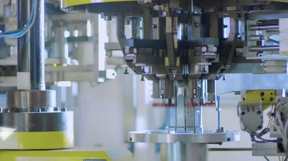
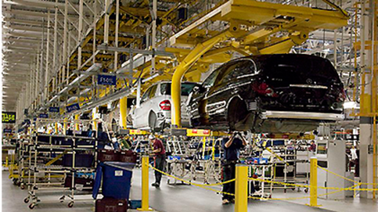

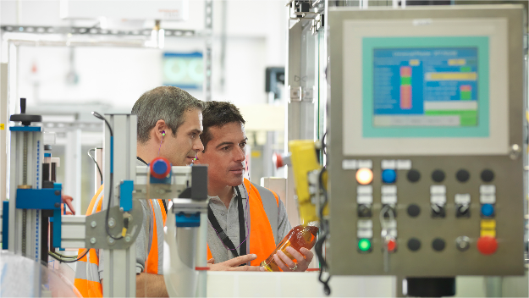

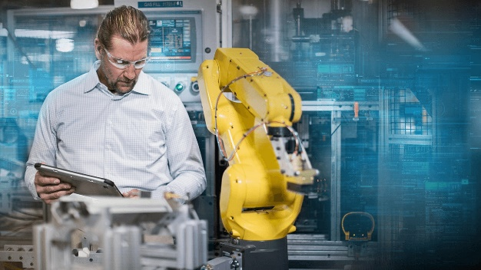
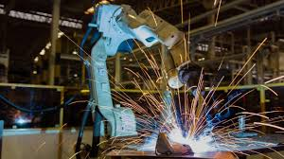
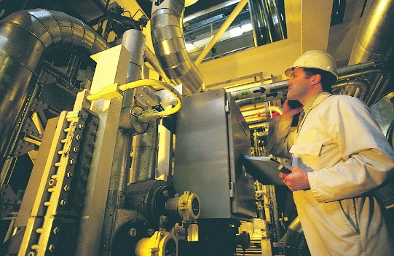
Application Domain
Manufacturing
Analytics
Production
Performance
Process
Quality
Predictive Maintenance
Data Processing
Production Rules
Remote Services
Sensor Cloud
Notes:
THE APPLICATION DOMAIN The application domain represents the collection of functions implementing application logic that realizes specific business functionalities. Functions in this domain apply application logic, rules and models at a coarse-grained, high level for optimization in a global scope. They do not maintain low-level continuing operations, as these are delegated to functions in the control domain that must maintain local rules and models in the event of connectivity loss. Requests to the control domain from the application domain are advisory so as not to violate safety, security, or other operational constraints. The decomposition of the application domain is illustrated in Figure 6-4. Logics and Rules comprises logics (rules, models, engines, activity flows, etc.) implementing specific functionality that is required for the use case under consideration. It is expected that there are great variations in these functions in both its contents and its constructs among the use cases. APIs and UI represent a set of functions that an application exposes its functionalities as APIs for other applications to consume, or human user interface enabling human interactions with the application.

Slide 16
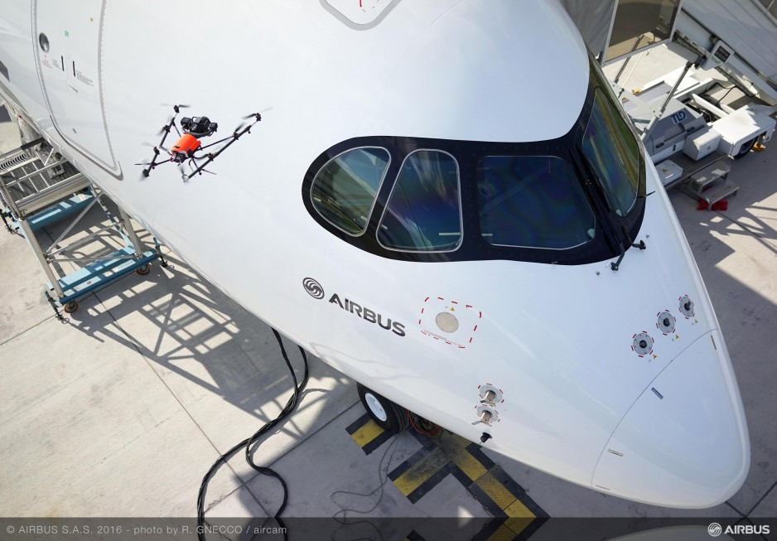
Themes of the Industrial Internet of things
Current investment is focusing on Brownfield and Greenfield installations.
IIoT is enabling real-time visibility into industrial process
Analyzing data and extracting insight allow creates a virtuous cycle of business improvement
Notes:
Riding on continued advancement of computation and communication technologies, the industrial internet can dramatically transform industrial control systems in two major themes: Increasing local collaborative autonomy: New sensing and detection technologies provide more and more accurate data. Greater embedded computational power enables more advanced analytics of these data and better models of the state of a physical system and the environment in which it operates. The result of this combination transforms control systems from merely automatic to autonomous, allowing them to react appropriately even when the system’s designers did not anticipate the current system state. Ubiquitous connectivity between peer systems enables a level of fusion and collaboration that was previously impractical. Increasing system optimization through global orchestration: Collecting sensor data from across the control systems and applying analytics, including models developed through machine learning, to these data, we can gain insight to a business’s operations. With these insights, we can improve decision-making and optimize the system operations globally through automatic and autonomous orchestration.

Slide 17
CROSSCUTTING FUNCTIONS AND SYSTEM CHARACTERISTICS
Resilience
Privacy
Scalability
Compliance
Compliance
Security
Functional Domains
Control
Operations
Information
Application
Control
Physical System
Notes:
CROSSCUTTING FUNCTIONS AND SYSTEM CHARACTERISTICS The functional components described so far in the functional domains focus on major system functions that are generally required to support generic IIoT usages and to realize generic IIoT system capabilities for business purpose. However, additional functions must be provided to enable the major system functions. Often these enabling functions, the so-called crosscutting functions, need to be made available across many of the system functional components. For example, system functions need to be connected so they can interact with each other to complete functionality at the system level. Therefore, connectivity is considered a crosscutting function. An important element in the industrial internet is the application of analytics on the data gathered from the industrial assets and control systems to gain insights on their operations. To enable analytics on these asset data, many of the system functional components require concerted effort on data management. Therefore, data management is also considered a crosscutting function.
On the other hand, the aggregate behavior of an IIoT system is not the simple sum of what is provided by its constituent functional components. Like any complex system, there are emergent behaviors or properties resulting from the interactions of the constituent parts. These emergent system-wide properties are called system characteristics.
The system and crosscutting functional analysis largely concerns how the system works while the analysis of system characteristics emphasizes how well the system works. For example, to ensure security in a system, a certain set of security functions, as crosscutting functions, must be implemented in each of the functional components and their communications, such as encryption and authentication. However, how secure the system as a whole is depends on how these functions are implemented and how securely these functional components are integrated and interact with each other—as an emergent property. In fact, a system is as secure as its weakest component, or link between components. The same is true for safety, resilience and any other system property. The trust into a system based on a set of such system characteristics, including safety, security, resilience, reliability and privacy, is defined as trustworthiness of the system.
This reference architecture places a strong emphasis on both the functions needed to support the system’s business purpose and ensuring adequate system characteristics so that the functions are performed correctly and the business purpose is not compromised.

Slide 18
FUNCTIONAL DOMAINS & COMPUTATIONAL DEPLOYMENT PATTERNS Edge
Edge Network
Platform Network
Enterprise Network
Information Domain
$ Monetization
Control Domain
Data Flows
Data & Analytics Services
Ingestion & Transformation
Streaming and Batching
Higher Level Info. Flows
Business Domain
Bi Analytics
CRM
EMR
ECS
MYA
Business Apps.
Actuators
Gateway
Orchestration Flows
Controller
Data Flows
Operational Flows
Application Domain
Operations Domain
Control Automation
API and Operator Portal
Process Flows
Manufacturing Flows
Customer Apps.
Sensors
Provisioning & Deployment
Asset & Metadata
Predictive Analytics &
Optimization
Asset Mgmt. Flows
Operator Apps
(IT & OT)
Notes:
The term Cyber-physical systems (CPS) has been defined as the systems in which natural and human made systems (physical space) are tightly integrated with computation, communication and control systems (cyber space). Cyberphysical systems has been called as national research priority of the United States and European research council (Horizon 2020 program) in various sectors such as automotive, aerospace, civil, railways, medical and manufacturing (Gill 2008) (Anon 2013). Considering recent developments and broad implementation of sensors, data acquisition systems, computer networks and cloud computing have prepared the infrastructure for designing and implementing cyber-physical systems in the aforementioned industry sectors. On the other hand, the vast usage of sensors and control systems in the industry results in generating huge amount of data. Managing such high volume of data, which is called Big Data, requires specific consideration (Lee et al. 2013). Therefore, in the big data environment, it is important to have a systematic approach for acquiring, managing and analyzing the data in order to acquire relevant knowledge from it. Cyber-physical systems can be used to address these issue in today’s industry by bringing autonomous control, self-awareness and selfmanagement capabilities to industrial machines (National Institute of & Technology 2013) .

