Slide 1

Sensors and Actuators
Industrial IoT
Software and Services Group
IoT Developer Relations, Intel

Slide 2
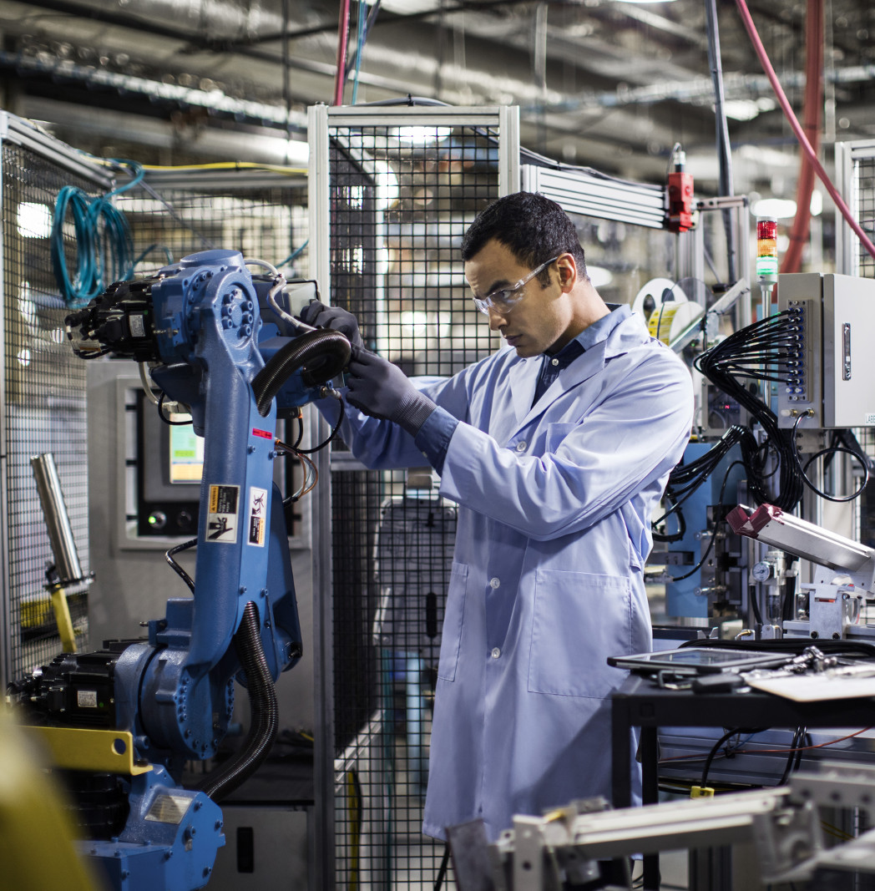
Cyber-Physical
Cyber-Physical Systems (CPS) are integrations of computation, networking, and physical processes.
Physical processes affect the computation model of the process and vice-versa.
The economic impact of cyber-physical systems is vastly greater than what has been realized. Major investments are being made worldwide to develop the technology.

Slide 3
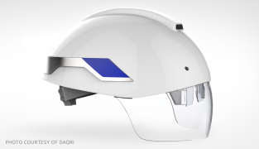
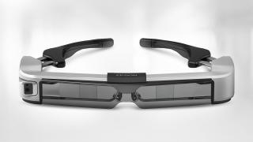


Sensors for products that enhance worker safety
DAQRI Brings Augmented Reality to Industry
The DAQRI Smart Helmet* powered by Intel allows wearers to overlay maps, schematics, and thermal images to effectively see through walls, pipes, and other solid objects.
Epson Offers Augmented-Reality-Ready Smart Glasses
MOVERIO* smart glasses are powered by an Intel Atom® processor.The BT-350 is designed for multi-user, augmented reality applications, such as remote support, arts & culture, enterprise drone, and subtitling & translation.
Fujitsu Improves Worker Management
Fujitsu’s UBIQUITOUSWARE* is an industrial worker management platform enabling data acquisition from a wide variety of sensors. An Intel® architecture-based IoT gateway gathers, filters, and applies local analytics.
KNAPP Aims at Zero Defects
The KNAPP IVII Headset* is an Intel-powered wireless, smart worker wearable solution with a unique see-through display that gives workers access to both real and virtual information.

Slide 4
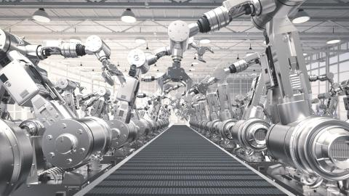
Sensing for Automation and Robotics
Intel® architecture-based connected worker solutions bring essential capabilities, including:
Continuous environmental monitoring and alerts, both locally on the gateway, and in the remote command center
Immediate, one-to-one “over the shoulder” coaching by remote experts
Timely access to contextually relevant, critical information while on the job
Contextual augmented-reality-based training on site.

Slide 5
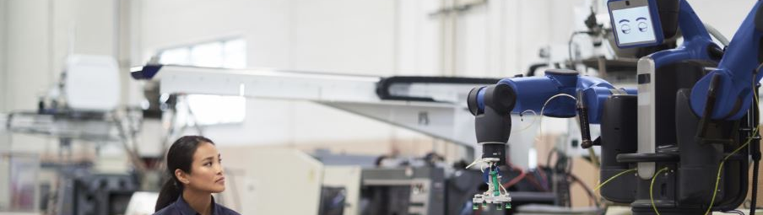
Industrial Sensors

Slide 6
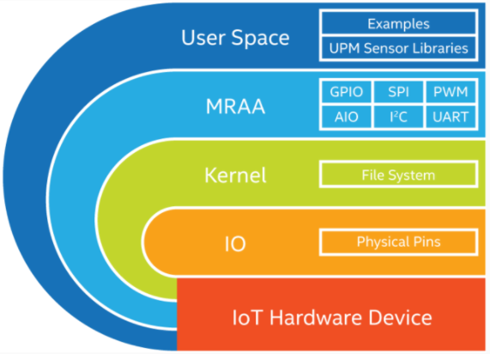
MRAA - An I/O Library for the Internet of Things
Provides I/O abstraction across both Intel and non-Intel (community added) MCU boards, UNIX boards and IoT Gateways.
X86
Minnowboard
NUC
UP2 Board
Intel® NUC
UP* and UP Squared*
Arduino* and Genuino* 101
ARM
Raspberry Pi
Banana Pi
Beaglebone Black
phyBOARD-Wega
96Boards
https://github.com/intel-iot-devkit/mraa

Slide 7
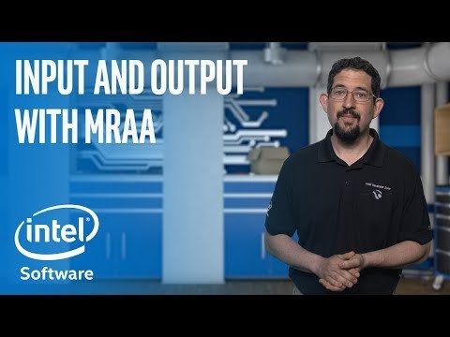
MRAA, UPM Introdction video

Slide 8
Introducing Intel IoT Device Libraries: MRAA and UPM
libmraa aka “MRAA”: https://github.com/intel-iot-devkit/mraa
Open Source IO Libs (UART, SPI, GPIO, I2C, AIO)
Provides higher level abstraction making hardware IO easier to use from userspace
Enables portability between devices
Supports Intel® Galileo and Intel® Edison boards, MinnowBoard MAX, etc.
UPM: https://github.com/intel-iot-devkit/upm
High level library repository of sensor drivers
Sensors/Actuators using libmraa
Making it easy to control
Expanding support to Industrial grade sensors
UPM and MRAA make it easy to build IoT projects!

Slide 9
















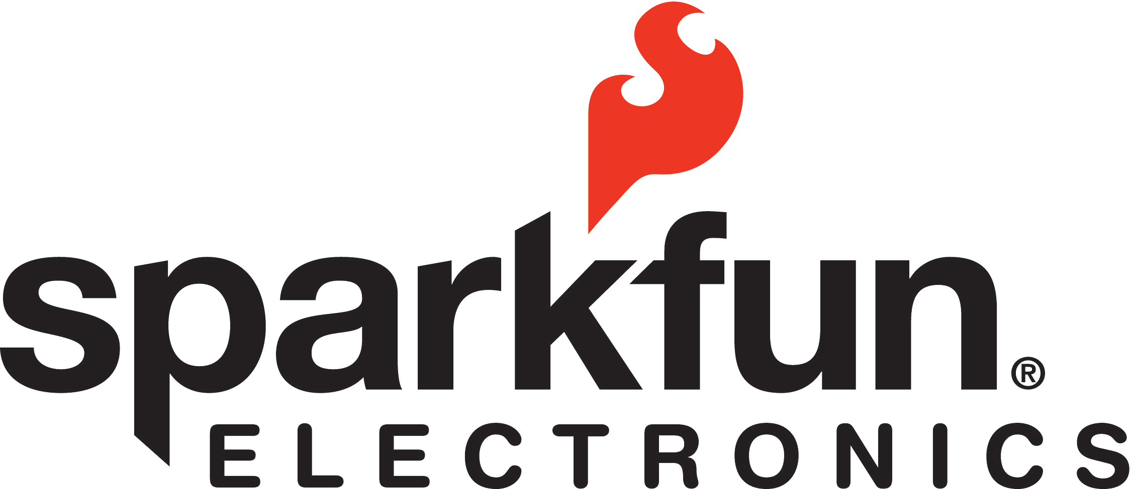









Making Sensors and Actuators Accessible
Support for Multiple Operating Systems
Support for Multiple Languages
Maker Sensors
Industrial Sensors

Slide 10
MRAA & UPM – Architecture
UPM Module
UPM Module
UPM Module
UPM Module
UPM C++ Interfaces
iTemp
iGyro
iCompass
iAccel
iMotor
iDisplay
iLoRaWAN
iLTEClient
Others …
iSensor
iActuator
iRadio
iio
UPM C generic interfaces
Mraa C/C++ APIs
Libmodbus
Bacnet
Others …
GPIO
i2c
SPI
UART
PWM
Linux Kernel

Slide 11
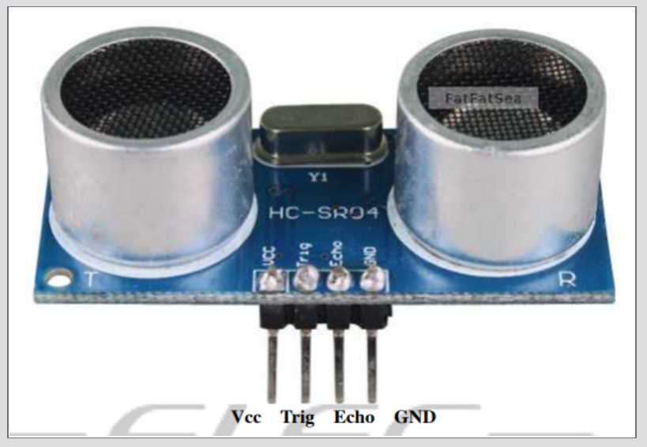
MRAA and UPM Benefit
Let’s see what kind of advantage MRAA, UPM brings sensor software development with Ultrasound Sensor example
GOTO: https://github.com/SSG-DRD-IOT/ultrasound_sensor (https://goo.gl/cbQmcH)

