Slide 1

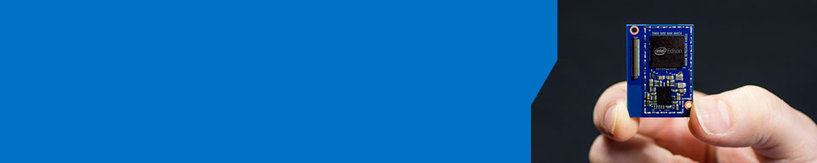
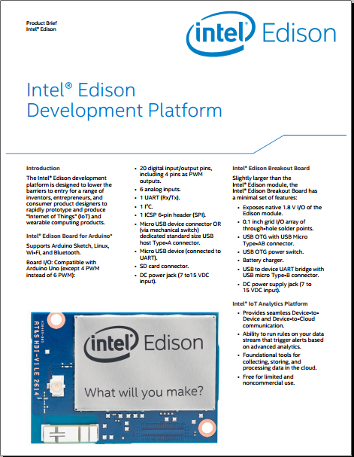
What Will You Make?
Intel® Edison - Create wearables and other products for the Internet of Things
Intel Facts
Global headquarters: Santa Clara, California
100,000+ employees worldwide
55 percent of employees reside in the U.S.
Intel’s vision: This decade we will create and extend computing technology to connect and enrich the life of every person on earth
Notes:
Intel is very heavily committed to the development of the Internet of Things, through development of our silicon & software products.
One of the foundation stones of this capability from the HW point of view are the Edison & Galileo development boards, they are based on our embedded silicon system on a chip processors.
As you can see from our vision we are centrally focused on getting devices to connect & communicate.

Slide 2
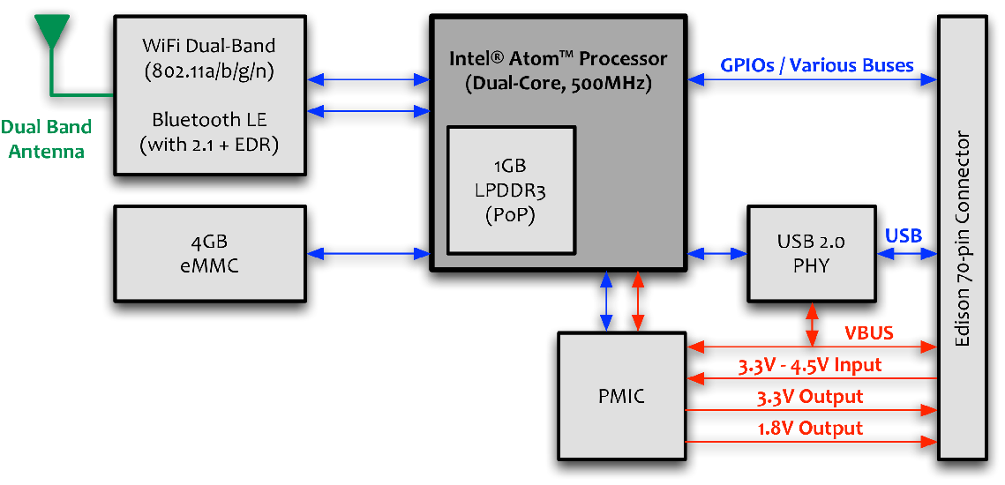
Intel® Edison Block Diagram

Slide 3
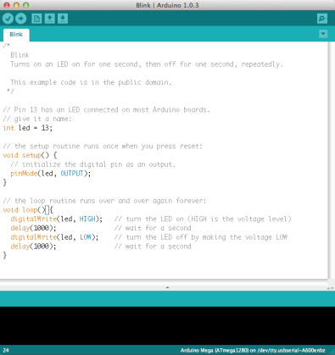
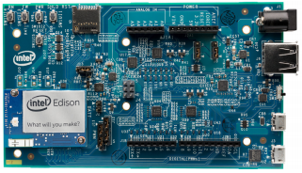
What is Arduino?
An open-source hardware and software platform for building electronics projects
A physical programmable circuit board (often referred to as a microcontroller)
A piece of software, or IDE (Integrated Development Environment) that runs on your computer, used to write and upload computer code to the physical board (supports Mac/Windows/Linux)

Slide 4
Intel® Edison Board for Arduino
Board I/O: Compatible with Arduino* Uno (except only 4 PWM instead of 6 PWM)
20 digital input/output pins including 4 pins as PWM outputs
6 analog inputs
1 UART (RX/TX)
1 I2C
1 ICSP 6-pin header (SPI)
Micro USB device connector OR (via mechanical switch) dedicated standard size USB host Type-A connector
Micro USB device (connected to UART)
SD Card connector
DC power jack (7V – 15V DC input)
Arduino Sketch, Linux, WiFi & BT
Other names and brands may be claimed by the property of others by all third party name and the notation.

Slide 5
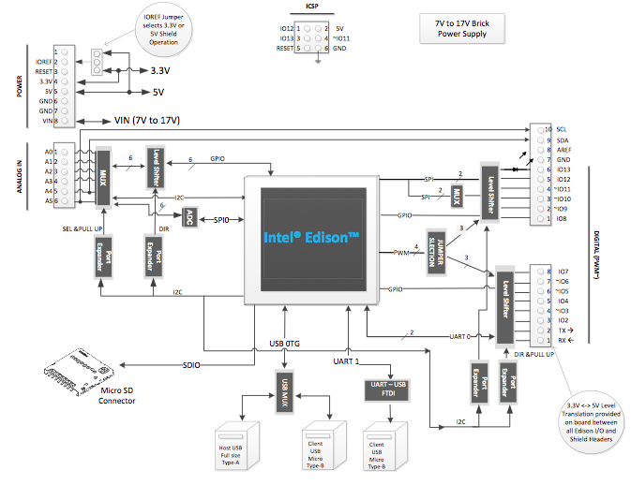
Intel® Edison Arduino Expansion Board Block Diagram

Slide 6
Arduino Shields
There are hundreds of shields available from dozens of suppliers
GSM/Wifi/Bluetooth Ethernet/GPS
Battery/Solar RS232/RS485
RFID/Xbee/NFC SD/EEPROM
Midi/WAV/MP3 Camera/Video/Home
Sensors/LCDs Robotics/Fun/Actuators
shieldlist.org
adafruit.com
cooking-hacks.com
sparkfun.com
store.arduino.cc
cutidigi.com
etc

Slide 7
Edison Developer Options
Arduino*
Developer
Java script
Developer
Embedded
Developer
Visual
Programming
MCU
Developer
Cloud
IoT Kit & Mashery*
IDE
Arduino* IDE
Win */ Mac*
Intel XDK
Win*/ Mac*/ Linux*
Eclipse
Win*/ Mac* / Linux*
Wyliodrin*
Web
Win*/ Mac* / Linux*
Programming
Language
Arduino* Sketch
C++
Javascript (Node JS)
C/ C++/Python
Visual
Javascript
C/C++
Tools/ Libraries
Arduino* Libraries
Intel XDK
ISS
Wyliodrin*
MCU SDK
OS /
Boot Image
Yocto Linux* 1.6
RTOS
* Windows is a registered trademark of Microsoft Corporation in the United States and other countries. Other names and brands may be claimed by the property of others by all third party name and the notation.

Slide 8
Arduino
Software overview

Slide 9
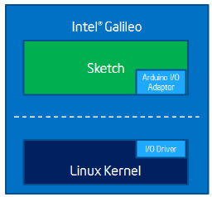
Arduino Software Compatibility
Familiar Arduino IDE with example sketches
Edison
Load Sketch from PC to Edison

Slide 10
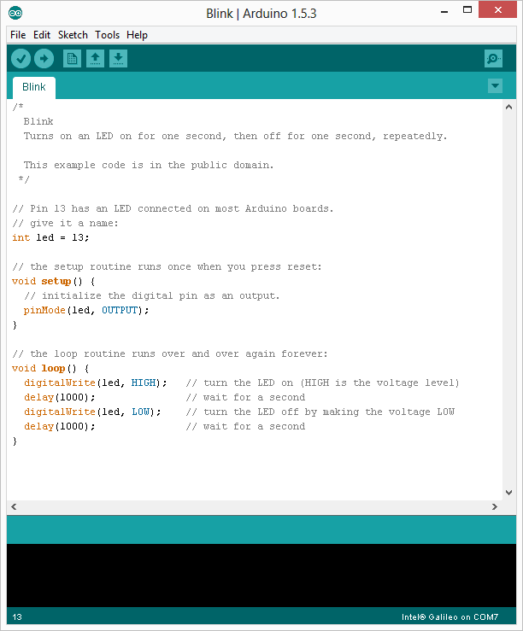
Sketch Overview
Comment Block
Comment
Global Variable
Code executed once on initial load
Code Loop ran continuously

Slide 11
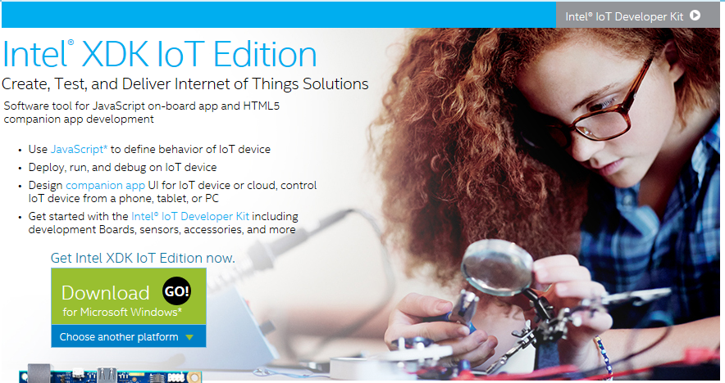
Intel® XDK – IoT Edition
https://software.intel.com/en-us/html5/xdk-iot
Notes:
Intel XDK IoT Edition simplifies IoT app development from design, test, to deployment on Intel Edison and Intel Galileo boards, and enables accompanying companion apps to interact with IoT devices in new ways. With Intel XDK IoT Edition’s advanced capabilities Makers get an integrated IoT development approach to: ▪ Create, run, and debug IoT applications using Node.js* on Intel Edison and Intel Galileo Boards ▪ Design HTML5 companion apps to interact with IoT devices from phones, tablets, PCs, or through cloud services This dual capability helps Makers speed time to a complete solution to reach millions of devices in new markets, from home automation, connected devices, transportation, to smart appliances, and more.
Integrated create, debug, and run tools for JavaScript* on-board application development • Enables easy on-board app development and deployment for many IoT devices • Utilizes Node.js* to define behavior of IoT device • Deploy, run, debug on IoT device with Node.js* • Quick start samples and templates for IoT • Integration with cloud, web services, and sensors through JavaScript* APIs • Secured SSH tunnel daemon support with user password or key-based authentication • SSH and Serial terminal connection support

Slide 12
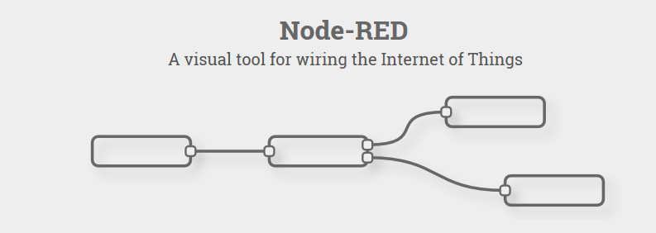
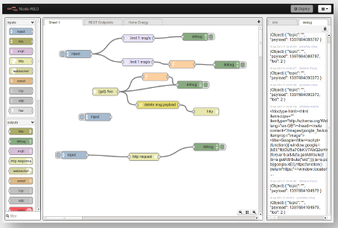

Node Red
http://nodered.org/
Notes:
Node-RED is a tool for wiring together hardware devices, APIs and online services in new and interesting ways.
Node-RED provides a browser-based flow editor that makes it easy to wire together flows using the wide range nodes in the palette. Flows can be then deployed to the runtime in a single-click.
JavaScript functions can be created within the editor using the a rich text editor.
A built-in library allows you to save useful functions, templates or flows for re-use.
The light-weight runtime is built on Node.js, taking full advantage of its event-driven, non-blocking model. This makes it ideal to run at the edge of the network on low-cost hardware

Slide 13
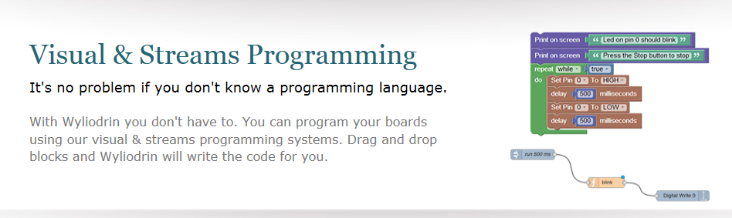
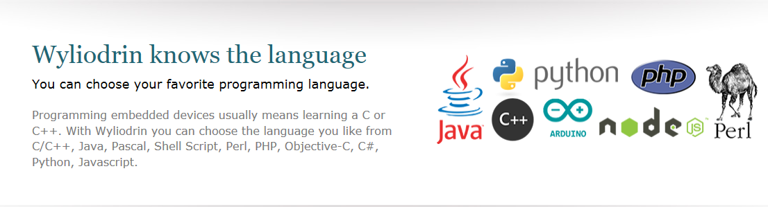
Wyliodrin
https://www.wyliodrin.com/
https://projects.wyliodrin.com/wiki/boards_setup/arduinogalileo
Notes:
Wyliodrin is a service that allows you to visually create applications for your board and control it directly from the browser.
With the Wyliodrin service you can create applications for your board without having to:
Connect your board to a monitor, keyboard and mouse
Use SSH to connect to it
Know a programming language (C, Java or Python) in detail
Search for drivers of sensors etc
Visual Programming allows you to create applications without having to write the code yourself. You just drag and drop your desired pre-defined application components (blocks) to create the application you want.

Slide 14


Let’s see how it works…….

Slide 15
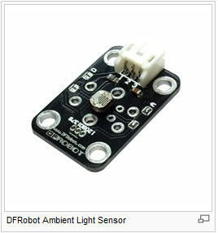
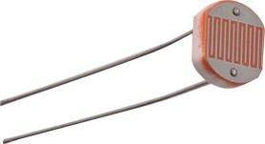
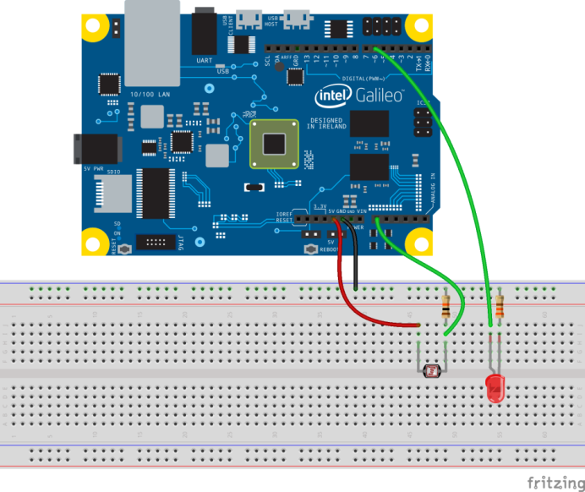
Adding a Sensor
#define A_PIN 0 //analog pin for LDR
#define D_PIN 6 //digital pin for LED
int value;
void setup() {
pinMode(D_PIN, OUTPUT);
}
void loop() {
value = map(analogRead(A_PIN), 0, 1023, 0, 255);
analogWrite(D_PIN, value);
}
Light Distance Temperature Acceleration Vibration
Motion Touch Gas
Sound
Etc….
Great breadboarding tool – fritzing
http://fritzing.org/home/

Slide 16

How does this get communicated ???
Using Edison’s WiFi capability
IBM Bluemix Cloud service
– http://datafest.mybluemix.net/?cm_mmc=IBMEcoDNA-_-IICSVL-_-outbound-_-Datafest2015
https://console.ng.bluemix.net/home
Portal uses MQTT Broker to communicate to devices - http://mqtt.com/
Note :- Arduino native MQTT library needs to be modified to work on Edison & Galileo – we have the library here ☺
For testing purposes, there is a test portal to validate that data is being sent.
https://quickstart.internetofthings.ibmcloud.com/#/

Slide 17
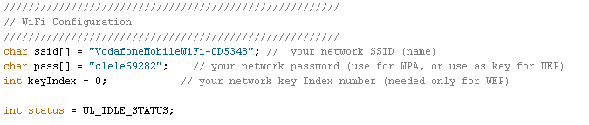
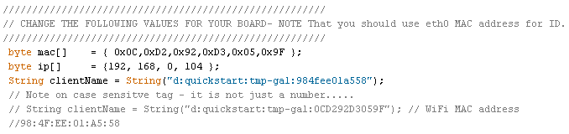
Let’s look at a simple MQTT Test
Setup Temperature Sensor input to A0 of Galileo
Sample Arduino Sketch provided – EdisonTemp.ino
Notes :-
Setup WiFi connection
All you need is SSID & Passphrase
Configure MQTT Session
Client Name format
d:quickstart:<name>:mac
Max length 34 characters
WiFi MAC address used as a unique Identifier - found inside Edison Box
MAC address is case sensitive – consistent cut & paste needed ☺

Slide 18
Where do I find everything ??

Slide 19
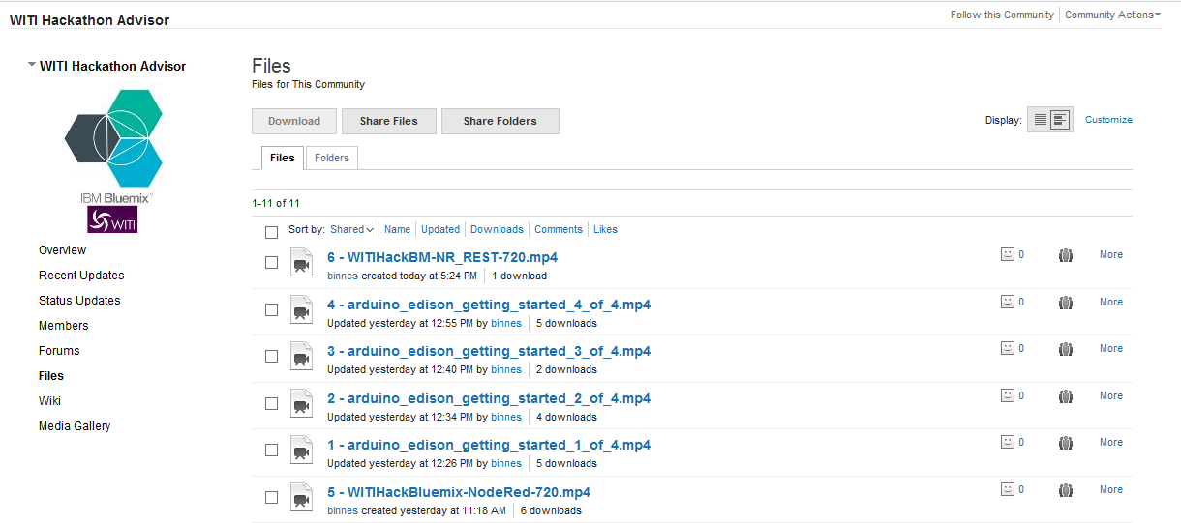
WITI Hackathon – IBM Site
Videos guiding you through the topics covered in today’s Webinar

Slide 20
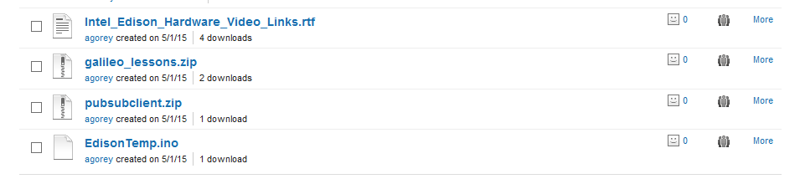
Getting Started Files – IBM Site
Video Links to other Edison Training Material
Powerpoint tutorials for getting started with Arduino IDE
MQTT Arduino Library for Edison & Galileo
Example MQTT Arduino Sketch to IBM Quickstart
https://www.ibm.com/developerworks/community/groups/service/html/communityview?communityUuid=062ec653-df20-41f8-aef8-be4566dfe442#fullpageWidgetId=Wd63664788fd0_4928_98be_429ec526a3b4

Slide 21
Support From Intel – Where to Go
The IBM WITI Page is your one-stop-shop for support
Intel will monitor the forum pages & provide any assistance required during the Hackathon event.
Intel have a wide spread across Geos who will monitor the forum
Target response time is 24hr
Intel will continue to post further useful documents & guides to the IBM pages over the coming days & weeks.

Slide 23
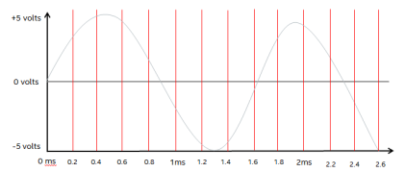
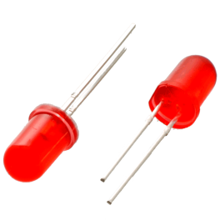
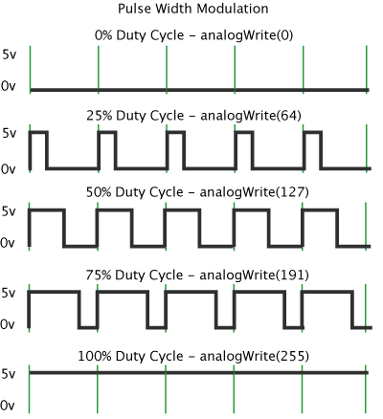
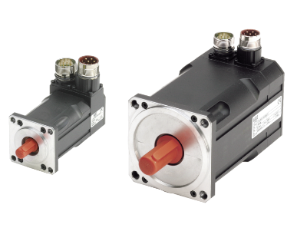
Controlling The I/O
Digital Input / Output
These are used to control single digital singles & can be set to either output a signal or receive a signal.
Uses – reading input signals like switches, controlling outputs LEDs, Motors, Relays
Analogue Digital Converter
12 bit accuracy, 6 channels available through Arduino pins
ADC sampling at 5kHz- take a ‘snapshot’ of the voltage level every 200uS
PWM – Pseudo Analogue Outputs
PWM stands for Pulse Width Modulation
Used to get analogue results by digital means
Sends pulses of power to simulate voltage
The duration of high power is know as the ‘Pulse Width’

Slide 24
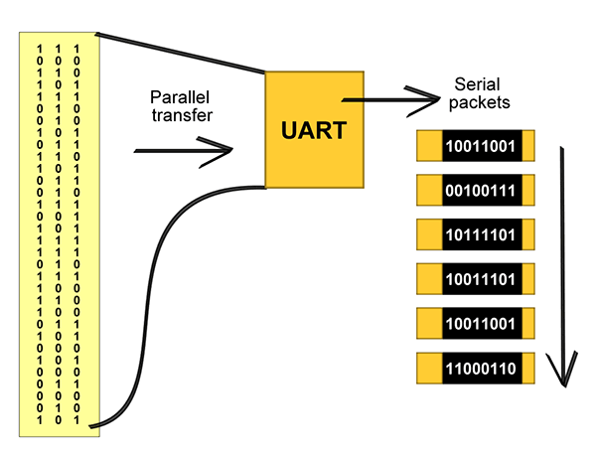
Controlling the I/O
UART
UART stands for Universal Asynchronous Receiver/Transmitter (UART)
It is a piece of computer hardware that translates data between parallel and serial forms.
The universal designation indicates that the data format and transmission speeds are configurable.
It takes bytes of data and transmits the individual bits in a sequential fashion.
At the destination, a second UART re-assembles the bits into complete bytes.
Second UART available Arduino pins
I2C
I²C stands for Inter-Integrated Circuit
It is a bus used for attaching low-speed peripherals to computer motherboards and embedded systems.
See http://en.wikipedia.org/wiki/I%C2%B2C for more information.
Low speed data communication
Collecting data from sensors and other devices.
Available through Arduino pins

