Slide 1
IBM WITI Hackathon
Sensor Circuits

Slide 2
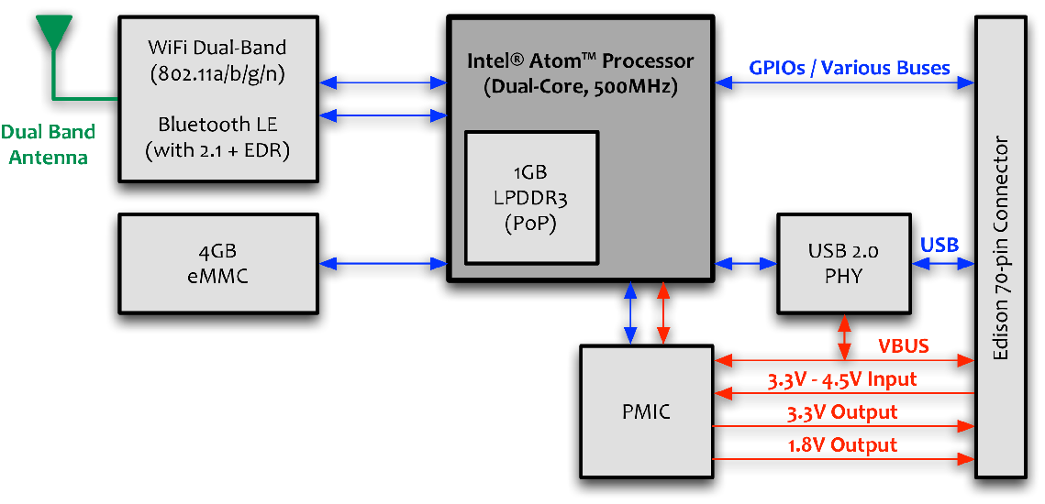
Intel® Edison Block Diagram

Slide 3
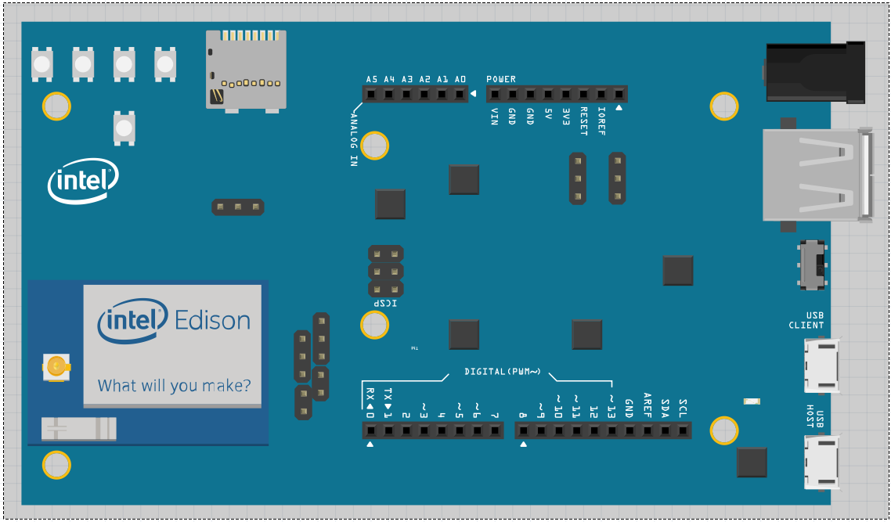
Edison Arduino Mapping
ADC Inputs
VCC & GND
GPIO + PWM + SPI
UART
I2C

Slide 4
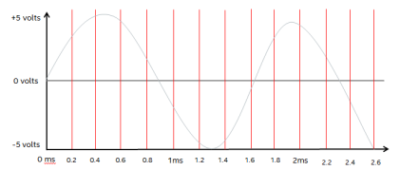
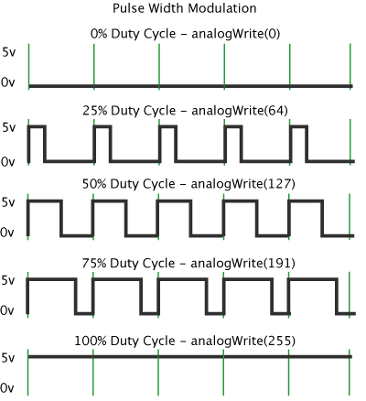
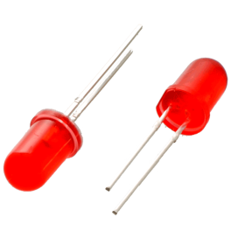
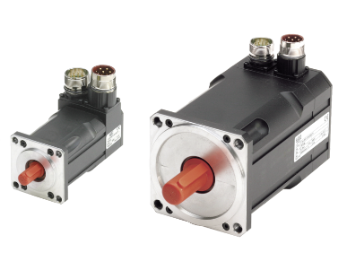
Controlling The I/O
Digital Input / Output
These are used to control single digital singles & can be set to either output a signal or receive a signal.
Uses – reading input signals like switches, controlling outputs LEDs, Motors, Relays
Analogue Digital Converter
12 bit accuracy, 6 channels available through Arduino pins
ADC sampling at 5kHz- take a ‘snapshot’ of the voltage level every 200uS
PWM – Pseudo Analogue Outputs
PWM stands for Pulse Width Modulation
Used to get analogue results by digital means
Sends pulses of power to simulate voltage
The duration of high power is know as the ‘Pulse Width’

Slide 5
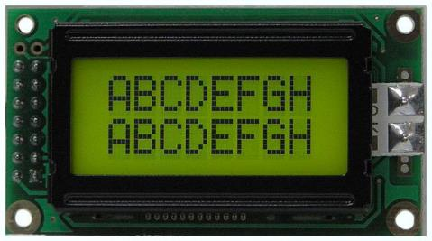
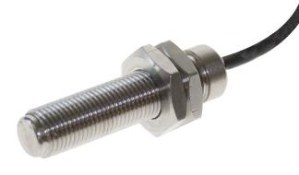
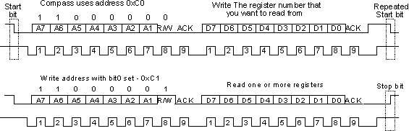
Controlling the I/O
UART
UART - Universal Asynchronous Receiver/Transmitter (UART)
The universal designation indicates that the data format and transmission speeds are configurable.
It takes bytes of data and transmits the individual bits in a sequential fashion.
Second UART available Arduino pins
I2C
I²C stands for Inter-Integrated Circuit
See http://en.wikipedia.org/wiki/I%C2%B2C for more information.
Low speed data communication
Collecting data from sensors and other devices.
Available through Arduino pins
SPI
SPI stands for Serial Peripheral Interface
It is a synchronous serial communication interface specification used for short distance communication in embedded systems.
SPI devices communicate in full duplex mode using a master-slave architecture with a single master.
Direct Connect to Edison Arduino Header.
One-Wire Serial
Simple signalling scheme half-duplex bi-directional communications between master and one or more slaves sharing a common data line.
Both power delivery and data communication take place over this single line.
Requires additional Edison Circuitry to have split Rx &Tx

Slide 6
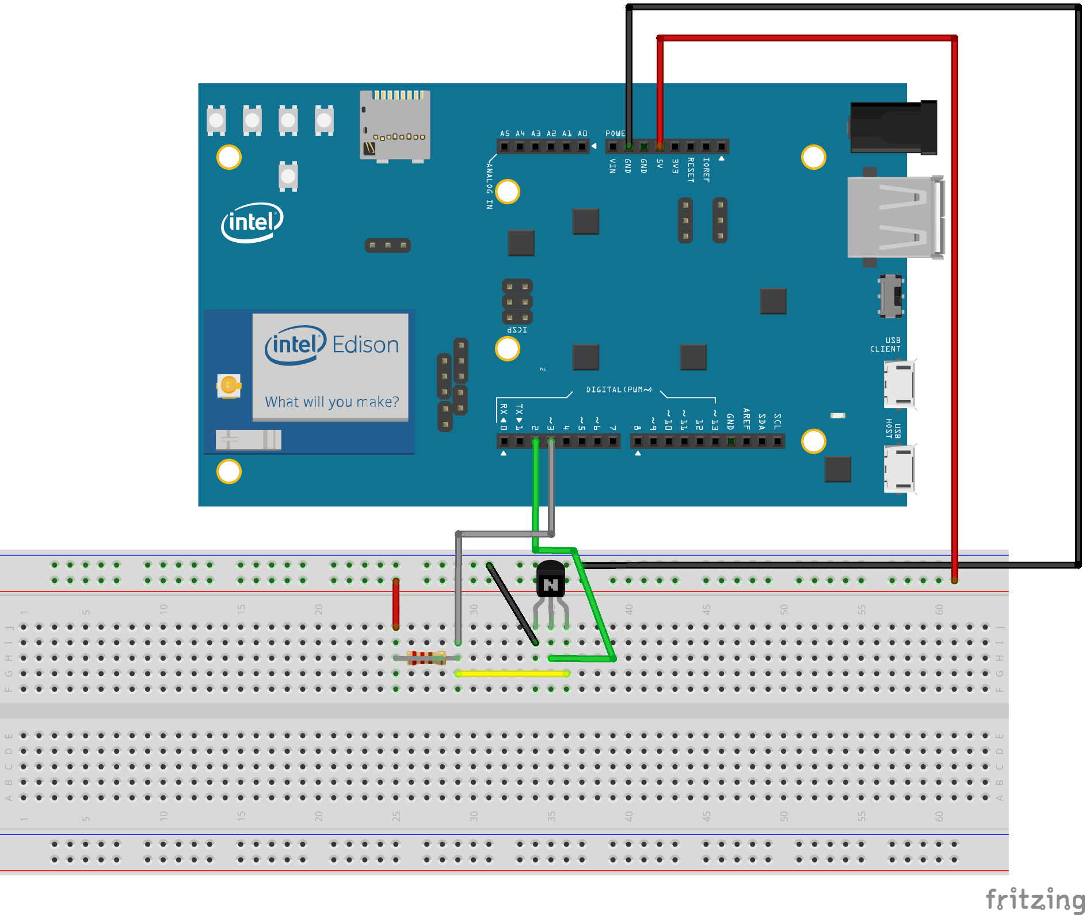
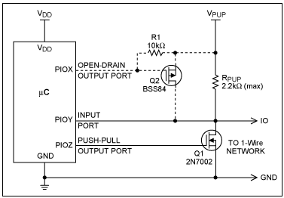
Useful Circuits – One-Wire Serial implementation
VCC
GND
Sensor

Slide 7
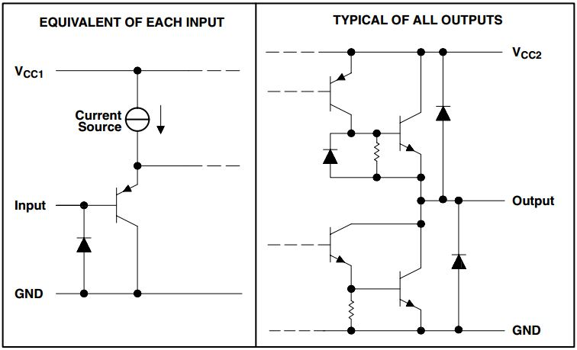
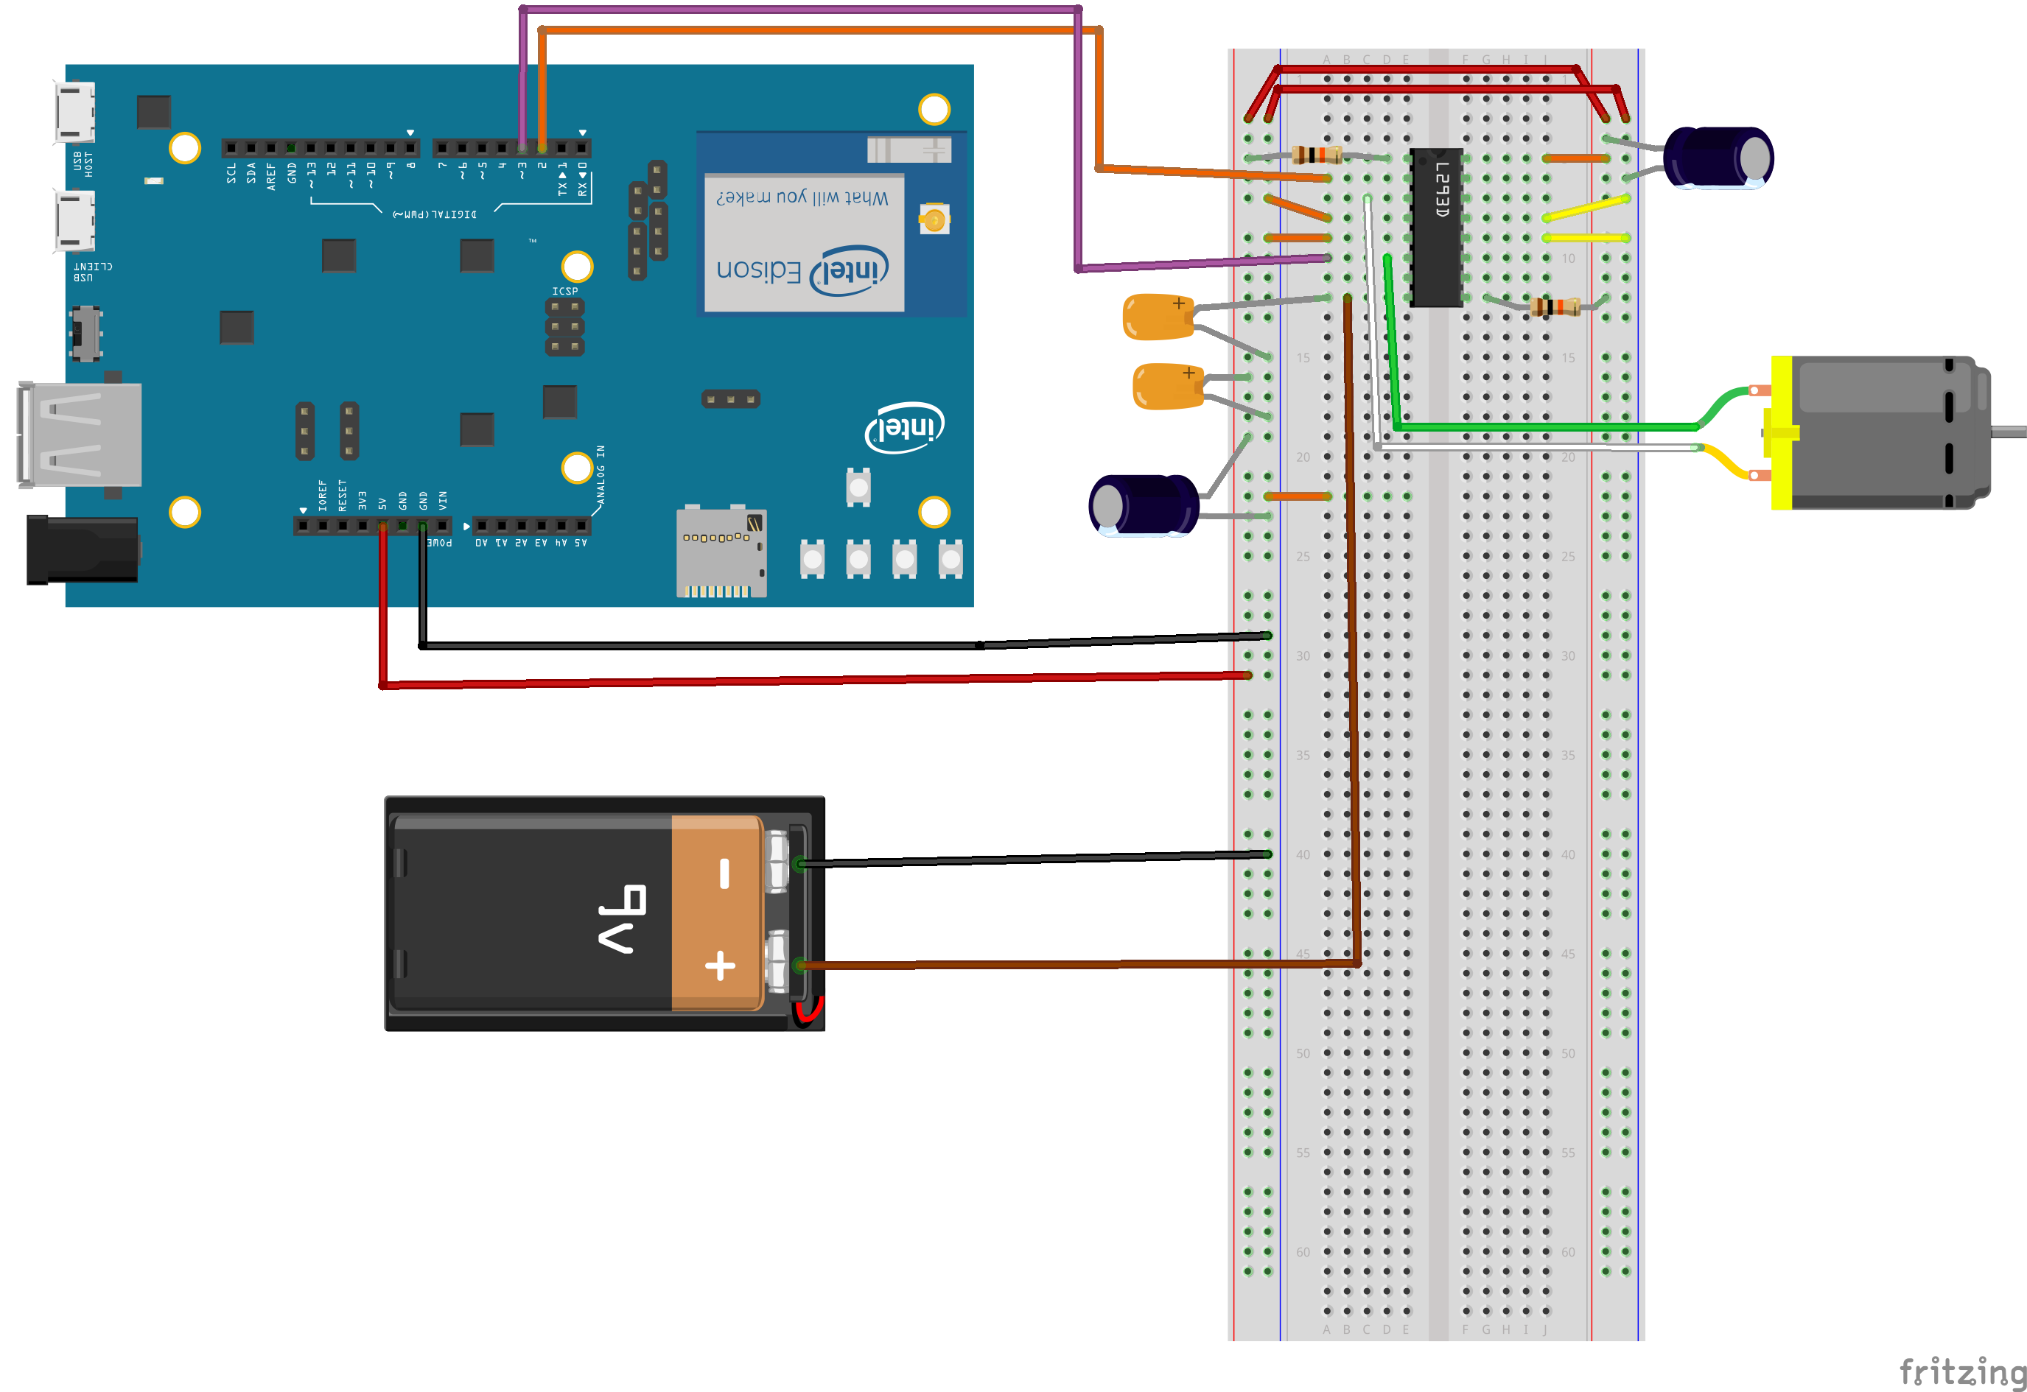
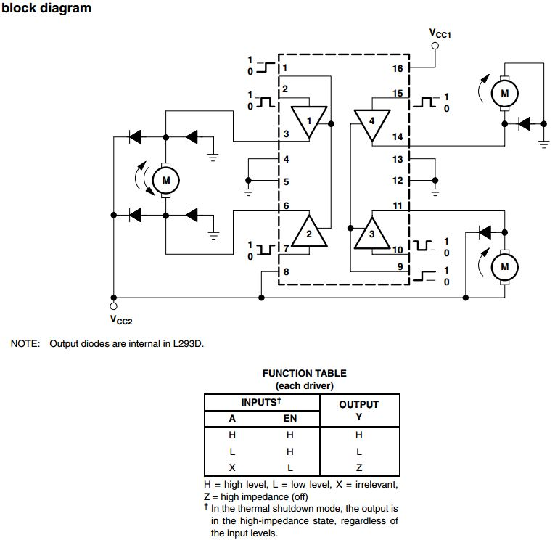
Controlling a DC Motor – Drive Circuit
L293DN
Motor Control is a combination of a drive circuit & PWM outputs to control speed.
Circuit shown can drive Motor in both directions.
GPIOs perform control function for Battery Voltage.
Making Pin 2 high and Pin 3 low will rotate the DC motor in one direction.
Making Pin 2 low and Pin 2 high will rotate
the DC motor in the opposite direction.

