Slide 1
Co-design of Compiler, Library and Runtime for Sparse Applications
Hongbo Rong, Jongsoo Park, Mikhail Smelyanskiy, Todd Anderson
PSL & PCL
SSR Talk, Feb. 26, 2015

Slide 2
Acknowledgement
PSL
Hai Liu, Chunling Hu, Rajkishore Barik, Tatiana Shpeisman, Youfeng Wu
PCL
Victor W. Lee, Narayanan Sundaram, Pradeep Dubey
SSG
Paul Petersen, Geoff Lowney, Greg Henry

Slide 3
Problem statement
There are building blocks shared by many sparse applications
SpMV, triangular solver, etc.
Every kernel is of high performance individually
written and tuned by a library expert
But a sequence of calls to them may not
They are not designed to cooperate with each other

Slide 4
Our goal
Make the kernels cooperate with each other
Minimize changes in libraries like MKL
Optimize a wide range of sparse applications with high productivity

Slide 5
Background: PSE and Julia
This work is part of the PSE project
PSE (Problem-Solving Environment)
Address the gap between productivity and performance
Target customers: scientists, data analysts, etc
Target languages: scripting languages (Julia so far)
Julia
High-level scripting language similar to MatLab
Matrix and vector are first class citizens
Much easier to analyze the context than C

Slide 6
Overview
Characteristics of sparse workloads
vs. dense linear algebra
Optimization opportunities
Co-designed compiler, library and runtime
Global redundancy removal: Saving BW and computations with inspector/executor model
Improving Locality: reordering and kernel fusion

Slide 7
Sparse Matrix
Source: often derived from “connections”
Dense connection is less common or uninteresting
e.g., mesh discretization of structure, social network
Relationship with graph
Sparse matrix with n rows and m non-zeros: interpret as a graph with n nodes and m edges
m << n² for n nodes and m edges
Importance of sparsity
m can be huge (>10⁹) and n² often overflows memory
Want to keep sparsity

Slide 8
Two Types of Sparse Matrix
Scientific matrix with uniform degree distribution
Domain: HPC. e.g., modeling physical structure
Benchmark: solver and optimization algorithms
Social network graph with power-law distribution
a.k.a. scale-free graphs, small world network
Domain: big-data analytics. e.g., social network, web links
Benchmark: BFS, shortest path, page rank, triangle count, …
This talk focuses on the former, but techniques can be applied to power-law matrix

Slide 9
Characteristics
Often manipulated with iterative algorithms
Direct algorithms increase density of the original sparse matrix, sometimes up to orders of magnitude
Performance is memory BW bound
Iterative algorithms have low arithmetic intensity
Data-dependent behavior
Indirect and irregular memory access
The amount and shape of parallelism varies

Slide 10
Examples
Building blocks
SpMV
Triangular solver
Algorithms
Basic conjugate gradient
Preconditioned conjugate gradient
Interior-point method
Newton-Krylov method

Slide 11
Canonical example – (Basic) Conjugate Gradient
while (!converged) {
y = A*x // sparse matrix-vector mult.
…
} // sparsity pattern of A doesn’t change
Observation 1: cost of JIT-compilation, specialization for input can be amortized

Slide 12
Building Block1 – SpMV
for each row i of A // compute y=A*x
sum = 0
for j in [A.rowptr[i], A.rowptr[i + 1])
sum += A.values[j]*x[A.colidx[j]] // 2 FP ops, 12 bytes
y[i] = sum
Observation 2: performance is memory BW
(only perform 2 FP operations for each matrix element)

Slide 13
Building Block1 – SpMV
for each row i of A // compute y=A*x
sum = 0
for j in [A.rowptr[i], A.rowptr[i + 1])
sum += A.values[j]*x[A.colidx[j]]
y[i] = sum
Observation 3: data-dependent irregular memory access
The best in-memory storage format differs (the above is CSR)

Slide 14
Building Block2 – forward triangular solver
for each row i of L // solve Lx=b (L lower triangular)
sum = b[i]
for j in [L.rowptr[i], L.rowptr[i + 1])
sum -= L.values[j]*x[L.colidx[j]]
x[i] = sum
Observation 4: data-dependent parallelism
Loop-carried dependency depend on array colidx

Slide 15
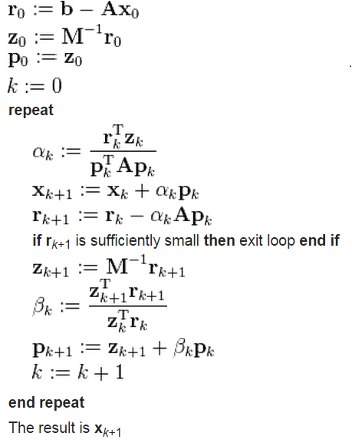
Preconditioned CG (e.g., HPCG)
Iterative algorithm
A and M⁻¹ doesn’t change
Multiple kernels can be fused

Slide 16
Preconditioned CG (e.g., HPCG)
Can use various preconditioners M⁻¹ (GS, multi-color GS, hybrid GS, Multigrid)
Want to optimize the whole loop for best performance
Difficult with black-box PCG library call

Slide 17
Interior-Point Method for Convex Optimization
while (!converged) {
}
Sparse direct solver inside a loop
Sparsity of M doesn’t change
Want to hoist redundant computation
Difficult with black-box direct solver library call
Scaling performance of interior-point method on large-scale chip multiprocessor system, Smelyanskiy et al., SC’07

Slide 18
Newton-Krylov CFD Solver
Nested solvers
Sparsity of A doesn’t change in outer loop
A=LU //ILU
Outer solver:
Newton method
Inner solver:
Krylov method
y=Ax //Flux:
y = L⁻¹b //Backward solver
x= U⁻¹y //Forward solver
Want to hoist redundant computation
Difficult with black-box Krylov solver library call
50~100 iterations
t=t+Δt

Slide 19
Optimization Opportunities
(Nested) Iterative algorithms. Matrices don’t change or changes slow
→ Global redundancy optimization
Memory BW bound
→ Locality optimization by fusing kernels
Need to provide context information to optimized kernels
Black-box library routines insufficient

Slide 20
Overview
Characteristics of sparse workloads
vs. dense linear algebra
Optimization opportunities
Co-designed compiler, library and runtime
Global redundancy optimization: Saving BW and computations with inspector/executor model
Improving Locality: reordering and kernel fusion

Slide 21
Co-design of compiler, library and runtime
Co-design them to specialize sparse applications in context
Compile- & run-time context-specific optimizations
Compiler
Identify context & convey to library
Loops, constant structures/values, frequent patterns
Compile-time context-specific optimizations
Reordering
Library
Computation and reuse
Kernel fusion
Runtime
Common optimizations as services
Matrix format conversion, Building task graph, Scheduling

Slide 22
Providing context-info to library
knob.constant_matrices = {M}
, knob)
User transparent. No source annotation
Compiler relatively easily identifies context info for a script
Library inspects data only when data change

Slide 23
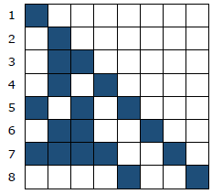
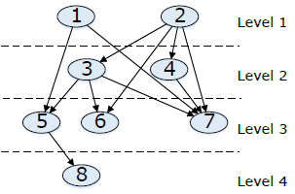
Global redundancy optimization(Reuse)
Data-dependent task graph for forward triangular solver [Park, et al. ISC’2014]
Sparsity pattern: data-dependent, constant across iterations
Task graph (one row for one task), level scheduling
Time consuming to build
Reuse

Slide 24
Global redundancy optimization(Reuse) : Initial evaluation of speedup potential
Base No reuse Reuse
Base No reuse Reuse
HPCG and Hypre: both call a sparse kernel SYGS
Baseline: sequential SYGS
Parallel SYGS: building task graph + task scheduling
Compare Reuse and NoReuse of task graph and schedule
Endeavor HSW: 2 CPUs, each 14 cores, 2.6GHz, 64GB memory
1 openmp thread per core, fine scatter
HPCG only: 1 MPI process per CPU, 1 openmp per core, fine scatter

Slide 25
Co-design
Acknowledgement: The idea of a matrix-specific KNOB is from Geoff Lowney

Slide 26
In general …
Every matrix has a MKNOB, with a public version
Every function has a FKNOB, referring to MKNOBs and having their private versions
Every function writing to a matrix increases the public version
Every function reading to a matrix compares with the public version, rebuilds internal persistent data, and updates its private version
Slow-changing matrices (like Physical simulation and MD) are then handled naturally

Slide 27
HPCG skeleton

Slide 28
HPCG skeleton after optimization

Slide 29
Data structures

Slide 30
Library Functions

Slide 31
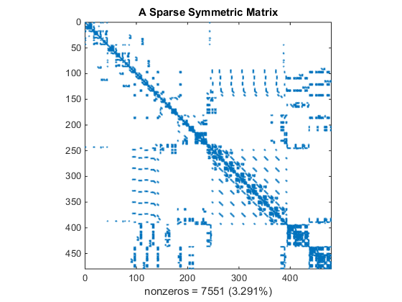
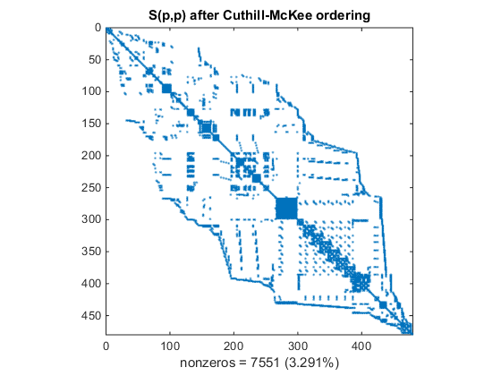
Reordering
CG
A = reorder(A)
Potential:
~20% for HPCG on Xeon Phi [Park et al. SC’14]
~50% for SpMV on a 16-core Sandy Bridge Xeon [Karantasis et al. SC’14]
Pictures from http://www.mathworks.com

Slide 32
Reordering
A = reorder(A)
p = reorder(p)
Loop recognition
while (!converge)
q=A*p;
print(q)
reorder p as well
Liveness analysis
q = reverseReorder(q)
Type inference
q must be reverse reordered
Feasibility test
Reorder and reverse reorder

Slide 33
2015 Plan
Open source of a Julia package
optimizations
Global redundancy optimization (Reuse)
Reordering
Benchmarks:
CG, PCG, IPM, CFD, AMG
Target applications: general sparse iterative applications
External publication
Starting discussion with MKL & external library teams

