Slide 1
Encrypted Computing SDK Polynomial Instruction Set Architecture Tools
Flavio Bergamaschi, Privacy Technologies Research, Intel Labs
7th March 2025

Slide 2

Notices and Disclaimers
For notices, disclaimers, and details about performance claims, visit www.intel.com/PerformanceIndex or scan the QR code:
© Intel Corporation. Intel, the Intel logo, and other Intel marks are trademarks of Intel Corporation or its subsidiaries. Other names and brands may be claimed as the property of others.

Slide 3
Encrypted Computing SDK Modular Approach
FHE program
Multistage transformation (compiler) pipeline
Inspired by the LLVM
Based on language independent intermediate representations (IR)
Each stage promotes a separation of concerns
Each stage applies dedicated transformations and optimizations
FHE lib (OpenFHE)
Encrypted Computing SDK
FHE to Poly IR
Polynomial IR
p-ISA tools
p-ISA IR
Assembler tools
HERACLES Binaries
Host Runtime
HERACLES Silicon

Slide 4
HERACLES SDK Integration with future 3rd Party Tools
App (e.g., C++, Python, etc)
App (e.g., C++, Python, etc)
FHE program
Translation to FHE
HEIR Compiler
FHE lib (OpenFHE)
Encrypted Computing SDK
FHE to Poly IR
Polynomial IR
p-ISA tools
p-ISA IR
Assembler tools
HERACLES Binaries
Host Runtime
HERACLES Silicon

Slide 5
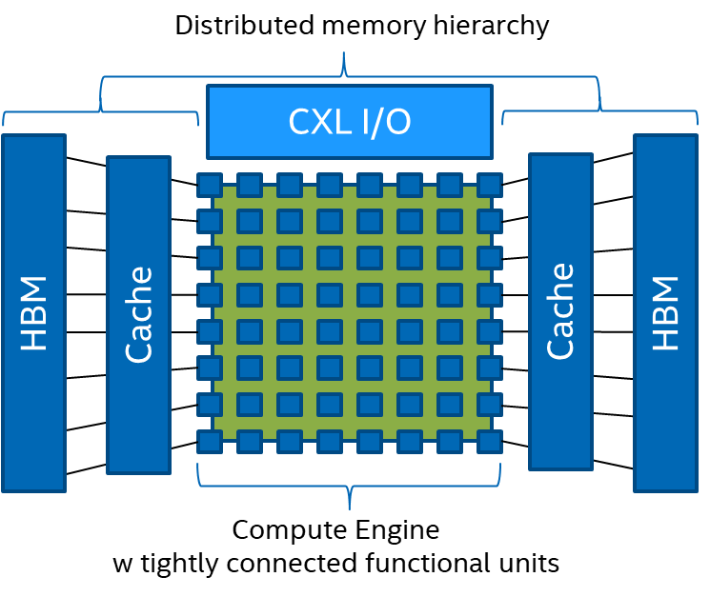
HERACLES Overview
Memory physical organization
SPAD
SPAD
Mfetch Inst.
Cfetch Inst.
Xecute Inst

Slide 6
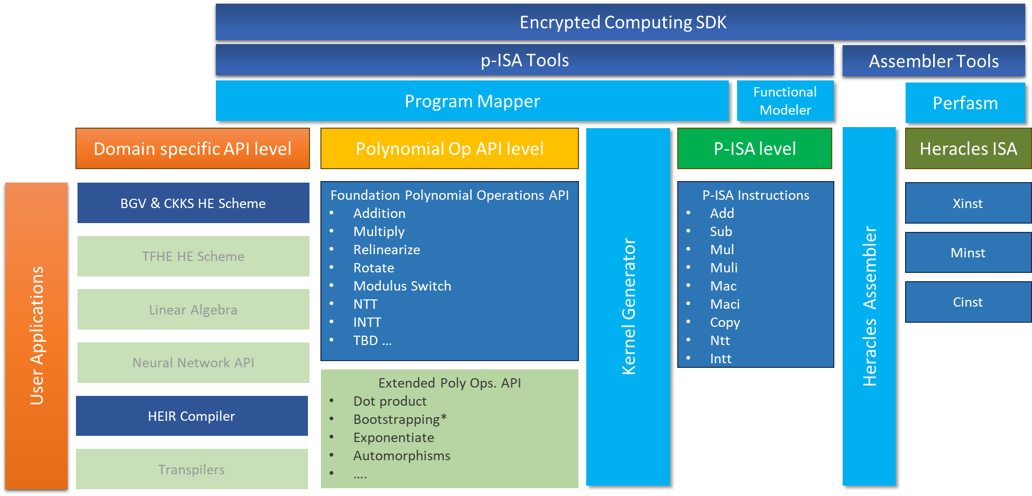
Encrypted Computing SDK Components Overview

Slide 7
Current E2E Software Stack – Building Toward an Encrypted Computing SDK
FHE Data Trace
P-ISA Functional Simulator CPU Backend
Common FHE Application
FHE Program Trace
P-ISA Kernel
Simulation
P-ISA Program Mapper
file.xinst
HERACLES Assembler
file.cinst
Binary Encoding
Memory File
file.minst
Emulation
P-ISA OP Generator

Slide 8
Current syntax & semantic for the program trace
instruction,scheme,ring dimension,krns,arg0,arg1,arg2,…
mul_plain,BGV,16384,5,ctprod0-2-4,ct0-2-4,pt0-1-4
Instruction:Multiply Plain, Scheme:BGV, Ring Dimension:16384, krns:5
arg0: output cyphertext (ctprod0) with ring dimension 16384, krns 5, order 2, current rns terms 4
arg1: input cyphertext (ct0) with ring dimension 16384, krns 5, order 2, current rns terms 4
arg2: input cyphertext (ct1) with ring dimension 16384, krns 5, order 1, current rns terms 4

Slide 9
Revised/proposed syntax & semantic for the program trace
Scheme, Ring Dimension, Instruction, arg1 Ctxt(+params), arg2 Ctxt(+params),… Ctxt(+params) = Ctxt label, RNS Primes, Order, Mult. Depth, Level
CKKS,16384,MULT,ct01f9,8,3,2,2,ct018d,8,2,1,2,ct01ba,8,2,1,2,
Scheme: CKKS, Ring Dimension: 16384, Operation: Multiplication
Input cyphertexts (ct018d and ct01ba) each with ring dimension 16384, 8 RNS primes, order 2, depth 1, and level2
Output cyphertext (ct01f9) with ring dimension 16384, 8 RNS primes, order 3, depth 2, and level 2
CKKS,16384,RELIN,ct0298,8,2,2,2,ct01f9,8,3,2,2,
Input cyphertexts (ct01f9) with ring dimension 16384, 8 RNS primes, order 3, depth 2, and level 2
Output cyphertext (ct0298) with ring dimension 16384, 8 RNS primes, order 2, depth 2, and level 2

Slide 10
Questions ?

