Slide 1

Full Correlation Matrix Analysis
Yida Wang
Parallel Computing Lab, Intel Labs

Slide 2
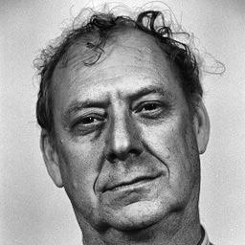
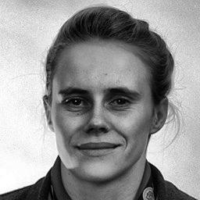
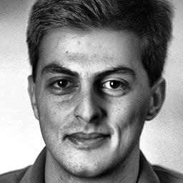
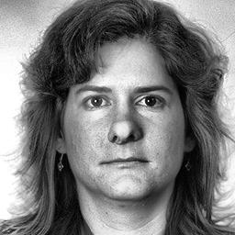
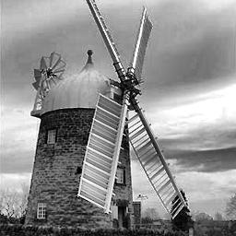
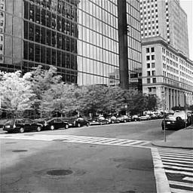
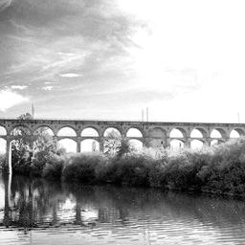
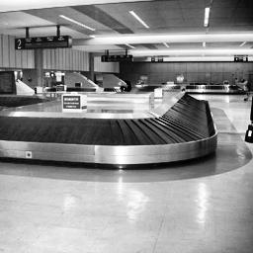
Why Functional Interactions
Time
…
Region A:
Patterns of Activity
Region B:
Interactions
Interactions
Region X:

Slide 3
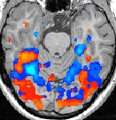
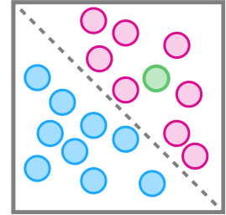
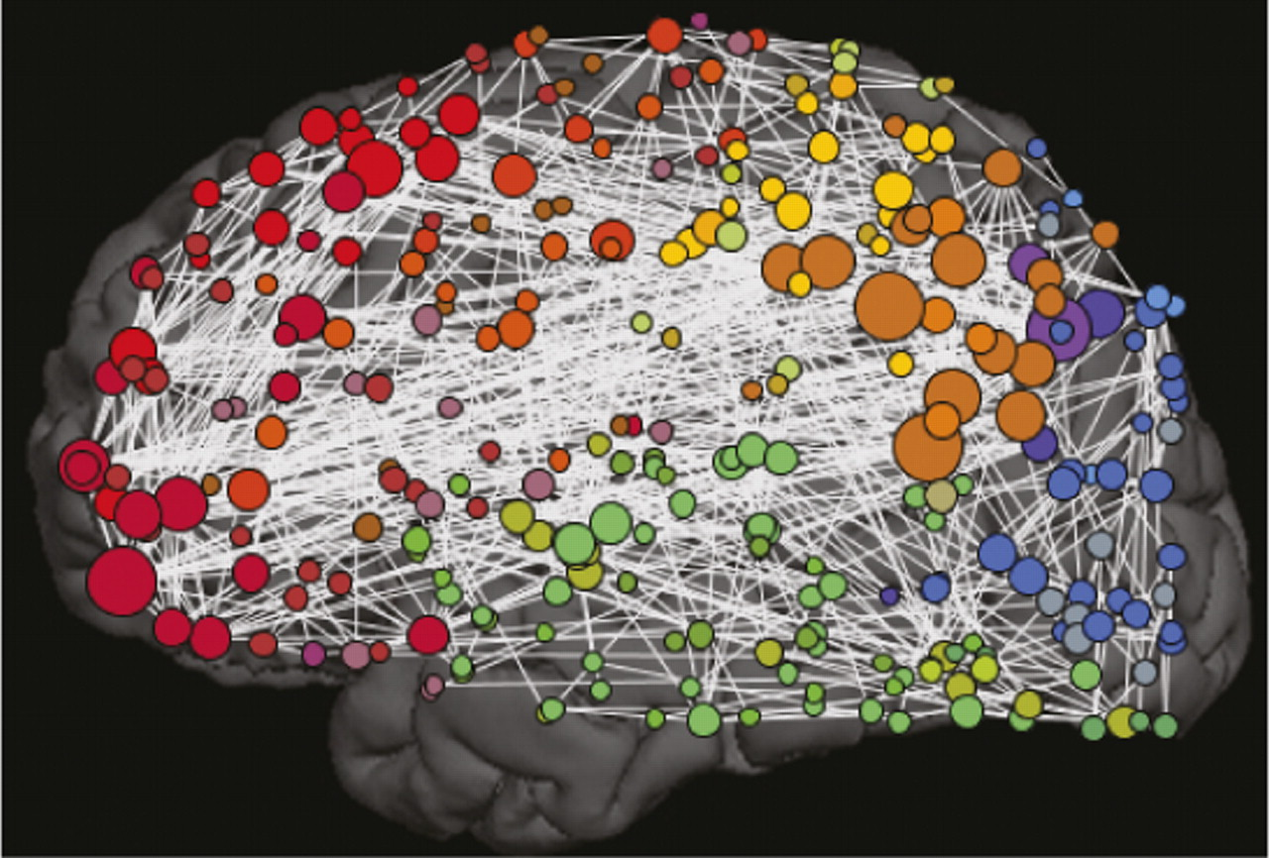
Activity vs. Correlation
Machine learning classifiers used to identify
distributed patterns of neural activity,
a.k.a. multivariate pattern analysis (MVPA)
light computation
Want to know about more than just patterns of activity…
How do brain subsystems interact with
one another
What is the circuitry (revealed by
functional interactions)
Need to EXHAUSTIVELY study
temporal correlations of all brain voxels

Slide 4
Full Correlation Matrix Analysis (FCMA)
Full Correlation Matrix
Correlation Matrix of
Selected Voxels
Time
Epoch of interest
5 GB
Hundreds of epochs
Voxel selection (Feature selection)
…
…
…
Epoch of interest
Model training
5 GB
Training
Model
…
Classification
New Epoch of interest
?
?
Applying the top
voxel list
Applying the model
to predict

Slide 5
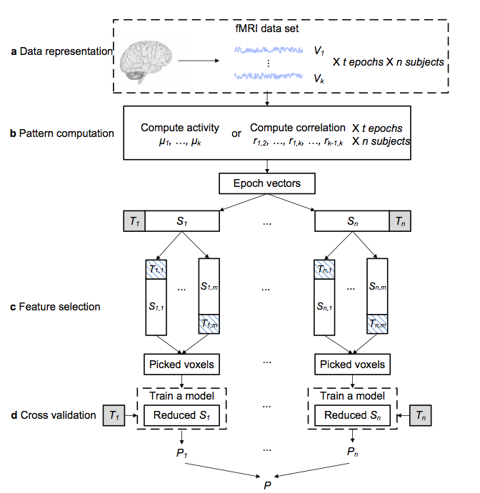

Slide 6
Classification Accuracy

Slide 7
a Voxel selection based on individual activity
b Voxel selection based on correlation of activity
Identified by FCMA
Wang et al. J Neurosci Meth. ’15

Slide 8
fcma in Brainiak

Slide 9
Install BrainIAK in Metacortex
In Metacortex, create an python 3.6 environment in ~/.conda/env to install
module load python/3.5
conda create -n py36 python=3.6 numpy scipy pip
source activate py36
pip install brainiak
NOTE: make sure your default MPI is Intel MPI
$ which mpirun
/opt/intel/compilers_and_libraries_2016.1.150/linux/mpi/intel64/bin/mpirun

Slide 10
Download demo data
git clone https://github.com/IntelPNI/brainiak.git
cd brainiak/examples/fcma
sh download_data.sh
Requires:
Subject-by-subject Image data in NIfTI in the same directory
Mask file in NIfTI
Epoch file in npy

Slide 11
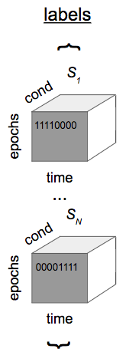
Epoch file
3D ndarray in shape [cond, epoch, time]
Assumptions:
all activity data contains the same number of voxels (apply the same mask file);
all subjects have the same number of epochs;
len(epoch_list) equals the number of subjects;
an epoch is always a continuous time course.

Slide 12
Demo
Correlation-based voxel selection
Correlation-based training and classification
Activity-based voxel selection
Activity-based training and classification
Standalone high-performance correlation computation

