Slide 1
Intel® Extension for PyTorch* Deep Dive
AI Forum
Jing Xu , Ying Hu
AI Customer Engineering
AIA

Slide 2
Notices & Disclaimers
Intel technologies may require enabled hardware, software or service activation. Learn more at intel.com or from the OEM or retailer.
Your costs and results may vary.
Intel does not control or audit third-party data. You should consult other sources to evaluate accuracy.
Optimization Notice: Intel's compilers may or may not optimize to the same degree for non-Intel microprocessors for optimizations that are not unique to Intel microprocessors. These optimizations include SSE2, SSE3, and SSSE3 instruction sets and other optimizations. Intel does not guarantee the availability, functionality, or effectiveness of any optimization on microprocessors not manufactured by Intel. Microprocessor-dependent optimizations in this product are intended for use with Intel microprocessors. Certain optimizations not specific to Intel microarchitecture are reserved for Intel microprocessors. Please refer to the applicable product User and Reference Guides for more information regarding the specific instruction sets covered by this notice. Notice Revision #20110804. https://software.intel.com/en-us/articles/optimization-notice
Software and workloads used in performance tests may have been optimized for performance only on Intel microprocessors.
Performance tests, such as SYSmark and MobileMark, are measured using specific computer systems, components, software, operations and functions. Any change to any of those factors may cause the results to vary. You should consult other information and performance tests to assist you in fully evaluating your contemplated purchases, including the performance of that product when combined with other products. See backup for configuration details. For more complete information about performance and benchmark results, visit www.intel.com/benchmarks.
Performance results are based on testing as of dates shown in configurations and may not reflect all publicly available updates. See configuration disclosure for details. No product or component can be absolutely secure.
No license (express or implied, by estoppel or otherwise) to any intellectual property rights is granted by this document.
Intel disclaims all express and implied warranties, including without limitation, the implied warranties of merchantability, fitness for a particular purpose, and non-infringement, as well as any warranty arising from course of performance, course of dealing, or usage in trade.
© Intel Corporation. Intel, the Intel logo, and other Intel marks are trademarks of Intel Corporation or its subsidiaries. Other names and brands may be claimed as the property of others.

Slide 3
How to reach AICE for AIA and oneAPI AI SW support
All Geos/ASMO – Manoj Agnihotri
PRC & APJ – Ying Hu
EMEA – Severine Habert
Support
PDL: ai.tce.support.baton@intel.com
JIRA: MLIT
Service center: Goto/isvc
Intel AI forums
Community.intel.com
Github
Goto/aitce

Slide 4
Agenda
Overview
Features
Installation Guide
Performance Tuning Guide
Case Study

Slide 5
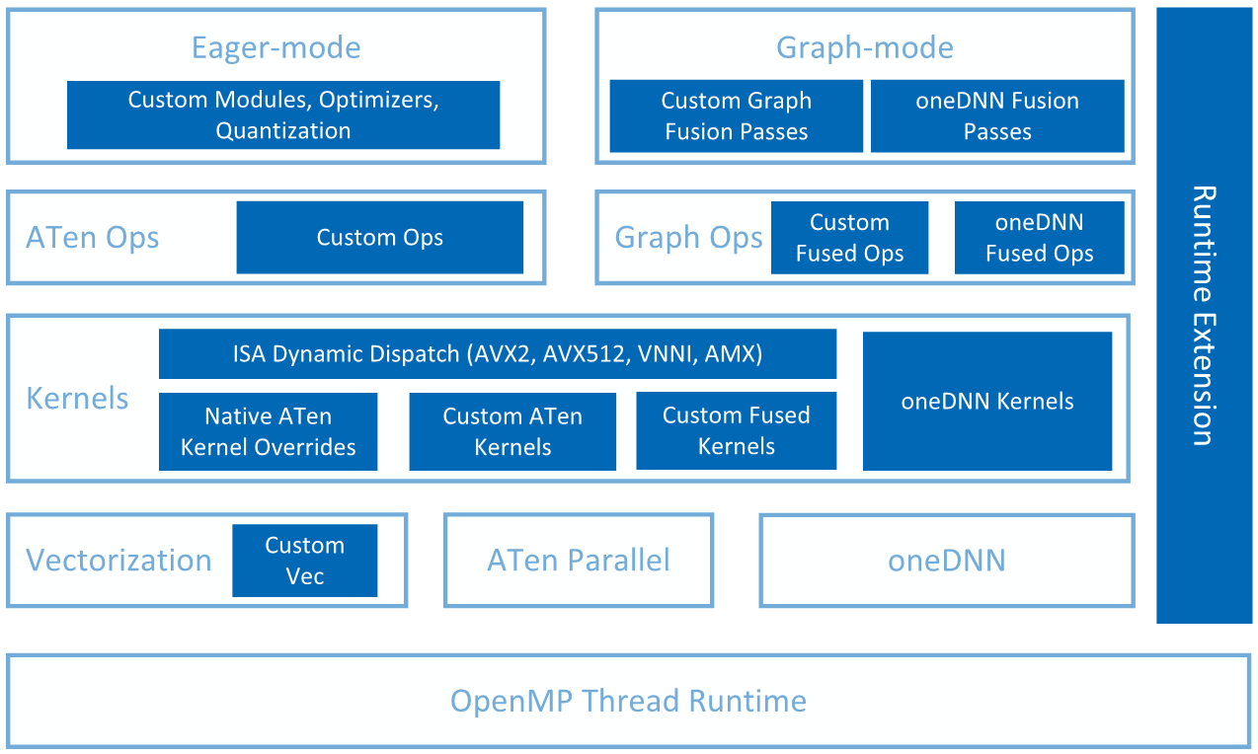
Overview
Extends PyTorch with optimizations for extra performance boost on Intel hardware.
Open sourced on Github
Optimized operators and kernels are registered through PyTorch dispatching mechanism.
Loaded dynamically in Python script.
Dynamically linked in CPP executables.
https://intel.github.io/intel-extension-for-pytorch/1.11.0/index.html
https://github.com/intel/intel-extension-for-pytorch

Slide 6
NHWC
Feature

Slide 7
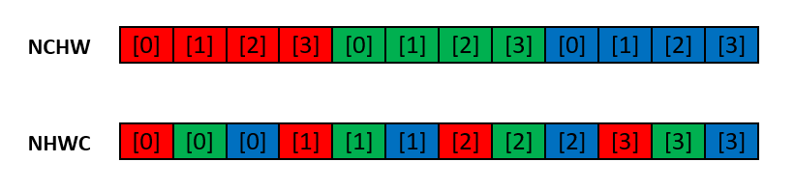
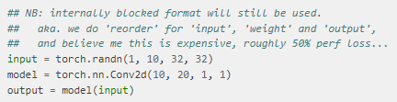
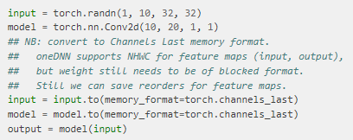
Data Layouts in PyTorch
Used in Vision workloads
NCHW
Default format
torch.contiguous_format
NHWC
A working-in-progress feature of PyTorch
torch.channels_last
NHWC format yields higher performance

Slide 8
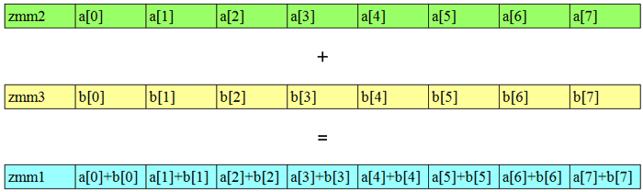
Vectorization
a
z = a + b
+
b
FP32
FP32
FP32
=
a+b
ISA | Length | Num of FP32
AVX | 128 bits | 4
AVX2 | 256 bits | 8
AVX512 | 512 bits | 16
https://www.intel.com/content/www/us/en/developer/articles/technical/improve-performance-with-vectorization.html

Slide 9
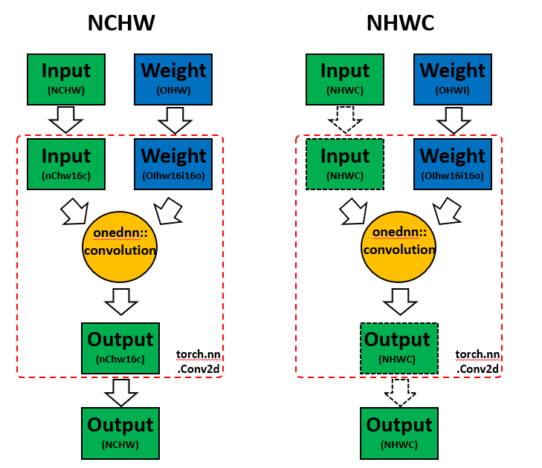
Benefit of NHWC in Intel® Extension for PyTorch*
Solid line arrows indicate hard copy is required.
Dot line arrows indicate simple memory view, no hard copy.

Slide 10
Auto Mixed Precision (AMP)
Feature

Slide 11
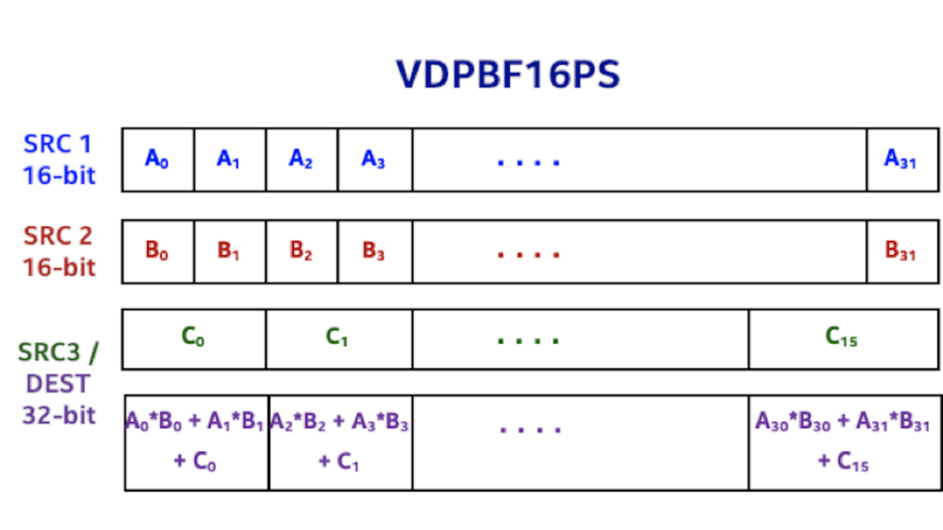
BFloat16 Data Type
8 bits
23 bits
FP32
S | E | E | E | E | E | E | E | E | M | M | M | M | M | M | M | M | M | M | M | M | M | M | M | M | M | M | M | M | M | M | M
BF16
S | E | E | E | E | E | E | E | E | M | M | M | M | M | M | M
7 bits
BFloat16 data type specific instructions:
VCVTNE2PS2BF16 | Convert Two Packed Single Data to One Packed BF16 Data
VCVTNEPS2BF16 | Convert Packed Single Data to Packed BF16 Data
VDPBF16PS | Dot Product of BF16 Pairs Accumulated into Packed Single Precision
https://www.intel.com/content/dam/develop/external/us/en/documents/bf16-hardware-numerics-definition-white-paper.pdf

Slide 12

Auto Mixed Precision (AMP)
3 Categories of operators
lower_precision_fp
Computation bound operators that could get performance boost with BFloat16.
E.g.: conv, linear
Fallthrough
Operators that runs with both Float32 and BFloat16 but might not get performance boost with BFloat16.
E.g.: relu, max_pool2d
FP32
Operators that are not enabled with BFloat16 support yet. Inputs of them are casted into float32 before execution.
E.g.: max_pool3d, group_norm
conv
conv
BFloat16
relu
relu
group_norm
group_norm
Float32
relu
relu
linear
linear
BFloat16

Slide 13
Graph Optimization
Feature

Slide 14
Operator Fusion
Operator 1
Operator 1
Read data from memory
Read data from memory
Kernel computation
Kernel computation
Fused Operator
Read data from memory
Write data to memory
Write data to memory
Kernel 1 computation
Operator 2
Operator 2
Kernel 2 computation
Read data from memory
Read data from memory
Write data to memory
Kernel computation
Kernel computation
Write data to memory
Write data to memory

Slide 15
FP32 & BF16 fusion patterns
Conv2D + ReLU
Conv2D + SUM
Conv2D + SUM + ReLU
Conv2D + Sigmoid
Conv2D + Sigmoid + MUL
Conv2D + HardTanh
Conv2D + SiLU
Conv2D + ELU
Conv3D + ReLU
Conv3D + SUM
Conv3D + SUM + ReLU
Conv3D + SiLU
Linear + ReLU
Linear + GELU
Add + LayerNorm
Div + Add + Softmax
Linear + Linear + Linear
View + Transpose + Contiguous + View

Slide 16
INT8 fusion patterns
INT8 IN -> FP32 OUT
dequant -> conv
dequant -> linear
dequant -> conv -> relu
dequant -> conv -> sum
dequant -> conv -> sum -> relu
dequant -> linear -> relu
dequant -> linear -> gelu
dequant -> linear -> sigmoid
dequant -> linear -> sum
dequant -> bmm
dequant -> bmm -> div
INT8 IN -> INT8 OUT
dequant -> conv -> quant
dequant -> linear -> quant
dequant -> conv -> relu -> quant
dequant -> conv -> sum -> dequant
dequant -> conv -> sum -> relu -> quant
dequant -> linear -> relu -> quant
dequant -> linear -> gelu -> quant
dequant -> linear -> sigmoid -> quant
dequant -> linear -> sum -> quant
dequant -> bmm -> quant
dequant -> bmm -> div -> quant
dequant -> max_pool2d -> quant

Slide 17
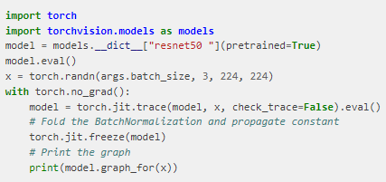
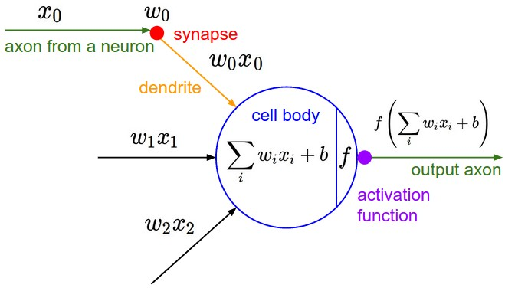
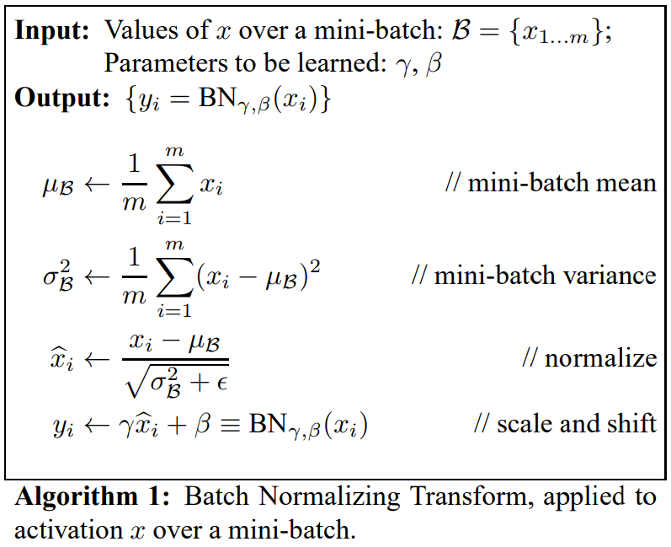








BatchNorm Folding
$$y=W×x+b$$
$$y=γ×\frac{(W×x+b)−μ}{\sqrt{σ^{2}+ε}}+β$$
+
$$y=γ×\frac{W×x}{\sqrt{σ^{2}+ε}}+γ×\frac{b−μ}{\sqrt{σ^{2}+ε}}+β$$
$$y=γ×\frac{W}{\sqrt{σ^{2}+ε}}×x+γ×\frac{b−μ}{\sqrt{σ^{2}+ε}}+β$$
$$y=γ×\frac{x−μ}{\sqrt{σ^{2}+ε}}+β$$
Conv + BatchNorm = Conv’
$$y=W^{′}×x+b′$$
$$W^{′}=γ×\frac{W}{\sqrt{σ^{2}+ε}}$$
$$b^{′}=γ×\frac{b−μ}{\sqrt{σ^{2}+ε}}+β$$
https://arxiv.org/pdf/1502.03167.pdf
https://cs231n.github.io/convolutional-networks/#conv

Slide 18
Optimizer Optimization
Feature

Slide 19
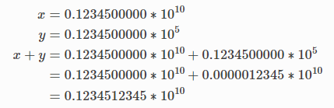
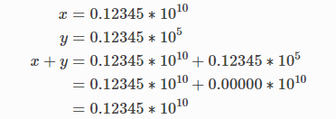
Split-SGD
Stochastic Gradient Descent (SGD) is the most widely used method to update weights from gradients, which involves a lot of accumulation operations.
Accumulated accuracy loss brought by BFloat16
Split-SGD uses FP32 to do the weights update while keeping a copy with BFloat16.
Computation with high precision
Computation with low precision

Slide 20
Runtime Extension
Experimental Feature

Slide 21
Task An asynchronous mechanism to run multiple streams for inference
Intel OpenMP library is required.
model = SimpleNet()
model.eval()
cpu_pool1 = ipex.runtime.CPUPool([0, 1, 2, 3])
cpu_pool2 = ipex.runtime.CPUPool([4, 5, 6, 7])
task1 = ipex.runtime.Task(model, cpu_pool1)
task2 = ipex.runtime.Task(model, cpu_pool2)
y1_future = task1(x1)
y2_future = task2(x2)
y1 = y1_future.get()
y2 = y2_future.get()
Main Thread
Threads
Cores
x1 Sub-Batch 16
x2 Sub-Batch 16
0
1
2
3
y1_future
0
1
2
3
4
5
6
7
 |  | 0
 |  | 1
 |  | 2
 |  | 3
0
1
2
3
Batch of input data
bs=32
 |  | 4
 |  | 5
 |  | 6
 |  | 7
4
5
6
7
y2_future
4
5
6
7
Threads
Model (share by all streams)

Slide 22
MultiStreamModule
Intel OpenMP library is required.
# Convert the model into multi_Stream_model
cpu_pool = ipex.cpu.runtime.CPUPool(node_id=0)
multi_Stream_model = ipex.cpu.runtime.MultiStreamModule(model, num_streams=4, cpu_pool=cpu_pool)
output = multi_Stream_model(input)
Threads
Cores
Sub-Batch 16
Sub-Batch 16
Sub-Batch 16
Sub-Batch 16
0
1
2
3
4
5
6
7
8
9
10
11
12
13
14
15
OUTPUT[0]
OUTPUT[1]
OUTPUT[2]
OUTPUT[3]
0
1
2
3
4
5
6
7
8
9
10
11
12
13
14
15
input
Batch of input data
bs=64
OUTPUT
Socket 0
Model (share by all streams)
MultiStreamModule

Slide 23
INT8 Quantization
Experimental Feature

Slide 24
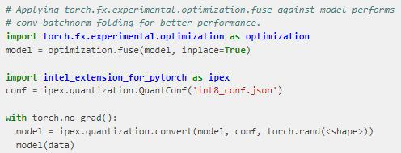


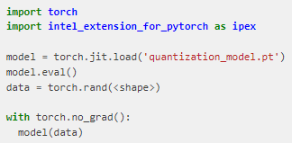

Default Recipe of IPEX INT8 Quantization Easy to use
Calibrate
Apply batchnorm folding
Get a QuantConf object
Calibrate with dataset
Save the conf object to a file
Convert model and save to a file
Deployment: Imperative Mode
Deployment: Graph Mode

Slide 25


Repo & Doc Resource
GITHUB Repo
https://github.com/intel/intel-extension-for-pytorch
Documentation
https://intel.github.io/intel-extension-for-pytorch/
Contributing to Intel® Extension for PyTorch*
https://intel.github.io/intel-extension-for-pytorch/tutorials/contribution.html
Model Zone
https://github.com/IntelAI/models/tree/pytorch-r1.11-models
GITHUB Repo
Document
Notes:
Eikan: IPEX repo link, document, how to contribute

Slide 26
Examples

Slide 27
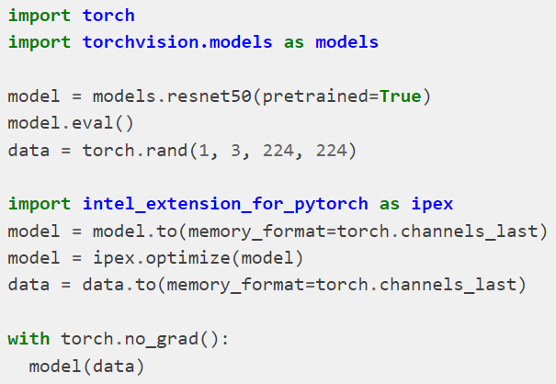
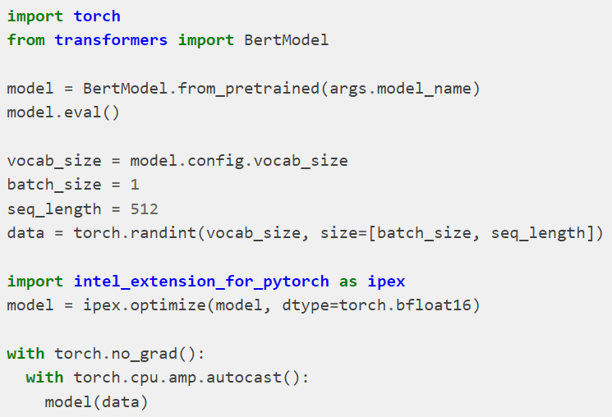
Python – Imperative Mode
FP32
BFloat16
https://intel.github.io/intel-extension-for-pytorch/1.11.0/tutorials/examples.html

Slide 28
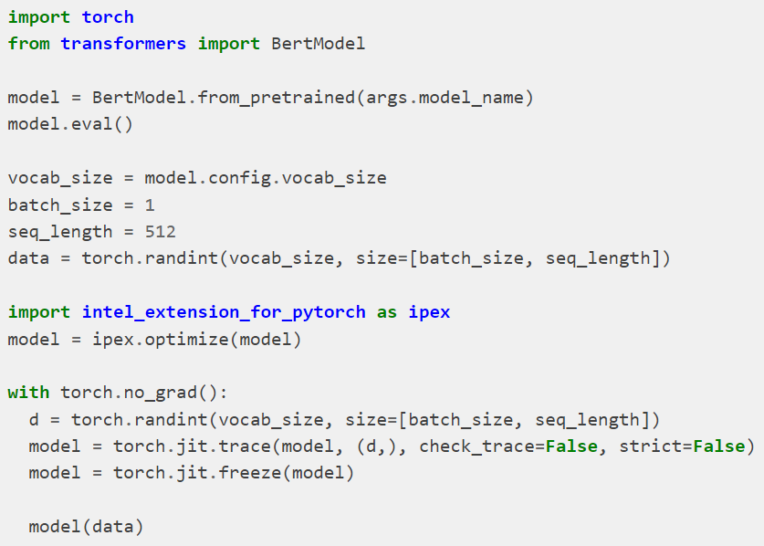
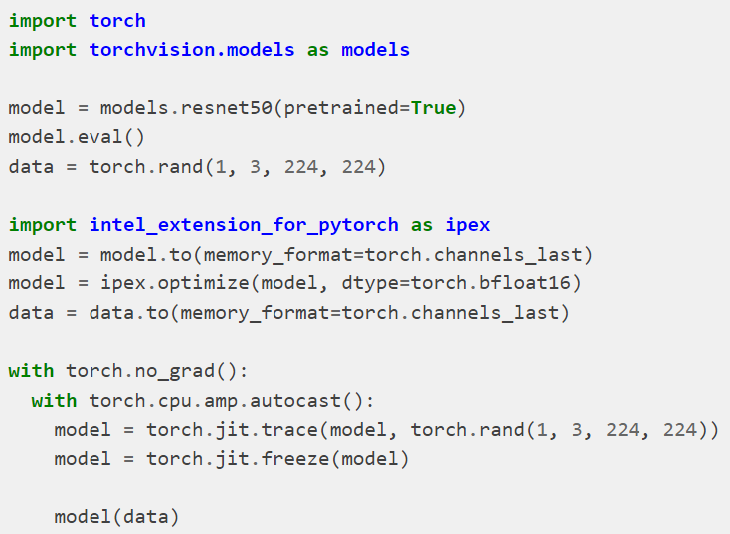
Python – TorchScript Mode
FP32
BFloat16
https://intel.github.io/intel-extension-for-pytorch/1.11.0/tutorials/examples.html

Slide 29
Case Study

Slide 30
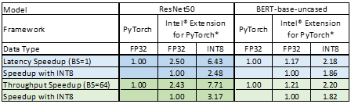
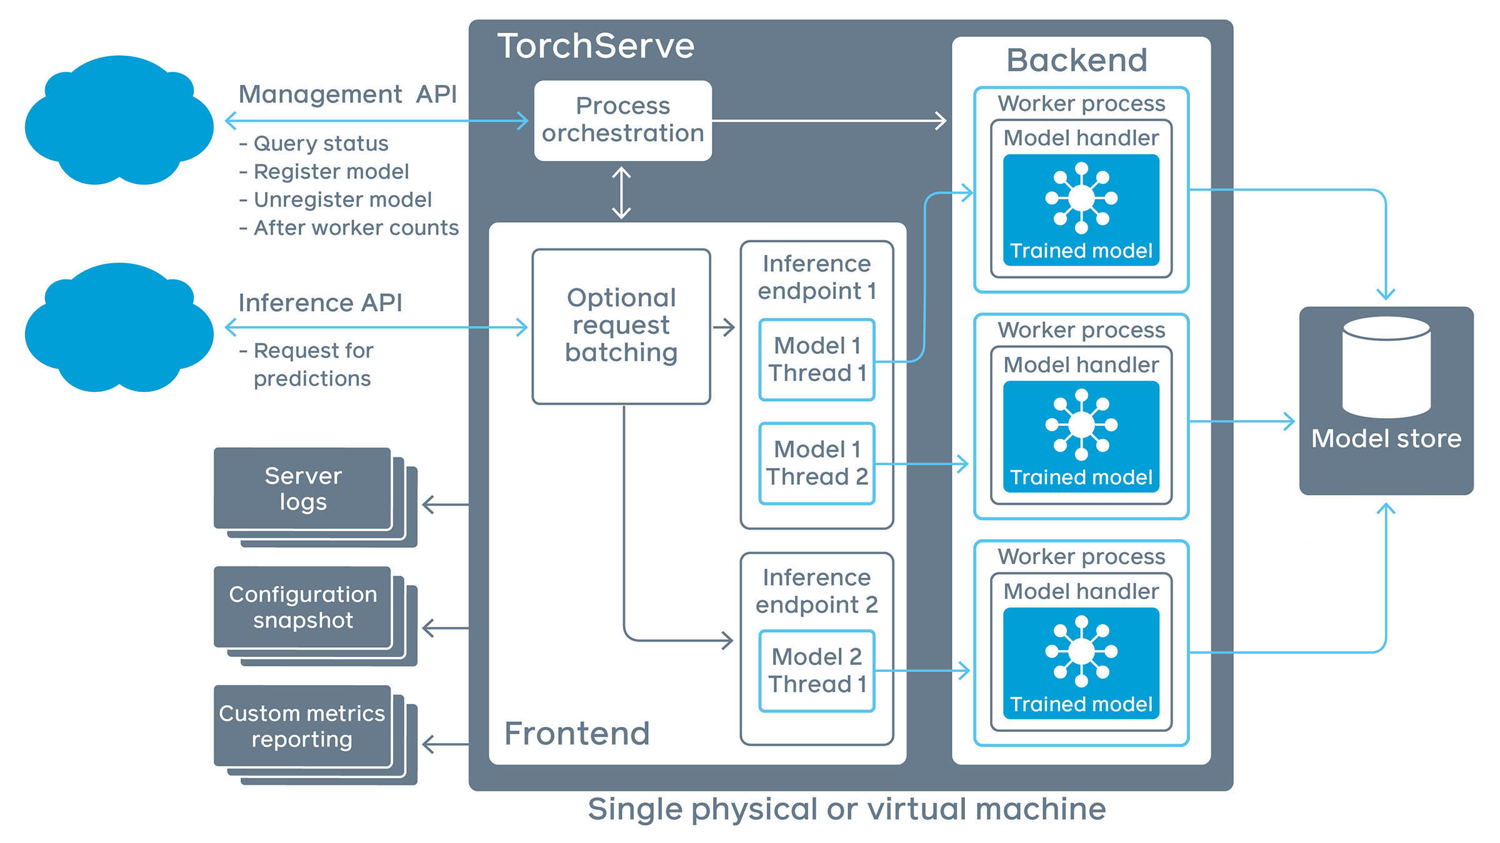
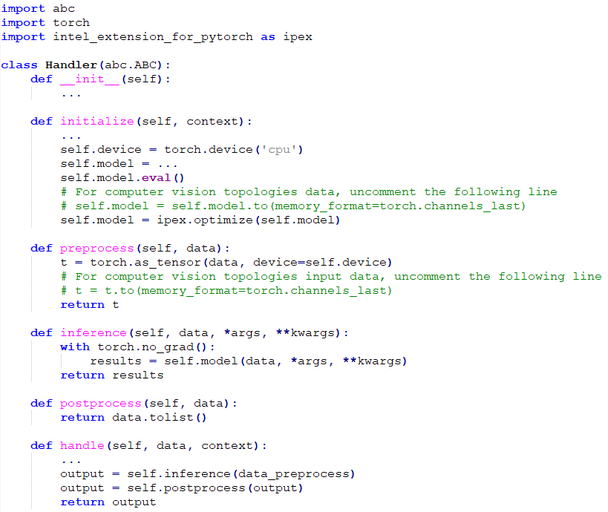
Accelerate TorchServe with Intel® Extension for PyTorch*
Meta: Mark Saroufim, Hamid Shojanazeri, Patrick Hu, Geeta Chauhan
Intel: Jing Xu, Min Jean Cho, Jianan Gu, Jiong Gong, Ashok Emani, Eikan Wang, Fan Zhao, Sheik Mohamed Imran
Performance optimization from Intel® Extension for PyTorch* for inference workloads on Intel® Xeon® scalable processors.
Ease-of-use and High-performance Deep Learning Computation with Intel® Extension for PyTorch*
Intel® Extension for PyTorch*
Performance Result
Intel® Extension for PyTorch* brings the up-to-date Intel software/hardware features, and streamlines the work to enable Intel accelerated library for PyTorch
We evaluated the performance boost of TorchServe with Intel® Extension for PyTorch* on Resnet 50 and BERT-Base uncased, covering representative deep learning tasks in Computer Vision and NLP respectively. The performance speed-up is compared with that of FP32 on stock PyTorch, and is contributed by operator optimization, layout conversion optimization and graph optimization from Intel® Extension for PyTorch*.
TorchServe is a performant, flexible and easy to use tool for serving PyTorch eager mode and torschripted models. It makes users easy to deploy their PyTorch models to their real services. Intel is collaborating with Facebook to take advantage of performance boosting from Intel® Extension for PyTorch* from TorchServe, so that users can easily deploy their PyTorch models with out of the box satisfying performance. With these SW advancements, we demonstrated ease-of-use IPEX user-facing API, and we also showcased 1.17x~2.5x speed-up with Intel® Extension for PyTorch* FP32 inference with the stock PyTorch and 2.18x~7.71x speed-up with Intel® Extension for PyTorch* INT8 inference with the stock PyTorch.
Table 1. Single instance inference performance gains over baseline (stock PyTorch), measured on AWS EC2 m6i.24xlarge instances. The Resnet 50 model uses the kitten image. The BERT uses the HuggingFace sample text. The instance uses 24 cores on 1 socket of the instance.
TorchServe
TorchServe-Intel® Extension for PyTorch* Integration
2 extra steps to enable Intel® Extension for PyTorch* on CPU with TorchServe.
Tested by Intel as of 11/18/2021. Amazon EC2 m6i.24xlarge, 2-socket Intel(R) Xeon(R) Platinum 8375C CPU @ 2.90GHz, 96 cores HT ON Turbo ON Total Memory 384 GB (- slots/ 192GB/ 3200 MHz), BIOS: 1.0 (ucode:0xd000311), Ubuntu 18.04.6 LTS kernel 5.4.0-1059-aws, Deep Learning Framework: PyTorch v1.10.0+cpu, IPEX release/1.10, Compiler: gcc (Ubuntu 7.5.0-3ubuntu1~18.04) 7.5.0, Resnet50, BS=1, real data, 1 instance/1 socket, BERT, BS=1, real data, 1 instance/1 socket.
Terminology:
Frontend: The request/response handling component of TorchServe. This portion of the serving component handles both request/response coming from clients and manages the lifecycles of the models.
Model Workers: These workers are responsible for running the actual inference on the models.
Model: Models could be a script_module (JIT saved models) or eager_mode_models. These models can provide custom pre- and post-processing of data along with any other model artifacts such as state_dicts. Models can be loaded from cloud storage or from local hosts.
Model Store: This is a directory in which all the loadable models exist.

Slide 31


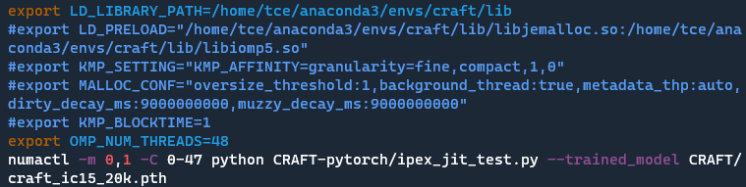

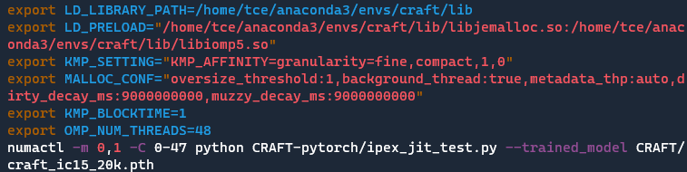
Workload: Optical Character Recognition (OCR)
As part of NAVER’s CLOVA platform, customer uses its Character-Region Awareness For Text detection (CRAFT) model to find the location of letters in an image and identify the type of letters from various languages and styles.
Results:
Intel optimizations for PyTorch (IPEX) shown 74% better performance with 24 cores, 84% with 48 cores on Intel(R) Xeon(R) Gold 6240R CPU on inference part.
Key Learnings:
Intel OpenMP* Libraries and jemalloc library (a malloc implementation that emphasizes fragmentation avoidance and scalable concurrency support) may bring more efficient CPU usages, and thus improve performance.
Deep Dive:
With default PyTorch running configuration, CPU usage is not high enough. Meanwhile, red bars shown in htop indicates that a number of CPU resources are running into spin.
Enabling Intel OpenMP* Libraries and jemalloc library raised CPU resource usage. Meanwhile it suppressed occurrence of spinning on CPU cores.
Effects of applying Intel OpenMP* Libraries and jemalloc library
Product Feedback:
Performance tuning, as an advanced IPEX usage, requires certain experiences.
Notes:
include key learnings, insights, and product feedback we have due to this engagement
KT: GiGA Genie https://www.youtube.com/watch?v=RjKQL3QE_-4 02:58

Slide 32





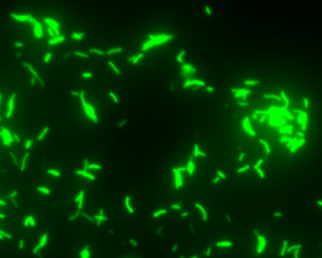

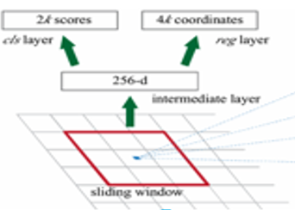
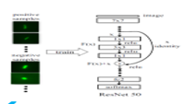
KFBIO DL Solution for TB diagnosis using Intel Extension For PyTorch*
11.5 x efficiency boost for fast M. Tuberculosis Digital Diagnosis
Accelerate M. Tuberculosis detection using detectron2 with Intel Extension for PyTorch*
Fully utilize the Intel Xeon Scalable processors resource by running inference on multi-core with multi-instances
Even better throughput than NV T4
TB Deep Learning Diagnosis System
Transfer Learning & Detection
Adaptive Learning
TB Sampling
Dyeing
Doctor Check
Digital Image
Scanning & Classification using DL model
https://github.com/intel/intel-extension-for-pytorch
Notes:
Use Case
Digital pathology information system that integrates scanner equipment with DL solutions for pathological analytics and diagnosis. The use case is to detect M. Tuberculosis image using detectron2 in PyTorch 1.4
Problem:
Expect competitive performance comparing NV dGPU card.
Solution:
Using Intel optimized PyTorch and IPEX , multi-instances boost the throughput 11.5 x and better than NV dGPU T4.
Key Learnings : lantency : 15.15 s to 1.8s
KFBIO Accelerates Mycobacterium Tuberculosis Detection with Intel® AI
According to the World Health Organization (WHO), tuberculosis (TB) is one of the top ten causes of death and the leading cause from a single infectious agent (above HIV/AIDS). One of the WHO’s Sustainable Development Goals is to end the TB epidemic by 2030. Some 58 million lives were saved through TB diagnosis and treatment between 2000 and 2018,¹ thus rapid and accurate detection remains critical to continuing to reduce the number of cases each year.
intel/intel-extension-for-pytorch: A Python package for extending the official PyTorch that can easily obtain performance on Intel platform (github.com)
https://www.intel.com/content/dam/www/public/us/en/documents/success-stories/kfbio-article-1-summary.pdf
https://builders.intel.com/docs/aibuilders/m-tuberculosis-detection-with-intelr-ai.pdf

Slide 33

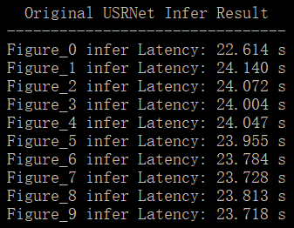
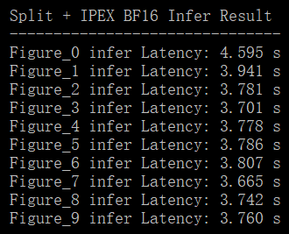
Optimized USRNet Inference with Figure Split Algorithm and IPEX 6.4 x efficiency boost to do Image Super Resolution
Steps of the figure split algorithm designed for USRNet inference:
Optimization results : a. IPEX, b. Figure split, c. Combined figure split algorithm & IPEX

Slide 34

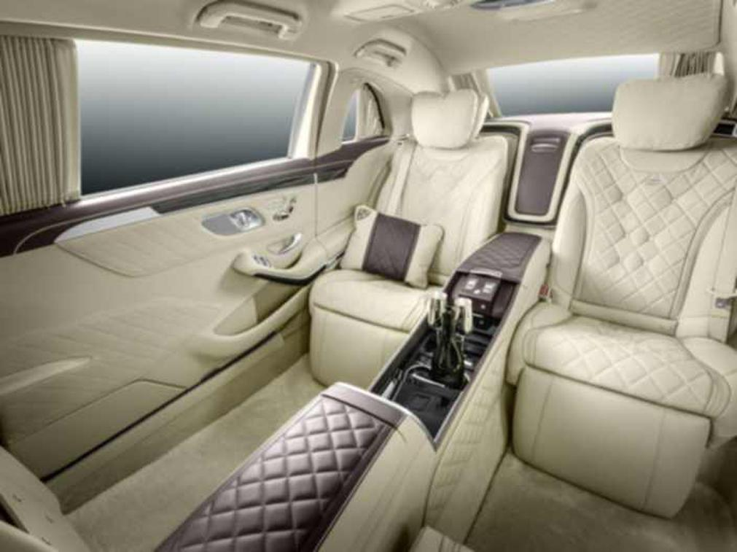
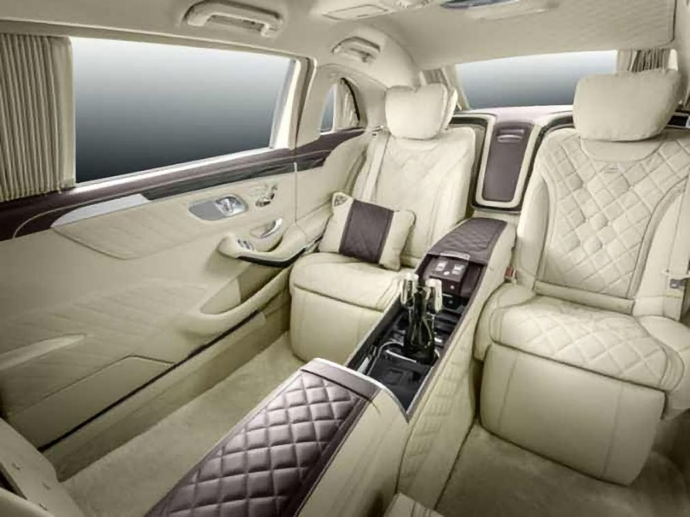
Model for Image Enhancement
For image sharpening and denoising.
Model structure: similar to ResNet
After enhancement

Slide 35
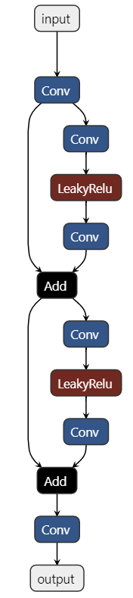
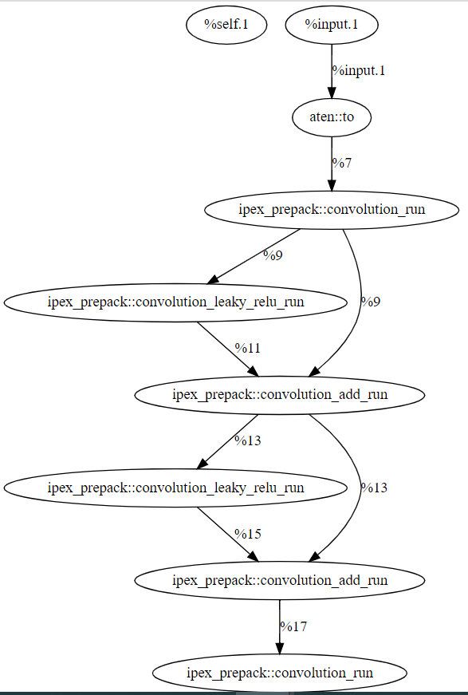
Optimization
Operator fusion optimization
BF16 enabled
Notes:
算子融合​: 尽可能重用寄存器或缓存中的数据，减少内存访问。有的场景甚至甚至直接减少计算量。
BF16背后的想法是通过降低数字的精度来减少计算能力和将张量相乘所需的能源消耗。

Slide 36
Result(s)
#Physical Core | Original model (s) | After IPEX fp32 | After IPEX bf16 | After IPEX bf16+fusion
24 | 0.33 | 0.164 | 0.092 | 0.035
#Physical Core | 24 | 48 | 72 | 96
After IPEX bf16+fusion | 0.035 | 0.024 | 0.018 | 0.014
CPX 8360HL
4 NUMA
24 cores/NUMA

Slide 37

Intel Extension for PyTorch Int8 Quantization for Roblox - online gaming
Usage: Detect bullying, or negative content of chats among players in the game.
A deal of $30M was closed last year. There is $170M opportunity this year.
Using Intel Extension for PyTorch int8 with DistilBert inference.
28x boost comparing to the original non-optimized code, on an SPR machine with AMX INT8.
Latency (s) | Scenario 1 | Scenario 2 | Scenario 3 | Scenario 4 | Scenario 5
 | PyTorch Single-thread | PyTorch Multi-thread | IPEX | IPEX +Torchscript | IPEX +INT8
All physical cores on 1 node | 139.22 | 10.92 | 10.89 | 8.10 | 4.99
4 cores | 139.11 | 39.91 | 39.99 | 37.39 | 8.38
Notes:
https://en.wikipedia.org/wiki/Roblox_Corporation
Roblox set the maximum length of tokens to 512. But usually the input sentence has various length. Below figure shows what Roblox optimized:
Column 1 is the baseline bert
Column 2 is the Distilbert (smaller model)
Column3 changes input to Dynamic Shape, which is faster than fixed input
Column4 is int8 quantization
So, by changing input to fixed length (padding for short input) may degrade the performance on short input. I don’t understand why int8 must use fixed input?

Slide 38
Intel DCAI-DPEA
DCAI-DPEA team handles benchmarking on several topologies over FP32, BF16 and INT8 for both training and inference.
rnn_t
ssd_rn34
maskrcnn
bert_large
dlrm
resnext101_32x16d
resnet50_v15
Quote
The launch script improves 20% efficiency when we enable and debug AI workloads.

Slide 39

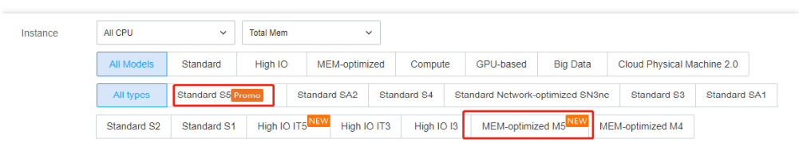

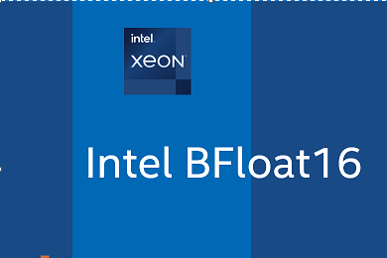
Tencent Cloud
Tencent Cloud provides various types of Cloud Virtual Machine for different application development. The Standard S5 and Memory Optimized M5 instance types come with the 2nd generation Intel® Xeon® processor and support Intel® DL Boost, making them suitable for machine learning or deep learning.
>
Intel® BFloat16 image on Tencent Cloud market Allows broad users to benefit from the performance acceleration by Intel Eextension for PyTorch (the work to upgrade version is ongoing) and Intel’s Hero Hardware features (DL Boost AMX) on Intel® Xeon Scalable processor.
Notes:
Work with the CESG, marketing team , pm to upgrade the latest version of IPEX

