Slide 1

AROGYA
Care beyond
the consultation
A population health command center
for each patient’s next step.
Idea submission
Notes:
Arogya focuses on continuity of care across visits. Its central idea is to make unfinished steps visible so care teams can follow through. This is an idea-submission pitch, with a prototype foundation and a proposed supervised pilot. Cover artwork is an AI-generated editorial illustration, not a photograph of a real patient or clinic. Built-in image generation prompt: refined gouache illustration of an Indian community health worker, clinician and adult woman patient reviewing a plain paper folder in an outpatient clinic, deep teal background with quiet negative space on the left.
Project sources: README.md; user-provided problem and solution statements.

Slide 2
The gaps between visits
A biopsy is complete.
The next step is still uncertain.
Patients and families
Repeat travel and uncertainty
when a report or referral stalls.
Clinicians and care coordinators
Records sit across hospitals, labs,
referral slips and spreadsheets.
Large caseloads make it difficult
to spot every unfinished step.
Initial focus: cancer care. The journey model also supports chronic and maternal care.
02
Notes:
The problem is fragmented follow-through. A completed procedure does not guarantee that a report reaches the clinician, a referral becomes a specialist visit, or a patient returns. Arogya is intended for clinicians, community health workers and care coordinators. These are problem scenarios, not measured project outcomes or published prevalence estimates.
Project sources: README.md, The Problem; HACKATHON_SCRIPT.md, problem narrative.

Slide 3
A prioritized worklist for unfinished care
Each alert connects a patient, a reason and the record needed to act.
Patient | Why attention is needed | Care team response
Patient A | Pathology pending after dispatch | Check with the laboratory
Patient B | Scheduled follow-up is overdue | Contact and reschedule
Patient C | Referral marked incomplete | Review the referral status
Illustrative worklist. Care teams review alerts and record the action taken.
03
Notes:
The prototype computes care gaps from explicit rules. Current examples include overdue follow-ups, pathology processing beyond seven days, explicitly incomplete referrals, and investigations pending beyond seven days. The response column illustrates the operational next step; it is not an automated clinical recommendation. Human staff perform outreach and update the records.
Project sources: Arogya/main.py: care_gaps(), dashboard(), get_patient(); Arogya_UI/src/components/Dashboard.jsx.

Slide 4
A delayed report, made visible
Illustrative patient journey
01
Capture the event
02
Detect the gap
The care team records a biopsy
and specimen dispatch date.
The report remains pending beyond
a seven-day waiting period.
03
Review the record
04
Complete the next step
The alert opens the patient’s history
so staff can check the delay.
Staff obtain the report and update
the record and referral status.
04
Notes:
Walk the jury through one care gap rather than listing every feature. The example uses the existing biopsy/report workflow. Configurable clinical timelines are a future pilot requirement; the current prototype uses fixed rules, including a seven-day pathology rule. Report retrieval and patient contact remain human actions. The proposed outcome is faster follow-through, which needs measurement in a pilot.
Project sources: Arogya/main.py: compute_journey(), care_gaps(), upload_report(); Arogya_UI/src/components/PatientProfile.jsx.

Slide 5
Continuity of care is the organizing principle
Across the population
Within each patient’s journey
Who needs attention today?
What remains unfinished?
A ranked worklist shows the reason
for each alert across disease registries.
Eight stages connect screening,
investigations, referrals and follow-up.
Supporting tools: registry queries, a 3D Cancer Atlas and a research Prediction Lab.
Prediction outputs require clinical validation before use in care decisions.
05
Notes:
Differentiate on care coordination: a population worklist links to longitudinal patient context. Avoid claiming superiority over a specific competitor without evidence. The assistant currently uses keyword matching, not an LLM. The 3D atlas is educational procedural anatomy. The Prediction Lab uses public research datasets and must not be presented as clinically validated. Global feature importances describe model behavior, not an explanation of an individual patient’s outcome.
Project sources: Arogya/main.py: ai_assistant(), registry(), compute_journey(); Arogya/ml.py; Arogya_UI/src/components/CancerAtlas.jsx.

Slide 6
Technology and data flow
Layer | Technology | Role
Interface | React, Vite, Three.js | Clinical forms and 3D views
Clinical API | FastAPI, Python | Records and care-gap rules
Data and identity | PostgreSQL, Google sign-in | Persistent records and sign-in
Research models | scikit-learn | Gradient Boosting classifiers
Deployment | Docker, Nginx, Cloud Run | Containerized cloud deployment
Records enter through the API. Rules compute the journey. The interface presents the worklist.
06
Notes:
React and Vite implement the interface. FastAPI exposes the clinical APIs and deterministic workflow logic. PostgreSQL currently stores JSONB collections. Google Identity verifies sign-in. Three scikit-learn Gradient Boosting models use public breast, lung and cervical datasets with held-out evaluation. Docker and Nginx provide packaging for planned Cloud Run deployment; deployment success is not claimed. Reliable multi-instance writes, protected documents and production authorization remain release criteria.
Project sources: Arogya/requirements.txt; Arogya/database.py; Arogya/ml.py; Arogya/Dockerfile; Arogya_UI/package.json; Arogya_UI/Dockerfile; Arogya_UI/nginx.conf.template.

Slide 7
A prototype foundation and a focused build plan
Prototype foundation
Before a clinic pilot
52
Reliable and protected records
Access controls, input validation,
audit history and safe persistence.
synthetic patient profiles
across nine disease registries
Workflow validation with care teams
Clinical forms, journey logic, reports
and a population care-gap dashboard.
Review alert rules, task ownership
and escalation needs with users.
07
Notes:
The 52 profiles and nine registries describe synthetic demo data generated by seed.py. They are not patient adoption, clinical validation or pilot traction. The source includes registration, clinical record forms, uploads, journeys and a care-gap dashboard. Production hardening and supervised workflow validation are planned work, not completed claims. Future ownership and escalation functionality should follow care-team feedback.
Project sources: Arogya/seed.py: build_seed(), CONDITIONS; Arogya_UI/src/components/PatientProfile.jsx; project code review in this conversation.

Slide 8
A pilot that measures follow-through
Proposed scope
What we would measure
One clinic.
One biopsy-to-referral pathway.
Time from alert to staff review
Overdue follow-ups resolved
Referrals completed
Staff time spent preparing worklists
Establish a baseline, run a supervised
pilot and review results with the care team.
We seek a clinical workflow partner to help test and refine the approach.
08
Notes:
This is a proposed pilot, not an existing partnership. Focus on a narrow cancer-care pathway so the team can test workflow usability and data quality before expansion. Establish baseline measures before selecting targets. Compare time to review, follow-up resolution, referral completion and staff worklist preparation effort. Record denominators and compare equivalent periods. No impact percentage or clinical outcome claim is made. The ask is access to a care team for supervised co-design and evaluation.
Project sources: Proposed evaluation plan authored for this idea submission; no measured outcomes or existing clinical partners claimed.

Slide 9
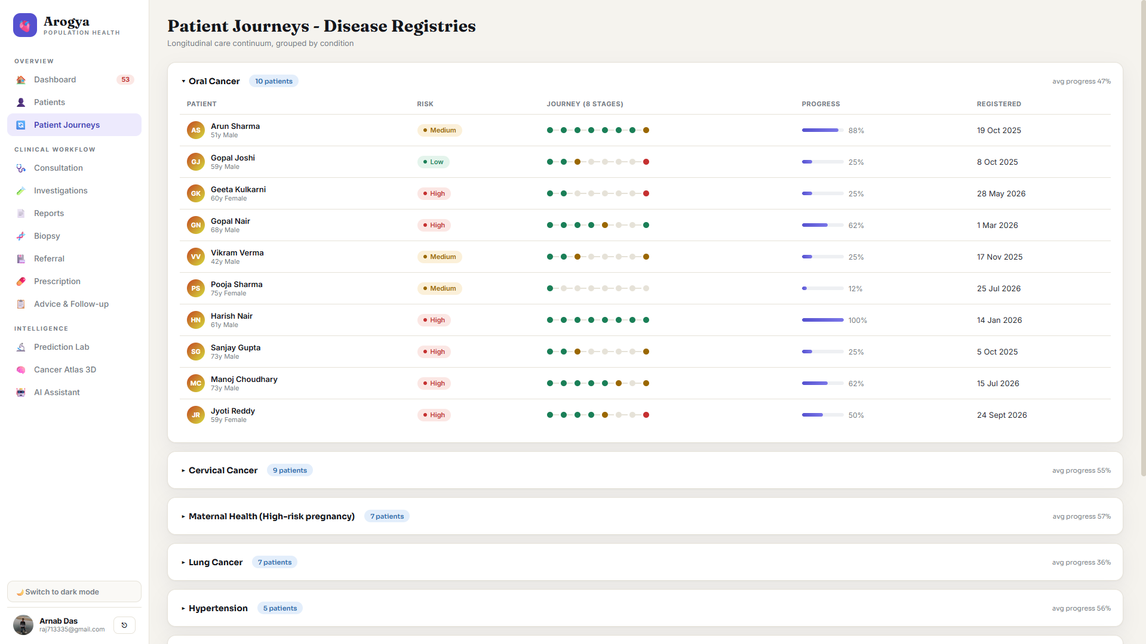
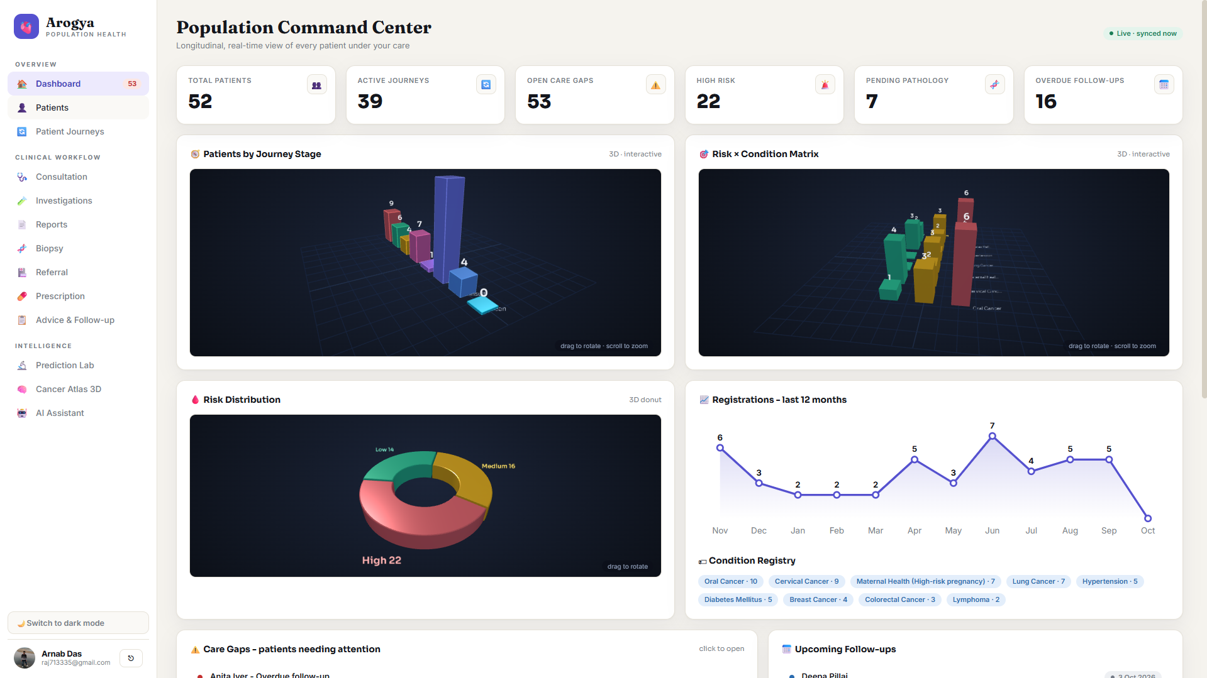
Application Screenshots
07
Notes:
The 52 profiles and nine registries describe synthetic demo data generated by seed.py. They are not patient adoption, clinical validation or pilot traction. The source includes registration, clinical record forms, uploads, journeys and a care-gap dashboard. Production hardening and supervised workflow validation are planned work, not completed claims. Future ownership and escalation functionality should follow care-team feedback.
Project sources: Arogya/seed.py: build_seed(), CONDITIONS; Arogya_UI/src/components/PatientProfile.jsx; project code review in this conversation.

Slide 10
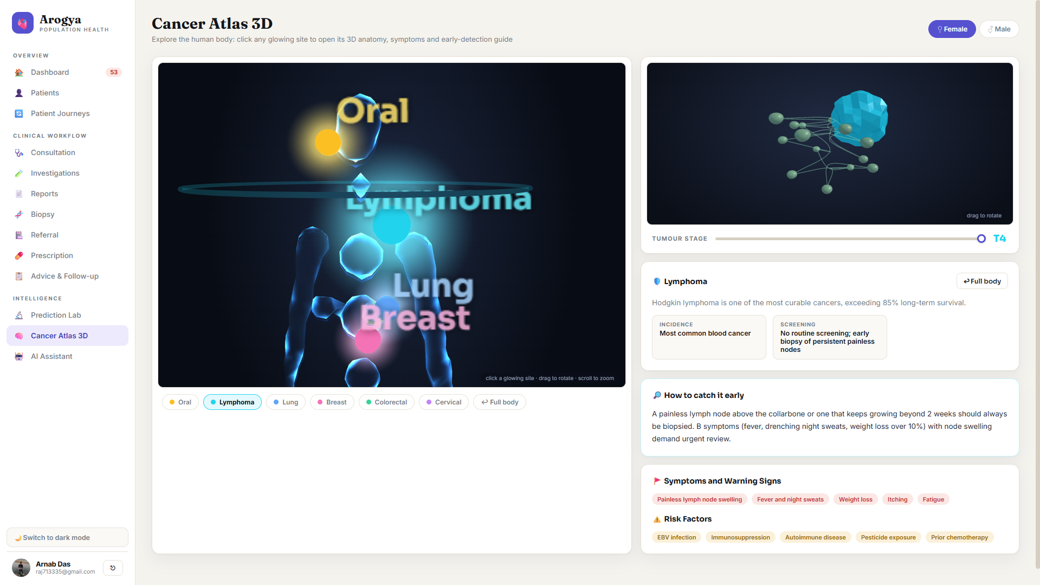
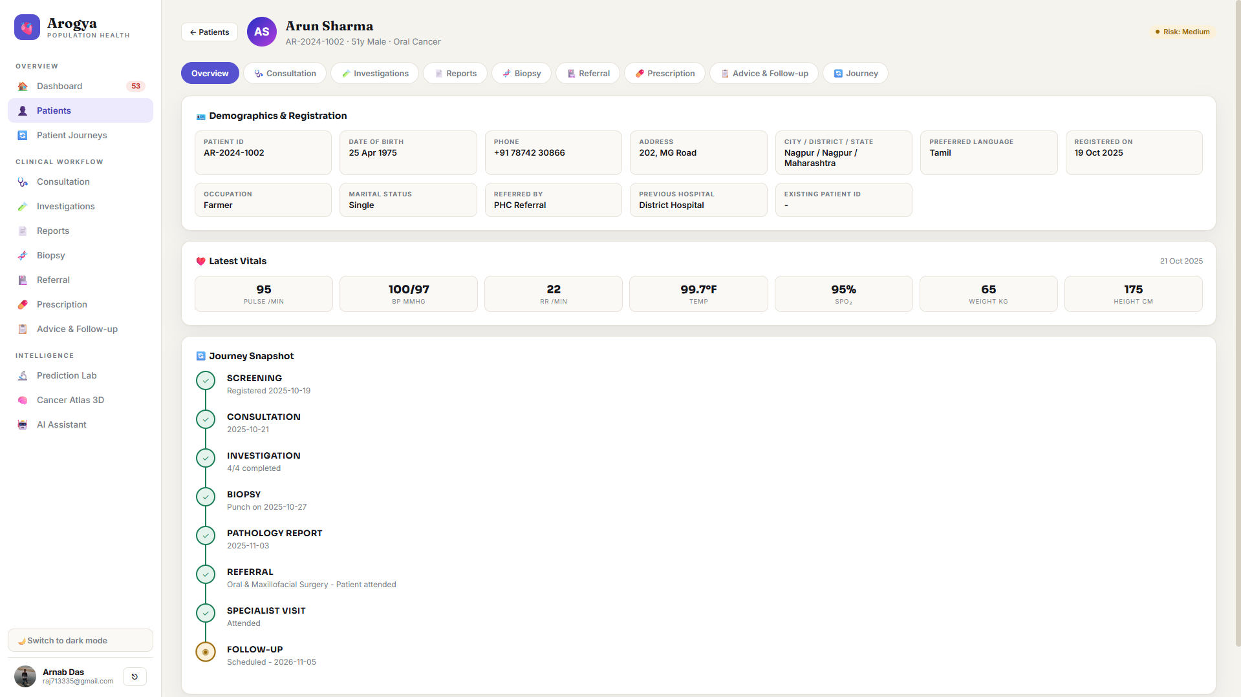
Application Screenshots
07
Notes:
The 52 profiles and nine registries describe synthetic demo data generated by seed.py. They are not patient adoption, clinical validation or pilot traction. The source includes registration, clinical record forms, uploads, journeys and a care-gap dashboard. Production hardening and supervised workflow validation are planned work, not completed claims. Future ownership and escalation functionality should follow care-team feedback.
Project sources: Arogya/seed.py: build_seed(), CONDITIONS; Arogya_UI/src/components/PatientProfile.jsx; project code review in this conversation.

Slide 11
Thank You
YouTube
https://www.youtube.com/watch?v=oGJvubxuSfI
GitHub
https://github.com/IntelegixLabs/Arogya
07
Notes:
The 52 profiles and nine registries describe synthetic demo data generated by seed.py. They are not patient adoption, clinical validation or pilot traction. The source includes registration, clinical record forms, uploads, journeys and a care-gap dashboard. Production hardening and supervised workflow validation are planned work, not completed claims. Future ownership and escalation functionality should follow care-team feedback.
Project sources: Arogya/seed.py: build_seed(), CONDITIONS; Arogya_UI/src/components/PatientProfile.jsx; project code review in this conversation.

