Slide 1
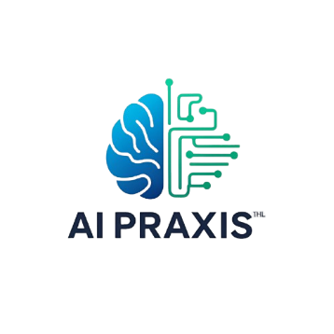
Profile
Services
Product
Contact
AI Praxis
Inteli
Instituto de Tecnologia e Liderança
Marcos Moura
Prof. Bryan Kano

Slide 2

Summary
Goal
Architecture
Solution
Contacts
Conclusion

Slide 3
The Goal
AI Praxis aims to promote responsible, effective, and accessible use of artificial intelligence in the workplace. The project offers a Moodle-based platform with open learning content in Portuguese. Designed in four modules, its first course, "How to Create an AI Use Policy for Your Organization," addresses responsible AI practices. The project facilitates the formation of critical and strategic AI skills among professionals.
Explore More

Slide 4
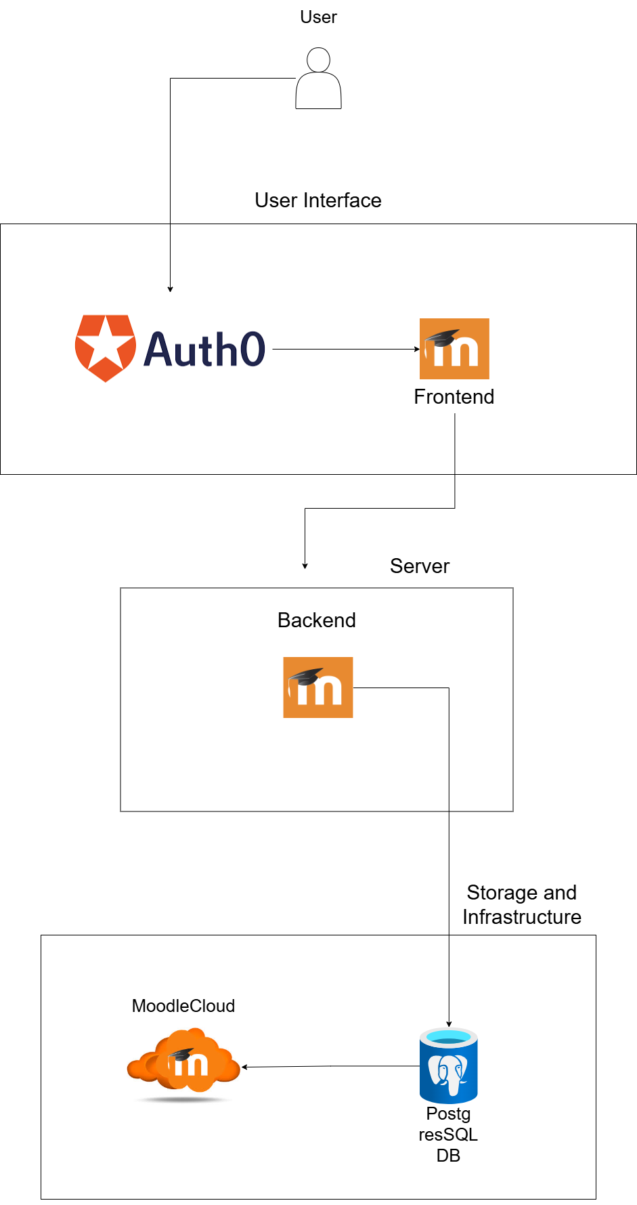
Solution Architecture
User Interface Layer
Application Layer (Backend)
User
Moodle Frontend
Auth0
Moodle Cloud
Storage and Infrastructure
Moodle Cloud
Postgres DB

Slide 5
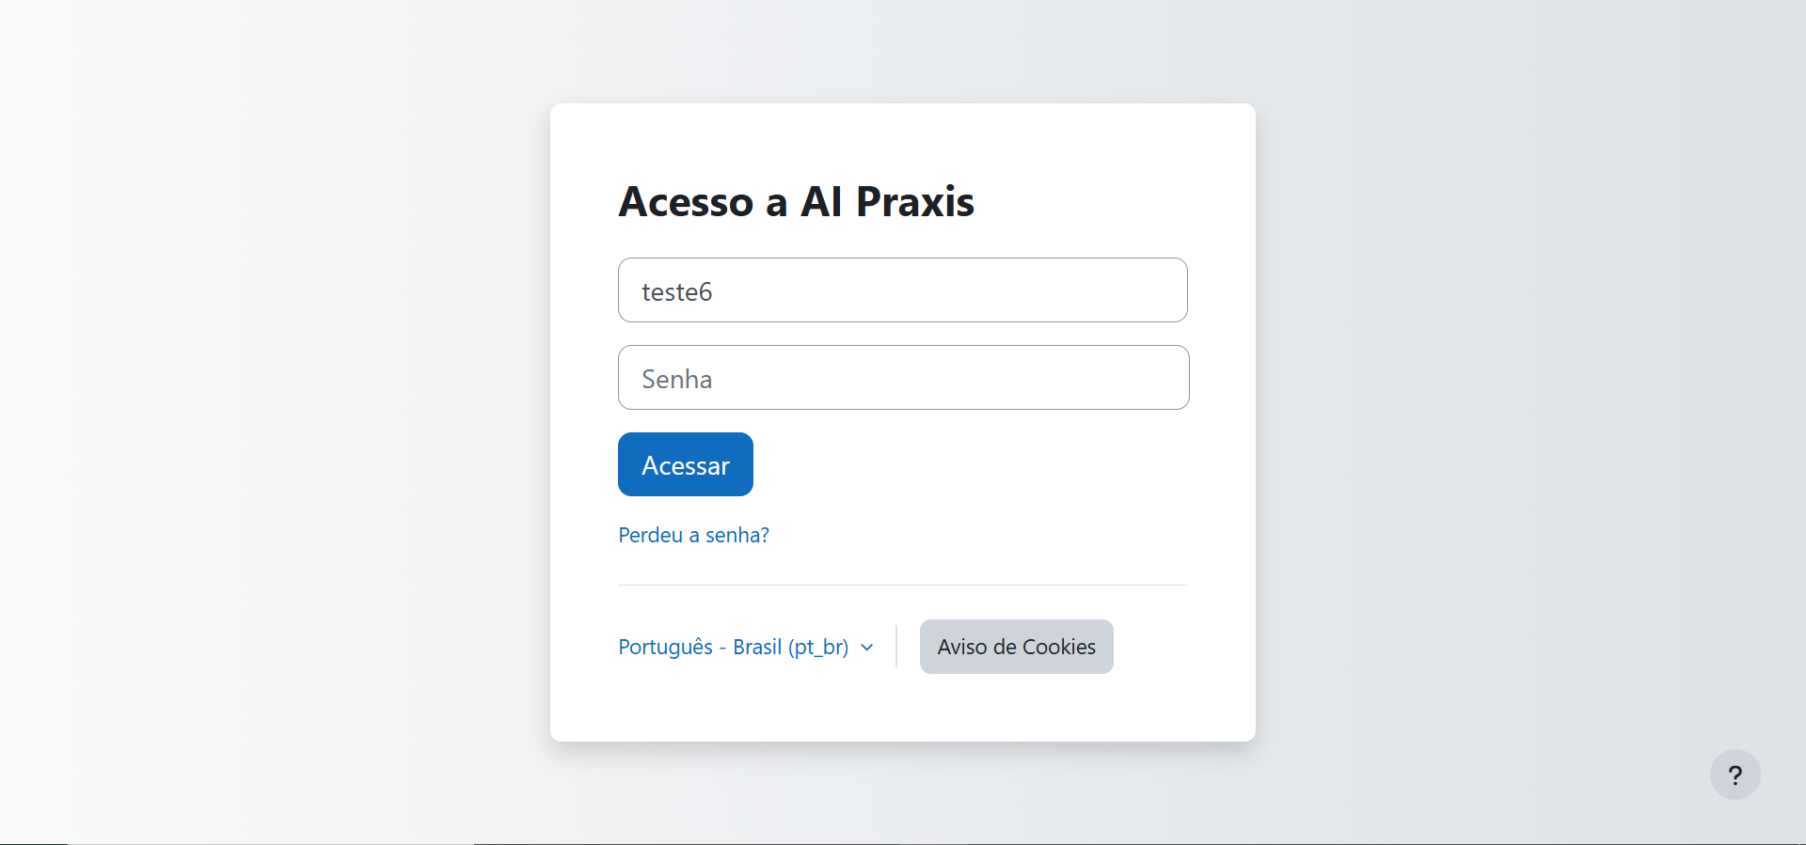
Login Page

Slide 6
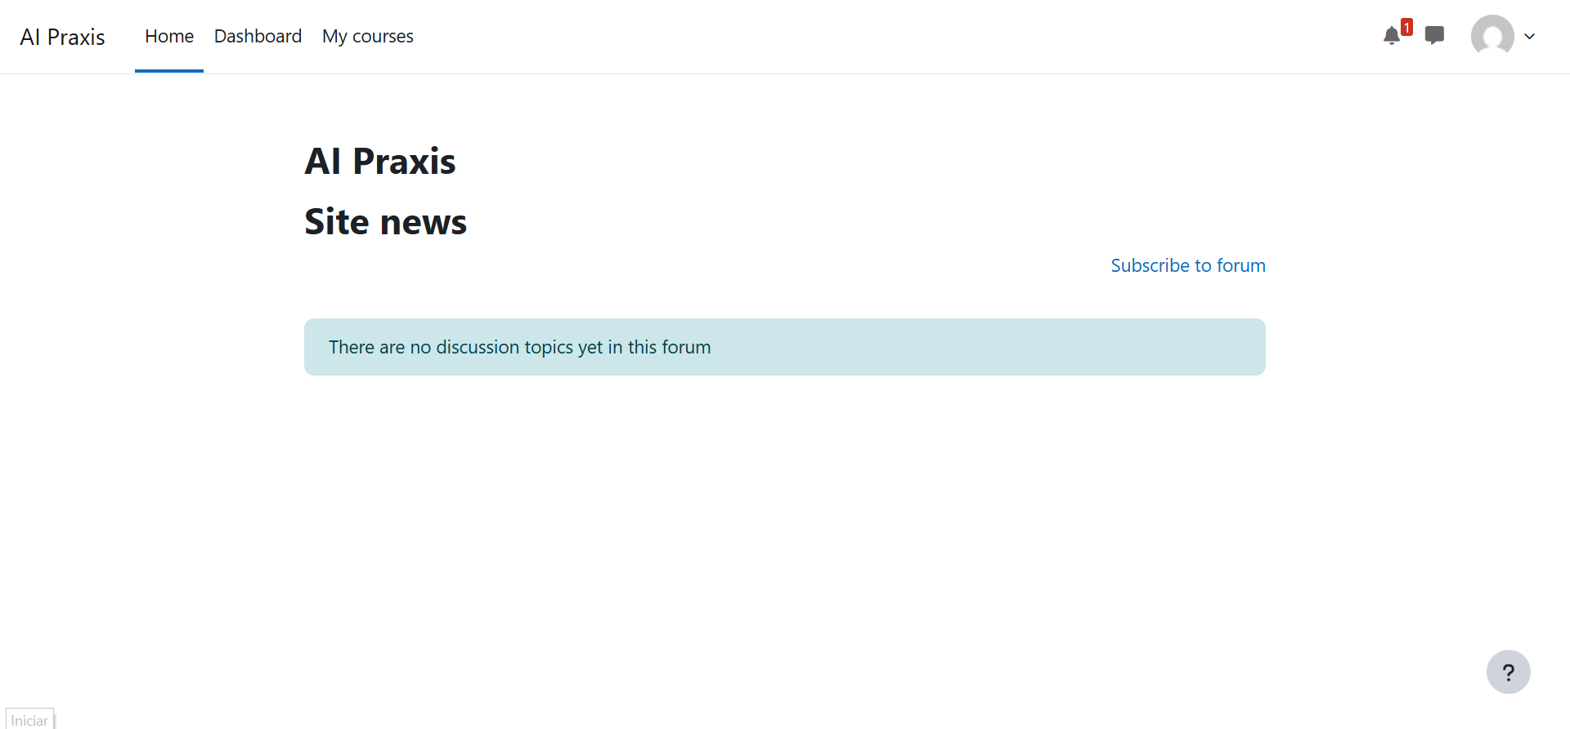
Home Page

Slide 7
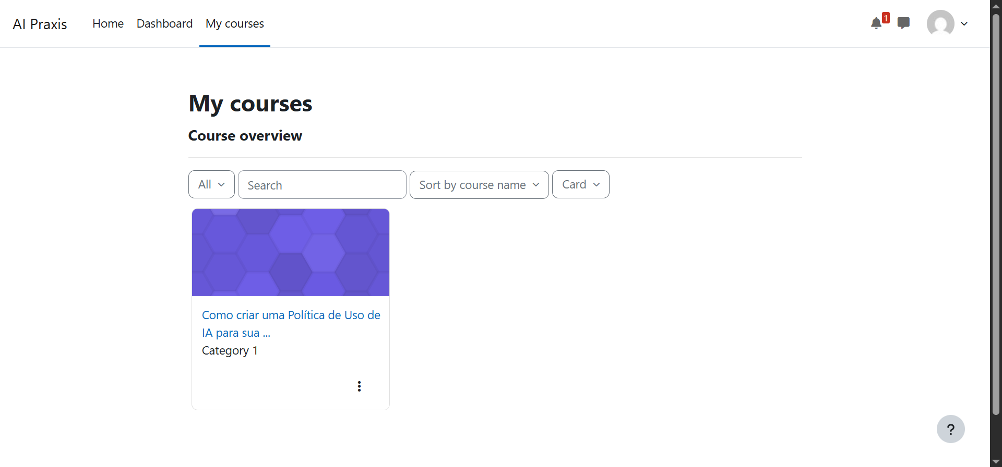
My Courses

Slide 8
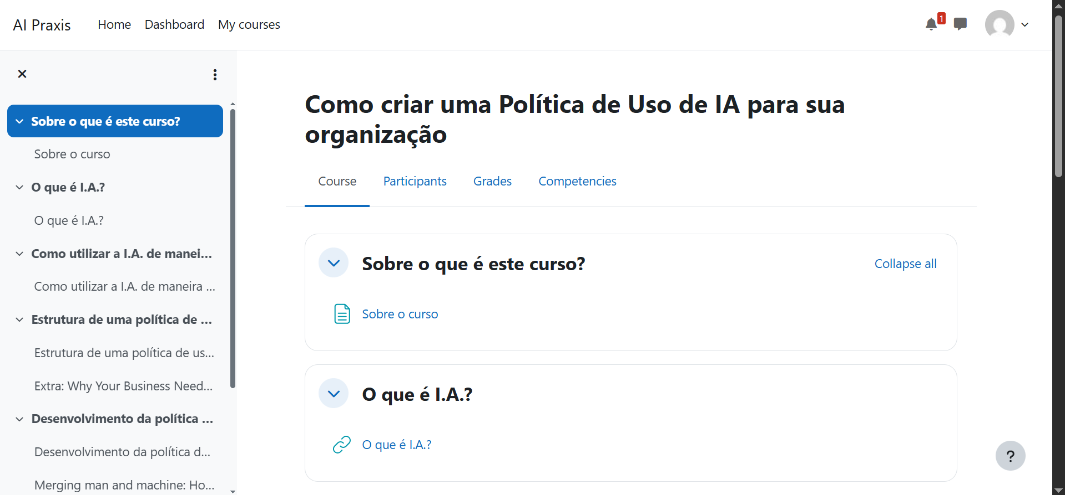
Course

Slide 9
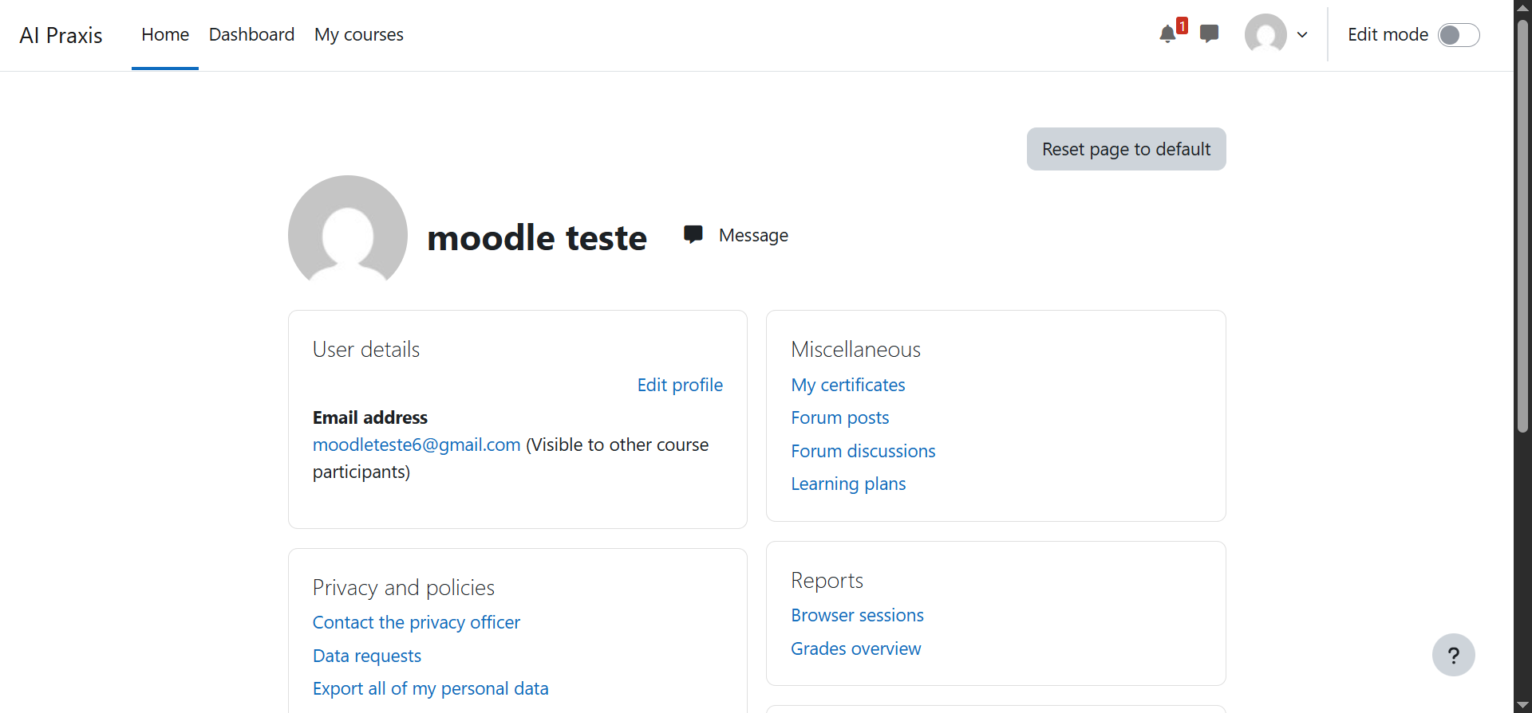
Profile Page

Slide 10
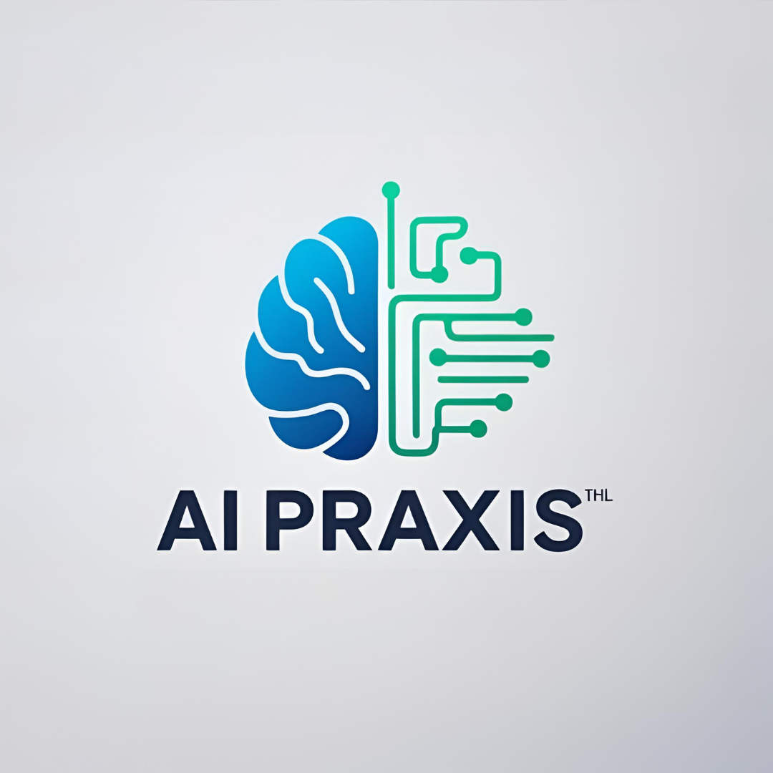
Contacts
Address Company
Phone & Email
São Paulo - SP
Butantã
+55 11 953408388
marcos.moura@sou.inteli.edu.br

Slide 11
Profile
Services
Product
Contact
Thank you!
São Paulo - 11/04/2025

