Slide 1
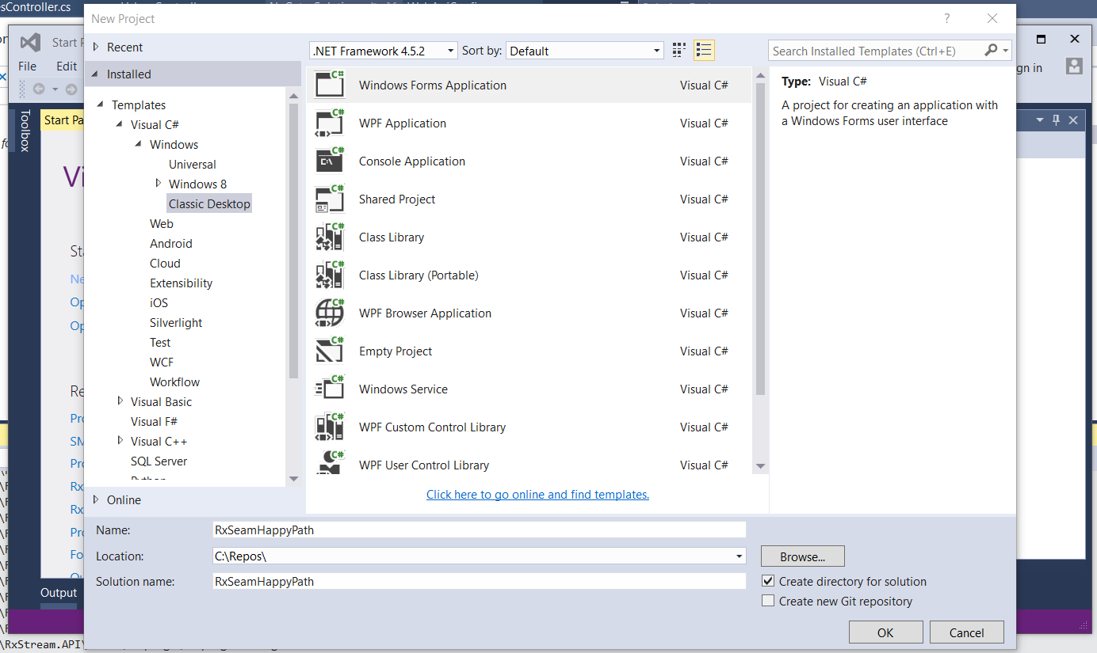
Create a simple forms app

Slide 2
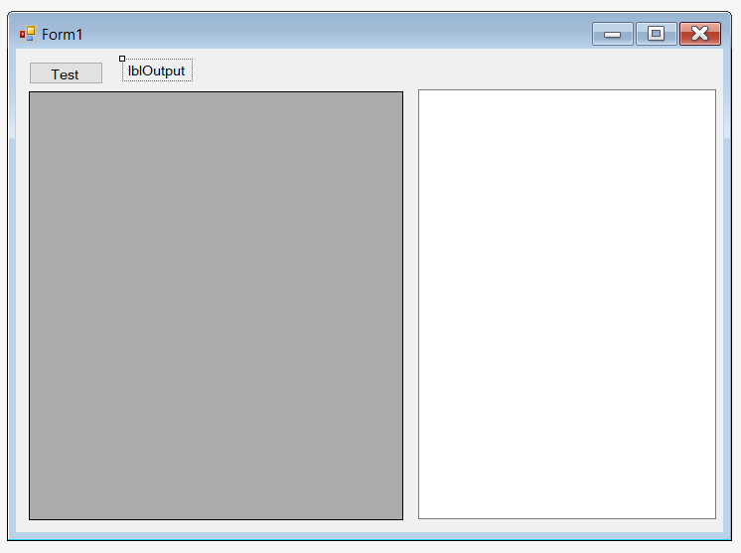
Go ahead and add a button, grid view, text box and label. I called mine: btnTest, gridJson, txtJson and lblOutput

Slide 3
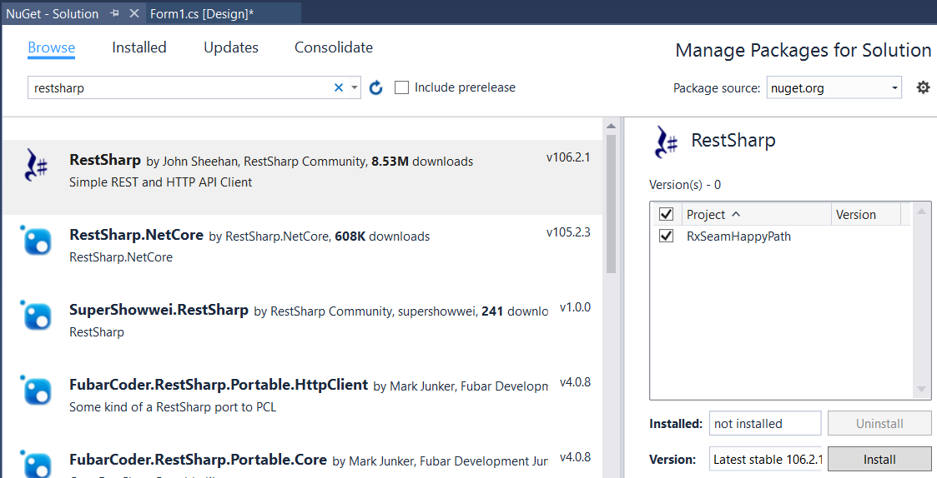
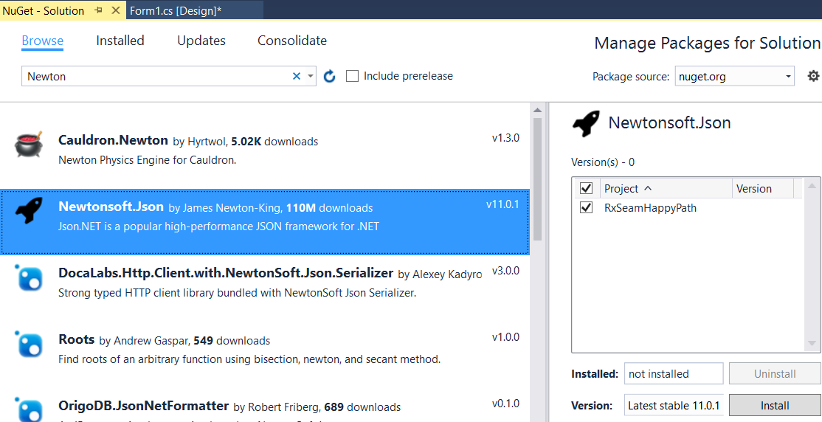
In NuGet package manager add RestSharp and Newtonsoft.Json packages

Slide 4
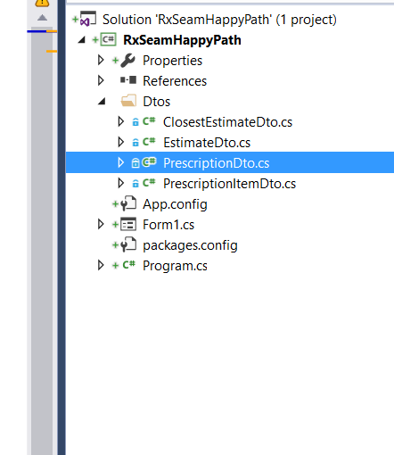
Add a Dto folder and the following Dtos that will help you with serialization

Slide 5
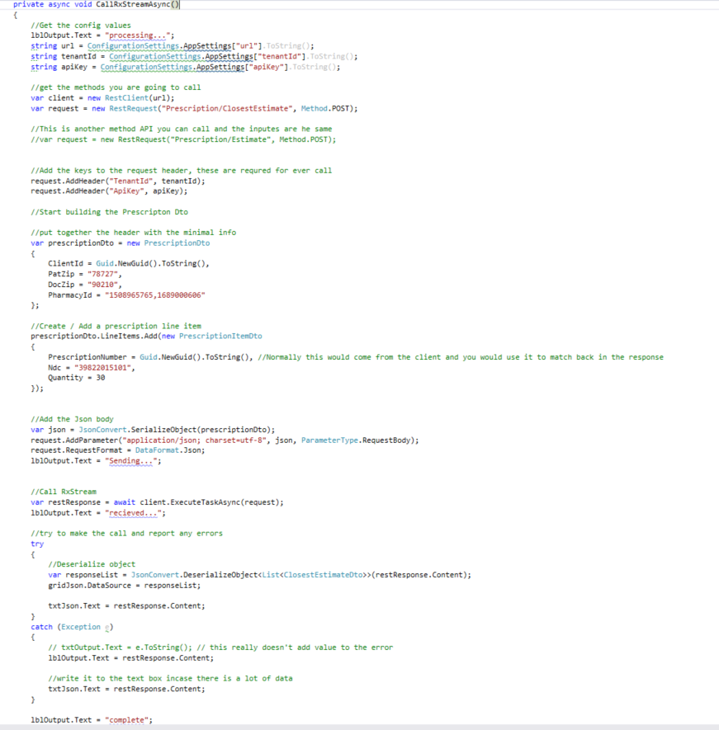
Pull all your setting from a config file
Setup your rest client with the method you want to call
Add your Tenant and API key, this is required for all requests
Setup a prescription header, this one is with the minim amount of data
Add a line item to the collection, you can add as many as you want
Serialize you class / dto into Json and attach it to the request to send to RxStream
Send the data to RxStream in async fashion
deserialize your response into an object you can do something with. In this case a collection of ClosestEstimateDto’s

Slide 6
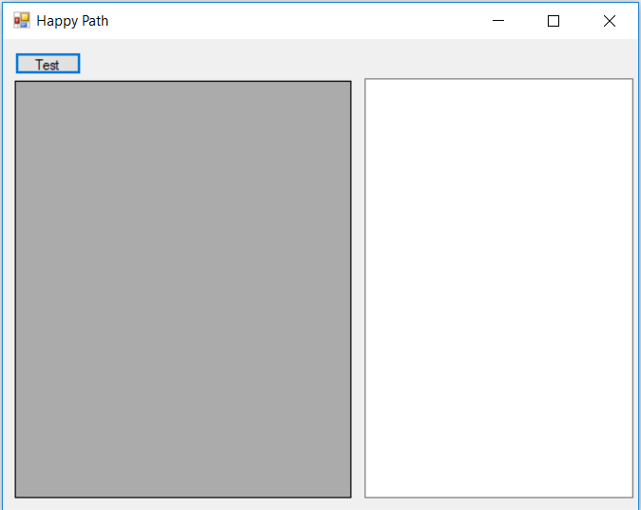
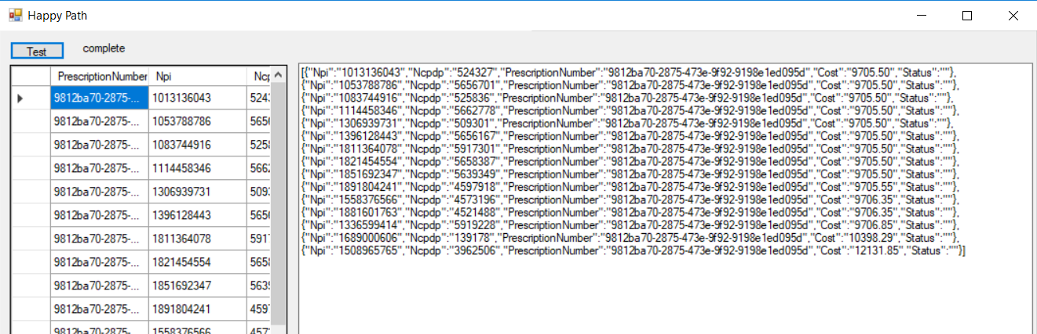
Raw response
Deserialized response

