Slide 1
Modular Platform based on Cdm8 processor
Repin Nikolay
Tatarinov Nikita
Group 21213

Slide 2
Idea
In our project we deiced not to design proprietary devices, but to develop a universal platform, that have a lot of applications and can be configured to solve different tasks.

Slide 3
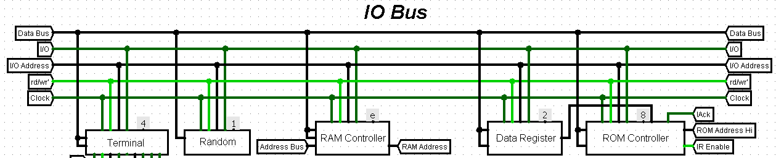
Modular
Main scheme consists of modules (devices) connected only with wires with no additional elements
Just like devices on system bus of regular PC

Slide 4
Features of this platform
Display controller
Expandable ROM and RAM both up 32 KB
A lot of other useful peripheral devices
Joystick, Terminal, Keypad Controllers
Interrupt Arbiter
Random number generator
Hex and 7-segment display drivers
16-bit Math Coprocessor

Slide 5
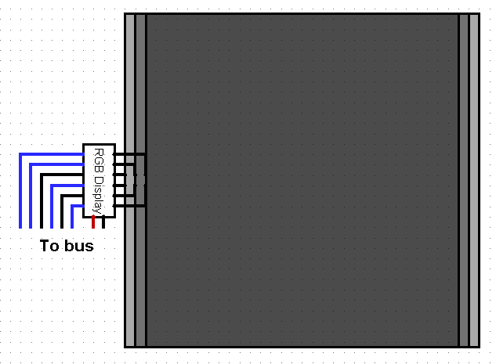
Display
32x32 or 30x32 pixels
1 or 8 colors

Slide 6
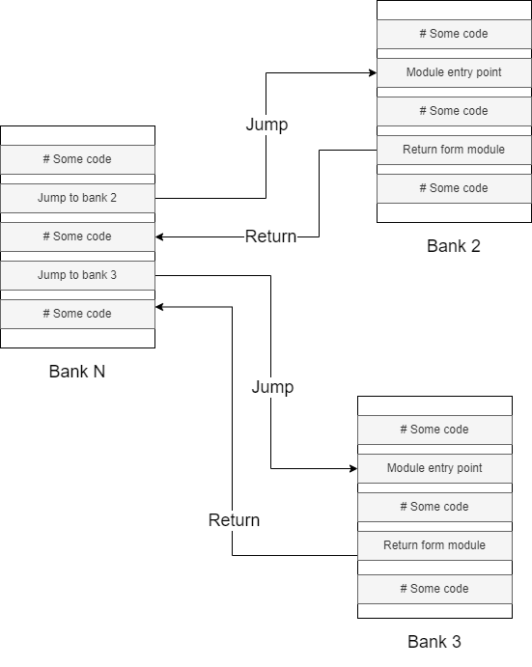
Our approach to memory banks
Banks are independent 256 bytes sections of ROM
We can jump from random place of one bank to random place of other bank
We can return from bank to the place where we had been before
Supports recursive calls

Slide 7
Problem
ROM image consists of continuous 256 byte modules
Cocol (standard linker) can’t generate images larger than 256 bytes.

Slide 8
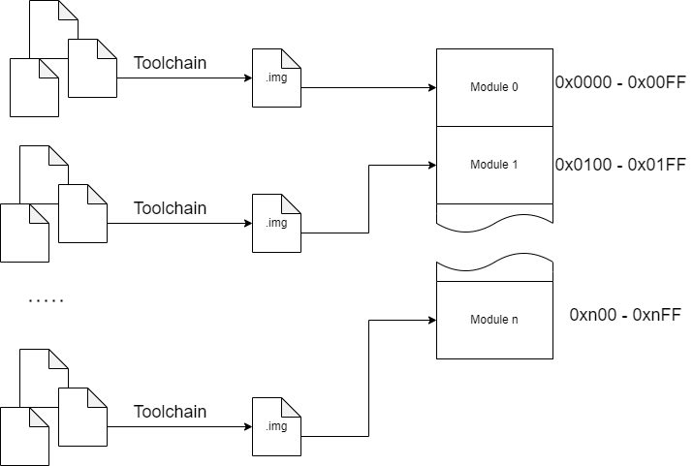
Solution: cocomake
Configurable build system that can produce imager larger that 256 bytes
Incremental

Slide 9
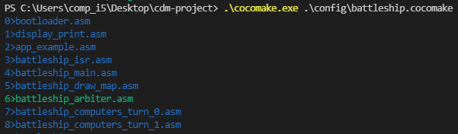
Incremental building

Slide 10
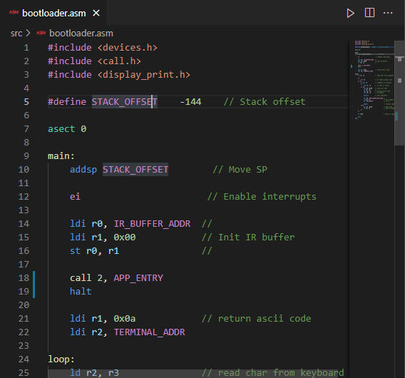
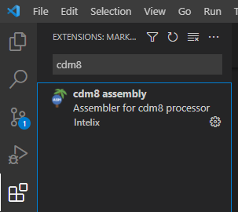
VS Code extension
Syntax Highlighting
Snippets

Slide 11
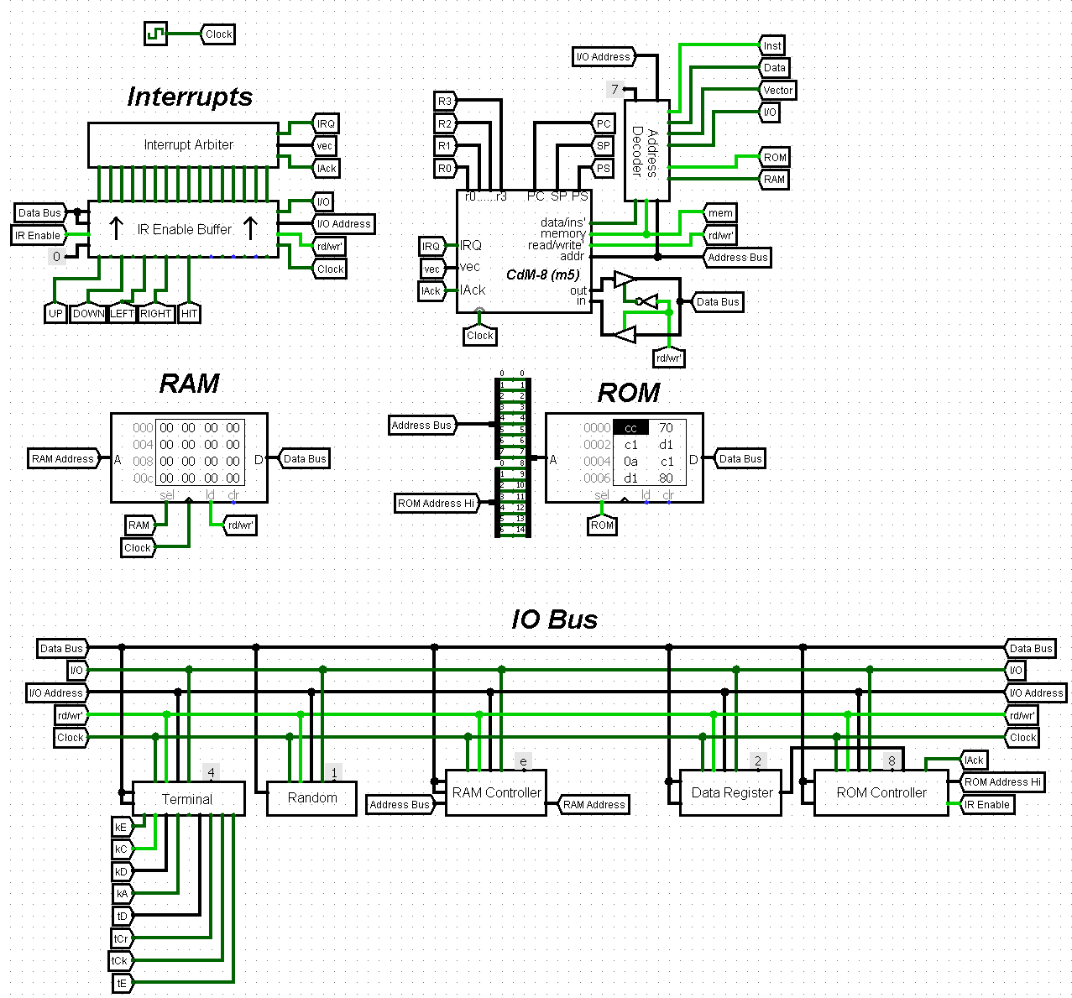
Scheme

Slide 12
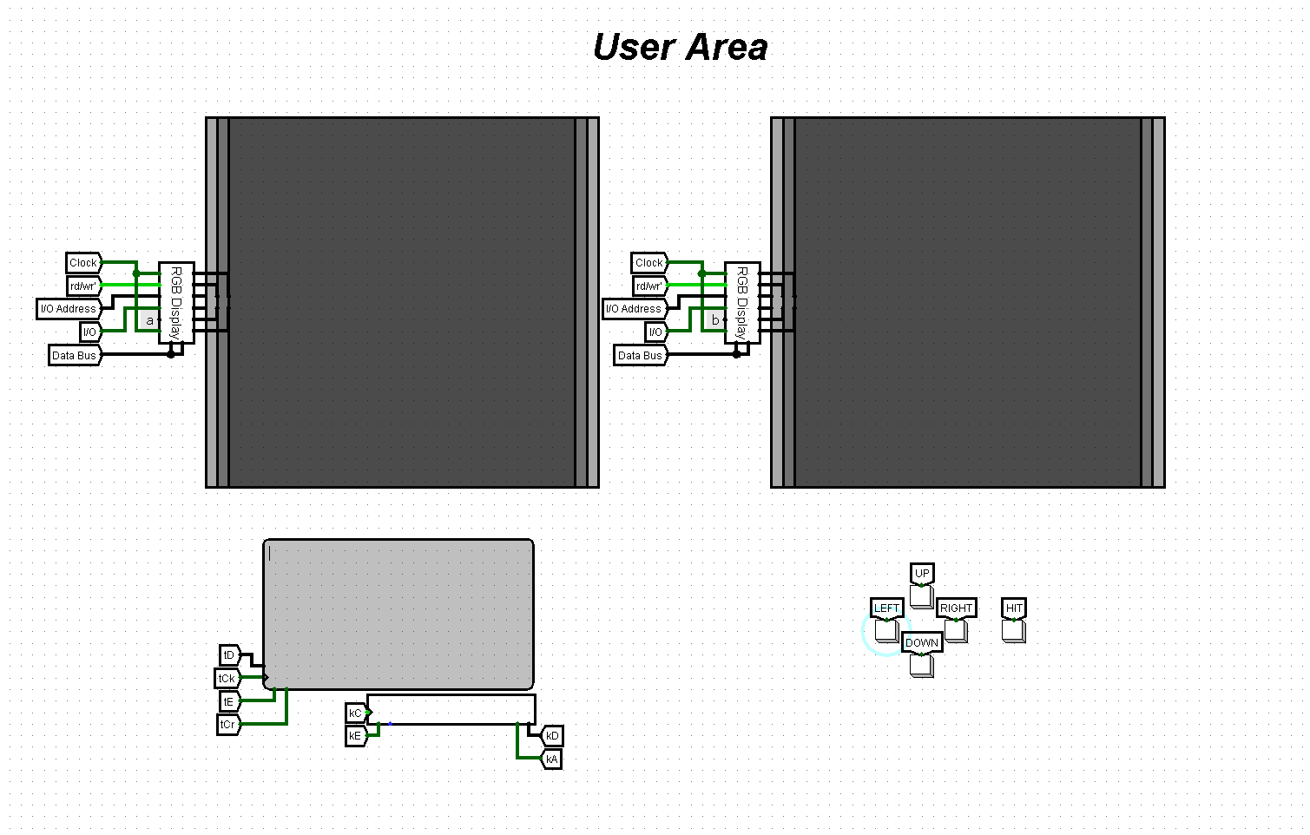

Slide 13
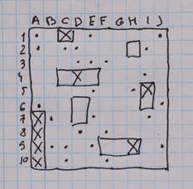
Battleship Game
Soviet/Russian variant
Involves a lot of graphics
Uses a lot of memory

Slide 14
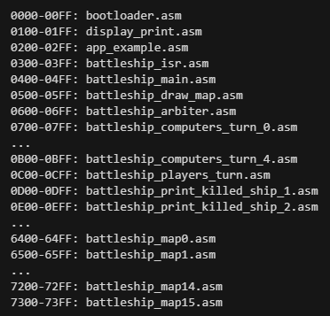
Programs structure

Slide 15
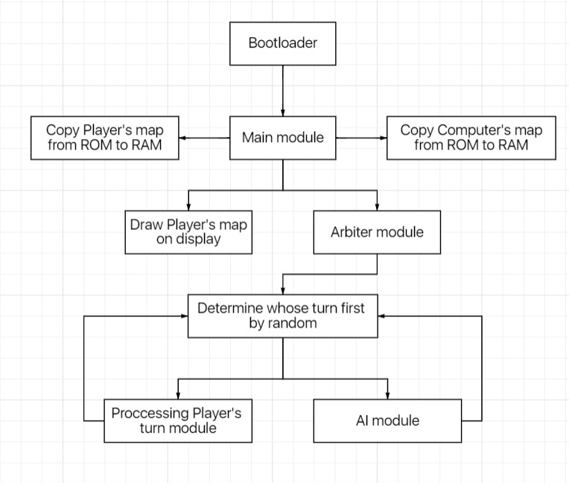
Game logic

Slide 16
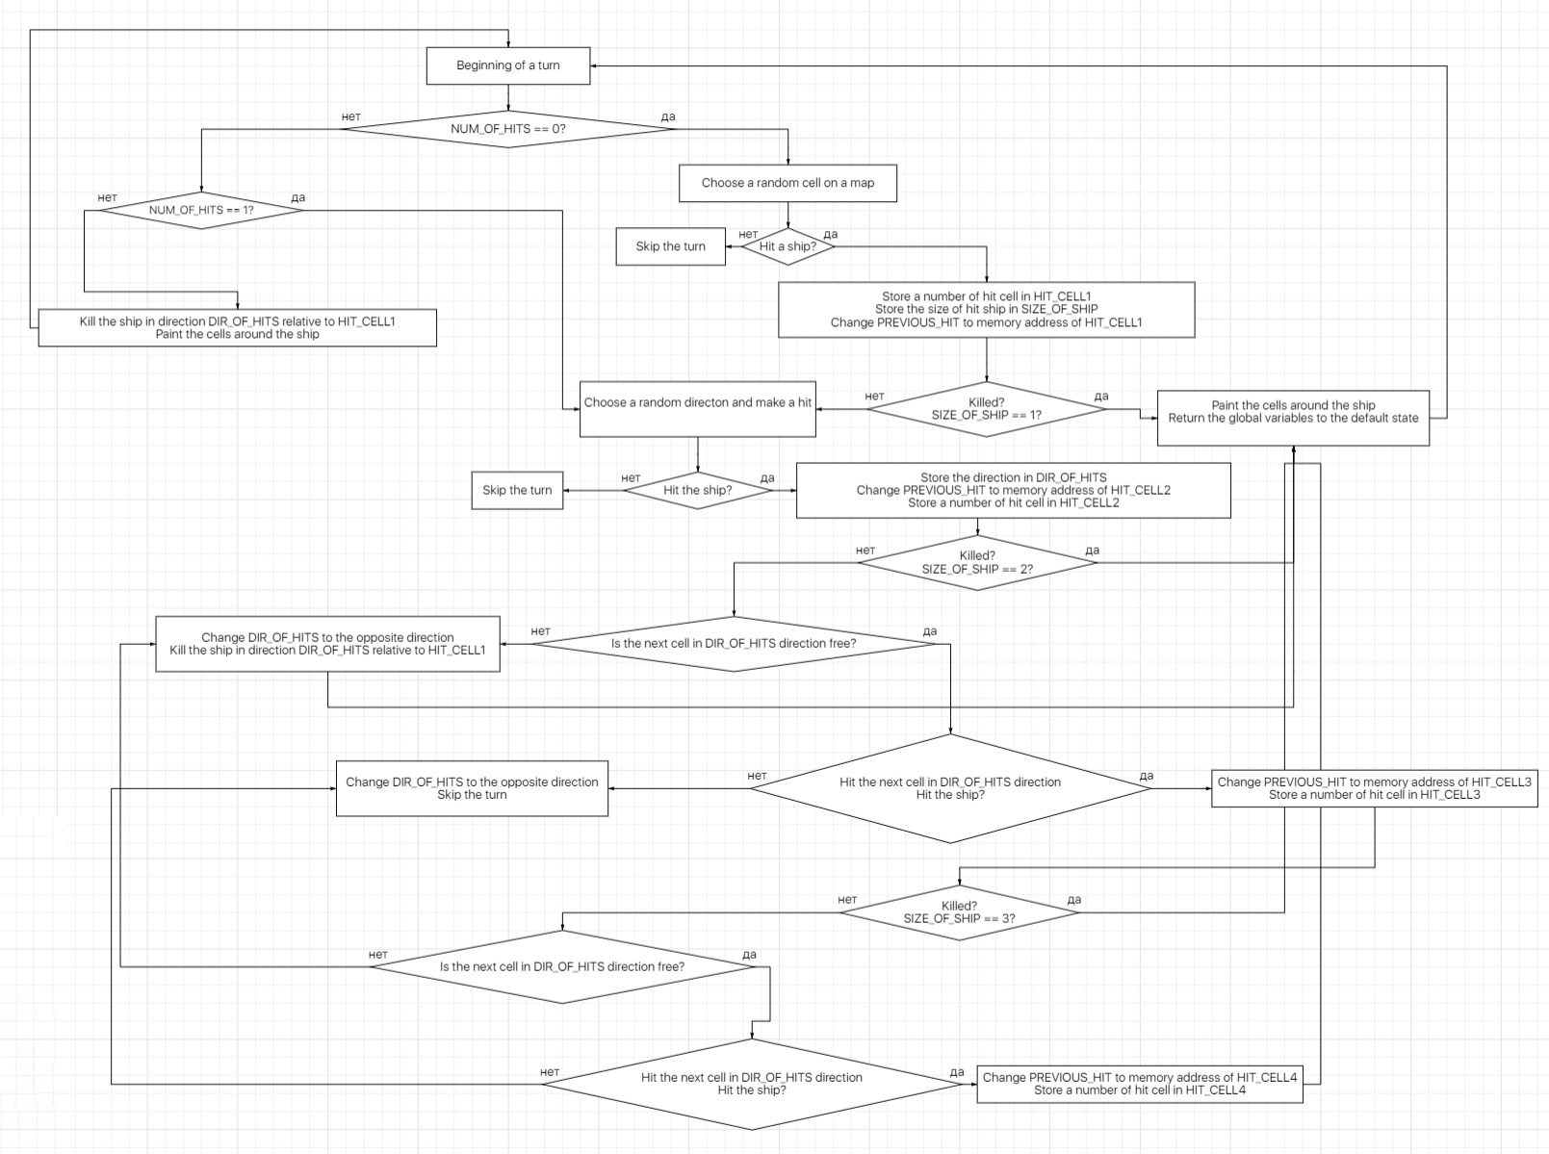
AI logic

Slide 17
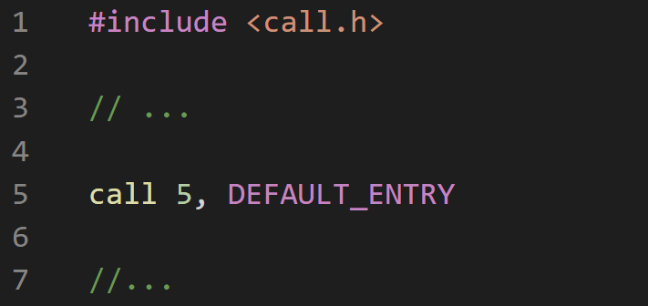
C preprocessor
Common constants
Libraries

Slide 18
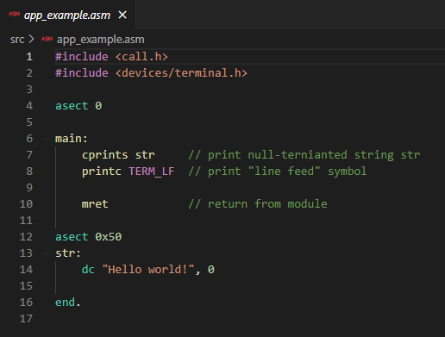
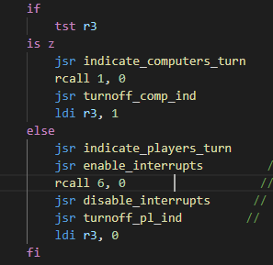
Code samples

Slide 19
Let’s go to Logisim!

