Slide 1



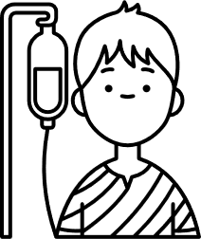
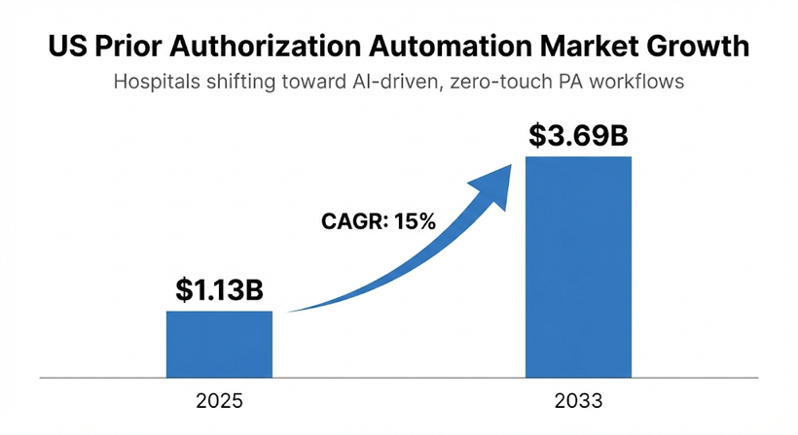
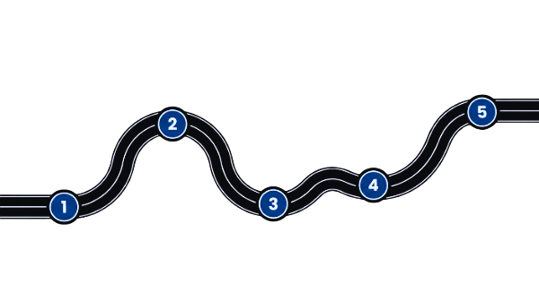

AutoAuth - Autonomous Prior Authorization Orchestrator
Business Need/Opportunity
Target Segment
Healthcare providers face massive administrative burdens and delays due to manual Prior Authorization (PA) processes. Clinicians spend hours extracting data from EHRs to map against complex, changing payer policies, leading to delayed patient care and high denial rates.
Problem Statement
Manual PA creates revenue leakage through avoidable denials and rework on high-cost claims.
Administrative workload is exploding, forcing hospitals to hire/reassign staff just to handle PA volume.
Regulatory pressure is increasing (CMS PA modernization rules + stricter turnaround expectations), making automation urgent.
Hospital PA Coordinators / Authorization Teams (main users)
Revenue Cycle / Billing Operations (submission + tracking)
Ordering Physicians / Clinicians (medical necessity + peer-to-peer)
Patients (faster approvals, fewer care delays)
Market Size and Growth
Future Readiness
2) Hackathon PoC (Working Demo)
Upload patient docs
Evidence extraction + policy checklist
Auto-generate PA request packet
Human review + approve/deny simulation
4.Enterprise Scale & Automation
Add RFI communication loop + appeal automation
Peer-to-peer support module
Multi-hospital + multi-payer scaling
Audit log + chain of custody
Team Name: IntelliAgents
5) Market Launch & Expansion
Rollout as enterprise PA automation platform
Continuous policy updates + compliance reporting
Expand to all PA categories (medical + pharmacy + DME + inpatient)
Team Members:
A Sai Teja Venkata Vinay
K Pranay
K Nikhil Vijay Kumar
J Hareesh
A Sri Akshay Satya Srinivas
US Prior Authorization Automation market: $1.13B (2025)
Projected to reach $3.69B by 2033 at ~15% CAGR, driven by hospitals shifting toward AI-driven, zero-touch PA workflows
1.Problem Research & Validation
Study PA pain points + denial reasons.
Identify key stakeholders (PA coordinators, payers, doctors).
Define success KPIs (time-to-approval, denial rate)
3) Pilot Integration (Hospital Workflow)
Connect to EHR using FHIR / SMART
Add payer policy library (version controlled)
Support portal/fax/API submission paths

Slide 2
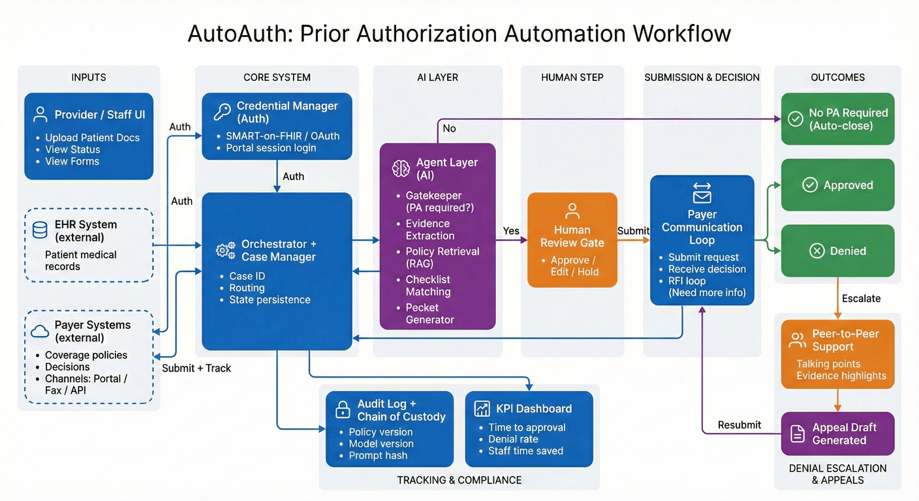
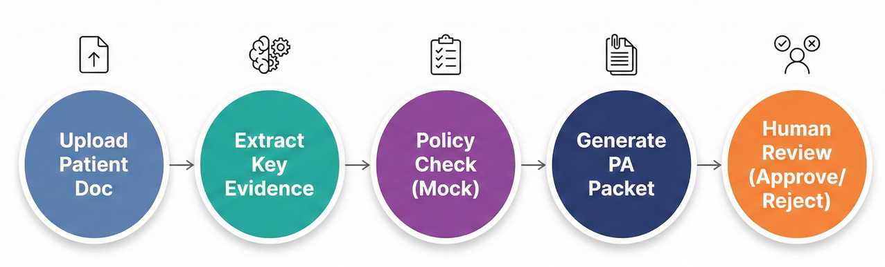

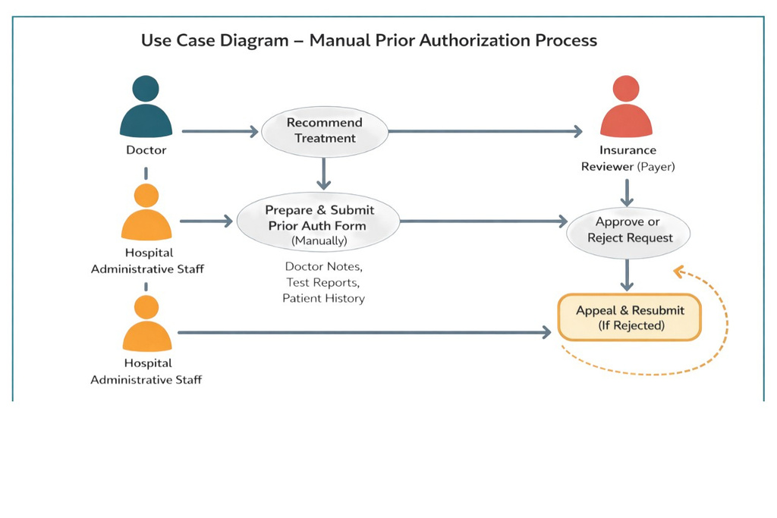
Solution Details
AutoAuth is an agent-driven Prior Authorization assistant that extracts clinical evidence from EHR documents, matches it to payer rules, generates a complete PA packet, and supports submission, tracking, RFIs, and appeals with final human confirmation.
Proof of Concept
Key Features
Advantages
Upload patient docs / EHR intake
Clinical evidence extraction (diagnosis, procedure, labs, history)
Policy retrieval + requirement checklist matching
Auto-generate PA request packet (summary + attachments)
Submission + payer communication loop (RFI handling)
Reduces administrative workload for PA coordinators by automating evidence extraction and packet preparation
Improves first-pass approval rate by validating missing documents before submission
Faster patient care by reducing delays caused by manual PA workflows
Audit-ready traceability with policy versioning + case history logging
Scales across PA types (medical + pharmacy + specialty + DME)

