Slide 1
IntelliBus Proposal Presentation
September 1, 2021
ECE-4872-L10
Group Members: Noah Chong, Shadman Ahmed, Thomas Talbot, Yue Pan (David)
Primary Advisor: Dr. Vijay Madisetti

Slide 2
Problem
Human congestion in public areas and transportation leads to money spent on inefficient public transportation and higher rates of virus transmission and exposure.
Local governments are looking for ways to reduce costs and more efficiently utilize public transit.

Slide 3
Solution
IntelliBus provides real-time passenger data capture and analytics, so that transportation authorities can better utilize resources and provide a better service to their customers.

Slide 4
Description
Project Goal - design and prototype an IoT device that will track bus location and the aggregate number of riders.
Passenger Counting System | Cloud-Based Web Application
Infrared Sensors Microcontroller LTE-M module GPS antenna | AWS IoT gateway with public IP address noSQL database on AWS Website with QuickSight dashboards and OpenLayers maps API
Notes:
Thomas -
This slide gives a high level description of the project. The goal is to design and prototype an IoT device that ultimately displays real-time updates of bus location and total passengers on a cloud-based web application. We have divided the project into two main components. The embedded passenger counting system will contain infrared sensors to capture passengers entering and exiting the bus doors, a microcontroller that will process sensor inputs and store the total passenger count.
And an LTE-M module on the microcontroller will transmit the current number of bus riders and bus location to an IoT gateway.
The second component of the project is a cloud-based web application that will be built upon a noSQL database of time-stamped passenger counts. AWS IoT Core is the gateway that will connect the embedded passenger counting system with the back-end noSQL database. A web dashboard will actively refresh with the latest passenger counts and bus locations pulled from the database. For the front-end, we we plan on using tools like Amazon’s Quicksight dashboards and the OpenLayer maps API. These tools will allow End-users like Transportation departments and bus riders to analyze passenger traffic statistics and bus maps on our website.

Slide 5

Customer Requirements
Target User - Transportation Departments without passenger data
Requirement | Priority
Accurate display of passenger counts | HIGH
Easy to Install | HIGH
Cost less than $800 | MEDIUM
Timely web application response | MEDIUM
Notes:
Thomas-
the target user of our product is transportation departments that provide bus services. And The highest priority for that customer is to deliver an accurate display of passenger counts and bus locations on our website.
Another top priority is that the IoT solution can be setup easily and affordably across an entire bus fleet. To be quickly setup, our passenger counting system will use an existing bus power supply, and fit within the dimensions of a bus doorway.
our goal is that the product would cost no more than $800.
- Transportation departments will only purchase our product if bus passengers are pleased with the website display. to keep passengers happy, the website we design should respond to HTTP requests within 5 seconds.

Slide 6

Engineering Requirements
Requirement | Priority | Customer Need
Transmit to the cloud with a minimum throughput | HIGH | Accuracy & Timeliness
Respond HTTP requests within 5 s | HIGH | Accuracy & Timeliness
Area < 680 cm² | HIGH | Ease of Installation
Charge using 5V USB | HIGH | Ease of Installation
Embedded device cost under $200 | MEDIUM | Cost & Scalability
Notes:
Thomas -
This slide shows how the engineering requirements of the project will meet the customer needs discussed on the previous slide.
The product will fail if it cannot respond to user requests in a punctual fashion. There are two potential network bottlenecks within the system. Between the IoT device and the cloud database, there should be a minimum throughput of 5.6 kbps to allow enough time for data processing. Transportation departments and passengers should receive HTTP responses from the AWS virtual machine within 5 s.
In addition to timing performance, the device should easily integrate into a modern bus infrastructure. The embedded system should charge using a 5 V USB cable and the size should not hinder passenger movement. To be scalable, the total cost of the embedded device hardware should be less than $200. For prototyping, the top engineering goal is to show that the IoT device can accurately display passenger count data on a website within a reasonable amount of time.

Slide 7
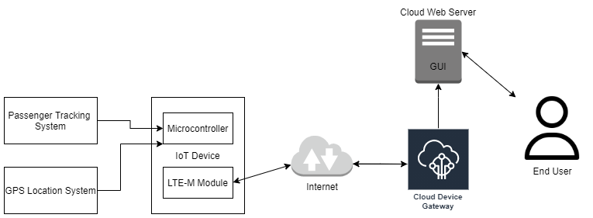
System Overview
Low SWaP IoT Devices & Sensors
Cloud-based IoT Endpoint and Processing
Visualization with Open-source GIS software
End-User access through a web-portal
Notes:
Shad -
There are two main components to IntelliBus: the IoT embedded device and the web applications. The IoT device consists of a microcontroller, tracking sensors, and LTE-M module. The web application is responsible for providing a real-time dashboard of bus locations, passenger counts, and viewing pertinent graphical statistics and analytics. Figure here shows the overall system architecture of IntelliBus

Slide 8







System Overview - Technologies
Visualization
Data Processing
Notes:
Shad --
Here is a little more detail about the frameworks and services that we will be using. For the Visualization and Frontend of the map viz that shows near real-time route information, we will use OpenLayers JS framework. It integrates really well with NodeJS and will provide a simple way to take GeoJSON info and map them appropriately. For the analytics side of the vizluations, we plan to leverage some enterprise level Business Intel

Slide 9
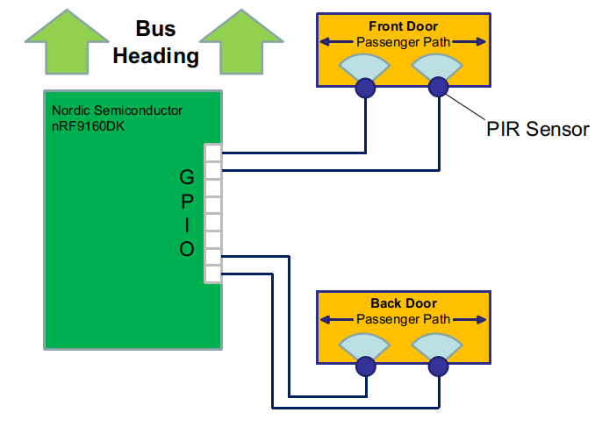
On-bus Hardware Organization
Jumper wires connect the microcontroller to the sensors
GPIO ports are used for communication as sensors produces a digital 1 or 0
Two PIR sensors for each door
PIR sensors are placed facing the passing passengers
Notes:
Hardware architecture and mechanism for counting people

Slide 10
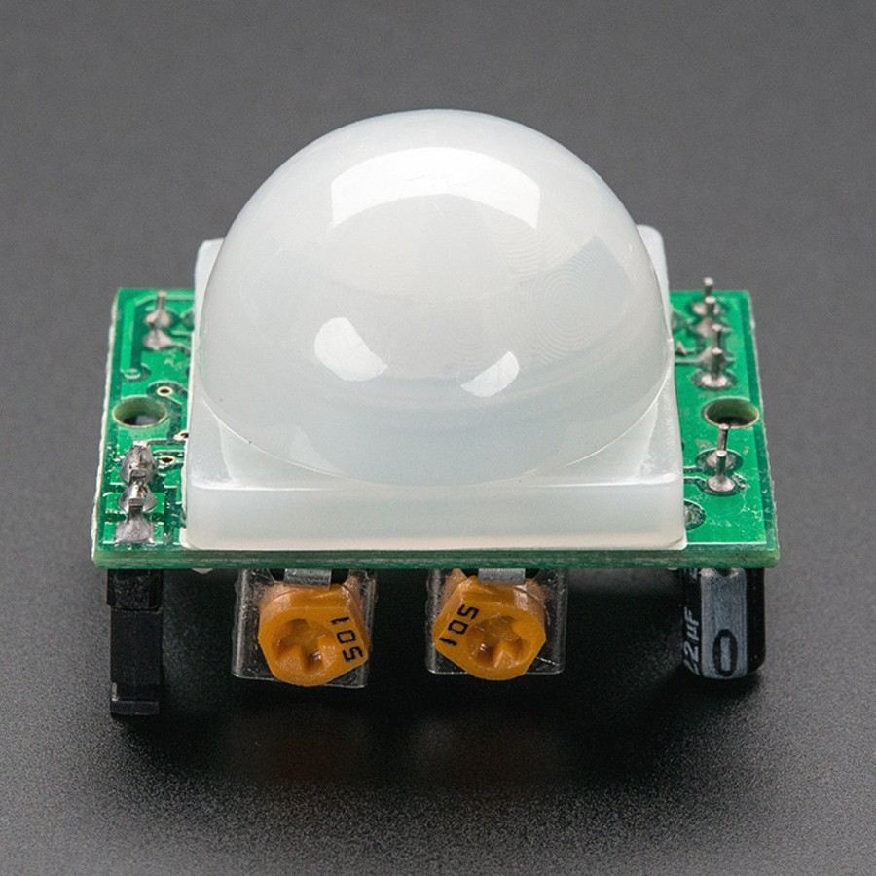
PIR Sensor
Passive InfraRed sensors
Common practice for motion detectors
Differential detection units
Adjustable ambient threshold
Low cost
Notes:
Common practice for motion detectors in shops and surveillance products
Differential detection: changing environment temperature does not affect accuracy
Adjustable ambient threshold: we will experiment with it to find the best
Low cost: at ~$2 per unit

Slide 11
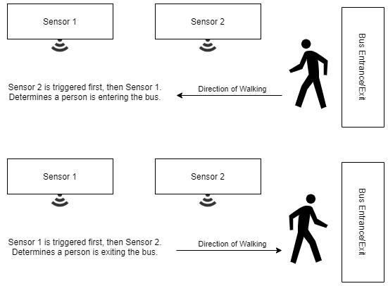
Passenger Counting Mechanism
Two PIR sensors will face the path of passenger’s entry and exit
When passenger moves in / out of the bus, the two sensors triggers at different times
We will design an algorithm that updates the passenger counts based on the time at which each sensor triggers, as well as handle possible edge cases.

Slide 12
Microcontroller Options
Product | Connectivity | Price
Nordic Semiconductor nRF9160 | LTE-M, NB-IoT, Bluetooth, GPS | $139.00
BeagleBone Rev C | WiFi, Ethernet | $89.99
Raspberry Pi 4 | WiFi, Ethernet | $75.00
Notes:
Shadman -
There are a few options we have for microcontrollers for the passenger counting system. The first option is to use the Nordic Semiconductor nRF9160. This would allow the team to explore using LTE-M connectivity and would be the board of choice if the project was to be deployed on a moving bus in the future.
The team will also explore using wifi to connect to the gateway system. One such option is the, Beagle Bone which runs Linux and has connections to WiFi and Ethernet to transmit data. The Beagle Bone is a good option for a prototype of our project since there is already examples and documentation available about connecting BeagleBone with AWS IoT Core.
A few team members already have the Rasberry Pi 4, so this is a potentially good option for early prototyping to initially test if we can send data over WiFi to a noSQL database on AWS.

Slide 13
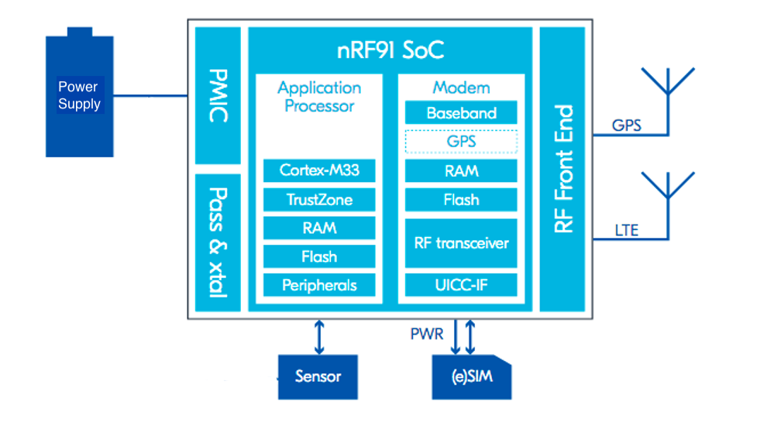
Microcontroller Diagram
nRF9160 DK cellular IoT development kit with dedicated LTE and GPS antennas
Notes:
Shad --
The DK cellular device is the optimal choice for the project because of its built-in LTE and GPS capabilities, application processor, and 24 GPIOs. The LTE antenna will be optimized for global bus operations supporting all LTE frequency bands in the 698-960 MHz and 1710-2200 MHz ranges. For ease of development, the nRF9160 comes bundled with an iBasis SIM card preloaded with 10 MB
The device features a 3.0-5.5 V power supply from an external battery but can also be powered using 5 V USB. The application processor includes a 64 MHz Arm Cortex-M33 CPU with 1 MB of flash and 256 KB of RAM dedicated for the application, which are adequate hardware resources for the passenger counting program. The 24 GPIOs can be configured to interface with the infrared sensor arrays.

Slide 14
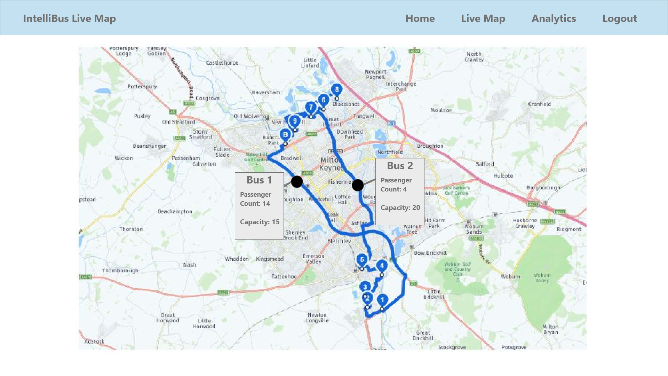
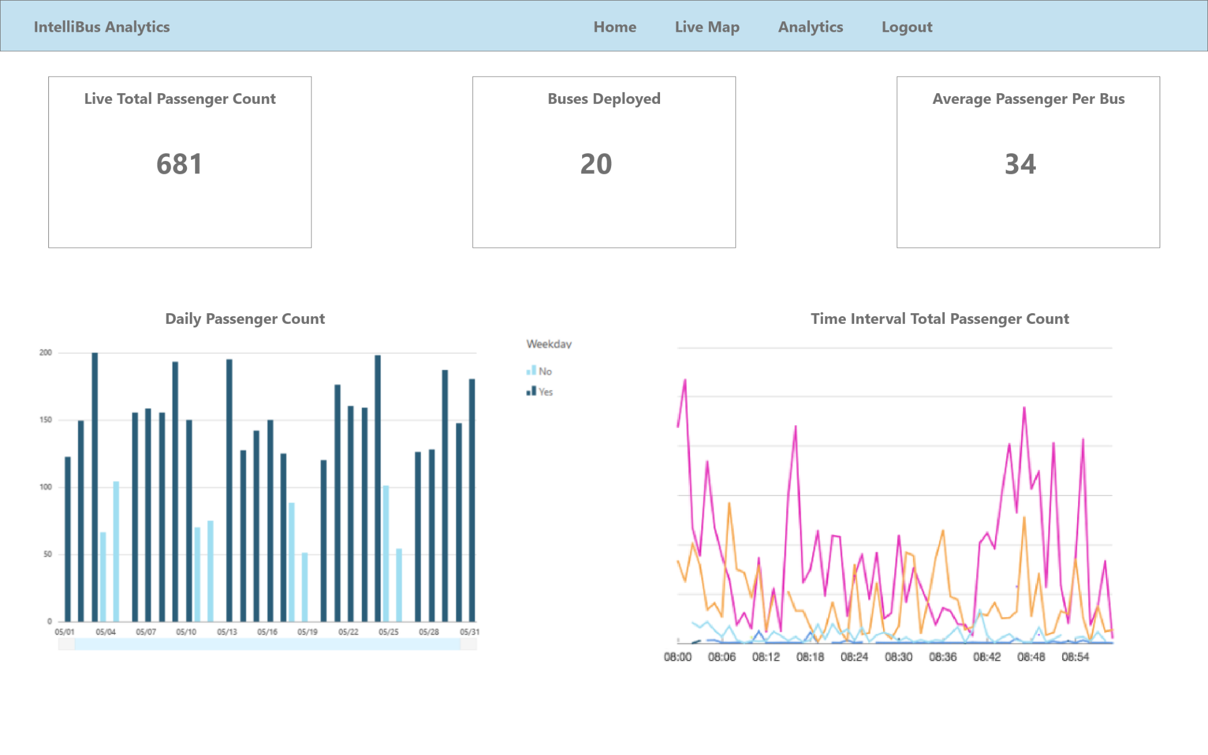
Project Demonstration
Live-Feed Webapp
Analytics Dashboard
Notes:
Shad --
The web application pulls from the database to present the end-users with live maps and passengers counts
The live-feed webapp proposed GUI for the live map and passenger count.
The analytics dashboard will provide web-embeddable machine learning business intelligence (BI) GUI dashboards -- either using AWS Quicksight or Microsoft PowerBI -- which will allow end-users to have insights on the data and make predictions.

Slide 15
Schedule
Sep. 11th
Oct. 10th
Oct. 23rd
Nov. 23rd
Dec. 7th
Setup
Local Environments
Hardware setup
Small-Scale Integration
Hardware and IoT communication
WebApp and Visualization integration
Total System Integration
Sensor → IoT → Backend → Visualization → WebApp
Presentation
Package repo & demo
Expo Presentation

Slide 16

Budget
Product | Cost
Cellular IoT Development Kit | $139.00
Infrared Sensors | $10.00
Wires and Connectors | $10.00
Total Parts Expense | $159.00
Using open-source software tools and AWS free-tier helped save on cost.
Funding ($125 per student): $500
Parts Expense: ($159)
_______________________________________
$341
Notes:
Thomas - The equipment for a prototype of the IntelliBus system includes the cellular IoT development kit, infrared sensors to track passenger motion, and additional wires and connectors. The Nordic Semiconductor cellular IoT development kit is the most expensive item in the budget at $139.00 [7]. Passive infrared sensors come in batches of 6, and the per batch cost is $10 [20]. Wires and connectors are estimated to be around $10 as well. Bringing the total Parts expense to $159
The embedded software development environment will come included with the cellular IoT kit. The prototype should not need more than 10GB of standard storage and will use Amazon Web Services' free-tier. Using open-source software tools for the front and back-end of the website will also help save on cost.
The funding for the project is $125 per student, leaving us $341 below the top of our budget. Using the current evaluation, there is no indication that the project will exceed the funding provided by the ECE department.

Slide 17
Leadership Roles
Noah Chong - Webmaster, Frontend Software Lead, Expo Coordinator
Shadman Ahmed - Project Leader, Backend Software Lead
David Pan - Financial Manager, Embedded Systems Co-Lead
Thomas Talbot - Embedded Systems Co-Lead, Documentation Lead
Notes:
Thomas -
Noah Chong will serve as …
Team members may be called upon to assist in other areas of the project depending on the workload.

Slide 18
Any Questions?

