Slide 1
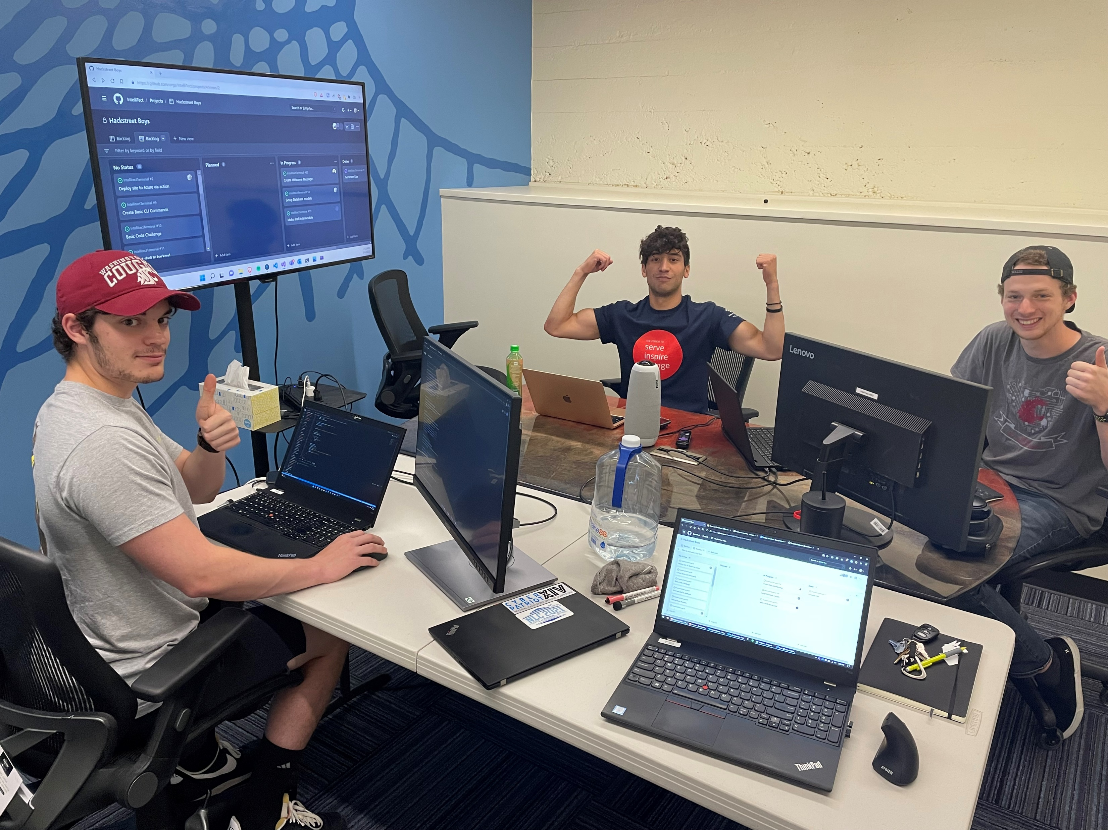
The HackStreet Boys 😎

Slide 2
https://intellitect.com

Slide 3
console.intellitect.com

Slide 4
The Prompt
The prompt for the 2022 IntelliTect Hackathon was to create a web app to be showcased on the IntelliTect website.

Slide 5
Our Idea
Create a "Google Foobar" inspired project to entice people viewing our blogs and IntelliTect website.
Request coding related challenges from a server
Execute submitted code samples on the server
Bash CLI and filesystem front end
Expandable, easy to implement anything on for future use

Slide 6
Bash Inspired Commands
Help
Ls
Cat
Cd
Clear / ctrl L
pwd

Slide 8
What we would improve
Fully flesh out bash with bash history (up arrow)
Format requests better in a text editor
Run security checks on python files submitted

