Slide 1
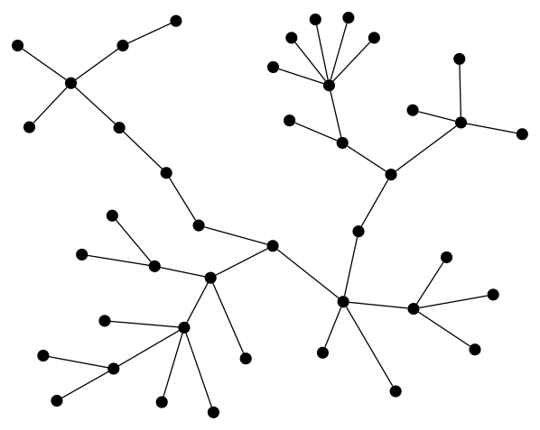
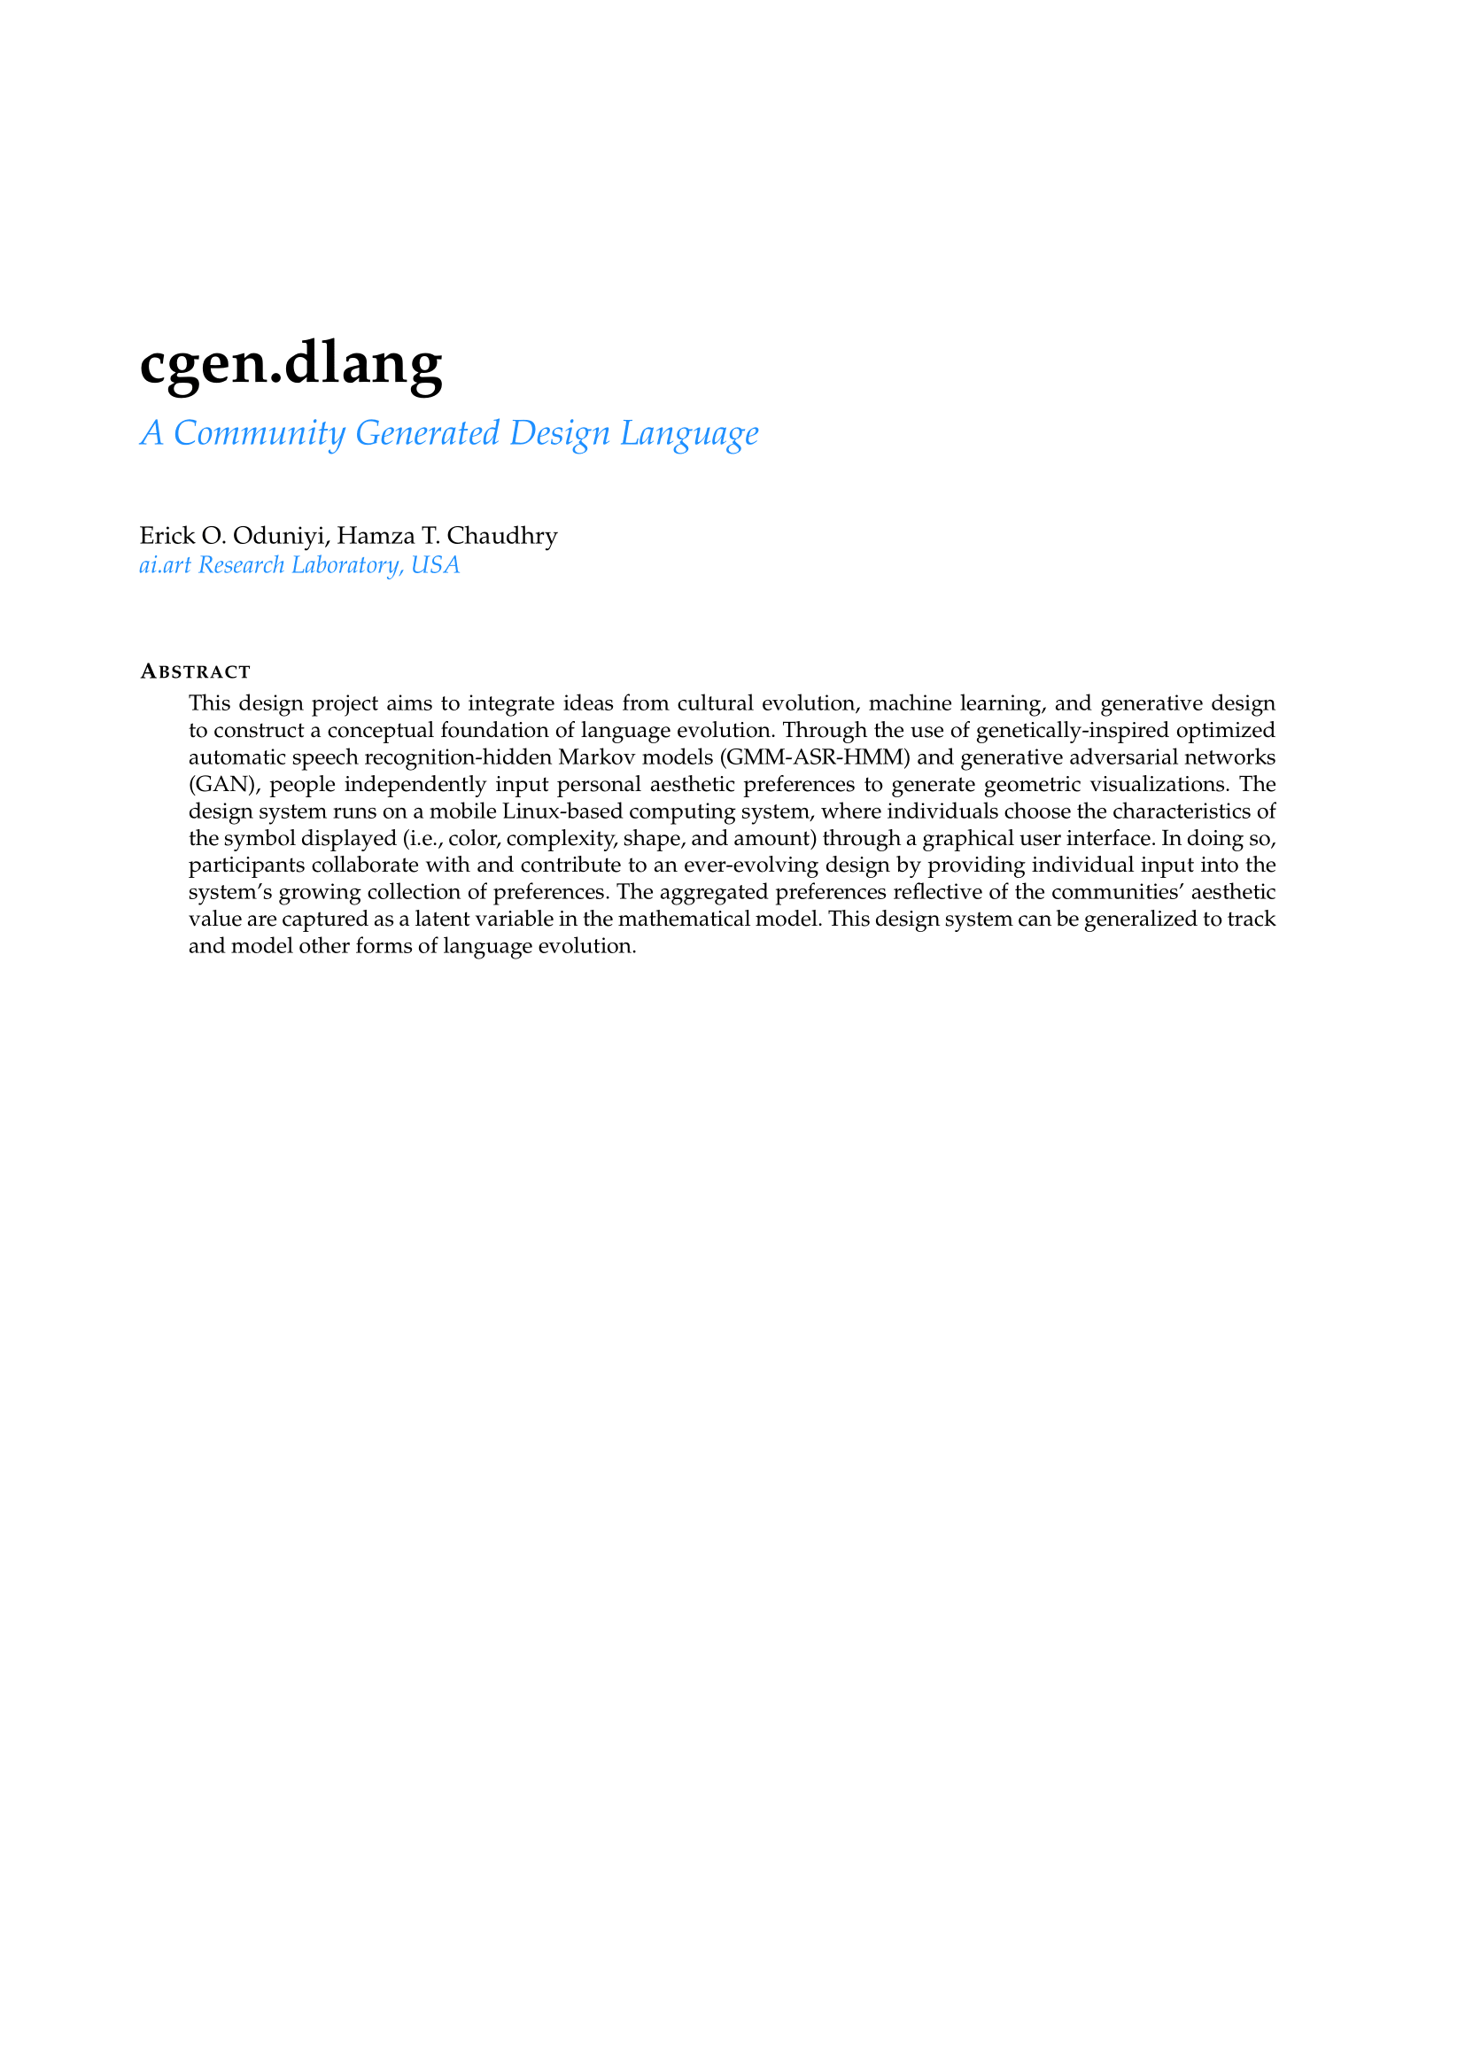
abstract-cover

Slide 2
ABSTRACT SUBMITTED
abstract-preview

Slide 3
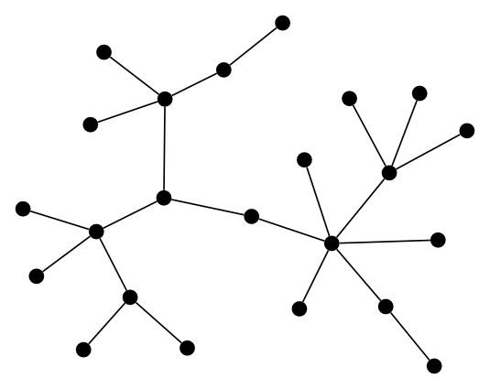

Slide 4
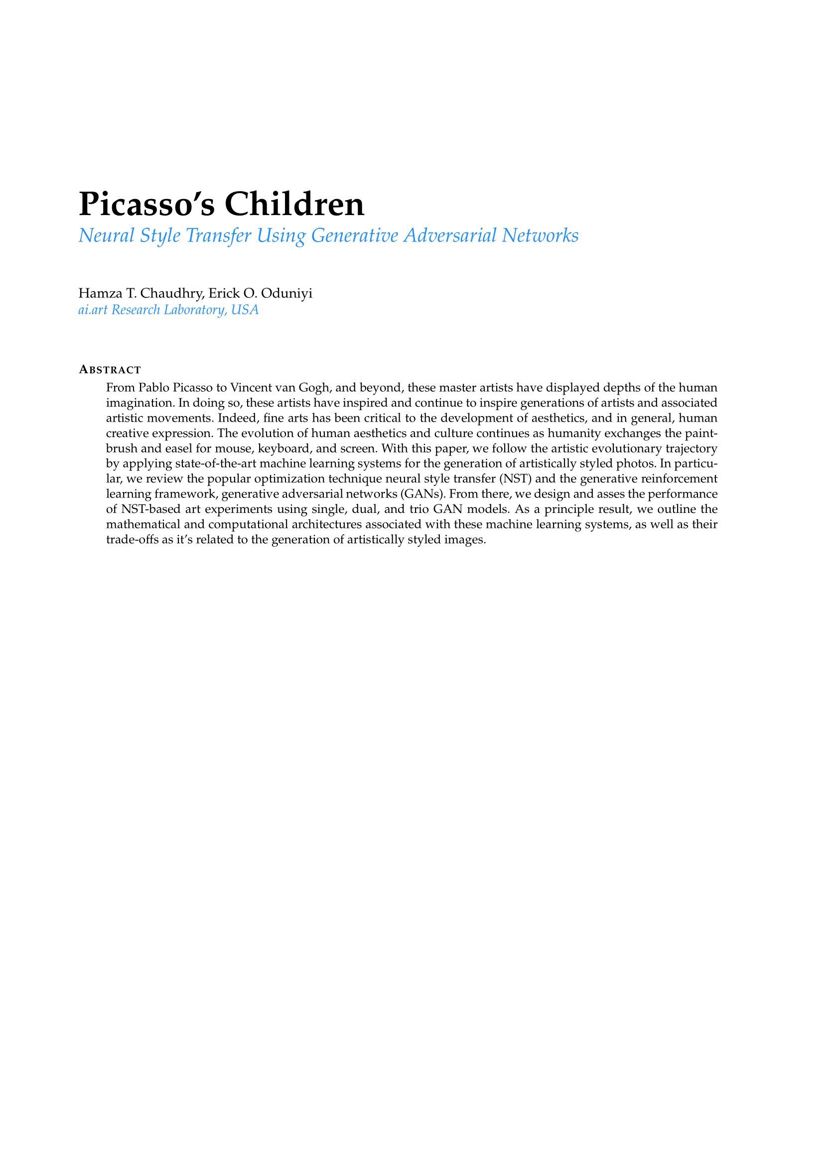
abstract-cover

Slide 5
WORKING ABSTRACT
abstract-preview

Slide 7
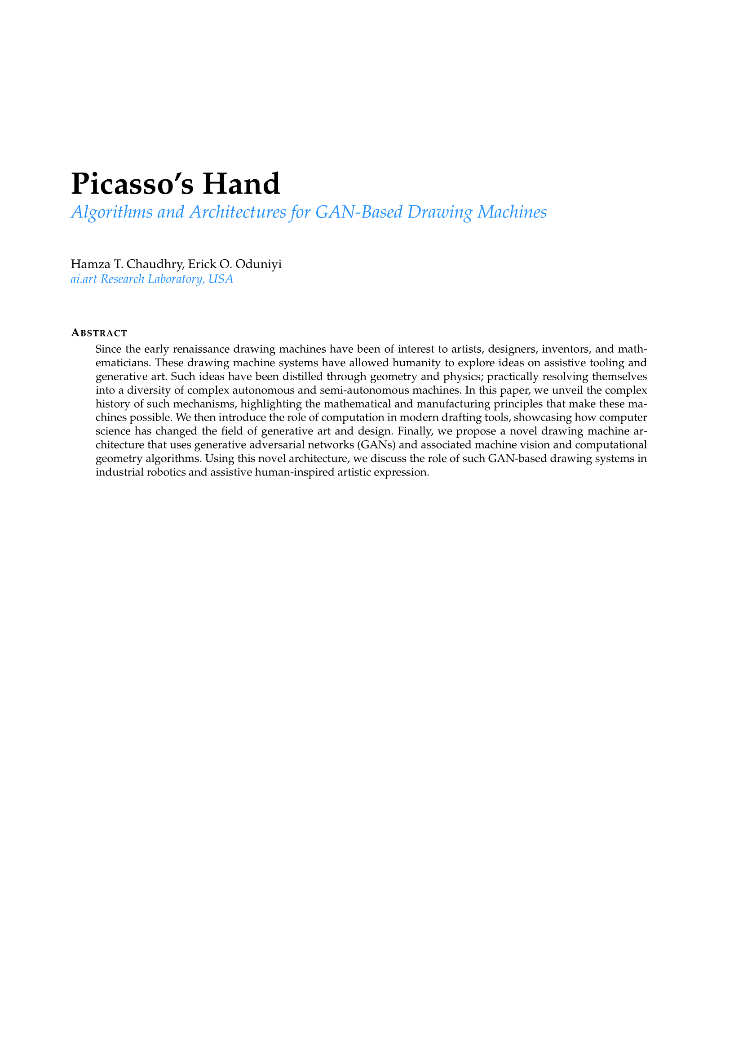
abstract-cover

Slide 8
WORKING ABSTRACT
abstract-preview

Slide 9
ai.art
intelligent computational artistic expressions
drawing.machine()
Platform for machine generated art.
augment.space()
Tools for mapping architectural spaces.
art.wellness()
Assisting health and wellness through art.

