Slide 1

A Minor Project Mid-Term On
Career Matching and Resume Optimizer
Submitted in Partial Fulfillment of the Requirements for
The Degree of Bachelor of Engineering in Information Technology
Under Pokhara University
Submitted by:
Aman Sheikh, 211506, Shikshya K.C., 211541, Shreya Khanal, 211546
Introduction
Vision Craft: Career Counseling and Resume Optimizer is a technological solution designed to address the evolving needs and challenges within the healthcare sector. This innovative platform leverages digital advancements to streamline and enhance the process of scheduling appointments with healthcare professionals. In this section, problems, project objectives, it’s significance, project scope, and limitations will be described in detail.

Slide 2
A Minor Project Proposal On
Vision Craft: Career Counseling and Resume Optimizer
Submitted in Partial Fulfillment of the Requirements for
The Degree of Bachelor of Engineering in Information Technology
Under Pokhara University
Submitted by:
Aman Sheikh, 211506, Shikshya K.C., 211541, Shreya Khanal, 211546
Introduction
Career Matching and Resume Optimizer aims to make career matching more accessible for students as well as graduates. It accommodates its users by helping match a career based on their interests, skills to remove dilemma of choosing career. AI-powered resume optimizer is integrated to enhance resume for ATS. In this presentation, we will explore problems and motivation, objectives, project scope and limitations.
Problem Statement
Struggle to select a professional path owing to a lack of direction
Difficulty in matching interests, talents, or hobbies with relevant opportunities
Challenges in developing professional resumes due to inadequate portrayal of skills.
Existing career counseling services often provide generalized guidance.

Slide 3
Introduction
MedAppoint: Doctor Appointment System is a technological solution designed to address the evolving needs and challenges within the healthcare sector. This innovative platform leverages digital advancements to streamline and enhance the process of scheduling appointments with healthcare professionals. In this section, problems, project objectives, it’s significance, project scope, and limitations will be described in detail.
Problem Statement
Struggle to select a career path owing to a lack of direction
Difficulty in matching interests, talents or hobbies with relevant opportunities
Challenges in developing professional resumes due to inadequate portrayal of skills.
Objectives
To create an AI-powered platform for personalized and easily accessible career coaching.
Use of quizzes and assessment exams to evaluate users' talents and interests.
Specific job suggestions based on tailored analysis.
AI-powered CV optimizer to analyze existing resumes.
Identification of areas for improvement in resumes highlighting key skills effectively.
Goal to help students properly evaluate their skills and seize new opportunities.

Slide 4
Problem Statement
Struggle to select a professional path owing to a lack of direction
Difficulty in matching interests, talents, or hobbies with relevant opportunities
Challenges in developing professional resumes due to inadequate portrayal of skills.
Existing career counseling services often provide generalized guidance.
Objectives
To help users identify potential career fields based on their interests, skills and preferences.
To optimize resumes for better presentation of skills and experiences
To provide a general career plan for students to enter a competitive job market.
Literature Review

Slide 5
Methodology

Slide 6
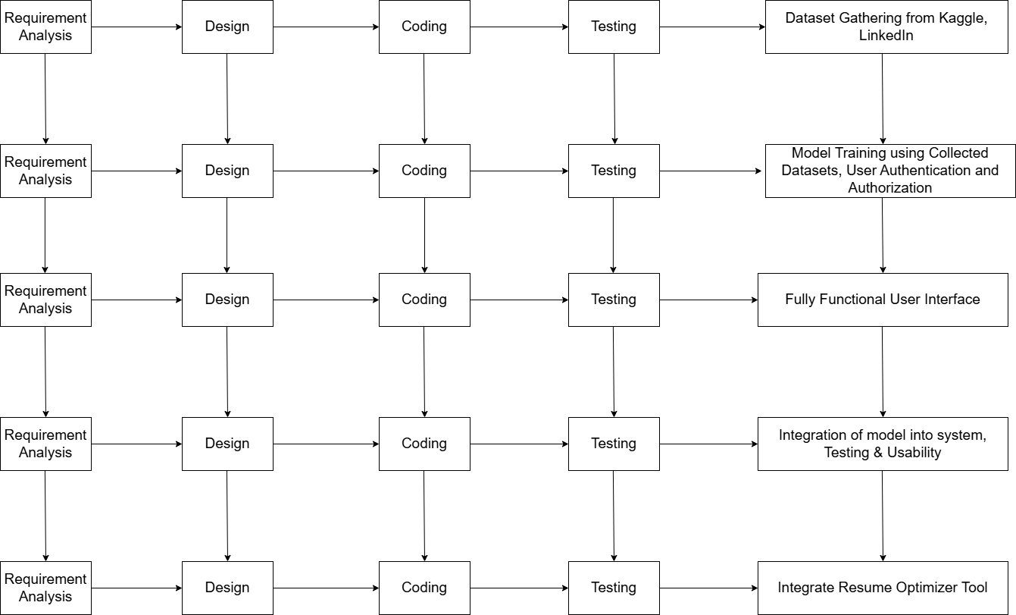
Methodology
SDLC
Incremental Model Overview:
Approach involves breaking down development into smaller increments.
Phases: Requirement Analysis, Design, Implementation and Testing
First Increment: Dataset gathering
Dataset gathering using platforms like Kaggle and LinkedIn
Dataset collected to train model was 'Job Recommendation based on JD' from Kaggle
Second Increment: Model Training
Model trained using attributes such as skills, experience, desired salary range, career title, role, industry and domian knowledge.
User Authentication and Authorization is integrated by creating signup/login page
Testing and Maintenance
Implementation
Design

Slide 7
Methodology
SDLC
Third Increment : Test Accuracy and Usability
Accuracy and usability of model is tested to meet the requirements
Fourth Increment: Fully Functional User Interface(UI)
Fully functional UI designed to make the platform accessible and easy to navigate for users
Enables users to receive career recommendation which enhances their experience
Fifth Increment: Integrate resume Optimizer Tool
Integration of resume optimizer that helps users to enhance their resumes
Enhances resume by highlighting key skills and experiences making resume ready for ATS
Testing and Maintenance
Implementation
Design

Slide 8
SDLC
Incremental Model Overview:
Approach involves breaking down development into smaller increments.
Phases: Requirement Analysis, Design, Implementation, Testing, and Maintenance.
First Increment: Core Product Development
Dataset gathering using Google Forms
Design of Machine Learning Model (Core Product)
Major functionalities developed: user account creation and login.
Second Increment: Dashboard Implementation
UI/UX Designing
Integration of dashboard where users can view their profiles, suggestions and optimize their resume.
Requirement Analysis
Collection of Datasets from different platforms like Kaggle, LinkedIn
Analyzed these datasets to understand its behavior
Cleaned data by handling missing values and removing duplicates
Preprocessed raw data into suitable format
Developed different questions
Requirement Analysis
Testing and Maintenance
Design
Implementation

Slide 9
Design
System Architecture: A system architecture linking the client-side, server, database, and machine learning model for career recommendations and resume analysis.
Database Design: Created a database schema that efficiently stores and retrieves data related to users and other relevant entities. Established relationships between tables for data consistency.
User Interface Design: Developed user interface design using Figma. A responsive design accessible across different devices using technologies like HTML, CSS, JavaScript, PHP, and MySQL.
Testing and Maintenance
Design
Implementation

Slide 10
Implementation
The About Us page shares our bakery's story, rooted in a passion for baking and a commitment to quality.
Customers get a glimpse of the bakers behind the scenes and the love they pour into every creation.
Coding Standards: Utilized PHP and its framework Laravel for server-side scripting, HTML, CSS, and JavaScript for client-side development. Python used for ML model development.
Security Measures: Includes User Authentication and Authorization
Testing and Maintenance
Implementation

Slide 11
Testing and Maintenance
Tested model using smaller datasets in Google Colab
Checked model's accuracy
Testing and evaluation will continue
Periodic updates and enhancements
Address emerging needs and improve functionality
Testing and Maintenance
Implementation

Slide 12
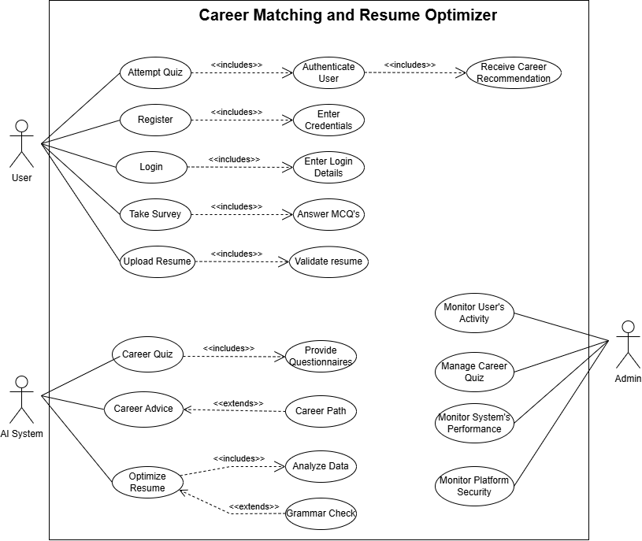
Use-Case Diagram

Slide 13
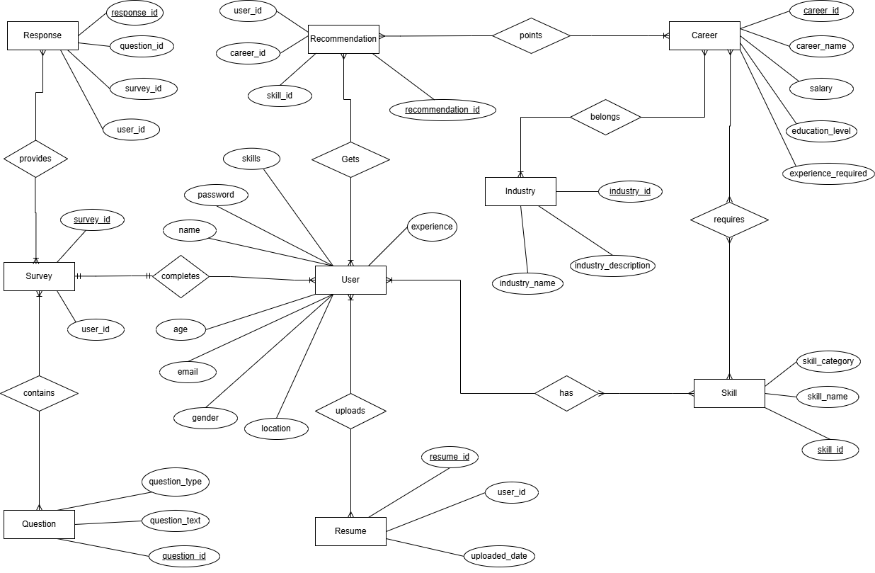
ER Diagram

Slide 14
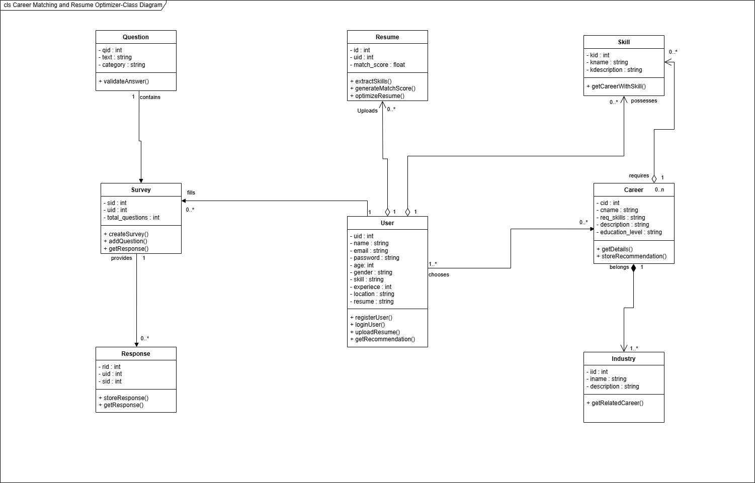
Class Diagram

Slide 15
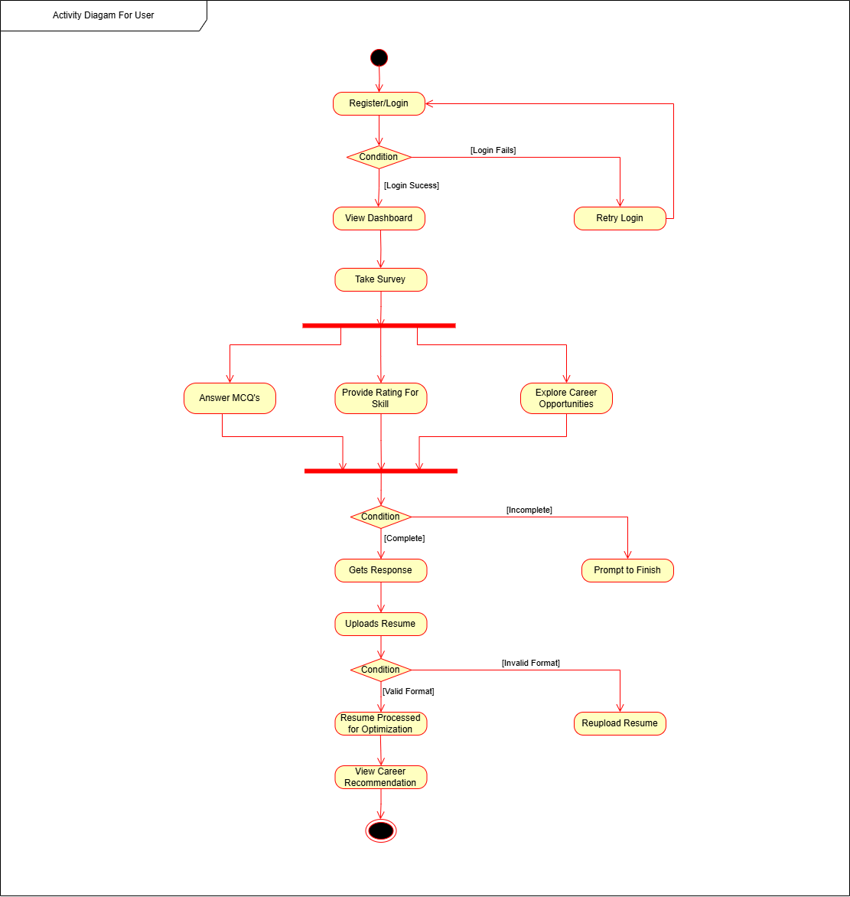
Activity Diagram:
For User

Slide 16
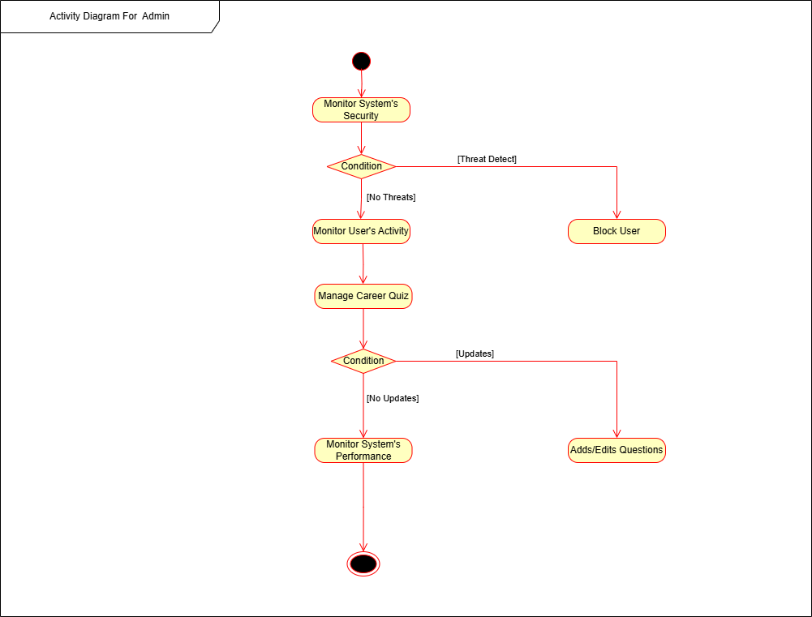
Activity Diagram:
For Admin

Slide 17
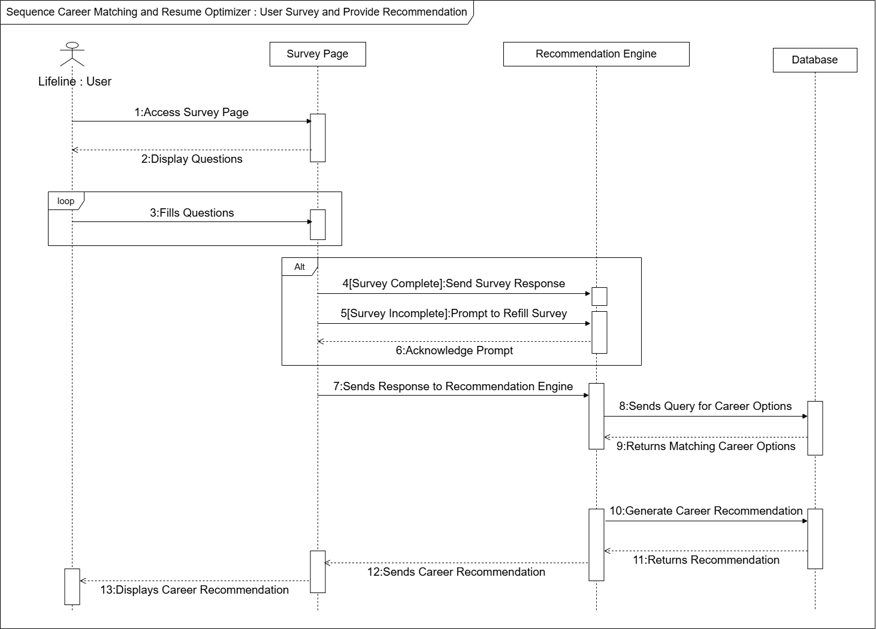
Sequence Diagram:
For User Survey

Slide 18
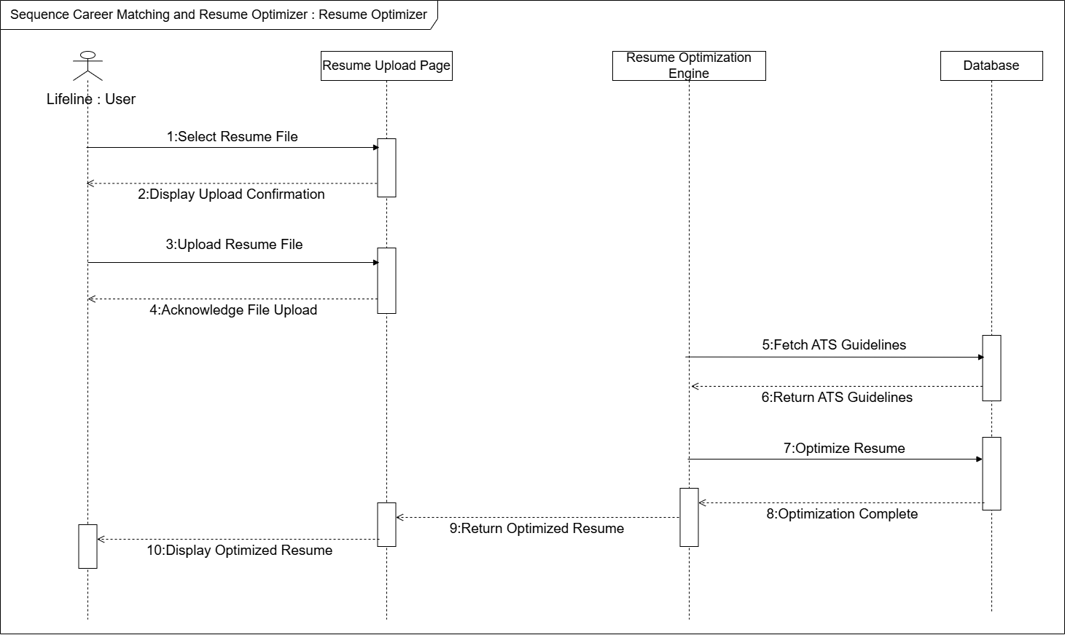
Sequence Diagram:
For Resume
Optimization

Slide 19
Tasks Done so Far
Dataset Gathering: Dataset gathered for requirement analysis from different platforms like Kaggle, LinkedIn .
Model Training and Testing Preparation: Prepared smaller dataset and splitted into 80 percent for training and 30 percent for testing subsets in Google Colab
Backend Development: Backend developed using Laravel.
Basic User Interface: A homepage and dashboard is created for navigation purpose
User Authentication and Authorization: Basic signup/login page created for user authentication and authorization and dashboard is created

Slide 20
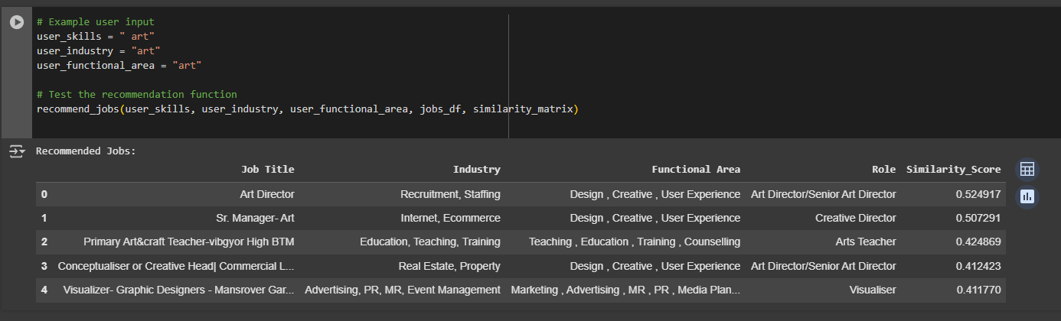
Model Trained in Google Colab

Slide 21
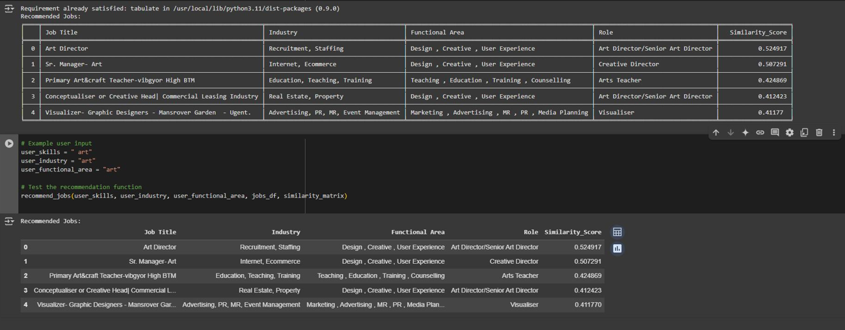
Model Trained in Google Colab

Slide 22
Results and Discussion
Model training preparations: Used a smaller dataset which was divided 80 percent into training and 20 percent into testing
Backend Development: Backend functionalities developed using Laravel which enables integration with frontend development and model training modules
Basic User Interface: Includes homepage and dashboard with user authentication and authorization by creating signup/login page
Survey: A section will be added in home page allowing users to fill questions to match career

Slide 23
Tasks Remaining
Integration of Model into System: Trained and tested model in Google Colab to be integrated into the system via API and the platform’s accuracy and usability to be tested
Development of Fully Functional UI: Fully functional user interface to be developed ensuring ease of navigation for users.
Development of Resume Optimization Model: Machine Learning model to be built and trained to analyze and optimize resumes for applicant tracking system by highlighting key skills, experiences

Slide 24
Proposed Deliverables
Interactive User Interface: A responsive online resource for resume enhancement, career advice and quizzes.
AI-Powered Career Suggestions: Matches career derived from user input.
Resume Optimizer: AI-powered recommendations to enhance current resumes with an emphasis on content improvement and ATS compatibility.
User Authorization and Authentication: Sign-up and Login page integrated for user authentication and authorization
Database and Reports: Centralized user data storage featuring downloadable insights for resume enhancement and career assessment.

Slide 25
TASK DIVISION
GROUP MEMBERS | TASK
Aman Sheikh | Back-End Design, Database Design
Shreya Khanal | Research and Data Analysis, Model Train
Shikshya K.C. | Front-End Design, Documentation
Individual tasks are flexible as we move forward with the software development phases and increments.

Slide 26
GANTT CHART

Slide 27
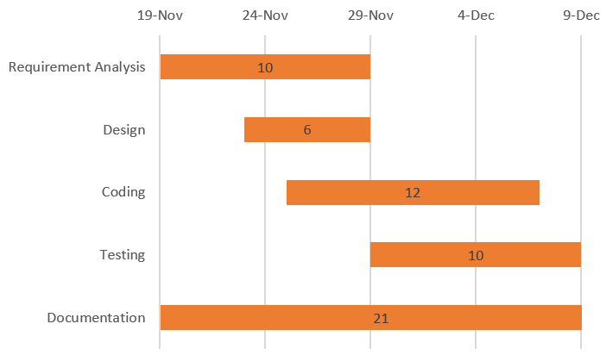
For Iteration 1
Fig: Gantt Chart
Testing and Debugging
Approximated Duration (in Days): 19 1st Increment:
13 Days
2nd Increment:
6 Days

Slide 28
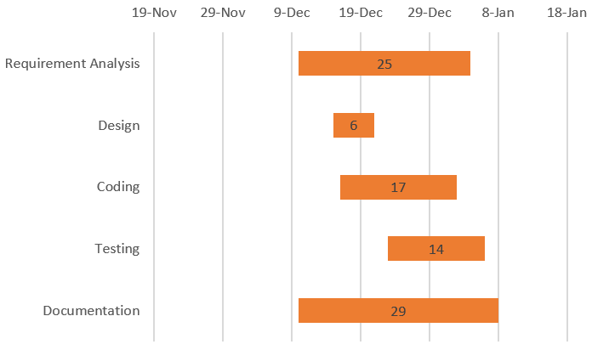
For Iteration 2
Fig: Gantt Chart
Testing and Debugging
Approximated Duration (in Days): 19 1st Increment:
13 Days
2nd Increment:
6 Days

Slide 29
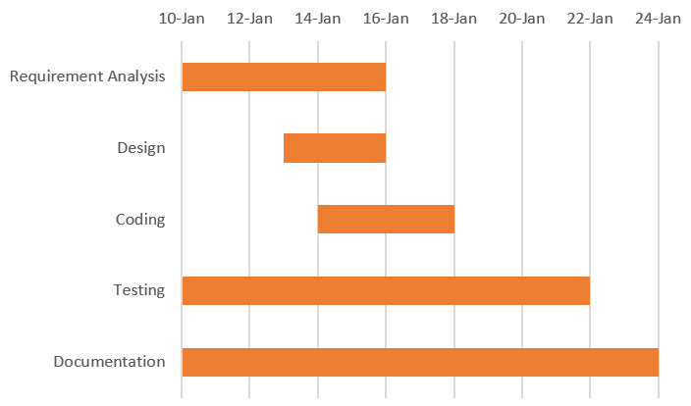
For Iteration 3
Fig: Gantt Chart
Testing and Debugging
Approximated Duration (in Days): 19 1st Increment:
13 Days
2nd Increment:
6 Days

Slide 30
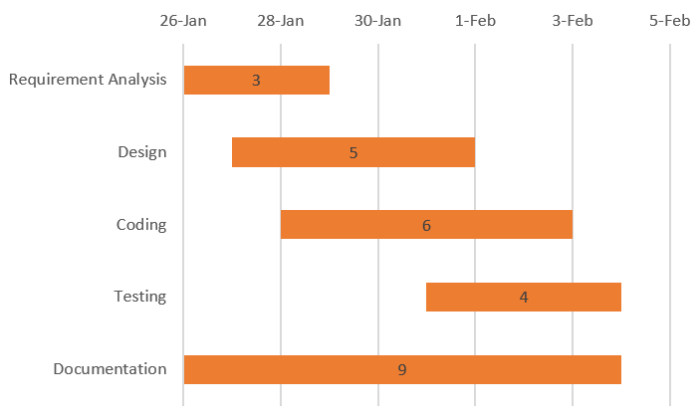
For Iteration 4
Fig: Gantt Chart
Testing and Debugging
Approximated Duration (in Days): 19 1st Increment:
13 Days
2nd Increment:
6 Days

Slide 31
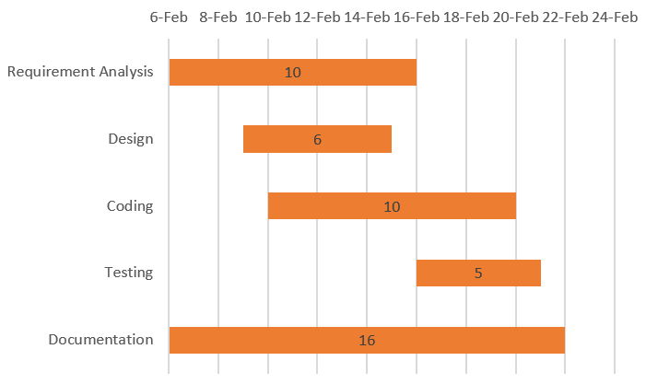
For Iteration 5
Fig: Gantt Chart
Testing and Debugging
Approximated Duration (in Days): 19 1st Increment:
13 Days
2nd Increment:
6 Days

