Slide 1
Text Mining

Slide 2
Background
Use Case
Self Check Calibration Report (SeCart)
PSS RDA has over 200 lab equipment that requires annual calibration and Lab Managers need to track and review these calibration reports. However, manually reviewing these calibration reports take a long time.
Hence, SeCart is a AI solution developed with the purpose of:
Using AI text mining & NLP techniques to read and extract all the calibration reports and store into database
Keep track of calibration status/date and be notified automatically for expiring certificates due for a recalibration
Predict equipment issue by checking and comparing historical data for recalibration
Value of use case
Easier and faster generation of Certificates and Reports for audit purposes
Cost saving in terms of earlier prediction and plan equipment calibration downtime
Faster extraction and storing of report data into central database with the help of AI
Summary of Certificate and Report in user friendly web application for faster result analysis and feedback.

Slide 3
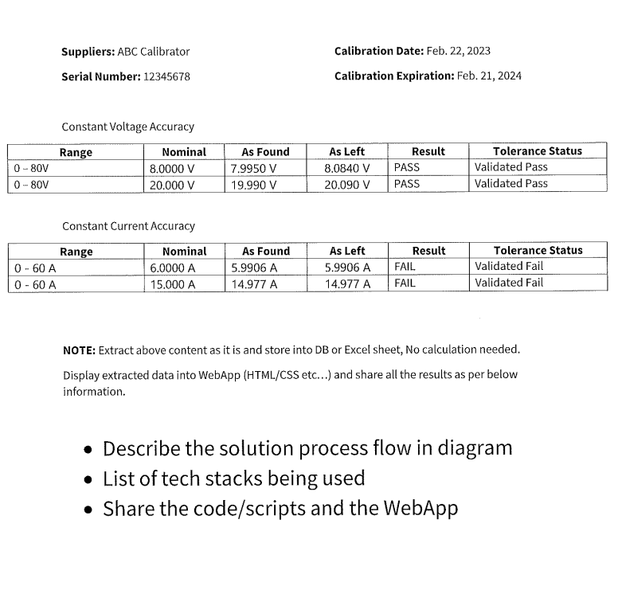
Background
Objective
Employ some of the basic text mining techniques that is utilized in SeCart to extract the content in the following PDF and store it in an excel/database (excluding AI and NLP techniques)
Some of the commonly used techniques in SeCart are Regular Expression (RegEx) and Camelot.

Slide 4
Python Library Use Case
S/N | Name | Version | Description/Application
1 | PyPDF2 | 1.26.0 | Allows to read, render or modify pdf documents
2 | Re | 2.2.1 | To work with regex pattern - specifies a set of strings that matches it
3 | Camelot | 0.9.0 | Extract table from pdf files
4 | Pandas | 2.0.0 | For data manipulation and analysis
5 | Matplotlib | 3.8.2 | For creating static, animated, and interactive visualizations in Python.

Slide 5
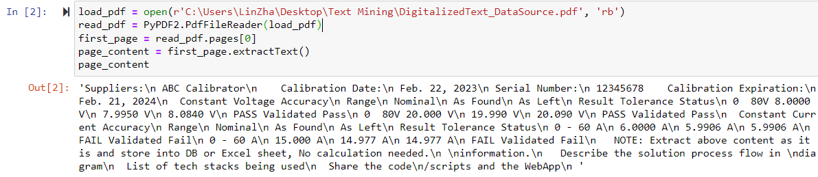
PyPDF2
PyPDF2 is a library capable of extracting text, splitting, merging and cropping the pages of PDF files. It can also add custom data, viewing options, and passwords to PDF files.
PyPDF2
Load PDF
Read
Write
Merge
Use Case: Extract all the content in the PDF in a raw format in order to process it using RegEx

Slide 6
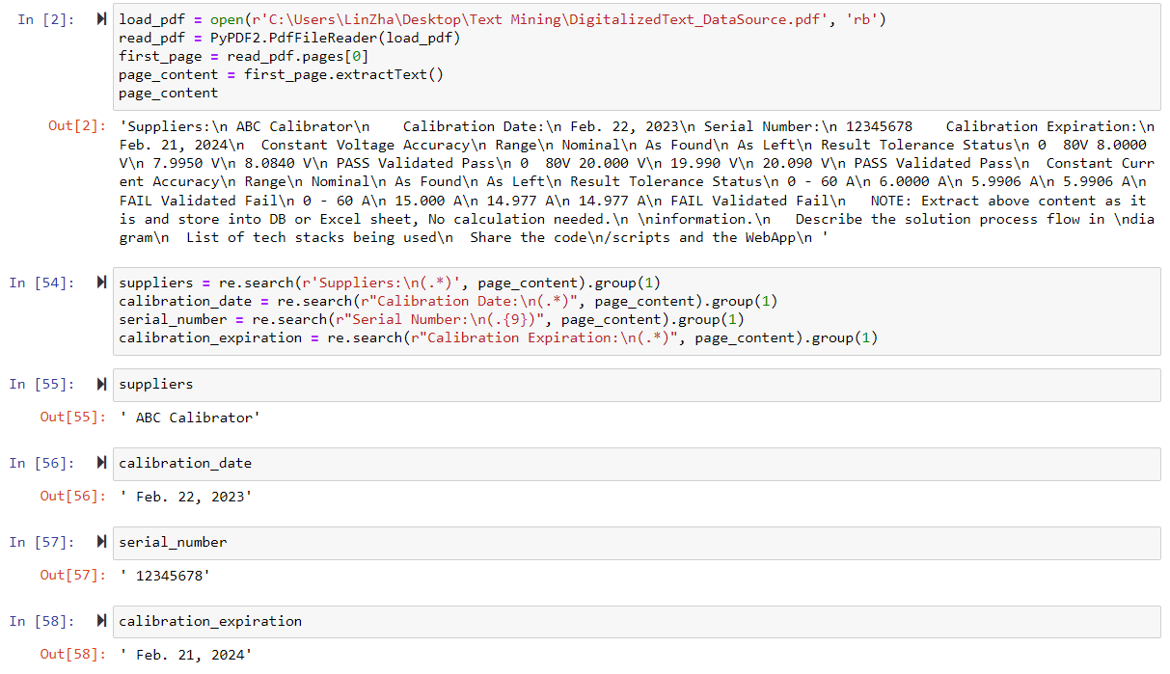
Regular Expression (RegEx)
A Regular Expression (RegEx for short) is a syntax that allows you to match strings with specific pattern.
Quantifiers/Metacharacters in Regex
Use Case
Syntax | Explanation
[0 – 9] OR \d | Any numbers from 0 to 9
[^abc] | Any character except a, b and c
[A – Za – z] | Any alphabets A to Z or a to z
. | Any characters or special characters except new line
\w | Any characters A to Z, a to z, 0 to 9 including underscore
\s | Whitespace character
Types of brackets | Explanation
[ ]? | Occurs 0 or 1 time
[ ]+ | Occurs 1 or more times
[ ]* | Occurs 0 or more times
[ ]{n} | Occurs “n” number of times
[ ]{n,} | Occurs “n” or more times
[ ]{y,z} | Occurs at least “y” times but less than “z” times

Slide 7
Regular Expression (RegEx)
The following expression is used to extract text from the PDF: re.search( “syntax”, “pdf content” ).group(1)
The syntax “ .* ” is used to extract all non-tabulated text in the PDF i.e Supplier, Calibration Date, Serial Number, Calibration Expiration.
The “group(1)” represents the first parenthesised subgroup that will be extracted, which in this case e.g r 'Suppliers: \n(.*)’, it will show what’s extracted from the syntax (.*) only.

Slide 8
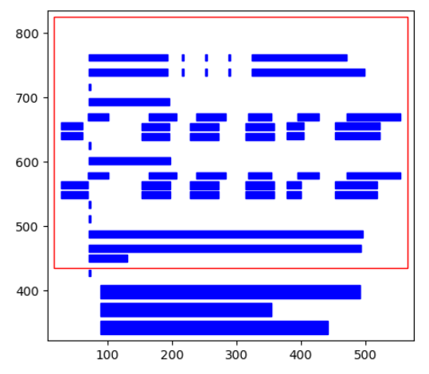
Camelot
Camelot is a library that helps to extract the Constant Voltage Accuracy table and Constant Current Accuracy table from PDF.
The plot () method can be used to generate a matplotlib plot of various elements that were detected on the pdf page while processing.
Using the plot generated and tweaking different configuration parameters to select table areas, column separators and debug bad table outputs
Use case:
Coordinate of 2 corners of the table circled in red (x1, y1, x2, y2)

Slide 9
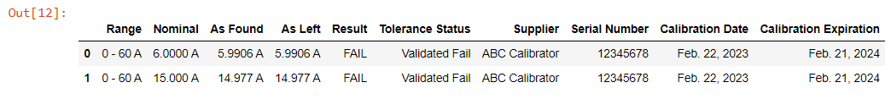
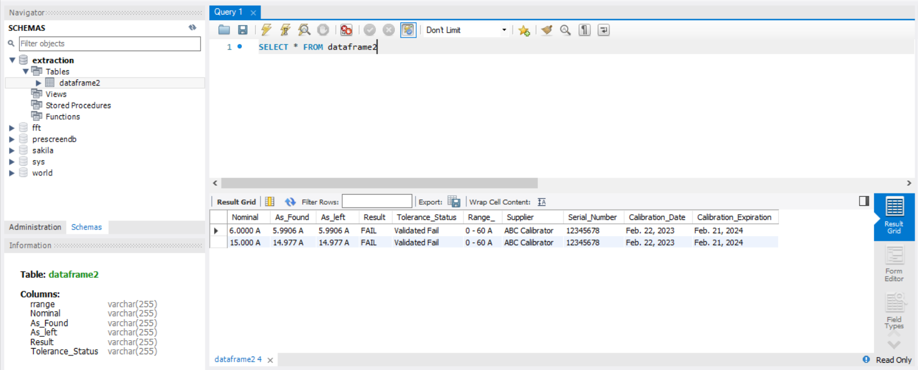
Result/Validation
All required content are extracted successfully from the PDF file in the form of a merged DataFrame using pandas and stored in MySQL database.

Slide 10
Summary
This text mining project is simply extracting the content from a PDF file and storing it in an excel/Database.
Using PyPDF2, we are able to extract all the raw content in the PDF file in order to utilize RegEx
All the required content in the PDF file (Suppliers, Calibration Date, Serial Number, Calibration Expiration, Constant Voltage Accuracy table, Constant Current Accuracy table) are merged into a DataFrame using pandas and stored in a database.

