Slide 1
Data Communication Introduction Lecture-1
Dr. Naveed Ahmad
Assistant Professor
Department of Computer Science
University of Peshawar
n.ahmad@upesh.edu.pk

Slide 2
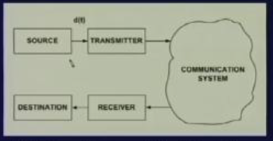
Data Communication Model
Source:- where the data is originated ,
Transmitter:- converting data into suitable form for transmission through the medium.
Communication System:- medium through which signal is sent, WAN, LAN etc.
Receiver:- Which receives the signal and convert it into data or message.
Destination:- where the data is sent

Slide 3
Data and signal
Data and data types e.g. Analog and digital data
Signal and signal types e.g. analog and digital signal
Periodic and periodic signal characteristics.
Time and Frequency domain representation of signals
Spectrum and bandwidth of signals.
Propagation time and bandwidth
Impairment of signals such as attenuation , distortion and noise.
Bandwidth of medium .
Bit rate and baud rate
Shanon capacity in noisy channel

Slide 4
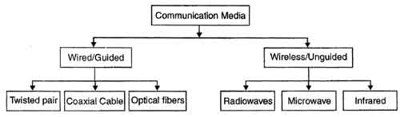
Media
Two type of media
Its characteristics, data rate, impairment affect , coverage in KM etc.

Slide 5
Signal Conversion Techniques
Signal Data has to be converted into signal for transmission through transmission media .
In general whenever the signal is digital in nature or when we do digital transmission the conversion process is known as encoding.
On the other hand whenever the signal is analog in nature whether it is analog data or digital data we call it modulation that means the technique is known as modulation
What type of signal we should used, it depends on situation and available bandwidth.
Data | Signal | Approach
Digital | Digital | Encoding
Analog | Digital | Encoding
Analog | Analog | Modulation
Digital | Analog | Modulation

Slide 6
Digital data to Digital signals Techniques
Encoding
Polar
UniPolar
Bipolar
AMI
B8ZS
HDB3
NRZ
RZ
Manchester
Differential Manchester

Slide 7
Analog data to Digital signals Techniques
Modulation
Pulse Code Modulation (PCM)
Delta Modulation (DM)

Slide 8
Analog data to Analog signals Techniques
Modulation
Amplitude Modulation
Angle Modulation
Phase Modulation
Frequency Modulation

Slide 9
Digital data to Analog signals Techniques
Modulation
ASK
FSK
PSK
QAM

Slide 10
Multiplexing techniques
Whenever the bandwidth of the medium is very high it is possible to send several signal simultaneously and the technique that can be used is known as multiplexing.
Multiplexing
FDM
TDM
Inverse TDM
Synchronous
Asynchronous

Slide 11
Multiplexing applications
Telephone System
DSL Technology
Cable Modem
SONET

Slide 12
Data Communication Model
The signal passes through the medium because of the various impairments the signal that is being sent S(t) is not same as it is received by the receiver. so signal received through the medium is different from what has been sent but what the receiver wants is a same thing now so we have to find out what kind of problem or what is the difference between the original signal and the received signal.
D(t)
S(t)
Source
Transmitter
Communication
System
Destination
Receiver
S’(t)

Slide 13
Interfacing
Modes of Communication
- parallel and serial
-simplex, half duplex and full duplex
DTE and DCE interfaces
-RS-232
-Null modem
-X.21
Standard modem s

Slide 14
Error Detection and Correction
Types of Error
-single bit error
- burst error
Error Detection techniques
-parity check
-two dimensional parity check
-checksum
-CRC
Error correction technique
-forward error correction (hamming code)
-backward error correction (Stop and wait ARQ, Go back N ARQ, Selective repeat ARQ)

Slide 15
Flow Control
Stop and wait flow control
Sliding window flow control
Performance of flow control

Slide 16
Data link control
Key components of data link control
-frame synchronization
-flow control
-Error control
-link management
High level data link control (HDLC)

Slide 17
Data Communication through WAN
Switching techniques
Routing
Congestion control
Medium Access Control (ALOHA, CSMA/CD)
Frame Relay, X.25, ATM
Cellular System
Satellite Communication

Slide 18
Data Communication through LAN
Addressing
Error detection/correction
Transmission Medium
Topology
Medium Access Control
High Speed LANS
Wireless LANs

Slide 19
Data Communication through LAN
Segmentation and Reassembly
Encapsulation
Connection control
Order delivery
Addressing
Multiplexing
TCP/IP
Data compression
Data encryption

Slide 20
Layered Architecture
What and Why layered approach
Layers and interfaces
OSI layers
Protocols

