Slide 1
Wireless and Mobile Communication Introduction Lecture-1
Dr. Naveed Ahmad
Assistant Professor
Department of Computer Science
University of Peshawar
n.ahmad@upesh.edu.pk

Slide 2
Evolution of Mobile Radio Communications
Mobile telephone was introduced in 1946, but due to some technology drawbacks and high cost.
Cellular concept in 1960 at Bell Lab and its connection with PSTN give rapid growth to this technology.
Advanced Mobile Phone System (AMPS) was the rst U.S. cellular telephone system and it was deployed in 1983.
The number of cellular telephone users grew from 25000 in 1984 to around 4.8 billion in the year 2014 and the demand rate is increasing day by day.

Slide 3
Present Day Mobile Communication
Initially the mobile communication was limited between one pair of users on single channel pair.
The range of mobility was defined by the transmitter power, type of antenna used and the frequency of operation.
With the increase in the number of users, accommodating them within the limited available frequency spectrum became a major problem.
To resolve this problem, the concept of cellular communication was evolved.
The present day cellular communication uses a basic unit called cell.
Each cell consists of small hexagonal area with a base station located at the center of the cell which communicates with the user.
To accommodate multiple users Time Division multiple Access (TDMA), Code Division Multiple Access (CDMA), Frequency Division Multiple Access (FDMA) and their hybrids are used

Slide 4
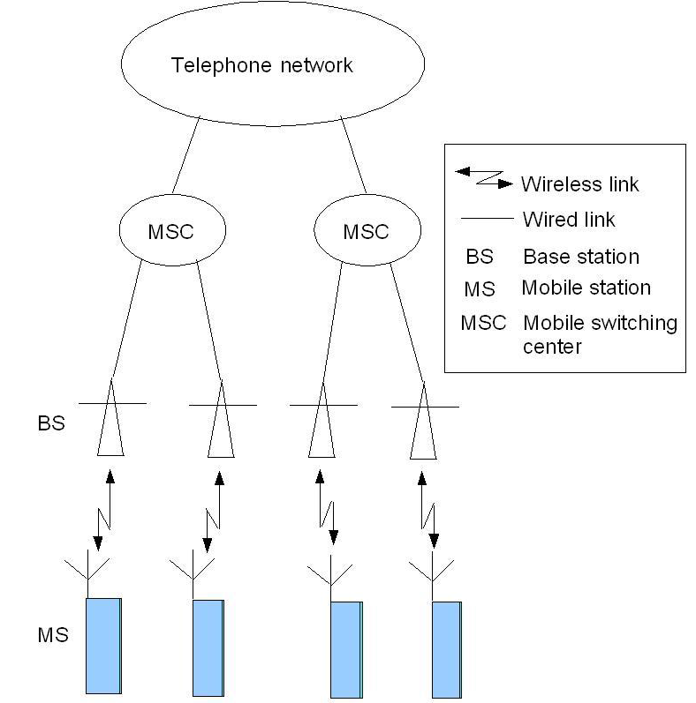
Basic mobile communication structure.

Slide 5
Fundamental Techniques
By definition, mobile radio terminal means any radio terminal that could be moved during its operation.
Depending on the radio channel, there can be three different types of mobile communication.
In general, however, a Mobile Station (MS) or subscriber unit communicates to a fixed Base Station (BS) which in turn communicates to the desired user at the other end.
The MS consists of transceiver, control circuitry, duplexer and an antenna while the BS consists of transceiver and channel multiplexer along with antennas mounted on the tower.

Slide 6
Fundamental Techniques
The BS are also linked to a power source for the transmission of the radio signals for communication and are connected to a fixed backbone network.
The fixed backbone network is a wired network that links all the base stations and also the landline and other telephone networks through wires.
The Mobile Switching Centre (MSC) is sometimes also called Mobile Telephone Switching Office (MTSO).
The radio signals emitted by the BS decay as the signals travel away from it.

Slide 7
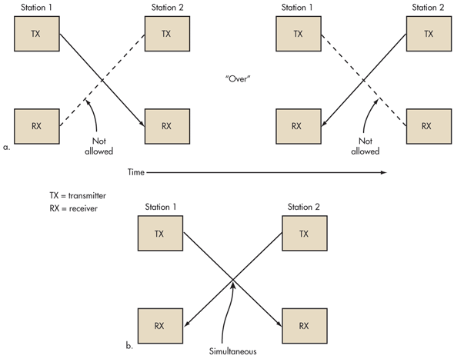
Radio Transmission Techniques
Based on the type of channels being utilized, mobile radio transmission systems may be classified as the following three categories
Simplex:- Communication is unidirectional , example is pager
Half duplex:- non simultaneous bidirectional communication, example is walk takie
Full Duplex:- Simultaneously bidirectional communication, telephone, mobile
This is possible by one of the two following methods

Slide 8
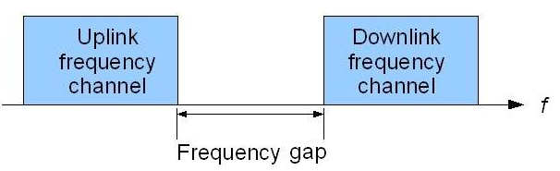
Frequency Division Duplexing (FDD)
FDD supports two-way radio communication by using two distinct radio channels.
One frequency channel is transmitted downstream from the BS to the MS (forward channel).
A second frequency is used in the upstream direction and supports transmission from the MS to the BS (reverse channel).
Because of the pairing of frequencies, simultaneous transmission in both directions is possible.
To mitigate self-interference between upstream and downstream transmissions, a minimum amount of frequency separation must be maintained between the frequency pair. These so-called guard bands aren’t useable, so they’re wasteful

Slide 9
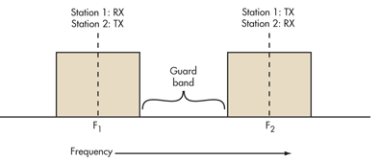
Frequency Division Duplexing (FDD)
FDD requires two symmetrical segments of spectrum for the uplink and downlink channels.
In some systems (GSM) the 25-MHz band from 869 to 894 MHz is used as the downlink (DL) spectrum from the cell site tower to the handset, and the 25-MHz band from 824 to 849 MHz is used as the uplink (UL) spectrum from the handset to cell site.
FDD also works on a cable where transmit and receive channels are given different parts of the cable spectrum, as in cable TV systems. Again, filters are used to keep the channels separate.
Another disadvantage with FDD is the difficulty of using special antenna techniques like multiple-input multiple-output (MIMO) and beamforming. These technologies are a core part of the new Long-Term Evolution (LTE) 4G cell phone strategies for increasing data rates

Slide 10
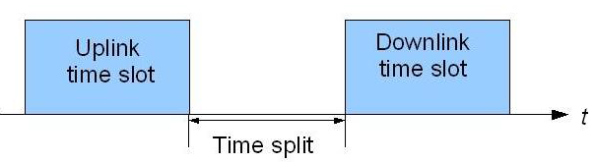
Time Division Duplexing (TDD)
TDD uses a single frequency band to transmit signals in both the downstream and upstream directions.
TDD operates by toggling transmission directions over a time interval.
This toggling takes place very rapidly and is imperceptible to the user.
TDD alternates the transmission and reception of station data over time. Time slots may be variable in length.
In some TDD systems, the alternating time slots are of the same duration or have equal DL and UL times. However, the system doesn’t have to be 50/50 symmetrical. The system can be asymmetrical as required.

Slide 11
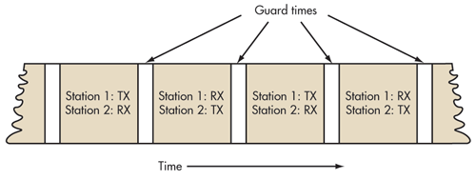
Time Division Duplexing (TDD)
The real advantage of TDD is that it only needs a single channel of frequency spectrum. Furthermore, no spectrum-wasteful guard bands or channel separations are needed.
The downside is that successful implementation of TDD needs a very precise timing and synchronization system at both the transmitter and receiver to make sure time slots don’t overlap or otherwise interfere with one another.

Slide 12
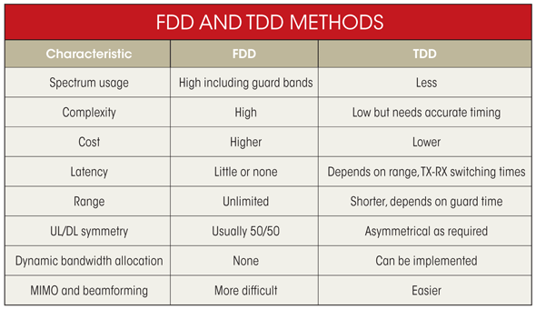
FDD Vs TDD
TDD appears to be the better overall choice, but FDD is far more widely implemented because of prior frequency spectrum assignments and earlier technologies. FDD will continue to dominate the cellular business for now. Yet as spectrum becomes more costly and scarce, TDD will become more widely adopted as spectrum is reallocated and repurposed.

Slide 13
Single MS/Multiple MS
A single MS for a dedicated BS.
Cordless telephone systems are full duplex communication systems that use radio to connect to a portable handset to a single dedicated BS, which is then connected to a dedicated telephone line with a specific telephone number on the Public Switched Telephone Network (PSTN).
Many MS for a single BS
A mobile system, in general, on the other hand, is the example of the second category of a full duplex mobile system where many users connect among themselves via a single BS

Slide 14
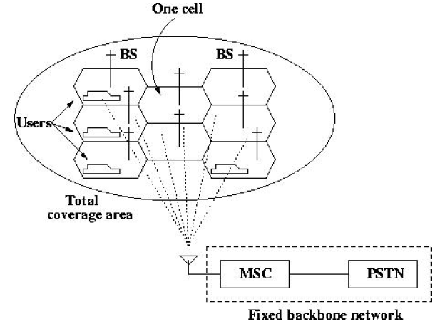
How a Mobile Call is Actually Made?
In order to know how a mobile call is made, we should first look into the basics of cellular concept and main operational channels involved in making a call.

Slide 15
Cellular Concept
For a large geographic coverage area, a high powered transmitter therefore has to be used.
But a high power radio transmitter causes harm to environment.
Mobile communication thus calls for replacing the high power transmitters by low power transmitters by dividing the coverage area into small segments, called cells.
Each cell uses a certain number of the available channels and a group of adjacent cells together use all the available channels.
Such a group is called a cluster. This cluster can repeat itself and hence the same set of channels can be used again and again.
Each cell has a low power transmitter with a coverage area equal to the area of the cell.

Slide 16
Operational Channels
In each cell, there are four types of channels that take active part during a mobile call. These are:
Forward Voice Channel (FVC): This channel is used for the voice transmission from the BS to the MS.
Reverse Voice Channel (RVC): This is used for the voice transmission from the MS to the BS.
Forward Control Channel (FCC): Control channels are generally used for controlling the activity of the call, i.e., they are used for setting up calls and to divert the call to unused voice channels. Hence these are also called setup channels. These channels transmit and receive call initiation and service request messages. The FCC is used for control signalling purpose from the BS to MS.
Reverse Control Channel (RCC): This is used for the call control purpose from the MS to the BS. Control channels are usually monitored by mobiles.

Slide 17
Making a Call
When a mobile is idle, i.e., it is not experiencing the process of a call, then it searches all the FCCs to determine the one with the highest signal strength.
The mobile then monitors this particular FCC. However, when the signal strength falls below a particular threshold that is insufficient for a call to take place, the mobile again searches all the FCCs for the one with the highest signal strength.
For a particular country or continent, the control channels will be the same.
So all mobiles in that country or continent will search among the same set of control channels.
However, when a mobile moves to a different country or continent, then the control channels for that particular location will be different and hence the mobile will not work.

Slide 18
Making a Call
Each mobile has a mobile identification number (MIN). When a user wants to make a call, he sends a call request to the MSC on the reverse control channel. He also sends the MIN of the person to whom the call has to be made.
The MSC then sends this MIN to all the base stations.
The base station transmits this MIN and all the mobiles within the coverage area of that base station receive the MIN and match it with their own.
If the MIN matches with a particular MS, that mobile sends an acknowledgment to the BS.
The BS then informs the MSC that the mobile is within its coverage area.
The MSC then instructs the base station to access specific unused voice channel pair.

Slide 19
Making a Call
The base station then sends a message to the mobile to move to the particular channels and it also sends a signal to the mobile for ringing.
In order to maintain the quality of the call, the MSC adjusts the transmitted power of the mobile which is usually expressed in dB or dBm.
When a mobile moves from the coverage area of one base station to the coverage area of another base station i.e., from one cell to another cell, then the signal strength of the initial base station may not be sufficient to continue the call in progress.
So the call has to be transferred to the other base station. This is called handoff.
In such cases, in order to maintain the call, the MSC transfers the call to one of the unused voice channels of the new base station or it transfers the control of the current voice channels to the new base station.

