Slide 1
Data Communication Data and signals Lecture-3
Dr. Naveed Ahmad
Assistant Professor
Department of Computer Science
University of Peshawar
n.ahmad@upesh.edu.pk

Slide 2
Outline
Explain what is data
Distinguish between Analog and Digital signal
Explain the difference between time and Frequency domain representation of signal
Specify the bandwidth of a signal
Specify the Sources of impairment
Explain Attenuation and Unit of Attenuation
Explain Data Rate Limits and Nyquist Bit Rate
Distinguish between Bit Rate and Baud Rate
Identify Noise Sources

Slide 3
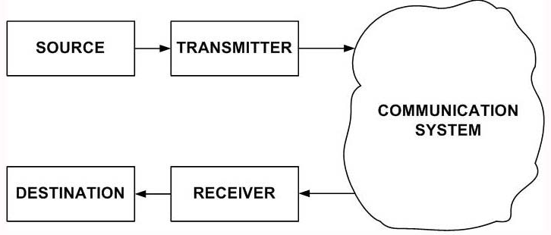
Data communication Model
Source is where the data is originated. Typically it is a computer, but it can be any other electronic equipment such as telephone handset, video camera, etc, which can generate data for transmission to some destination. The data to be sent is represented by x(t).
Transmitter: As data cannot be sent in its native form, it is necessary to convert it into signal. This is performed with the help of a transmitter such as modem. The signal that is sent by the transmitter is represented by s(t).

Slide 4
Data communication Model
Communication Medium: The signal can be sent to the receiver through a communication medium, which could be a simple twisted-pair of wire, a coaxial cable, optical fiber or wireless communication system. It may be noted that the signal that comes out of the communication medium is s’(t), which is different from s(t) that was sent by the transmitter. This is due to various impairments that the signal suffers as it passes through the communication medium.
Receiver: The receiver receives the signal s’(t) and converts it back to data d’(t) before forwarding to the destination. The data that the destination receives may not be identical to that of d(t), because of the corruption of data.
Destination: Destination is where the data is absorbed. Again, it can be a computer system, a telephone handset, a television set and so on

Slide 5
Data
Data refers to information that conveys some meaning based on some mutually agreed up rules or conventions between a sender and a receiver and today it comes in a variety of forms such as text, graphics, audio, video and animation.
For example we hear many noise disturbances from the environment but we do not interpret every thing as data. But whenever we hear a music or song then we can interpret it and we can understand the meaning of that song and that can be considered as data. That means uncorrelated incoherent signal or information whatever we receive is not data. But what we can interpret obviously that interpretation is based on some knowledge of the data that means some standard norm or some mutually agreed upon convention. So this is your significance of data or meaning of data.

Slide 6
Data types
Data can be of two types; analog and digital.
Analog data take on continuous values on some interval. Typical examples of analog data are voice and video. The data that are collected from the real world with the help of transducers are continuous-valued or analog in nature.
On the contrary, digital data take on discrete values. Text or character strings can be considered as examples of digital data. Characters are represented by suitable codes, e.g. ASCII code, where each character is represented by a 7-bit code

Slide 7
Data types-example
For example temperature, pressure etc are all analog in nature and these analog parameters are usually converted to electrical form with the help of transducers. Transducers are essentially some kind of energy conversion device so on this side we apply physical parameter it can be temperature, pressure, light intensity and on this side we apply that on this we get some electrical signal voltage or current so this is your transducer. And transducer produces here an electrical signal which is also analog in nature usually. That means we get continuous values of the electrical signal corresponding to the physical parameter on this side for anyone of the parameters.

Slide 8
Data types-example
For example 0 is 0 0 1, 0 0 0 0 then one is your 0 1 1, 0 0 0 1 that is the ASCII code for 1. That means in the computer whenever we press the keyboard and press the character essentially 1 0 0 0 0 0 1 is sent to the computer. That means keyboard senses the character code 1 0 0 0 0 0 1. Thus some of the ASCII characters examples are given here and this is an example of digital data.

Slide 9
Signals
It is electrical, electronic or optical representation of data, which can be sent over a communication medium. Stated in mathematical terms, a signal is merely a function of the data. For example, a microphone converts voice data into voice signal, which can be sent over a pair of wire.
Signals can be interpreted as either analog or digital
In reality, all signals are analog

Slide 10
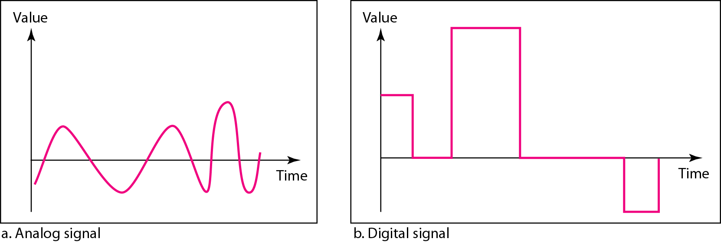
Signal types
signals can be of two different types analog and digital.
It can be either analog or it can be digital. An analog signal has continuous values over a period of time or you can say the infinite number of values over a period of time. For example here this is an example of an analog signal.
Signaling: It is an act of sending signal over communication medium
Transmission: Communication of data by propagation and processing is known as transmission.

Slide 11
Analog signal
As you can see a microphone converts voice data into voice signal. As we have seen whenever somebody is speaking or singing he makes some vibration in the air.
So that audio data can be converted into audio signal or electrical energy with the help of microphone, that microphone is essentially a transducer which converts that vibration or pressure on the microphone into electrical signal generating voice signal which can be sent over a pair of wires.

Slide 12
Time Domain Concept
Continuous signal
Infinite number of points at any given time
Discrete signal
Finite number of points at any given time; maintains a constant level then changes to another constant level
Periodic signal
Pattern repeated over time
Aperiodic (non-periodic) signal
Pattern not repeated over time

Slide 13
Time Domain Concept
In data communications, we commonly use periodic analog signals and non periodic digital signals.
Periodic analog signals can be classified as simple or composite.
A simple periodic analog signal, a sine wave, cannot be decomposed into simpler signals.
A composite periodic analog signal is composed of multiple sine waves.

Slide 14
Periodic signal
A signal is periodic is s(t+T)= s(t)
Analog signals usually are periodic in nature for example a sine wave. Now this sine wave is repeating as you can see after this time t is known as the time period where t is equal to time period. That means after time t the signal will be same as the previous portion. The same thing that is this part will be repeated here so this is another t. So mathematically as you can see when s(t) plus t is equal to s(t) for the range minus infinity to plus infinity of time that means it is starting from any time, it has started long back and it is generated continuously then we call it a periodic signal and it is a time period t, this T is the time period.

Slide 15
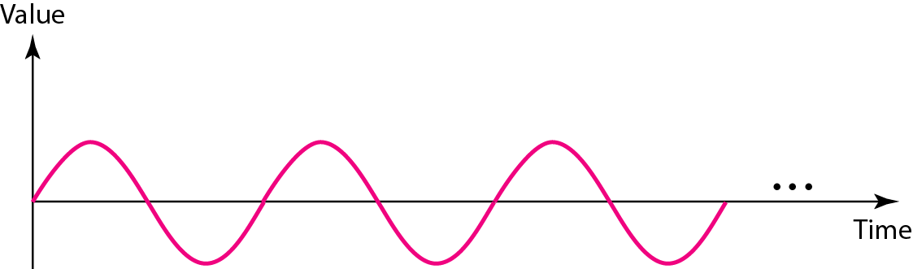
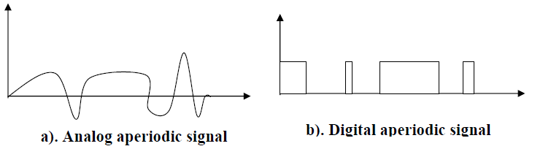
Periodic vs aproiodic
An aperiodic signal or nonperiodic signal changes constantly without exhibiting a pattern or cycle that repeats over time

Slide 16
Periodic signal parameters
A periodic signal is characterized by the following three parameters.
Amplitude: It is the value of the signal at different instants of time. It is measured in volts.
Frequency: It is inverse of the time period, i.e. f = 1/T. The unit of frequency is Hertz (Hz) or cycles per second.
Frequency is the rate of change with respect to time.
Change in a short span of time means high frequency.
Change over a long span of time means low frequency.
If a signal does not change at all, its frequency is zero.
if a signal changes instantaneously, its frequency is infinite.

Slide 17

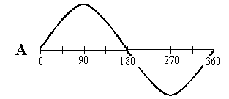
Periodic signal parameters
Phase: It gives a measure of the relative position in time of two signals within a single period. It is represented by φ in degrees or radian.
Phase describes the position of the waveform relative to time 0.
Frequency and period are the inverse of each other.

Slide 18
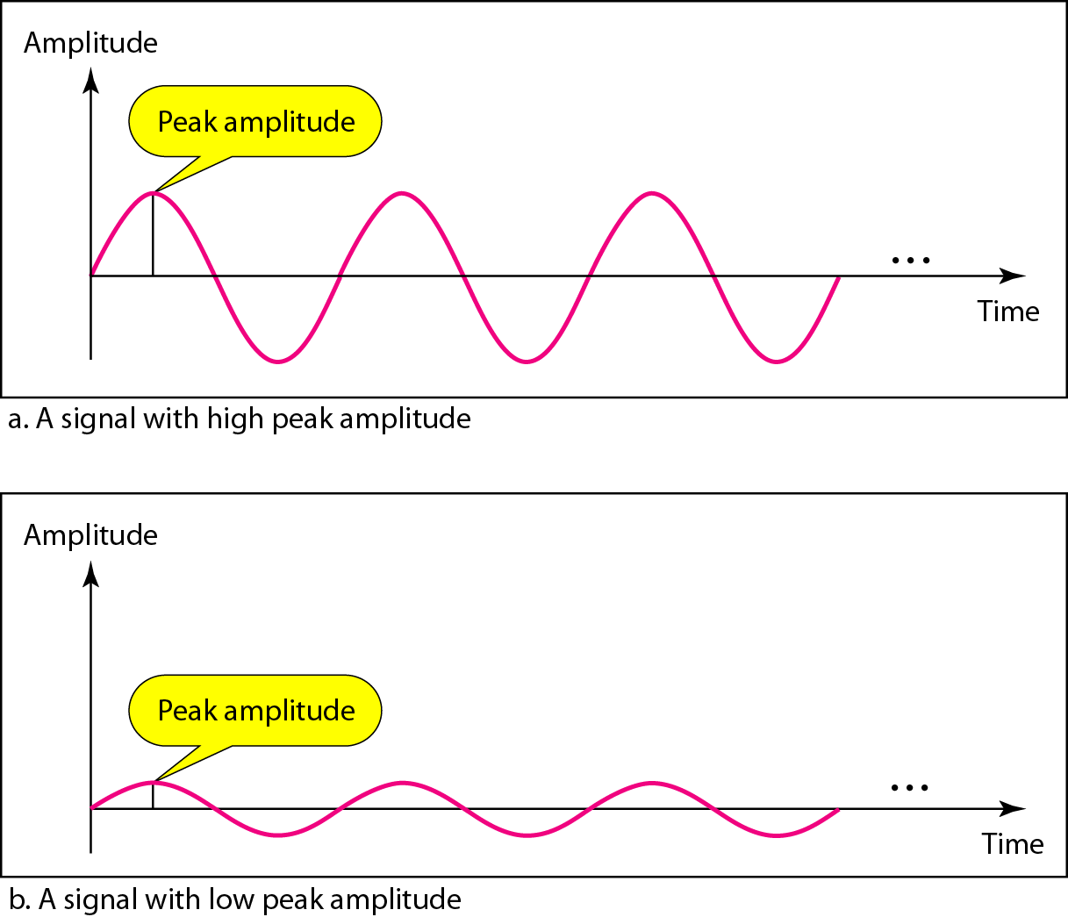
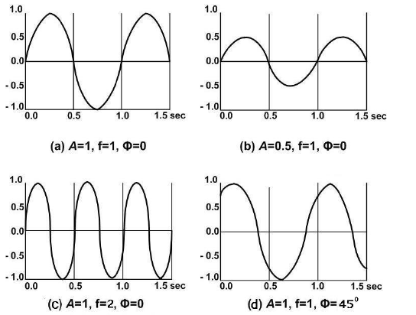
Examples

Slide 19
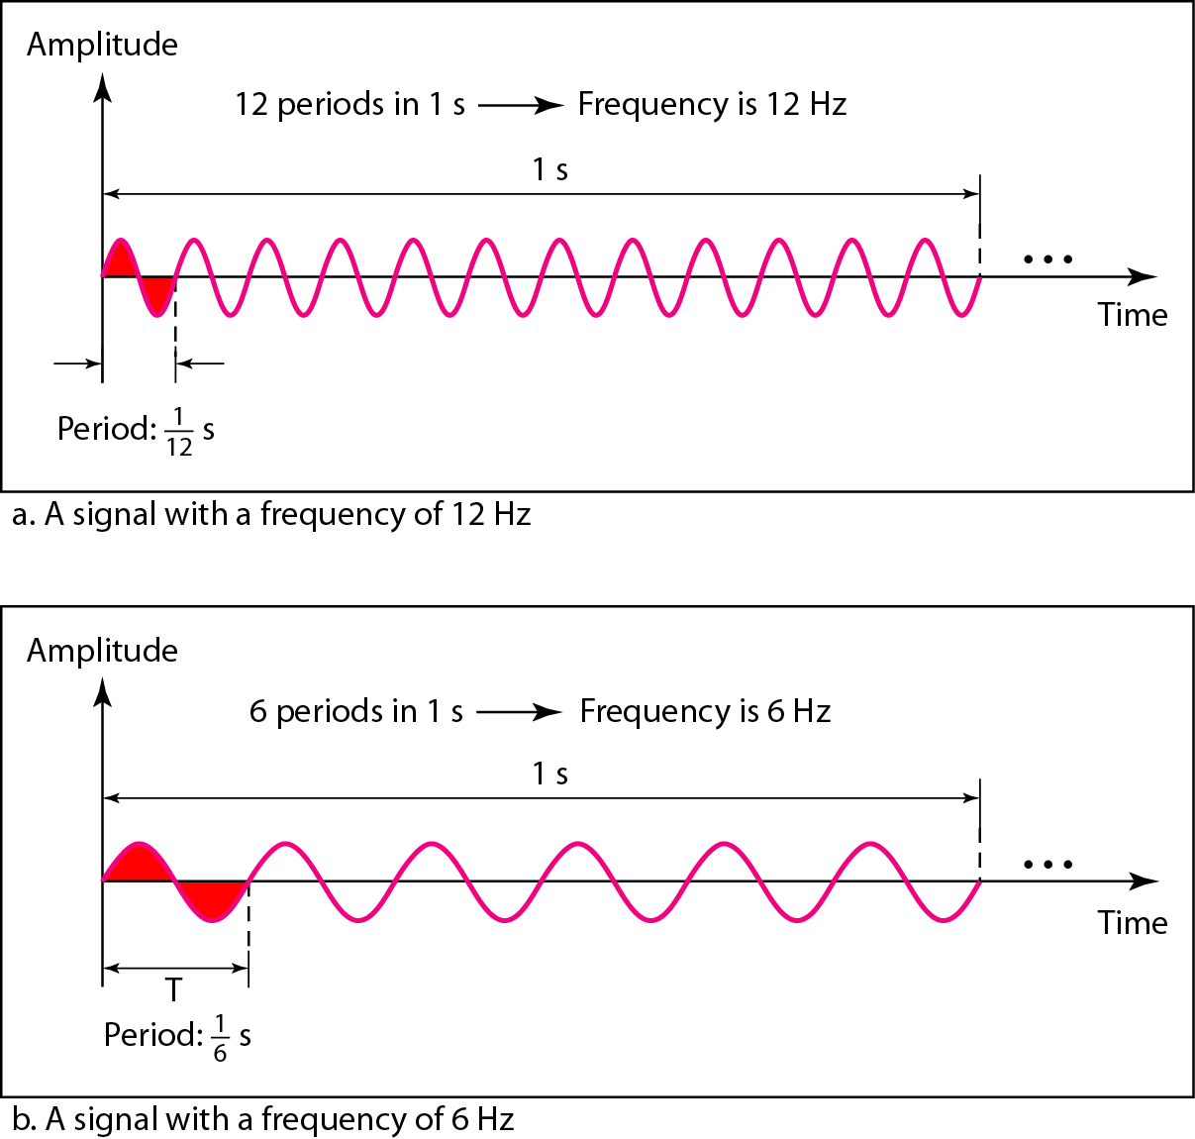
Example

Slide 20
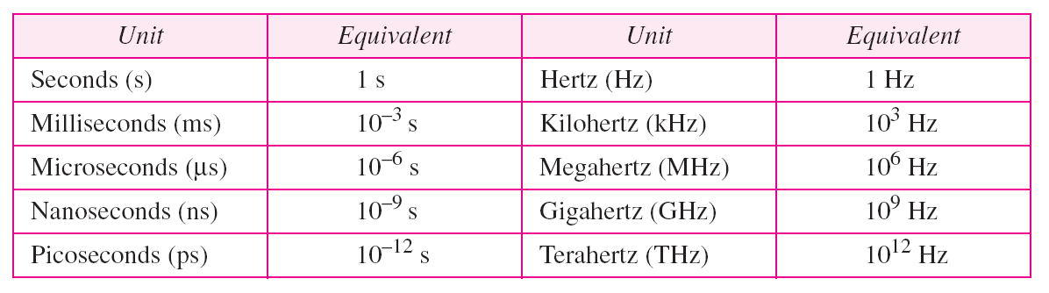
Units
Amplitude , it is in volts but sometimes the voltage can be of very small so in such case we can call it millivolt then we write mV millivolt that means something which is equal to 10 to the power minus 3V or sometimes we have to represent high voltage then we can say that it is KV that means it is 10 to the power 3V.
Phase is measured in degrees, e.g. 90, 180, 270, 360.

Slide 21
Examples
The power we use at home has a frequency of 60 Hz. The period of this sine wave can be determined as follows:
The period of a signal is 100 ms. What is its frequency in kilohertz?
First we change 100 ms to seconds, and then we calculate the frequency from the period (1 Hz = 10⁻³ kHz).

Slide 22
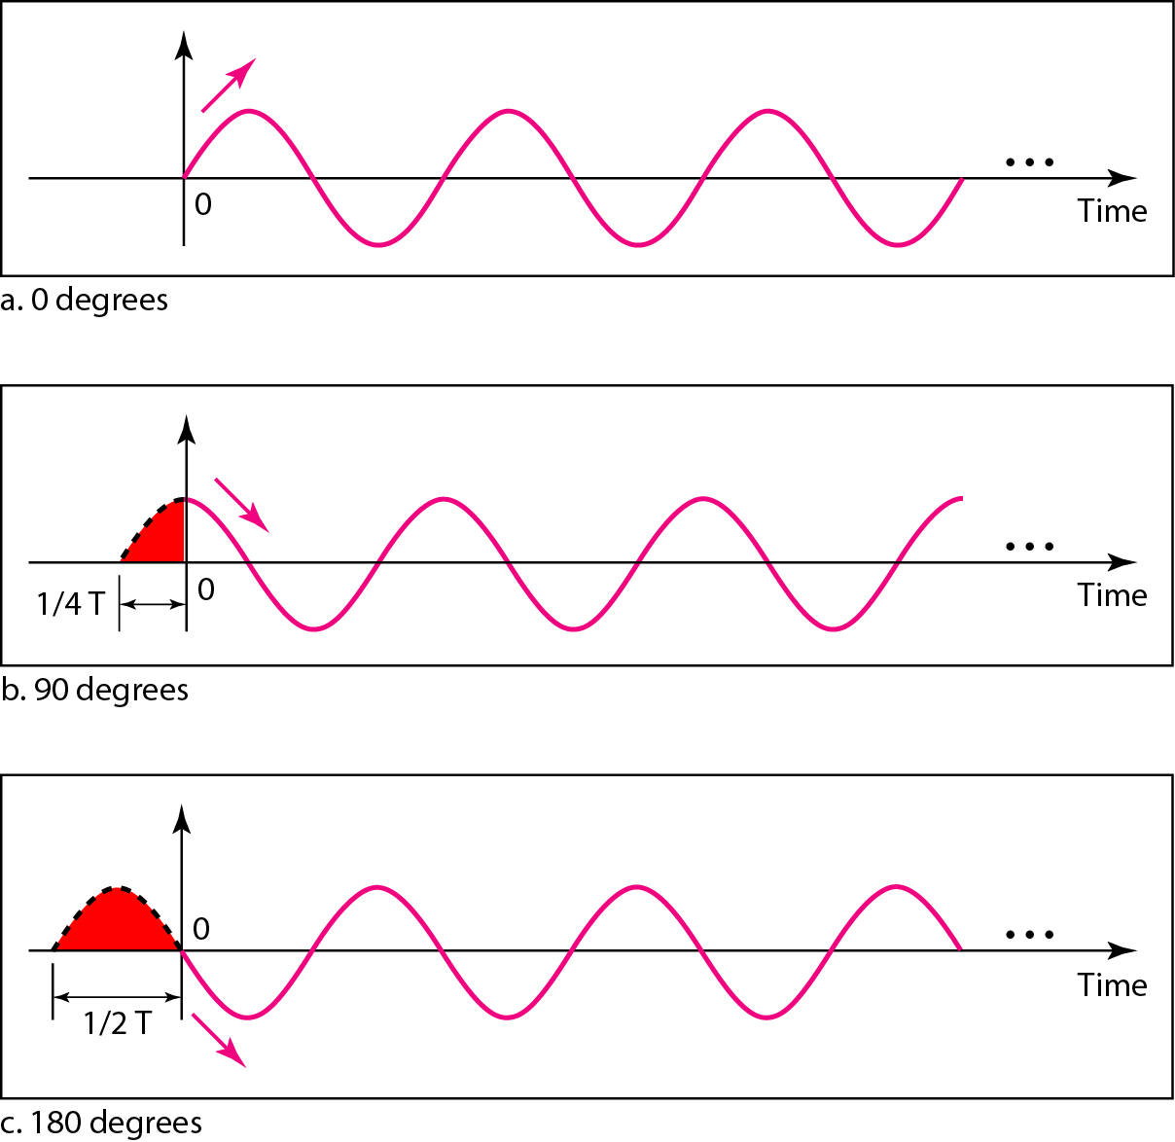
Phase shift
A sine wave is offset 1/6 cycle with respect to time 0. What is its phase in degrees and radians?
Solution:- We know that 1 complete cycle is 360°. Therefore, 1/6 cycle is

Slide 23
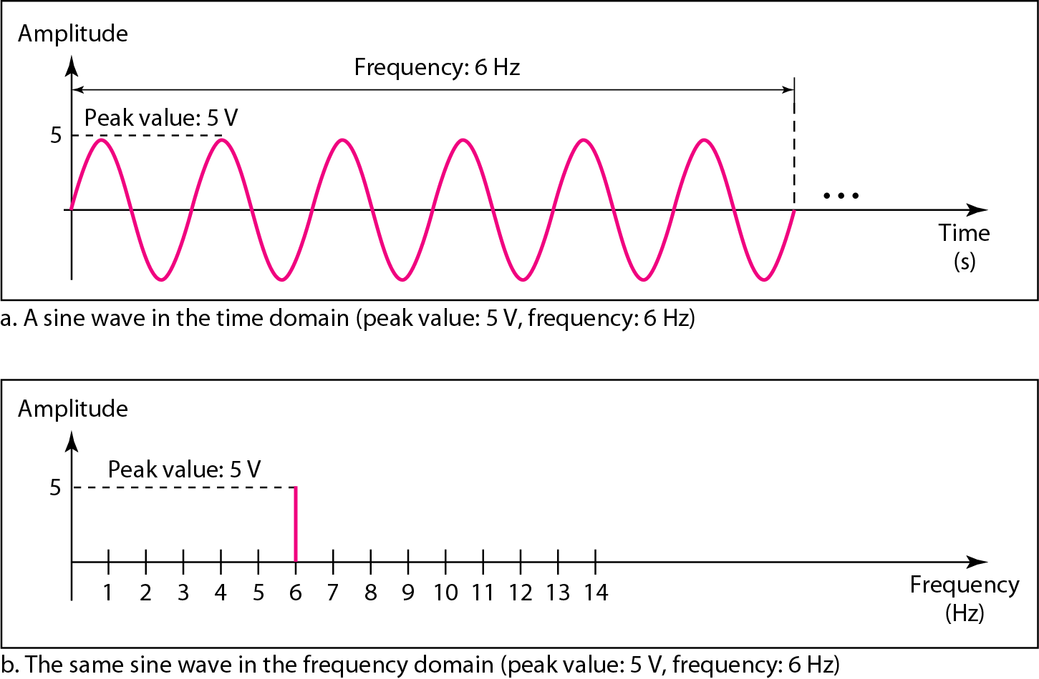
Frequency Domain Concept
The time domain representation displays a signal using time-domain plot, which shows changes in signal amplitude with time. The time-domain plot can be visualized with the help of an oscilloscope. The relationship between amplitude and frequency is provided by frequency domain representation, which can be displayed with the help of spectrum analyser

Slide 24
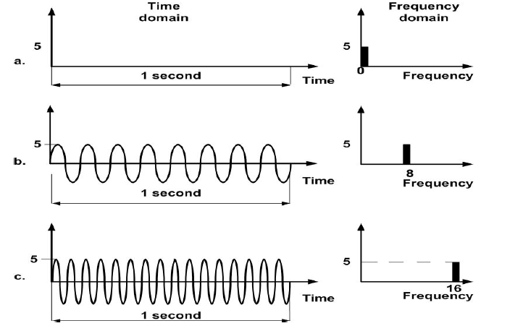
Example

Slide 25
Example
In the previous diagram A gives you a signal having one second and within one second how many pulses are there? There are 1 2 3 4 5 6 7 8 so there are eight pulses. So it has got frequency f and time period is equal to 1/8 second. And this corresponds to 5 units may be 5V so if we have a look at the frequency domain representation we get a line here at frequency f is equal to 8.
On the other hand here is another signal which has frequency 16. If you count you will get sixteen full periods within one second, this is one second. So it has got time period 1/16 second. And as you can see here frequency domain representation is given here and we get a line of the same voltage with amplitude 5.

Slide 26
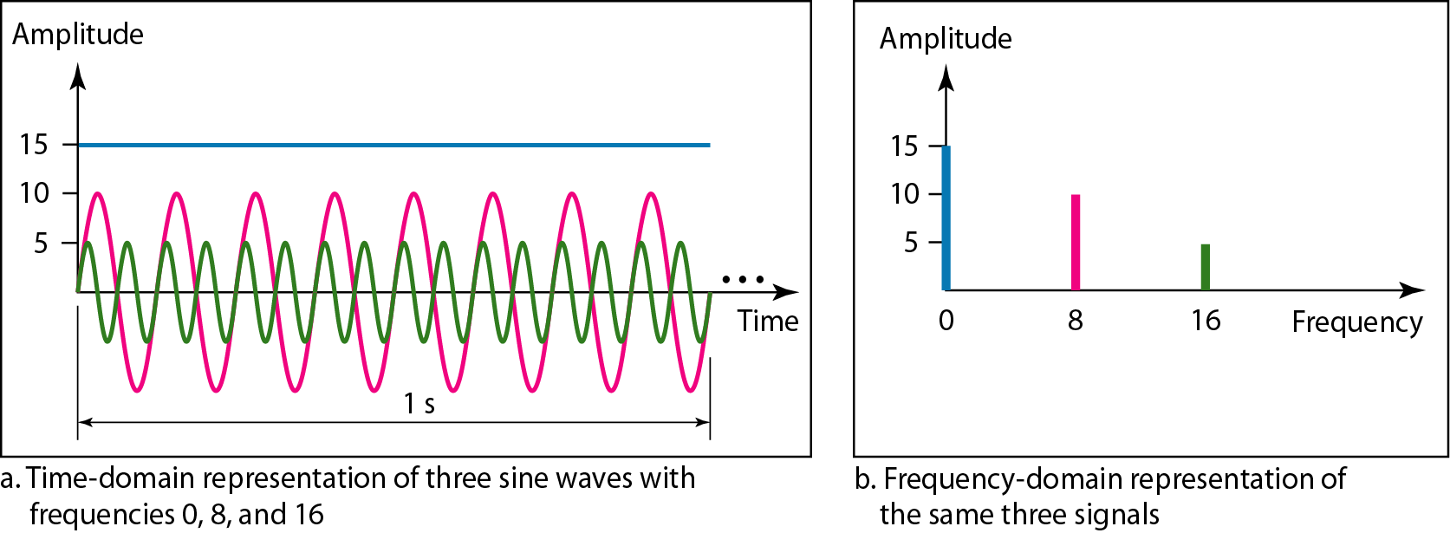
Example
The frequency domain is more compact and useful when we are dealing with more than one sine wave. For example, Figure shows three sine waves, each with different amplitude and frequency. All can be represented by three spikes in the frequency domain.

Slide 27
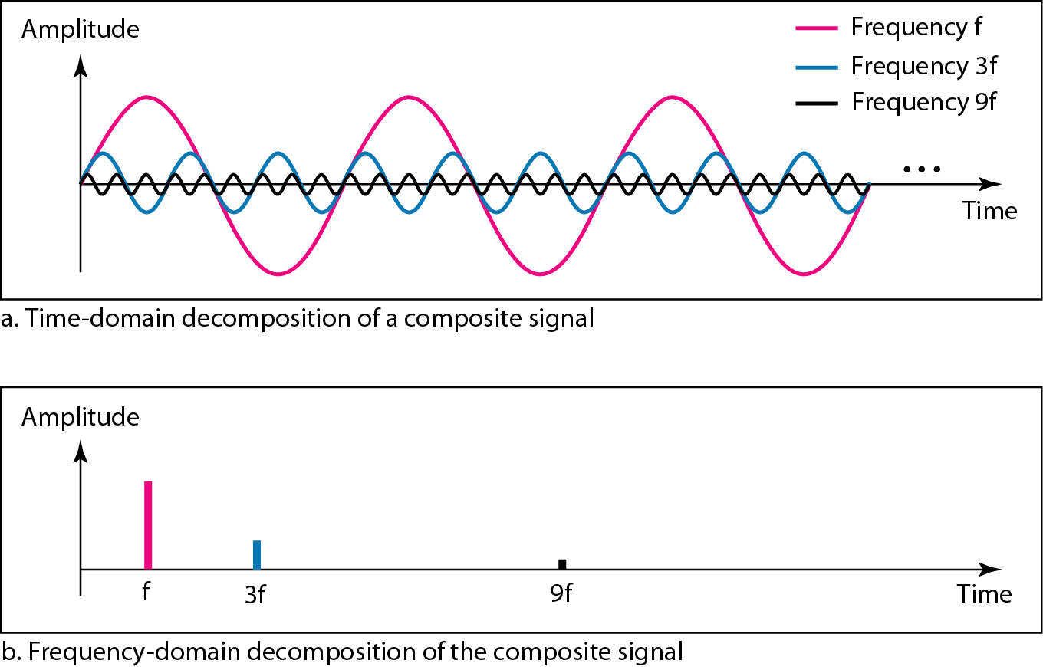
Decomposition of a composite periodic signal

Slide 28
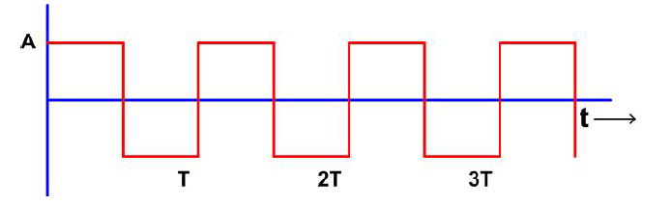
Frequency Spectrum
Now, whenever we are considering particularly a digital signal or a composite analog signal as we have seen it comprises many frequency components and that is expressed in terms of frequency spectrum. And frequency spectrum of a signal is the range of frequencies a signal contains.

Slide 29
Frequency Spectrum
Frequency spectrum of a signal is the range of frequencies that a signal contains.
Example: Consider a square wave shown in Fig. It can be represented by a series of sine waves S(t) = 4A/πsin2πft + 4A/3πsin(2π(3f)t) + 4A/5πsin2π (5f)t + . . . having frequency components f, 3f, 5f, … and amplitudes 4A/π, 4A/3π, 4A/5π and so on. The frequency spectrum of this signal can be approximation comprising only the first and third harmonics

Slide 30
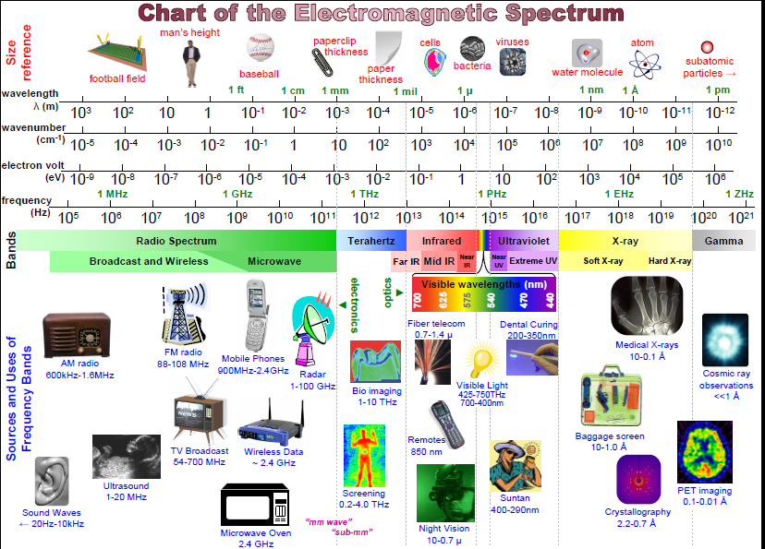

Slide 31
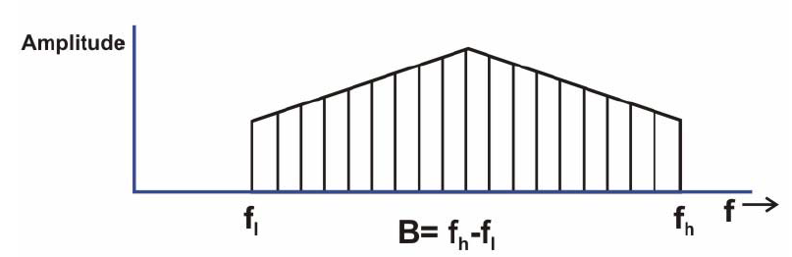
Bandwidth
The range of frequencies over which most of the signal energy of a signal is contained is known as bandwidth or effective bandwidth of the signal. The term ‘most’ is somewhat arbitrary .

Slide 32
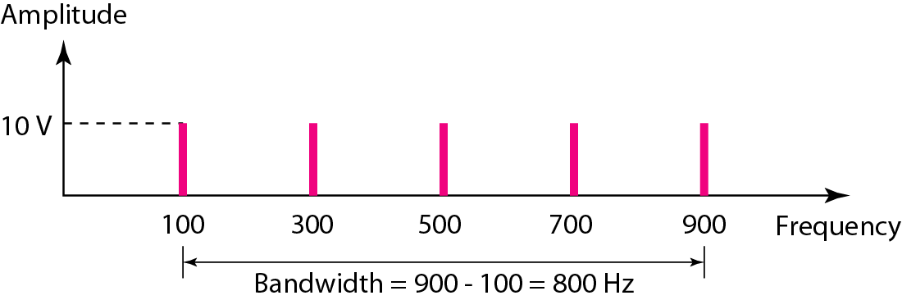
Example
If a periodic signal is decomposed into five sine waves with frequencies of 100, 300, 500, 700, and 900 Hz, what is its bandwidth? Draw the spectrum (range of frequencies), assuming all components have a maximum amplitude of 10 V.
Solution
Let fh be the highest frequency, fl the lowest frequency, and B the bandwidth. Then
The spectrum has only five spikes, at 100, 300, 500, 700, and 900 Hz

Slide 33
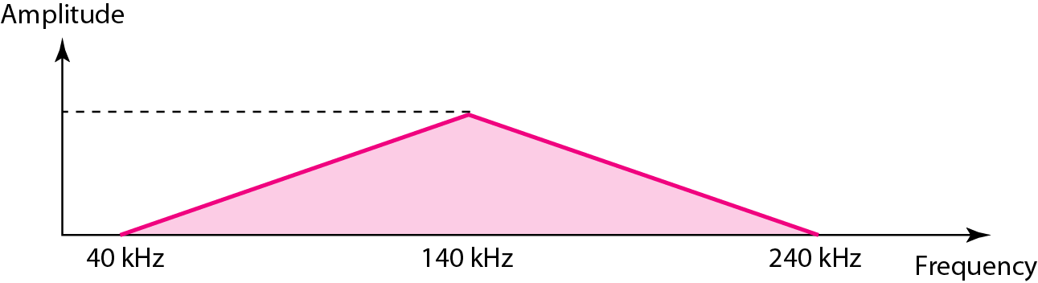
Example
A non periodic composite signal has a bandwidth of 200 kHz, with a middle frequency of 140 kHz and peak amplitude of 20 V. The two extreme frequencies have an amplitude of 0. Draw the frequency domain of the signal
Solution
The lowest frequency must be at 40 kHz and the highest at 240 kHz

Slide 34
Digital Signal
In addition to being represented by an analog signal, information can also be represented by a digital signal. For example, a 1 can be encoded as a positive voltage and a 0 as zero voltage. A digital signal can have more than two levels. In this case, we can send more than 1 bit for each level.
In addition to being represented by an analog signal, data can be also be represented by a digital signal. Most digital signals are aperiodic and thus, period or frequency is not appropriate. Two new terms, bit interval (instead of period) and bit rate (instead of frequency) are used to describe digital signals.
The bit interval is the time required to send one single bit. The bit rate is the number of bit interval per second. This mean that the bit rate is the number of bits send in one second, usually expressed in bits per second (bps)

Slide 35
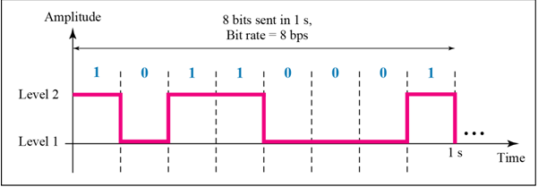
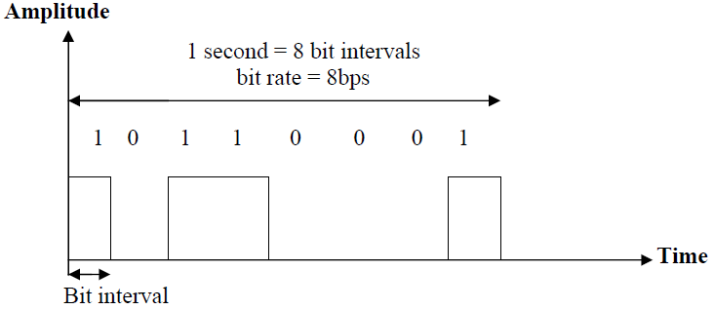
Bit rate interval and bit rate

Slide 36
Example
Assume we need to download text documents at the rate of 100 pages per minute. What is the required bit rate of the channel?
Solution
A page is an average of 24 lines with 80 characters in each line. If we assume that one character requires 8 bits, the bit rate is

Slide 37
Example
What is the bit rate for high-definition TV (HDTV)?
HDTV uses digital signals to broadcast high quality video signals. The HDTV screen is normally a ratio of 16 : 9. There are 1920 by 1080 pixels per screen, and the screen is renewed 30 times per second. Twenty-four bits represents one color pixel.
The TV stations reduce this rate to 20 to 40 Mbps through compression

Slide 38
Propagation time and wavelenght
It is the time required for the signal to travel from one point of transmission medium to another .
propagation time= distance/propagation speed
wavelength it is the distance occupied in space by a single period
wavelength= propagation speed x time period
or
= propagation speed /frequency

