Slide 1
Data Communication Transmission Impairments and channel capacity Lecture-4
Dr. Naveed Ahmad
Assistant Professor
Department of Computer Science
University of Peshawar
n.ahmad@upesh.edu.pk

Slide 2
Impairments
As we know to send data you have to convert it into a signal either analog or digital then that signal has to be passed through a medium it can be a simple medium or a complex communication system. Whatever it may be the transmitter and receiver will be linked by some medium. And unfortunately the medium that we use is not ideal.
By that what do we mean?
Normally by ideal we mean that whatever is sent by the transmitter should be received by the receiver but because of the limitation of the medium that will not happen there will be some impairments which we shall discuss.
Three types of impairments such as attenuation, distortion, noise.

Slide 3
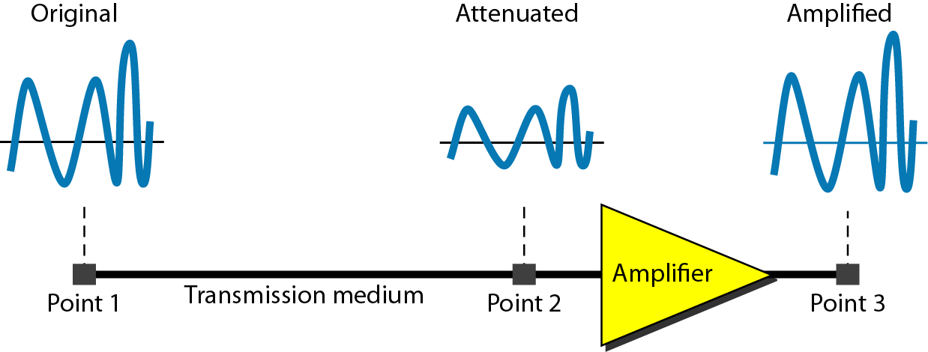
Attenuation
Physics. a decrease in a property, as energy, per unit area of a wave or a beam of particles, occurring as the distance from the source increases as a result of absorption, scattering, spreading in three dimensions, etc.
Attenuation can be considered as the loss of energy as the signal passes through a medium.
Normally the unit that we use is known as decibel dB .

Slide 4
Decibels
Decibles (dB) is measures of the relative strength of the two signals.
If P1 and P2 are signals strength at two different points sender (point1) and receiver (Point2) respectively is called dB.
N_{dB} = 10 x log₁₀ (P2 / P1)
P2 = ending power level in watts
P1 = beginning power level in watts

Slide 5
Examples
Let the energy strength or power at point 2 is 1/10 with respect to point 1. Then attenuation in dB is 10 x log₁₀ (1/10) that is -10 dB.
It may be noted that the loss of power is represented by a negative sign. So we find that whenever there is attenuation by looking at the sign of that decibel value we can find out the level of attenuation and also you can identify that it is attenuation.
On the other hand let the gain as it passes through an amplifier is hundred times at point three with respect to point 2. Then the gain in dB is 10 x log₁₀ 100 /1 that is 20 dB. In this case as we find this is positive

Slide 6
dB (- and +)
So whenever we amplify then we get a value which is positive and whenever attenuation occurs we get a value which is negative.
Now as it passes through several points say in other words a channel is in cascade with an amplifier then may be say from here there is another channel so in this way it can be cascaded. So what we can do is we can add up the dB values to find out the final attenuation or gain at a point 3 with respect to one.
For example, in this case say the signal strength at point 3 with respect to one can be obtained by adding the attenuation between P1 to P2 then amplification between 2 to 3 is equal to -10+ 20 is equal to 10 dB.

Slide 7

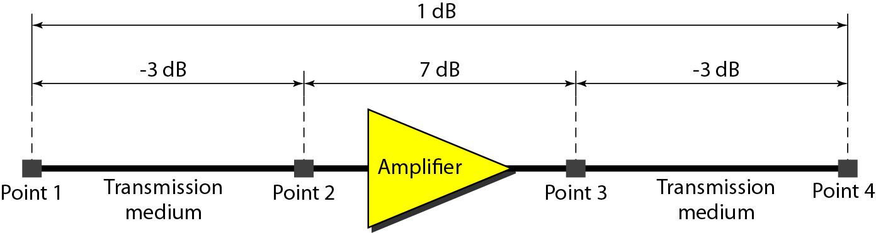
Why dB in decimal ?
One reason that engineers use the decibel to measure the changes in the strength of a signal is that decibel numbers can be added (or subtracted) when we are measuring several points (cascading) instead of just two. In Figure a signal travels from point 1 to point 4. In this case, the decibel value can be calculated as

Slide 8
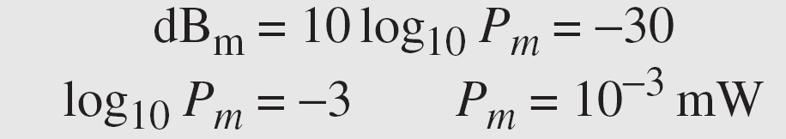
dBm
Sometimes the decibel is used to measure signal power in milliwatts. In this case, it is referred to as dBm and is calculated as dBm = 10 x log₁₀ Pm , where Pm is the power in milliwatts. Calculate the power of a signal with dBm = −30.
Solution
We can calculate the power in the signal as

Slide 9
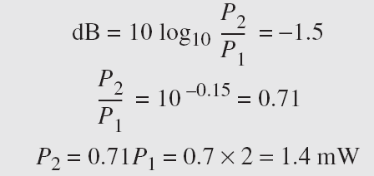
Example
The loss in a cable is usually defined in decibels per kilometer (dB/km). If the signal at the beginning of a cable with −0.3 dB/km has a power of 2 mW, what is the power of the signal at 5 km?
Solution
The loss in the cable in decibels is 5 × (−0.3) = −1.5 dB. We can calculate the power as

Slide 10
Distortion
It has been found that attenuation of all frequency components are not same, some frequencies are passed without attenuation, some are weakened and some are completely blocked so we can see that there are three situations; some are passed without attenuation, some are weakened and some are blocked this leads to what is known as distortion .
That means what the transmitter is sending at the other end of the medium the receiver is not getting the same thing they are not same. So in such a situation we can say that signal is distorted or it has suffered distortion.

Slide 11
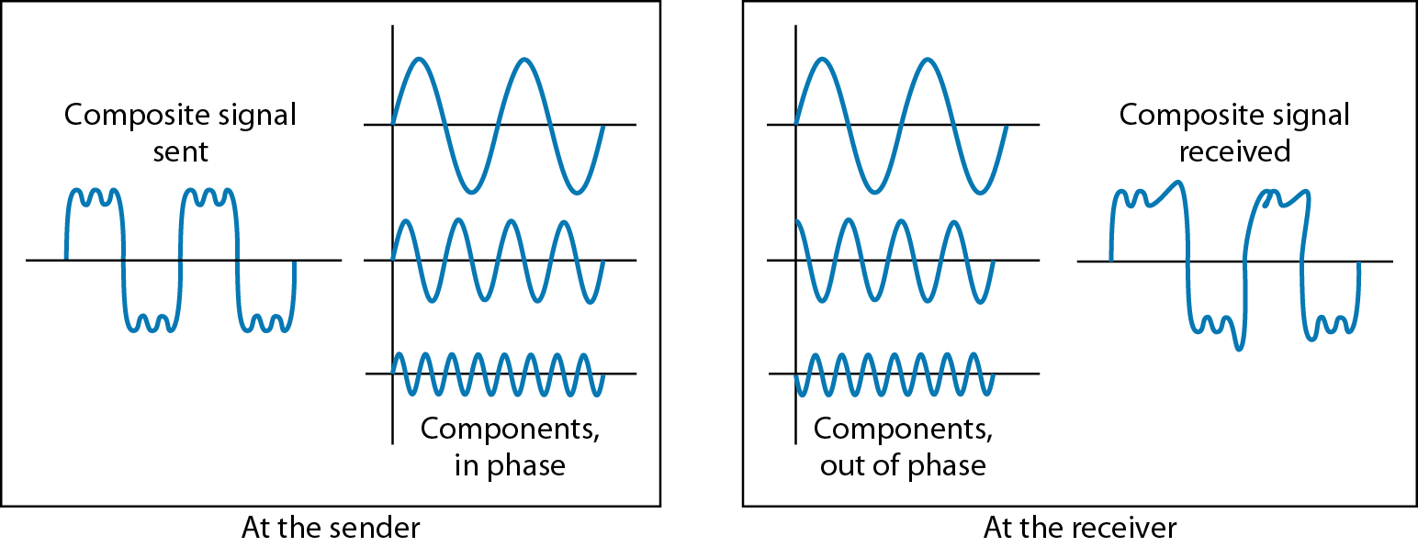
Distortion- example
For example this is an input signal and this is the medium through which the signal is being sent. And as it is sent through the medium at the other end of the output we get the output signal which is much different from the input signal and this will be decided by the bandwidth of the channel or medium.

Slide 12
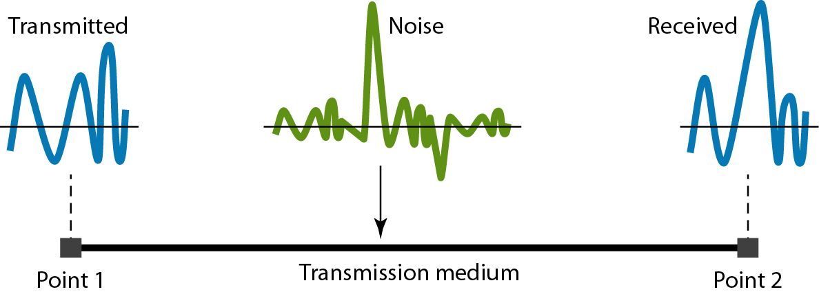
Noise
Additional signals inserted between transmitter and receiver
Noise is the major limiting factor in communication system performance .
Unwanted, usually random, signals inserted between transmitter and receiver

Slide 13
Noise
Noise can be divided into 4 main categories
Thermal — Due to thermal agitation of electrons in all electronic devices — Uniformly distributed across the bandwidth — Also referred to a white noise •
Intermodulation — Signals that are the sum and difference of original frequencies sharing the same transmission medium — Example: mixing of signals at f1 and f2 may produce energy at f1±f2, which could interfere with an intended signal at (f1+f2) or (f1-f2)
Crosstalk — Unwanted coupling between signal paths — Antennas or wires may pick up other unwanted signals, eg. phone line
Impulse — Non continuous, consisting of irregular pulses or noise spikes of short duration but of high amplitude — e.g. External electromagnetic interference, such as lightning

Slide 14
Signal to Noise Ratio (SNR or S/N)
Signal to noise ratio shows the ratio of signal power to noise power
Power often expressed in watts
S/N = signal power/noise power
Just a simple ratio

Slide 15
Signal to Noise Ratio_{dB} (SNR_{dB} or S/N_{dB})
Signal to noise ratio_{dB} shows the ratio of signal power to noise power in decibels
S/N_{dB} = 10 log₁₀ (signal power/noise power)
Example 1: Signal power = 1000 watts, noise power = 20 mw
Example 2: Signal power = 100 w, noise power = 0.000002w

Slide 16
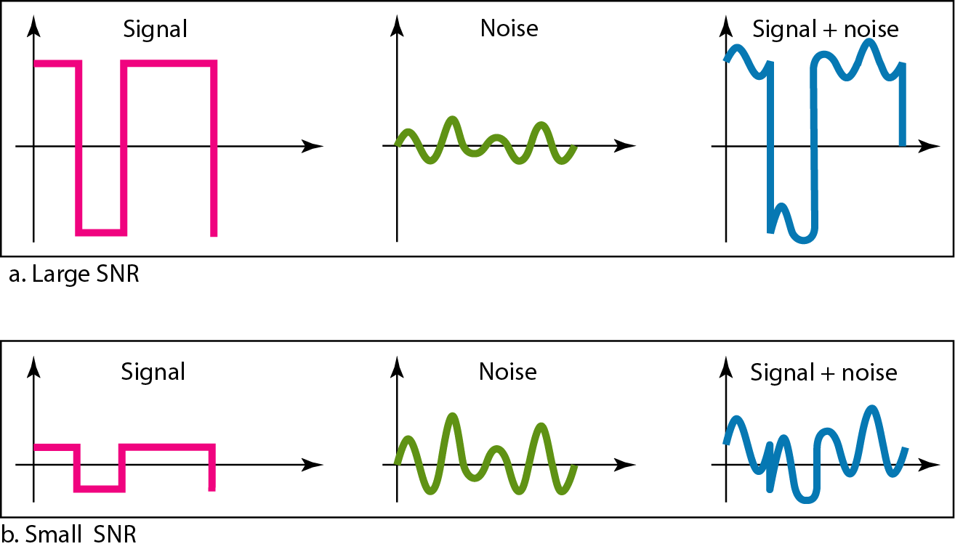
Signal to Noise Ratio_{dB}
What if you know the S/N_{db} but want to know the signal power level?
For example, you are given that S/N_{db} = 85. What is the signal power level?
The power of a signal is 10 mW and the power of the noise is 1 μW; what are the values of SNR and SNR_{dB} ?
Solution
The values of SNR and SNRdB can be calculated as follows:

Slide 17
Example

Slide 18
In nutshell
Signal Bandwidth – the bandwidth of the transmitted signal or the range of frequencies present in the signal, as constrained by the transmitter.
Channel Bandwidth – the range of signal bandwidths allowed by a communication channel without significant loss of energy (attenuation).
Channel Capacity or Maximum Data rate – the maximum rate (in bps) at which data can be transmitted over a given communication link, or channel.

Slide 19
Data rate limits
we know we are interested in sending data through a medium and we want to send it as fast as possible.
Or in other words we want to send it at a high speed. Obviously we want the maximum possible speed. But at what speed we can send will depend on several parameters of the medium.
What are the parameters of the medium?
bandwidth of the channel
number of levels used in the signal
noise level in the channel

Slide 20
Bandwidth
Bandwidth of a signal is the signal frequencies where most of the energy lies.
Here it is somewhat different. Here bandwidth refers to the range of frequencies that a medium can pass without a loss of 1 half of the power that is -3 dB contained in the signal.
So you see that the bandwidth term is used to refer to the bandwidth of a signal, it also refers to the bandwidth of a channel. So, whenever we refer to the bandwidth of a signal we refer to the major frequency components.
On the other hand whenever we refer to a medium we mention the range of frequencies that can be sent without much attenuation through the channel

Slide 21
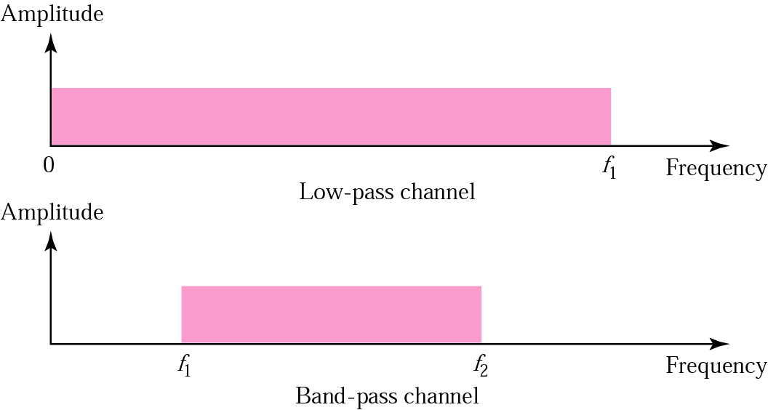
Low pass and Band pass chanel
Low-pass channel : has a bandwidth with frequencies between 0 and f (f could be anything including infinity).
Band-pass channel : has a bandwidth with frequencies between f1 (>=0) and f2
A band-pass channel is more easily available than a low-pass channel.

Slide 22
Nyquist bit rate-noisless channel
As we already mentioned that the signal we send to the other end is dependent on the bandwidth of the channel, noise of the channel because of these parameters.
Now let us see that in case of a noiseless channel we assume that there is no noise although it is not true in practice but for an ideal channel that means without noise the maximum bit rate is given by the Nyquist bit rate and it is equal
C= 2.B.log 2L
where C is known as the channel capacity, B is the bandwidth of the channel and L is the number of signal levels.

Slide 23
Channel Capacity
As we have seen so far, there is a variety of impairments that distort or corrupt a signal.
To what extent do these impairments limit the maximum achievable data rate?
Channel Capacity is the maximum rate at which data can be transmitted over a communication channel.
Data rate —In bits per second (bps) —Rate at which data can be communicated
Bandwidth —In cycles per second, or Hertz —Constrained by transmitter and medium

Slide 24
Baud Rate
Actually to understand the number of signal levels another parameter know as baud rate has to be understood.
The baud rate of a signal or the signaling rate is defined as the number of distinct symbols transmitted per second irrespective of the form of encoding.
A symbol is one of several voltage, frequency, or phase changes.
Now in a single bit interval it is possible to send the number of distinct symbols that can be transmitted per second.
Actually it will depend on how much we are sending within the bit interval. In a bit interval multiple levels can be sent then we can send more information.

Slide 25
Baud Rate
By using multiple symbols, multiple bits can be transmitted per symbol. For example, if the symbol rate is 4800 baud and each symbol represents two bits, that translates into an overall bit rate of 9600 bits/s. Normally the number of symbols is some power of two.
If N is the number of bits per symbol, then the number of required symbols is S = 2N. Thus, the gross bit rate is:
R = baud rate x log2S = baud rate x 3.32 log10S
If the baud rate is 4800 and there are two bits per symbol, the number of symbols is 22 = 4.
The bit rate is: R = 4800 x 3.32 log(4) = 4800 x 2 = 9600 bits/s
If there’s only one bit per symbol, as is the case with binary NRZ, the bit and baud rates remain the same.

Slide 26
Why Multiple Bits Per Baud?
By transmitting more than one bit per baud, higher data rates can be transmitted in a narrower channel. Recall that the maximum possible data rate is determined by the bandwidth of the transmission channel

Slide 27
Baseband signal
For example in case of baseband digitals transmission where the number of levels is two that means within a bit interval we can send either 0V or 1V.
So we have got two distinct values or two levels; zero level and one level. So in this case it is two. Suppose it is possible to send 0V, 0.5V, 1V and then 2V like that. Let’s take these four values we can send 0, 0.5, 1 and 2 so in this case the number of levels is not 2 but 4.
That means within that bit period we can send one of the four values 0V, 0.5V, 1V or 2V so in that case L is equal to 4. So, depending on how many levels are present the maximum baud rate will be dependent on that.

Slide 28
Bit rate
The bit rate or information rate is the actual equivalent number of bits transmitted per second.
That means this allows us whenever we are able to put more number of levels within a particular bit interval then we can send more information for a given bandwidth.
For example, the bit rate or information rate is the actual equivalent number of bits transmitted per second.
The speed of the data is expressed in bits per second (bits/s or bps). The data rate
R is a function of the duration of the bit or bit time (TB), R = 1/TB
Rate is also called channel capacity C. If the bit time is 10 ns, the data rate equals:
R = 1/10 x 10–9 = 100 million bits/s
This is usually expressed as 100 Mbits/s.

Slide 29
Example
Consider a noiseless channel with a bandwidth of 3000 Hz transmitting a signal with two signal levels. The maximum bit rate can be calculated as
Consider the same noiseless channel transmitting a signal with four signal levels (for each level, we send 2 bits). The maximum bit rate can be calculated as

Slide 30
Example
We need to send 265 kbps over a noiseless channel with a bandwidth of 20 kHz. How many signal levels do we need?
Solution: We can use the Nyquist formula as shown
Since this result is not a power of 2, we need to either increase the number of levels or reduce the bit rate. If we have 128 levels, the bit rate is 280 kbps. If we have 64 levels, the bit rate is 240 kbps.

Slide 31
Shannon capacity
Shannon (which includes noise)
Maximum data rate (in bps) = B x log₂(1 + S/N)
B = bandwidth, or frequency
S = signal power in watts
N = noise power in watts (S/N = SNR)
Example: H = 3400 Hz, S = 0.2 w, N = 0.0002 w
Max data rate = 3400 x log₂(1 + 1000)
= 3400 x 9.97
= 33898 bps

Slide 32
Example
Consider an extremely noisy channel in which the value of the signal-to-noise ratio is almost zero. In other words, the noise is so strong that the signal is faint. For this channel the capacity C is calculated as
This means that the capacity of this channel is zero regardless of the bandwidth. In other words, we cannot receive any data through this channel.

Slide 33
Example
We can calculate the theoretical highest bit rate of a regular telephone line. A telephone line normally has a bandwidth of 3000. The signal-to-noise ratio is usually 3162. For this channel the capacity is calculated as
This means that the highest bit rate for a telephone line is 34.860 kbps. If we want to send data faster than this, we can either increase the bandwidth of the line or improve the signal-to-noise ratio.

Slide 34
Example
The signal-to-noise ratio is often given in decibels. Assume that SNRdB = 36 and the channel bandwidth is 2 MHz. The theoretical channel capacity can be calculated as
We have a channel with a 1-MHz bandwidth. The SNR for this channel is 63. What are the appropriate bit rate and signal level?
Solution
First, we use the Shannon formula to find the upper limit.

Slide 35
Example
The Shannon formula gives us 6 Mbps, the upper limit. For better performance we choose something lower, 4 Mbps, for example. Then we use the Nyquist formula to find the number of signal levels.

Slide 36
Summary
Thus to summarize the relationship between bandwidth, data rate and channel capacity,
In general, greater the signal bandwidth, the higher the information-carrying capacity
But transmission system & receiver’s capability limit the bandwidth that can be transmitted
Hence data rate depends on Available bandwidth for transmission Channel capacity and Signal-to-Noise Ratio Receiver Capability
More the frequency allotted, more the channel bandwidth, more the processing capability of the receiver, greater the information transfer rate that can be achieved.

Slide 37
Facts
Increasing the levels of a signal may reduce the reliability of the system.
The Shannon capacity gives us the upper limit; the Nyquist formula tells us how many signal levels we need.
In networking, we use the term bandwidth in two contexts.
The first, bandwidth in hertz, refers to the range of frequencies in a composite signal or the range of frequencies that a channel can pass.
The second, bandwidth in bits per second, refers to the speed of bit transmission in a channel or link.

Slide 38
Facts
As the bandwidth increases, so too can the data rate.
Stated another way, to transmit a high data rate, we need a wide bandwidth.
OR
We need to use a signaling technique that has a high number of signal levels.
The bandwidth of a subscriber line is 4 kHz for voice or data. The bandwidth of this line for data transmission can be up to 56,000 bps using a sophisticated modem to change the digital signal to analog

Slide 39
Assignment-1
How do you use the Nyquist formula?
4000 Hz, 8 signal levels, data rate?
50,000 bps data rate, 4000 Hz, how many signal levels?
How do you use the Shannon formula?
8000 Hz, signal power = 20w, noise power = 0.002w, what is the data rate?
5000 Hz, signal power = 50w, data rate = 20000bps, what is the possible noise power?

