Slide 1
Data Communication Guided Media Lecture-5
Dr. Naveed Ahmad
Assistant Professor
Department of Computer Science
University of Peshawar
n.ahmad@upesh.edu.pk

Slide 2
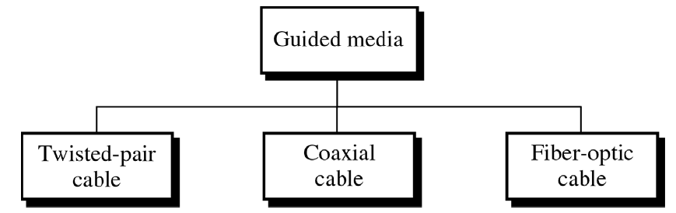
Guided Media
Guided Media, are those media that provide a conduit from one device to another.
guided transmission media where waves are guided along a solid medium such as copper, twisted pair, copper coaxial cable or optical fiber

Slide 3
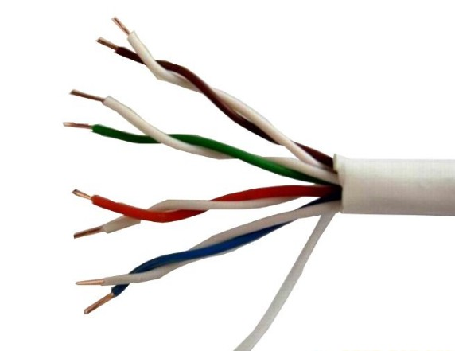
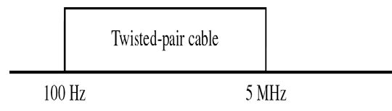
Twisted Pair Cable
A twisted pair cable consists of two insulated copper wires arranged in a regular spiral pattern.
Typically a number of pairs are bundled together into a cable by wrapping them in a tough protective sheath.
Twisted pair comes in two forms:
–Unshielded Twisted Pair (UTP) cable
–Shielded Twisted Pair (STP) cable

Slide 4
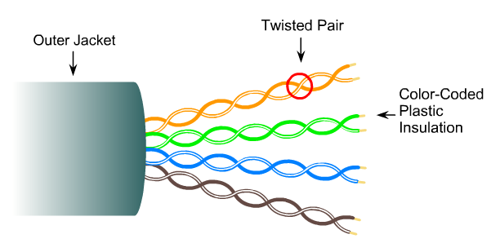
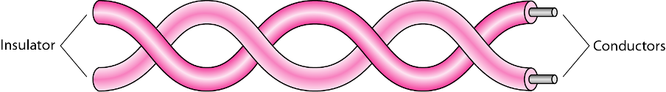
Twisted Pair cable

Slide 5
Why twisting
Now you may be asking what is the need for twisting, why we are twisting the wires, why not just put two wires as it is, what is the need for twisting.
The need for twisting arises because of a phenomenon called crosstalk.
Thus signal passing in one pair of wire will induce signal in another pair of wire.
So in our somewhat experience of telephone system we know that whenever we are talking in the background if you listen carefully you can here some conversation and that conversation we normally call as crosstalk.
The crosstalk is arising because the adjacent pairs are inducing some signal in the twisted pair of wire while the conversation is on between both speakers.

Slide 6
how it reduces the crosstalk?
Current is flowing in one direction in one way and it is flowing in the reverse direction in another way.
And if they are twisted together actually the field induced by this wire will be just opposite to the field induced by the other wire that means they will cancel out each other.
So what is happening in this case is the twisting is actually canceling out the interferences between adjacent pairs of wires. In other words it is minimizing crosstalk

Slide 7
Categories
you may be asking that whether the number of twist per inch play any role? That means number of twist per some length say per inch or per feet whatever it may be does it play an important role? Yes, actually tighter twisting provides much better performance but also it increases the cost.
Category | Bandwidth | Digital/Analog | Use
1 | very low | Analog | Telephone
2 | < 2 MHz | Analog/digital | 4Mbps token ring
3 | 16 MHz | Digital | 10-100 Mbps Ethernet
4 | 20 MHz | Digital | 16 Mbps token ring
5 | 100 MHz | Digital | 100 – 1000 Mbps Ethernet
5E | 100 MHz | Digital | 100 – 1000 Mbps Ethernet
6 | 250 MHz | Digital | 1 – 10 Gbps Ethernet
6A | 500 MHz | Digital | 1 – 10 Gbps Ethernet
7 | 600 MHz | Digital | 10 Gbps Ethernet
7A | 1000 MHz | Digital | 40-100 Gbps Ethernet

Slide 8
Unshielded Twisted Pair cable- UTP
UTP cable is the most common type of Telecommunication Medium in use today
Although mostly used in Telephone systems,, its frequency range is suitable for transmitting both data and voice,
Its cheap, flexible and easy to install
Higher grades of UTP are used in many LAN technologies including Ethernet and Token Ring.
UTP comes in different categories.

Slide 9
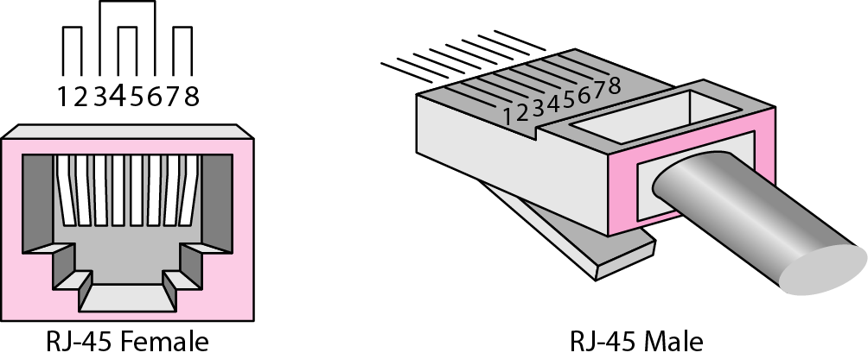
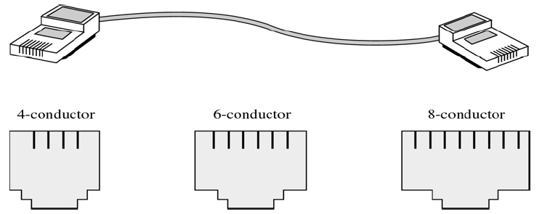
UTP Connectors
UTP is mostly connected to the networked devices via a type of snap-in plug like that used with telephone jacks
Connectors are either male (plug) or female (the receptacle)
Male connectors snap into female connectors and have a repressible tab (key) that locks them in place

Slide 10
Shielded Twisted Pair cable- STP
Has a metal foil or braided-mesh covering that encases each pair of insulated conductors .
The metal casing prevents the penetration of EM noise
It also can eliminate a phenomenon called Crosstalk, which is the undesired effect of one circuit (or channel) on another circuit (or channel)
Shielding each pair of twisted pair can eliminate most crosstalk
STP Cable has the same quality considerations and uses the same connectors as UTP but the shield must be connected to a ground
STP is more expensive than UTP but is less susceptible to noise

Slide 11
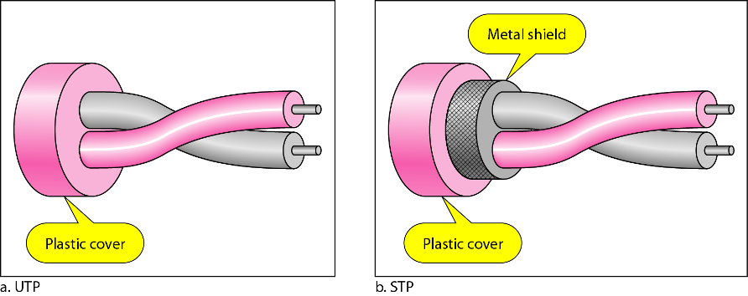

Slide 12
Coaxial
Instead of having two wires, coaxial cable has a central core conductor of solid or stranded wire (usually copper) enclosed in an insulating sheath
This is in turn encased in an outer conductor of metal foil, braid or a combination of the two
The outer metallic wrapping serves both as a shield against Noise and as the second conductor which completes the circuit
This outer conductor is also enclosed in an insulating sheath and the whole cable is protected by a plastic cover .
Coax carries signals signals of higher frequency ranges than twisted pair cable

Slide 13
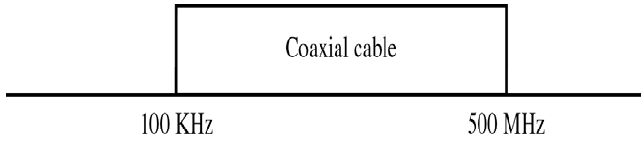
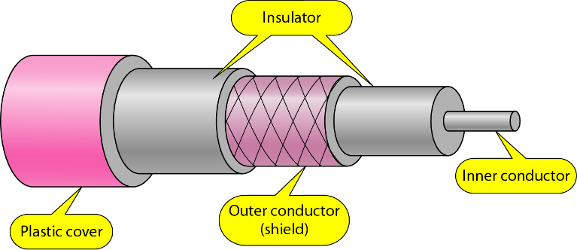
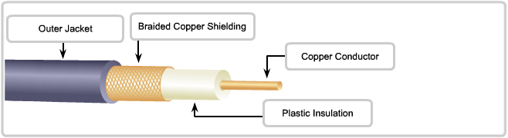

Slide 14
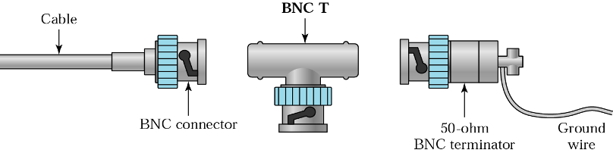
Coaxial Cable Standards
Different coaxial cable designs are categorized by their Radio government ( RG ) ratings
Each RG number denotes a unique set of physical specifications, including
–the wire gauge of inner conductor
– the thickness and type of inner insulator
–Construction of the shield
–Size and type of outer casing
RG8, 9, 11,58 used for LAN
RG59 for TV

Slide 15
Coaxial Cable Connectors
Over the years, a no. of connectors have been designed for use with coaxial cable
Most common of the connectors is called “BARREL connector” because of its shape
Of the barrel connectors, the most popular is the Bayonet Network Connector (BNC)
BNC connector pushes on and locks into place with half turn
Other types of barrel connectors either screw together and so require more effort to install or push on w/o locking which is less secure
Coaxial cables are familiar in Cable TV and VCR hookups that employ both threaded and clip on style
Two other commonly used connectors are T-connectors and Terminators
T-connector (used in Thin Ethernet) allows a secondary cable or cables to branch off from a main line
Terminators are required for bus topologies where one main cable acts as a backbone with branches to several devices but does not itself terminate in a device

Slide 16
Optical Fiber
Until this point we have discussed conductive (metal) cables that transmit signals in the form of current
Optical fiber is made of glass or plastic
It transmits signals in the form of light
The Nature of Light The speed of light
300,000 Km/sec in a vacuum
Depends on the density of the medium through which it is travelling.
The higher the density, the slower the speed

Slide 17
Refraction
Light travels in a straight line as long as it is moving through a single uniform structure
If a ray of light travelling through one substance enters another (more or less dense) substance, its speed changes abruptly causing the ray to change direction
This phenomenon is called Refraction
Example of Refraction
A pencil sticking out of a glass of water appears bent because the light by which we see it changes direction as it moves from air to water

Slide 18
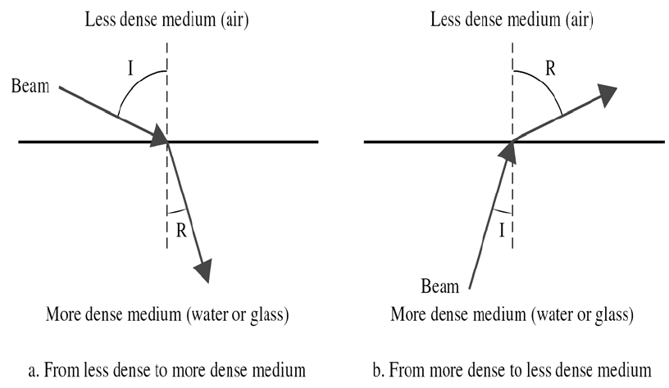
Direction of Refraction
Direction in which a light is refracted depends upon the density of a medium .
A beam of light moves from a less dense into a more dense medium bend towards vertical axis
Incident angle is ‘I’ and Refracted angle is ‘R’

Slide 19
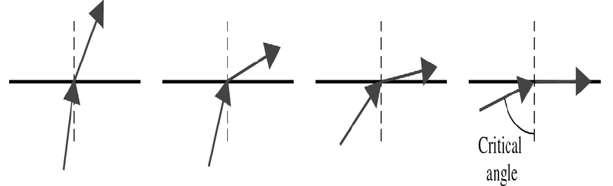
Critical Angle
We have a beam of light moving from a more dense to a less dense medium
We gradually increase the angle of incidence measured from vertical axis
As angle of incidence increases, so does the angle of refraction
The angle at which refracted line lies on the horizontal axis is called critical angle.

Slide 20
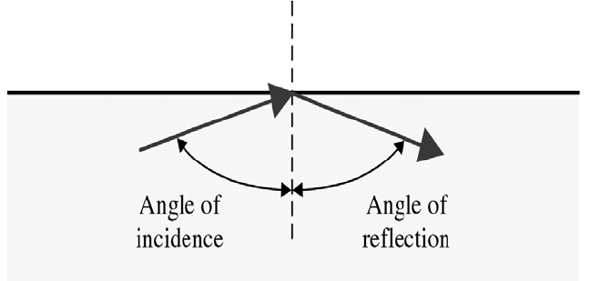
Reflection
When angle of incidence becomes greater than critical angle, reflection occurs
Light no longer passes into the less denser medium but is reflected back into the same medium
The Angle of Incidence (I) = Angle of Reflection (R)

Slide 21
Optical Fibers & Reflection
Optical fibers use Reflection to guide light through a channel
A glass or plastic CORE is surrounded by a CLADDING of less dense glass or plastic
The difference in the density of CORE and CLADDING is such that the beam of light moving through the core is reflected off the cladding
Information is encoded onto a beam of light as a series of ON-OFF flashes that represent 1 and 0 bits

Slide 22
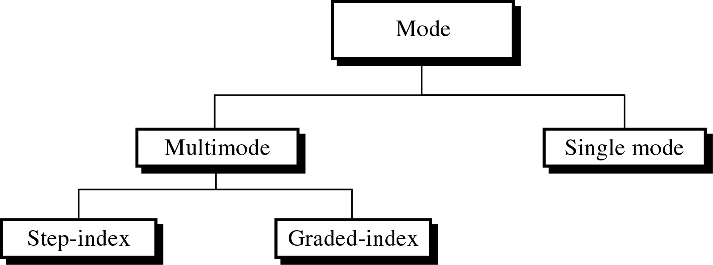
Propagation Modes

Slide 23
Fiber Optic
Fiber Technology supports two modes for the propagation of light
Multimode
Single Mode
Each of these modes require fiber with different physical characteristics
There are two further sub categories of Multimode Fiber:
Multimode Step-Index Fiber
Multimode Graded-Index Fiber

Slide 24
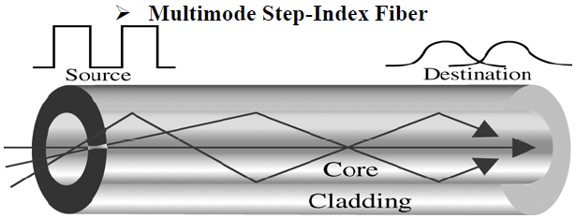
Multimode Fiber
Multiple beams from a light source move through the core in different paths
Two types of the Multimode fiber:
Multimode Step Index Fiber
Multimode Graded Index Fiber

Slide 25
Multimode Fiber step→index
Density of the CORE remains constant from the center to the edges
A beam of light moves through this constant density in a straight line until it reaches the interface of the core and the cladding
At the interface, there is an abrupt change to lower density, that alters the angle of the beam’s motion Step Index→ Suddenness of this change
Some beams travel straight and reach the destination without reflecting
Some strike the interface of core and cladding at an angle smaller than critical angle and penetrate cladding and are lost .
Others hit edge of the core at angles greater than critical angle and bounce back and forth to the destination

Slide 26
Disadvantage of Multimode Step-Index Fiber
Each beams angle is equal to its angle of reflection
If I is small, R is small and the beam will require more bounces and it will take more time to reach the destination
If I is large, R is large and beam will reach destination quickly
In other words there is a difference is Path Lengths that results into a distortion at the receiver
This distortion limits the data rate and make Multimode Step index fiber inadequate for precise applications

Slide 27
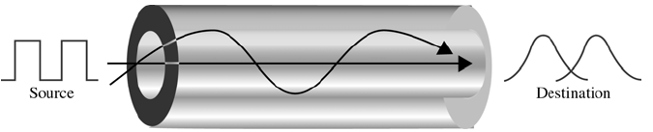
Multimode Graded-Index Fiber
The solution to the above problem is Multimode Graded Index Fiber
A grade index fiber is the one with varying densities
Density is highest at the center of the core and decreases gradually to its lowest at the edge.
The signal is introduced at the center of the core
The horiz beams move straight to the receiver
Beams at other angles moves through the series of constantly changing densities
Each density difference causes each beam to refract into a curve
Signal can be reconstructed with far greater precision as all the beams reach the receiver at almost the same time

Slide 28
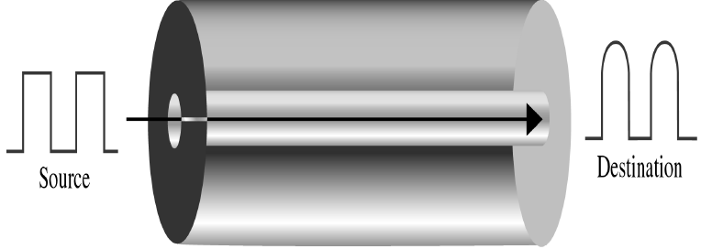
Single Mode Fiber
Uses step index fiber and a highly focused source of light that limits beams to a small range of angles all close to the horizontal
Single Mode fiber is manufactured with a much smaller Diameter than Multimode
All of the beams arrive at the destination together and can be recombined without distortion to the signal

Slide 29
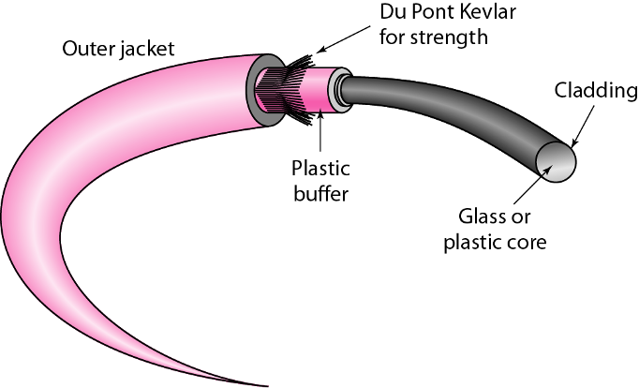
Fiber optic Cable Composition
A core is surrounded by cladding forming the Fiber.
In most cases, fiber is covered by a Buffer layer that protects it from moisture.
Finally the entire cable is encased in an outer jacket
Both core and cladding can be made of either glass or plastic but must be of different densities
In addition the inner core must be ultra pure and completely regular in size and shape
Chemical differences in material and even small variations in the size or shape of the core alter the angle of reflection and distort the signals

Slide 30
Fiber optic Cable Composition
Some applications can handle a certain amount of distortion and their cables can be made cheaply but others depend on complete uniformity .
The outer jacket can be made of several materials including Teflon, Plastic Fibrous Plastic, metal tubing.
Each of these materials have purpose.
Plastic is lightweight and cheap but do not provide structural strength and can emit fumes when burnt
Metal tubing provides strength but is costly
Teflon is lightweight and can be used in open air but it is expensive and does not increase cable strength .

Slide 31
Light sources for optical cable
For tx to occur the sending device must have a light source and the receiving device with a photosensitive cell (photodiode)
Photodiode converts the light into current usable by the computer .
The light source can be LED or ILD.
LED:- Cheaper but provide Unfocused light that strikes the boundaries of channel at uncontrollable angles. Limited to short distance use.
Laser:- can be focussed to a narrow range allowing control over angle of incident.

Slide 32
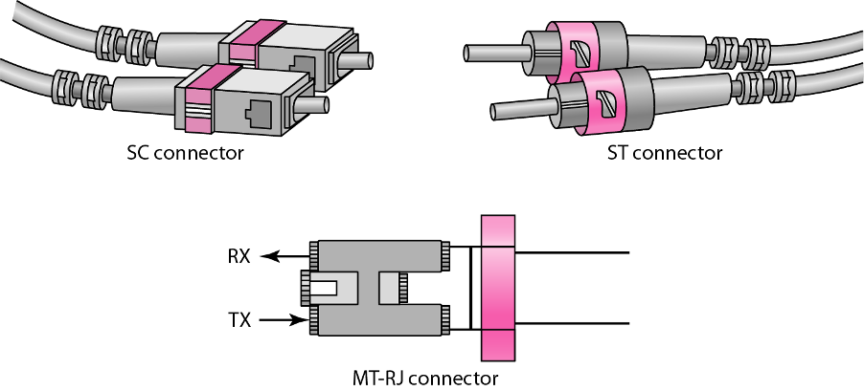
Fiber optic cable connector
If connector is over tight two cores can be compressed and angle of reflection of the signal will be altered.
All of popular connectors are Barrel shaped that come in male and female versions
The cable has a male connector that fixes into a female connector attached to the devices to be connected.

Slide 33
Advantages of fiber optic
Noise Resistance:
Because fiber uses light rather than electricity, noise is not a factor .
External light the only form of possible interference is blocked from the channel by the Outer jacket .
Less Signal Attenuation
Fiber optic Transmission distance is significantly greater than other media.
A signal can run miles w/o regeneration
Higher Bandwidth
Can support higher BWs and higher data rates
High rates are not utilized by absence of signal generation and reception technology.

Slide 34
DisAdvantages of fiber optic
COST
Expensive
No impurities or imperfections can be tolerated, so manufacturing is costly.
Laser light sources can be expensive
INSTALLATION
Roughness & Cracking of core cannot be tolerated .
All connections must be perfectly alligned.
Fragility
Glass fiber is very fragile
Can not be used in extreme conditions where hardware portability is required.

