Slide 1
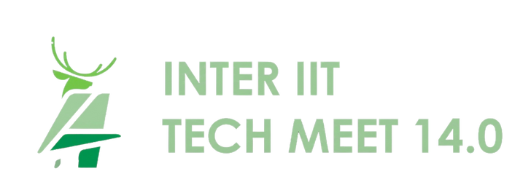
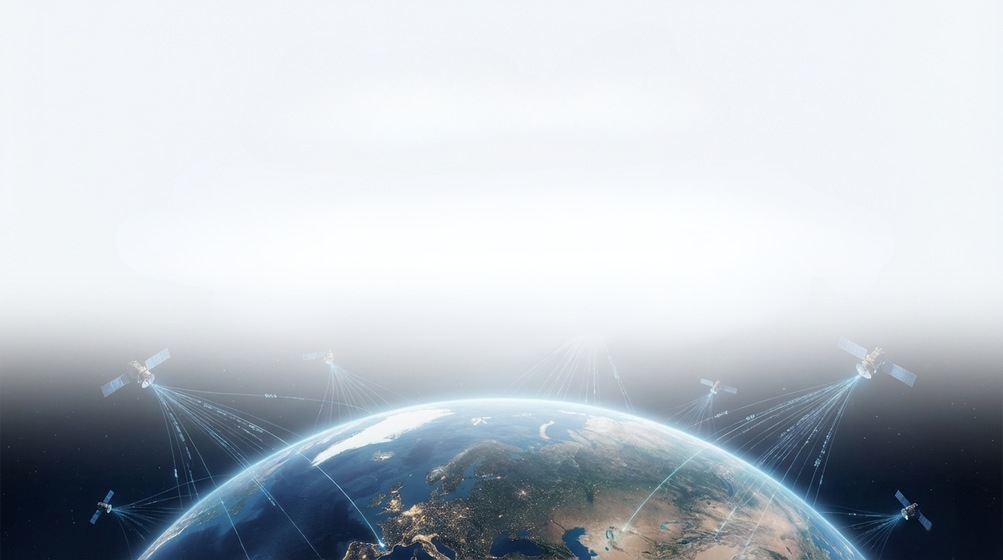

Team 65
  GeoNLI: Natural Language Interpretation Of Satellite Images
A Unified Vision Language Framework For
Geospatial Intelligence

Slide 2


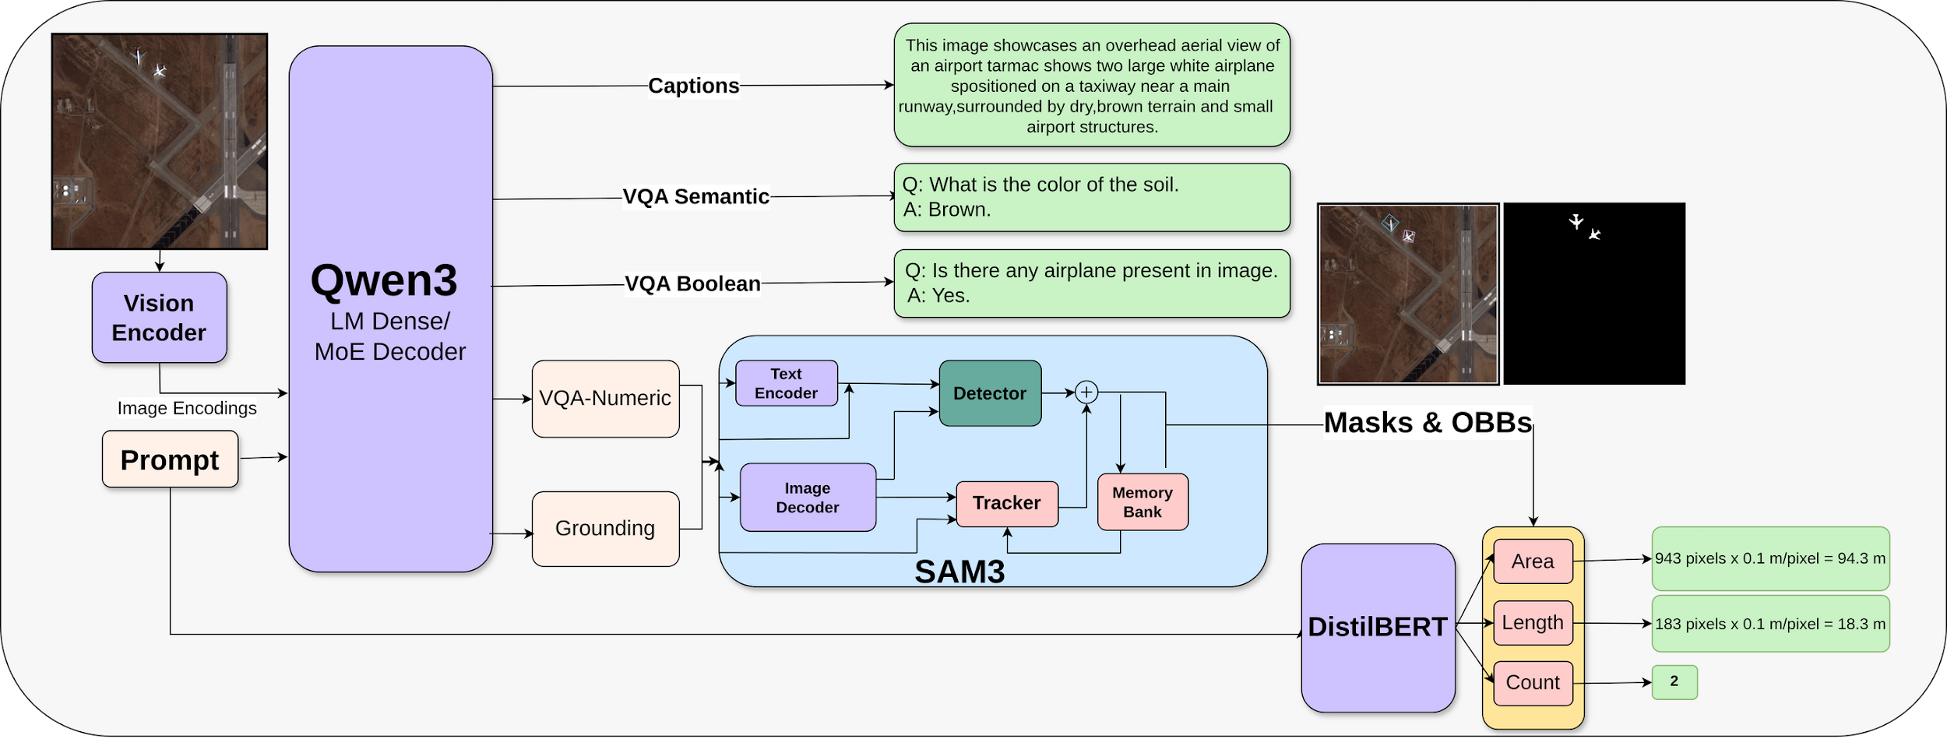
Our Solution : An End to End Reasoning & Segmentation Pipeline
Our Solution : An End to End Reasoning & Segmentation Pipeline
Our Solution : An End to End Reasoning & Segmentation Pipeline
We built a unified pipeline that translates raw satellite pixels into actionable, quantitative insights through a three stage process
We built a unified pipeline that translates raw satellite pixels into actionable, quantitative insights through a three stage process
We built a unified pipeline that translates raw satellite pixels into actionable, quantitative insights through a three stage process

Slide 3

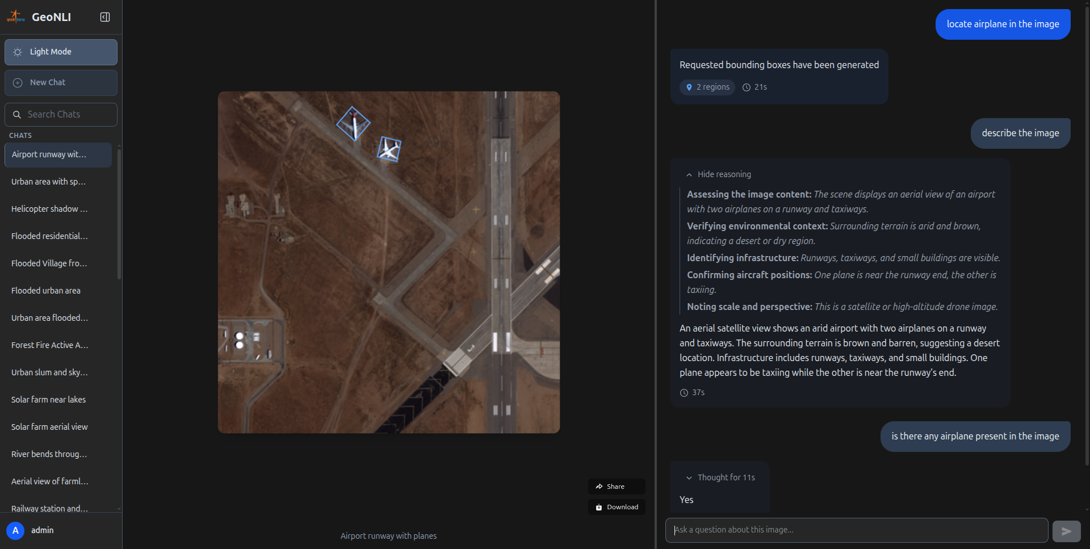
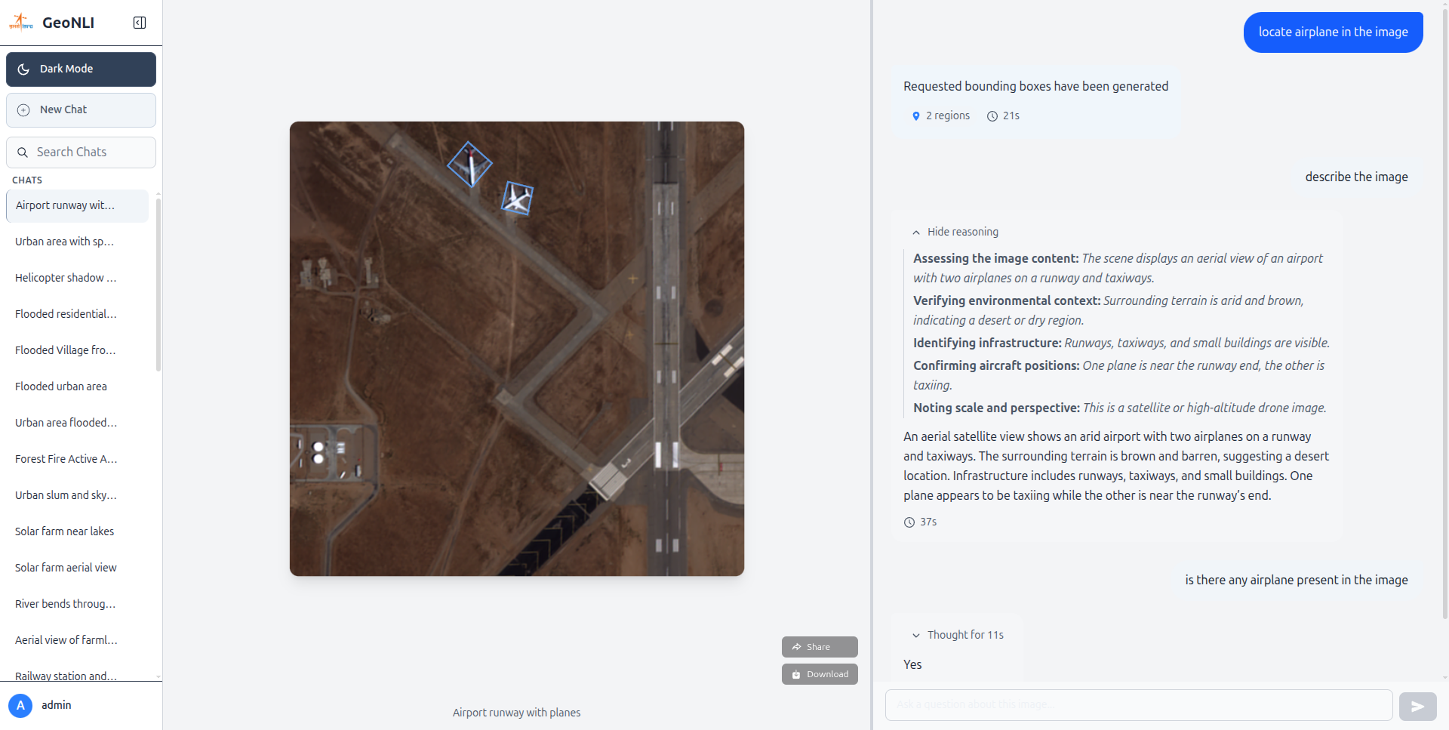
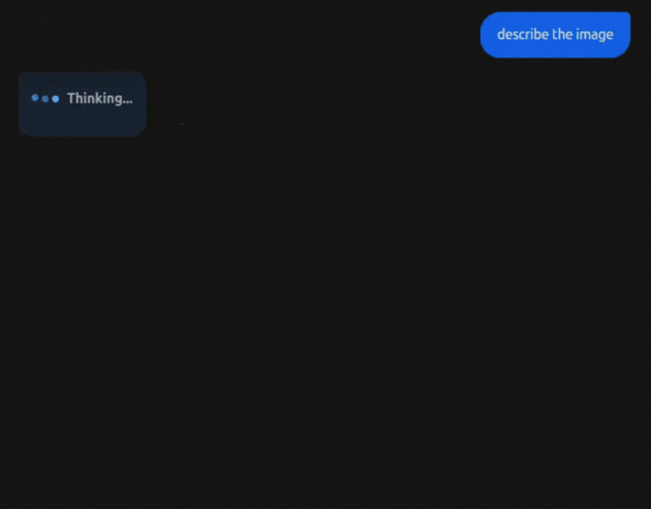







Software UI/UX and Architecture
Software UI/UX and Architecture

Slide 4
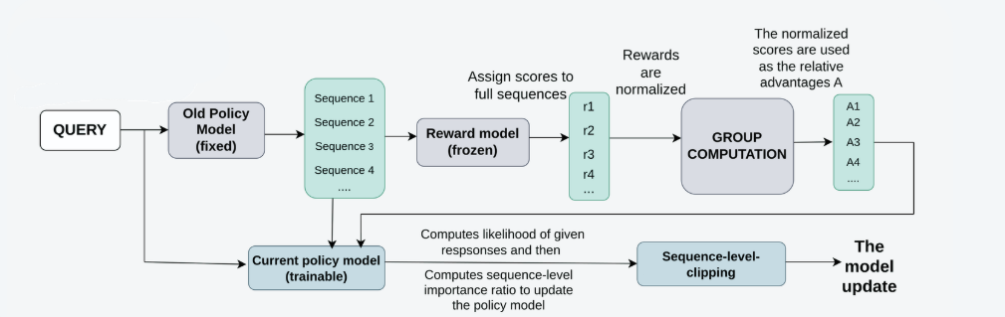

Superior reasoning with GSPO
Key innovations:
  PPO and GRPO are computationally intensive and tend to become unstable with long, detailed outputs, they often succumb to issues such as reward hacking or even model collapse.
  We adopted GSPO, which removes the need for a critic model. By optimizing at the sequence level, it stabilizes training and enables the model to generate more coherent and accurate reasoning.
  This results into a VLM capable of delivering higher-quality analysis for complex geospatial scenes, as demonstrated in our results.

Slide 5
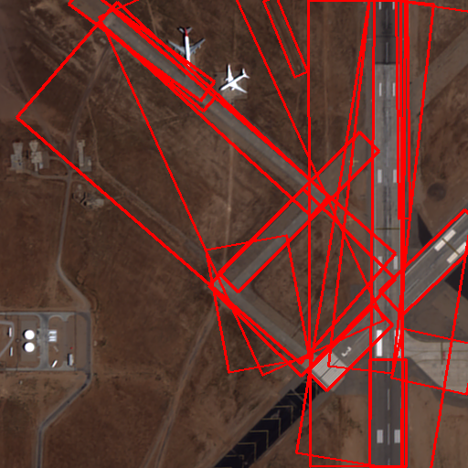
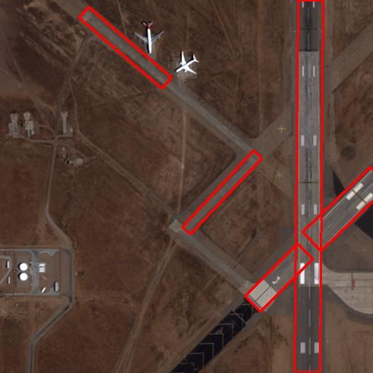





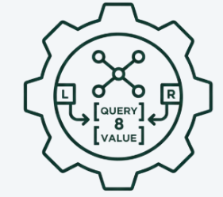
Precision Grounding with Enhanced Segmentation
|
|
|
|
|
|
|
|
|
|
|
|
Before NMS
After NMS
NMS Threshold = 0.05
Key Techniques employed:
To ensure computational efficiency while adapting to the remote sensing domain, we employed Low-Rank Adaptation (LoRA) by injecting trainable rank-8 decomposition matrices into the attention module's query and value weights.
The model is trained using a composite loss function aimed at maximizing Mean Intersection over Union (mIoU) while ensuring robust mask selection
To refine the instance segmentation output, the framework applies Non-Max Suppression (NMS) to the generated Instance Bounding Boxes (IBBs). This step effectively removes duplicate or highly overlapping boxes,

Slide 6
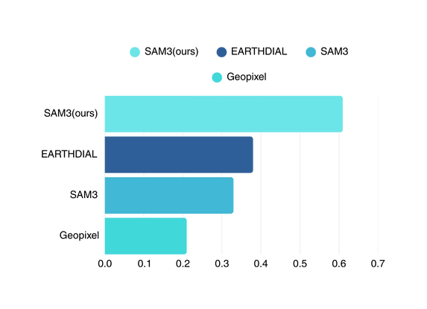
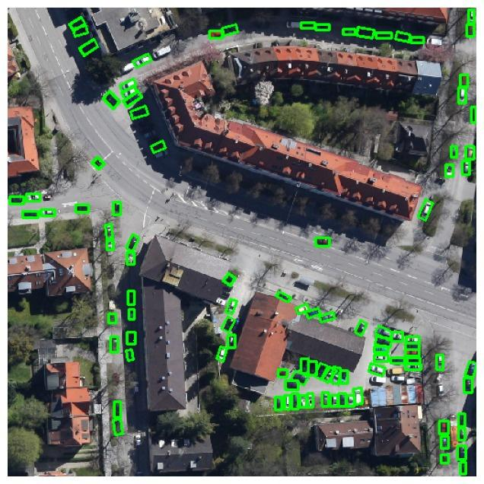
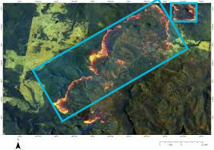
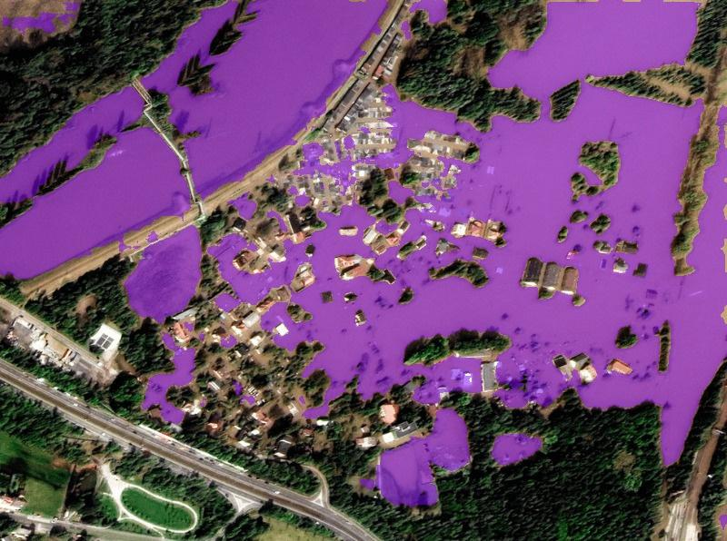
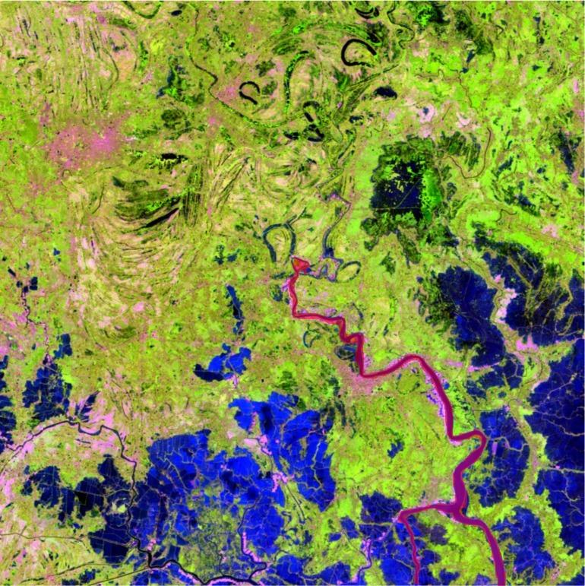
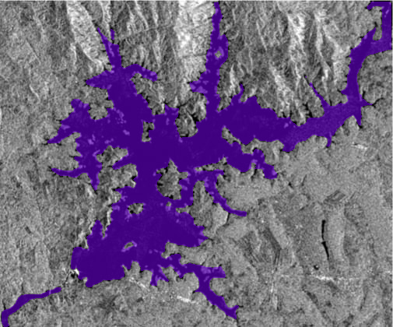
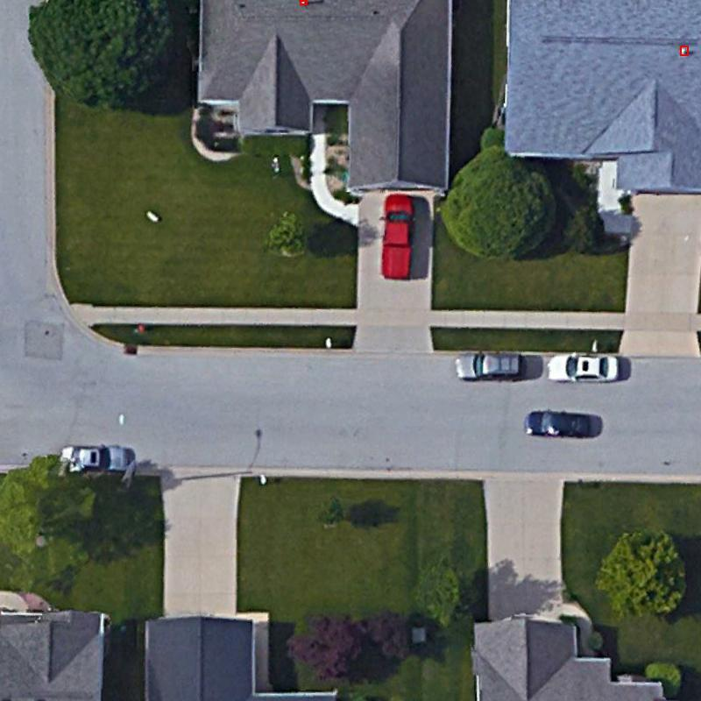
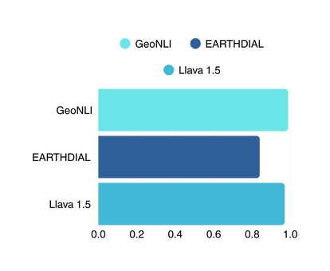
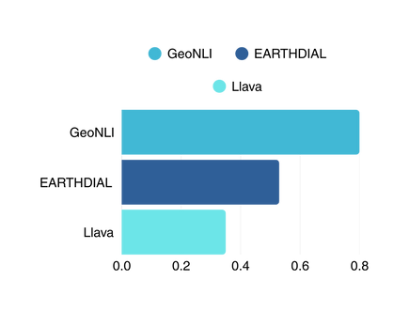

Test Results
Test Results
Grounding
Real world use cases
Real world use cases
Flood area detection
Raw IR inference
Segmentation over FCC
Antenna
Dense object detection
Forest Fire Detection
Forest Fire Detection
Dense object detection
Raw IR inference
Captioning
Antenna
Segmentation over FCC
Flood area detection
Numeric QA

Slide 7






CURRENT LIMITATIONS & FUTURE ROADMAP
Current Limitations
Future Roadmap
  Due to compute constraints we were unable to fine tune our models on larger datasets for higher no. of epochs
  Advanced MultiModal Fusion: integrate Sar/IR imagery more deeply using a KAN based autoencoder for more interpretable feature fusion.
  Supports only short user queries or requires abstraction due to limited Context length of SAM3 text encoder
  Online & Continual Learning: Implement a framework for the model to continuously learn and improve from user interactions and new data over time
• Enhance the VQA engine to support
more complex geometric and spectral
analysis directly from user queries.
  Replacing static with a Kubernetes based architecture, enabling auto static scaling that dynamically adjusts resources according to system load

Slide 8
THANK
YOU

Slide 9
APPENDIX
Dataset Formation
KAN Based Dimensionality Reduction
  Due to unavailability of high quality annotations for SAR/IR datasets . We used existing close sourced LLMs to generate annotations.
  22 IR and 18 SAR channels were generated using texture, polarimetric and spectral-based features. These derived channels capture rich and discriminative information, enabling accurate reasoning over imagery that may appear visually uninformative.
  SAR and IR bands were used to create False color Composites (FCCs) which emphasized on aspects like vegetation , soil , water bodies etc which are then feed into the LLM for annotations.
  Passing these many channels in the vlm may cause training instability . therefore for dimensionality reduction KAN was used
  The IR dataset utilizes Harmonized Landsat Senitel (HLS) data . The SAR dataset is sourced from Alaska Satellite Facility (ASF)
  KAN captures the complex non linear relationship between the input channels and outputs physically meaningful latent channels .

