Slide 1
ECE 554: Minilab 1
Simulation & debugging

Slide 2
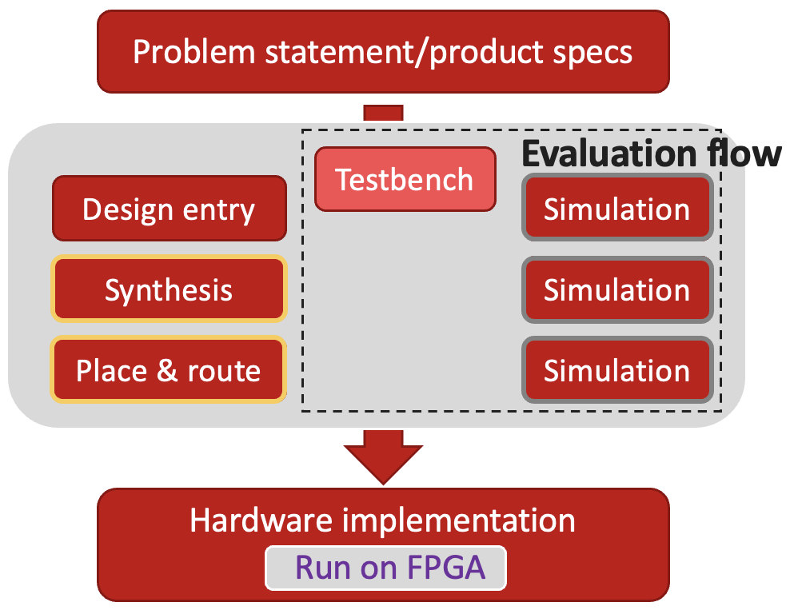
Minilab 0 - Minilab 1
Focus of Minilab 0
Focus of Minilab 0
ECE 554: Digital Engineering Laboratory (Spring 2025)

Slide 3
Design validation
Test and debug at several steps in the process‏
  At architecture level - functional simulation of HDL.
  At RTL level - functional simulation of RTL HDL.
  At logic design or synthesis - functional simulation of gate-level circuit.
  At implementation - timing simulation of schematic, netlist or HDL with implementation-based timing information (functional simulation can also be useful here)‏.
  At programmed FPGA level - in-circuit test of function and timing.
Minilab 1
Part 1
Minilab 1
Part 2
ECE 554: Digital Engineering Laboratory (Spring 2025)

Slide 4
Example design: matrix-vector multiplication
a00 a01 a02 a03 a04 a05 a06 a07
a10 a11 a12 a13 a14 a15 a16 a17
a20 a21 a22 a23 a24 a25 a26 a27
a30 a31 a32 a33 a34 a35 a36 a37
a40 a41 a42 a43 a44 a45 a46 a47
a50 a51 a52 a53 a54 a55 a56 a57
a60 a61 a62 a63 a64 a65 a66 a67
a70 a71 a72 a73 a74 a75 a76 a77
b00
b01
b02
b03
b04
b05
b06
b07
c00
c01
c02
c03
c04
c05
c06
c07
LEGEND:
FIFO Entry
a77
MAC
a76
+ 1 cycle
a75
A
B
C
+ 1 cycle
a74
a73
Create an array of 8 MAC units
  A entries (MAC in): 8 bits; B entries (MAC in): 8 bits; C entries (MAC out): 24 bits.
  Inputs A and B are provided to the MACs through FIFOs as shown in the diagram.
  MAC operations begin after all FIFOs are full. At that time, an En signal gets triggered.
  The En signal propagates in the MAC array from left to right with one cycle of delay per MAC.
  B inputs propagate through the MAC array similarly to En.
  The results accumulated in C are cleared upon the arrival of a Clr signal.
a27
a72
a17
a26
a71
a07
a16
a25
.
a70
a06
a15
a24
.
a05
a14
a23
.
a04
a13
a22
a03
a12
a21
a02
a11
a20
a01
a10
a00
b07
b06
b05
b04
b03
b02
b01
b00
c00
c01
c02
. . .
c07
ECE 554: Digital Engineering Laboratory (Spring 2025)

Slide 5
Instantiating Regular Structures
0
vec[0]
vec[1]
vec[2]
vec[DIM-1]
op1
op2
op1
op2
op1
op2
…
op1
op2
sum
sum
sum
sum
sum
module vector_reduce(input [15:0] vec [7:0],
output [15:0] sum);
logic [15:0] sums [8:0]; // note extra wiring
always_comb begin
sums[0] = 0;
for(int i=0; i<8; ++i) begin
sums[i+1] = sums[i] + vec[i];
end // for
end // always_comb
endmodule // vector_reduce
module vector_reduce(input [15:0] vec [7:0],
output [15:0] sum);
logic [15:0] sums [8:0]; // note extra wiring
assign sums[0] = 0;
assign sum = sums[8];
genvar i;
generate
for (i=0; i < 8; ++i) begin
myadder (.op1(vec[i]),
.op2(sums[i]),
.sum(sums[i+1]));
end // for(i
endgenerate
endmodule // vector_reduce
ECE 554: Digital Engineering Laboratory (Spring 2025)

Slide 6
Part 1
‏Part 1 consists of 2 subparts.
  Part 1a: Complete the design and simulate it with a testbench.
    A memory module with a .mif file is provided along with the required IP files. The memory module has a partial implementation of INTEL Avalon MM slave interface. Apart from the matrix-vector multiplication module, design a module that fetches data from the provided memory module to fill the FIFOs. Look at Tables 1 & 2 and Figure 7 here for more details on Avalon MM Interface.
    The testbench should print all interface signals, states, and output signals.
    Use this command to simulate in QuestaSim.
    vsim work.<your_testbench_name>_tb -L C:/intelFPGA_lite/21.1/questa_fse/intel/verilog/altera_mf -voptargs="+acc"
  Part 1b: Fix design to meet timing constraints.
    Change the clock in the Synopsys Design Constraint (.sdc) file to 200 MHz by changing the clock period (in nanoseconds).
    Synthesize the design again and see if it meets timing by looking at the reports from the Timing Analyzer. Here is a helpful video that shows how to do it.
    Fix the design to meet the timing requirements of the 200 MHz clock.
ECE 554: Digital Engineering Laboratory (Spring 2025)

Slide 7
Part 2
‏Part 2 also consists of 2 subparts.
  Part 2a:
    Use LEDs to display and track the states of your top-level state-machine.
    Use 7-segment display the outputs of the MACs. (Please)
    Note 1: Use switches to control the displays. The board has 10 switches; so, there are 2^10 different ways of control.
    Note 2: Minilab 0 codes may be handy.
  Part 2b: Use SignalTap to ensure that you have implemented the Avalon MM interface correctly.
ECE 554: Digital Engineering Laboratory (Spring 2025)

Slide 8
Demo
‏Simulation of working design
Timing analyzer report
On-board testing with LEDs, 7-segment display, and switches.
On-board testing with SignalTap
ECE 554: Digital Engineering Laboratory (Spring 2025)

Slide 9
Deliverables
‏Create a new public GitHub repository for your minilab submission (1 per team.
Push all relevant files to the repository, including your codes, testbenches, and simulation logs. If for the implementation IPs are used, also add all IP-related files.
NOTE: Simulation log with proper print statements from the testbench that explains whether a test passed or failed. If the design failed a test, it should print where and why it failed.
Minilab 1 report is due on 2/4 before the start of Minilab 2.
In your report (1 per team), explain:
  How you tested the design via simulation (screenshot of waveform).
  How you fixed the design to meet the timing constraint.
  How you tested the design on board using an example and snapshot of the board that shows it.
  How you tested the design using SignalTap (screenshot of waveform around the trigger condition).
  Explain any difficulties that you faced during the whole process and how you overcame it.
ECE 554: Digital Engineering Laboratory (Spring 2025)

Slide 10
Questions?

