Slide 1

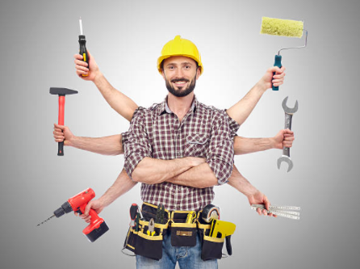
Craftive App: The creative Craftsman
– IPP Presentation M4
Fantastic Trio: Lisa Weinmann, Jiexiang Shu, Runcong Chen
Technische Universität München
Munich, 19.01.2022
Source: Mann Für Mit Tools Stockfoto und mehr Bilder von Handwerker - iStock (istockphoto.com)

Slide 2
Content
Improvements
Demonstration of HiFi Web App
Experimental Design
Source: Mann Für Mit Tools Stockfoto und mehr Bilder von Handwerker - iStock (istockphoto.com)
Lisa Weinmann, Jiexiang Shu, Runcong Chen | Fantastic Trio | Craftive App | 19.01.22

Slide 3
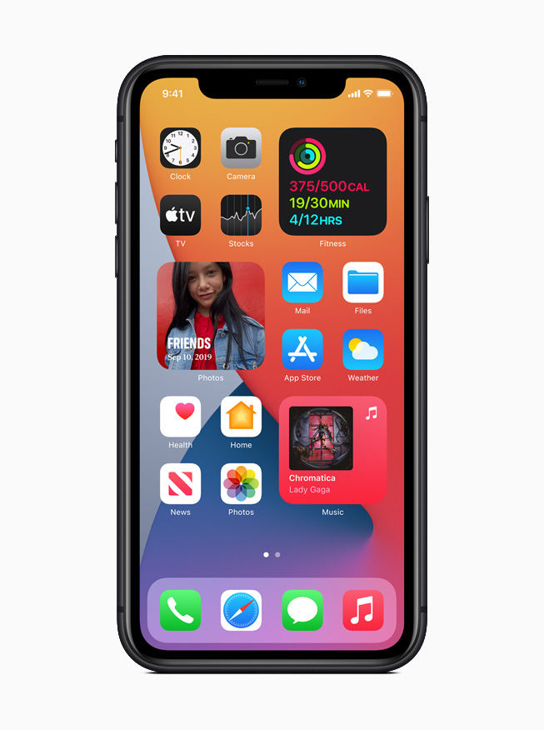
Improvements
Demonstration of HiFi Web App
Experimental Design
Improvements
Continue to improve the user flow
Add Payment page
Add function of deleting request
Change some aesthetic designs of App
Source:https://www.apple.com/newsroom/images/product/os/ios/standard/Apple_iphone11_ios14-springboard-widgets_09162020_inline.jpg.large.jpg
Lisa Weinmann, Jiexiang Shu, Runcong Chen | Fantastic Trio | Craftive App | 19.01.22

Slide 4
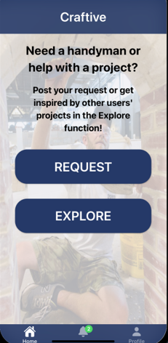
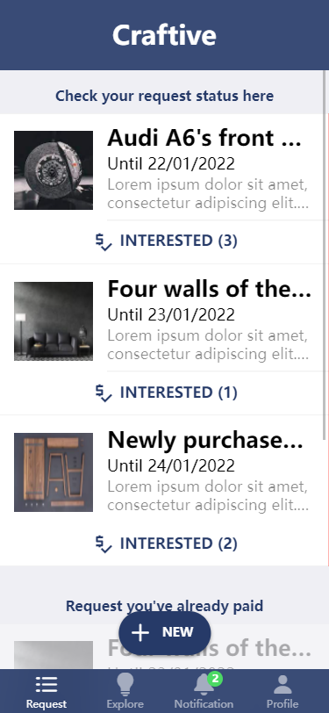
Improvements
Demonstration of HiFi Web App
Experimental Design
User flow
Make ‘Home’ icon divided into ‘Request’ and ‘Explore’ icon
Lisa Weinmann, Jiexiang Shu, Runcong Chen | Fantastic Trio | Craftive App | 19.01.22

Slide 5
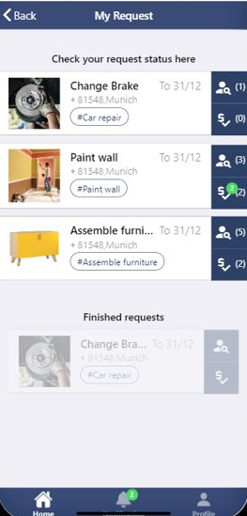
Improvements
Demonstration of HiFi Web App
Experimental Design
User flow
Don’t let information overflowed
Lisa Weinmann, Jiexiang Shu, Runcong Chen | Fantastic Trio | Craftive App | 19.01.22

Slide 6
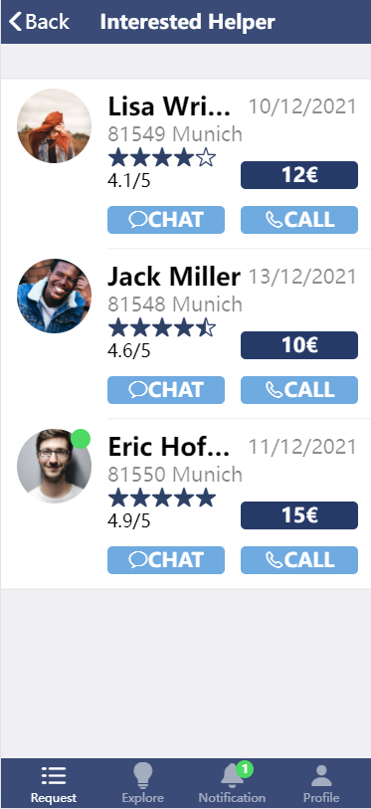
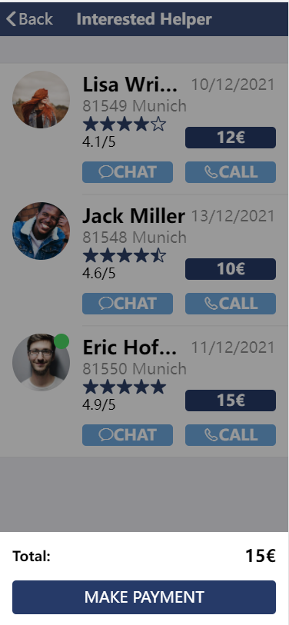
Improvements
Demonstration of HiFi Web App
Experimental Design
Payment function
User can directly pay for request
Lisa Weinmann, Jiexiang Shu, Runcong Chen | Fantastic Trio | Craftive App | 19.01.22

Slide 7
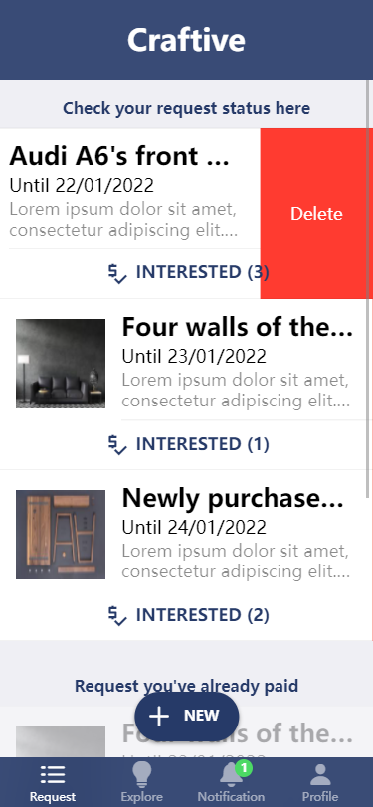
Improvements
Demonstration of HiFi Web App
Experimental Design
Delete request
Add function of deleting request
Lisa Weinmann, Jiexiang Shu, Runcong Chen | Fantastic Trio | Craftive App | 19.01.22

Slide 8
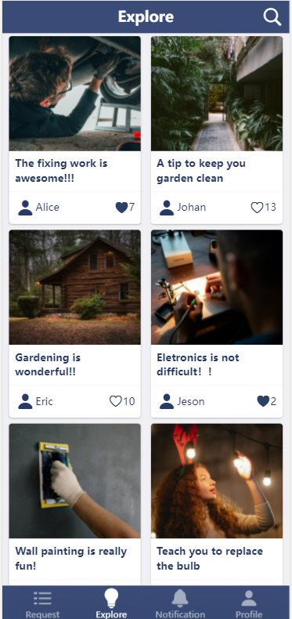
Improvements
Demonstration of HiFi Web App
Experimental Design
Aesthetic designs
New design for ‘Explore’ page
Lisa Weinmann, Jiexiang Shu, Runcong Chen | Fantastic Trio | Craftive App | 19.01.22

Slide 9
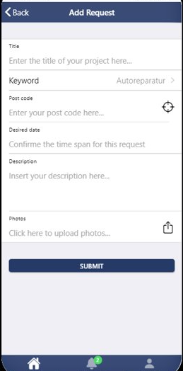
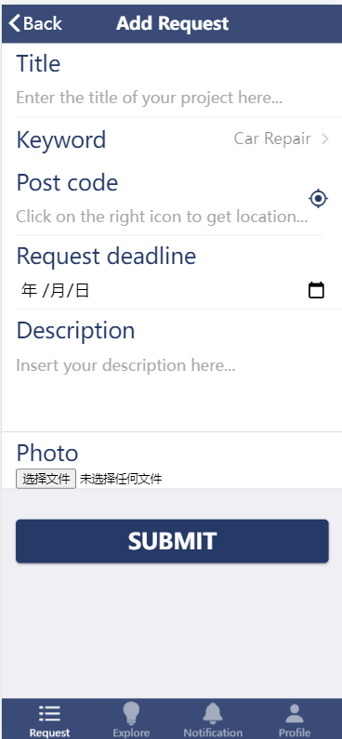
Improvements
Demonstration of HiFi Web App
Experimental Design
Aesthetic designs
Change some icons
Change font-size
Change color of buttons
…
Lisa Weinmann, Jiexiang Shu, Runcong Chen | Fantastic Trio | Craftive App | 19.01.22

Slide 10
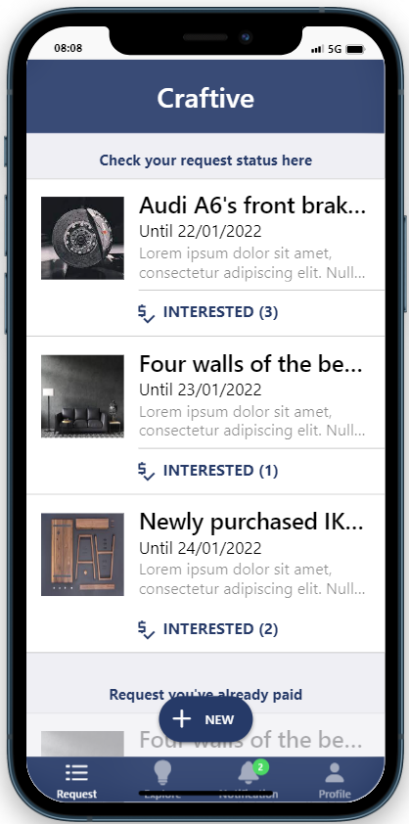
Improvements
Demonstration of HiFi Web App
Experimental Design
Demonstration of HiFi Web App
Link to the web prototype: http://192.168.2.214:3000/
Homepage of the APP
Lisa Weinmann, Jiexiang Shu, Runcong Chen | Fantastic Trio | Craftive App | 19.01.22

Slide 11
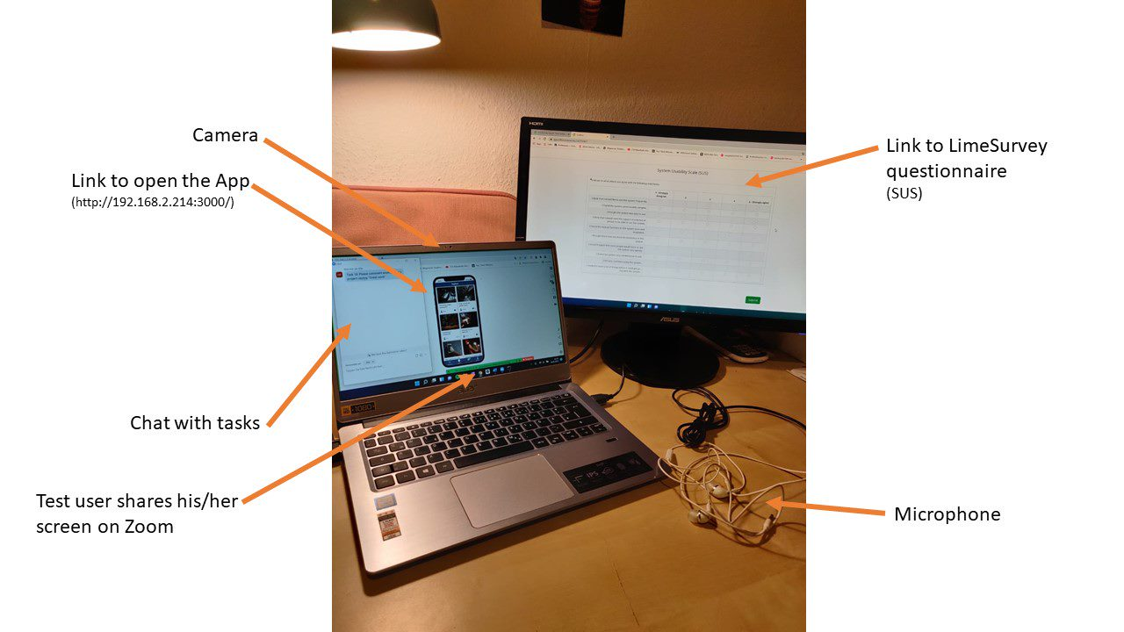
Improvements
Demonstration of HiFi Web App
Experimental Design
Experimental Design
Experimental Procedure-
Part 1
30 minutes per session, 10 test users
Experimenter not allowed to help
Experiment Setup
Starting point: opening the app by the test user
Test user will get the tasks via the chat function & will be read out loud
Lisa Weinmann, Jiexiang Shu, Runcong Chen | Fantastic Trio | Craftive App | 19.01.22

Slide 12
Improvements
Demonstration of HiFi Web App
Experimental Design
Experimental Design – Hypothesis & Metrics
Component | Hypothesis Example | Objective measures
1. Learnability | 1.2 The user can complete the creation of a second request faster than the creation of the first request. | The ratio between the number of cases in which the statement is true and the number of cases in which it is false. (No =0, Yes = 1)
2. Effectiveness | 2.2 At least 78% of the test persons manage the task of deleting a request. | The ratio between the number of tasks completed successfully and the total number of tasks undertaken.
3. Efficiency | 3.1 The average time of creating a new request (high level performance task) does not exceed 100 seconds. | The time users take to complete a specific task.
Lisa Weinmann, Jiexiang Shu, Runcong Chen | Fantastic Trio | Craftive App | 19.01.22

Slide 13
Improvements
Demonstration of HiFi Web App
Experimental Design
Quantitative Evaluation – Hypothesis & Metrics
Component | Hypothesis Example | Objective measures
4. Memorability | 4.1 60% of the test persons can remember the steps to fulfill the task of texting a possible helper during a debriefing after the test. | Ratio between the number of users who can remember the steps for fulfilling a specific task and the number of users who cannot.
5. Errors | 5.1 At most 70% of the test persons will make an error while commenting a specific project on the first try. | Ratio between the users who will make an error fulfilling a task and the users who will not.
6. Subjective Satisfaction | 6.1 The prototype achieves at least a rating of 6 out of 10 on average. | Rating number
Lisa Weinmann, Jiexiang Shu, Runcong Chen | Fantastic Trio | Craftive App | 19.01.22

Slide 14
Improvements
Demonstration of HiFi Web App
Experimental Design
Experimental Design – Test cases
Task | Instruction
Task 2 | Please release a request with the following dates: Title: Paint walls of my kitchen Keyword: Painting works Post Code: 80995 Request deadline: 02.02.2022 Description: Can someone help me painting the walls in my kitchen? Photo: you don´t have to select one
Task 4 | Please select one person to help you with the problem of Audi A6´s front brakes and fulfill the steps to enter into the deal
Task 8 | Please check the rating of a user´s profile
Task 10 | Please comment another user´s project saying “Great work”
Task 11 | Please have a look at the amount of projects you liked with your own profile
Task 14 | Please name as many system features (functionalities) of the app that you remember. You have 30 seconds to do this.
Lisa Weinmann, Jiexiang Shu, Runcong Chen | Fantastic Trio | Craftive App | 19.01.22

Slide 15
Improvements
Demonstration of HiFi Web App
Experimental Design
Experimental Design
Experimental Procedure - Part 2
Test user will get link to LimeSurvey questionnaire (SUS)
Experiment will be video recorded --> data collection afterwards
Data collection: speech observation, time measurement, counting events
Compiling data in Excel and analyzing with SPSS
Lisa Weinmann, Jiexiang Shu, Runcong Chen | Fantastic Trio | Craftive App | 19.01.22

Slide 16
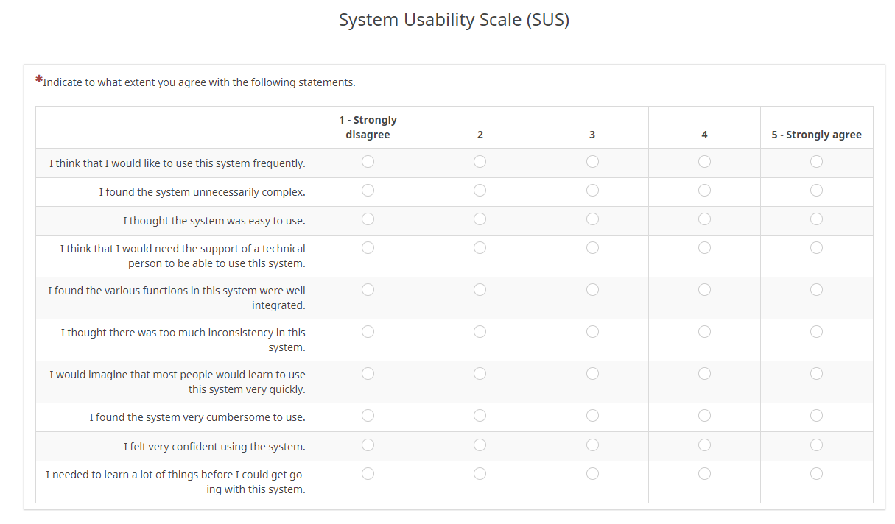
Improvements
Demonstration of HiFi Web App
Experimental Design
Experimental Design - Metrics
Subjective measures
System Usability Scale (SUS) by Brooke (1996)
Advantages
Simple and short questionnaire; not too in-depth
Can be used on small sample sizes with reliable results
Lisa Weinmann, Jiexiang Shu, Runcong Chen | Fantastic Trio | Craftive App | 19.01.22

Slide 17
Improvements
Demonstration of HiFi Web App
Experimental Design
Experimental Design - Quantitative Criteria
Hypothesis Example | Objective measures | Quantitative Criteria (Treshold value)
1.2 The user can complete the creation of a second request faster than the creation of the first request. | The ratio between the number of cases in which the statement is true and the number of cases in which it is false. (No =0, Yes = 1) | Number ≥ 60% --> subjective estimate (above-average)
2.2 At least 78% of the test persons manage the task of deleting a request. | The ratio between the number of tasks completed successfully and the total number of tasks undertaken. | Ratio (Effectiveness) ≥ 0.78 --> Basis: Literature: average task completion rate is 78%
3.1 The average time of creating a new request (high level performance task) does not exceed 100 seconds. | The time users take to complete a specific task. | Time ≤ 100 seconds --> Basis: Test run
5.1 At most 70% of the test persons will make an error while commenting a specific project on the first try. | Ratio between the users who will make an error fulfilling a task and the users who will not. | Ratio (Errors) ≤ 0.7 --> Basis: Literature: average number of errors per task is 70%
Lisa Weinmann, Jiexiang Shu, Runcong Chen | Fantastic Trio | Craftive App | 19.01.22

Slide 18
Improvements
Demonstration of HiFi Web App
Quantitative Evaluation
THANK YOU!
And looking forward to your FEEDBACK!
Lisa Weinmann, Jiexiang Shu, Runcong Chen| Fantastic Trio | Craftive App | 19.01.22

