Slide 1


Craftive App: The creative Craftsman
– IPP Presentation M3
Fantastic Trio: Lisa Weinmann, Jiexiang Shu, Runcong Chen
Technische Universität München
Munich, 15.12.2021
Source: Mann Für Mit Tools Stockfoto und mehr Bilder von Handwerker - iStock (istockphoto.com)

Slide 2
Content
Frameworks
Demonstration of Web Prototype
Qualitative Evaluation
Source: Mann Für Mit Tools Stockfoto und mehr Bilder von Handwerker - iStock (istockphoto.com)
Lisa Weinmann, Jiexiang Shu, Runcong Chen | Fantastic Trio | Craftive App | 15.12.21

Slide 3
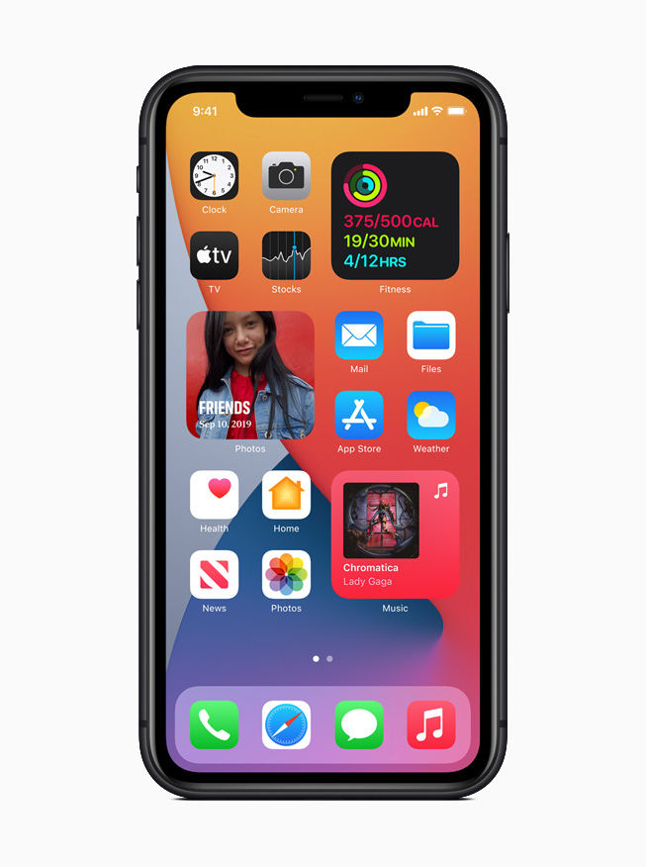
Frameworks
Web Prototype
Qualitative Evaluation
Goals
Platform: IOS
Easy to adapt to equipment
Easy to test
Product more marketable
Source:https://www.apple.com/newsroom/images/product/os/ios/standard/Apple_iphone11_ios14-springboard-widgets_09162020_inline.jpg.large.jpg
Lisa Weinmann, Jiexiang Shu, Runcong Chen | Fantastic Trio | Craftive App | 15.12.21

Slide 4

Frameworks
Web Prototype
Qualitative Evaluation
Frameworks
Framework7
Based on design on IOS and Android
Can use CLI quickly to create structure
Has a large number of components
Source:https://framework7.io/i/share-banner.jpg
Lisa Weinmann, Jiexiang Shu, Runcong Chen | Fantastic Trio | Craftive App | 15.12.21

Slide 5

Frameworks
Web Prototype
Qualitative Evaluation
Programming Language
Vue
Simple and easy to understand
Match well with Framework7
Is a common and popular programming language in the enterprise
https://www.positivethinking.tech/wp-content/uploads/2021/01/Logo-Vuejs.png
Lisa Weinmann, Jiexiang Shu, Runcong Chen | Fantastic Trio | Craftive App | 15.12.21

Slide 6
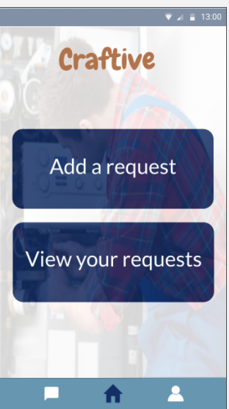
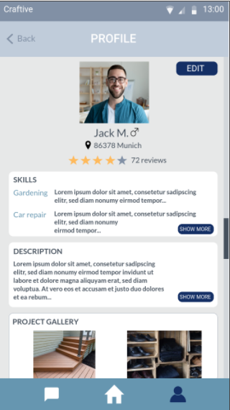
Frameworks
Web Prototype
Qualitative Evaluation
Style Of Prototype
Platform: Marvel Prototype
Choose theme color: #263a68
Contrast:
Background color:
Badge color:
Choose appropriate font and font size
Change the inappropriate user flow
11.12:1 > 3:1*
6.04:1 > 3:1*
* Minimum contrast according to ISO 9231-303: Ergonomics of human-system interaction
Lisa Weinmann, Jiexiang Shu, Runcong Chen | Fantastic Trio | Craftive App | 15.12.21

Slide 7
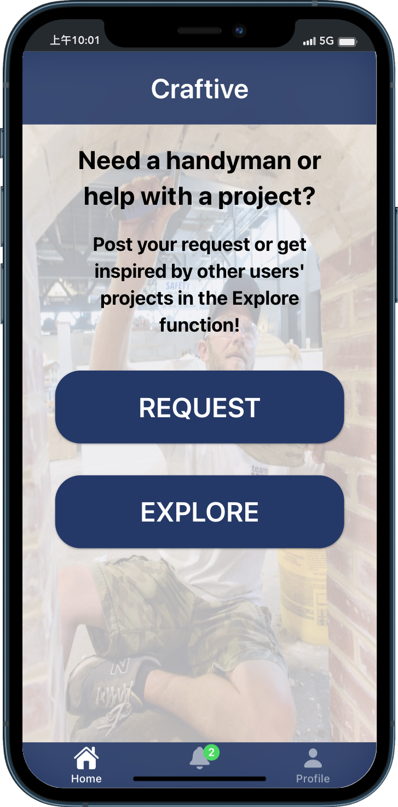
Frameworks
Web Prototype
Qualitative Evaluation
Demonstration of Web Prototype
Analog equipment: iPhone 12 PRO(IOS 14)
Viewport resolution (CSS rules)
Width: 390 pixels
Height: 844 pixels
For more details, please see the web prototype: http://192.168.2.214:3000/
Homepage of APP
Lisa Weinmann, Jiexiang Shu, Runcong Chen | Fantastic Trio | Craftive App | 15.12.21

Slide 8

Frameworks
Web Prototype
Qualitative Evaluation
Qualitative Evaluation
Evaluation Criteria/Aspects
Missing/unnecessary functions
Understandable designs
General "User Flow"
Source: https://usabilitygeek.com/wp-content/uploads/2018/06/smart-ux-use-cases-lead.jpg
Lisa Weinmann, Jiexiang Shu, Runcong Chen | Fantastic Trio | Craftive App | 15.12.21

Slide 9
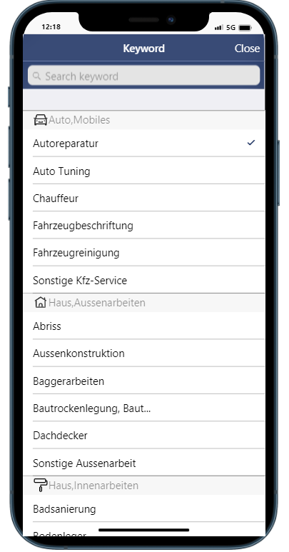
Frameworks
Web Prototype
Qualitative Evaluation
Qualitative Evaluation: Missing/unnecessary functions
Additional submit buttons
Modify pop-up notifications
Lisa Weinmann, Jiexiang Shu, Runcong Chen | Fantastic Trio | Craftive App | 15.12.21

Slide 10
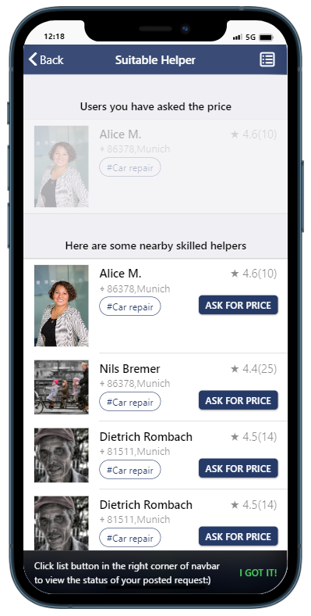
Frameworks
Web Prototype
Qualitative Evaluation
Qualitative Evaluation: Missing/unnecessary functions
Additional submit buttons
Modify pop-up notifications
Lisa Weinmann, Jiexiang Shu, Runcong Chen | Fantastic Trio | Craftive App | 15.12.21

Slide 11
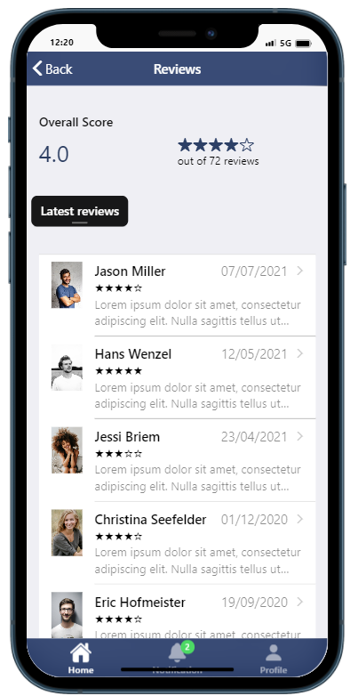
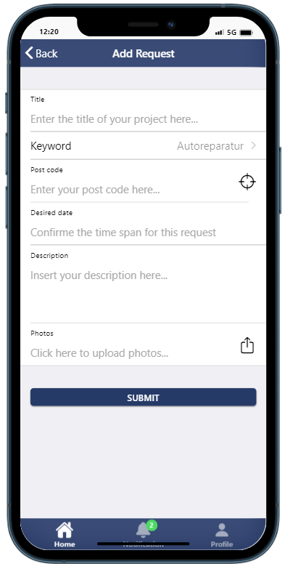
Frameworks
Web Prototype
Qualitative Evaluation
Qualitative Evaluation: Understandable designs
Functionalities of buttons not recognized
"Location" icon when entering zip code
Lisa Weinmann, Jiexiang Shu, Runcong Chen | Fantastic Trio | Craftive App | 15.12.21

Slide 12
Frameworks
Web Prototype
Qualitative Evaluation
Qualitative Evaluation: Understandable designs
Functionalities of buttons not recognized
"Location" icon when entering zip code
Lisa Weinmann, Jiexiang Shu, Runcong Chen | Fantastic Trio | Craftive App | 15.12.21

Slide 13
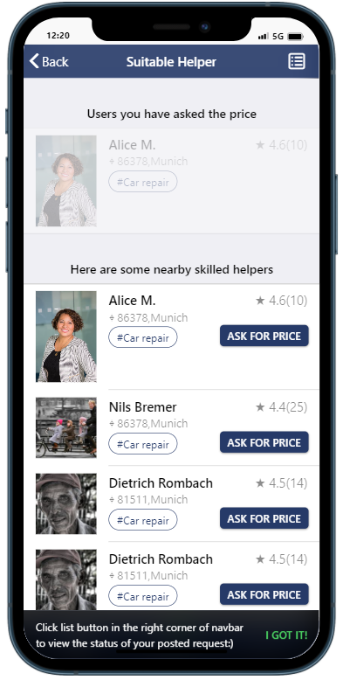
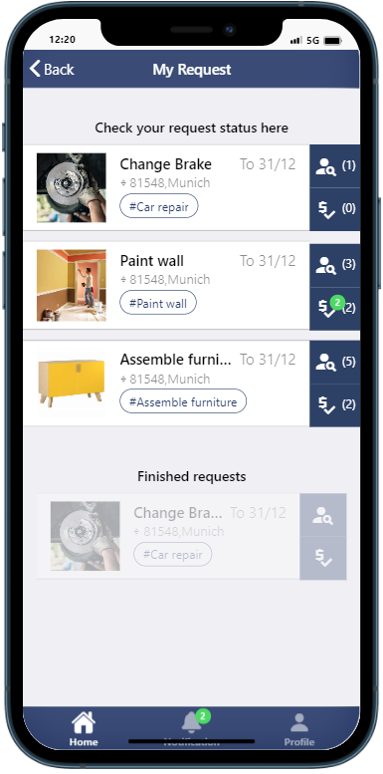
Frameworks
Web Prototype
Qualitative Evaluation
Qualitative Evaluation: "User Flow"
Main focus on functionalities of "Ask for price" and "See offer"
Lisa Weinmann, Jiexiang Shu, Runcong Chen | Fantastic Trio | Craftive App | 15.12.21

Slide 14
Frameworks
Web Prototype
Qualitative Evaluation
THANK YOU!
And looking forward to your FEEDBACK!
Lisa Weinmann, Jiexiang Shu, Runcong Chen| Fantastic Trio | Craftive App | 15.12.21

