Slide 1


Craftive App: The creative Craftsman
– IPP Presentation M1
Fantastic Trio: Lisa Weinmann, Jiexiang Shu, Runcong Chen
Technische Universität München
Munich, 10.11.2021
Source: Mann Für Mit Tools Stockfoto und mehr Bilder von Handwerker - iStock (istockphoto.com)

Slide 2
Content
Qualitative Research
Personas and Scenarios
LoFi Paper Prototyping
Usability Experiment
Source: Mann Für Mit Tools Stockfoto und mehr Bilder von Handwerker - iStock (istockphoto.com)
Lisa Weinmann, Jiexiang Shu, Runcong Chen| Fantastic Trio | Craftive App | 10.11.21

Slide 3

Qualitative Research
Personas and Scenarios
LoFi Paper Prototyping
Usability Experiment
Interview
Participants: 6
Identify: Students, Employees, Retired
Nationality: Germany, China
Content: Demands, Functions, Concerns
Source: business-interview-illustration-vector-id977762310 (612×612) (istockphoto.com)
Lisa Weinmann, Jiexiang Shu, Runcong Chen| Fantastic Trio | Craftive App | 10.11.21

Slide 4



Qualitative Research
Personas and Scenarios
LoFi Paper Prototyping
Usability Experiment
Results
Functions
Demands
Concerns
All the Interviewees would like to use Craftive App
Some Interviewees want to have explore function
For elderly people, they prefer to contact by phone rather than typing
…
Release the request and accept the order
Exploring function to get inspiration
Calling function
Find Craftsman/request by categories
Evaluation and rating system
…
Female and elderly interviewees will be more concerned about safety
Some people concern about help-provider’s professional competence
…
Lisa Weinmann, Jiexiang Shu, Runcong Chen| Fantastic Trio | Craftive App | 10.11.21

Slide 5
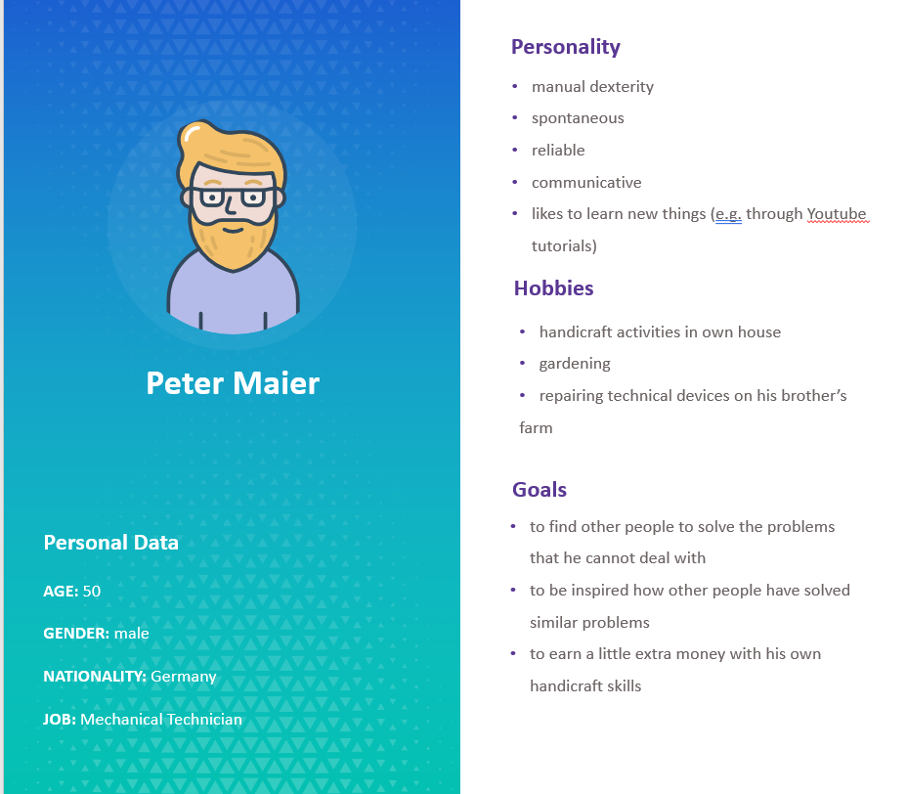
Qualitative Research
Personas and Scenarios
LoFi Paper Prototyping
Usability Experiment
Personas and Scenarios
Specialist of craft
Earn extra money
Willing to find new idea
Lisa Weinmann, Jiexiang Shu, Runcong Chen| Fantastic Trio | Craftive App | 10.11.21
Notes:
We want to know:
Who they are
What they like
Why they use the App
When they use the App

Slide 6
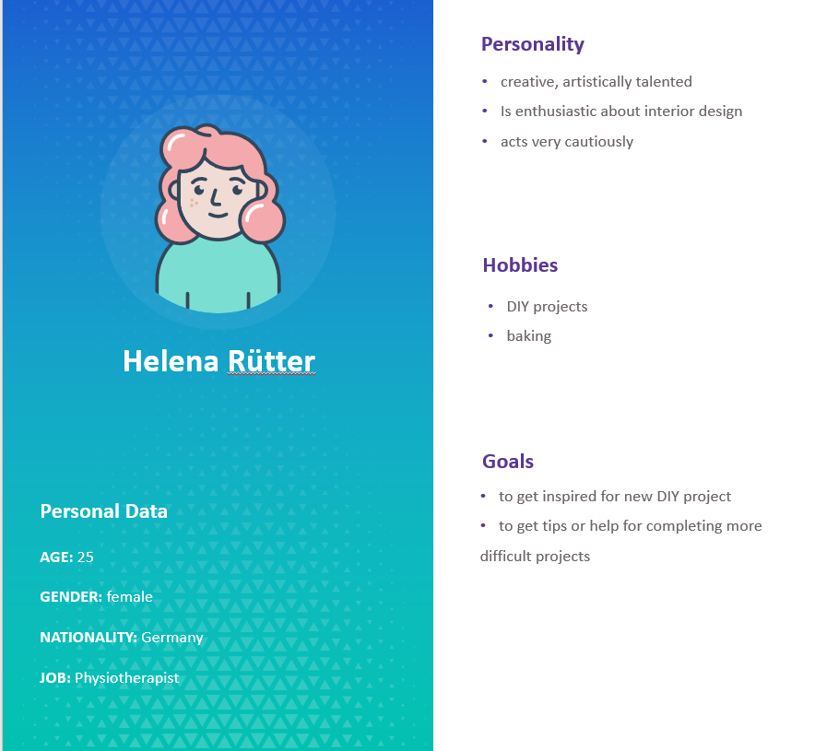
Qualitative Research
Personas and Scenarios
LoFi Paper Prototyping
Usability Experiment
Personas and Scenarios
Enthusiastic with craft work
Want to get inspiration of DIY
Find someone to help her Project
Lisa Weinmann, Jiexiang Shu, Runcong Chen| Fantastic Trio | Craftive App | 10.11.21

Slide 7
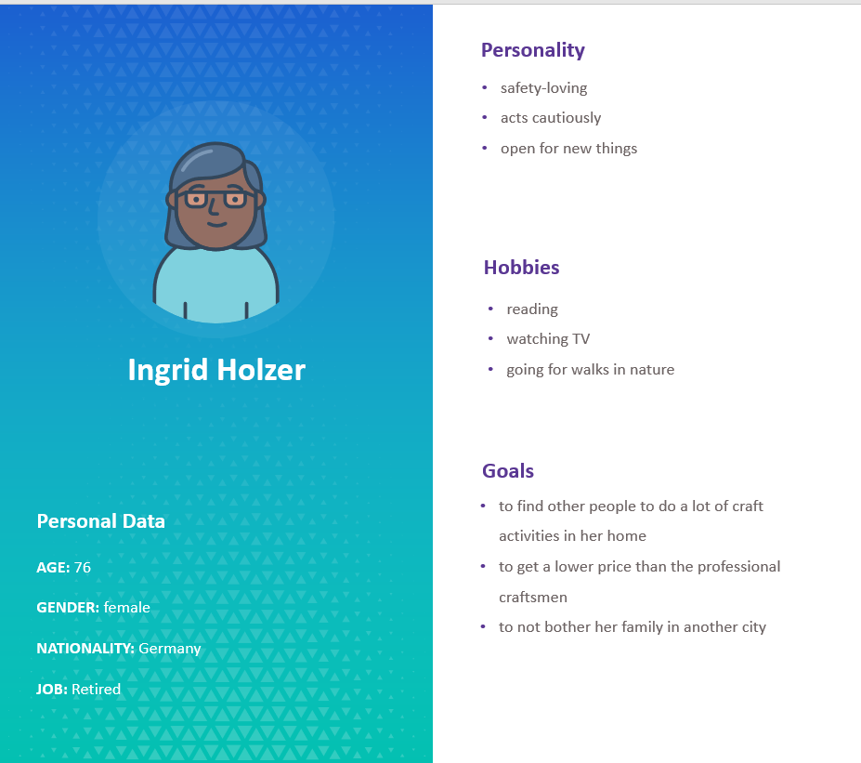
Qualitative Research
Personas and Scenarios
LoFi Paper Prototyping
Usability Experiment
Personas and Scenarios
No energy to do craft work
Want to enjoy the lower price
Cannot use the complex App
Lisa Weinmann, Jiexiang Shu, Runcong Chen| Fantastic Trio | Craftive App | 10.11.21

Slide 8

Qualitative Research
Personas and Scenarios
LoFi Paper Prototyping
Usability Experiment
Analysis of views
THE
ONE
Basis
The analysis bases on the results of qualitative results and personas
THE
TWO
Functions
The App has two core functions, “explore” and “request”
THE
THREE
Views
The App has eight different views to achieve all the functions
Lisa Weinmann, Jiexiang Shu, Runcong Chen| Fantastic Trio | Craftive App | 10.11.21

Slide 9
Qualitative Research
Personas and Scenarios
LoFi Paper Prototyping
Usability Experiment
Structure of views
Add request
Search craftsman
Browse profile
Contact craftsman
Notification
Use the keyword to find request
Edit my profile
Explore ideas
Lisa Weinmann, Jiexiang Shu, Runcong Chen| Fantastic Trio | Craftive App | 10.11.21

Slide 10
Qualitative Research
Personas and Scenarios
LoFi Paper Prototyping
Usability Experiment
Draw the views
Hardware:
iPad
Apple Pencil
Software:
Notability
PowerPoint
Lisa Weinmann, Jiexiang Shu, Runcong Chen| Fantastic Trio | Craftive App | 10.11.21

Slide 11
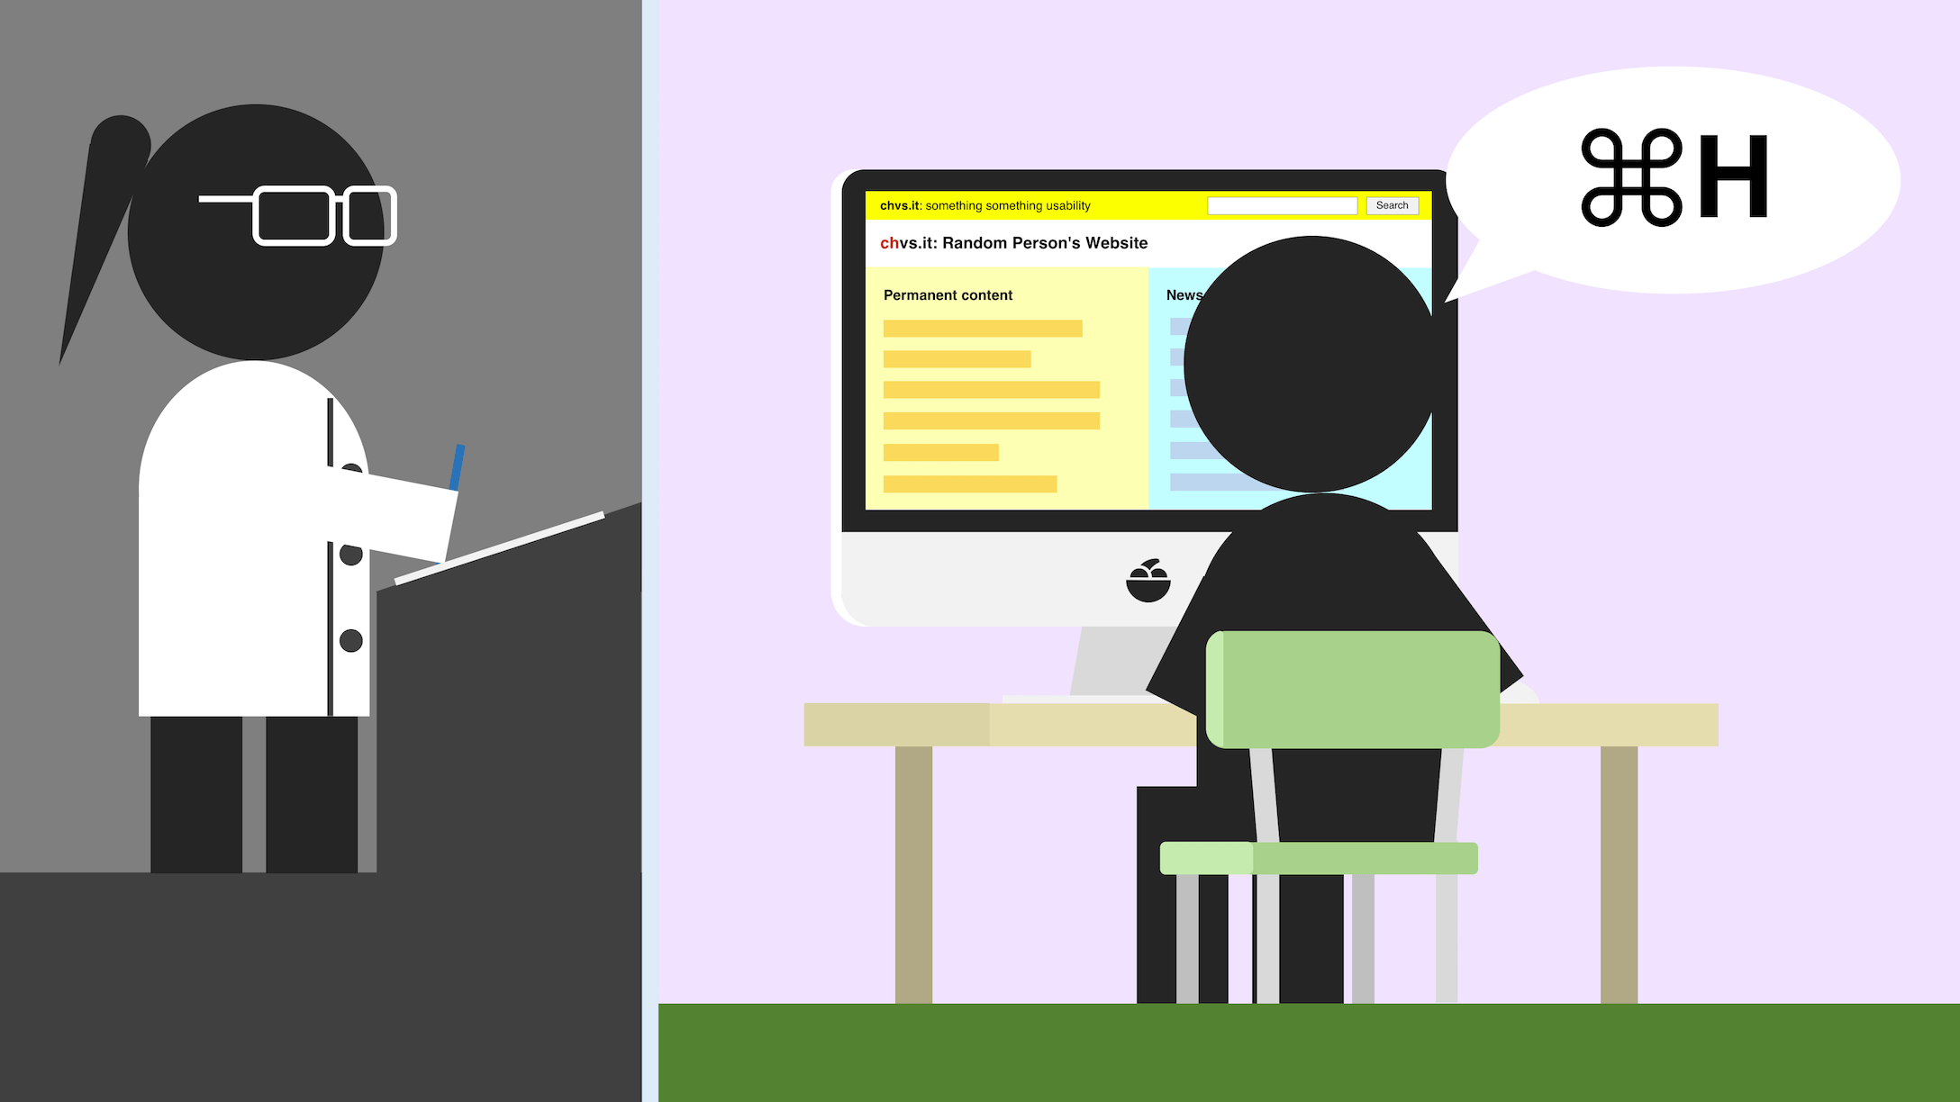
Qualitative Research
Personas and Scenarios
LoFi Paper Prototyping
Usability Experiment
Usability Experiment
Target:
Know the user experience of the App
Find improvements
Method:
Thinking aloud experiment
Source: 2176.webp (2176×1224) (chuniversiteit.nl)
Lisa Weinmann, Jiexiang Shu, Runcong Chen| Fantastic Trio | Craftive App | 10.11.21

Slide 12

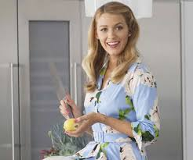

Qualitative Research
Personas and Scenarios
LoFi Paper Prototyping
Usability Experiment
Test group
Gender: male
Age: 22
Profession: mechatronics engineer
Gender: female
Age: 55
Profession: housewife
Gender: female
Age: 27
Profession: student
Lisa Weinmann, Jiexiang Shu, Runcong Chen| Fantastic Trio | Craftive App | 10.11.21

Slide 13
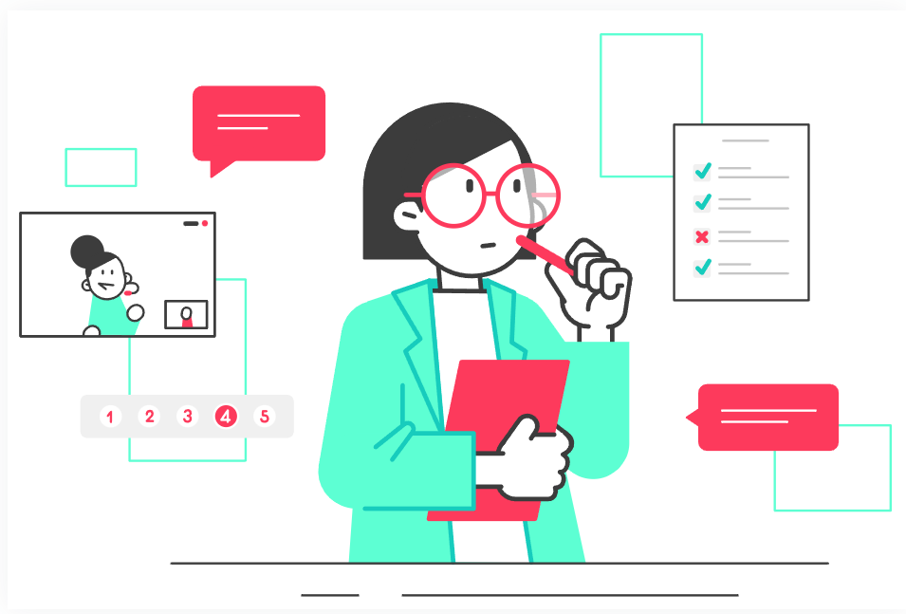
Qualitative Research
Personas and Scenarios
LoFi Paper Prototyping
Usability Experiment
Usability Report
Need to improvements:
Confusing names of button
Too many input boxes
Without a subdivision for “notification box”
Complex rating system
…
Source: images (275×183) (gstatic.com)
Lisa Weinmann, Jiexiang Shu, Runcong Chen| Fantastic Trio | Craftive App | 10.11.21

Slide 14
Qualitative Research
Personas and Scenarios
LoFi Paper Prototyping
Usability Experiment
THANKS
And looking forward to your FEEDBACK!
Lisa Weinmann, Jiexiang Shu, Runcong Chen| Fantastic Trio | Craftive App | 10.11.21

