Slide 1

Personality
Scenario
manual dexterity
spontaneous
reliable
communicative
likes to learn new things (e.g. through Youtube tutorials)
Peter Maier owns his own apartment building. A few weeks ago, the residents of a rented apartment moved out. Before looking for new tenants for the apartment, he partially renovated the apartment. Among other things, he installed a new parquet floor in the living room. Now he has some parquet flooring left over, which he now stores in the basement. Peter Maier has already had a profile in the app “Craftive" for several months, in which he has stated, among other things, that he can lay floors. One day, he receives a notification via the app “Craftive" that a person within a radius of 20km (which he set when he set up his profile) has placed an ad with the keyword "laying floors". A young family would like to lay a new floor in the children's room of their apartment, but they do not have the necessary tools and have never done anything like this before. Peter Maier comments on the ad and offers his help. Using the chat function, Peter Maier calls the father of the family to clarify details. He offers to bring the necessary tools and the remaining parquet floor. Although a price had been set in the ad, Peter Maier now quotes a higher price. Both find this only fair, since he also provides the materials. They agree on a date when Peter Maier will go to the family and do the agreed work.
After the work is done, Peter Maier publishes a photo of the final result in the app “Craftive" with some information about the material used and some tips that had to be taken into account when laying the floor. He is always pleased when these photos are liked or commented on by others.
The young family is very satisfied with Peter Maier's work and therefore leaves a positive rating on his profile in the form of a star rating and a comment.
Hobbies
handicraft activities in own house
gardening
repairing technical devices on his brother’s farm
Peter Maier
Goals
to find other people to solve the problems that he cannot deal with
to be inspired how other people have solved similar problems
to earn a little extra money with his own handicraft skills
Personal Data
AGE: 50
GENDER: male
NATIONALITY: Germany
JOB: Mechanical Technician

Slide 2
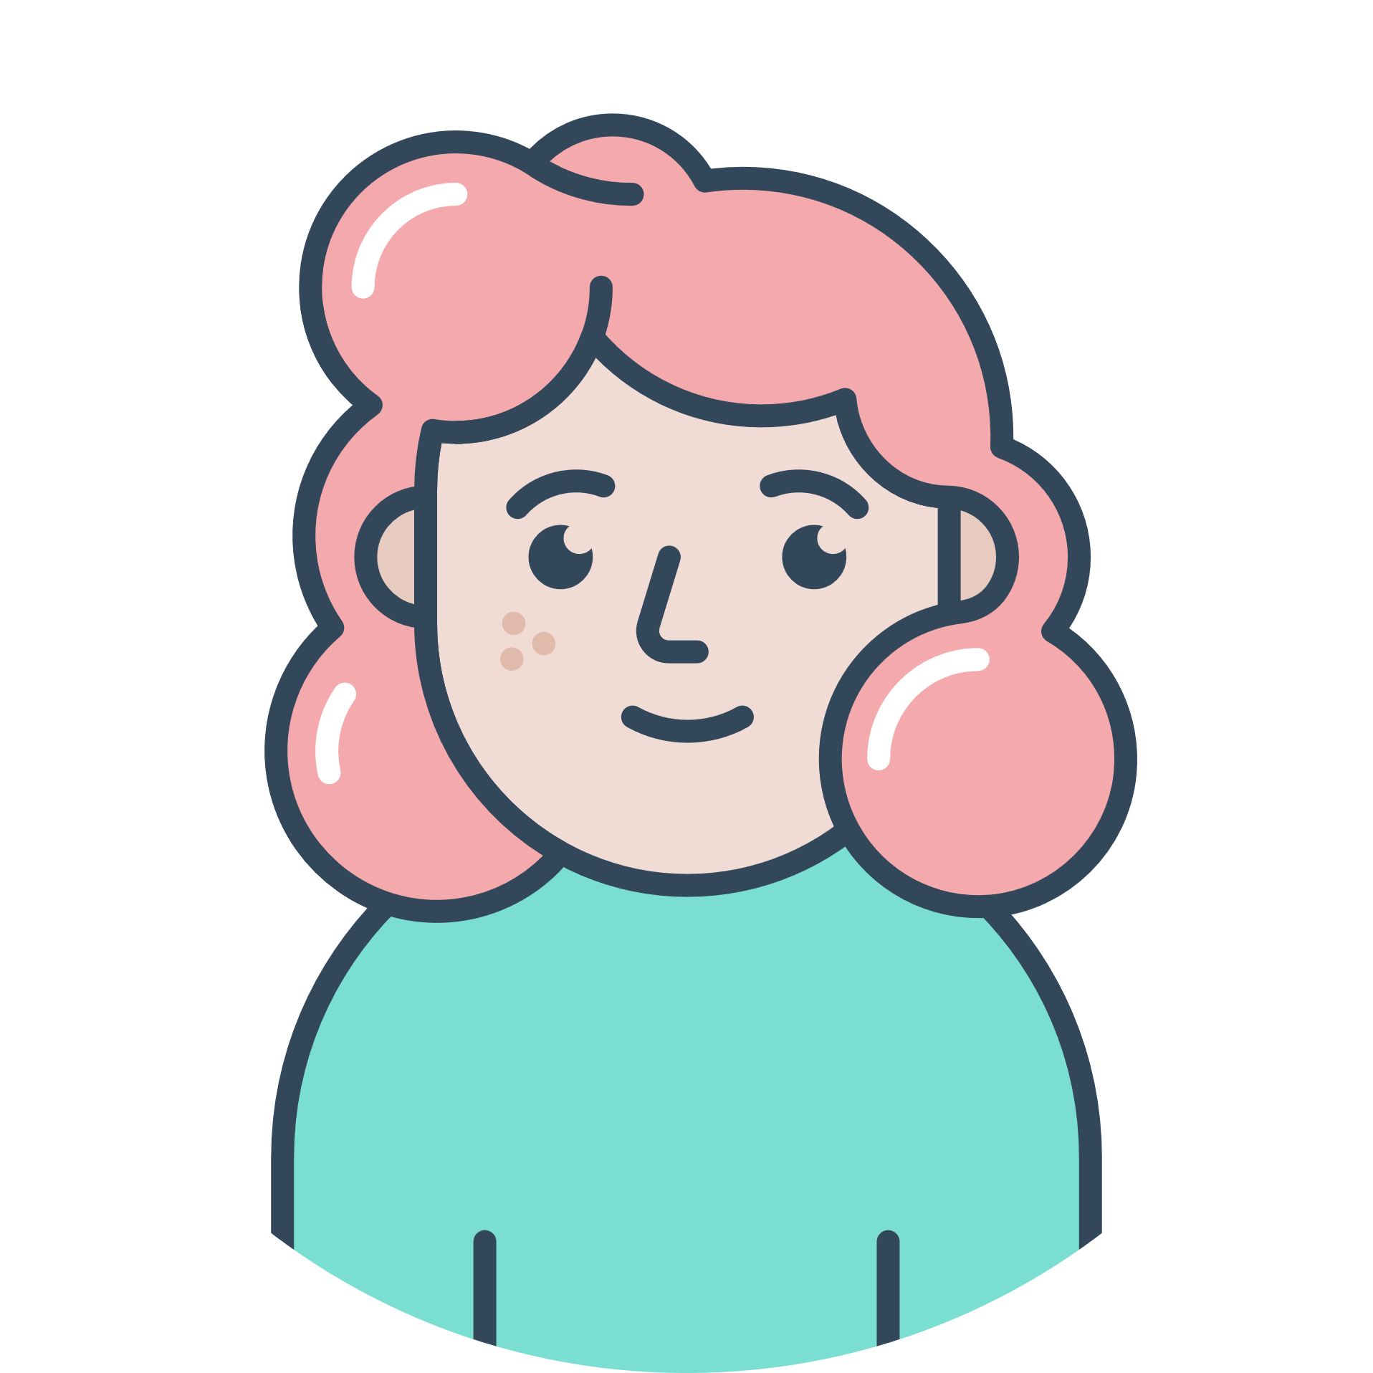
Personality
Scenario
creative, artistically talented
Is enthusiastic about interior design
acts very cautiously
Helena Rütter has moved to another city after completing her apprenticeship and into her first apartment of her own there. She has a lot of new furniture and has furnished everything according to her wishes. For the move, she got a beautiful old, high-quality solid wood closet as a gift from her grandma. She considers the closet an heirloom and really wants to keep it, however, she doesn‘t like all the details on the wardrobe. She is thinking of sanding the closet and maybe refinishing it or changing the arrangement of the compartments in the closet. Fortunately, a few weeks ago she came across an app called “Craftive” where she is now creating a profile. To do so, she entered her age, name and a brief description of herself. Optionally, she could now select some keywords from craft activities that she offers. However, since she does not want to offer any activities, she does not make a selection at this point. On the Exploring page of the app, she enters the term “closet” in the keyword search. She browses through the photos that other users have posted of their converted closets. She likes one closet in particular, so she writes to the person who posted the picture and asks for details about the process in the chat. Since the other user does not charge any money for his information, she gives him a positive rating via his profile. After exchanging ideas with the person, she now knows how to proceed and can put her project into action herself. After she has completed her closet project, she also posts a picture on the Exploring page.
Hobbies
DIY projects
baking
Helena Rütter
Goals
to get inspired for new DIY project
to get tips or help for completing more difficult projects
Personal Data
AGE: 25
GENDER: female
NATIONALITY: Germany
JOB: Physiotherapist

Slide 3

Personality
Scenario
safety-loving
acts cautiously
open for new things
Ingrid Holzer is already a bit older and unfortunately physically no longer able to do many activities. In her head, however, she is still very fit, and since she is open to new things and wants to keep up with the times, she bought a cell phone some time ago. Her family helped her set up the phone and she is now coping well with it. Recently, she now also owns a laptop. She wants to use it to Skype with her grandchildren, among other things. However, since her son and his family moved to another city a few weeks ago, they can't help her set up the laptop.
She has installed the app called “Craftive" on her cell phone, which she manages well. She posts an ad stating that she needs help setting up her new laptop. She also adds the information that female helpers are preferred. At the end of the ad, she also selects the category "IT" so that people who have specified this category as a skill in their profile will be notified about the new ad.
A young student responds to the ad and offers to help Ingrid Holzer. Using the telephone function in the chat, the two make an appointment. However, the young student does not show up on the day of the agreed appointment. Ingrid Holzer then leaves a negative rating on the student's profile, so that other users are warned of the student's unreliability. However, Ingrid Holzer does not give up and posts a new ad in the hope that this time a more reliable person will come forward.
Hobbies
reading
watching TV
going for walks in nature
Ingrid Holzer
Goals
to find other people to do a lot of craft activities in her home
to get a lower price than the professional craftsmen
to not bother her family in another city
Personal Data
AGE: 76
GENDER: female
NATIONALITY: Germany
JOB: Retired

