Slide 1

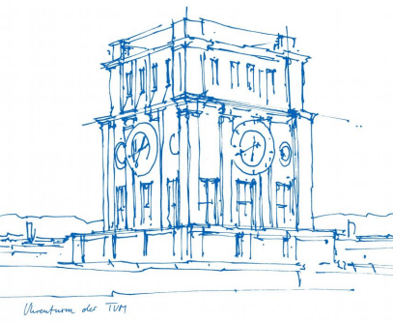
Interaction Prototyping
Lehrstuhl für Ergonomie TUM School of Engineering Design Technische Universität München
Ideas Generation
Vincent Brunner
Beatrice Seibert
Stefano Ferrari
Winter Semester 2021/2022

Slide 2
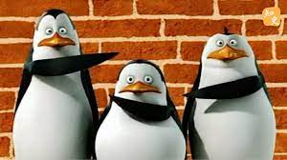
Who are we?
Beatrice Seibert
Vincent Brunner
Stefano Ferrari
→ Rolling Penguins
Vincent Brunner | Beatrice Seibert |Stefano Ferrari| IPD | Winter Semester 2021/2022
1

Slide 3
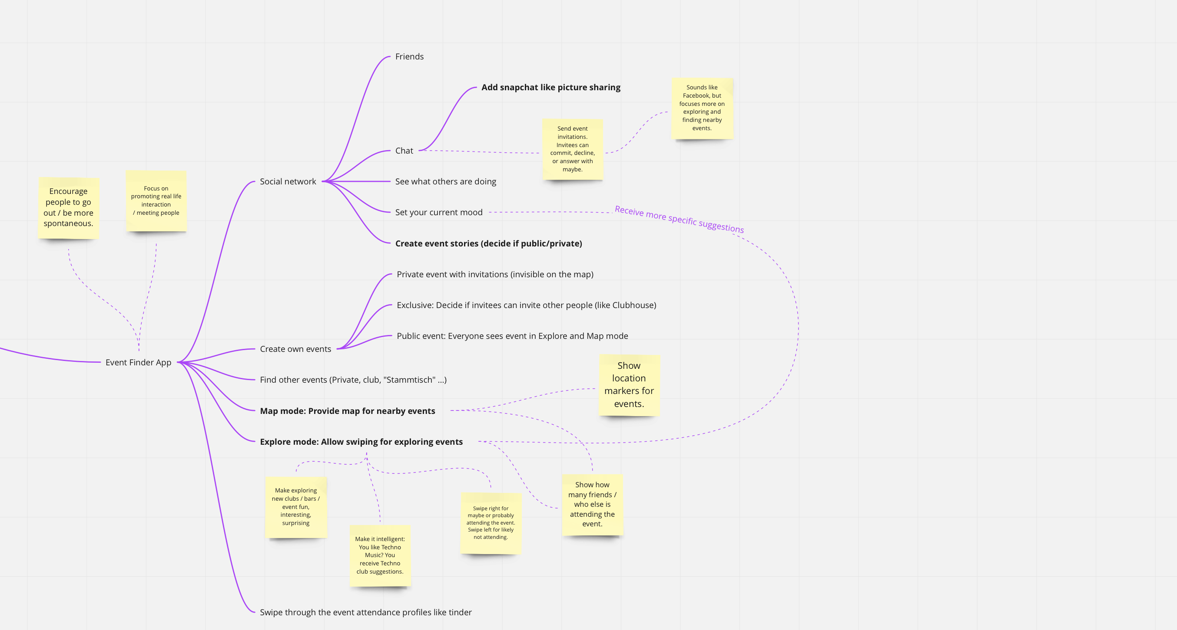
Event Finder
Goal
Find and attend events more spontaneously and out of your usual bubble.
Target Group
People with a smartphone with age 16 to 40.
Functions
Social Media, friends, chats
Create, invite to, and attend events
Explore or visit nearby events
Interaction
Swipe for exploring events
zoom and drag event map
create stories/snaps in the chat or profile
Vincent Brunner | Beatrice Seibert |Stefano Ferrari| IPD | Winter Semester 2021/2022
2

Slide 4
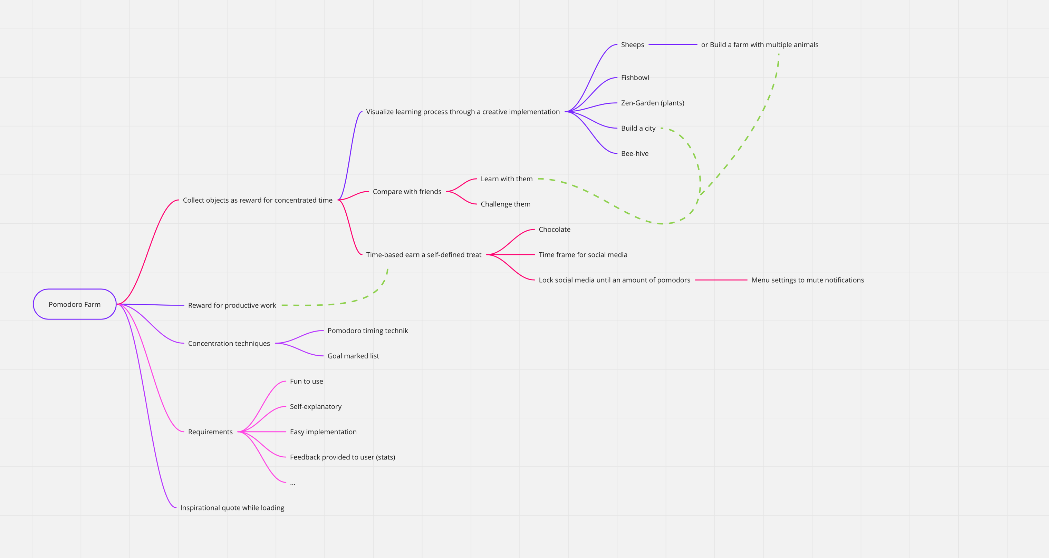
Pomodoro Farm
Goal
Improve working/studying efficiency through creative implementations of concentration techniques.
Target Group
People with a smartphone with age 14 to 30.
Functions
Fun to use, friends, reward your effort
Develop, achieve, and visualize results
Create your own mini world based on your input
Interaction
Set concentration techniques, modify and develop your own creations
Vincent Brunner | Beatrice Seibert |Stefano Ferrari| IPD | Winter Semester 2021/2022
3

Slide 5
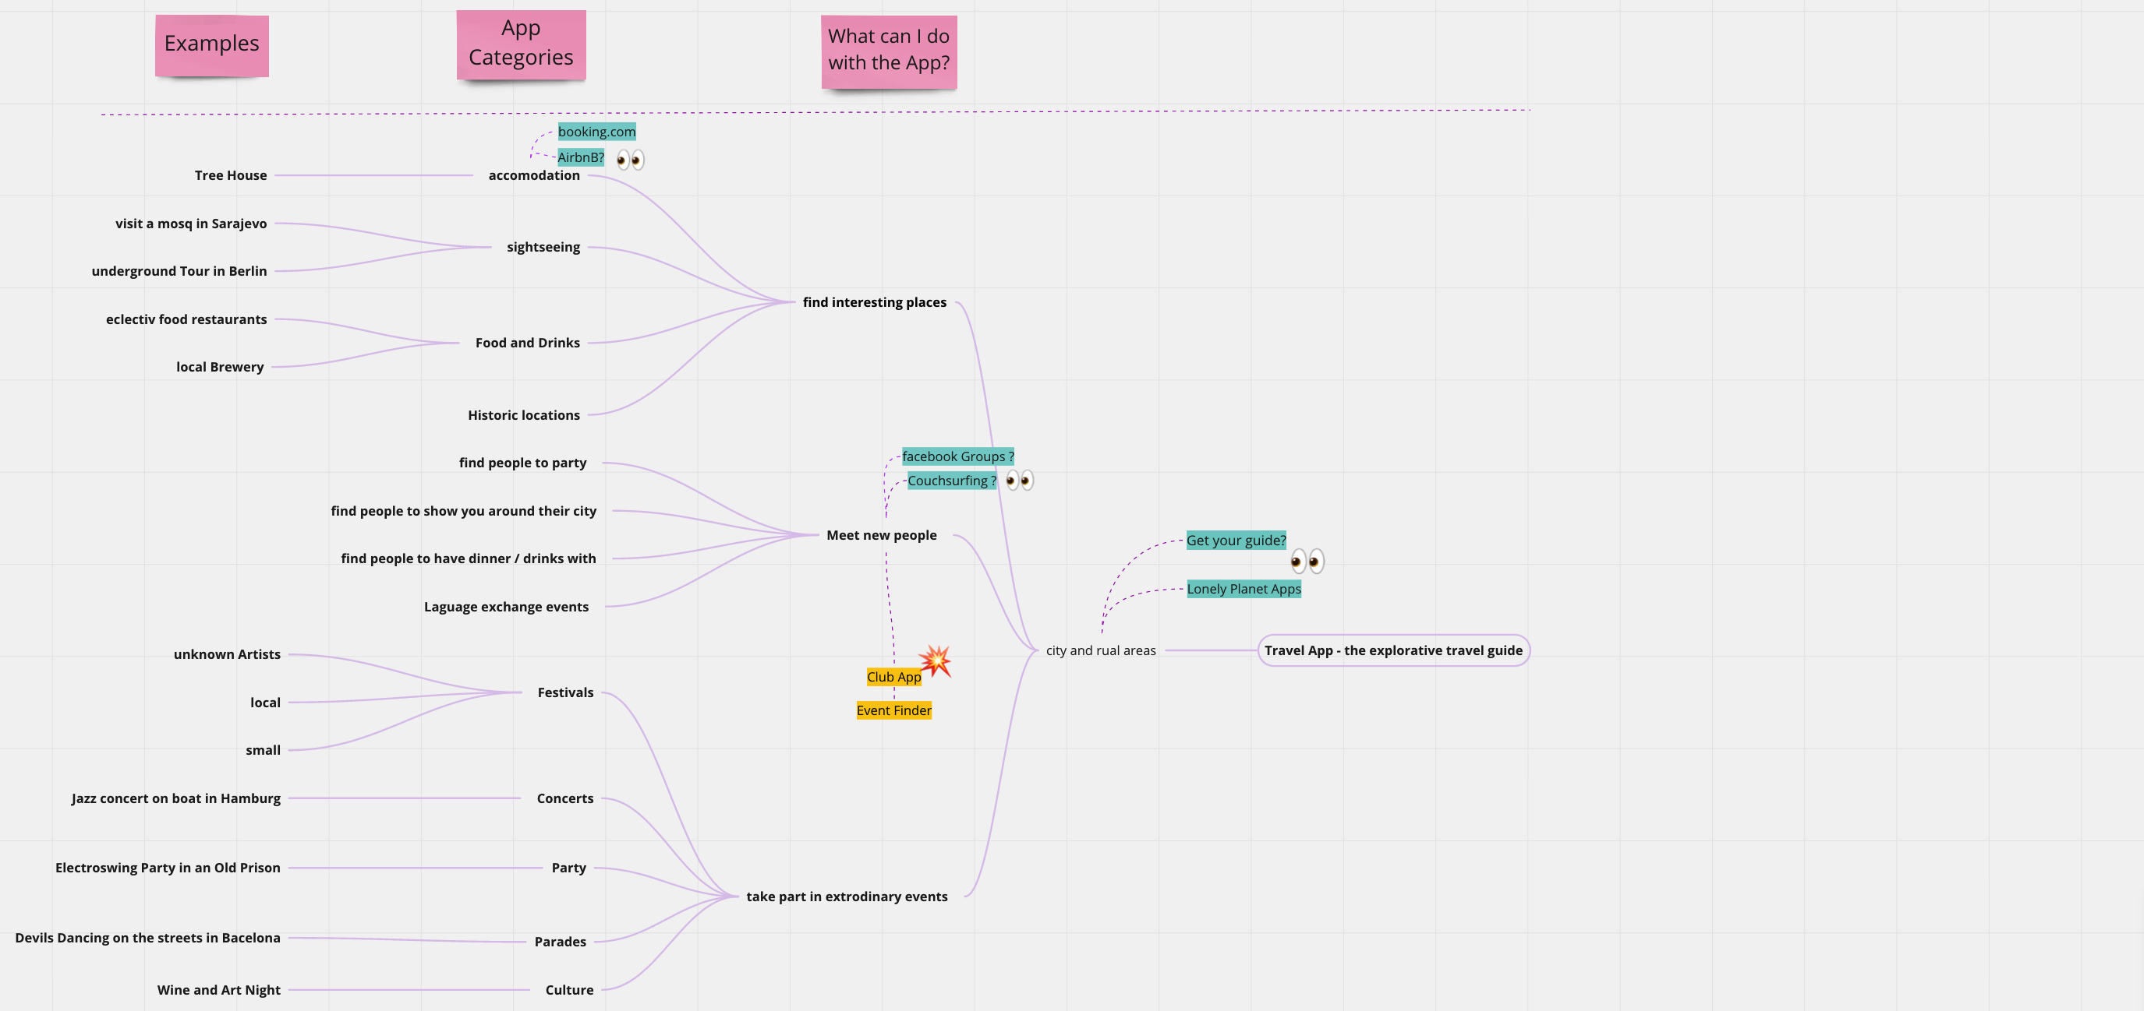
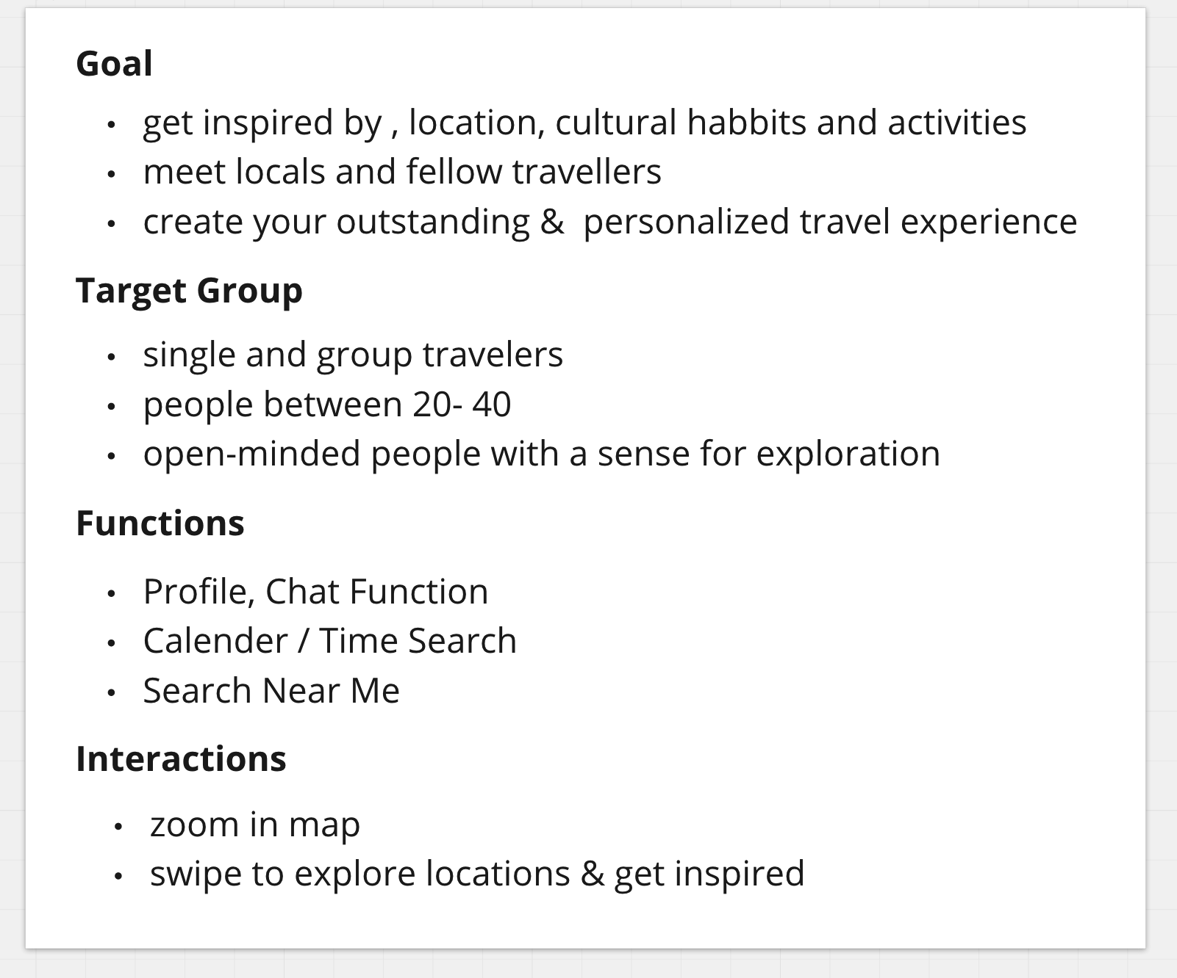
The Explorative Travel Guide
Vincent Brunner | Beatrice Seibert |Stefano Ferrari| IPD | Winter Semester 2021/2022
4

