Slide 1
FunTravel Milestone 2
Shuo Hua, Arina Mironova
1

Slide 2
Table of contents
01
Use Cases
02
Usability requirements
03
Prototype
04
Evaluation
Shuo Hua, Arina Mironova
2

Slide 3
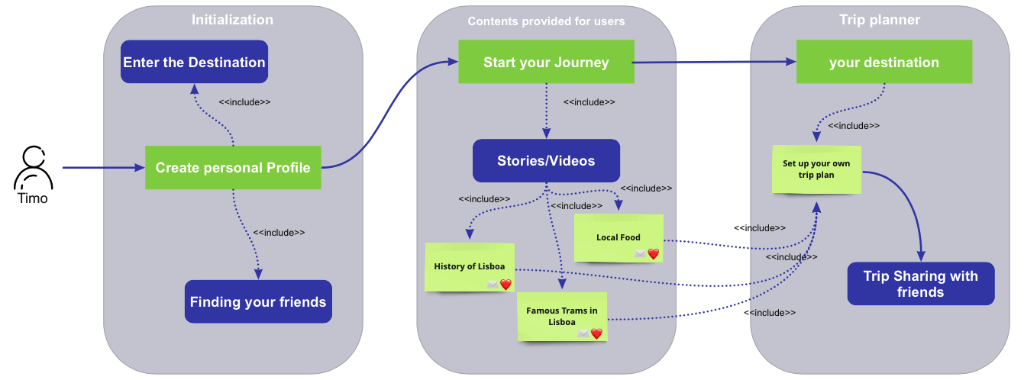
Use Cases
Shuo Hua, Arina Mironova
4

Slide 4
Usability requirements
We decided to keep 2 main functions ”reading stories” and “watching videos” based on the selected travel destination.
We define the usability requirements as following:
Colorful and memorable design of the app
Need and wish to learn more about different travel places
Need to be connected to the friends
Need to save destinations in one place
Need to be able to have stories and videos in one place
These requirements lead to additional functions of FunTravel App:
Save travel destinations
Share travel destinations with friends
Add new friends
Shuo Hua, Arina Mironova
4

Slide 5
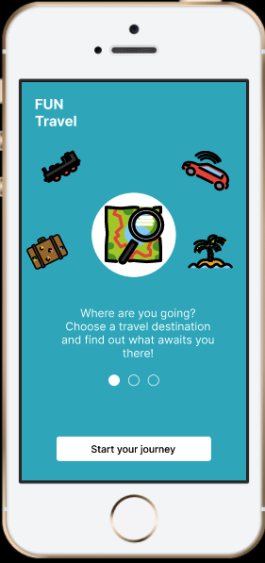
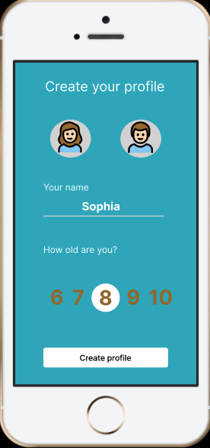
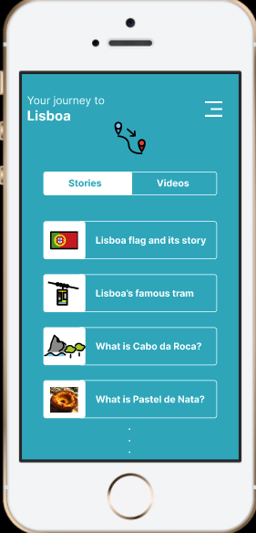
Prototype
Shuo Hua, Arina Mironova
4

Slide 6
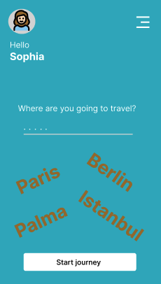
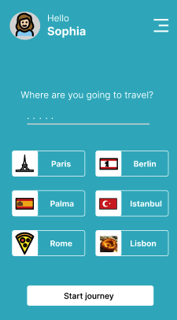
Heuristic Evaluation
City suggestions don’t look aesthetic
Use Flags and redesign the city icon to make it more attractive
Shuo Hua, Arina Mironova
5
Notes:
Car: 55%
Bus: 55% train: 22%
100% are having IPad
The most children are watching videos in youtube or play pre-downloaded games

Slide 7
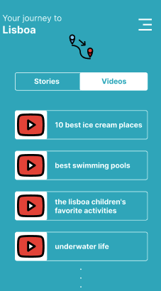
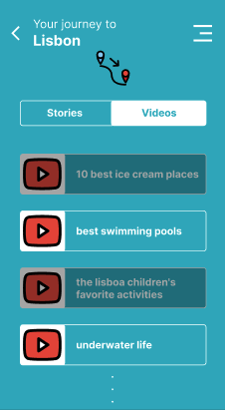
Heuristic Evaluation
Cannot tell the difference between the videos already watched and the videos still not watched
Add a shadow filter to the videos that have been watched by the users
Shuo Hua, Arina Mironova
5
Notes:
Car: 55%
Bus: 55% train: 22%
100% are having IPad
The most children are watching videos in youtube or play pre-downloaded games

Slide 8
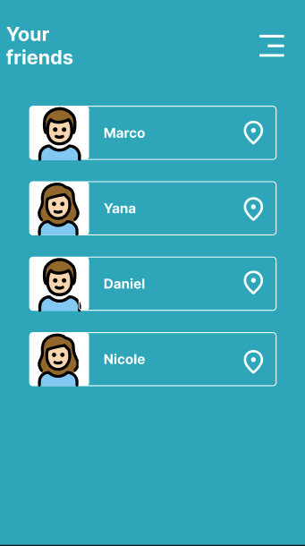
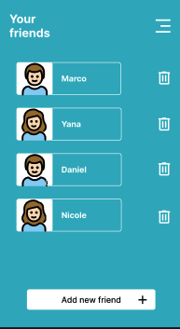
Heuristic Evaluation
There‘s no button for adding or deleting friends
Increase bin icon and “add new friends“ square for these two fuctions
Shuo Hua, Arina Mironova
5
Notes:
Car: 55%
Bus: 55% train: 22%
100% are having IPad
The most children are watching videos in youtube or play pre-downloaded games

Slide 9
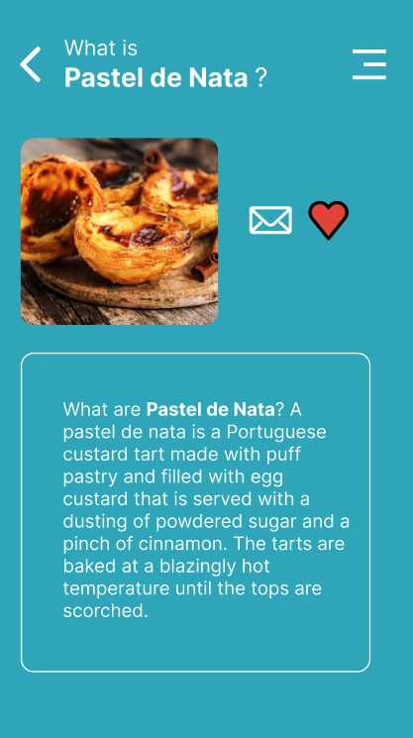
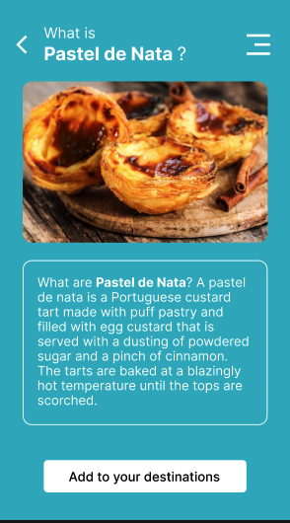
Heuristic Evaluation
Not clear about what the letter and heart icon mean/How to bookmark this story/video that I like?
Remove share and liking function in this interface and put “Add to your destination” square to provide bookmarking function
Shuo Hua, Arina Mironova
5
Notes:
Car: 55%
Bus: 55% train: 22%
100% are having IPad
The most children are watching videos in youtube or play pre-downloaded games

Slide 10
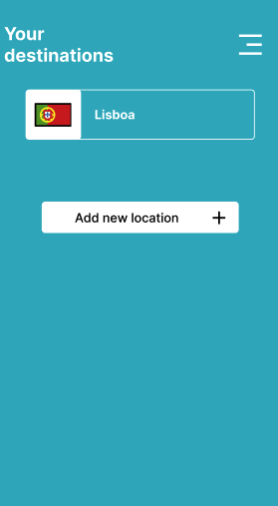
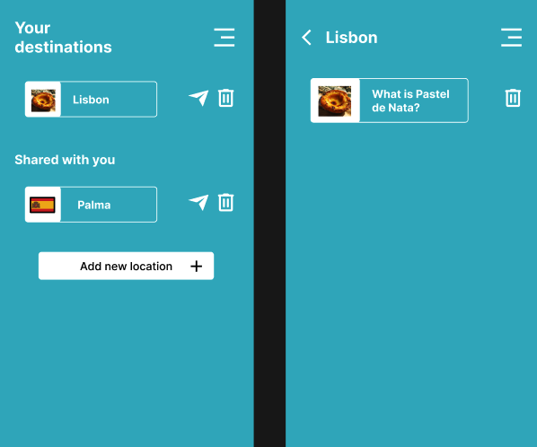
Heuristic Evaluation
Transfer sharing function to your destination part/Add bin icon to make the user edit his/her own trip plan
Shuo Hua, Arina Mironova
5
Notes:
Car: 55%
Bus: 55% train: 22%
100% are having IPad
The most children are watching videos in youtube or play pre-downloaded games

Slide 11
Thank you for your attention!

