Slide 1
Messy count data

Slide 2
Types of zeros
Structural zeros.
Design/sampling error.
3. Observer error
4. Smelt error
Notes:
1. Delta smelt are not caught because the habitat is not suitable (too hot, to clear, too salty).
2 Delta smelt are not caught because the midwater trawl doesn't sample the top part of the water well and smelt hang out near the surface.
3. Delta smelt were caught, but Rosie thought they were Wakasagi.
4. The habitat was suitable but the smelt weren't using it.

Slide 3
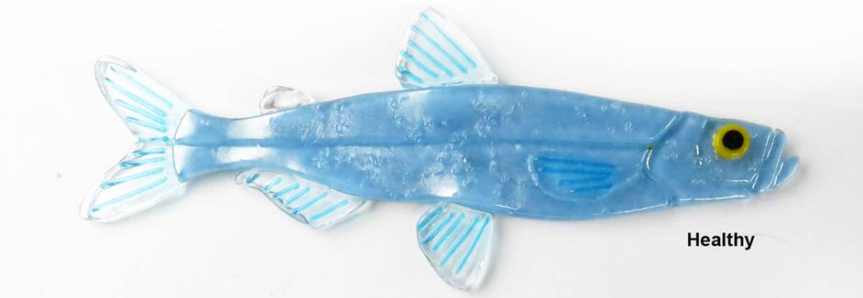
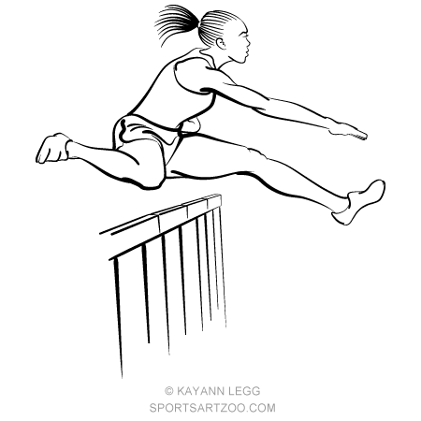
Hurdle (two-part) model
I am not here because the habitat is bad.
You thought I was a wakasagi
The habitat is good, but I’m not here
You trawled right under me and didn’t catch me
0 smelt
>0 smelt
Here I am!
Notes:
Sketch of a two-part, or hurdle model. There are two processes; one is causing zeros
versus non-zeros, the other process is explaining the non-zero counts. This is expressed with the
hurdle in the circle; you have to cross it to get non-zero counts. The model does not make a
distinction between the different types of zeros

Slide 4
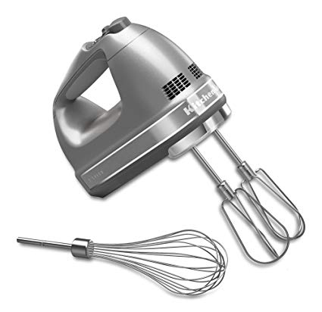
Zero-inflated (mixture) model
You thought I was a wakasagi
The habitat is good, but I’m not here
You trawled right under me and didn’t catch me
0 smelt
I am not here because the habitat is bad.
0 smelt
>0 smelt
Here I am!
Notes:
Sketch of the underlying principle of mixture models (ZIP and ZINB). In counting
hippos at sites, one can measure a zero because the habitat is not good (the hippos don’t like
the covariates), or due to poor experimental design and inexperienced observers (or experienced
observers but difficult to observe species)

