Slide 1
Creating an inventory of peer-reviewed scientific literature using
✨ LLMs ✨
IEP Data Science Project Work Team meeting
November 13, 2025
Lucy Andrews, PhD (lucy.andrews@water.ca.gov)

Slide 2
The Task
Create an inventory of peer-reviewed scientific publications to which DWR has contributed (authorship, funding).
Identify the nature of DWR's contributions.
Identify partners in publishing.
Classify publications by field using a custom taxonomy of disciplines.
Export the inventory as a user-friendly flat file.
Create a visualization front-end for DWR staff (and eventually the public) to interact with the inventory.

Slide 3
Complexities
Journals host primary metadata and serve the them via APIs with idiosyncratic structures.
A few centralizing services host or scrape metadata from journals to create comprehensive APIs that serve standardized metadata from far fewer endpoints, but metadata standardization is imperfect.
Some fields are served "as-is," rather than in analysis-friendly structures.
Cleaning and classifying publications requires working with unstructured text.

Slide 4
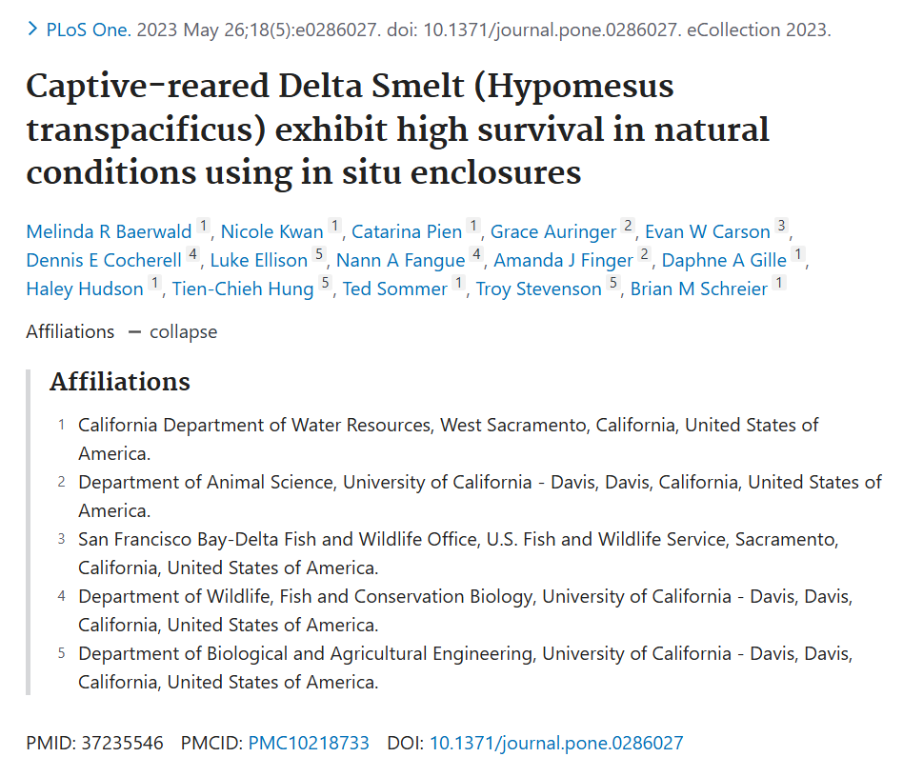
+ abstract
+ other metadata such as count of times cited

Slide 5
Activities and Approaches
Import, clean, and reshape data
API calls
Functional programming
Large language models
Classify publications
Large language models

Slide 6




Import, Clean, and Reshape: APIs
not yet...
Keyword searches in works metadata fields (e.g., "California Department of Water Resources" in author affiliation)
Funder unique identifier ( )

Slide 7
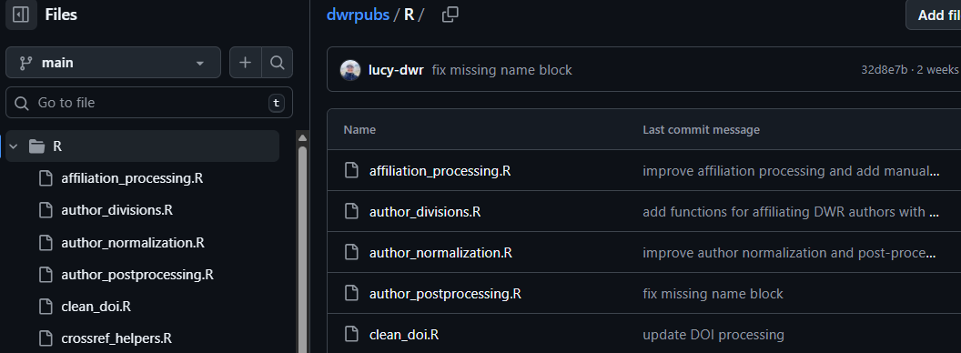

Import, Clean, and Reshape: Functional Programming
Data served by API endpoints, especially author names and affiliations, often have nested and heterogeneous structures and may require intermediate parsing and reshaping

Slide 8
An Interlude: LLMs for Analytic Work
Brainstorm
Generate code
Analyze unstructured text
Open-ended questions and ensuing discussion, such as:
Does this structure seem feasible?
How could I improve this?
What problems should I anticipate?
What libraries should I try?
Functions
Tests
Documentation
README files
Regex
Data exploration
Munging and reshaping
Bug fixes
Summarization
Classification
Extraction
Standardization
Translation
Comparison

Slide 9
How LLMs Work
Neural networks trained on massive corpora of text
  Semi-supervised learning---initially unsupervised learning with unlabeled training data, then fine-tuning through supervised learning
Built from transformer architectures that model long-range dependencies in text
  Input data are processed with embedding models and self-attention mechanisms so that inputs are encoded in a context-aware fashion, rather than purely sequentially
  Semantic structures (meanings and relationships) emerge from embedding patterns

Slide 10
How LLMs Work
Core task is next-token prediction using supplied context as input
  Tokens are short sequences of characters (typically sub-word)
  Possible next tokens are associated with a probability distribution
  Generation (inference) happens by sampling from the distribution with parameters such as "temperature" controlling the balance of "creativity" and determinism, producing stochasticity

Slide 11
Considerations for Using an LLM
Stochasticity is often inherent and desired
Models reflect training data
  Training data is the entire internet; therefore, though most LLM providers build in supervised learning and control gates to minimize problematic inference, biases can persist
  LLM training data cut-off dates are often 6-12 months before LLM publication
In simple use, LLMs optimize for likelihood, not factuality
  Retrieval augmented generation and tool calling enable greater fidelity to source material

Slide 12
Considerations for Using an LLM
Indications
Contraindications
Unstructured or messy inputs
Pattern recognition or text transformation
Structured output (e.g., JSON)
Tolerance for minor errors
Requirement for precise factual accuracy
Sparse domain knowledge
Ambiguous input data
Requirement for deterministic output

Slide 13
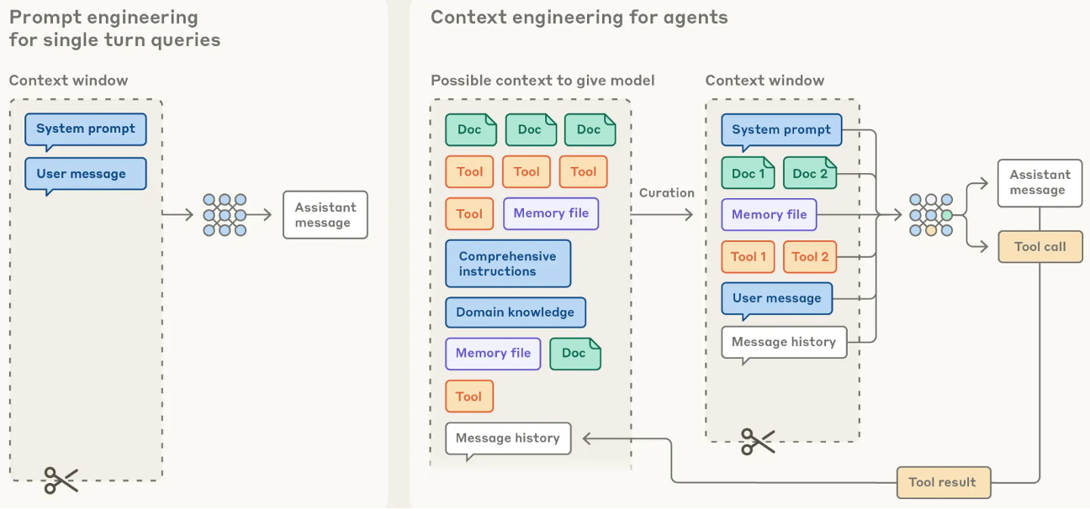
Context Engineering
Figure source: Anthropic

Slide 14
Context Engineering – Single Prompt
Common components:
  Role
  Instructions
  Important details
  Input description
  Output structure
  Examples

Slide 15
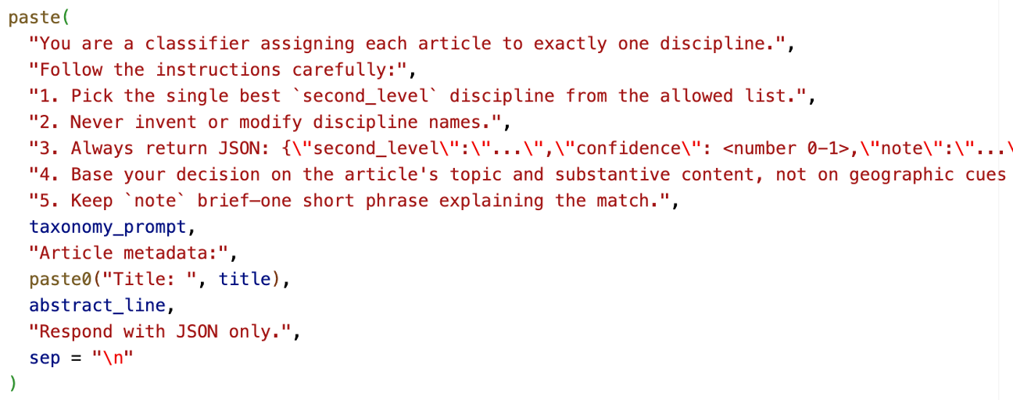
Context Engineering – Single Prompt

Slide 16





Context Engineering – Single Prompt
Model context protocol servers and clients
LLM-powered application chat UI
Direct calls
Chat
Retrieval-augmented generation (RAG)
LLM evaluation

Slide 17
Context Engineering - Agent
Large language model(s)
running tools
in a loop
to achieve a goal.
  Simon Willison

Slide 18
Context Engineering - Agent
Common components:
  System prompt (role, tone, bounds, etc.)
  Tools
  Memory (structured, compacted)
  Resources
  Architecture/orchestration

Slide 19




Agents in Code Development
Cline
open-source
vendor agnostic

Slide 20
Agents in Code Development
Context includes entire repository plus whatever other context the user wishes to supply
  Can be helpful to supply files such as AGENTS.md and periodically compress memory and key information to manage context window size
Option to work in "YOLO" mode (full agent), supervised mode, or chat mode
Helpful to ask for a plan first, then refine and work sequentially through the plan
It's possible to trace thinking, see full diffs, get explanations, etc.

Slide 21
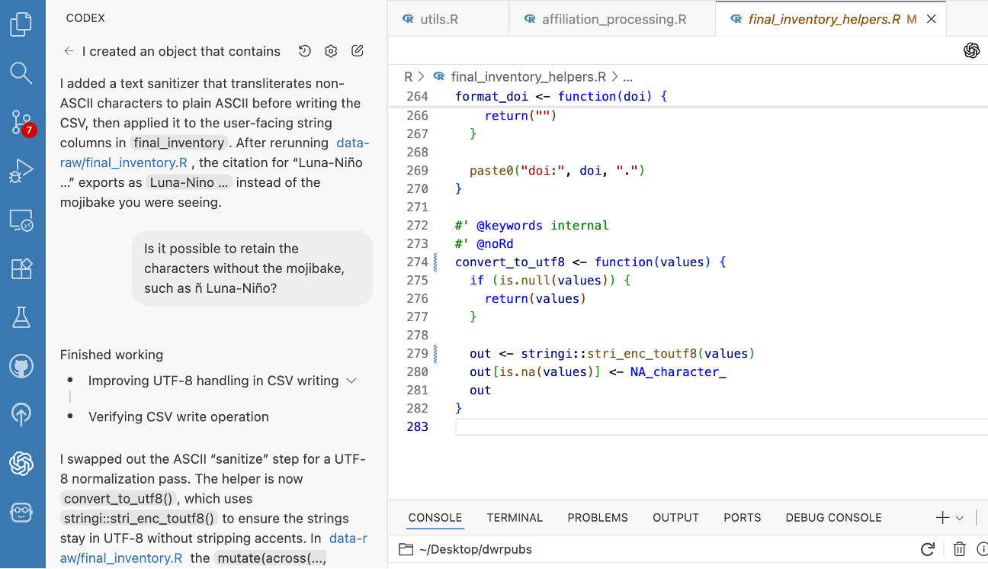

Slide 22


Agents in Code Development
Requirements:
API endpoint + base url or
Vendor authentication
Appropriate IDE
Budget:
Model
Use type (e.g., reasoning)
Input tokens, output tokens
Access:
Free trials or free models
Paid access (vendor or router)
Poppy (State employees, beta)

Slide 23
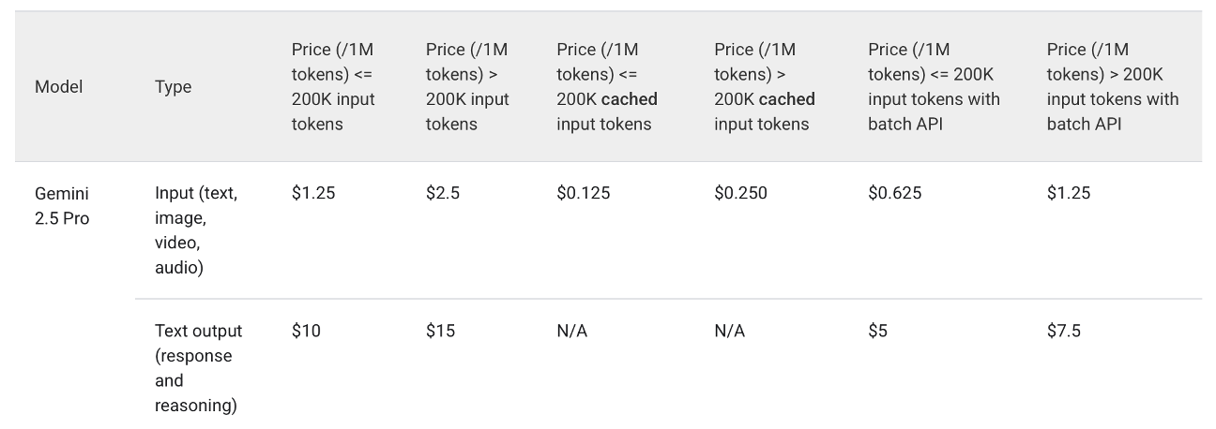
Agents in Code Development
A full day of complete vibe-coding with frontier models might cost $15

Slide 24
Human in the Loop
Generate code
Standard code review
Canonicalize affiliations
Iterative lookup table generation
Classify publications
Manual, random quality control

Slide 25
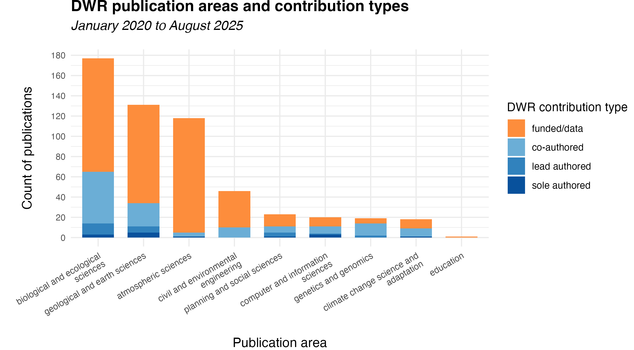
preliminary, will change!
missing much of 2025 and some QC
second-level classification also available

Slide 26
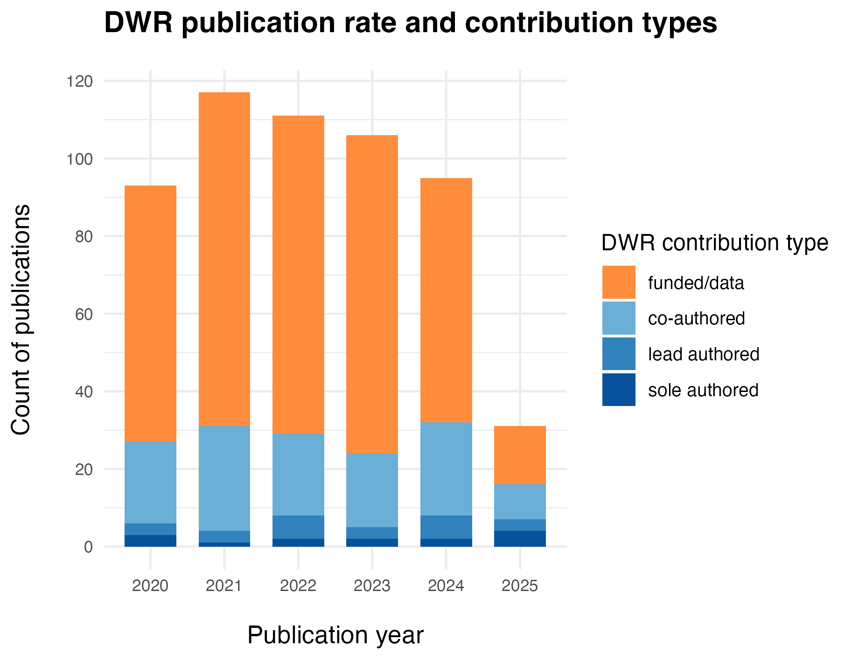
preliminary, will change!
missing much of 2025 and some QC

Slide 27
Entity | Number of publications (2020-2025)
UC Davis | 65
UC San Diego (incl. Scripps) | 44
USGS | 32
UCLA | 21
NOAA | 17
CDFW | 16
University of Colorado, Boulder | 15
CalTech (JPL) | 12
US Fish and Wildlife | 12
UC Berkeley | 12
More than 400 distinct entities in publications inventory!
preliminary, will change!
missing much of 2025 and some QC

Slide 28
Next Steps
Code and inventory finalization
R package publication
Automated pipeline development
Front-end application development
Extension to other CNRA agencies
Network analysis
Text and data mining
Cost:
Development time
$5.00?

Slide 29
Thanks! Let's Keep Talking! Possibilities...
Agent orchestration and relevant frameworks (e.g., LangChain)
Model selection, testing, and benchmarking for environmental data science
Chat UIs and LLMs for accessibility in applications (Shiny, Streamlit, etc.)
Open-weights model hosting, fine-tuning, and containerized deployments
Structured data extraction from unstructured files (e.g., scanned pdfs, images)
Semantic discovery of data and metadata
Multi-modal models and retrieval-augmented generation
Ethics, bias detection, risk mitigation, and model governance
Synthetic data generation
Versioning and reproducibility for LLM-assisted workflows

