Slide 1

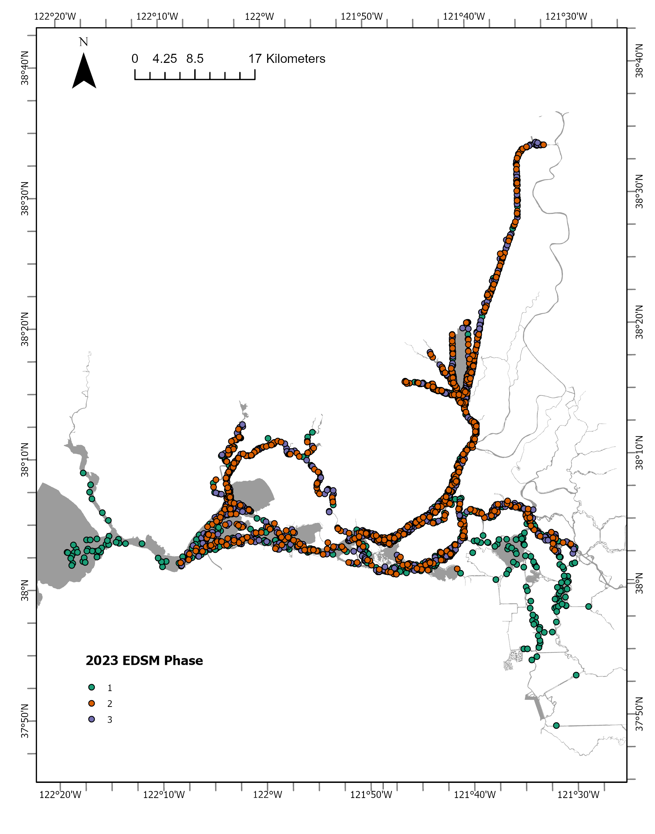
Using R to compare Lowrance GPX data to SQL database
Claudia Macfarlane
IEP Data Science PWT
Lodi FWO: EDSM Database Manager
Claudia_macfarlane@fws.gov

Slide 2
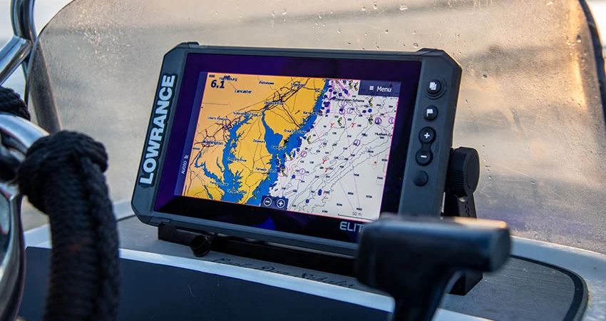
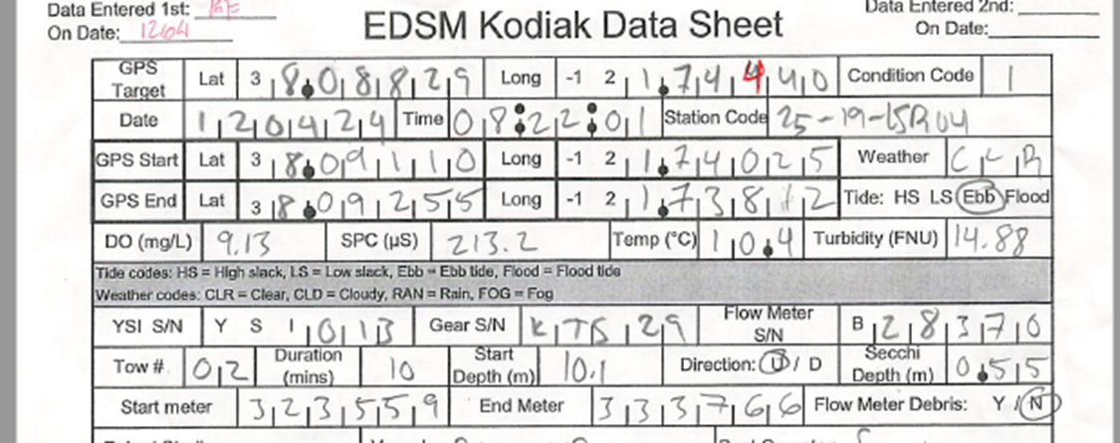
Setting the context:
Manually flag points and start and stop of each tow

Slide 3
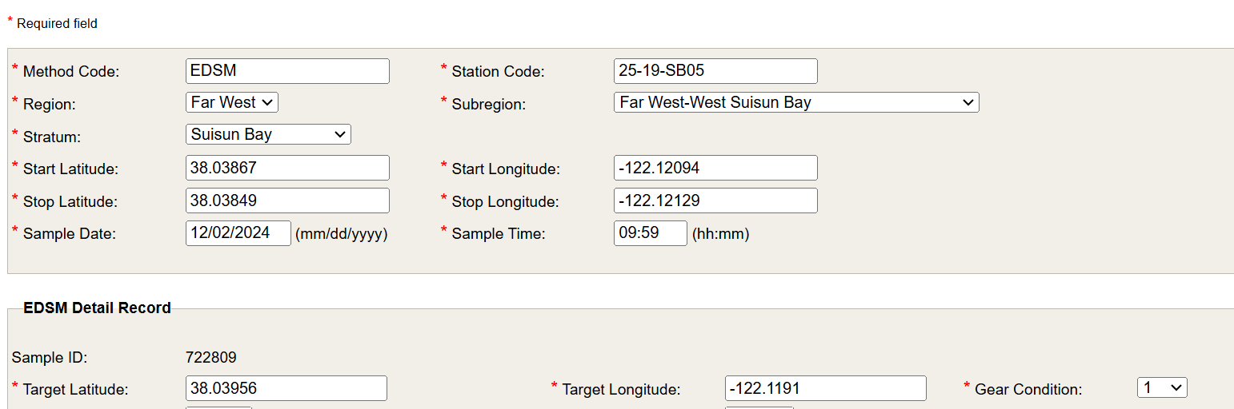
Target Coordinates vs Start/End Coordinates

Slide 4
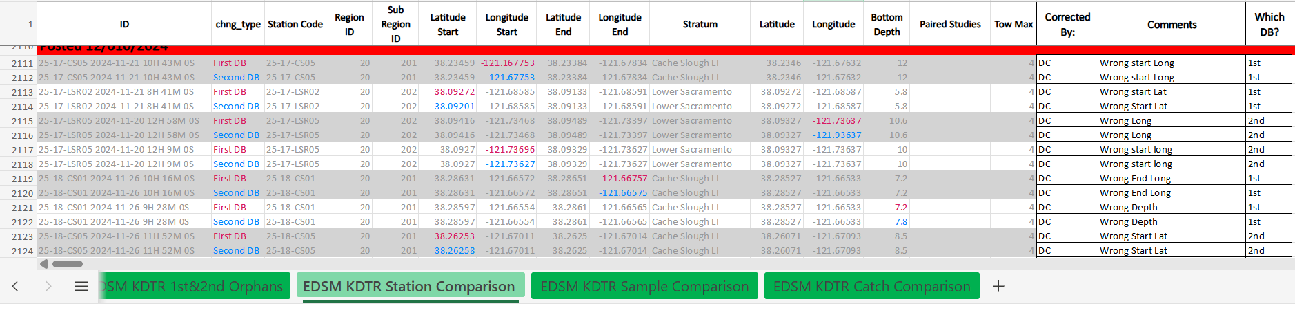
But we already do edits?????

Slide 6
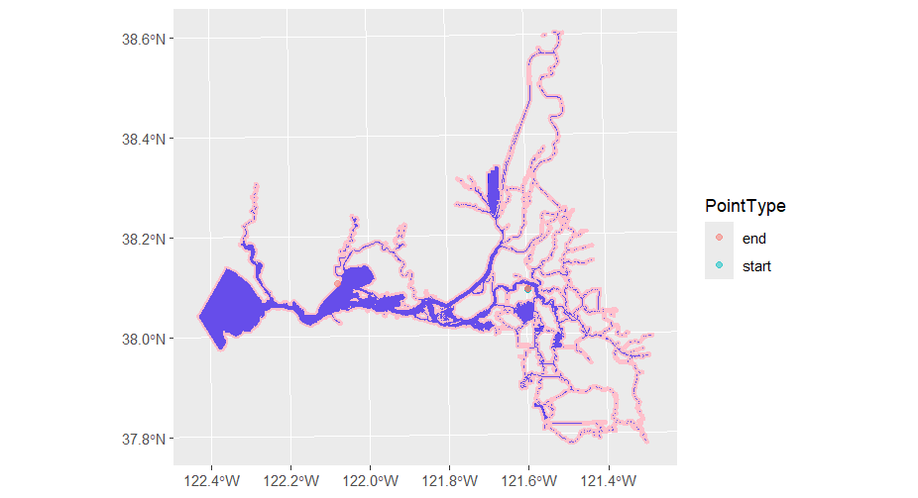
EDI QC Coordinate Code
This example:
add a reasonable buffer around the water and look for points outside the buffer

Slide 7
More importantly:
Approach 3: check distances between the three sets of coordinates associated with a site/sample## https://stackoverflow.com/questions/52551016/creating-sf-points-from-multiple-lat-longs
Calculate distances (as the crow flies) between target, start, and end points:
Sort by distances and plot (ex:Sort by descending distance from target to start)

Slide 8
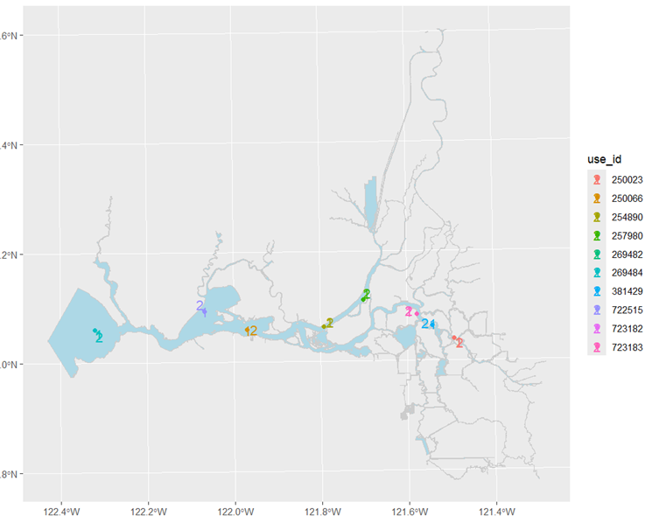
This section calculates distances (as the crow flies) between target, start, and end points. A dataframe is created with these distances and can be sorted to find the largest distances between target to start, target to end, and start to end. These are plotted to show the start end and target points for investigation. This allows for the finest level of QC and uncovers transcription errors not detected by the other two approaches.
Notes:
This section calculates distances (as the crow flies) between target, start, and end points. A dataframe is created with these distances and is sorted to find the largest distances between target to start, target to end, and start to end. These are plotted to show the start end and target points for investigation. This allows for the finest level of QC and uncovers transcription errors not detected by the other two approaches.

Slide 9
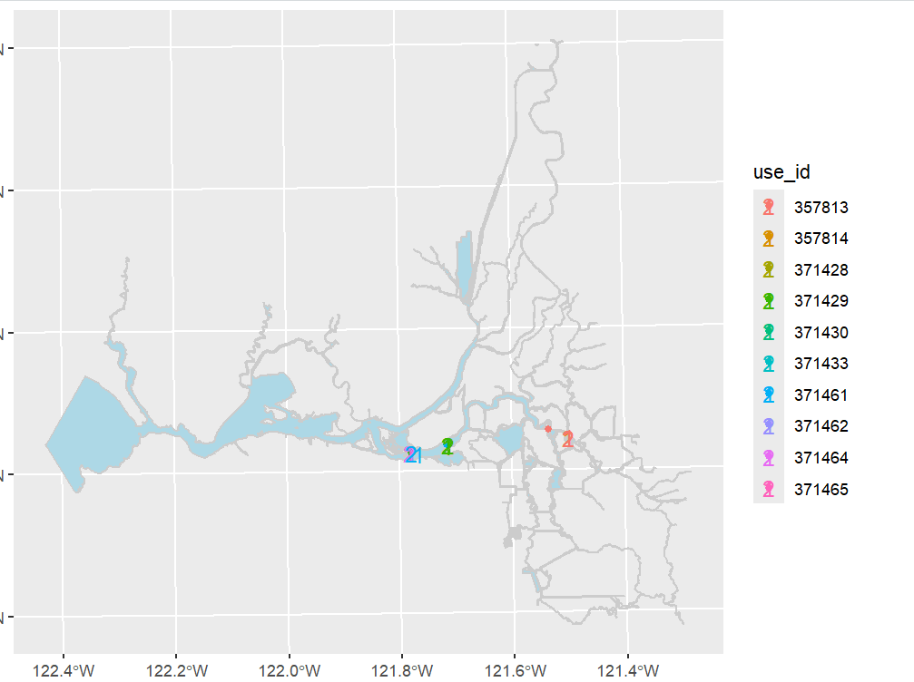

Slide 10
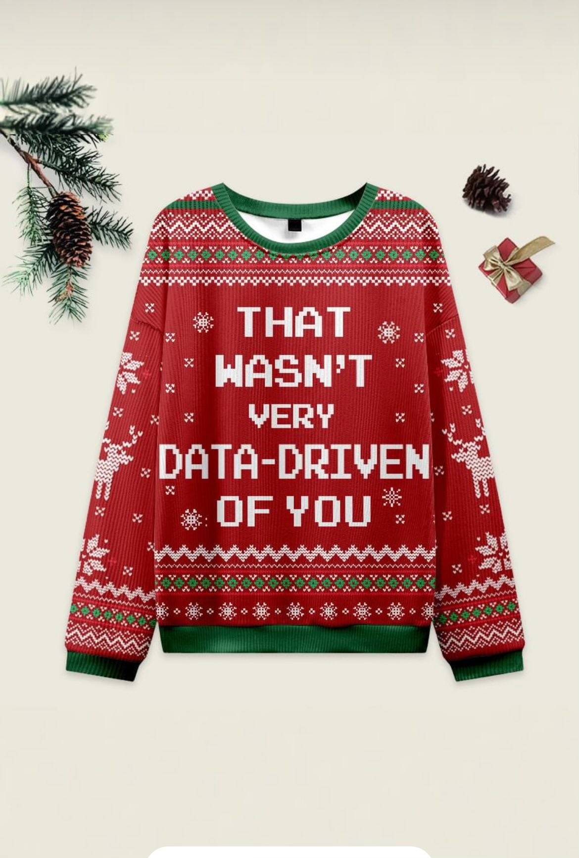
What to do if you find an error with no apparent solution.
This uncovered points with possible transcription errors.
Plotting possible transcription errors on GoogleEarth worked for some but major drawbacks..
Need for ground truthing and determining whether the GPS unit cursor wasn’t cleared or the data collector transposed number. Handwriting can pose an issue (but edits typically pick these up).
Some times there are no clues and we need to pull in other data.

Slide 11
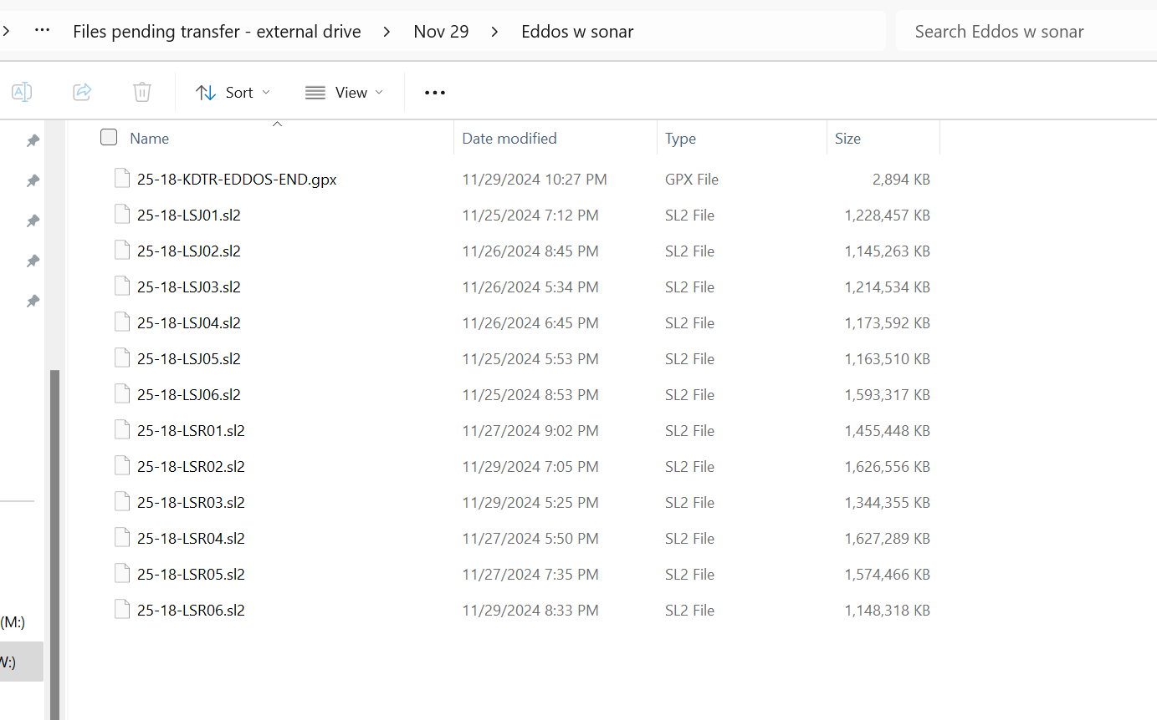
So about those Lowrance Files

Slide 12
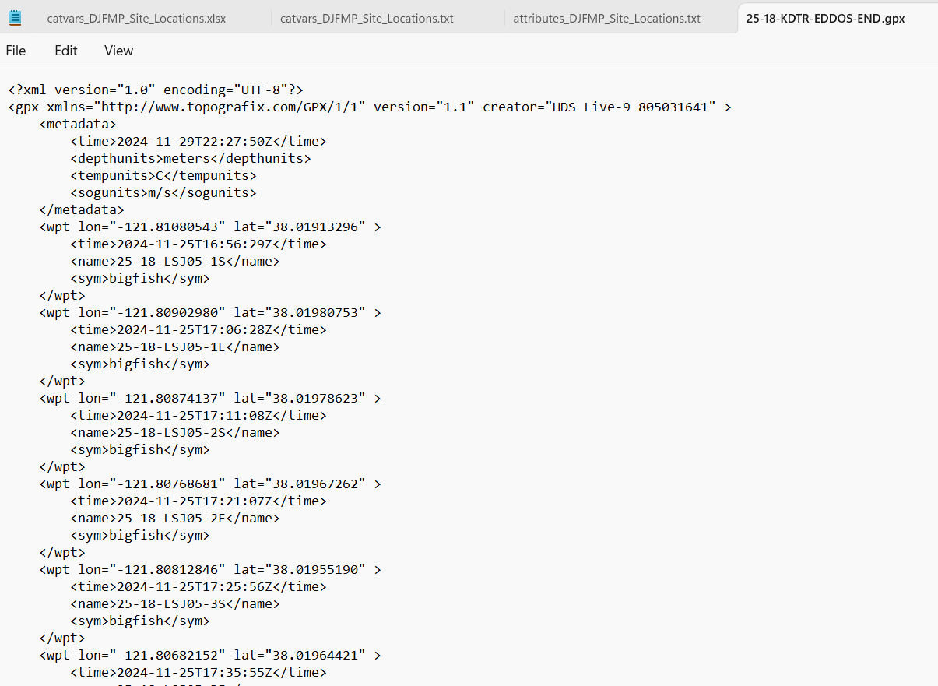
Basically just a nested XML file.

Slide 13
CODE

Slide 14
Comparedf output:

Slide 15
Still not perfect with rounding or with complete GPX data.

Slide 16
Next Steps/Issues
GPX files failing to be read or misnamed.
QC for Lowrance
Rounding and code issues (this is newly written so still a long way to go)
Request for tips/tricks/resources

