Slide 1

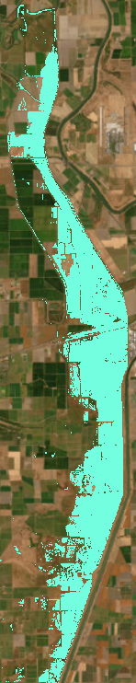
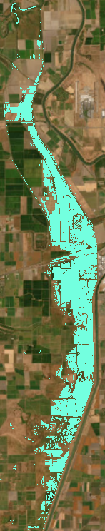
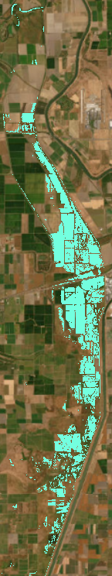

Raster image lingo & the Terra & LandscapeMetrics package
February 2026
Data Science Meeting
Shruti Khanna

Slide 2
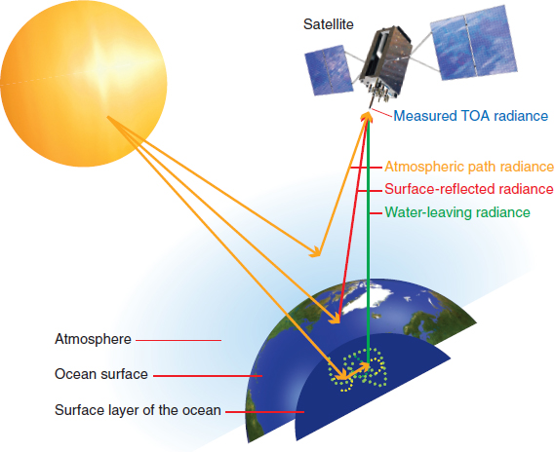
Remotely Sensed Data
Camera photo
UAV images
Aerial photos (manned)
Satellite imagery
Aerial spectro-scopy
Active sensors (LiDAR)
& Earth surface

Slide 3
Domains of remote sensing data
Space
Spectral
Time
Field of View → pixel size on ground
Number of bits used to save the digital number recorded by the sensor
Panchromatic → multispectral → hyperspectral
Radio-
metric

Slide 4

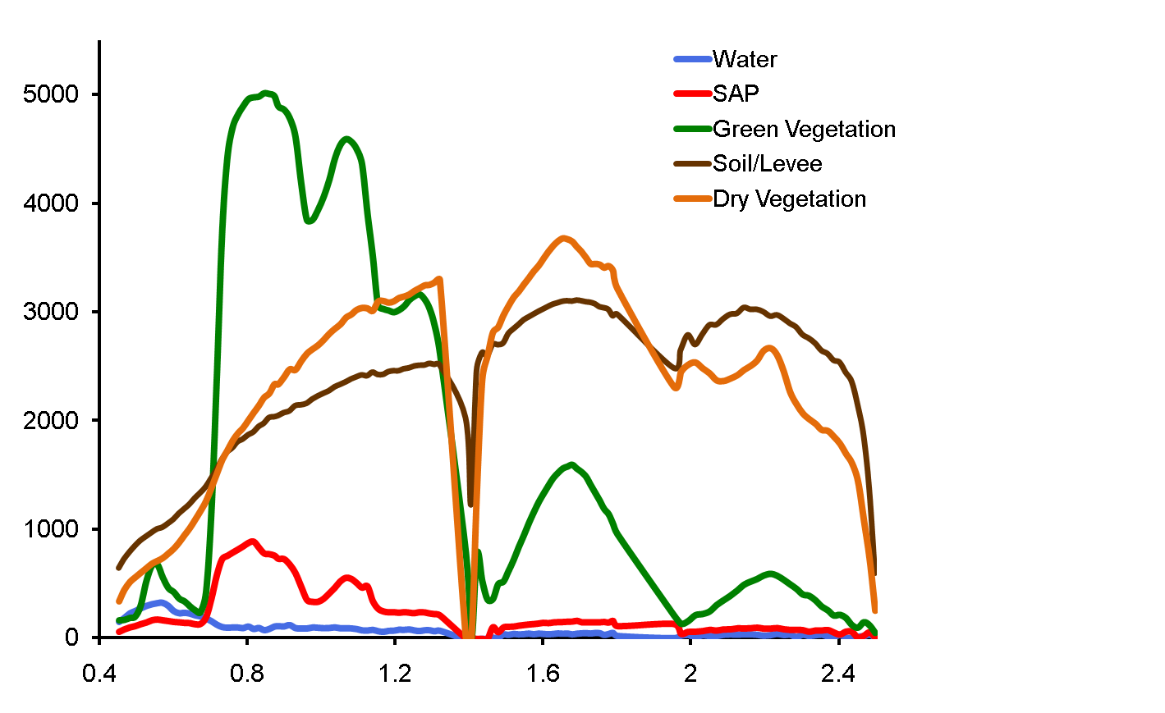
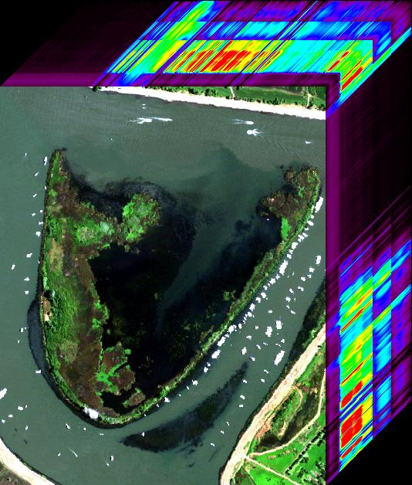
Aspects of an Image
Soil
Water
Dry Vegetation
Green Vegetation
Aquatic Vegetation
Spectral bands
X
Pixel
Reflectance * 10000
y
Wavelength in µm
Raster/Image

Slide 5
Temporal resolution and extent
~ 2km 1km 250m-1km 10-20m 15-30m
GOES AVHRR & MODIS Sentinel-2 & 1 Landsat 8
5-15min 1-2 days 5-6 days 16 days
0 2 4 6 8 10 12 14 days
(1972) (1975) (1978) (1999) (2014-15)
Landsat GOES AVHRR MODIS S1,S2
1970 1975 1980 1985 1990 1995 2000 2005 2010

Slide 6
Terra package (some functions)
terra::vect – read a vector file
terra::rast – read a raster file
terra::aggregate – aggregate to make multi-polygons to result in one multi-polygon per field value of the field a vector is aggregated on
terra::disagg – same as “split multipart polygons” in ArcGIS – splits all multipart polygons into singlepart polygons
terra:: expanse – same as “calculate geometry -> area” i.e. calculates area of each distinct polygon
terra::as.polygons – convert a class raster to a vector polygons layer
terra::intersect – same as ‘intersect’ in ArcGIS – intersect two vectors
terra::perim – calculate perimeter of each polygon
terra::buffer – buffer each polygon by a positive or negative distance

Slide 7
Landscape Metrics package
Landscape metrics are quantitative measures that describe the composition and configuration of a landscape
landscapemetrics::calculate_lsm – calculate all landscape metrics defined in a list on a raster or a single metric at the patch, class, or entire image level
calculate_lsm(classRaster, what = lsm.list, count_boundary = FALSE)
calculate_lsm(classRaster, level = "patch", metric = "enn" )

Slide 8
Metric | Name | Type | Level | Function Name
area | patch area | area and edge metric | patch | lsm_p_area
cai | core area index | core area metric | patch | lsm_p_cai
circle | related circumscribing circle | shape metric | patch | lsm_p_circle
contig | contiguity index | shape metric | patch | lsm_p_contig
core | core area | core area metric | patch | lsm_p_core
enn | euclidean nearest neighbor | aggregation metric | patch | lsm_p_enn
frac | fractal dimension index | shape metric | patch | lsm_p_frac
gyrate | radius of gyration | area and edge metric | patch | lsm_p_gyrate
ncore | number of core areas | core area metric | patch | lsm_p_ncore
para | perimeter-area ratio | shape metric | patch | lsm_p_para
perim | patch perimeter | area and edge metric | patch | lsm_p_perim
shape | shape index | shape metric | patch | lsm_p_shape

Slide 9
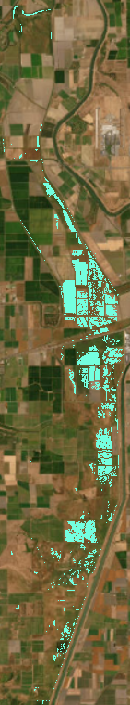
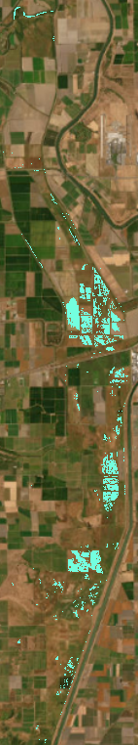
Patch Size
03/04
03/09
03/14
03/19
03/24
2024 water year

Slide 10
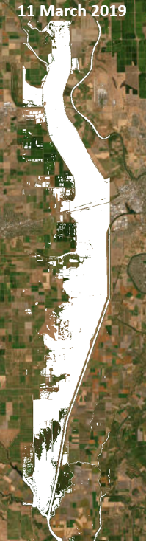
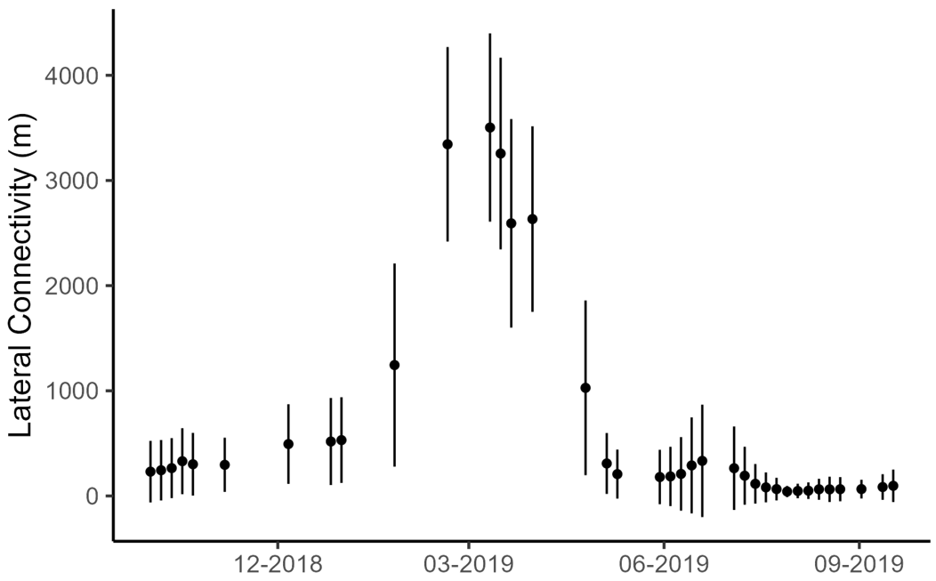
Lateral Connectivity

