Slide 1
Determining sample size with a GLMM
Lauren Yamane, USFWS – San Joaquin River Restoration Program

Slide 2
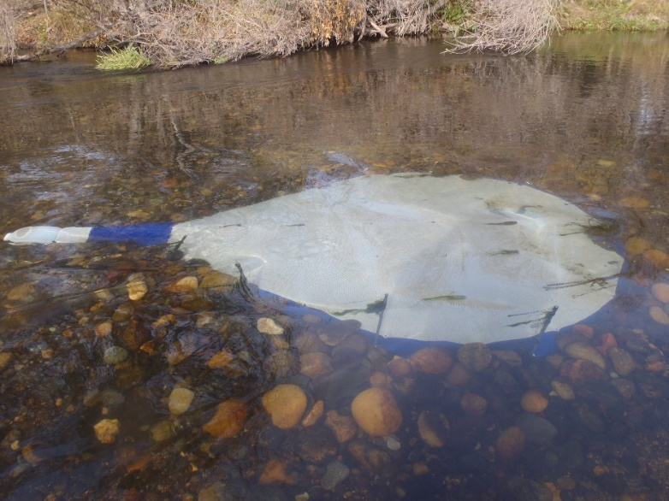
Questions
Monitoring goal: Evaluation of the survival of incubating salmon eggs in existing gravel beds, and relate to habitat variables
Hydraulic conductivity – provides flow through incubation gravel within a redd
Delivers O2, removes waste
Emergence traps on top of redds catch fry as the emerge from gravel
Issue: Recent low emergence
Is low emergence due to redd capping?
Overarching design question: How many samples (redds) do we need to detect an effect of capping a redd on the egg-to-fry (ETF) survival?

Slide 3
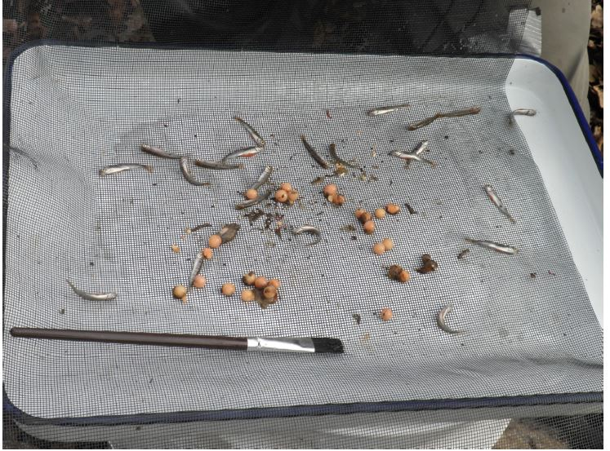
Eggs and Fry

Slide 4
Model Structure
a) 'fixed' effect is the capping treatment: uncapped vs. capped redd
Note: I need advice on incorporating this effect into model!
b) the random effect is the redd into which eyed eggs are planted;
c) continuous covariate is ambient bed hydraulic conductivity, i.e. the conductivity of the surrounding gravel has a linear effect on egg-to-fry (ETF) survival ;
d) Response variable: number of (successful) emergent fry based on 250 eyed eggs planted in each redd at start of incubation season.
Binomial distribution

Slide 5
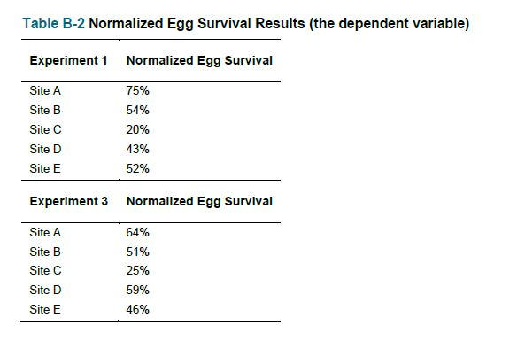
ETF survival

Slide 6
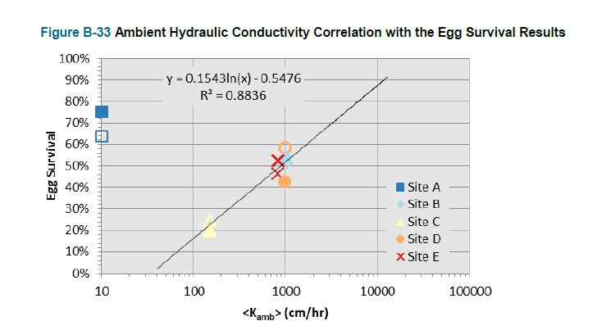
Egg survival vs. Ambient bed hydraulic conductivity
From 5 sites (i.e. redds)

Slide 7
Packages and sources
```{r setup, include=FALSE}
library(lattice)
library(lme4)
# See Chapter 19 of Kery's Introduction to WinBUGS for ecologists
```

Slide 8
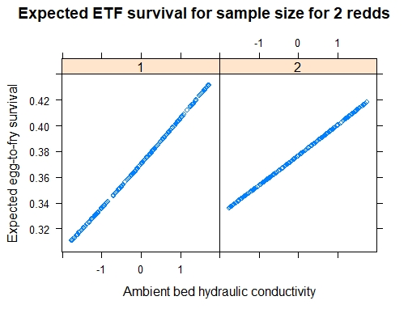
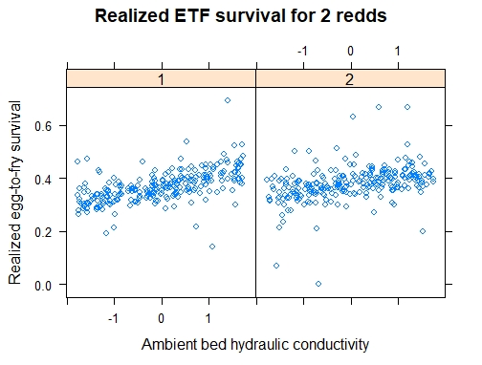

Slide 9
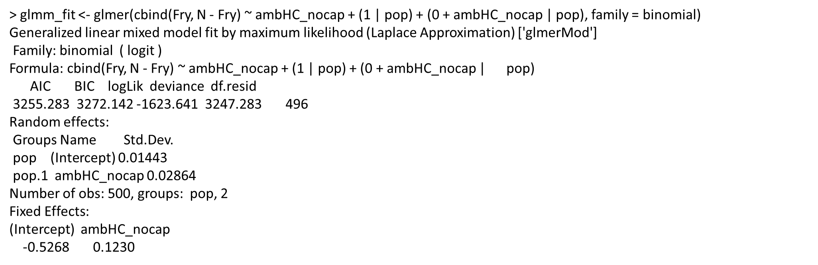
2 redds fit

Slide 10
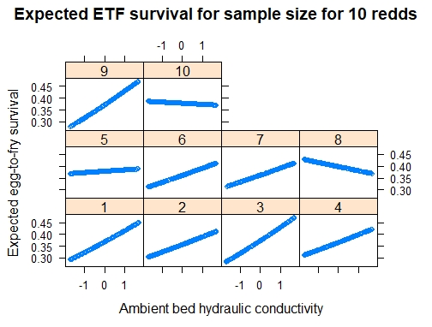
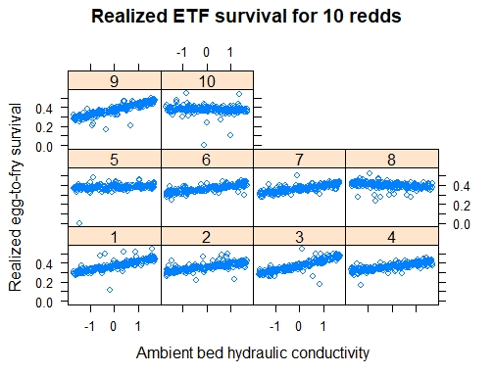
10 redds

Slide 11
10 redds fit
> glmm_fit
Generalized linear mixed model fit by maximum likelihood (Laplace Approximation) ['glmerMod']
Family: binomial ( logit )
Formula: cbind(Fry, N - Fry) ~ ambHC_nocap + (1 | pop) + (0 + ambHC_nocap | pop)
AIC BIC logLik deviance df.resid
20453.66 20476.96 -10222.83 20445.66 2496
Random effects:
Groups Name Std.Dev.
pop (Intercept) 0.04881
pop.1 ambHC_nocap 0.09930
Number of obs: 2500, groups: pop, 10
Fixed Effects:
(Intercept) ambHC_nocap
-0.5351 0.1174

