Slide 1


Beyond the Shapefile
Why GeoPackage is the Modern Standard for Open Spatial Data
Kyle Hardage, PhD, PG
Engineering Geologist
California Department of Water Resources
Sustainable Groundwater Management Office
IEP Meeting
May 14, 2026
Notes:
Quick survey of who is familiar with geopackages.
Late to the GIS game (2021), quickly learned about shapefiles and promptly sought alternatives (usually R-specific .rds and .rda)

Slide 2
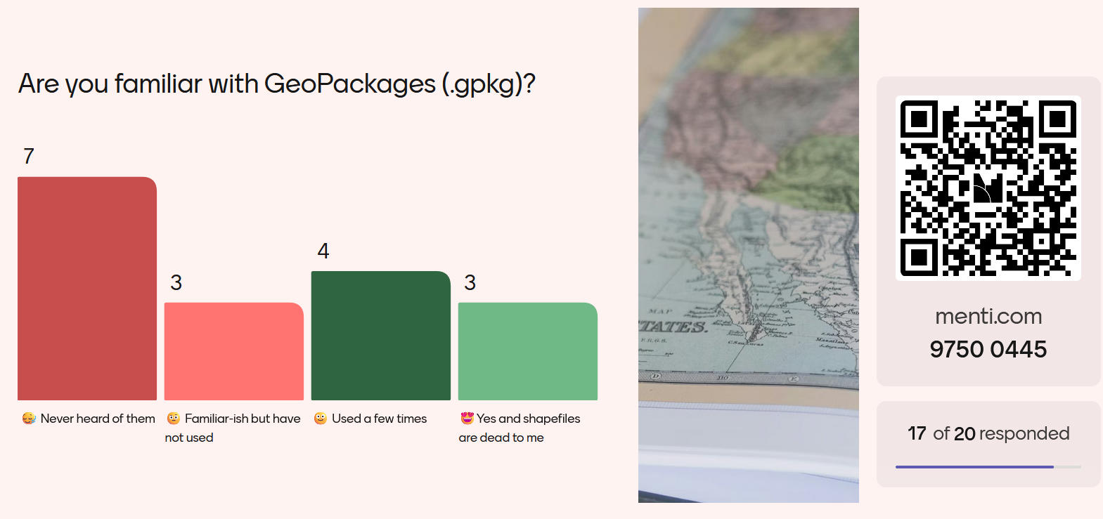

Menti survey results
Notes:
Presentation is text heavy, cannot cover everything, but use as a reference later

Slide 3
Overview
Problem Background
Ubiquity of shapefiles and limitations
GPKG Overview and Comparison
GPKG in the geospatial ecosystem
GPKG Under the Hood
Technical background
SQL and databases
SQLite
Advantages / Disadvantages
Comparison to ESRI geodatabases
Example usage across platforms
Practical migration guidance
(optional R demo)
Notes:
Presentation is text heavy, cannot cover everything, but use as a reference later

Slide 4
Problem background
Why shapefiles persist
Wide support across platforms
Open specification (but technically still proprietary to ESRI)
Familiarity
‘good enough’ (because apparently nothing has changed since 1998…)
Limitations
Legacy structure from the 1990s (and dBASE .dbf is from 1983)
10-character field name limit
Uncoordinated sidecar files (.shp, .dbf, .shx, .prj, etc….up to 12 known companion files)
No support for NULL in numeric fields (important for NULL error flags in programming)
Limited encoding options (often UTF-8 but no way to specify; special characters break)
Limited data types (float, integer, date, text; no time, datetime, logical, or others)
Opaquely rounds large float numbers up!
Multi-part geometries not supported (multi- linestrings and multi- polygons)
Max 255 fields (often not an issue but some analyses require wide-format matrices)
Raster support nearly non-existent
No internal metadata standard
Performance issues with large or complex datasets (< 2GB size due to dBASE 4000 byte limit)
Trouble with versioning, portability, file corruption (e.g. .dbf failure in OneDrive)

Slide 5
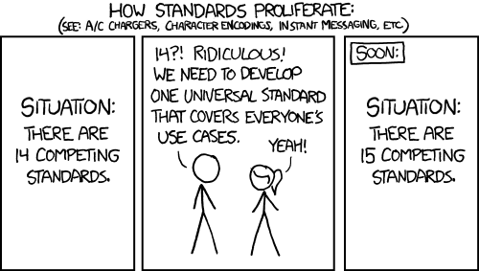
Modern standards
Alternatives proposed to accommodate modern complex data + workflows
GeoPackage emerging as the best replacement of .shp specifically

Slide 6
Geospatial file formats overview
Name | Extension | Information | Type | Model
ESRI Shapefile | .shp (+ .dbf +.shx) | Multi‑file format with limits: < 2 GB, no mixed geom types, name ≤ 10 chars, ≤ 255 columns | Vector | Partially open
GeoJSON | .geojson | JSON-based (text) simple features; often used for point / lat‑long data; TopoJSON is related | Vector | Open
KML | .kml | XML format for Google Earth visualization; compressed version is KMZ | Vector | Open
GPX | .gpx | XML schema for exchanging GPS data | Vector | Open
FlatGeobuf | .fgb | Single-file, fast read/write, supports streaming | Vector | Open
GeoTIFF | .tif / .tiff | Raster format embedding spatial metadata | Raster | Open
Arc ASCII | .asc | Text raster; header (6 lines) plus cell rows/cols | Raster | Open
SQLite / SpatiaLite | .sqlite | Standalone database; SpatiaLite adds spatial support; stores vector & raster | Vector and raster | Open
ESRI FileGDB | .gdb | ArcGIS geodatabase; multiple feature classes, topology; limited GDAL support | Vector and raster | Proprietary
GeoPackage | .gpkg | SQLite‑based, lightweight, platform‑independent; supports vector & limited raster | Vector and (limited) raster | Open
Modified from Table 8.1 of Geocomputation with R (2026) [see Links slide]

Slide 7
Format capabilities overview
name | long_name | write | copy | is_raster | is_vector | vsi
ESRI Shapefile | ESRI Shapefile | TRUE | FALSE | FALSE | TRUE | TRUE
GPX | GPX | TRUE | FALSE | FALSE | TRUE | TRUE
KML | Keyhole Markup Language (KML) | TRUE | FALSE | FALSE | TRUE | TRUE
GeoJSON | GeoJSON | TRUE | FALSE | FALSE | TRUE | TRUE
GPKG | GeoPackage | TRUE | TRUE | TRUE | TRUE | TRUE
FlatGeobuf | FlatGeobuf | TRUE | FALSE | FALSE | TRUE | TRUE
ESRI FileGDB | ESRI Geodatabase | TRUE | TRUE | TRUE | TRUE | ?
Modified from Table 8.3 of Geocomputation with R (2026) [see Links slide]
vsi = /vsicurl/, a GDAL protocol to access cloud-based files as if local

Slide 8
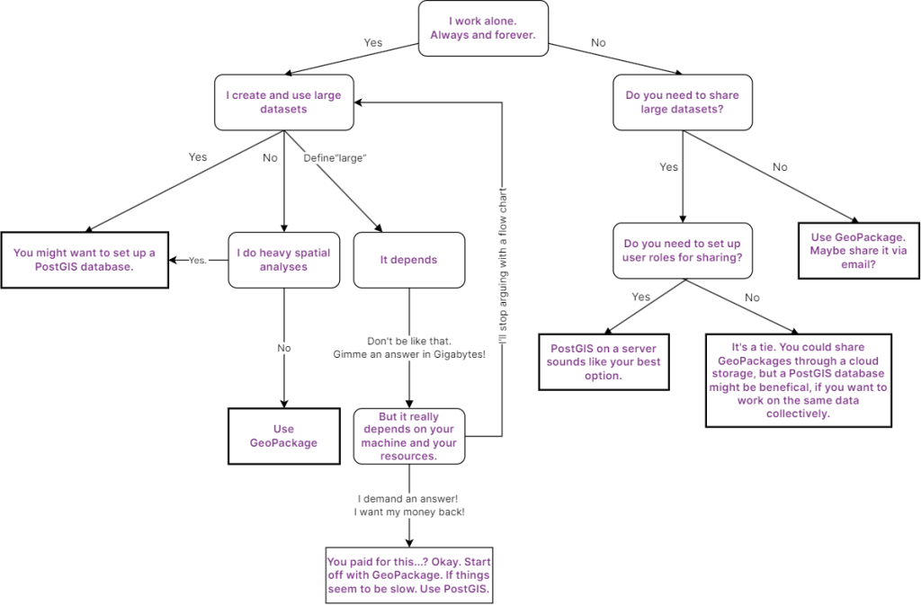
Deciding what to use
Emil Ehnström, gispo.fi

Slide 9

What is GeoPackage?
“GeoPackage is an open, standards-based, platform-independent, portable, self-describing, compact format for transferring geospatial information.” – Open Geospatial Consortium (OGC)
.gpkg = SQLite Database + GeoPackage Encoding Standards
Fully OGC‑compliant SQLite database
Single file (.gpkg) for entire dataset: vector, raster, tiles, attribute tables, metadata
Can have individual .gpkg for each .shp or raster, though
Cross‑platform: ArcGIS Pro, QGIS, GDAL/OGR, Python (geopandas, sqlite3), R (sf, terra, RSQLite)
Self-contained and portable
Extensible (Well Known Text (WKT) coordinate support, Tiled Grid coverage, symbology, others)
Natural fit for data exchange and long-term storage (primarily individual projects)
In short, an open-source standardized geodatabase

Slide 10
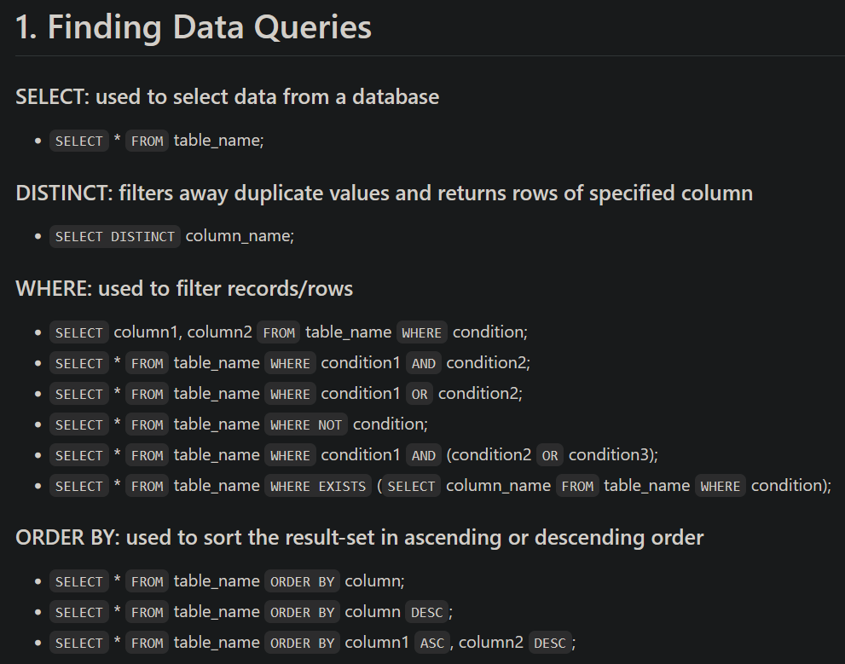
Under the hood: Structured Query Language (SQL)
SQL was developed to interact with data in relational database management systems (RDBMS)
Describes relational algebra to access many records at once
Declarative verbs form SQL statements
Various dialects depending on the RDMBS, but generally similar
Example: SELECT vs. select SELECT * vs. select IN vs. %in%

Slide 11
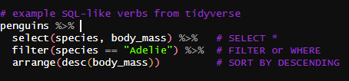
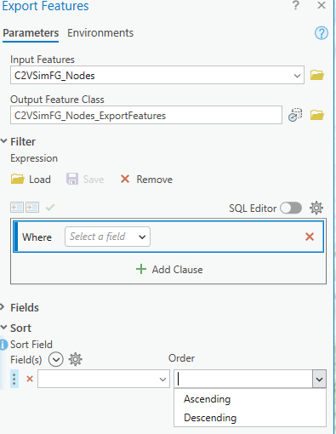
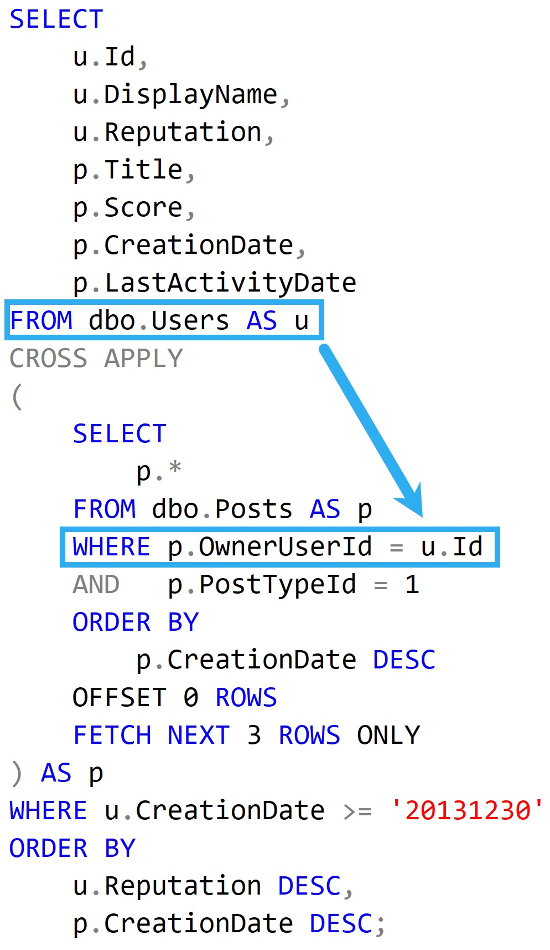


Under the hood: SQL and SQLite
You already know Structured Query Language (SQL)
SQL verbs inspire tidyverse functions
ArcPro uses SQL verbs (union and intersect derive from SQL)
SQLite is just a lightweight database developed for mobile applications

Slide 12
Under the hood: SQLite
SQLite is:
lightweight, file-based relational database
Transaction-safe edits
Efficient spatial indexing (R*Tree)
SQL queryable attributes and metadata
Scalability to very large datasets
read/write performance advantage over shapefiles (complex geometries)

Slide 13
Advantages & Disadvantages of GPKG
Advantages (against .shp in particular)
Supports multiple feature classes, rasters, and tables in one file (modern functionality)
Field names with real length, real data types, real null handling
Built-in metadata tables
Naming flexibility and fewer corrupted files
Transferability between software environments
Fast loading for scripting workflows (Python, R, command line)
More robust for cloud storage, versioning systems, and collaboration
Efficient (native) querying
Superior for large / complex datasets
Portable
Disadvantages
SQLite is complex binary format in C-language not suitable for streaming
Can be larger on-disk that .shp
Not as widely supported (yet) as .shp, GeoJSON, KML
Older software will likely never support it due to the same limitations inherent to shapefiles
More complex for users unfamiliar with manipulating database structure
But SQLite is well-documented

Slide 14
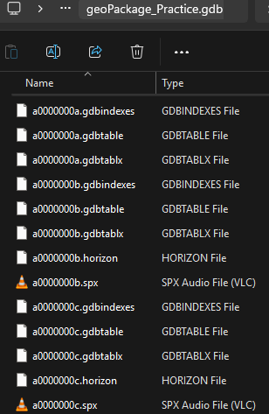
GeoPackage vs. Geodatabase
GeoPackages solve a lot of problems of shapefiles but are not a drop-in replacement for ESRI Geodatabases
Geodatabases are a proprietary .gdb directory with more file chaos than shapefiles but advanced functionality
Compared to geodatabase, a geopackage does not:
Support topology rules
Support feature datasets
Support relationship classes
Support attribute rules
Support domains
Support geometric networks
Support simultaneous user edits
Publish to a hosted web layer
Support ESRI-specific geoprocessing designed for .gdb
Auto-compress data
However, many limitations (and more) apply to .shp anyway
Some limitations may diminish through future extensibility

Slide 15
GPKG use across platforms QGIS, Arc Pro, R, Python

Slide 16
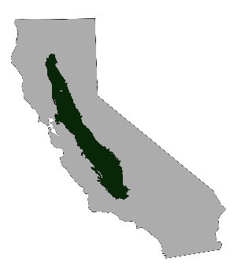
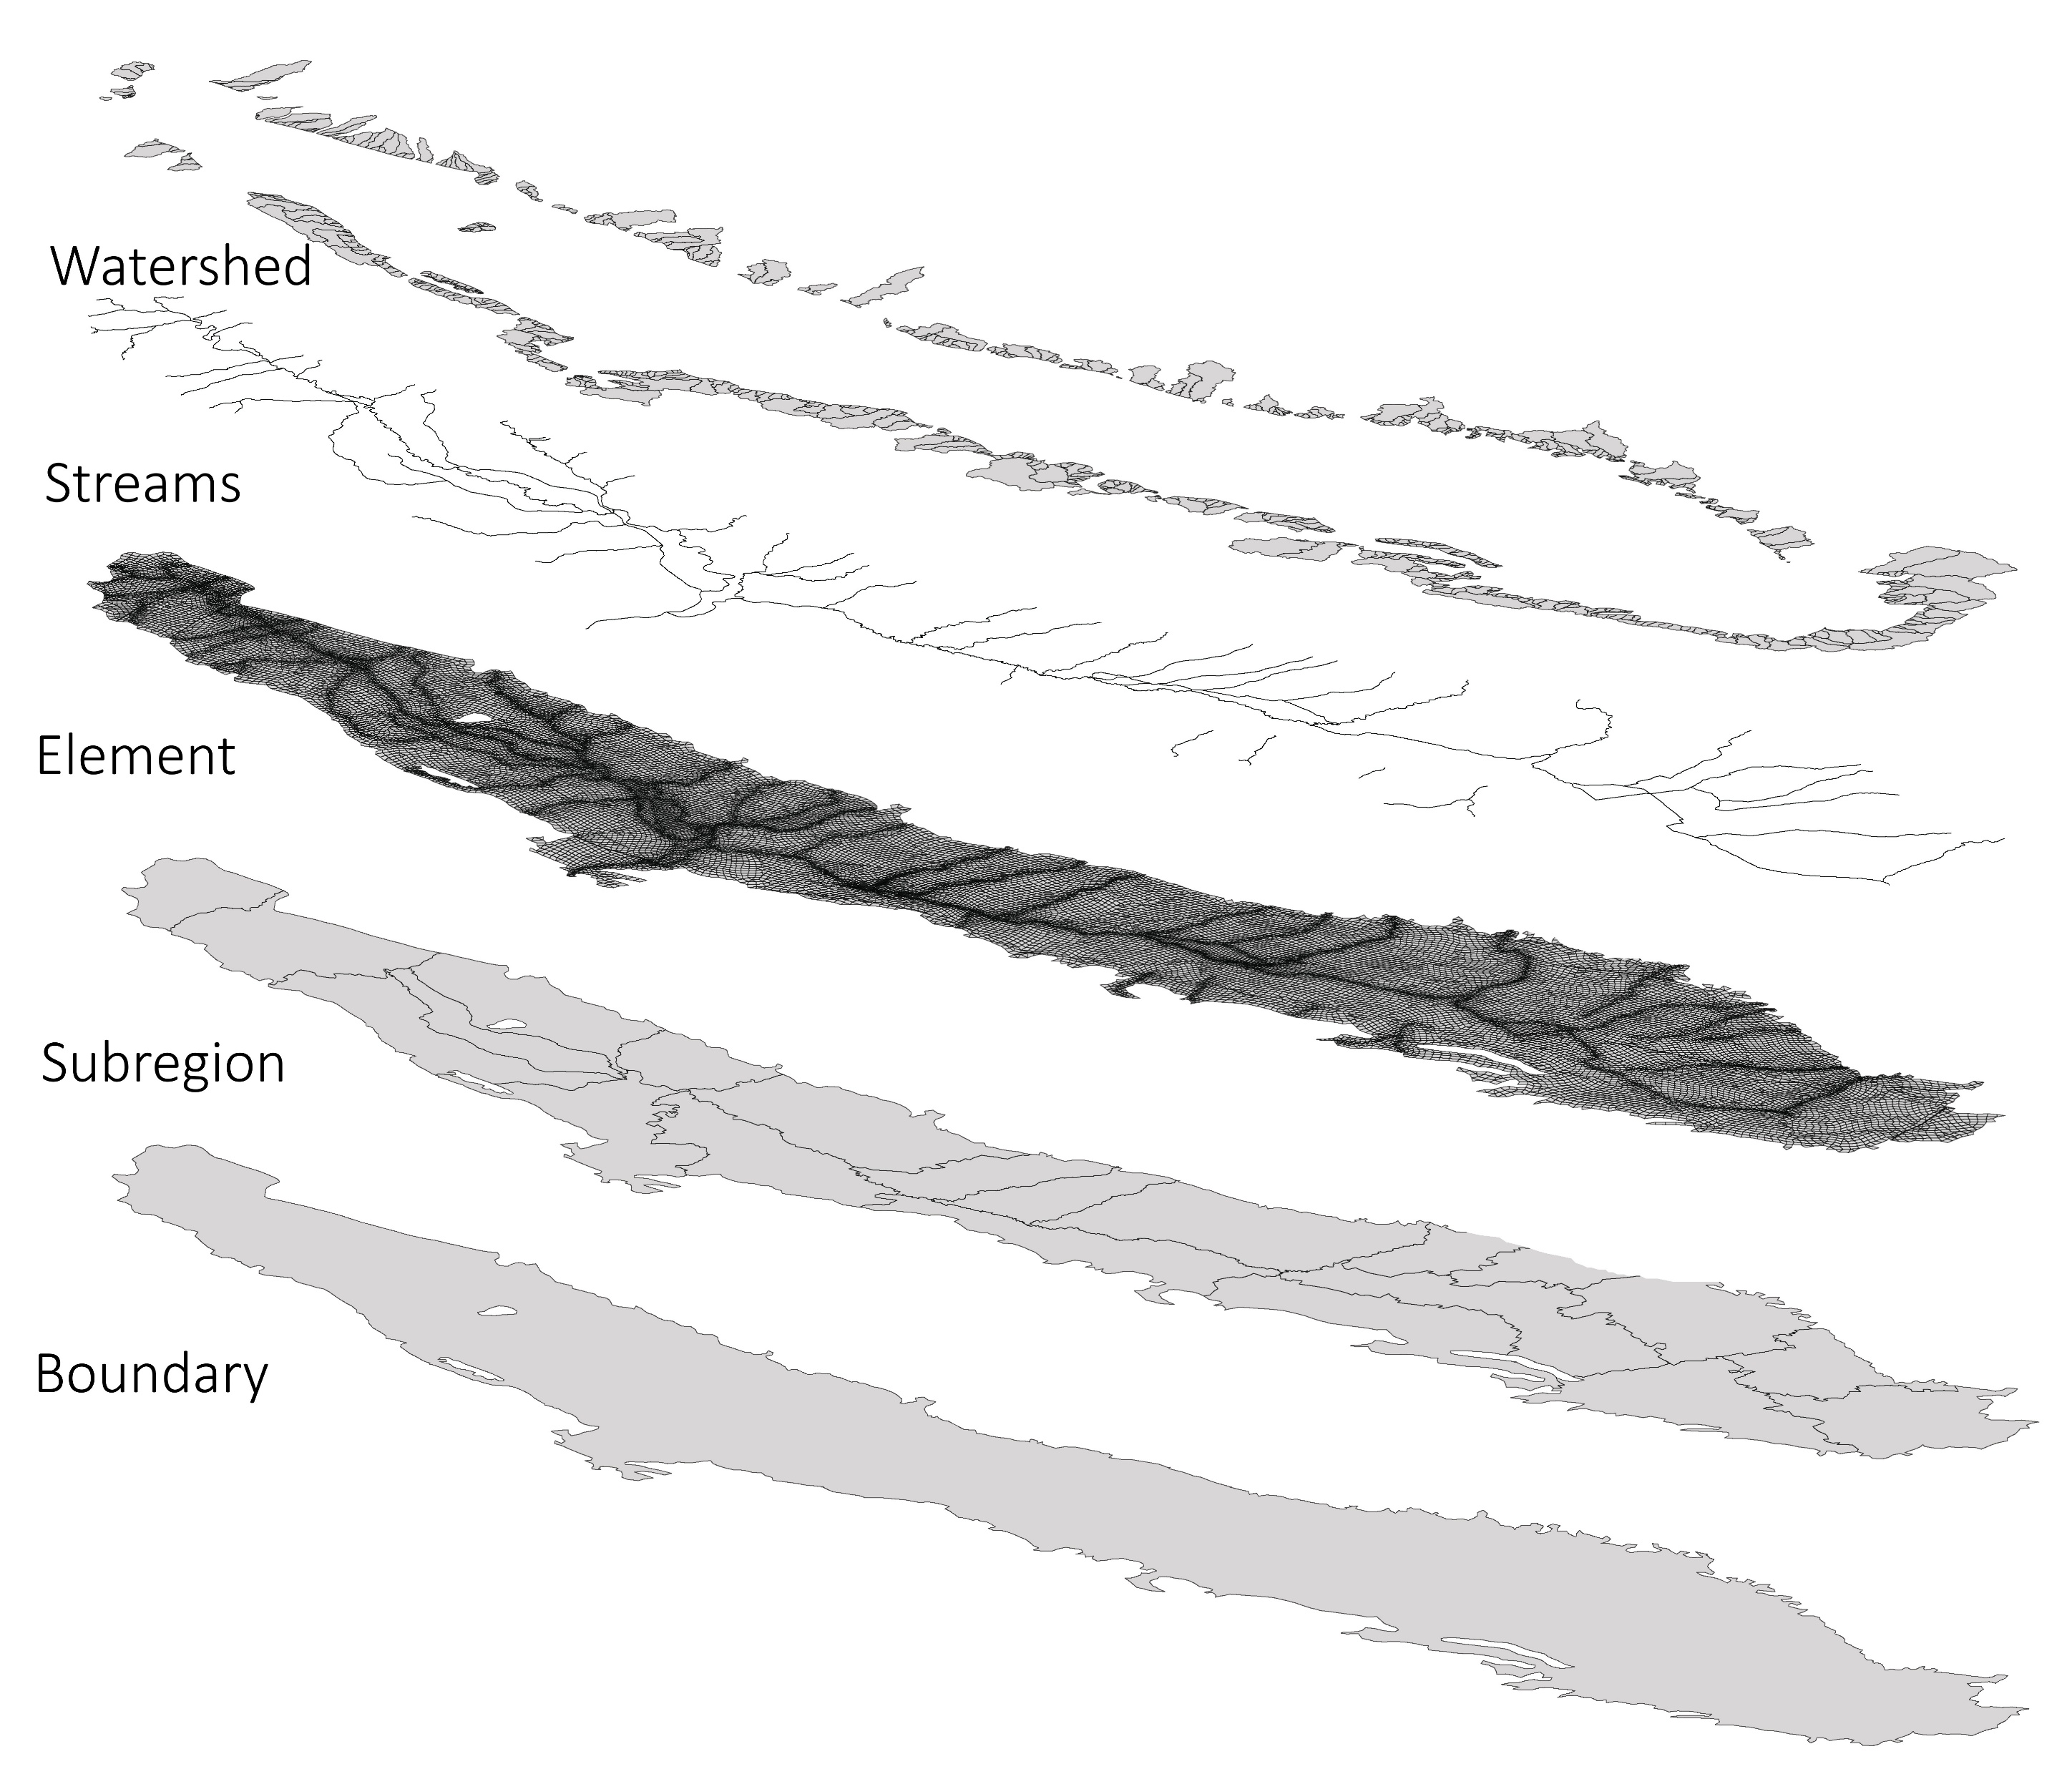
GPKG Creation and Usage
As example, will utilize GIS geometry of a DWR groundwater model
C2Vsim Fine Grid
DWR groundwater-surface water model of the Central Valley
Multiple spatial geometries defined for model areas
C2VsimFG comes packaged with .shp of the model
Analogously could consider ‘deltamapr’ pre-packaged spatial data

Slide 17
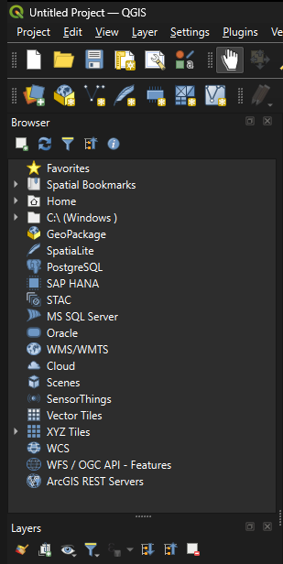
QGIS: GPKG is native
GeoPackage is the first option for creating spatial data
Note other options:
They’re SQL-type databases!
Microsoft SQL Server
Oracle
PostgreSQL
SpatiaLite

Slide 18
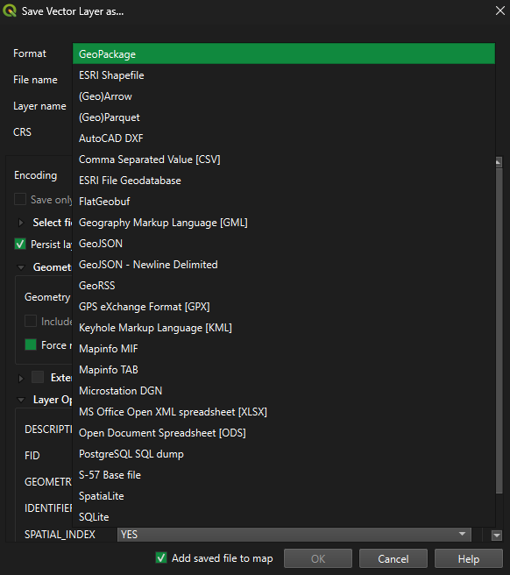
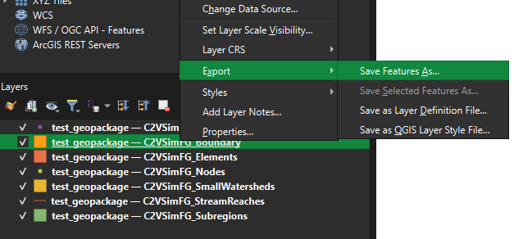


QGIS: GPKG is native
As straightforward as Export > Save Feature As > Geopackage

Slide 19
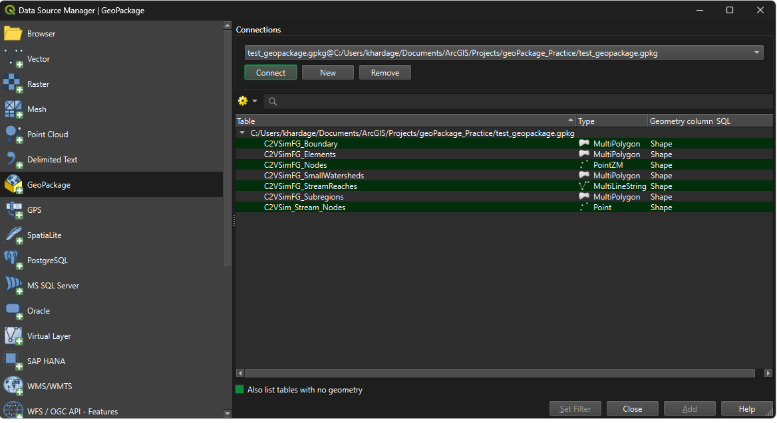
QGIS: GPKG is native
Result: one gpkg containing layers that were originally each shapfiles

Slide 20
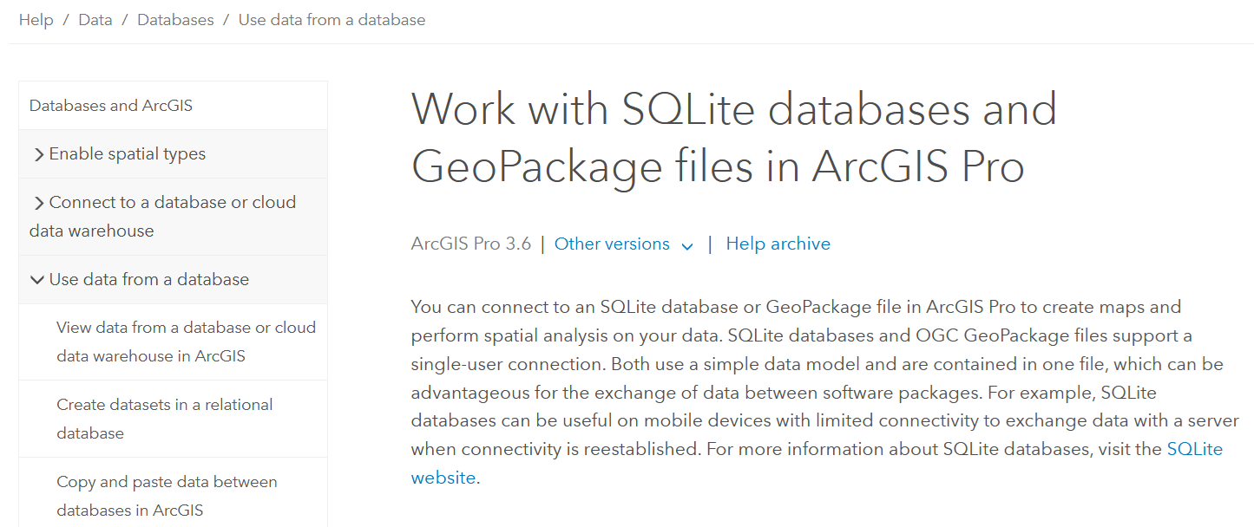
ArcGIS Pro: Working with GPKG
ESRI actually supports .gpkg to a limited extent (will explore later)

Slide 21
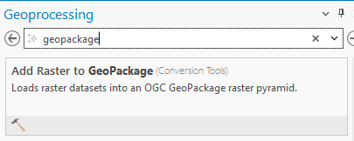
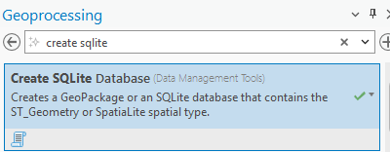
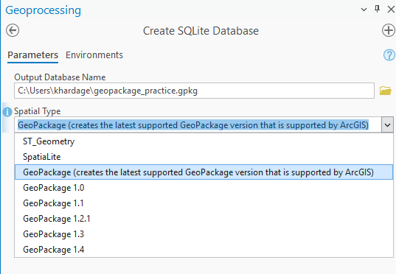
ArcGIS Pro: Working with GPKG
However, GPKG creation is obfuscated by not having an option to ‘export to GPKG’
Searching for ‘geopackge’ brings up only one option, to add a raster to an existing GPKG
Instead, create SQLite database and apply GPKG standard (note file type becomes .gpkg)

Slide 22
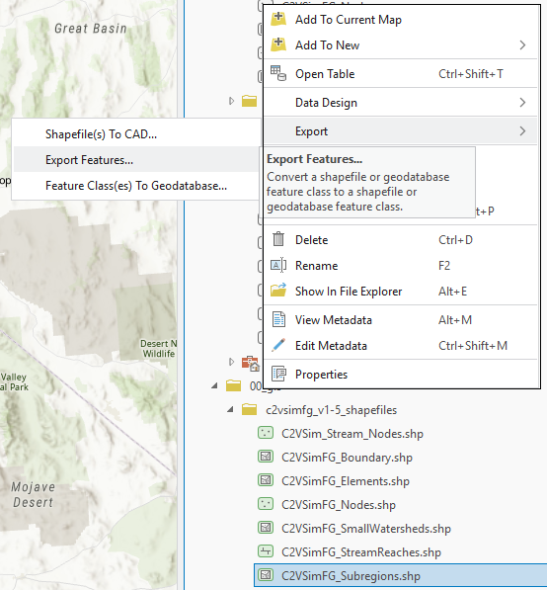
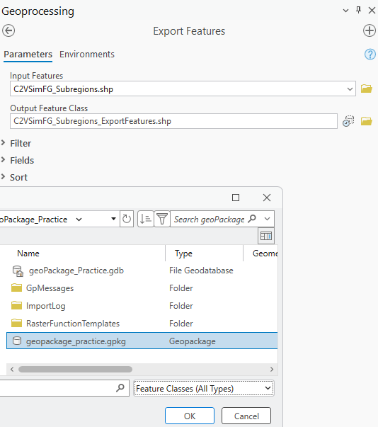
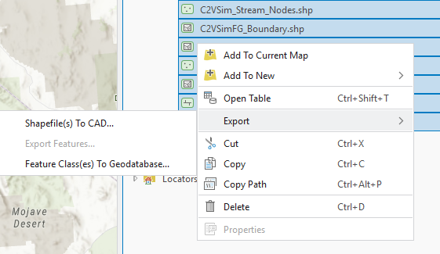
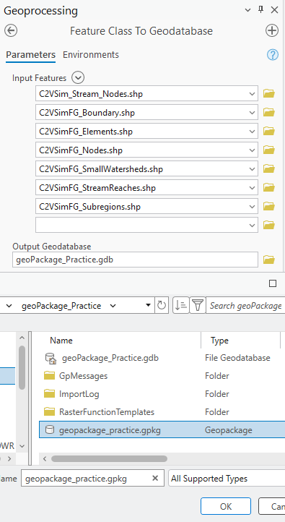
ArcGIS Pro: Working with GPKG
Now export shapefiles or gdb features to the GPKG you just created
NOTE: selecting 1 item offers ‘export’ option, selecting multiple uses Feature classes(s) to Geodatabase (so ESRI is implicitly calling GPKG a geodatabase
Export single feature
[no verb] send? multiple feature

Slide 23
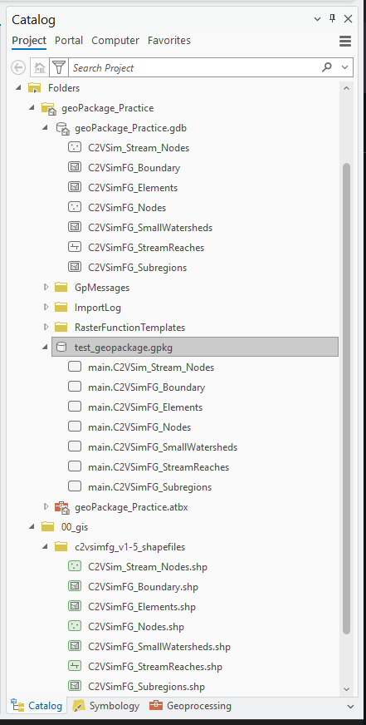
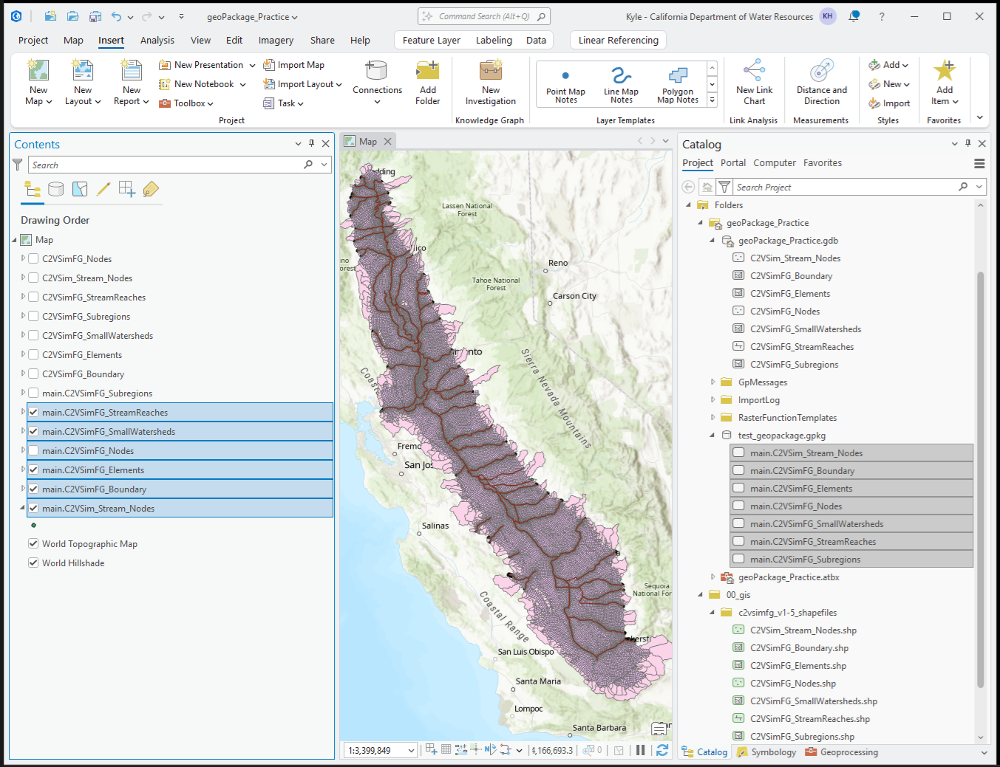
ArcGIS Pro: Working with GPKG
Result: a geodatabase-type geopackage
Note the lack of icons (a conscious decision)
.gdb
.gpkg
.shp

Slide 24
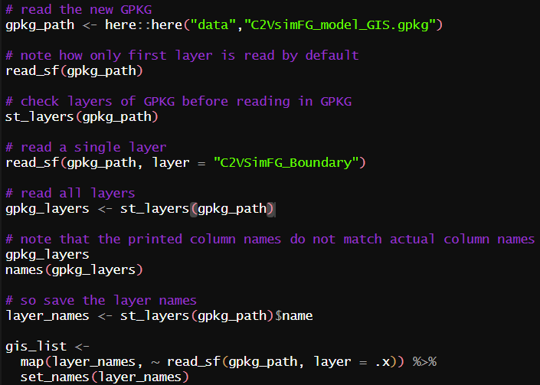
R: GPKG is native to sf
Read and write directly with read_sf()!
Just point to file path of .gpkg
NOTE! If multiple layers, read_sf() will default to (and warn) it only read the 1st
Use st_layers to retrieve all the layer names
Specify layer to read
Or use map() (or a for-loop) to read all

Slide 25
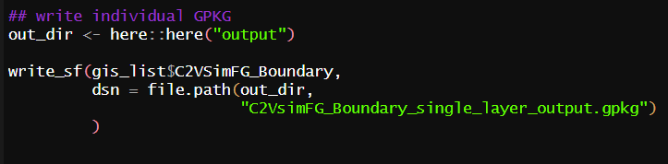
R: GPKG is native to sf
Write using write_sf to a data source name (dsn)
Will default to current working directory, so specify a file path

Slide 26

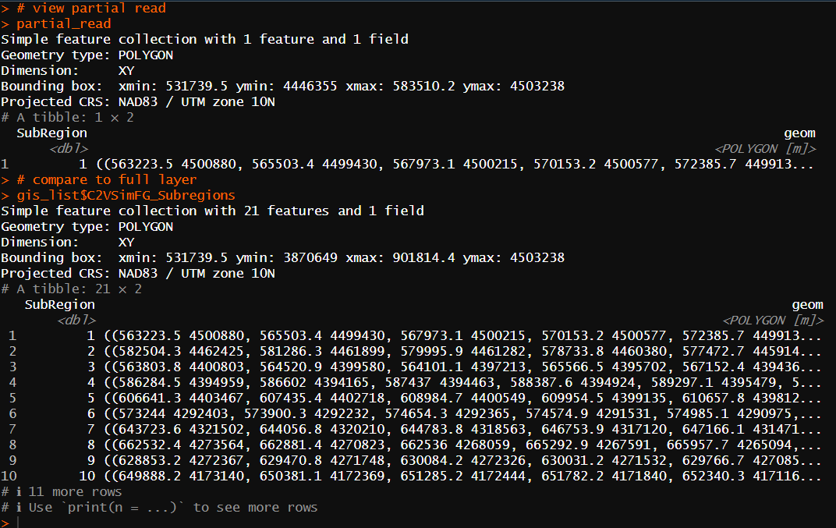
R: GPKG leverages SQLite
If dataset is very large, can send query directly to SQLite to pre-filter before loading into R session!
Uses the SQLite dialect of SQL (so may need to look up, or just have an LLM write it)
Superior if limited on RAM
Example: the State Water Board GAMA database for groundwater quality is 16+ GB of TEXT FILES
With spatial data, easily eats up to 32 GB RAM in one R session
Additional functionality with dplyr / dbplyr and RSQLite

Slide 27
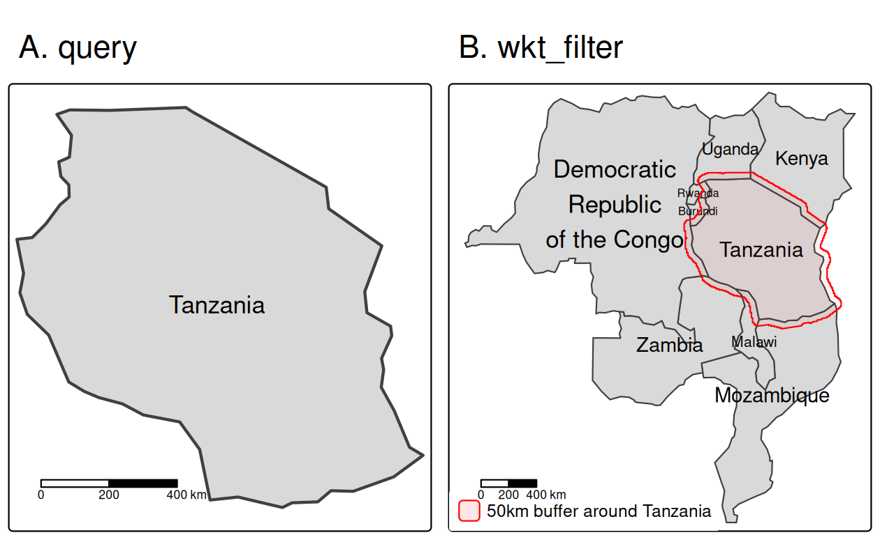
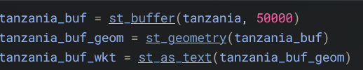
R: GPKG leverages SQLite
Spatial filter directly in GPKG before reading to R
Trick is to convert geometry to Well Known Text (WKT) which is queryable
Example from: https://r.geocompx.org/read-write#data-input
file_path/to/data.gpkg

Slide 28
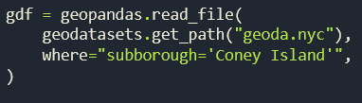

Python: GPKG is native to geopandas
I am not adept at python, but GPKG seems to behave like in R
https://geopandas.org/en/stable/docs/user_guide/io.html
Read/write appears to work much the same way as R ‘sf’
Read from .gpkg
Query .gpkg then read
Write .gpkg

Slide 29
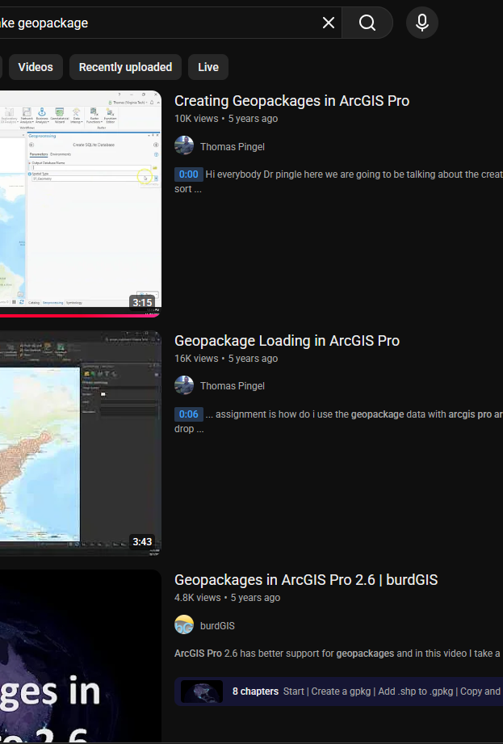
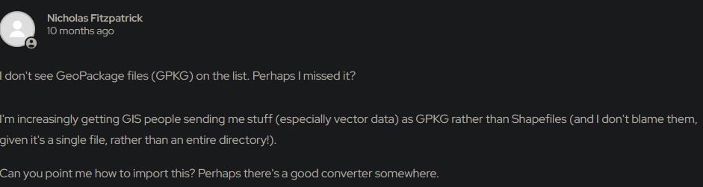
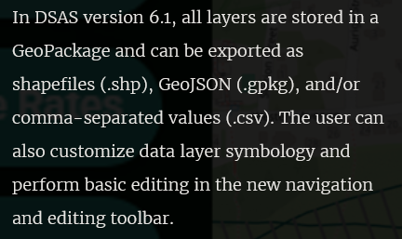
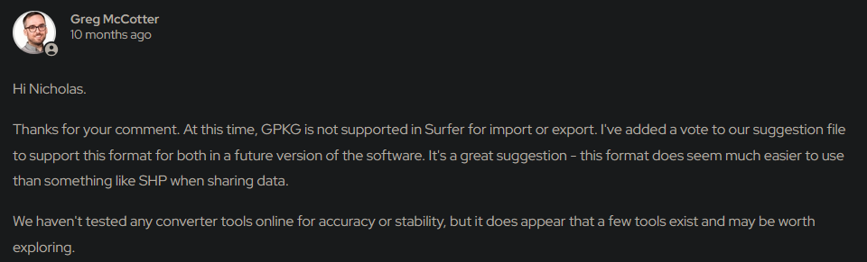
…is GPKG in the room with us now?
Despite advantages, why has GPKG not taken off?
YouTube videos commonly are from 5 YEARS AGO
A few reasons
ESRI proprietary solution with .gdb [seemingly directly from .shp]
External software dependencies (CAD / modeling software, Area of Interest uploads for websites)
Inertia (if it ain’t broke / we’ve always done it this way 🫠)
Lack of awareness…but rising!
5 years old 🤨
USGS Digital Shoreline Analysis Software
Comment exchange from Golden Software (geosciences software)

Slide 30
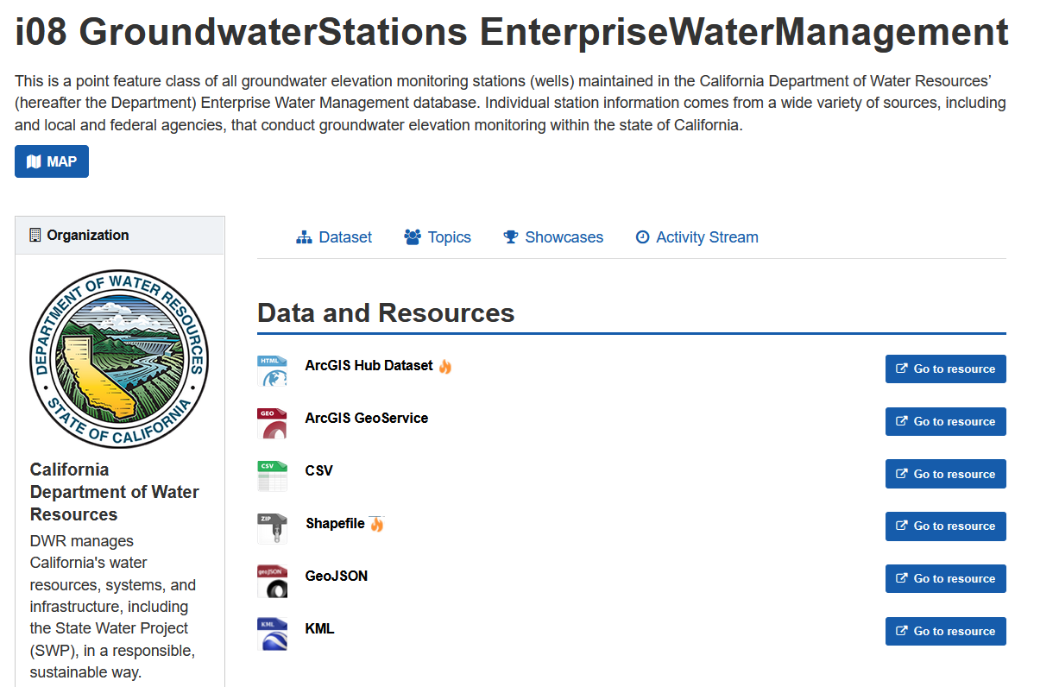
Another limitation: missing auto-export from AGOL
CNRA Open data uses automated exports from ESRI AGOL
Results in several spatial formats on CNRA pages
Currently there is no support for GPKG exports
This is not a technical limitation but a decision by ESRI
Increasing usage by GIS practitioners would create demand for support

Slide 31
Practical migration guidance
If largely working within ESRI ecosystem / cloud:
Continue to use ESRI .gdb for enterprise production
However, export to SQLite .gpkg instead of .shp for portable sharing or working in R / python
If not dependent on ESRI for day-to-day use:
Try GeoPackages!
Script to batch-convert .shp to .gpkg for projects
Include the .gpkg in your R Projects or Jupyter directories
And when shapefile is needed…
Export it from the .gdb or .gpkg
Treat it as file of last resort

Slide 32

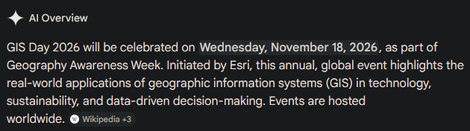
Summary
GeoPackage (.gpkg) is a modern, robust, open, future-proof SQLite database container with OGC Encoding Standards
Supports vector, raster, attributes, and metadata
Single file, full name support, more data types (NULL, datetime)
Compatible with R, Python, QGIS, and Arc Pro
SQL query benefits external to IDE
Less corruptible, syncs to State resources (OneDrive) 😌
Easily portable
Goal: learn more by GIS Day!

Slide 33
Links
❗Geocomputation with R (2026). Lovelace, Nowosod, and Muenchow. Detailed spatial format input / output in R (AMAZING, read sections 8.1 – 8.4): https://r.geocompx.org/read-write
Literally a whole website dedicated to shapefile alternatives: http://switchfromshapefile.org/
ArcGIS Blog (good overview of GPKG in the ESRI world): https://www.esri.com/arcgis-blog/products/product/data-management/how-to-use-ogc-geopackages-in-arcgis-pro
Comparison of spatial data types (GPKG, KML, GDB): https://www.touchgis.app/blog/what-is-geopackage-gpkg
GeoPackage vs. PostGIS (when to use what): https://www.gispo.fi/en/blog/geopackage-vs-postgis/
GeoPackge vs. Shapefiles: https://www.geoeasy.world/blog/comparing-shapefiles-and-geopackages-gpkg-a-detailed-analysis
Reading, writing, and inspecting GPKG in R: https://mgimond.github.io/Spatial/reading-and-writing-spatial-data-in-r.html
Intro the R package ‘gpkg’ https://cran.r-project.org/web/packages/gpkg/vignettes/intro.html
Python geopandas read/write with GPKG: https://geopandas.org/en/stable/docs/user_guide/io.html
QGIS GeoPackage creation example: https://qgis-in-mineral-exploration.readthedocs.io/en/latest/source/geological_data/geopackages.html
SQLite in Arc Pro: https://pro.arcgis.com/en/pro-app/latest/help/data/databases/work-with-sqlite-databases-in-arcgis-pro.htm
Cheatsheet for various SQL dialects: https://github.com/enochtangg/quick-SQL-cheatsheet
Geopackage standards: https://www.geopackage.org/
DWR GeoPackage creation training (DWR access only, sorry y’all): SharePoint link

Slide 34
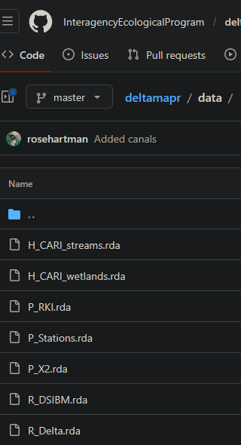
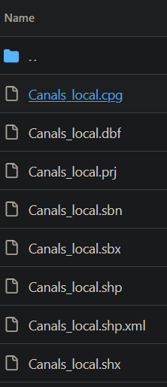
Aside: applicability to ‘deltamapr’ package
‘deltamapr’ comes packaged with GIS data
Formats are native R .rda
Likely to circumvent .shp limitations
If exporting to share, consider .gpkg
Can be read in R or python
Can be read in Arc Pro
Can be read in QGIS
Easily transferrable
Do you need separate .gpkg files?
Could have a function to export to .gpkg automatically

