Slide 1
RMarkdown
A flexible way to write code and reproducable reports

Slide 2
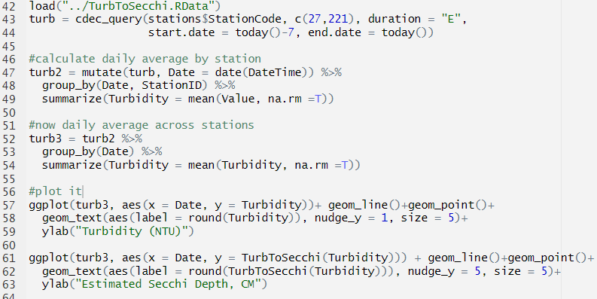
Code is hard to read
Notes:
For people who understand code, it’s easy to navigate an R file with a few comments, however we requently want to communicate the results of our analyses to people who don’t read code. So we often set up reports that include analysis results, plots, and discussion in one document. Sometimes we even want the code available for those that do read code.

Slide 3
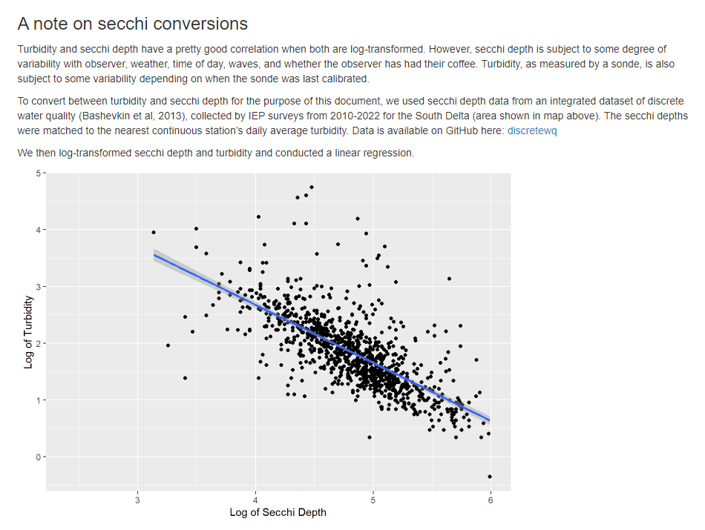
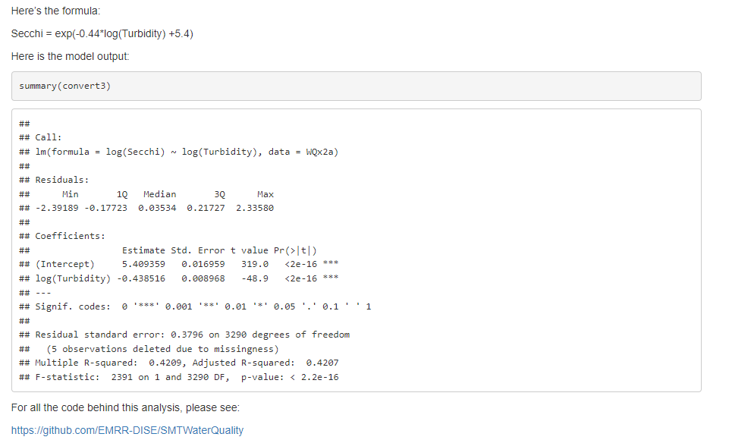
Automation is the best!
Notes:
Ideally, we could automatically generate the plots and include text and code ouputs all together. Then we could just re-run the script any time there were updaets. That is what R Markdown is for.

Slide 4
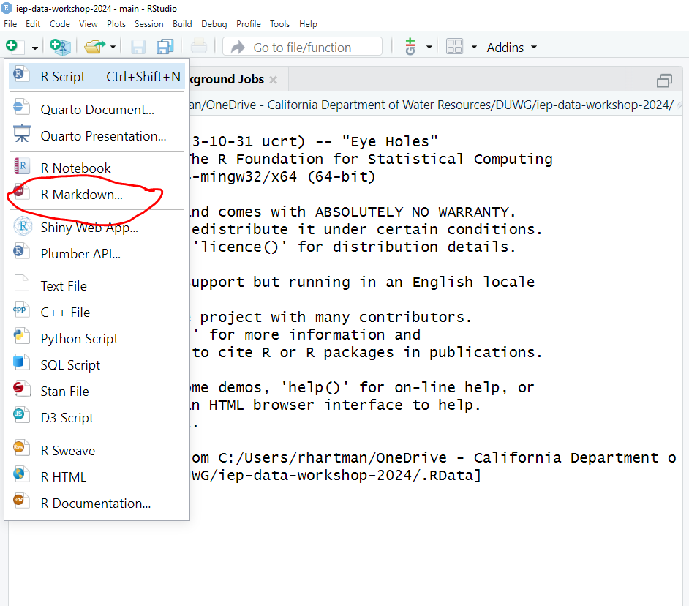
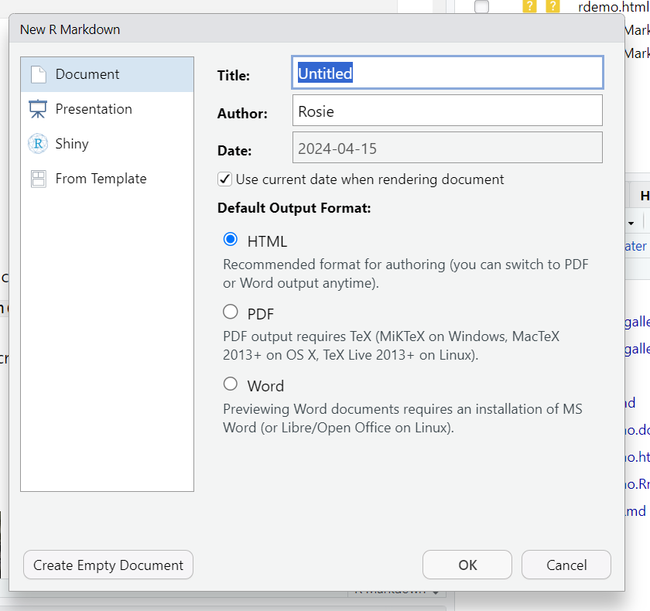
Rstudio integration
Notes:
Just hit the green plus mark on the paper symbol in the upper left, or go to file-new-markdown doc. You have some options for title, author excitera. This then automatically fills out your YAML header (more on that later)

Slide 5
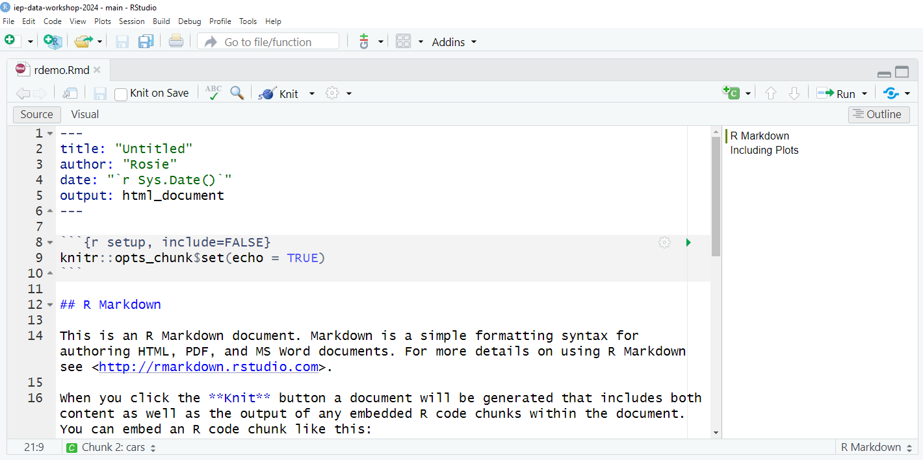
Anatomy
Outline
YAML header
Code chunk
Markdown chunk

Slide 6
Markdown formatting
Pandoc markdown
https://www.rstudio.com/wp-content/uploads/2015/03/rmarkdown-reference.pdf
css style sheets for fancy formatting

Slide 7
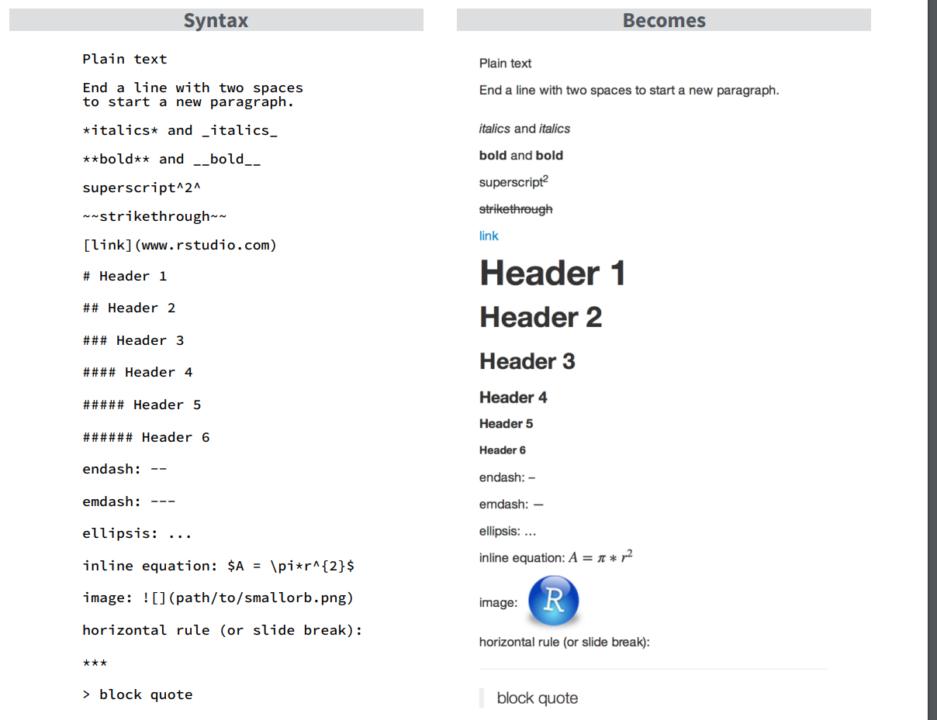

Slide 8
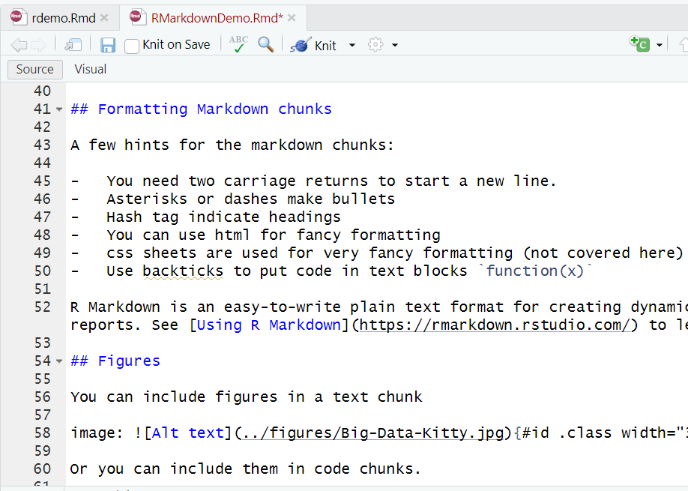
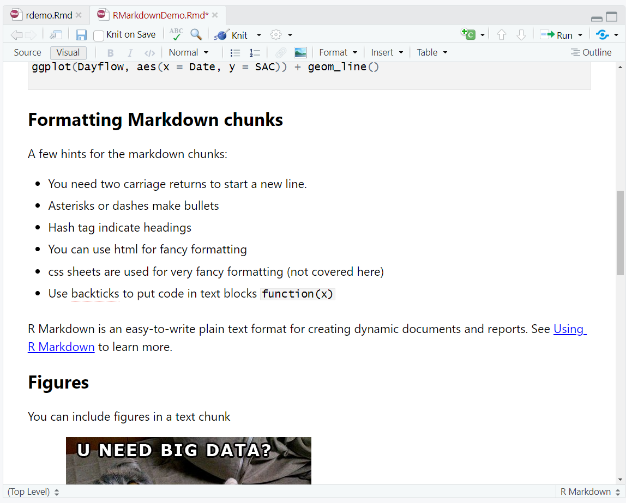
Source versus Visual editing
Source
Visual
Notes:
Rather than trying to remember all that markdown syntax yourself, you can also edit your document in ‘visual’ mode, which lets you edit it the same way you would a word document. You can switch back and forth at any time.

Slide 9
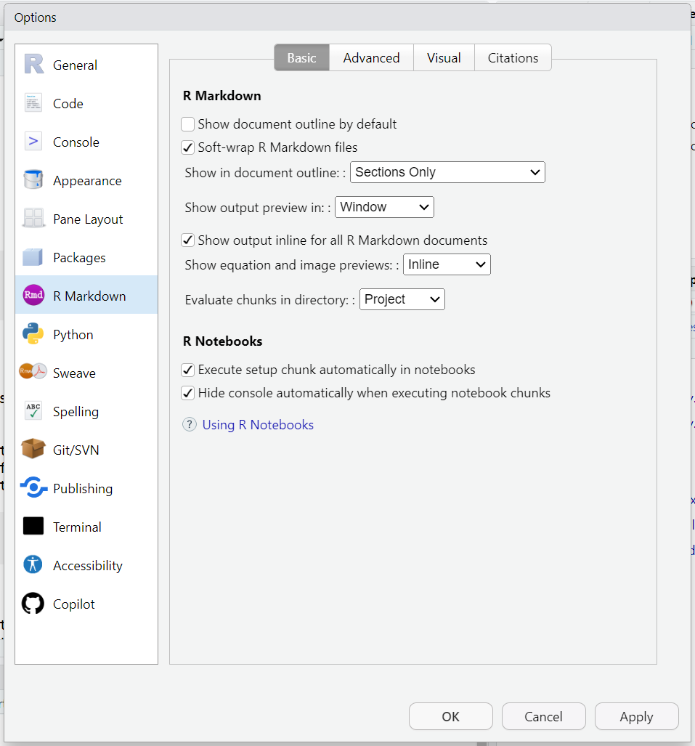
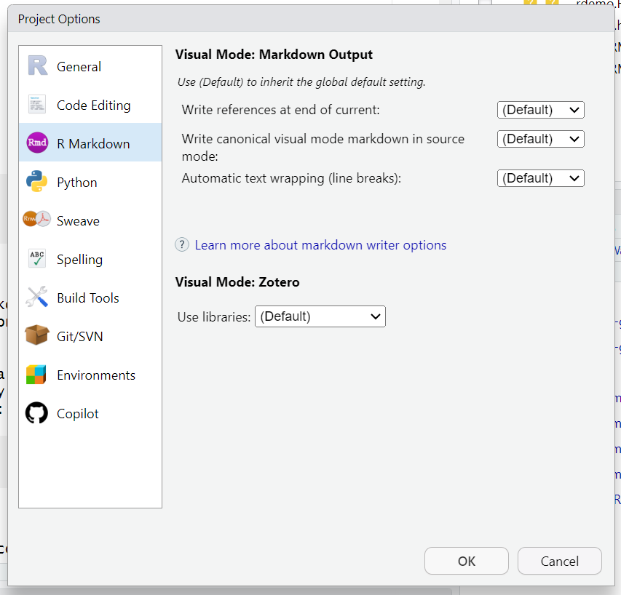
Other settings
Global options
Project options
Notes:
You can set other options in the global options menu or the project options menu. In particular, note the ‘show output preview’ optinos, the ‘evaluate chunk’ options. Mostly you can use the defaults here, but it’s nice to know these exist.

Slide 10
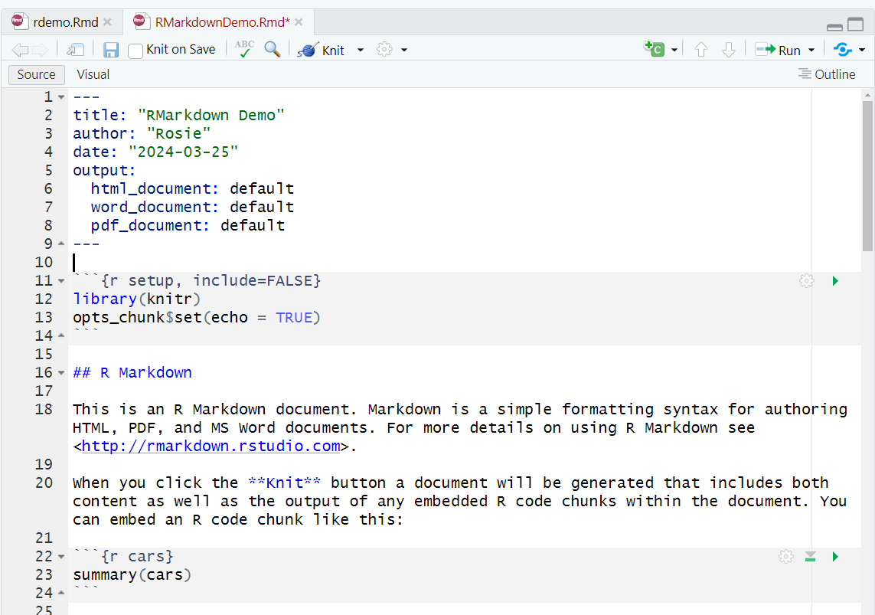
Running code
Run current chunk
Run all chunks above

Slide 11
Go to RStudio
Demo running code

Slide 12
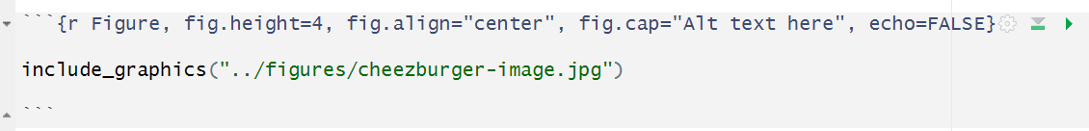
Chunk options
Some chunk options built in
Name of chunk
Chunk options
echo = TRUE
eval = TRUE
include = TRUE
error = TRUE
message = TRUE
warning = TRUE
dev = ‘png’
dpi = 72
fig.align = ‘default’
fig.height, fig.width = 7
fig.cap = NULL

Slide 13
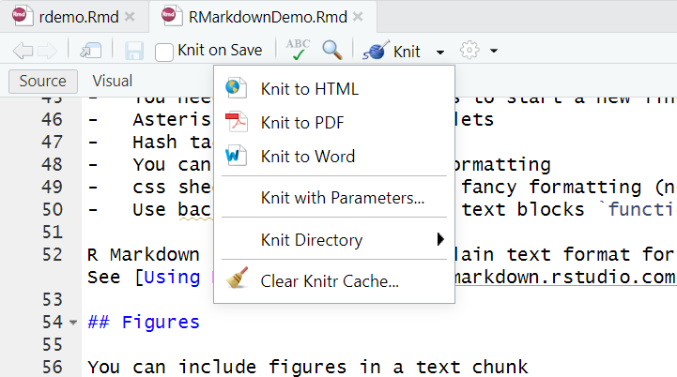
Kitting
Knit to HTML – default
Knit to PDF/word requires LaTex, extra installation

Slide 14
Go To Rstudio
Demo knitting

Slide 15
This is just the beginning!
Go to Rmarkdown gallery

Slide 16
Questions?

