Slide 1
Quarto RMarkdown
A flexible way to write code and reproducible reports
Rosemary Hartman
2024-4-18

Slide 2

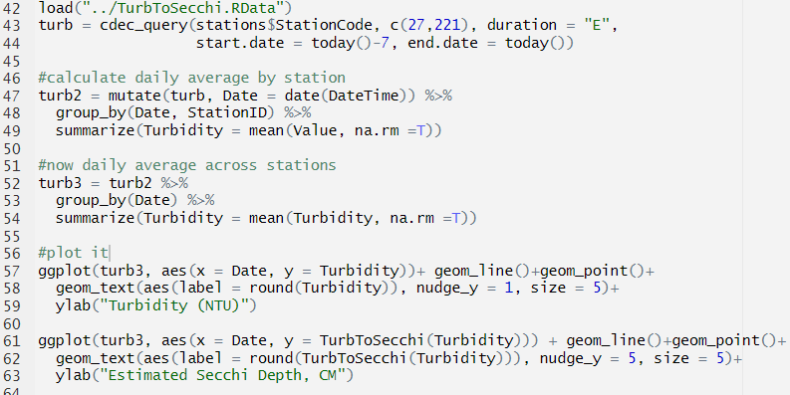
Code is hard to read
Notes:
For people who understand code, it’s easy to navigate an R file with a few comments, however we requently want to communicate the results of our analyses to people who don’t read code. So we often set up reports that include analysis results, plots, and discussion in one document. Sometimes we even want the code available for those that do read code.

Slide 3
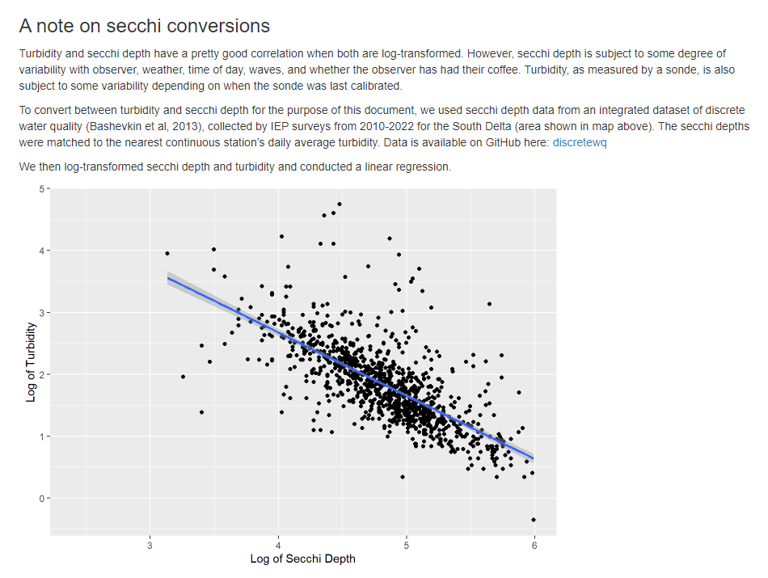
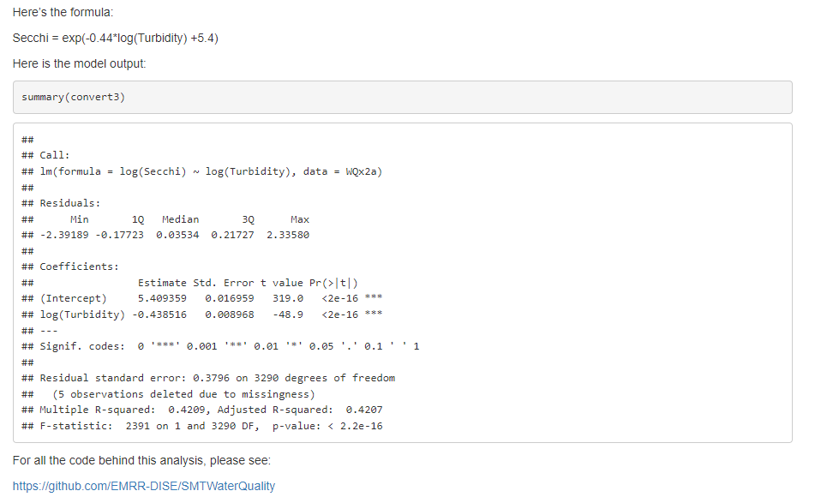
Automation is the best!
Notes:
Ideally, we could automatically generate the plots and include text and code ouputs all together. Then we could just re-run the script any time there were updaets. That is what quarto is for.
This is an example of a remote I made that updates automatically every day! Pretty basic, but there are a lot of more advanced options.

Slide 4

Quarto versus RMarkdown
Quarto
Rmarkdown
More functionality
New standard
More code languages supported
Does not require R
Previous standard
R-specific
But really they are basically the same thing…

Slide 5
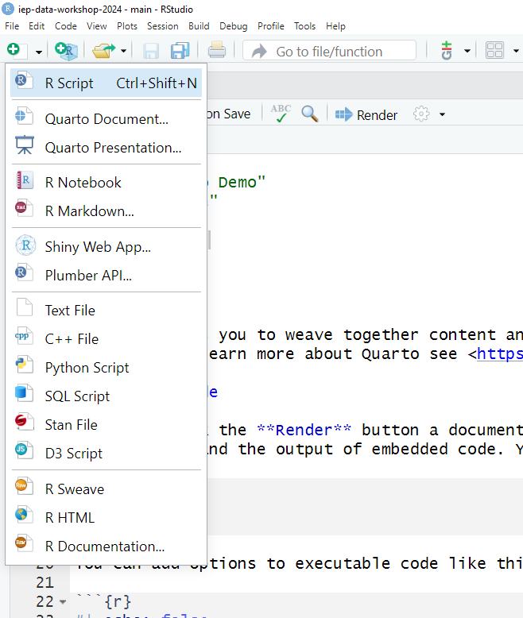
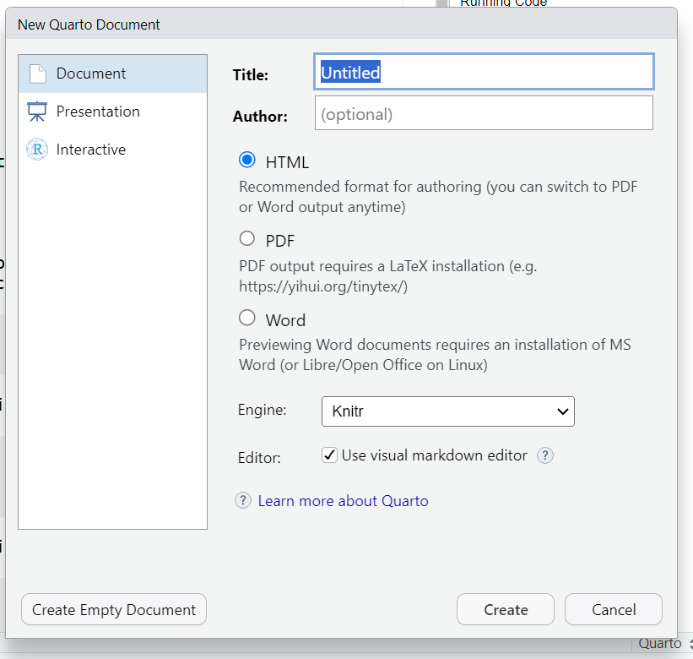
Rstudio integration
Notes:
Just hit the green plus mark on the paper symbol in the upper left, or go to file-new-markdown doc. You have some options for title, author excitera. This then automatically fills out your YAML header (more on that later)

Slide 6
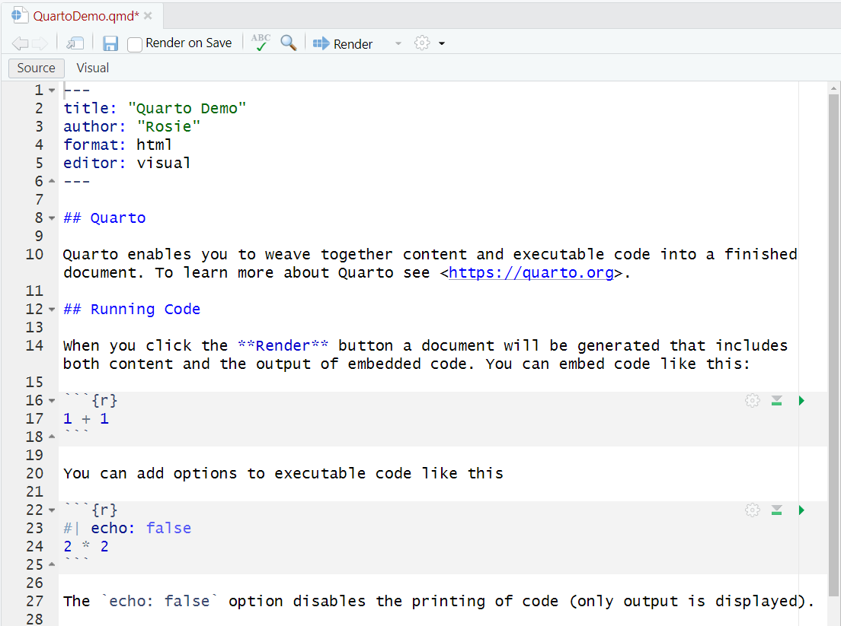
Anatomy
YAML header
Markdown chunk
Code chunk

Slide 7


Markdown formatting
Input
Pandoc markdown
https://quarto.org/docs/authoring/markdown-basics.html
css style sheets for fancy formatting
Output
Notes:
Your markdown chunks are formatted using pandoc markdown, though you can also include html (if you’re usin gHTML for the final report)

Slide 8
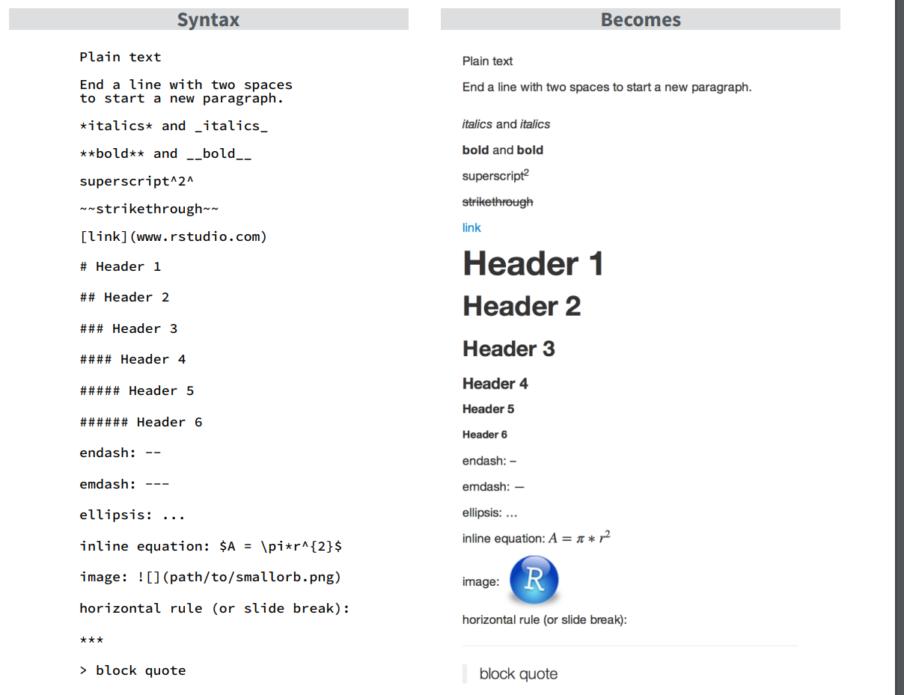

Slide 9
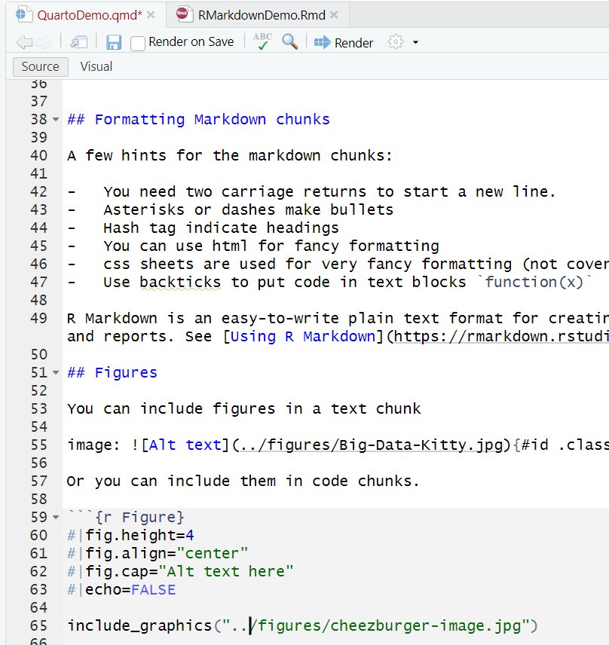
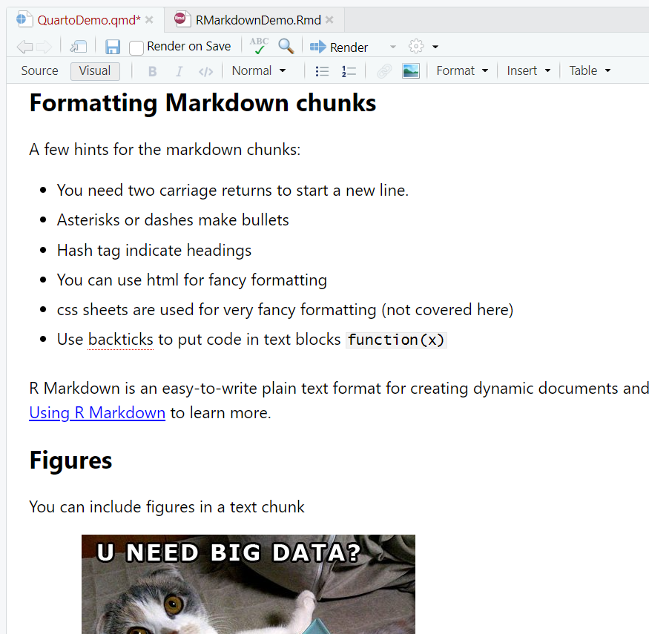
Source versus Visual editing
Source
Visual
Notes:
Rather than trying to remember all that markdown syntax yourself, you can also edit your document in ‘visual’ mode, which lets you edit it the same way you would a word document. You can switch back and forth at any time.

Slide 10
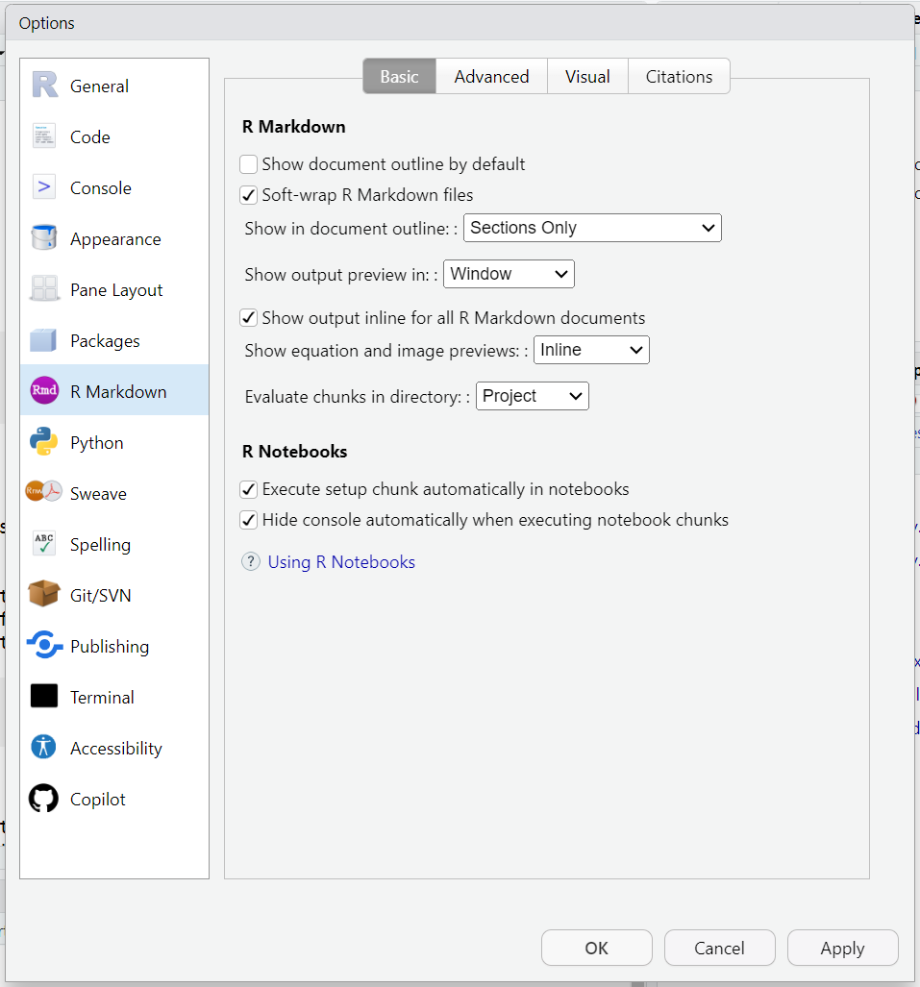
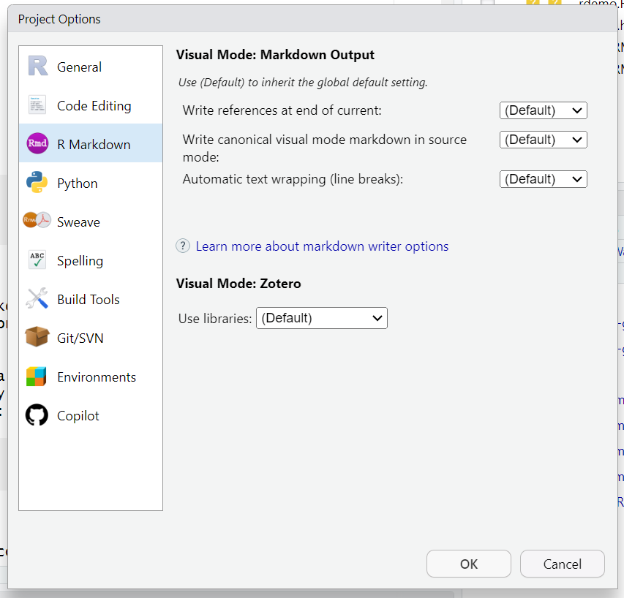
Other settings
Global options
Project options
Notes:
You can set other options in the global options menu or the project options menu. In particular, note the ‘show output preview’ optinos, the ‘evaluate chunk’ options. Mostly you can use the defaults here, but it’s nice to know these exist.

Slide 11
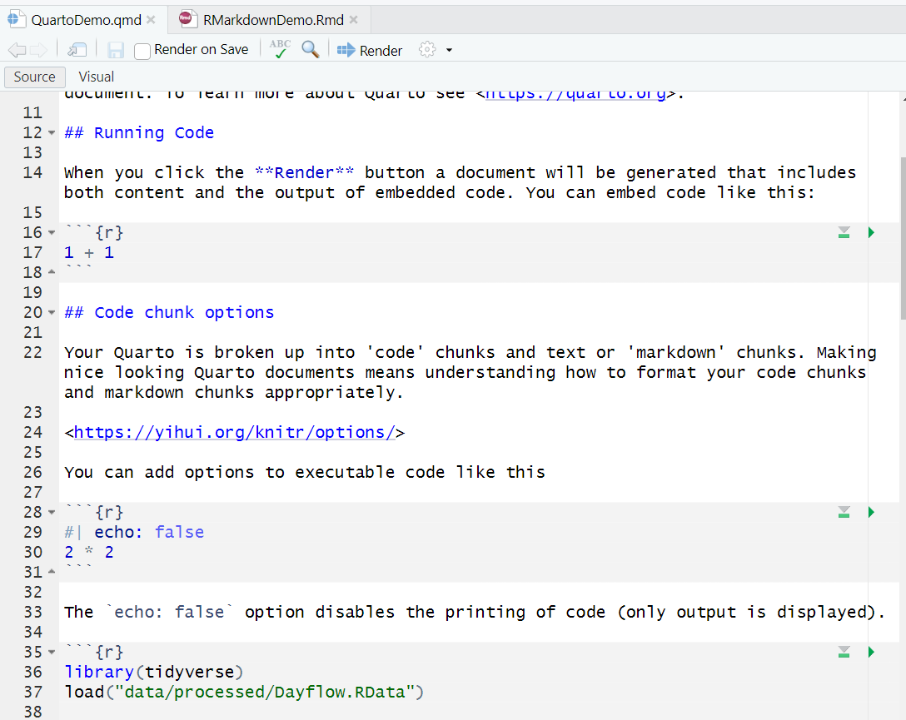
Running code
Run current chunk
Run all chunks above

Slide 12
Go to RStudio
Demo running code

Slide 13
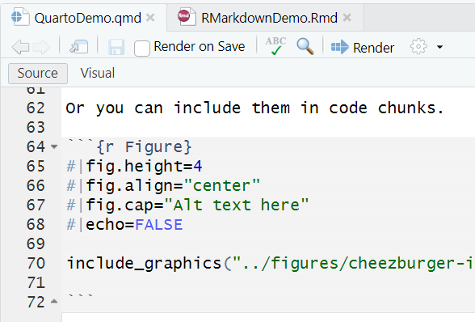
Chunk options
echo = TRUE
eval = TRUE
include = TRUE
error = TRUE
message = TRUE
warning = TRUE
Name of chunk
dev = ‘png’
dpi = 72
fig.align = ‘default’
fig.height, fig.width = 7
fig.cap = NULL
Chunk options

Slide 14
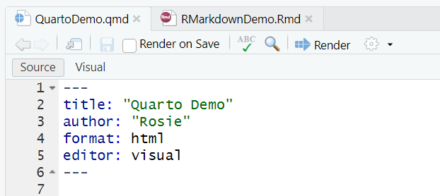
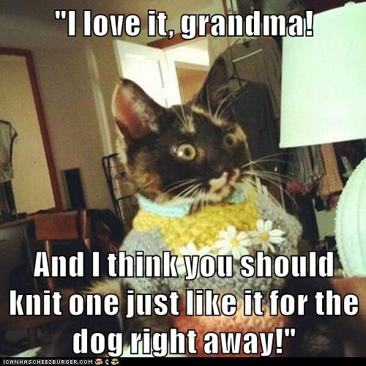
Rendering (knitting)
format: html – default
format: pdf - requires LaTex, extra installation

Slide 15
Go To Rstudio
Demo rendering

Slide 16

This is just the beginning!
Go to Quarto gallery
https://quarto.org/
https://quarto.org/docs/gallery/

Slide 17
Questions?

