Slide 1


Data Management, Visualization and Access Workshop
Catarina Pien
Bureau of Reclamation
IEP Workshop | April 18, 2024
Notes:
Welcome to today’s workshop, which we can consider the kickoff of the IEP workshop.
Thanks for participating today outside of the regular workshop slot, and we hope this is valuable for everyone.
We will be recording the workshop today, so anyone who misses it can watch at a later date.

Slide 2

Open
Transparency of the scientific process
The Open and Transparent Water Data Act (AB 1755) (2016)
Open Government Initiative – OPEN Government Data Act
FAIR principles
What does FAIR stand for?
Applicable to data/metadata, tools, workflows
FAIR Principles - GO FAIR (go-fair.org)
Image source: https://scijinks.gov/science/
Notes:
- Today we will be framing our workshop around open science, which emphasize transparency along the entire scientific process from data collection to analysis
- Benefits: Give you credit for the work you’ve done (citations)
Bigger impact of the data
Saves time for less data requests
Build trust
- In recent years the state and federal government have also been encouraging or requiring an increase in making data more public and transparent, which has led to there being more work on this front by gov’t agencies
- The FAIR principles are often discussed in conjunction with open science, as they describe some of the qualities desired for open science.
Freedom of Information Act
Public Records Act

Slide 3
Menti.com
https://www.menti.com/alghyxy4cn3a
Code: 5615 1936
What does FAIR stand for?

Slide 4
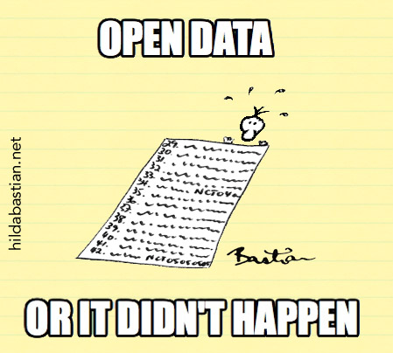
FAIR Principles
F indability
A ccessibility
I nteroperability
R euse
Data and metadata indexed together in searchable resource
Associated with globally unique and persistent identifier (e.g. DOI)

Slide 5
FAIR Principles
Data and metadata easily retrieved/downloaded by identifier
Protocols/Methods open, free, implementable
F indability
A ccessibility
I nteroperability
R euse

Slide 6
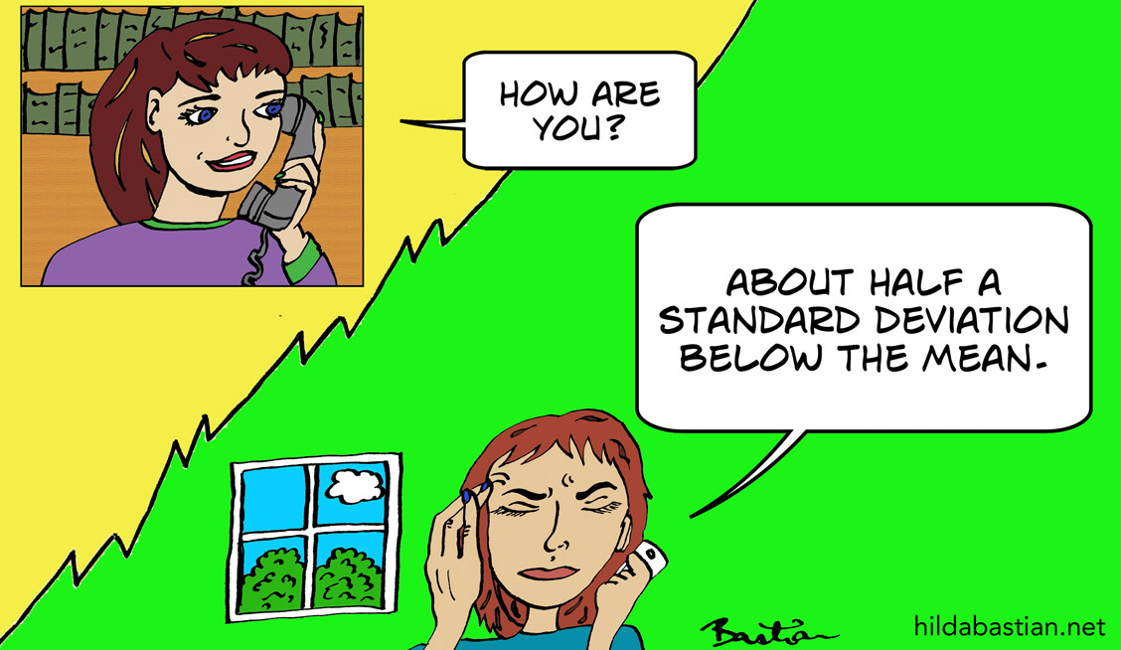
FAIR Principles
Use shared, relevant vocabularies, terminology, data standards
Data organized to be read and aggregated easily with other sources
Machine readable across different systems, software, hardware
F indability
A ccessibility
I nteroperability
R euse
Notes:
Use formats appropriate for individuals/ computers. Annotations using community standards, formats.
Definition: Ability for data to work across systems with differing hardware and software

Slide 7
FAIR Principles
Descriptive metadata
Inclusion of complementary files (code, documentation) needed to understand data/analysis
Clear, detailed provenance (data sources)
Clear, accessible usage license
F indability
A ccessibility
I nteroperability
R euse
Notes:
Assets downloadable for reuse

Slide 8



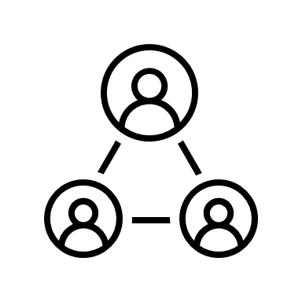




Challenges
An Open Data Framework for the San Francisco Estuary (SFEWS)
Lack of time, funding
Lack of knowledge for how to share data
Balance of data quality and timeliness of data
Misuse of data
Ownership of data

Slide 9
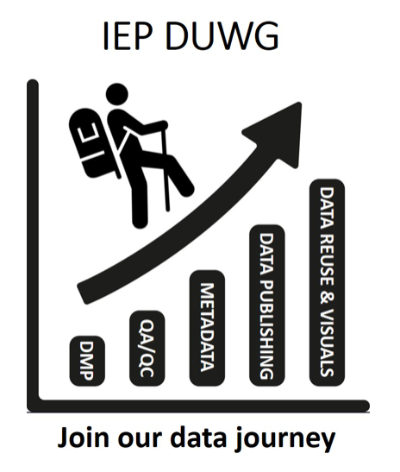
IEP Data Utilization Workgroup
Define shared data standards (data descriptions, documentation) across member agencies
Promote efficient and open data management practices by providing templates and resources for community
Provide support for member agencies, coordinate across other groups
Contact:
Sam Bashevkin (sam.bashevkin@waterboards.ca.gov) Dave Bosworth (David.Bosworth@water.ca.gov)
IEP Data Utilization Working Group (ca.gov)
Notes:
Templates – metadata, data management plans, SOP
Resources – data publication guidance and terminology, fish QA/QC guidance
Current and previous subcommittees: data publication, digital data entry, quality assurance

Slide 10




Workshop Objectives
Share practices and methods that support open science, FAIR principles
Provide data managers and users with resources, templates, guidance for data management
Share data sources, packages, code for streamlined, transparent data analysis, synthesis
Connect community with visualization tools, code, venues for increasing and improving data communication

Slide 11
Data Management and Access
9:10 Data Management (35 minutes)
9:45 Coded Data Access (30 minutes)
10:20 Break (15 minutes)
10:35 Metadata and Data Publication (75 minutes)
11:50 Break (1 hour)
12:50 Visualization Tools (60 minutes)
1:50 Break (15 minutes)
2:05 Visualization Examples (50 minutes)
2:55 Panel Q&A (30 minutes)
3:25 Closing (5 minutes)
Visualization
Agenda

Slide 12
Data Management and Access
9:10 Data Management (35 minutes)
9:45 Coded Data Access (30 minutes)
10:20 Break (15 minutes)
10:35 Metadata and Data Publication (75 minutes)
11:50 Break (1 hour)
Data management plan
Structure and format of data
Quality assurance/ Quality control
Data sharing
Notes:
Quick overviews for data management, structuring and formatting data, qa/qc, and data sharing

Slide 13





Data Management and Access
9:10 Data Management (35 minutes)
9:45 Coded Data Access (30 minutes)
10:20 Break (15 minutes)
10:35 Metadata and Data Publication (75 minutes)
11:50 Break (1 hour)

Slide 14

Data Management and Access
9:10 Data Management (35 minutes)
9:45 Coded Data Access (30 minutes)
10:20 Break (15 minutes)
10:35 Metadata and Data Publication (75 minutes)
11:50 Break (1 hour)

Slide 15





Visualization
1:50 Break (15 minutes)
2:05 Visualization Examples (50 minutes)
2:55 Panel Q&A (30 minutes)
3:25 Closing (5 minutes)
12:50 Visualization Tools (60 minutes)

Slide 16
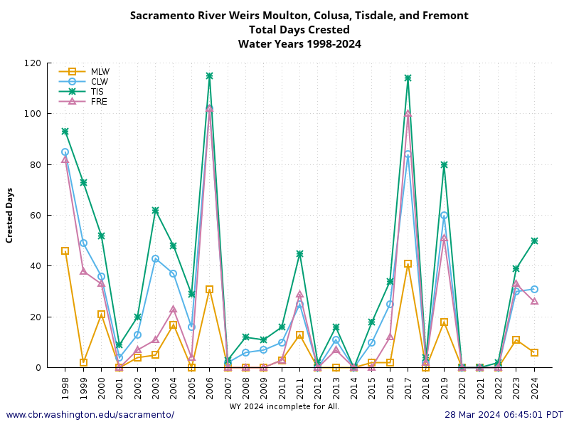

Bay-Delta Live
Visualization
1:50 Break (15 minutes)
2:05 Visualization Examples (50 minutes)
2:55 Panel Q&A (30 minutes)
3:25 Closing (5 minutes)
12:50 Visualization Tools (60 minutes)

Slide 17


Save questions for the end
Put questions in the Teams chat
1:50 Break (15 minutes)
2:05 Visualization Examples (50 minutes)
2:55 Panel Q&A (30 minutes)
3:25 Closing (5 minutes)
12:50 Visualization Tools (60 minutes)

Slide 18

To be shared out:
Resource list
Templates
Guidance
Useful data packages
Synthesized datasets
Examples of tools demonstrated
Other resources
Code and slides from this workshop: https://github.com/InteragencyEcologicalProgram/iep-data-workshop-2024/tree/main
Recording of this training (youtube)

Slide 19





Thanks
Christine Joab, Rosie Hartman, Dave Bosworth, Sam Bashevkin, Trinh Nguyen, Rachel Pisor, Denise Goodman, Nicole Kwan, Perry, Susannah Iltis, Amye Osti
DUWG and IEP community
See speaker bios (with contact info): https://nrm.dfg.ca.gov/FileHandler.ashx?DocumentID=220327&inline

