Slide 1



Coded Data Access with R
Dave Bosworth
CA Department of Water Resources (DWR)
Division of Integrated Science and Engineering (DISE)
Collaborative Science and Innovation Section (CSI)
Notes:
Data Utilization Working Group (DUWG)
This is a large topic, so this is meant to be a brief overview of topic – beginner to intermediate-level
Someone will put the link to the code used in this tutorial in the chat, so you can follow along if you like

Slide 2

What are we talking about here?
Using code to import data into R from an external (non-local) and open source
NOT: importing data from your hard drive, shared network, or SharePoint
Notes:
Typically accessing open data from online sources such as online data portals or repositories

Slide 3
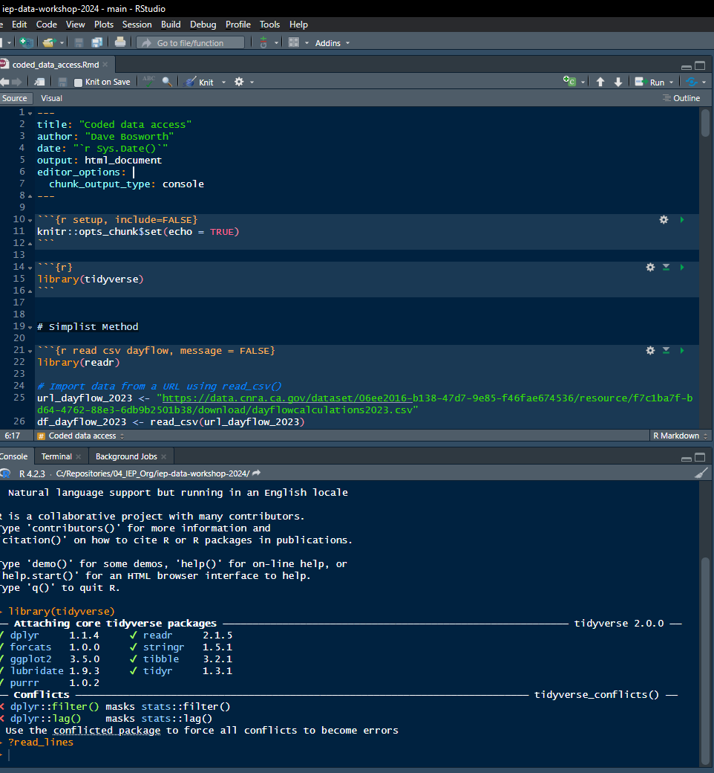
Outline
Simple Methods
Dedicated R packages
IEP Integrated datasets
Notes:
Dedicated R packages – help with accessing data, specific to Bay-Delta and IEP

Slide 4
Why bother?
Convenience
Efficiency
Reproducibility
Transportable
Versioning
Notes:
My preferred method for reproducible workflow – since its accessing open data available online
Keep track of updates
Be aware of changing versions of data in your data source
Also, may be good to save local copies if you’re concerned in the long-term availability of data

Slide 5
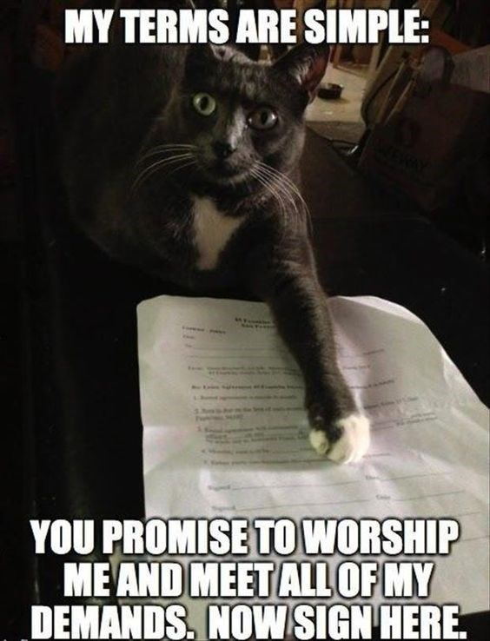
Simple Methods
read_csv() or read.csv() with a URL
download.file() to tempdir(), then import

Slide 6

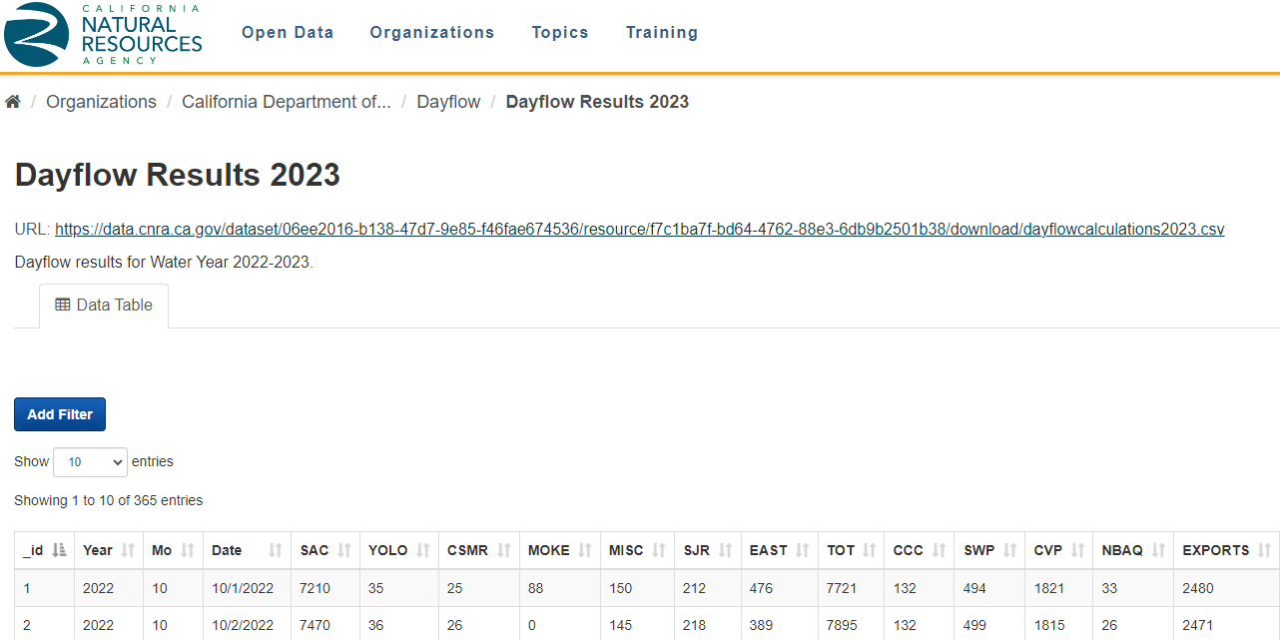

read_csv() with URL
Simple Methods
Use this workflow when URL points to a csv file
https://data.cnra.ca.gov/dataset/dayflow/resource/f7c1ba7f-bd64-4762-88e3-6db9b2501b38
Notes:
In this example, we’ll import Dayflow data for 2023 from CNRA data portal

Slide 7
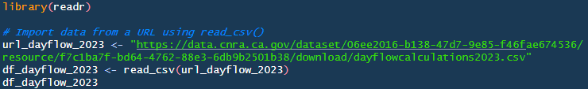
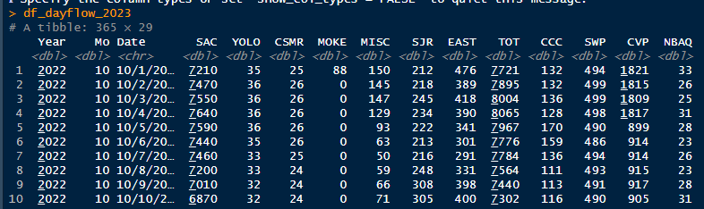
read_csv(“url”)
Simple Methods
Copy URL for csv file

Slide 8
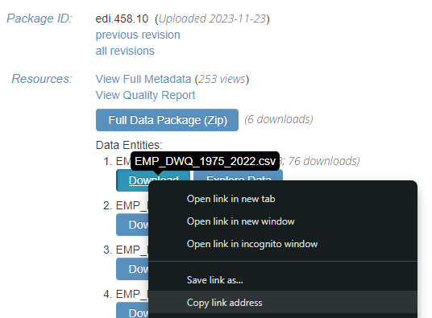
download.file() then import
Simple Methods
May need to use this workflow with certain file types – xlsx, pdf, zip
https://portal.edirepository.org/nis/dataviewer?packageid=edi.458.10&entityid=cf231071093ac2861893793517db26f3
EMP discrete water quality EDI data package: https://portal.edirepository.org/nis/mapbrowse?packageid=edi.458.10
Notes:
First mention when you would need to use this workflow
In this example, we’ll import EMP discrete WQ data from the Environmental Data Initiative (EDI) data repository

Slide 9
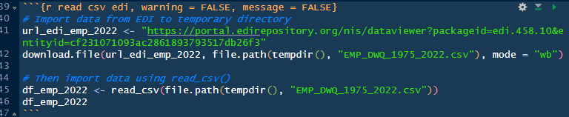
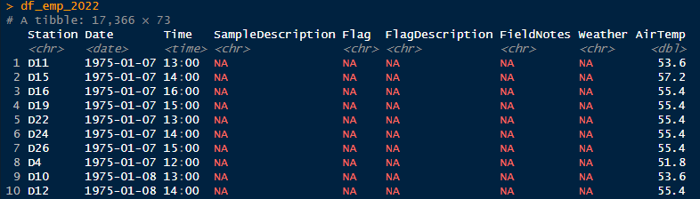
download.file() then import
Simple Methods

Slide 10
Dedicated R packages
EDIutils – EDI data
dataRetrieval – USGS NWIS
cder – CDEC data
Notes:
EDI = Environmental Data Initiative
NWIS = National Water Information System
CDEC = California Data Exchange Center

Slide 11


EDIutils
Dedicated R Packages
REST API client for the Environmental Data Initiative (EDI)
Allows for searching, accessing, and uploading data from R environment
Package documentation: https://docs.ropensci.org/EDIutils/
Available on CRAN
Notes:
These slides will be made available after the workshop, so I included links to documentation and installation for future reference

Slide 12
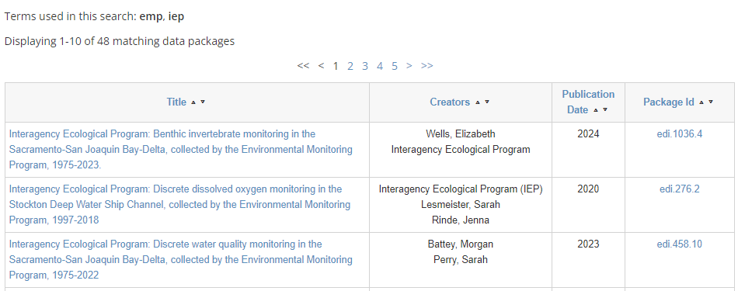

EDIutils
Dedicated R Packages
https://portal.edirepository.org/nis/simpleSearch
Notes:
Highlight some of the package functions by running through an example

Slide 13
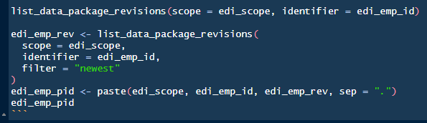

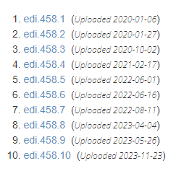

list_data_package_revisions()
Dedicated R Packages - EDIutils

Slide 14

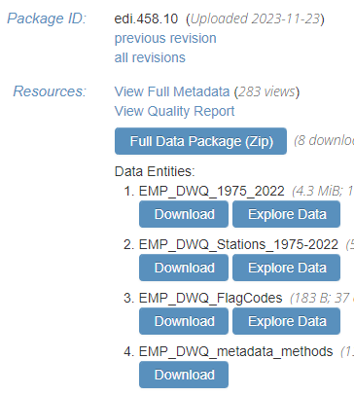
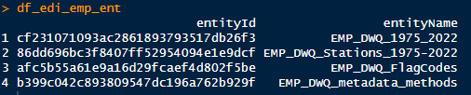
read_data_entity_names()
Dedicated R Packages - EDIutils
Notes:
There can be more than one component or “data entity” within a data package

Slide 15
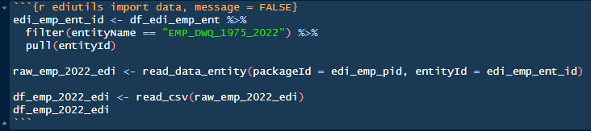
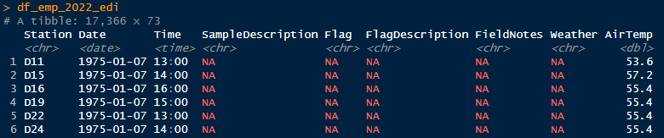
read_data_entity()
Dedicated R Packages - EDIutils
NOTE:
read_data_entity() imports data as raw bytes, need to use a reader function with it

Slide 16

dataRetrieval
Dedicated R Packages
Allows for loading USGS data into the R environment
NWIS and WQP web services
Package documentation: https://doi-usgs.github.io/dataRetrieval/
Available on CRAN
Notes:
NWIS = National Water Information System
WQP = Water Quality Portal – data from USEPA, USDA, USGS

Slide 17
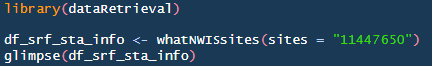
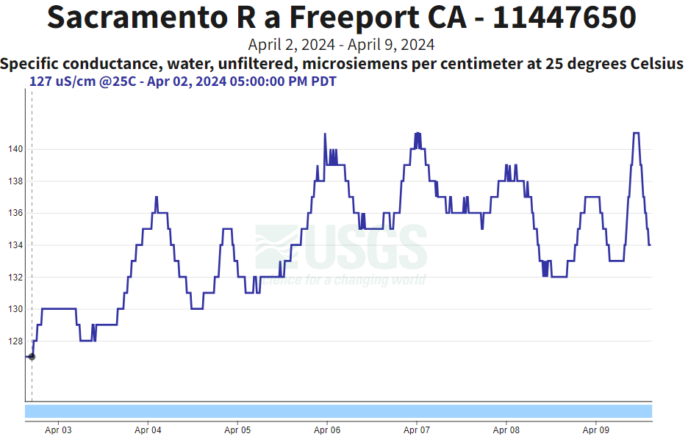
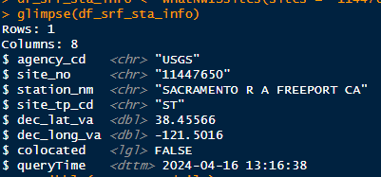
whatNWISsites()
Dedicated R Packages - dataRetrieval
Provides site information from NWIS
USGS Water Data: https://waterdata.usgs.gov/monitoring-location/11447650/
Notes:
We’ll focus on the NWIS web services
I’ll briefly show how to use the WQP web service functions later
Again, I’ll highlight some of the package functions by running through an example

Slide 18

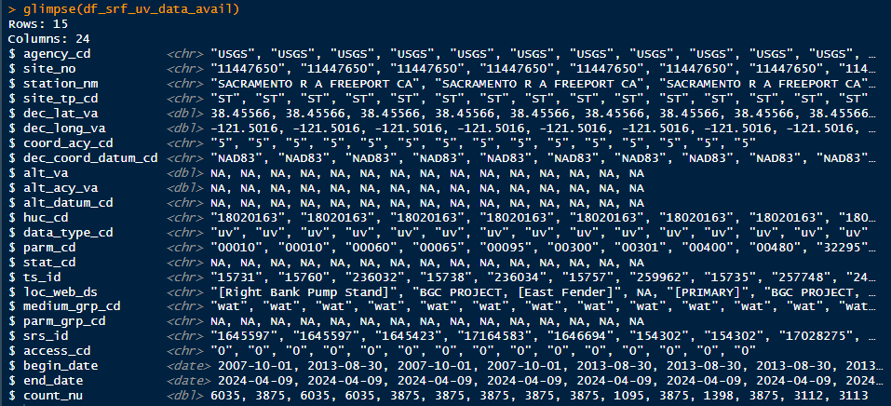
whatNWISdata()
Dedicated R Packages - dataRetrieval
Provides data availability for a site from NWIS
USGS Parameter Code
Period of record, Sample count
Notes:
Optional argument ‘service’, “uv” stands for instantaneous data

Slide 19
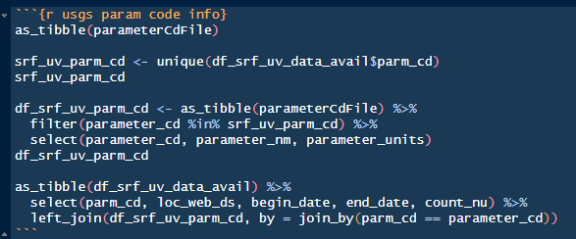
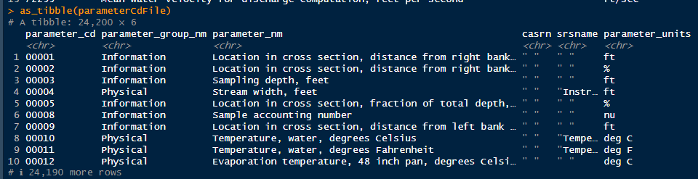
parameterCdFile
Dedicated R Packages - dataRetrieval
Complete list of USGS parameter codes
Parameter codes: https://help.waterdata.usgs.gov/codes-and-parameters/parameters
Notes:
To help with decoding the parameter codes, there is a table within the package that contains a list of all USGS parameter codes
Can search this table to learn more about the parameter code you’re interested in
Can also use this link to a USGS website provided here that helps with searching for parameter codes

Slide 20
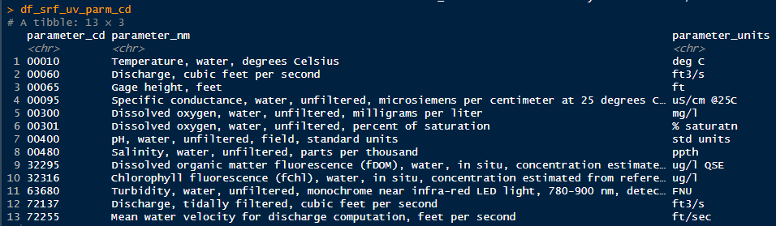
parameterCdFile - filtered
Dedicated R Packages - dataRetrieval
Notes:
So here is the parameter code list filtered to only show parameters collected at SR at Freeport

Slide 21
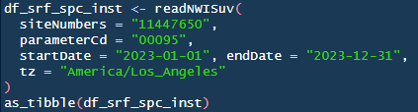
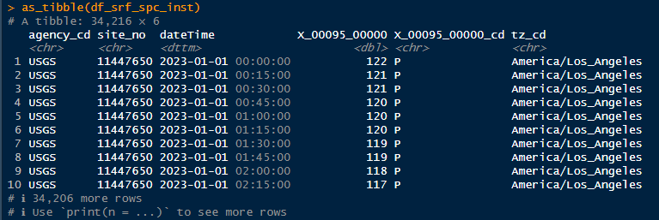
readNWISuv()
Dedicated R Packages - dataRetrieval
Import instantaneous data (“uv”) for one or more stations and parameters from NWIS
readNWISdv() –
Import daily data (“dv”) from NWIS
Same arguments with the addition of ‘statCd’:
‘00001’ – daily maximum
‘00002’ – daily minimum
‘00003’ – daily mean (default)
‘00006’ – daily sum
‘00008’ – daily median
https://help.waterdata.usgs.gov/code/stat_cd_nm_query?stat_nm_cd=%25&fmt=html
Notes:
Mention that you can provide more than one site number or parameter at a time
Point out data and quality code columns
A = approved
P = provisional

Slide 22
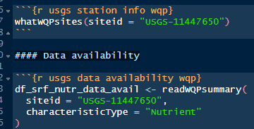
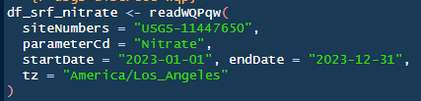
WQP Web Services
Dedicated R Packages - dataRetrieval
1) whatWQPsites() – Station Information
NOTE:
WQP functions require “USGS-” prefix for site codes
2) readWQPsummary() – Data availability
3) readWQPqw() – Import data
Notes:
These are the functions you want to use for accessing discrete WQ data collected by USGS
whatWQPsites – similar to whatNWISsites
readWQPsummary - Similar to whatNWISdata, optional argument ‘characteristicType’
Refer to package documentation for more information about these

Slide 23
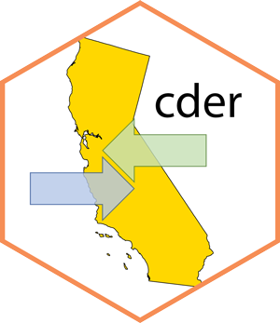
cder
Dedicated R Packages
Web API client for the California Data Exchange Center (CDEC)
Allows for importing data into the R environment
Package documentation: https://hydroecology.net/cder/index.html
Available on CRAN
Notes:
Mention other R packages for CDEC: CDECRetrieve, sharpshootR

Slide 24
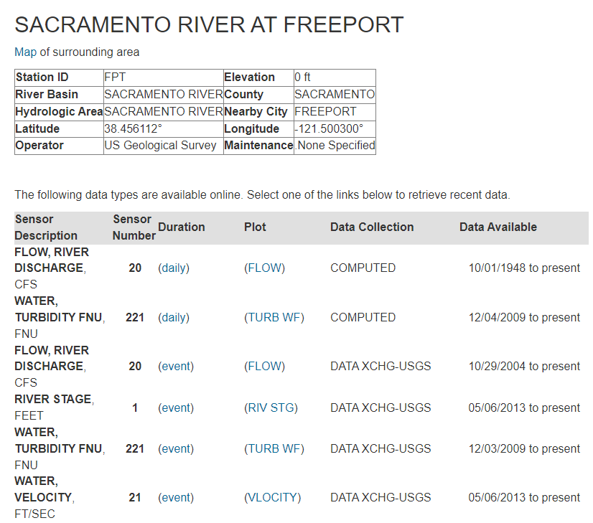

cdec_meta()
Dedicated R Packages - cder
Station information from CDEC

Slide 25
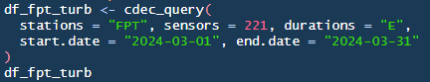
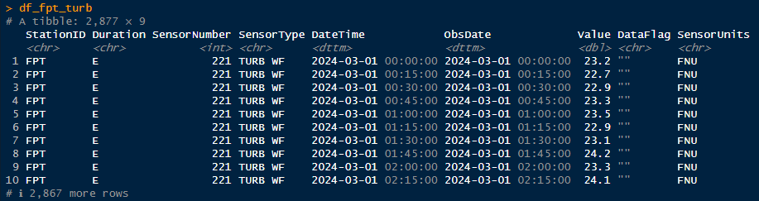
cdec_query()
Dedicated R Packages - cder
Import data for one or more stations and sensors from CDEC
Options for ‘durations’ argument:
‘E’ – event
‘H’ – hourly
‘D’ – daily
‘M’ – monthly

Slide 26

IEP Integrated datasets
deltafish
zooper
discretewq
deltamapr
Need to use “devtools::install_github()” function to install these packages
Also, for Windows computers, need to have RTools installed: https://cran.r-project.org/bin/windows/Rtools/

Slide 27

deltafish
IEP Integrated datasets
Provides easy query access to the very large published EDI dataset of IEP fish abundance and length data
1959-2021 from 9 surveys: Bay Study, FMWT, EDSM, 20mm, SLS, SKT, DJFMP, Suisun Marsh, STN
Available on GitHub: https://github.com/Delta-Stewardship-Council/deltafish
EDI data repository: https://portal.edirepository.org/nis/mapbrowse?scope=edi&identifier=1075

Slide 28
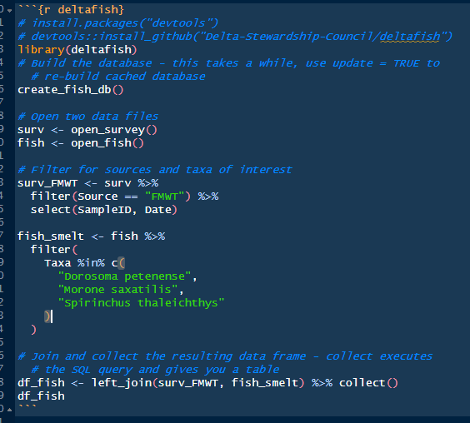
Build and load database
IEP Integrated datasets - deltafish
1) Build and cache database – set ‘update’ to TRUE to rebuild to latest version
2) Open two data files in database
Notes:
‘create_fish_db’ caches a local copy on your computer. After package installation, only need to run it once for each EDI update

Slide 29
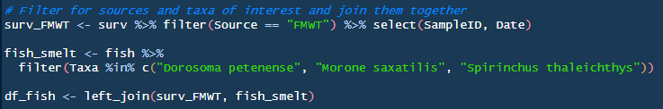
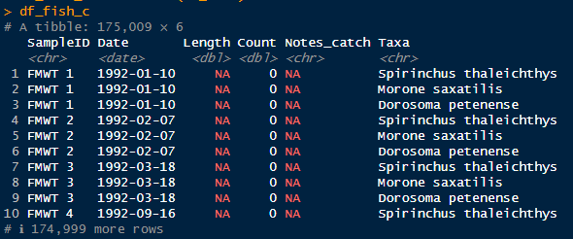

Build and run query
IEP Integrated datasets - deltafish
3) Build query by using ‘dplyr’ functions
4) Run query and import data into R workspace using ‘dplyr::collect()’
Notes:
Dorosoma petenense = Threadfin shad
Morone saxatilis = Striped bass
Spirinchus thaleichthys = Longfin smelt

Slide 30

zooper
IEP Integrated datasets
Allows for downloading and integrating IEP zooplankton data
1972-2021 from 7 surveys: 20mm, DOP, FRP, EMP, STN/FMWT, YBFMP, IEP zooplankton study
Available on GitHub: https://github.com/InteragencyEcologicalProgram/zooper
EDI data repository: https://portal.edirepository.org/nis/mapbrowse?scope=edi&identifier=539
Notes:
Data set is periodically published on EDI as a static version

Slide 31
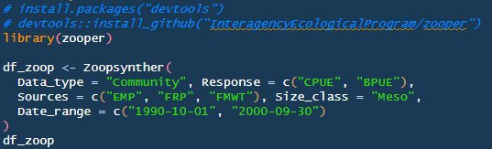
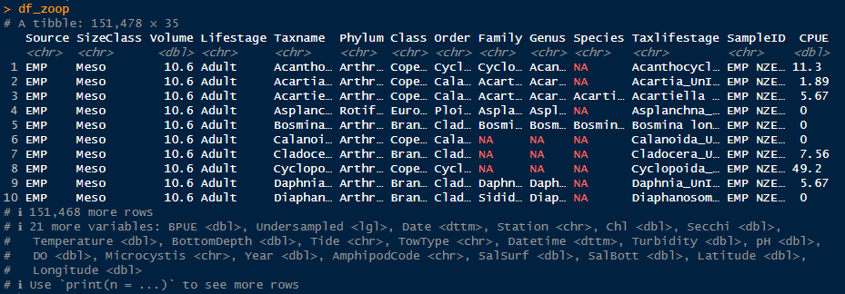
Zoopsynther()
IEP Integrated datasets - zooper
Use ‘Data_type’ argument to choose between two approaches to resolving differences in taxonomic resolution:
‘Taxa’ - all available data on given Taxa
‘Community’ - to conduct a community analysis
Notes:
Also mention Response, Sources, and Size_class (BPUE = biomass)

Slide 32

discretewq
IEP Integrated datasets
Provides an integrated dataset of IEP water quality data
1959-2022 from 16 surveys: Bay Study, FMWT, EDSM, 20mm, SLS, SKT, SDO, EMP, YBFMP, DJFMP, USBR-SDWSC, Suisun Marsh, STN, USGS-SFBS, USGS-CAWSC, DWR-NCRO
Available on GitHub: https://github.com/InteragencyEcologicalProgram/discretewq
EDI data repository: https://portal.edirepository.org/nis/mapbrowse?scope=edi&identifier=731
Notes:
Data set is periodically published on EDI as a static version

Slide 33
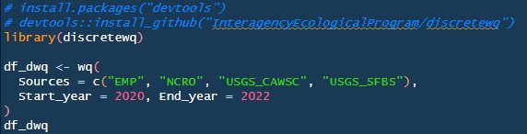
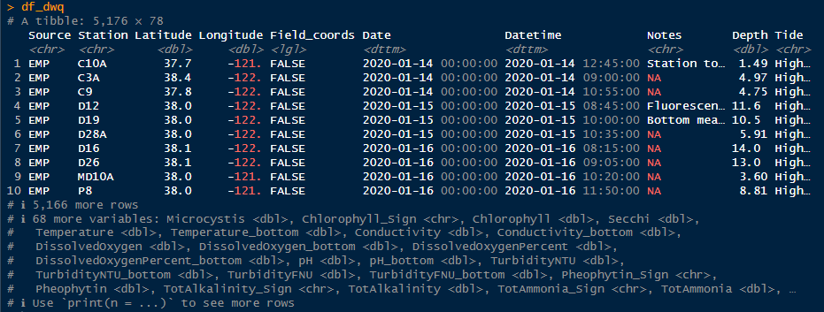
wq()
IEP Integrated datasets -discretewq

Slide 34
deltamapr
IEP Integrated datasets
Provides spatial data for the SF Bay-Delta
Data objects stored in ‘sf’ format as four data types:
Waterways (WW)
Regions (R)
Habitats (H)
Stations/Points (P)
See GitHub repository for list of data available: https://github.com/InteragencyEcologicalProgram/deltamapr
Notes:
sf = simple features, or I like to think of as spatial features

Slide 35
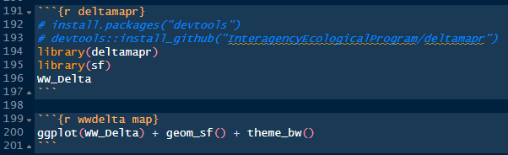
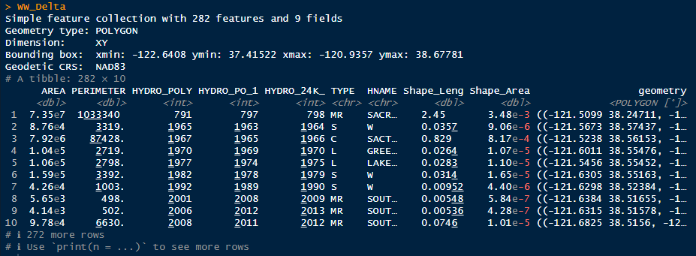
WW_Delta
IEP Integrated datasets - deltamapr
Notes:
Also need to load the sf package to work with this spatial data
WW_Delta data object = Delta Waterways

Slide 36
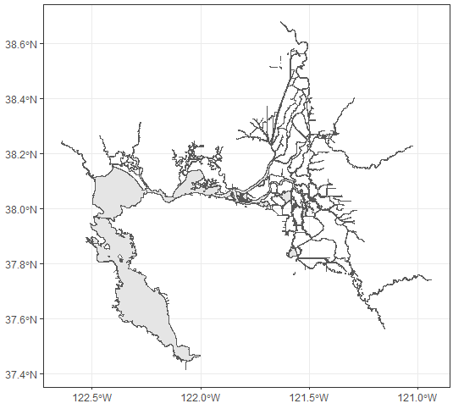
WW_Delta
IEP Integrated datasets - deltamapr

Slide 37

Other Resources
rvest package – Web scraping https://rvest.tidyverse.org/index.html
pdftools package – Extracting data from .pdf file https://docs.ropensci.org/pdftools/
contentid package – work with external data through content identifiers https://cboettig.github.io/contentid/
Code from this tutorial https://github.com/InteragencyEcologicalProgram/iep-data-workshop-2024/blob/main/coded_data_access/coded_data_access.Rmd
Notes:
That concludes this tutorial. I hope you found it to be useful.
Here are a few additional resources for accessing online data

Slide 38
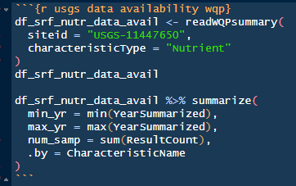
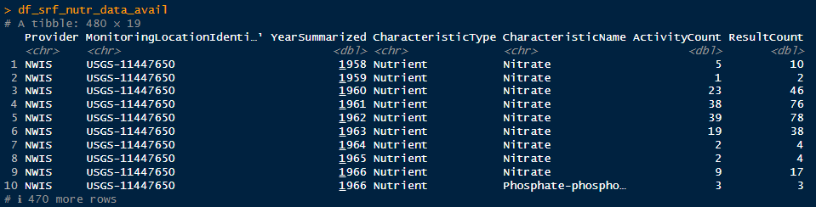
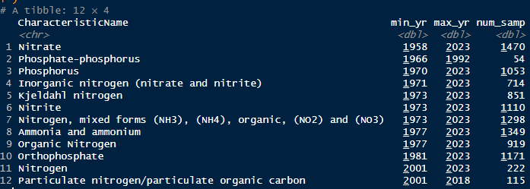
readWQPsummary()
Dedicated R Packages - dataRetrieval
Provide data availability for a site from WQP
Notes:
Similar to whatNWISdata
Optional argument ‘characteristicType’

Slide 39
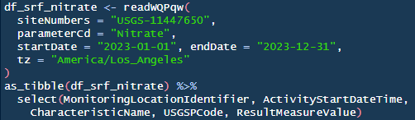
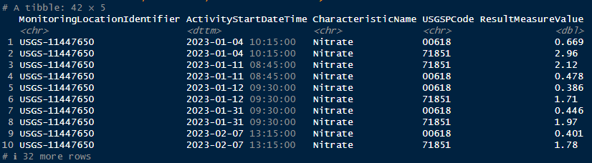
readWQPqw()
Dedicated R Packages - dataRetrieval
Import water quality data (“qw”) from WQP
Notes:
Note more than one parameter code

Slide 40
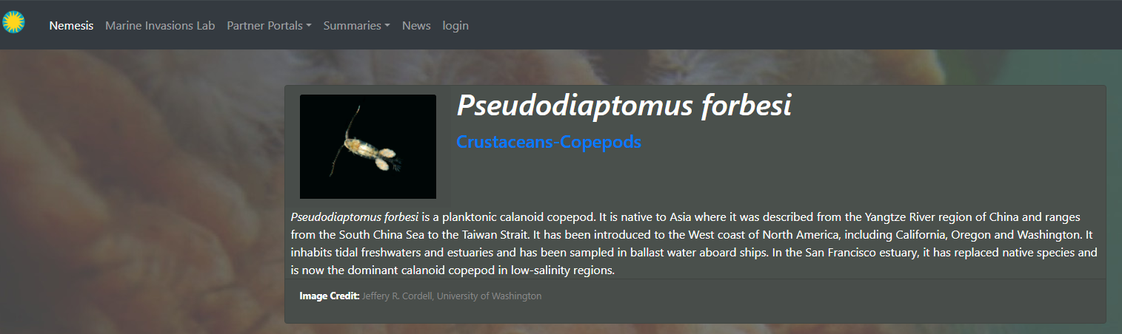
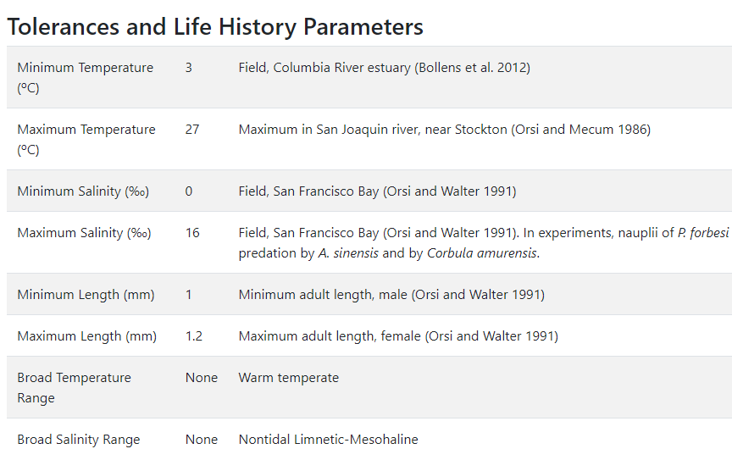
Web scraping
https://invasions.si.edu/nemesis/species_summary/-218

Slide 41

Web scraping
rvest R package: https://rvest.tidyverse.org/index.html
Helps with scraping data from webpages into the R environment
read_html() – reads an html page into R
html_elements() – find elements that match a CSS selector or XPath expression
Can use https://selectorgadget.com/ to find CSS selectors
html_table() – converts an html table to a data frame
html_text2() – retrieves text from an html element

Slide 42
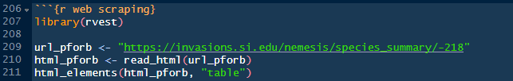
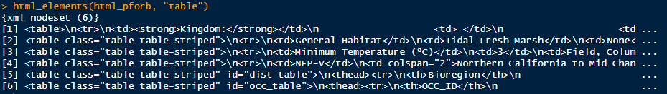
Web scraping

Slide 43
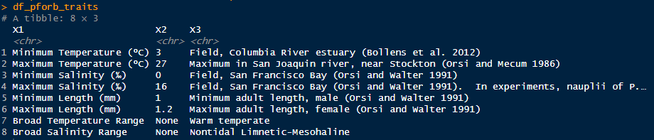
Web scraping

Slide 44

Extract data from .pdf
https://www.usbr.gov/mp/cvo/vungvari/dout0124.pdf

Slide 45
Extract data from .pdf
pdftools R package: https://docs.ropensci.org/pdftools/
Allows for extracting text from .pdf files into R environment
pdf_text() – extracts text from a .pdf file as a single string
Need to use additional functions to convert .pdf table into a useable data frame:
readr::read_lines()
various string manipulation functions from base R or stringr package
Available on CRAN

Slide 46


Extract data from .pdf

Slide 47

Extract data from .pdf

Slide 48

Extract data from .pdf

