Slide 1
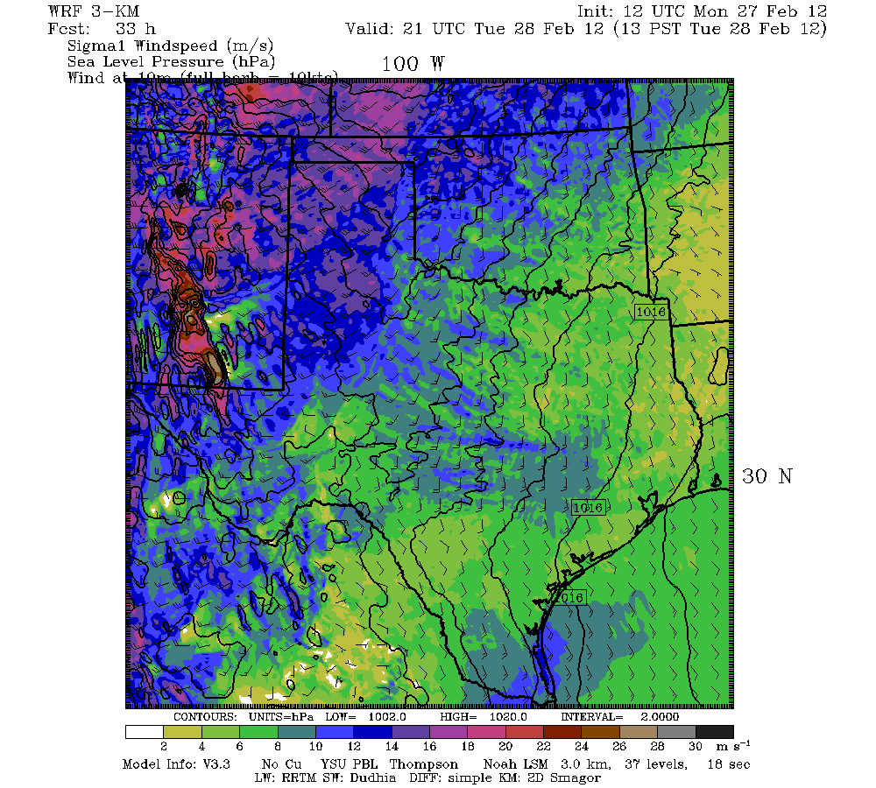
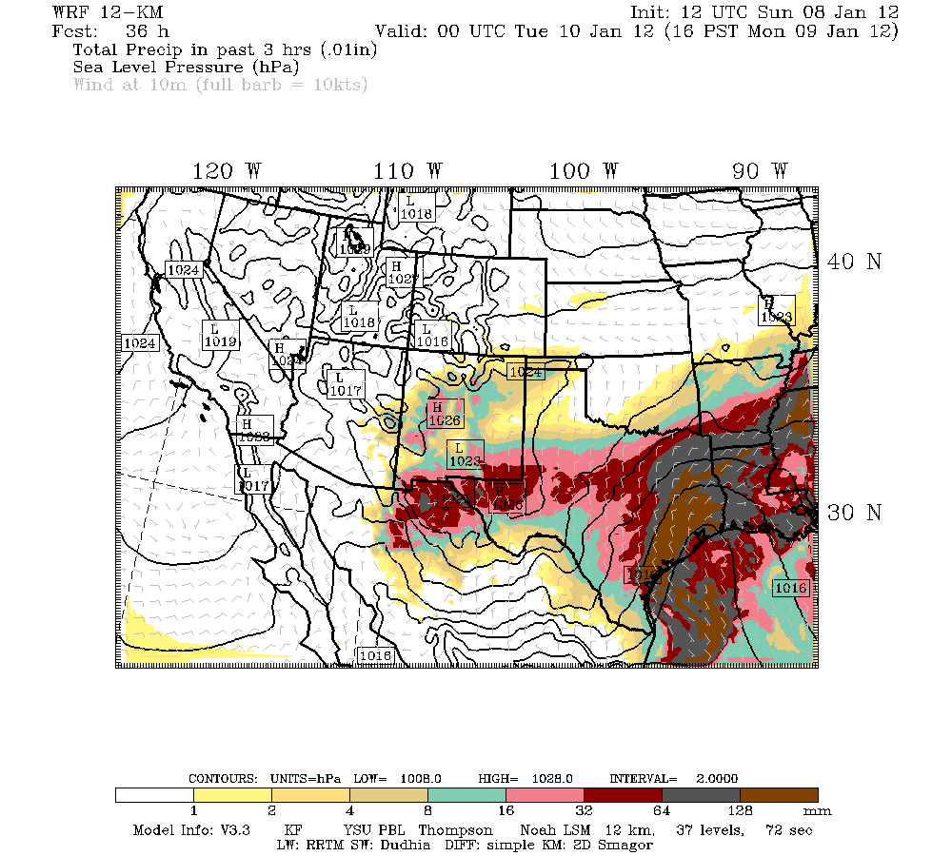
ATMO5332
WRF-ARW Tutorial
0.01”

Slide 2
Overview of WRF Modeling System
A bare-bones WRF run involves 4 major steps:
1) WRF Preprocessing System (WPS)
2) Initialization (real)
3) Numerical integration (WRF)
4) Visualization

Slide 3
Overview of WRF Modeling System
A bare-bones WRF run involves 4 major steps:
1) WRF Preprocessing System (WPS)
2) Initialization (real)
3) Numerical integration (WRF)
4) Visualization
Most steps above are capable of running
in parallel mode using multiple CPUs

Slide 4
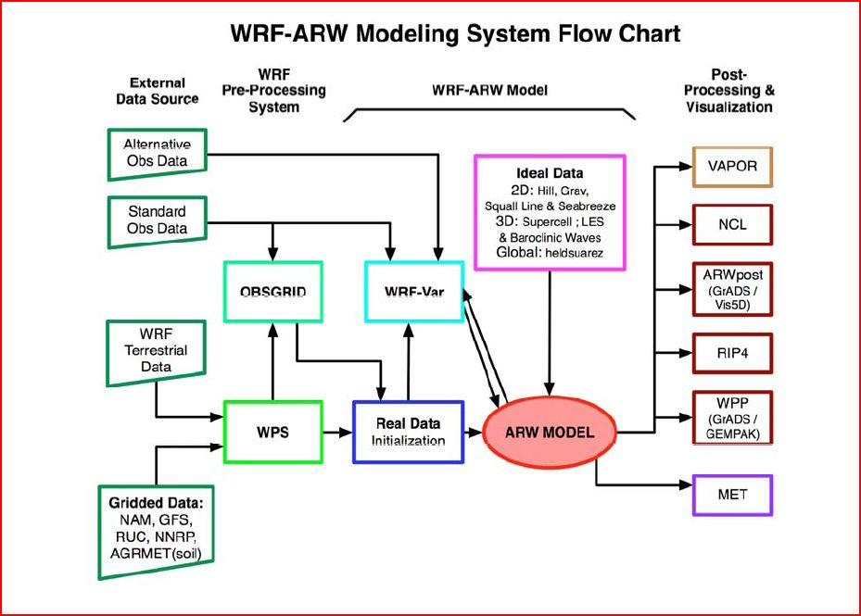
Overview of WRF Modeling System
Green boxes = Bare-bones run

Slide 5
WPS
WPS performs all preprocessing of data needed for a WRF numerical integration (define domains, get initial conditions…)

Slide 6
WPS
WPS performs all preprocessing of data needed for a WRF numerical integration (define domains, get initial conditions…)
WPS is controlled through a user-defined namelist called namelist.wps

Slide 7
WPS
WPS performs all preprocessing of data needed for a WRF numerical integration (define domains, get initial conditions…)
WPS is controlled through a user-defined namelist called namelist.wps
WPS is composed of three programs:
1) geogrid
2) ungrib
3) metgrid

Slide 8
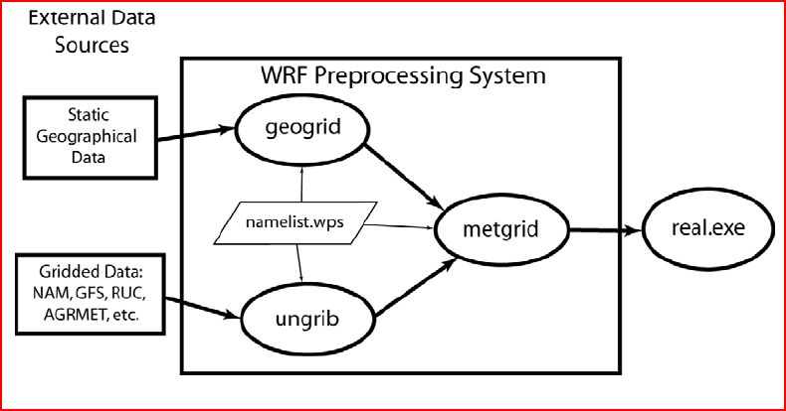
WPS

Slide 9
WPS - geogrid
Geogrid has the following purposes:
1) Define simulation domain (size, location,
horizontal resolution)

Slide 10
WPS - geogrid
Geogrid has the following purposes:
1) Define simulation domain (size, location,
horizontal resolution)
2) Indicate which geographical data will be
used (30-second, 2-minute)

Slide 11
WPS - geogrid
Geogrid has the following purposes:
1) Define simulation domain (size, location,
horizontal resolution)
2) Indicate which geographical data will be
used (30-second, 2-minute)
3) Choose map projection (lambert
conformal, polar stereographic,
mercator, lat/lon)

Slide 12
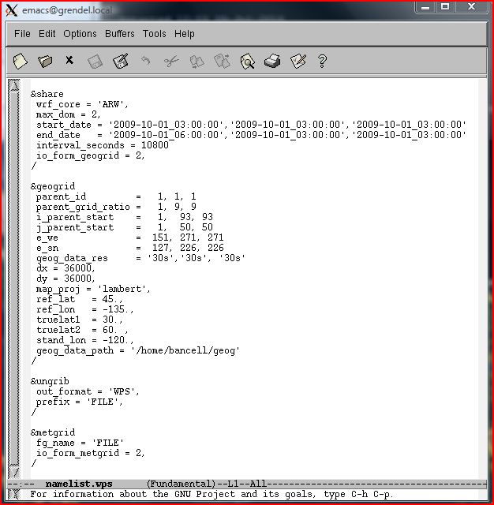
namelist.wps

Slide 13
namelist.wps (geogrid)

Slide 14
namelist.wps (geogrid)
(Each column represents a different domain)

Slide 15
WPS - geogrid
Input files needed to run geogrid:
1) Geographical data
(/lustre/research/bancell/geogV4/WPS_GEOG)
2) namelist.wps

Slide 16
WPS - geogrid
Input files needed to run geogrid:
1) Geographical data
(/lustre/research/bancell/geogV4/WPS_GEOG)
2) namelist.wps
Output from geogrid:
1) geo_em.d01.nc (would also have
geo_em.d02.nc for 2nd domain…)
2) geogrid.log files

Slide 17
WPS - geogrid
Final Notes on geogrid
geogrid only needs to be run once for the same domain
Like most of the WRF system output, geo_em.d0X.nc files are netcdf files
Nest parameters must be carefully set in namelist.wps for geogrid

Slide 18
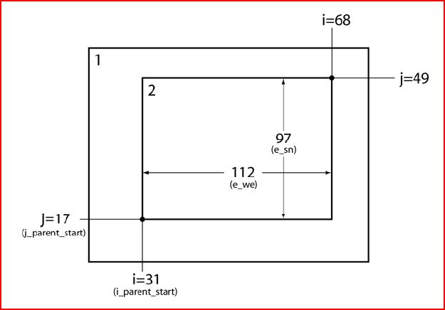
WPS - geogrid

Slide 19
namelist.wps (geogrid)
(Each column represents a different domain)

Slide 20
WPS - ungrib
ungrib has the following purpose:
1) Extract fields from external grib files
(such as a GFS forecast) and write this
information to WPS file format

Slide 21
namelist.wps (ungrib)

Slide 22
namelist.wps (ungrib)

Slide 23
WPS - ungrib
Input files needed to run ungrib:
1) External grib files
2) namelist.wps
3) A file called Vtable (instructs ungrib to
pull specific variables from various grib files)

Slide 24
WPS - ungrib
Input files needed to run ungrib:
1) External grib files
2) namelist.wps
3) A file called Vtable (instructs ungrib to
pull specific variables from various grib files)
Output from ungrib:
1) WPS format files called FILE:date
2) ungrib.log file

Slide 25
WPS - metgrid
metgrid has the following purpose:
1) Interpolate external meteorological data
(originally from grib files, now in WPS
format through program ungrib)
horizontally to defined grid points

Slide 26
namelist.wps (metgrid)

Slide 27
namelist.wps (metgrid)

Slide 28
WPS - metgrid
Input files needed to run metgrid:
1) FILE:date files from ungrib
2) geo_em.d0X.nc files from geogrid
3) namelist.wps

Slide 29
WPS - metgrid
Input files needed to run metgrid:
1) FILE:date files from ungrib
2) geo_em.d0X.nc files from geogrid
3) namelist.wps
Output from metgrid:
1) A set of files called met_em.d01.date.nc
(and met_em.d0X for nests)
2) metgrid.log files

Slide 30
WPS - metgrid
Final Notes on metgrid and WPS
met_em.d0X.date.nc files are netcdf files
All 3 WPS programs are run in the same directory (/lustre/work/your_userID/WPSV4)
Make sure to clean up files before each new WPS run

Slide 31
WRF Initialization (real)
real has the following purposes:
1) Create vertical model levels

Slide 32
WRF Initialization (real)
real has the following purposes:
1) Create vertical model levels
2) Interpolate meteorological data to vertical
model levels

Slide 33
WRF Initialization (real)
real has the following purposes:
1) Create vertical model levels
2) Interpolate meteorological data to vertical
model levels
3) Create input files (initial and boundary
conditions) for numerical integration

Slide 34
real
Input files needed to run real:
1) met_em.d0X.data.nc files from metgrid
2) namelist.input (parameter file for real
and wrf)

Slide 35
real
Input files needed to run real:
1) met_em.d0X.data.nc files from metgrid
2) namelist.input (parameter file for real
and wrf)
Output from real:
1) wrfinput_d01 and wrfbdy_d01
(additional wrfinput_d0X files if more
than 1 domain)
2) Log files (rsl.out.XXXX, rsl.error.XXXX)

Slide 36
namelist.input
real runs using parameters from the text file namelist.input, which has the following basic sections:
1) time_control
2) domains
3) physics
4) dynamics
5) bdy_control

Slide 37
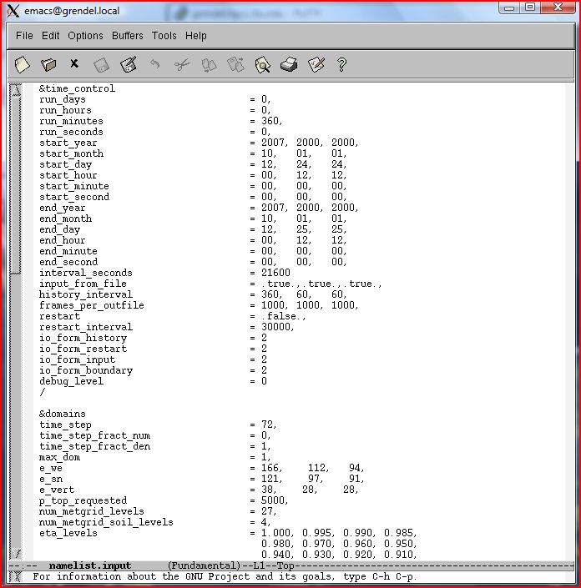
namelist.input
Much More

Slide 38
namelist.input – time_control

Slide 39
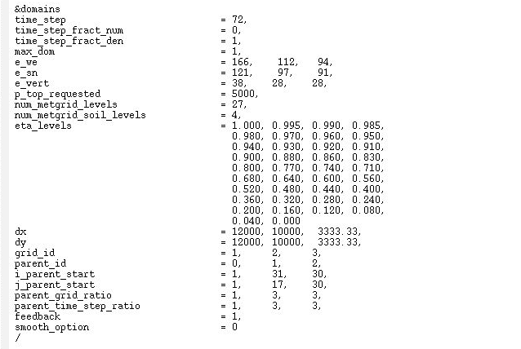
namelist.input – domains

Slide 40
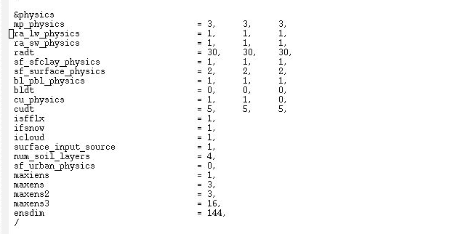
namelist.input – physics

Slide 41
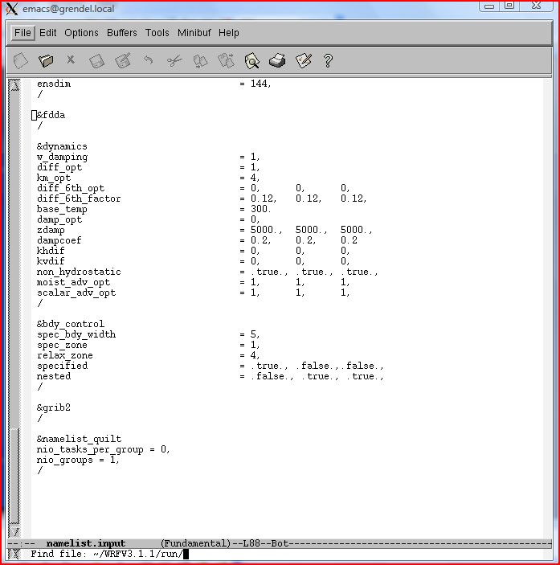
namelist.input – dynamics

Slide 42
namelist.input – bdy_control

Slide 43
WRF Numerical Integration (wrf)
wrf has the following purpose:
1) Numerically approximate the solutions to
the model equations to produce a
forecast!!!! Finally!!!!

Slide 44
wrf
Input files needed to run wrf:
1) wrfinput_d01 (and wrfinput_d0X for
nests), wrfbdy_d01 files from real
2) namelist.input (parameter file for real
and wrf)

Slide 45
wrf
Input files needed to run wrf:
1) wrfinput_d01 (and wrfinput_d0X for
nests), wrfbdy_d01 files from real
2) namelist.input (parameter file for real
and wrf)
Output from wrf:
1) wrfout_d01.date.nc (wrfout_d0X.date.nc
for more than one domain)
2) Log files (rsl.out.XXXX, rsl.error.XXXX)

Slide 46
real and wrf
Final Notes on real and wrf
All output files from real and wrf are netcdf files, and the contents of netcdf files can be viewed with the command:
ncdump –h filename
To view the contents of a single variable in a netcdf file, such as the variable “Times”, type
ncdump –v Times filename

Slide 47
real and wrf
Final Notes on real and wrf
Make sure to check the log files after a real and a wrf run to make sure your model run actually ran

Slide 48
real and wrf
Final Notes on real and wrf
Make sure to check the log files after a real and a wrf run to make sure your model run actually ran
real and wrf are run in the same directory:
/lustre/work/your_userID/WRFV4/run

Slide 49
real and wrf
Final Notes on real and wrf
Make sure to check the log files after a real and a wrf run to make sure your model run actually ran
real and wrf are run in the same directory:
/lustre/work/your_userID/WRFV4/run
Look at file README.namelist in /lustre/work/your_userID/WRFV4/run for a description of all namelist variables

Slide 50
Visualization (RIP)
RIP has the following purpose:
1) Forecasts have been made, now we have
to look at them – RIP produces plots of
desired forecast variables

Slide 51
Visualization (RIP)
RIP has the following purpose:
1) Forecasts have been made, now we have
to look at them – RIP produces plots of
desired forecast variables
RIP runs using 2 programs:
1) ripdp_wrfarw – data preparation
2) rip - plotting

Slide 52
ripdp_wrfarw
ripdp_wrfarw is run with 3 arguments:
ripdp_wrfarw data/wrfoutdata all wrfout_files
ripdp_wrfarw execute command
3) wrfout file from program WRF
1) Location where intermediate RIP data will go from ripdp_wrfarw
2) Tells ripdp_wrfarw to process all variables

Slide 53
rip
rip is run using 2 arguments:
rip data/wrfoutdata sfct.in
rip execute command
2) rip input file that tells rip what to plot
1) Temporary data name and location from ripdp_wrfarw

Slide 54
The rip input file
A formatted file with the “.in” extension (e.g. slp.in) tells rip what to plot and how to plot it

Slide 55
The rip input file
A formatted file with the “.in” extension (e.g. slp.in) tells rip what to plot and how to plot it
There are 3 sections to every .in file:
1) User input section
2) Color table
3) Plot specification table

Slide 56
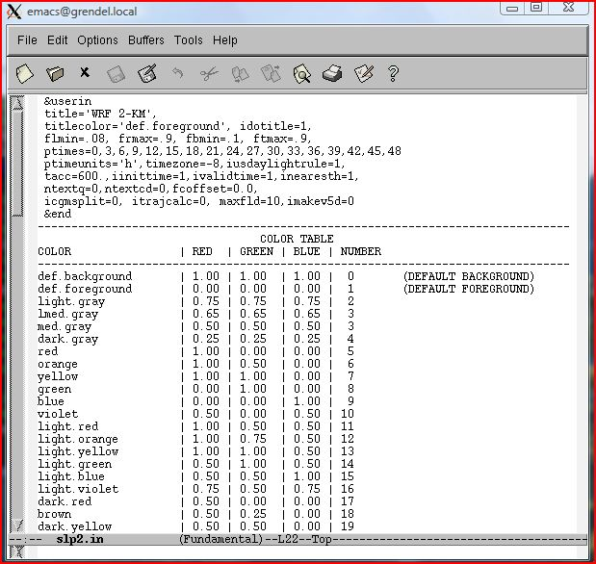
slp2.in
Much More

Slide 57
User Input Section

Slide 58
Color Table
Much More

Slide 59
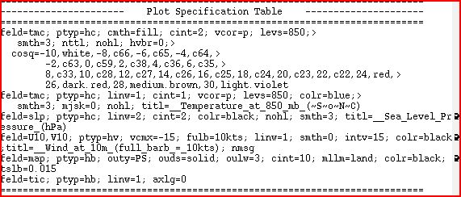
Plot Specification Table

Slide 60
rip
Output from rip is a computer graphics metafile (file with extenstion “.cgm”) that can be viewed with the idt image display tool or converted into .gif image files

Slide 61
Running WPS/WRF/RIP
Running WPS, real, WRF, and RIP requires a variety of scripts that must be submitted to the queue at the HPCC to run

Slide 62
Running WPS/WRF/RIP
Running WPS, real, WRF, and RIP requires a variety of scripts that must be submitted to the queue at the HPCC to run
The following is a step-by-step guide on how to setup the required directories, get the required files, and run WPS/real/WRF/RIP from your own directory

Slide 63
Required WPS Directory
Go to directory /lustre/work/your_userID
Type
“cp –r /lustre/research/bancell/class5332/WPSV4.5 ./WPSV4”
- This copies the WPS directory structure to
your work directory
- This is where you will run the WPS programs
(in /lustre/work/your_userID/WPSV4)

Slide 64
Required real/WRF Directory
Go to directory /lustre/work/your_userID
Type
“cp –r /lustre/research/bancell/class5332/WRFV4.5.1 ./WRFV4”
- This copies the real and WRF directory structure to your work directory
- This is where you will run real and wrf
(in /lustre/work/your_userID/WRFV4/run)

Slide 65
Required RIP directory
Go to directory /lustre/work/your_userID
Type
“cp –r /lustre/research/bancell/class5332/RIP ./RIP”
- This copies the RIP directory structure to
your work directory
- This is where you will run RIP
(in /lustre/work/your_userID/RIP)

Slide 66
Required Submission Script Directory
Go to directory /lustre/work/your_userID
Type
“cp –r /lustre/research/bancell/class5332/SUB ./sub”
- This copies the directory structure containing
the HPCC submission scripts to your work
directory
- This is where you will submit the scripts that
run the MPI WPS programs, real, wrf, and
rip (in /lustre/work/your_userID/sub)

Slide 67
Running WPS
geogrid
Modify the namelist.wps for your case in /lustre/work/your_userID/WPSV4)
Go to /lustre/work/your_userID/sub
Modify geogrid.scr for the correct directory paths
Type “sbatch geogrid.scr”
Make sure output files geo_em.d0X are generated in /lustre/work/your_userID/WPSV4
Check geogrid log files in the WPS directory and error_out_geogrid, submit_out_geogrid files in the sub directory if you have problems

Slide 68
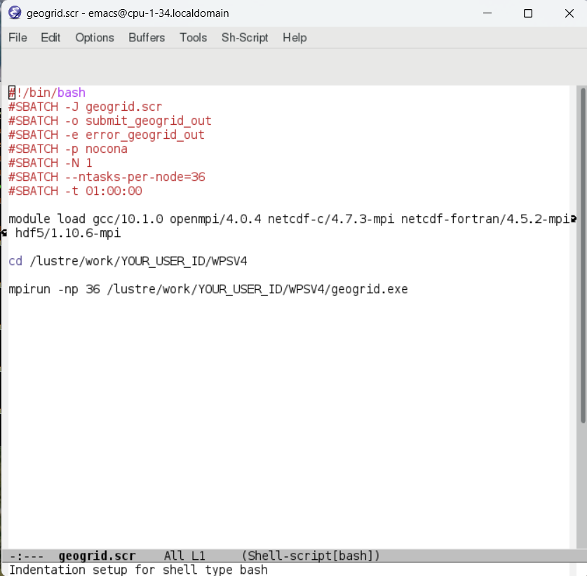

Slide 69
Running WPS
geogrid – Viewing your domain
To view the domain(s) you want to create with geogrid, use the plotgrids_new.ncl utility by following these steps:
1) Go to an interactive core on nocona (type “interactive”)
2) Make sure you are in /lustre/work/your_userID/WPSV4
3) Make sure you have miniconda3 installed, as well as the ncl_stable conda environment
4) Activate the ncl_stable environment with “conda activate ncl_stable”
5) Make sure MobaXterm is running
6) Type “ncl util/plotgrids_new.ncl”
After running plotgrids_new.ncl, a picture of your domain should pop up on your screen (as specified by your namelist.wps)
Use this utility to tinker with your domain until it looks how you want it to look, then run geogrid.exe

Slide 70
Running WPS
ungrib
GFS files for the homework are in /lustre/reserach/bancell/class5332/TESTGFS, copy them to your /data directory in your WPS directory
Go to /lustre/work/your_userID/WPSV4 and then type “./link_grib.csh data/gfs*”
- This links ungrib files to the GFS files in /data
Go to /lustre/work/your_userID/sub
Modify ungrib.scr for the correct directory paths
Type “sbatch ungrib.scr”
Make sure output files with prefix “FILE” are generated in /lustre/work/your_userID/WPSV4
Check ungrib.log file in the WPS directory and error_out_ungrib, submit_out_ungrib files in the sub directory if you have problems

Slide 71
Running WPS
metgrid
Go to /lustre/work/your_userID/sub
Modify metgrid.scr for the correct directory paths
Type “sbatch metgrid.scr”
Make sure all met_em.d0X files exist in /lustre/work/your_userID/WPSV4, check the metgrid log files in that directory and the error_out_metgrid and submit_out_metgrid files in the sub directory if there are problems

Slide 72
Running real
Go to /lustre/work/your_userID/WRFV4/run
Move all met_em.d0X files from the WPS directory to the above WRF directory
Modify the file namelist.input for your case
Go to /lustre/work/your_userID/sub
Modify real.scr for the correct directory paths
Type “sbatch real.scr”

Slide 73
Running real cont’d
Make sure the files wrfinput_d0X and wrfbdy_d01 exist in /lustre/work/your_userID/WRFV4/run, check rsl log files in that directory as well as submit_out_real, error_out_real log files in the sub directory if you have problems

Slide 74
Running wrf
Go to /lustre/work/your_userID/sub
Modify wrf.scr for the correct directory paths
Type “sbatch wrf.scr”
Make sure the file wrfout_d0X.date.nc exists in /lustre/work/your_userID/WRFV4/run, check rsl log files in that directory as well as submit_out_wrf, error_out_wrf log files in the sub directory if you have problems
Make sure your run finished by looking at the end of the rsl.out.0000 file in the WRF directory

Slide 75
Running RIP
Load the ncl_stable environment by typing
“conda activate ncl_stable”
Move all of your wrfout files from the WRF run to your /lustre/work/your_userID/RIP directory (do this one domain at a time)
Go to /lustre/work/your_userID/sub
Modify ripdp.scr for the correct directory paths
Type “sbatch ripdp.scr”

Slide 76
Running RIP cont’d
Make sure your /lustre/work/your_userID/RIP/data directory has files in it (from execution of ripdp_wrfarw)
Modify the .in files in /lustre/work/your_userID/RIP for your desired plot
Go to /lustre/work/your_userID/sub
Modify rip.scr for the correct directory paths and .in filenames
Type “sbatch rip.scr”

Slide 77
Running RIP cont’d
You can look at the resulting gif images with the command “animate -loop 0 *.gif” (you have to first load modules like this: “module load ansys gcc imagemagick”
You can see several examples of rip .in files in the /exampleripfiles directory of your RIP directory

Slide 78
Final WPS/WRF/RIP Notes
Clean up all files before your next run!!!! (WPS, real, wrf, RIP, and sub)
Programs fail for many reasons – carefully examine your log files to figure out why before asking for help

Slide 79
First Things First
To run WPS/WRF/RIP at HPCC on a shell using a PC, you need to download 2 things:
- Putty (gives you the shell, make sure to enable
X11 forwarding at Connection→SSH→X11), use
address login.hpcc.ttu.edu
- MobaXterm (gives ability to bring up external windows for graphics and text editing, for example with emacs) – this needs to be active to bring up external windows

Slide 80
First Things First
On a Mac, no downloads needed! Just bring up a shell and ssh to RedRaider with:
ssh –X your_userID@login.hpcc.ttu.edu
Note: When you login to RedRaider, you’ll be in your
home directory (/home/your_userID)
disk space limit on /home/your_userID: 500GB
disk space limit on /lustre/work/your_userID: 1.5TB

Slide 81
First Things First
If you are off campus, you’ll need the TTU VPN to connect to HPCC
Several HPCC-related problems can occur, for help with these email hpccsupport@ttu.edu and thoroughly describe your problem

